Slide 1
DECISION / 01
PILOT THE DECISION SYSTEM.
AUTHORIZATION
ONE
MATCHED-TASK PILOT
NOT AUTONOMOUS TASTE.
The walkthrough shows a stronger way to choose direction, compare alternatives, and recover from a wrong visual grammar. It does not prove faster delivery, higher usability, or business lift.
Hold the brief, proof, references, model budget, and acceptance criteria constant.
Observed demonstration + bounded analyst recommendation
Notes:
Open with the decision: authorize a governed pilot, not broad adoption. The walkthrough demonstrates choice architecture, not measured business impact.

Slide 2
EXECUTIVE READOUT
Three demonstrated mechanisms justify one controlled test
01
WORLD SELECTION
Macro direction becomes visible before implementation variants.
OBSERVED
02
BOUNDED COMPARISON
Local alternatives can be generated, tuned, and accepted side by side.
OBSERVED
03
REFERENCE RESET
A wrong visual grammar can trigger a deliberate macro departure.
OBSERVED
DECISION
Test whether the workflow reduces major direction resets without quality or control regressions.
ANALYST MODEL
02 / 14
Notes:
Separate observed mechanisms from the proposed decision. The three mechanisms justify testing, while every outcome claim remains unproven.

Slide 3
PROBLEM
A generic first draft moves the expensive decision downstream
REBUILD
Expensive
DIRECTION DEBATE
Late
GENERIC PAGE
Plausible
PROMPT
Fast
→
→
→
The workflow matters only if it makes macro direction explicit before teams accumulate implementation debt.
ANALYST MODEL
03 / 14
Notes:
The cost problem is directional debt. Fast generation has limited value when teams correct macro direction only after implementation begins.

Slide 4
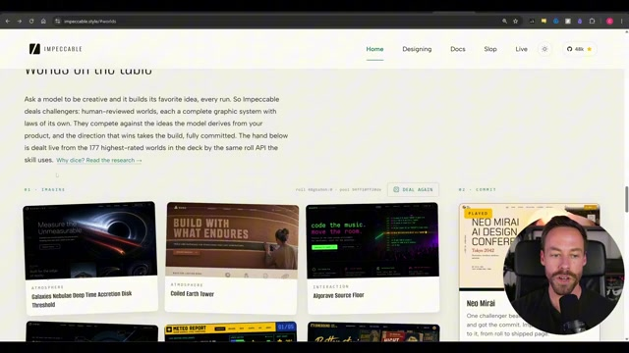
PROOF / WORLD SELECTION
Worlds turns ‘make it better’ into a visible macro decision
WHAT CHANGED
The visual grammar becomes a named choice before local variants are built.
Management implication
Assign a direction owner and record why the selected world fits the audience and task.
OBSERVED DEMONSTRATION
04 / 14
Notes:
Use the interface state as proof of visible macro choice. Require a named owner and recorded rationale before variants are built.

Slide 5
MECHANISM
Value comes from commitment—not from an endless menu
DIVERGE
COMMIT
CONVERGE
RELEASE
Expose genuinely different worlds
→
Name the owner and exit rule
→
Compare bounded local variants
→
Challenge, approve, record
Divergence earns its keep only when the process can stop, decide, and move forward.
ANALYST MODEL
05 / 14
Notes:
The feature count is incidental. Divergence produces value only when commitment gates stop rerolls and move the work forward.

Slide 6
TRADE-OFF
A higher creative ceiling shifts more risk to the operator
NARROW STYLE SKILL
IMPECCABLE
HIGHER FLOOR
HIGHER CEILING
Predictable novelty Narrower aesthetic range Lower judgment burden
Broader differentiation Greater operator variance Higher governance need
Use the conventional workflow when evidence is weak, the surface is standardized, or review capacity is limited.
ANALYST MODEL
06 / 14
Notes:
A narrow workflow can be the better choice. Generality raises differentiation and operator variance at the same time.

Slide 7
ROUTING RULE
Change radius—not tool preference—should route the work
DIRECTION CONFIDENCE
LOW
HIGH
LARGE CHANGE
REFERENCE RESET
TERMINAL
Reopen visual grammar
Change structure
SMALL CHANGE
STOP POLISHING
LIVE MODE
Clarify direction
Compare local variants
ANALYST MODEL
07 / 14
Notes:
Route by change altitude. Live is for bounded detail; terminal work changes structure; references reopen direction.

Slide 8
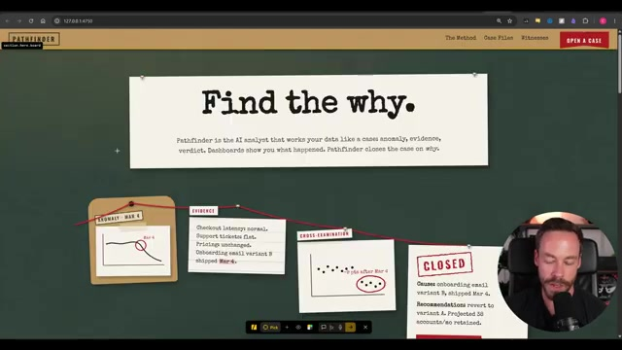
PROOF / LOCAL COMPARISON
Live Mode compresses a bounded compare–tune–accept loop
BOUNDARY
Use Live only after the macro direction is accepted.
Detail wrong → Live Structure wrong → terminal Direction wrong → reference reset
OBSERVED DEMONSTRATION
08 / 14
Notes:
Live Mode is valuable after direction is accepted. Do not use faster local iteration to rationalize weak visual grammar.

Slide 9
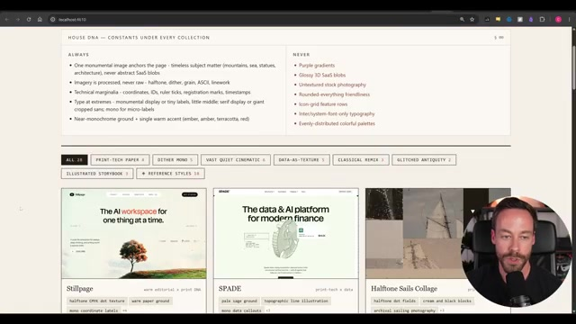
PROOF / DIRECTION RESET
A wrong visual grammar requires a reference reset—not more polish
ESCALATION
References reopen the macro decision when incremental refinement stalls.
Control
Record provenance and the specific design grammar being borrowed.
OBSERVED DEMONSTRATION
09 / 14
Notes:
A reference is a controlled reset mechanism, not decoration. Record provenance and the grammar being borrowed.

Slide 10
OPERATING MODEL
Humans own four irreversible decisions
FRAME TRUTH
COMMIT DIRECTION
RESOLVE TRADE-OFFS
APPROVE RELEASE
HUMAN OWNS
HUMAN OWNS
HUMAN OWNS
HUMAN OWNS
Audience, evidence, constraints
Visual grammar and rationale
Competing priorities
Independent fresh-context check
SYSTEM SUPPORTS
SYSTEM SUPPORTS
SYSTEM SUPPORTS
SYSTEM SUPPORTS
Structure the brief
Expand options
Generate + compare
Detect + record exceptions
AUTOMATE REVERSIBLE WORK. REQUIRE A FRESH-CONTEXT HUMAN CHECK BEFORE RELEASE.
ANALYST MODEL
10 / 14
Notes:
Allocate reversible work to the system and irreversible judgment to accountable people: truth, direction, trade-offs, and release. Release requires an independent fresh-context human check; system detection is support, not adjudication.

Slide 11
ORGANIZATIONAL MEMORY
Accepted decisions matter only when they constrain the next cycle
CHOSEN DECISIONS
→
DESIGN RECORD
→
FUTURE CONSTRAINTS
→
DETECT + OVERRIDE
Benefit
Less reinvention and lower variance across future work.
Risk
Stale taste becomes an invisible default. Version the record and permit explicit resets.
ANALYST MODEL
11 / 14
Notes:
The design record can reduce reinvention, but it must be versioned and explicitly resettable so stale taste does not become policy.

Slide 12
EVIDENCE BOUNDARY
The demo shows structured convergence—not measured optimization
0
1
2
3
4
5
AD HOC
GUIDED
STRUCTURED
CONTROLLED
MEASURED
OUTCOME
DEMONSTRATED: direction structure + elements of control
UNPROVEN: productivity + outcomes
Treat speed, usability, quality, and business impact as pilot hypotheses—not demonstrated benefits.
ANALYST MODEL
12 / 14
Notes:
Do not translate workflow sophistication into outcome certainty. Productivity, usability, quality, and commercial effects remain pilot hypotheses.

Slide 13
PILOT DESIGN
A matched-task test isolates workflow value from operator enthusiasm
FIXED INPUTS
CURRENT PROCESS
IMPECCABLE WORKFLOW
Same real brief
Conventional prompting and review
Worlds → commit → Live refinement
Same copy + proof
Same references
Matched task Matched operator profile Blind downstream review
PRIMARY ENDPOINT
Same model + time budget
Major direction resets before acceptance
ANALYST MODEL
13 / 14
Notes:
Hold inputs and operator profiles constant and blind downstream reviewers. Count major direction resets before acceptance as the primary endpoint.

Slide 14
DECISION / 14
EARN THE RIGHT TO SCALE.
Authorize pilot design—not enterprise rollout.
01
NAME THE OWNER
02
SELECT THE TASK
03
LOCK THE SCORECARD
One accountable lead for direction and release
One bounded landing-page workflow with real proof
Baseline, thresholds, blind reviewers, stop rules
Expand only if resets fall without accessibility, provenance, factual, performance, or cost regressions.
Notes:
Close on three actions: name the owner, select the bounded task, and lock the scorecard before any showcase output is reviewed.

