Slide 1
IMPECCABLE 4.0
Taste becomes an operating system.
A source-led briefing on Worlds, Live Mode, iteration, and design control
4.0
CLIENT BRIEFING · AUGUST 2026
1 / 15

Slide 2
Impeccable changes the decision system—not just the styling
The old loop
The Impeccable loop
PROMPT
→
OUTPUT
1
EXPAND
See materially different worlds
Accept the first plausible answer.
2
SELECT
Commit to one direction
3
ITERATE
Compare variants visually
4
REVIEW
Detect drift and defects
The product is a feedback architecture for taste.
2 / 15

Slide 3
The failure mode is convergence
Different prompts repeatedly settle on the same recognizable defaults.
PURPLE GRADIENT
ROUNDED CARD GRID
ICON CONFETTI
GENERIC HERO
SOFT-GLOW CHROME
SAME HIERARCHY
↘
↘
↘
PLAUSIBLE, POLISHED, INTERCHANGEABLE
3 / 15

Slide 4
Version 4.0 adds two decisive control surfaces
WORLDS
LIVE MODE
Expand the option space before committing.
Move local iteration from terminal text to visual choice.
177
PICK
REQUEST
high-rated visual worlds shown against the actual project
COMPARE
ACCEPT
4 / 15

Slide 5
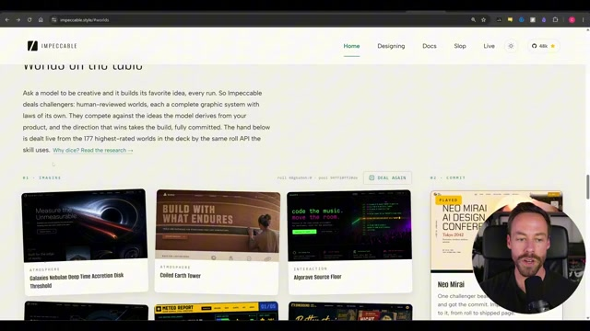
Worlds make direction selection concrete
Choose the visual grammar before building the page.
A world governs composition, type, material, rhythm, and interaction—not merely color.
5 / 15

Slide 6
Direction selection happens twice
First choose among worlds. Then compare variants inside the chosen world.
MANY POSSIBLE WORLDS
ONE WORLD, MULTIPLE EXPRESSIONS
Editorial archive
A
Constellation
Technical dossier
Civic poster
COMMIT
B
Dossier split
→
Field notebook
C
Find the why
Quiet utility
Range first. Refinement second.
6 / 15

Slide 7
Generality trades a higher ceiling for a lower floor
ONE-TRICK STYLE SKILL
IMPECCABLE
Predictable
Adaptable
Narrow range Lower operator burden Recognizable signature
Wide range Higher judgment burden Potentially distinctive result
The system creates room for taste; it does not supply taste automatically.
7 / 15

Slide 8
One-shot generation is the wrong mental model
BRIEF
WORLD
BUILD
LIVE
REVIEW
Define intent
Choose direction
Create a first pass
Tune components
Close defects
ITERATE · ITERATE · ITERATE
The first complete composition is a baseline, not a verdict.
8 / 15

Slide 9
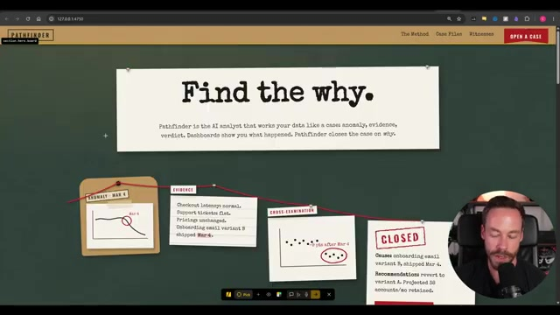
Live Mode turns local changes into visual decisions
Commands such as bolder, quieter, polish, and typeset can be applied to the selected region.
Select an element. Generate one to four variants. Tune. Accept.
9 / 15

Slide 10
Use the right interface for the altitude of change
MACRO
Terminal
New direction · layout reset · reference-driven rebuild
MICRO
Live Mode
Component variants · typography · polish · small adjustments
Escalate when the problem is direction—not detail.
10 / 15

Slide 11
Taste becomes durable through memory and independent review
Name recurring AI-default and production-defect patterns.
DETECT
Preserve colors, components, controls, and the chosen visual grammar.
DESIGN.MD
Use a fresh context as a second set of eyes before delivery.
FINISH REVIEW
A design system is the record of decisions—not the residue of a single output.
11 / 15

Slide 12
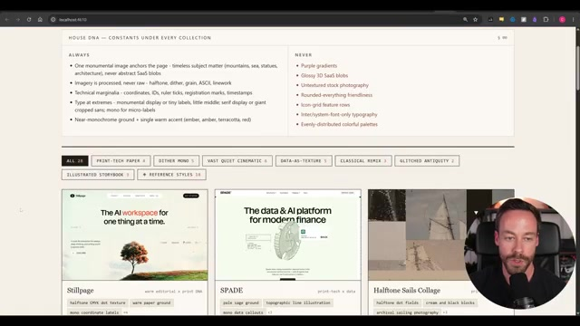
References are the escape hatch for a wrong direction
When the world is wrong, stop polishing it.
Supply a real reference, reset the macro direction in the terminal, then return to Live Mode for local refinement.
12 / 15

Slide 13
A practical operating model for teams
BRIEF
WORLDS
SELECT
BUILD
→
→
→
Truth and constraints
Expand directions
Commit visibly
Create the baseline
LIVE
DETECT
RECORD
REVIEW
→
→
→
Refine locally
Remove defaults
Preserve decisions
Fresh-context QA
Human judgment is present at every commitment point.
13 / 15

Slide 14
What Impeccable does not solve
1
Weak truth
A visual world cannot repair missing evidence.
2
Weak narrative
A design system cannot decide what the audience must understand.
3
Blind imitation
A reference is visual grammar—not permission to copy.
4
Absent judgment
More options only help when someone is willing to choose.
Design discipline complements content discipline. It never replaces it.
14 / 15

Slide 15
THE TAKEAWAY
Impeccable does not remove taste from the process.
It gives taste somewhere to operate.
Expand options → commit visibly → iterate at the right altitude → record the system → review independently
Prepared from the supplied Impeccable 4.0 demonstration
15 / 15

