Slide 1

CLIENT ACQUISITION OPERATING SYSTEM
How DeepGrid wins clients
Who we sell to, what we sell, what we may claim, and how a lead travels — built as files the team and the tooling both read
2 segments now
price by function
9 claims retired
1 lead state machine
DeepGrid Semi — client acquisition operating system · Level 3 build · 5 Aug 2026
1 / 15
Notes:
This deck documents an operating system, not a strategy opinion. Everything in it is written
into six context files that sit in the run folder — the deck is the readable version, the
files are what actually removes work.
The test that matters is not whether this deck is persuasive. It is whether a cold session,
given only those six files, produces outbound a founder would send.

Slide 2
The knowledge exists. It is just not usable.
Four documents, fourteen contradictions, nine retired claims — and no operating layer
Where they disagree
What is in circulation
What survives verification
FY32 gross margin
84% (IM) · 88% blended (July) · 72% kit (BP-1A)
72% kit only; 88% needs 120% on non-kit
Defence revenue
“₹1 Cr” (IM, July deck)
₹23.01L delivered, different entity, MCEME IP
Mandate date
“Live since April 2026”
GSR 184(E) was a draft; AEBS binds 1 Jan 2027
Compute claim
“39.3 TOPS measured on FPGA”
Artix-7 ceilings ~1.8 TOPS. It is a derivation
Price advantage
“3–7×” (IM) · “12.9×” (July)
~2.8–6.5× vs imports; ~2.3× loaded on cost
What this costs, per message
Why this is not a document problem
Every outbound email, proposal and call prep needs a human to reconcile four documents and recall which claims were retired. Pay that tax wrongly once and the buyer's evaluator finds it — costing the credibility of the true claims too.
The thinking is good — the July deck has a real ICP scorecard, two-track positioning and a banned-claims list. It has just never been written somewhere a person or a tool can execute against. “Read BP-1A §7” is a research task, not a context file.
DeepGrid Semi — client acquisition operating system · Level 3 build · 5 Aug 2026
2 / 15
Notes:
Open on the problem, not the answer. Without this slide the six files look like bureaucracy;
with it they look like the obvious fix.
The table is deliberately not a criticism of the team. Every row represents a document that
was right when written and was then superseded without the earlier one being withdrawn. That
is normal, and it is exactly what a context layer prevents.
The right-hand panel matters for the room: the thinking is genuinely good. What is missing is
somewhere for it to live that a person or a tool can act on.

Slide 3
The system is a ladder: two prompts, one chain, six files
Levels 1-3 built · gate run four times · the fourth tested the segment we can actually sell
File
What it carries
Status
L1 prompts/
Qualify-lead + first-contact, four-part structure
BUILT — unvalidated
L2 chains/
5-step outreach round, checkpoint after qualify
BUILT — never run
01-offer.md
Five-line ladder AD0–AD4, each with its evidence state
FIXED — recovered from BP-1A
02-icp.md
Who buys, who does not, and the prioritisation test
Ready
03-voice.md
5 verbatim samples from BP-1B + banned-words list
FIXED — was never blocked
04-proof.md
Every claim we may make, with evidence state
Founder approval on claimable set
05-objections.md
10 road objections + a 7-item AGV gap register
Partial — AGV set needs real calls
06-process.md
Lead states, stages, owners, approval gates
Ready
Why files and not a document
Round 4 — testing the sellable segment
Today every outbound message requires a human to reconcile four documents that disagree, and to remember which claims were retired. Files move that from a per-message task to a one-time write — and any tooling reads the same source the team does.
Rounds 1-3 all tested outbound to a port — the segment we had just demoted to design-partner. Round 4 tested government/PSU + AD0, the one thing sellable today. It recovered the AD0 Tower spec, a second GeM record, and a price defence that exists. It also caught a scoring model that summed to 12 out of 10.
DeepGrid Semi — client acquisition operating system · Level 3 build · 5 Aug 2026
3 / 15
Notes:
The framework this comes from is explicit that a deliverable which removes no work from
someone's calendar is a toy. So the deliverable is the files; this slide is the map.
Note the blocked row. Voice cannot be invented — it needs three real emails and three real
posts a founder actually wrote. Inventing one would produce the model's default voice, which
is the exact failure Level 3 exists to fix.

Slide 4
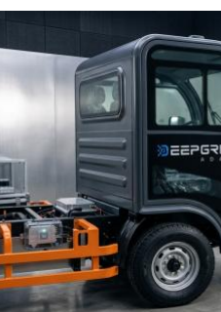
PART 01
Who we sell to
Two segments now, and the disqualifiers that save weeks
DeepGrid Semi — client acquisition operating system · Level 3 build · 5 Aug 2026
4 / 15
Notes:
Part one — targeting.

Slide 5
One segment sells today. The rest need something we do not hold
From 02-icp.md · the prioritisation test is what the buyer requires us to already hold
Segment
Why it is addressable
What it requires us to hold
Priority
Government / PSU / defence
Foreign silicon excluded by rule; GeM access proven
Eligibility, not certification
NOW
Plant, yard and port operators
Private land — no homologation gate at all
A working demo and a site reference — we have neither
DESIGN PARTNER
Large organised fleets (50+)
Real safety P&L, single decision-maker
Certified AEBS — not held until 2027
DESIGN PARTNER
OEM / Tier-1 line-fit
One relationship covers thousands of vehicles
Homologation + a relationship we lack
START NOW, CLOSES LATE
Disqualifiers — these matter more than the qualifiers
• Sub-five-truck operators (~3.5M). No purchasing process, price anchored at ₹4,500–11,000. Not addressable directly at any sane cost.
• Anyone buying purely to pass inspection — they will buy a ₹15,000–40,000 box and they are right to.
• Anyone needing certification today, or a quantified insurance outcome. Walk rather than invent one.
DeepGrid Semi — client acquisition operating system · Level 3 build · 5 Aug 2026
5 / 15
Notes:
The prioritisation rule is deliberately narrow and it is the whole slide: what does this
buyer require us to already hold?
Government and yard operators require eligibility and a demo. Both exist today. Everything
else waits on certification or a relationship we do not have.
The red panel is the half most ICP work omits. Knowing who wastes your time saves more weeks
than knowing who to target, and the third bullet is a discipline point — walking away from a
buyer who needs a number we cannot evidence is cheaper than inventing it.

Slide 6
Two contests, and only one of them is winnable on price
The ladder the buyer actually sees — from 02-icp.md and 05-objections.md
How to use this in a room
Against imports we win 2.8–6.5×. That contest is settled and does not need re-arguing.
Against the compliance box we are ~20× the anchor. Price is not an argument we can win here.
So never open a fleet conversation on price. Open on certified AEBS — what the ₹30,000 box physically cannot do.
Keep the import comparison for OEM and Tier-1 rooms, where the alternative bid really is ₹6.5L and up.
VERIFIED
AIS-140 street pricing confirmed independently Aug 2026; import prices per company deck, not benchmarked
DeepGrid Semi — client acquisition operating system · Level 3 build · 5 Aug 2026
6 / 15
Notes:
One axis, deliberately, so the asymmetry is impossible to miss: DeepGrid sits far closer to
the compliance box than to the imports, but the buyer's mental anchor is the box.
The instruction is the second bullet. Opening on price invites the comparison we lose.
Opening on certified AEBS moves the conversation to ground where a ₹30,000 device has no
answer at all.

Slide 7
Six products, not one price range
From 01-offer.md · AD0-AD2 is driver assistance · AD3 is it rented · AD4 is driverless
Line
What it actually is
ASP
Evidence today
Motion
AD0 basic
Smart mirror / 360° surround. Cameras replace mirrors; driver drives.
₹0.50L ⚠
Proven on FPGA
SELL
AD0 Tower
Pod: 3× 8MP cameras + 4D 77GHz radar + thermal + DMS + compute.
₹2.3L ⚠
Perception measured
SELL
AD2
Full truck kit — compute + software + sensors. Warns and can brake.
₹2.0–2.5L
Claim outruns silicon
SELL
AD3
The AD2 kit rented, not sold. Same hardware, different contract.
₹0.66 Cr/yr
Plan only, FY28+
PARTNER
AD4 Heavy
Driverless heavy transport AGV >5T. No driver in the cab.
₹3.50 Cr
No site, no reference
PARTNER
AD4 Seaport
Driverless container-yard AGV — stack to quay. No driver.
₹0.45 Cr
No site, no reference
PARTNER
⚠ Two products are both called AD0: ₹0.50L in the ADAS table, ₹2.3L for the Smart Mirror Tower — 4.6× apart, and only the Tower carries radar, thermal and DMS. Confirm which is being quoted before any AD0 outbound. The wider ₹0.50L-to-₹3.5 Cr spread is a ladder, not a discount band: AD0 and AD2 are what you sell, AD3 and AD4 are design partners only.
DeepGrid Semi — client acquisition operating system · Level 3 build · 5 Aug 2026
7 / 15
Notes:
This slide exists because it was missing, and its absence broke the cold-chat gate test.
The files described AD4 as "off-highway autonomy, ₹0.45-3.5 Cr" and never said what it does.
A cold assistant asked to write to a container port could not describe the product, because
the description was not there. It is recovered here from the BP-1A ADAS product-line table.
The important line is the one between AD2 and AD4. AD0 and AD2 are driver assistance: a human
drives and the system helps. AD4 removes the driver. Different buyer, different sales cycle,
and a completely different proof burden — a driverless multi-tonne vehicle operating near
people needs a safety case that does not exist yet.
Note the evidence column. Everything below AD2 is a plan. 96 percent of the AD4 revenue line
is an unbuilt product, so treat AD4 conversations as discovery, never as pipeline.

Slide 8
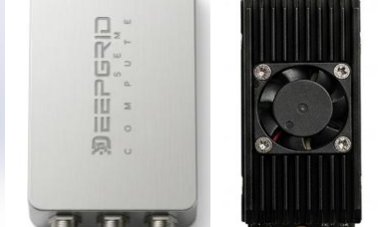
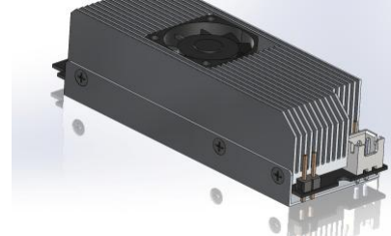
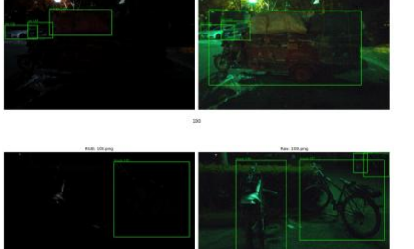
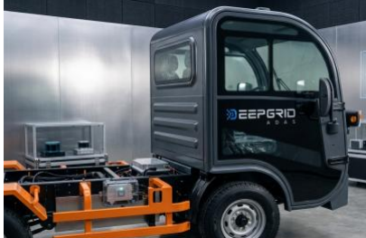
Price the function, give away the warnings
From 01-offer.md · the pricing change that removes the buyer's best objection
Function
What it is
Why it prices — or does not
Action
Certified AEBS (AIS-162)
Radar, brake actuation, proving-ground homologation
A ₹30k camera box cannot do this at any price
PRICE IT
Driver monitoring (DMS)
In-cabin perception, AIS-184 addressable
Hard to approximate; fleet-relevant
PRICE IT
LDW / BSD / warnings
Warning-only functions
Exactly what the cheap box does adequately
RIDE FREE
Sell the bundle and the buyer compares ₹2.3L to ₹30,000 on the box's terms. Sell the function and the box has no answer. Never open a fleet conversation on price.
DeepGrid Semi — client acquisition operating system · Level 3 build · 5 Aug 2026
8 / 15
Notes:
This is the single most useful change in the whole system and it costs nothing to adopt.
Neither of DeepGrid's plans prices by function — everything is quoted as a kit, which forces
a bundle-versus-box comparison that the cheap box wins.
Split it. AEBS needs radar, brake actuation and homologation; a camera box cannot deliver it
regardless of price. Driver monitoring is similarly hard to fake. Those two carry the price.
The warning functions are what the cheap box does fine. Giving them away removes the buyer's
strongest comparison and costs no margin that was ever winnable.

Slide 9


Two tracks, two proof burdens, never the same room
From 02-icp.md and 05-objections.md · positioning discipline
TRACK A · DEFENCE, PSU, YARDS — SELL NOW
TRACK B · FLEETS — RECRUIT DESIGN PARTNERS
Say: sovereign data, on-die HSM, Indian-designed, shipping on FPGA, GeM record, ₹23.01L delivered.
Never say: the retrofit price line, fleet ROI, or anything about insurance.
Gate: a named programme and a named SI partner by Month 3, or this is a services business rather than a silicon one.
Say: the 1 Oct 2027 AEBS requirement, one kit covering AEBS and DMS, influence over what gets certified for your fleet.
Never say: sovereign data, defence customers, or a 2026 deadline.
Gate: two design partners committing fleet access and a measurement baseline by Month 4.
A blurred statement reads as a company that has not chosen. The two stories are individually strong and jointly weak.
DeepGrid Semi — client acquisition operating system · Level 3 build · 5 Aug 2026
9 / 15
Notes:
The discipline rule is the easiest to break under pressure and usually with good intentions —
a fleet meeting is going badly and the defence traction is right there as proof somebody buys
this.
Resist it. Defence proof does not transfer; it signals the fleet product is a side project.
In reverse it is worse: a procurement officer who hears a per-unit retrofit pitch
re-categorises the whole conversation as commodity buying.
Both gates are revised from the original plan because verification showed the originals were
either unreachable or measuring the wrong thing.

Slide 10
What we may claim — and the nine claims now retired
From 04-proof.md · this file is the ceiling on every claim the system may make
May be claimed
Retired — never say
Claim
State
Retired claim
Why
GeM procurement record held
CONTRACTED
“39.3 TOPS measured”
Artix-7 ceilings ~1.8 TOPS
₹23.01L delivered — Robot Training
CONTRACTED*
“84% / 88% gross margin”
Retracted; blend needs 120%
YOLOv11n at 40 fps on FPGA
MEASURED
“12.9× cheaper”
Their ASP vs our die cost
Attention head at 24.25 ms
MEASURED
“₹1 Cr defence revenue”
₹23.01L; rest is L1
DGS001 running on FPGA
SILICON
“Transformer VLA on-chip”
Bandwidth-bound
15 provisional patents filed
FILED
“Mandate live since Apr 2026”
That rule was a draft
* sits in Deepgrid Datacentre, not Semi. IP is MCEME-owned. Not ADAS revenue — this caveat must always travel with it.
“Mandate-ready” · “ASIL-D”
Neither is held
Any insurance / accident %
No baseline, no actuary
DeepGrid Semi — client acquisition operating system · Level 3 build · 5 Aug 2026
10 / 15
Notes:
This is the page that protects the business, and it belongs in front of anyone client-facing
before their first meeting.
The left column is short on purpose. Two contracted items, two measured numbers, one live
demo, one filing. That is a real and defensible position for a company at this stage — and
far stronger than a longer list that collapses on inspection.
The right column exists because every one of those claims is disprovable by a competent
evaluator in a single meeting. Being caught once costs the credibility of everything else in
the room, including the true things on the left.

Slide 11
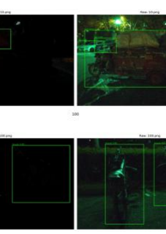
PART 02
How a lead travels
One intake path, one state machine, written-down approvals
DeepGrid Semi — client acquisition operating system · Level 3 build · 5 Aug 2026
11 / 15
Notes:
Part two — the pipeline.

Slide 12
One intake path, one state machine, one record per lead
From 06-process.md · this is the foundation everything automated sits on
new
researched
contacted
replied
booked
proposed
won / lost / dead
Every lead enters the same way regardless of source — referral, inbound, event, cold, GeM tender alert. Same record shape, same first step. Multiple intake paths is the most common reason these systems collapse.
Stage
What happens
Owner
Exit criterion
1–2
Source and qualify
Commercial lead
Passes ICP; disqualifiers cleared
3
Research
Commercial lead
Buying trigger found, or “none found” recorded
4–5
Contact and discovery
Commercial lead
Requirement, timeline, decision unit
6
Technical review
CTO
Their evaluator has seen demo and proof kit
7–8
Proposal and close
Commercial + founder
Priced by function; founder approved
9
Deploy
Engineering
Installed; baseline measurement started
Human approval, not negotiable: anything sent to a client · any price · any contract · any claim not in 04-proof.md · any lead scoring above 9.
DeepGrid Semi — client acquisition operating system · Level 3 build · 5 Aug 2026
12 / 15
Notes:
The state machine looks trivial and is the thing most acquisition systems get wrong.
One record, one state, one store. If two people — or later, two agents — disagree about
where a lead is, the store is broken and no amount of process fixes it.
One intake path matters just as much. The temptation is to handle referrals differently from
cold leads because referrals feel special. That is exactly how the record shape diverges and
the pipeline stops being countable.
The approval line at the bottom is written down in advance deliberately, so it is never a
judgement call in the moment.

Slide 13
Ten levels, built in order — we are at three
Each level must remove a task from somebody's calendar, or it is deleted
L3
L6
Building now
Blocked
the Brain
no CRM exists
Why Level 3 first
Levels 1 and 2 are trivial once the Brain exists — and writing them first would encode the contradictions between the four source documents.
Level 6 is genuinely blocked: there is no CRM or shared store, so a connected system has nowhere to read and write.
That is a purchase decision, not something to engineer around.
Effort is not the constraint — sequence is. Level 7 built on a broken Level 3 is just a faster mess.
DeepGrid Semi — client acquisition operating system · Level 3 build · 5 Aug 2026
13 / 15
Notes:
The chart is build effort, and it deliberately shows that effort is not what governs the
order — sequence is.
Level 10 dwarfs everything else at roughly two to four weeks on top of all the rest, which is
why jumping to it is the classic failure.
The blocked marker on Level 6 is the honest constraint. No CRM means no connection layer, and
no connection layer means agents have nothing real to act on. Fix that before anything above
it is worth attempting.

Slide 14
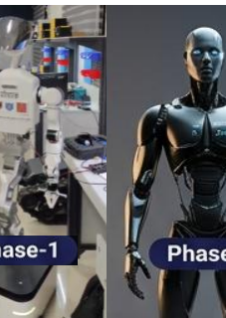
PART 03
What happens next
Three founder decisions gate everything else
DeepGrid Semi — client acquisition operating system · Level 3 build · 5 Aug 2026
14 / 15
Notes:
Part three — execution.

Slide 15
What happens next
Item 1 is one sentence from the founder and it blocks the whole port motion
#
Action
Owner
When
Why
1
Answer: is AD4 Seaport a vehicle or a retrofit kit?
Founder
Today
Decides replace-your-fleet vs convert-it; blocks all port outbound
2
Supply one real COLD email to a stranger
Founder
This week
5 samples recovered from BP-1B; all are replies, none are cold
3
Founder approves the claimable set in 04-proof.md
Founder
This week
Nothing goes out until this is signed
4
Founder approves pricing in 01-offer.md
Founder
This week
Price-by-function is a commitment, not a description
5
Re-run the cold-chat gate test after items 1–4
Commercial lead
Week 2
Run twice: guardrails pass, outbound still fails
6
Withdraw the June IM from circulation
Founder
Immediately
It carries six retired claims
7
Resolve the AD3 rent-vs-sale price conflict
Founder
Week 2
₹0.66 Cr/yr is ~26× the AD2 sale price
8
Name a defence programme and an SI partner
Commercial lead
Weeks 1–12
Track A has a proposition and no pipeline
9
Choose a CRM or shared store
Founder
Month 2
Unblocks Level 6 and everything above
10
Build the AD4 safety case, or stop pitching AD4
Founder
Before any port pilot
No funded functional-safety work exists for a driverless vehicle
Items 1–4 are founder decisions and they gate everything else. Item 1 is a single sentence. Item 10 is new: the driverless segment has no objection set and no safety case — until it does, AD4 is not pitchable as a product.
DeepGrid Semi — client acquisition operating system · Level 3 build · 5 Aug 2026
15 / 15
Notes:
Three of the eight need a founder specifically, and they are the three that gate the rest.
Voice samples cannot be delegated or invented. The claimable set is a commitment about what
the company will assert publicly. Pricing by function is a real pricing decision, not a
presentation choice.
Item five costs nothing and should happen today — the June IM is the most polished document
in the set and carries six claims that have been retired.
Item eight is the honest weakness in what has been built: the objection responses are drafted
from verified evidence rather than taken from real conversations, which is the opposite of
what the framework asks for. They are a starting point to be replaced, not a finished file.

