Slide 1

DEEPGRID · SEMI
PRE-SERIES A · CONFIDENTIAL
INVESTOR + GTM STRATEGY · V2.0
Vertically integrated
edge-AI silicon for
commercial vehicles.
DGRID
ALPHA / 28nm
Fabless custom-ASIC combo-die for autonomous / ADAS commercial fleets in India and the GCC. FPGA-validated architecture, 28 nm ASIC path, and a red-teamed go-to-market plan built to survive contact with buyers.
BLENDED ASK
PRIMARY ICP SCORE
COST REDUCTION
GTM DECISION
₹55 Cr
79.2%
3–7×
Proceed with
Conditions
₹45 Cr CCPS equity + ₹10 Cr CGTMSE debt (~$4.79M)
Tactical Defense & Off-Highway/Port, 3.96/5 weighted
vs imported ADAS stacks at equivalent function
5 conditions, day-90 re-scoring gate
01 · COVER
Not an offer to sell securities · For discussion only

Slide 2

02 · EXECUTIVE SUMMARY
DEEPGRID SEMI · PRE-SERIES A
The one-page thesis, with the numbers reconciled.
01 · WHAT IS VALIDATED
02 · WHY FPGA IS NOT THE BUSINESS
03 · WHAT WE ARE ASKING FOR
Architecture works on FPGA.
FPGA boards are uneconomic at volume.
₹55 Cr blended raise.
3D Systolic Tensor Cube (64×512 MAC, dual-issue @ 600 MHz) delivers a measured 39.3 TOPS INT8 on FPGA.
Batch-dispatch firmware demonstrates ~200× utilization gain vs naive per-frame scheduling on the same silicon.
Six-chiplet combo-die (A100 / R100 / T100 / D100 / S100 / H100) covers ADAS, radar, LiDAR, secure enclave, telematics and health in one BOM slot.
FPGA validation board cost is ~₹35,000 / unit. Fine for defense pilots, fatal for retrofit fleets.
The custom 28 nm ASIC path collapses die cost to $3.876 at 1M units (under $4) and total board BOM to ~$30.
This is the entire investment thesis: fund the ASIC transition, not another FPGA generation.
₹45 Cr CCPS equity (Pre-Series A) funds NRE + MPW tape-out + a 30-month runway to positive net income in FY2029.
₹10 Cr CGTMSE-backed venture debt covers working capital against 90–180 day government payment cycles.
Blended cost of capital is materially lower than a pure-equity round of the same size. Full use of funds on slide 35.
⚠ CORRECTION ON-SLIDE
Earlier materials cited a ₹25 Cr ask. The reconciled figure is ₹45 Cr equity CCPS + ₹10 Cr CGTMSE debt = ₹55 Cr blended. Any external document, deck, or one-pager still quoting ₹25 Cr should be withdrawn and replaced. Full corrections ledger on slide 06.
SECTION 1 · COMPANY, PROBLEM, SOLUTION
02 / 37

Slide 3
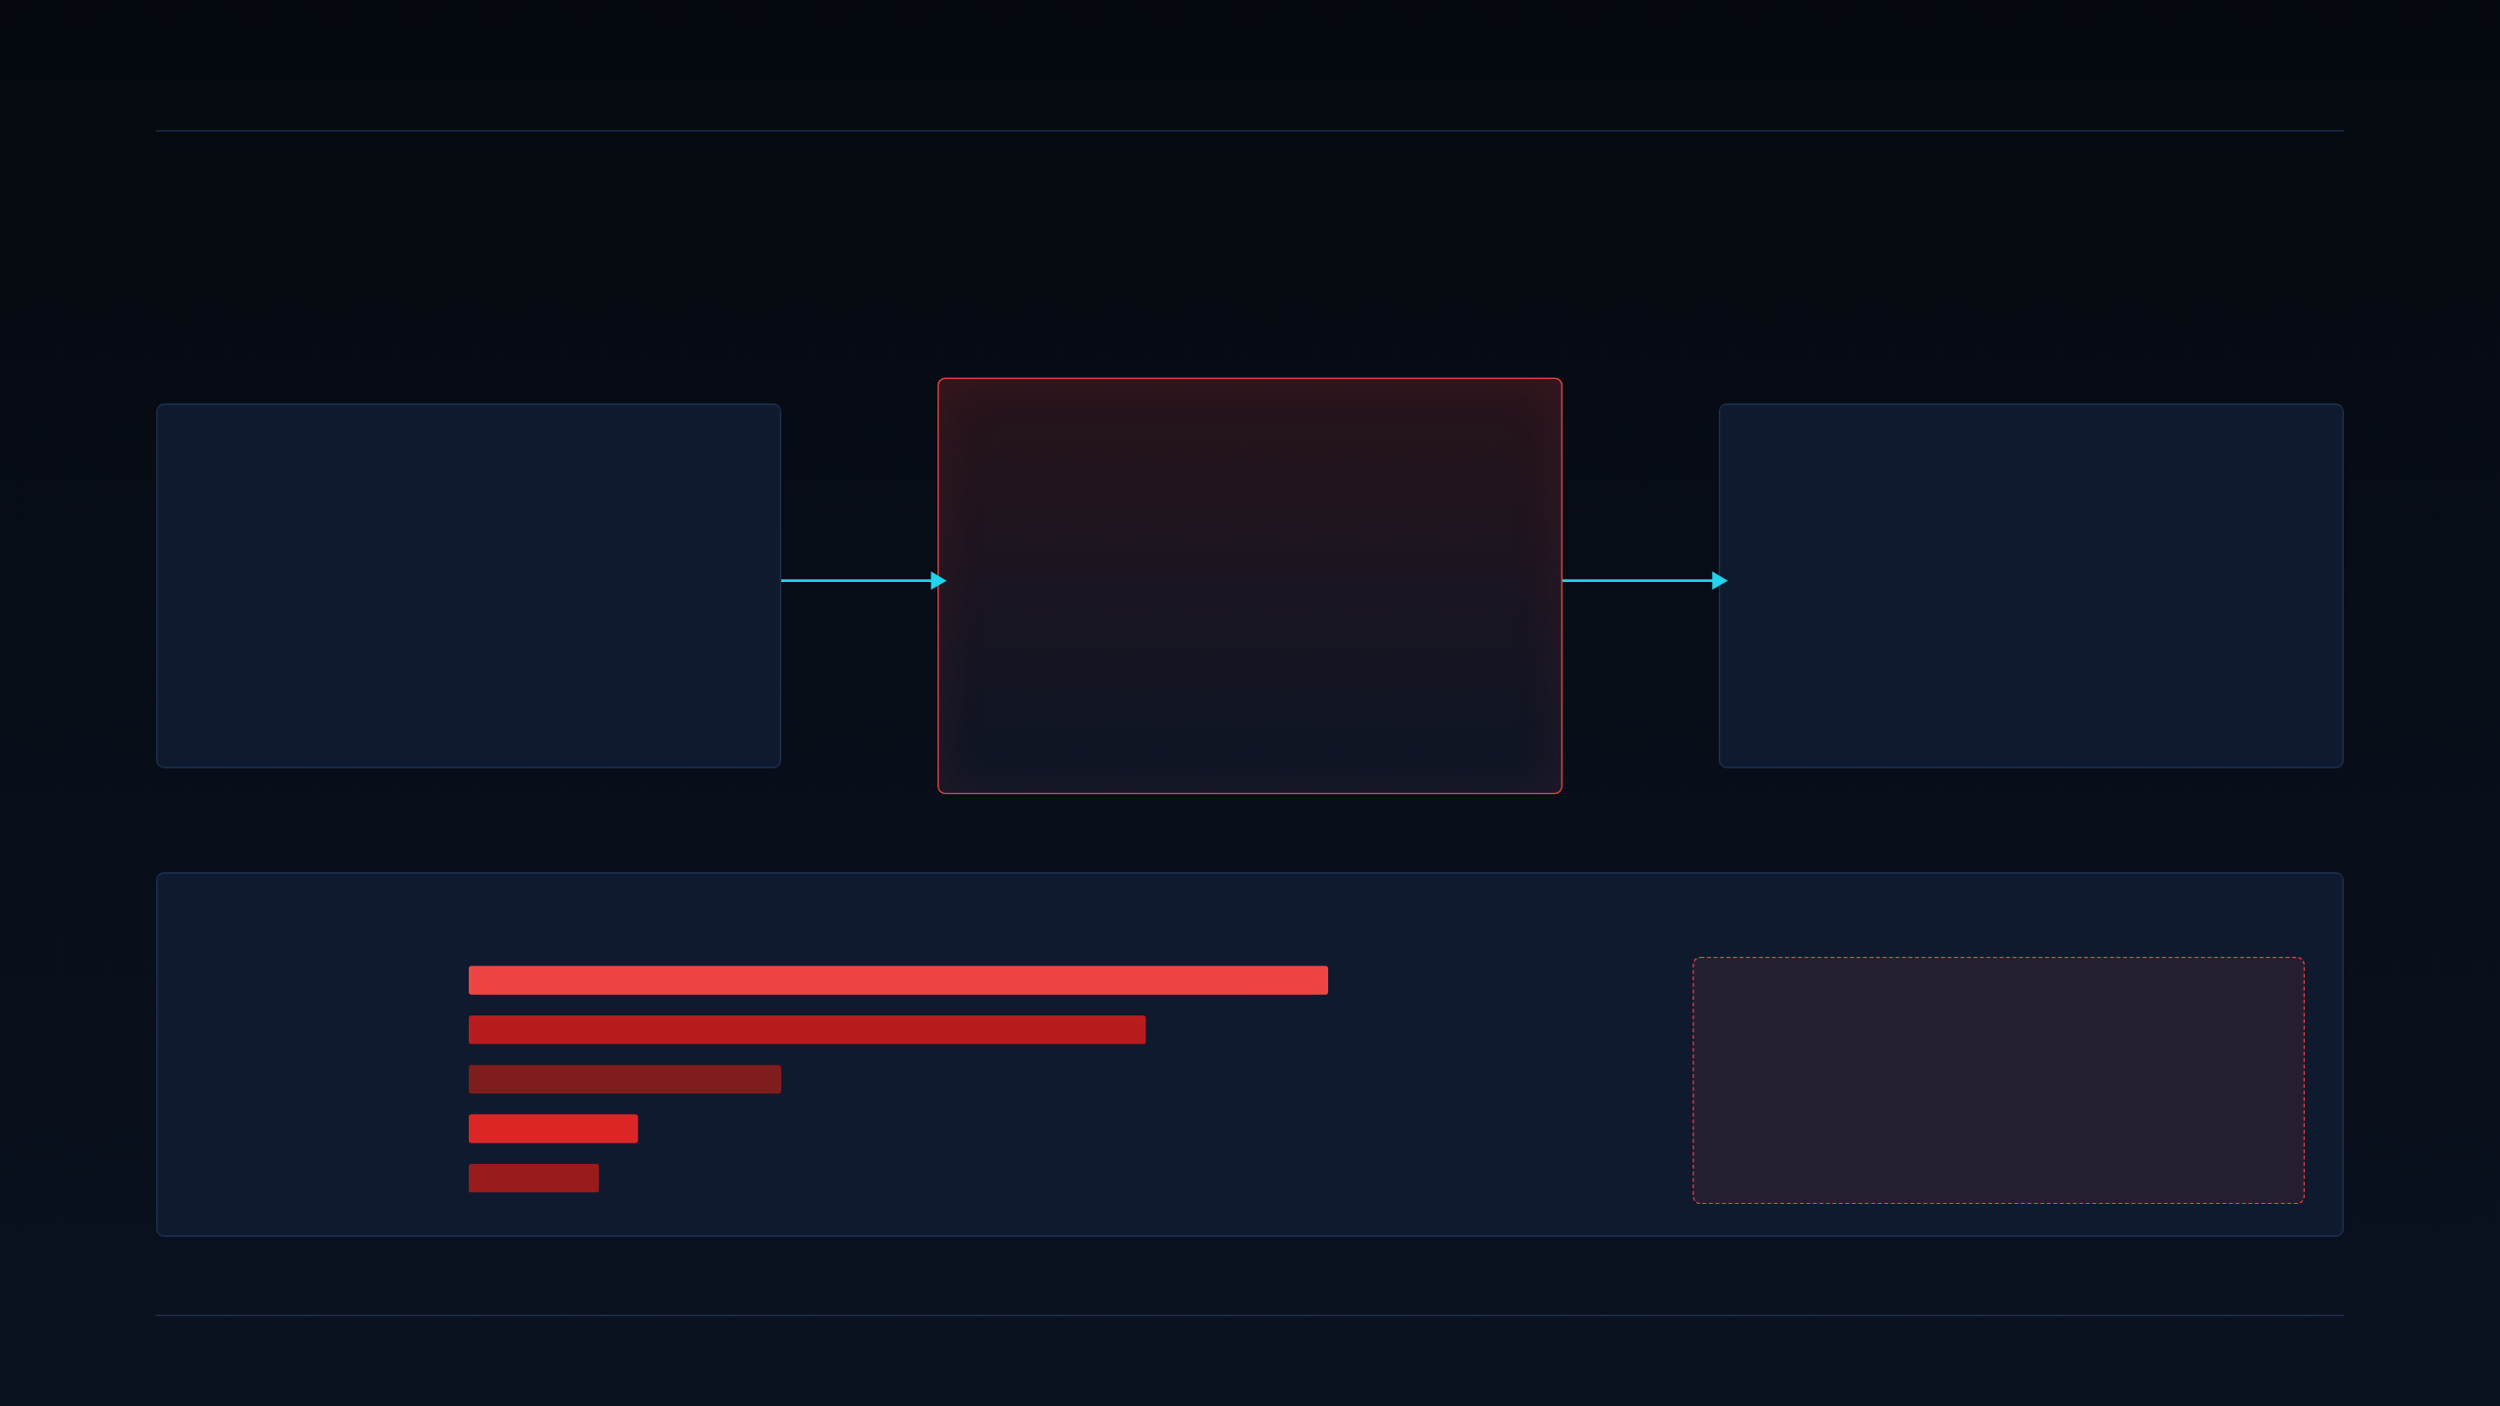
03 · CORE PROBLEM
DEEPGRID SEMI · PRE-SERIES A
The Squeeze Zone.
Every pure-play autonomy stack in India inherits merchant-silicon economics — and prices itself out of its own market.
LAYER 1 · SOFTWARE PLAYERS
LAYER 2 · WHERE VALUE LEAKS
LAYER 3 · MARKET OUTCOME
Pure-Play
AI Software
The Squeeze
Zone
Sales limited
to rich fleets.
Minus Zero, Swaayatt Robots, RoshAI — algorithm-first, hardware-agnostic. Excellent perception IP, but treats silicon as a black-box commodity.
Merchant silicon (NVIDIA DRIVE, Ambarella, Mobileye, Qualcomm) drives per-vehicle BOM past $6,000. Add radar, camera, enclosure, integration — the stack cannot land under fleet payback thresholds.
Only US / EU / GCC logistics majors can amortize the cost. Indian and cost-sensitive GCC fleets get shut out of the safety-mandate wave.
EVIDENCE — REPRESENTATIVE BOM COMPOSITION OF IMPORTED ADAS L2+ STACKS
Compute SoC
$2,400
TOTAL IMPORTED BOM
Radar 4× + LiDAR
$1,900
$6,000+
Cameras 6–8×
$880
Enclosure + wiring
$470
Representative L2+ stack. Excludes install labour. Fleet payback impossible below ₹8 L retrofit price at Indian diesel-fleet TCOs.
Integration + margin
$350+
SECTION 1 · COMPANY, PROBLEM, SOLUTION
03 / 37

Slide 4
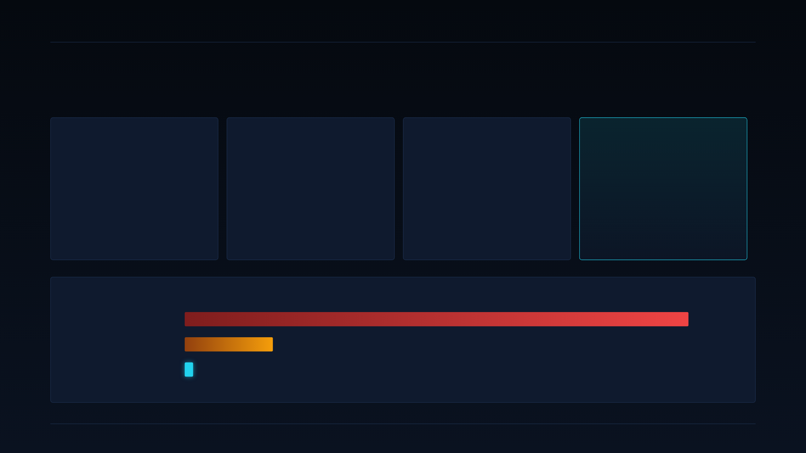
04 · SOLUTION
DEEPGRID SEMI · PRE-SERIES A
DGrid Alpha — a single combo-die closes the BOM gap.
Four proven engineering choices, one BOM slot, ~$30 board cost.
01 · COMPUTE FABRIC
02 · FIRMWARE
03 · INTEGRATION
04 · COST OUTCOME
3D Systolic
Tensor Cube
Batch-dispatch
scheduler
Six chiplets,
one combo-die
~$30 board
BOM at scale
64 × 512 MAC lattice, dual-issue @ 600 MHz → measured 39.3 TOPS INT8.
Sized for one 8MP camera cluster + 4-corner radar without off-chip DRAM thrash.
Micro-batches perception ops across camera + radar streams. Measured ~200× utilization gain over naive per-frame dispatch on the same silicon.
Reason MAC array actually reaches its TOPS ceiling.
ADAS, radar DSP, thermal / LiDAR DSP, secure enclave, telematics, and driver-health in one package on 28 nm HPC+.
Replaces the four-to-six chip stack most Tier-1 designs still ship.
Die cost $3.876 at 1M units (28 nm HPC+).
Board BOM ~$30 including package, PMIC, DDR, enclosure headers.
Direct comparison: Mobileye ASP $50 → 12.9× cost advantage at the compute node.
COMPUTE-NODE COST, APPLES-TO-APPLES (SINGLE UNIT SHOWN AT SCALE)
Merchant SoC (imported)
~$2,400
FPGA validation (current)
~$420 (₹35k)
DGrid Alpha 28 nm ASIC
$3.876 die · ~$30 board
Die cost from foundry quote at 1M units, 28 nm HPC+, ~20 mm² net. See slide 31 for full unit economics build-up.
SECTION 1 · COMPANY, PROBLEM, SOLUTION
04 / 37

Slide 5

05 · ARCHITECTURE
DEEPGRID SEMI · PRE-SERIES A
Six chiplets on one 28 nm combo-die.
Each chiplet maps to a specific regulatory function or revenue lane. No decorative silicon.
DGRID·ALPHA · 28NM HPC+
~20mm² · 6 CHIPLETS
CHIPLET → REGULATORY FUNCTION MAP
A100
R100
T100
CHIPLET
FUNCTION IT OWNS
INDIA MANDATE
REVENUE LANE
ADAS / AI Core
Radar DSP
Thermal / LiDAR DSP
A100
ADAS perception + fusion
AIS-184 / 186 / 187
Retrofit + OEM
39.3 TOPS INT8
77 GHz FMCW
MIPI CSI-2 + SPI
64×512 MAC tensor cube · perception, sensor fusion
FFT + CFAR pipeline · 4-corner radar aggregation
Night / low-light + optional solid-state LiDAR channel
R100
77 GHz radar processing
AIS-188 (AEBS)
Retrofit + OEM
D100
S100
H100
Secure Enclave
SDV Telematics
Health / Bio-ADC
T100
Thermal / LiDAR DSP
AIS-189 / 190 (night)
Off-highway, defense
Lockstep RISC-V
AIS-140 compliant
DMS analog front-end
ISO 26262 target, HSM, keys stay on-die (sovereign data)
GNSS + LTE + emergency button · kills secondary tracker
Drowsiness / distraction detection · AIS-184 relevant
D100
Secure boot, HSM, keys
ISO 26262 target
Defense (moat)
FABRIC
S100
Telematics + GNSS + LTE
AIS-140 / 162
SaaS attach
Coherent chiplet interconnect + unified LPDDR4 controller
Zero-copy tensor handoff A100 ↔ R100 ↔ T100. D100 owns the boot chain, S100 owns the modem, H100 streams straight into A100's classifier heads.
H100
DMS analog front-end
AIS-184 relevant
Retrofit + insurer
SECTION 1 · COMPANY, PROBLEM, SOLUTION
05 / 37

Slide 6

06 · CORRECTIONS LEDGER
DEEPGRID SEMI · PRE-SERIES A
Numbers we are explicitly retracting.
Every earlier draft, one-pager or external note quoting the left column should be withdrawn and replaced with the right.
ITEM
EARLIER / DRAFT FIGURE (RETRACTED)
RECONCILED FIGURE (USE)
WHY THE CHANGE
Blended Ask
₹25 Cr
₹55 Cr blended
₹45 Cr CCPS + ₹10 Cr CGTMSE
Original ₹25 Cr covered NRE only. Reconciled ask funds NRE + tape-out + 30-month runway to net-income-positive in FY2029.
Tape-out NRE
$8M
$3.17M
Full MPW phasing on slide 32
MPW (multi-project wafer) shuttle on 28 nm HPC+, shared reticle, no full-mask commit. Prior $8M assumed dedicated mask.
Break-even units
3,636 units
~174,908 chips
Crossing FY2032
Recalculated with actual NRE, fully-loaded opex, and chip-level (not board-level) margin. Retire the 3,636 figure entirely.
Die cost at 1M units
"< $3"
$3.876
Foundry-quoted, still under $4
Includes wafer, package, test, yield-loss provision. Still delivers a 12.9× advantage vs Mobileye ASP $50 — not 774×.
Banned narrative claims
"84% ASIC gross margin" · any insurance-premium-reduction % · "mandate-ready" AD2 · accident-reduction % · 5M+ truck TAM as pipeline
Do not repeat. See slide 18 for approved substitutes and slide 33 for the actual margin curve.
Each of these is either unreconciled arithmetic, unmeasured effect, or forecast confused with demand.
SECTION 1 · COMPANY, PROBLEM, SOLUTION
06 / 37

Slide 7
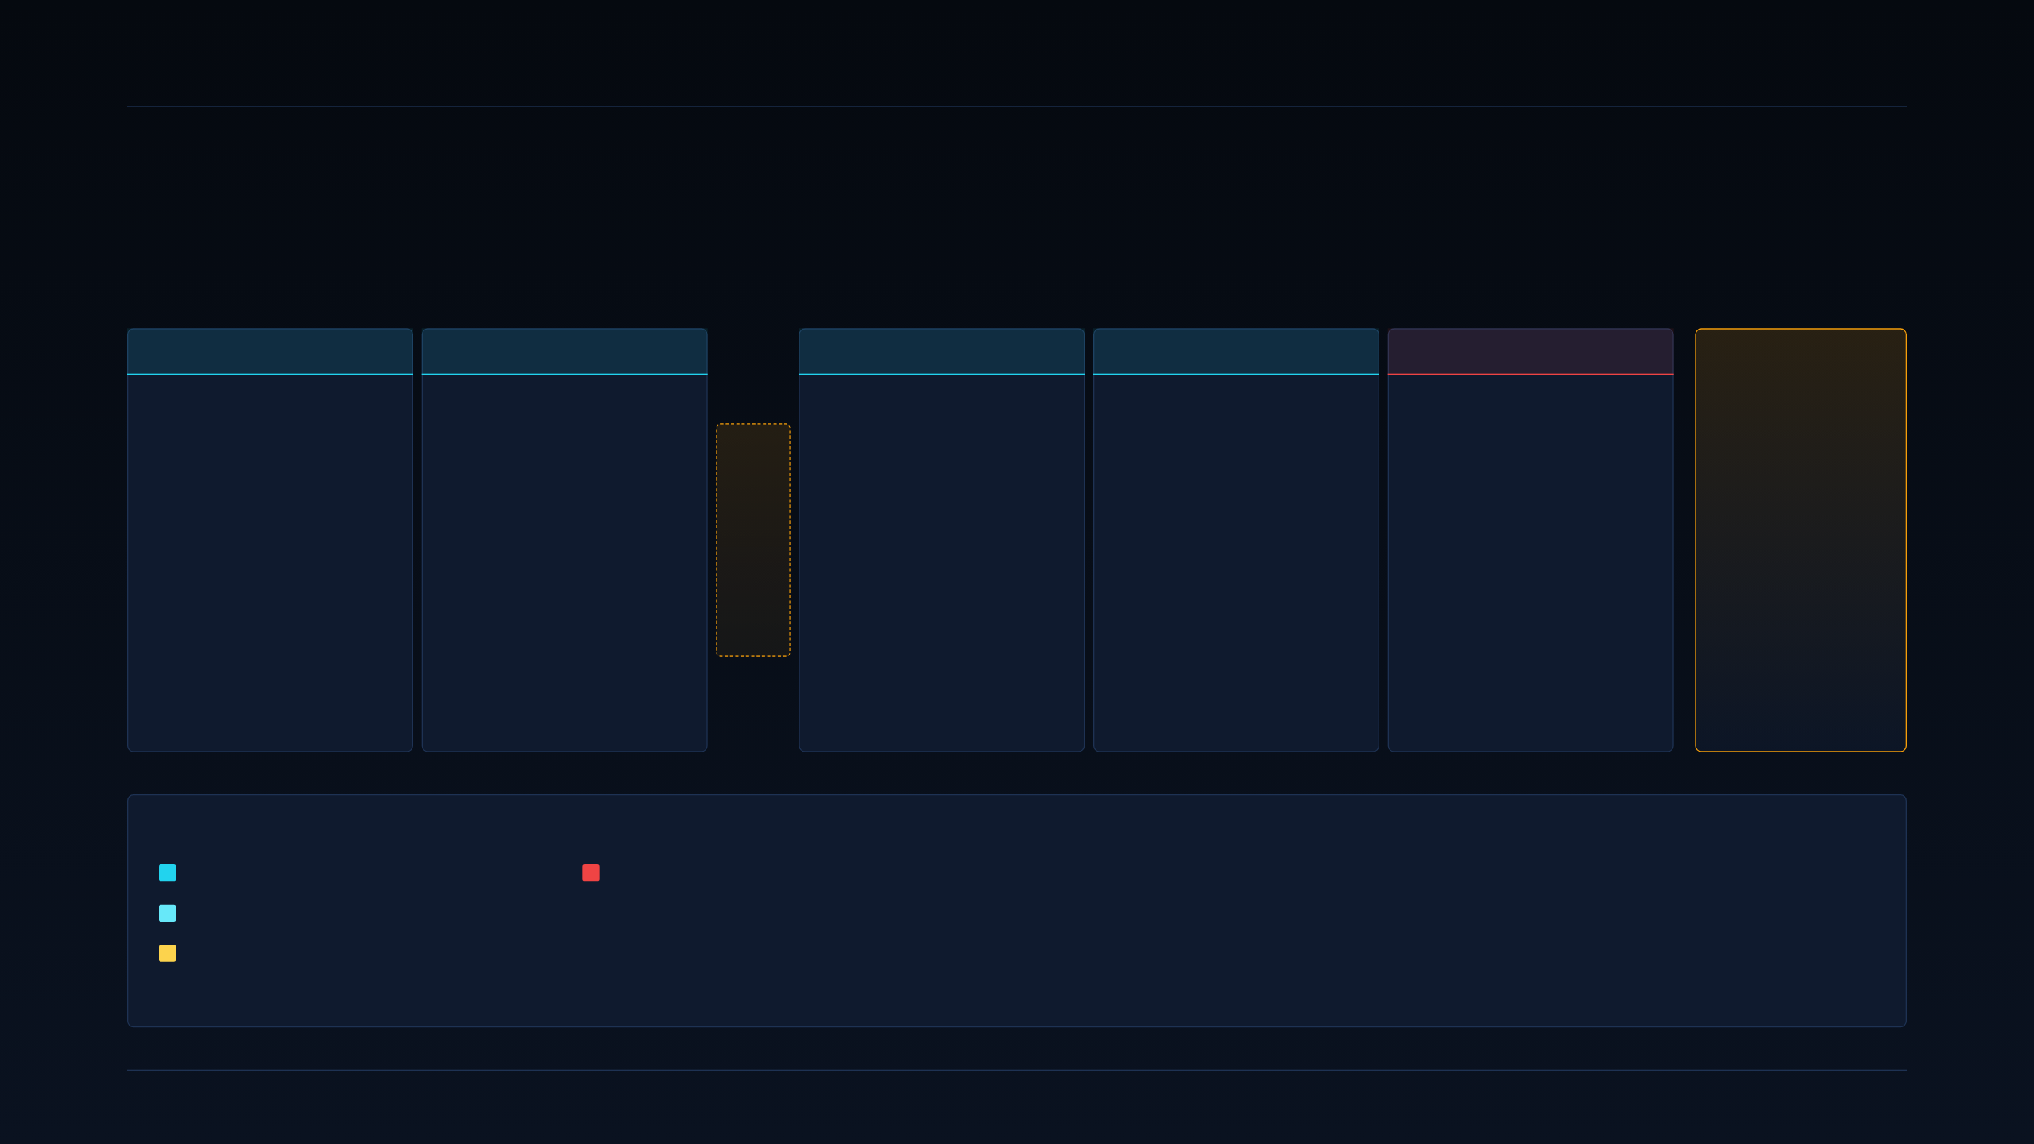
07 · GTM PIPELINE
DEEPGRID SEMI · PRE-SERIES A
How this GTM was built. Six stages, two gates, one red team.
Every downstream slide in this deck traces back to an artifact produced in one of these stages. Nothing is hand-wavy.
STAGE 0–1
STAGE 2
STAGE 3
STAGE 4
STAGE 5
DECISION
Source intake & competitor benchmark
ICP scoring
Validation design
GTM system
Red team
Proceed
with
Conditions
GATE 1
34 sourced claims from filings, mandate notifications, competitor material, primary interviews.
Each classified as one of: fact, claim, inference, unknown.
→ Feeds all scoring
Independent 10-dimension weighted scorecard. 5 candidate segments scored against evidence, not narrative preference.
Producer of the 79.2% / 68.0% / 52.4% / 46.4% / 43.0% numbers.
→ Methodology slide 08
MANDATORY · USER APPROVAL BEFORE ADVANCE
Fatal-assumptions test.
27-question buyer discovery guide (Defense + Fleet variants).
Paid-pilot charter template.
Kill criteria written before outreach, not after.
Positioning statements (two-track), pricing logic, channel matrix, and the 13-week execution plan.
→ Slides 17–20
Adversarial review against the plan produced by Stage 4.
Found 2 real gaps (Indian defense primes unassessed; nature of the ₹1 Cr revenue unconfirmed).
→ Slide 36
5 conditions, priority-ordered.
Day-90 hard re-scoring gate.
→ Slide 37
EVIDENCE-CLASSIFICATION LEGEND USED ACROSS THE DECK
FACT — directly observable, audited or cited.
UNKNOWN — flagged and gated, never treated as evidence.
CLAIM — asserted by a party with stake in it.
Of the 34 sourced claims: 12 facts, 11 claims, 8 inferences, 3 unknowns. The three unknowns include the nature of the ₹1 Cr Defense revenue (grant vs commercial sale), which gates further Defense resourcing until confirmed — see slide 36.
INFERENCE — derived from facts, not itself measured.
SECTION 2 · ICP & GTM STRATEGY
07 / 37

Slide 8

08 · ICP METHODOLOGY
DEEPGRID SEMI · PRE-SERIES A
Ten dimensions. Weighted. Applied identically to every segment.
Five core dimensions from the founder's original hypothesis, five added by the pipeline for evidence discipline.
FIVE CORE · FOUNDER HYPOTHESIS
WEIGHT
FIVE ADDED · EVIDENCE DISCIPLINE
WEIGHT
01
Regulatory Compulsion
Is buying forced by mandate on a hard date?
15%
06
Budget verified
Named line item, not "should have budget".
12%
02
Integration / Cert Friction
How much OEM validation stands between us and a sale?
10%
07
Competitive pressure
Real, active competitors already selling into the segment?
8%
03
Price Elasticity / BOM Limit
Can the buyer absorb our unit economics?
12%
08
Margin at this segment
Segment-specific gross margin, not deck-average.
8%
04
Sales Cycle
Weeks vs quarters vs years from intro to PO?
10%
09
Repeatability
Does the second sale look like the first?
5%
05
ODD Entropy
Complexity of the Operational Design Domain — highway is simpler than urban chaos.
—
10
Evidence strength
Booked revenue, signed pilot, LOI, quote — vs a claim.
5%
qualitative filter
These five are the founder's original ICP thesis. They ask who has to buy this, at what price, on what schedule. They are necessary but insufficient — they were passing the Fleet segment even without any signed customers.
Problem 15% · Urgency 15% · Fit 12% · Budget 12% · Cert 10% · Cycle 10% · Comp 8% · Margin 8% · Repeat 5% · Evidence 5% = 100%. Applied identically to all five candidate segments. See slide 09 for the resulting scorecard.
SECTION 2 · ICP & GTM STRATEGY
08 / 37

Slide 9
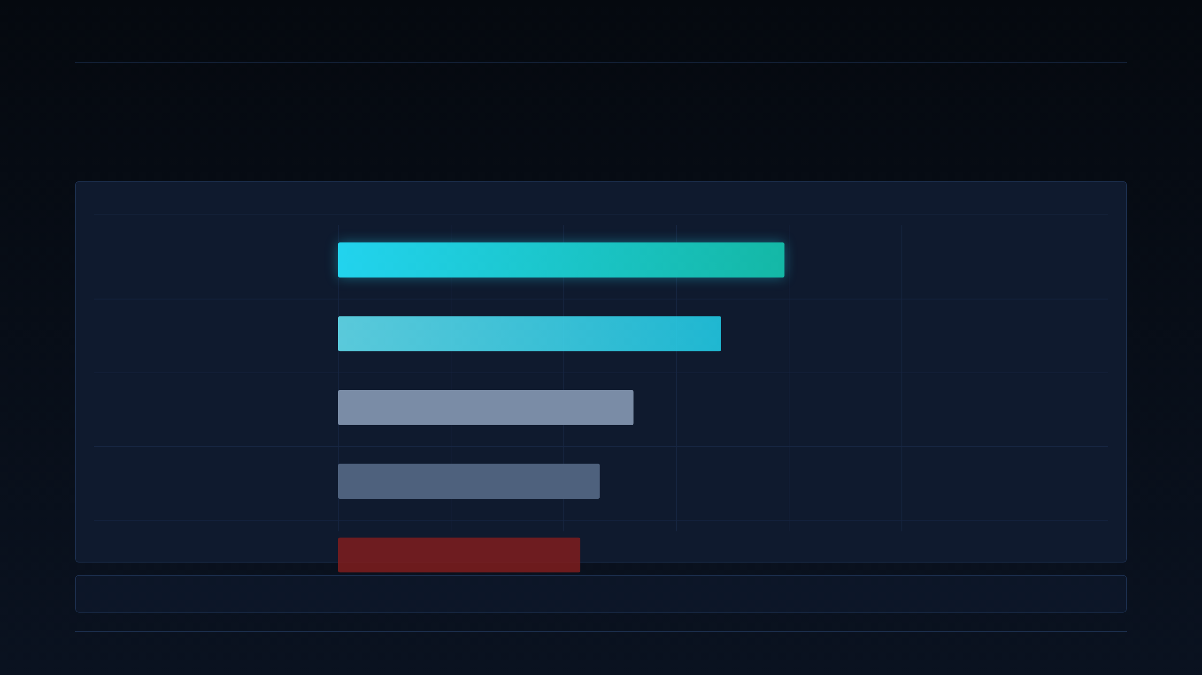
09 · WEIGHTED ICP SCORECARD
DEEPGRID SEMI · PRE-SERIES A
Five segments. One weighted score each. Ranked.
Scale 0–5 per dimension, weighted & summed. Bar length is the weighted average expressed as a % of 5.
SEGMENT
WEIGHTED SCORE (OF 5.00)
SCORE
VERDICT
Tactical Defense & Off-Highway / Port
Primary ICP · sovereign UGVs, border, AGVs
3.96 /5
79.2%
3PL / Dedicated Fleet Retrofit
Secondary experiment · N2/N3 trucks
3.40 /5
68.0%
AD0 Owner-Operator Direct
Below threshold · direct to individual truck owners
2.62 /5
52.4%
Automobile OEM / Tier-1
Deferred · long-term line-fit only via Tier-1
2.32 /5
46.4%
Commercial Motor Insurers
Anti-ICP · evidence partner at best, never customer
2.15 /5
43.0%
Weights: Problem 15% · Budget 12% · Urgency 15% · Fit 12% · Cert friction 10% · Sales cycle 10% · Competitive pressure 8% · Margin 8% · Repeatability 5% · Evidence 5%.
SECTION 2 · ICP & GTM STRATEGY
09 / 37

Slide 10
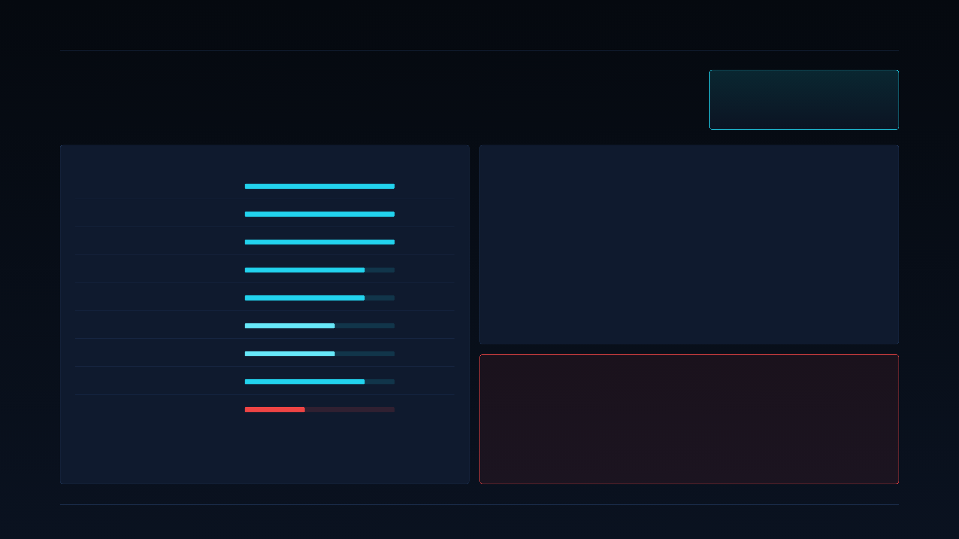
10 · ICP OPTION A — PRIMARY
DEEPGRID SEMI · PRE-SERIES A
Tactical Defense & Constrained Robotics.
WEIGHTED SCORE
3.96 / 5 · 79.2%
Sovereign UGVs, border surveillance, seaport & container-yard AGVs.
WHY IT SCORES 3.96 — DIMENSION DETAIL
WHY IT IS THE PRIMARY ICP
Evidence strength
5 / 5
Extremely cost-insensitive at the chip level. Sovereign buyers optimise for supply-chain sovereignty and audit posture, not BOM. Our ~$30 board is a rounding error against a UGV platform cost.
D100 secure enclave is a first-order feature. Lockstep RISC-V, on-die HSM, keys never leave the die. This maps directly onto Ministry of Defence data-sovereignty requirements — it is not a checkbox, it is the whole reason to buy.
Off-highway / port variants share the SKU. Container terminals in Mundra, Chennai and Jebel Ali need the same secure-boot AGV compute node. One BOM, two buyer types.
Revenue already exists. ~₹1 Cr in Defense contract revenue booked. It is the only external validation across all 5 candidate segments.
Budget verified
5 / 5
Technical fit (ships today)
5 / 5
Price elasticity
4 / 5
Regulatory / urgency
4 / 5
Sales cycle
3 / 5
Cert friction
3 / 5
Competitive pressure
4 / 5
⚠ RED-TEAM FLAG — GATES FURTHER DEFENSE RESOURCING
The exact nature of the ₹1 Cr revenue is unconfirmed.
Repeatability (the flaw)
2 / 5
Is it a commercial sale (repeatable customer signal) or a grant / subsidy / R&D contract (one-off, not customer signal)? These score entirely differently on dimensions 9 & 10. Until confirmed within one week (see slide 37, Condition 1), further Defense hiring / BD spend is paused. If it turns out to be a grant, Defense and Fleet re-score as evidence-equal.
Defense wins on evidence (real booked revenue vs zero signed Fleet customers), budget (cost-insensitive sovereign buyers), and technical fit (the product ships today). It loses on repeatability — and that is why it cannot be the whole plan. See slide 14 for the synthesis.
SECTION 2 · ICP & GTM STRATEGY
10 / 37

Slide 11
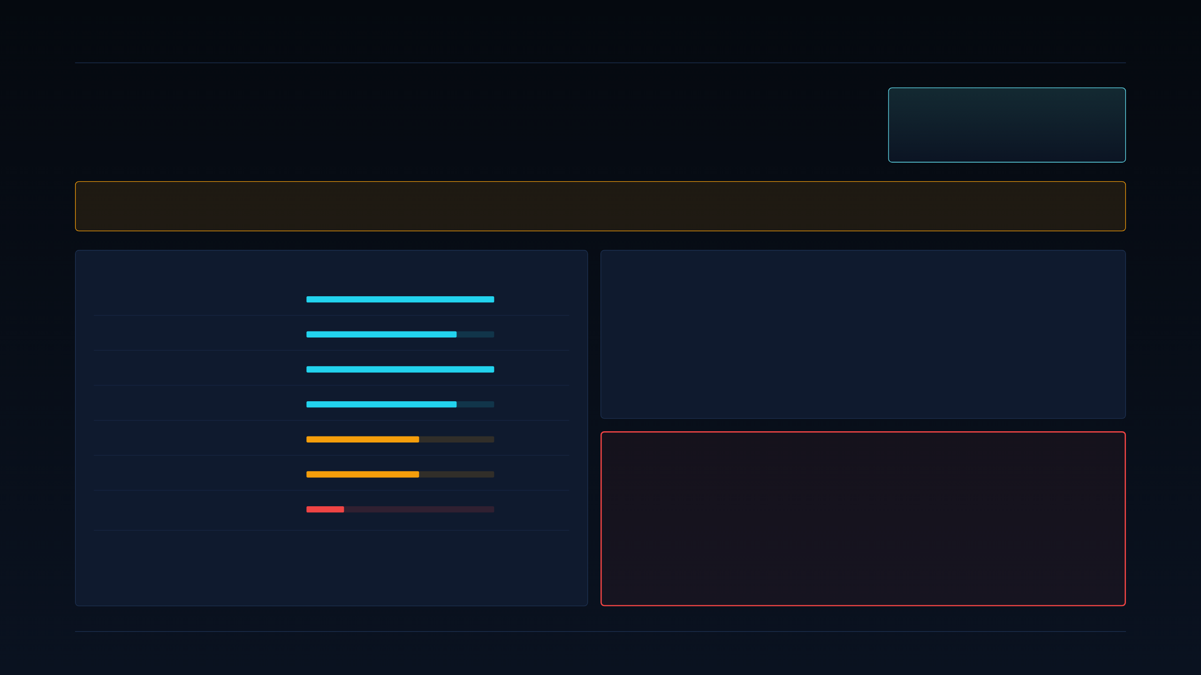
11 · ICP OPTION B — SECONDARY EXPERIMENT
DEEPGRID SEMI · PRE-SERIES A
Non-Discretionary Aftermarket Fleet Retrofit.
WEIGHTED SCORE
3.40 / 5 · 68.0%
Medium and heavy commercial vehicles — N2/N3 — forced by mandate to retrofit ADAS.
⚑ FOUNDER'S WORKING-HYPOTHESIS FAVOURITE — BUT STILL ASPIRATIONAL
Priced at ₹2–2.5 Lakh per retrofit kit. Zero signed customers. Every argument for this segment right now is theoretical.
DIMENSION DETAIL
WHY IT STAYS ON THE BOARD (NOT KILLED)
Regulatory urgency
5 / 5
India's N2/N3 fleet mandate wave (AIS-184/186/187/188) starts landing in FY26–27 and hits enforcement in FY28. That is a genuine ~5M-vehicle addressable base, and it is the segment that eventually justifies the ₹55 Cr raise as a chip-volume business.
But "eventually" and "if a fleet actually pays ₹2–2.5 L" are two different bets. Until one fleet signs, we don't know the price holds.
Technical fit
4 / 5
Repeatability
5 / 5
Cert friction
4 / 5
Price elasticity
3 / 5
⚑ KILL CRITERION — HARD, DATED, MEASURABLE
Sales cycle
3 / 5
At least 1 of the first 20 buyer interviews
must convert to a paid pilot within 90 days.
Evidence strength
1 / 5
Fleet scores 68% on mandate math and technical fit. Evidence dimension is the single reason it isn't primary. The kill criterion turns that 1/5 into a measurable test.
Pass → Fleet re-scores as co-primary, resource shifts. Fail → Fleet stays secondary; no additional GTM spend beyond discovery; revisit at Month 12 only if the mandate calendar tightens.
SECTION 2 · ICP & GTM STRATEGY
11 / 37

Slide 12
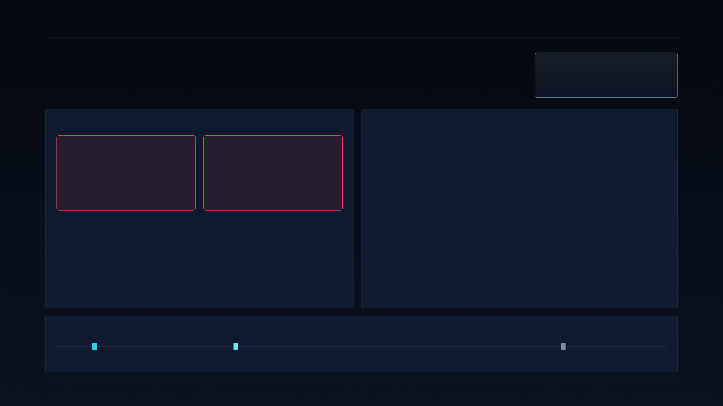
12 · ICP OPTION C — DEFERRED
DEEPGRID SEMI · PRE-SERIES A
OEM Factory Line-Fit Embedding.
WEIGHTED SCORE
2.32 / 5 · 46.4%
Long-term the biggest opportunity. Short-term the wrong door to knock on.
THE TWO SCORES THAT KILL IT RIGHT NOW
THE ONE ENTRY RULE
Enter only via a signed Tier-1 partnership.
CERT FRICTION
SALES CYCLE
1/5
1/5
Why Tier-1 changes the math. Uno Minda, Spark Minda or Bosch India already sit on OEM homologation panels. They amortise cert cost across their existing portfolio; we ride their AEC-Q100 audit trail.
What "signed" means. A binding co-development agreement with committed NRE reimbursement — not an MoU, not a "letter of interest". Any softer instrument does not unlock OEM resourcing.
Until then — the stop-doing list. No direct OEM BD calls, no OEM-facing marketing, no ISO 26262 pre-audit spend, no AEC-Q100 stress program on the FPGA validation board.
Phase 3 of the roadmap (slide 28) is where this switches on — not before.
Full OEM validation. ISO 26262 ASIL-B minimum, functional-safety audit, EMI/EMC, thermal cycling, 3-year AEC-Q100.
SOP cycles are 24–36 months. Design-in NRE only pays back after multi-year platform commitment.
These are the worst cert-friction and sales-cycle scores of any of the five segments. Under any resourcing plausible for a Pre-Series A, direct OEM sales cannot generate revenue inside the 30-month runway.
OTHER DIMENSIONS (FOR THE RECORD)
Fit 4/5 · Margin at OEM ASP 3/5 · Regulatory urgency 3/5 · Repeatability 4/5 · Evidence 1/5 (no LOI). Numerator good, denominator (time) fatal.
TIME-TO-FIRST-REVENUE BY SEGMENT (ORDER-OF-MAGNITUDE ESTIMATE)
Defense (booked)
Fleet pilot (if kill-criterion passes)
OEM SOP (via Tier-1, earliest)
0 mo
6 mo
12 mo
24 mo
36+ mo
SECTION 2 · ICP & GTM STRATEGY
12 / 37

Slide 13
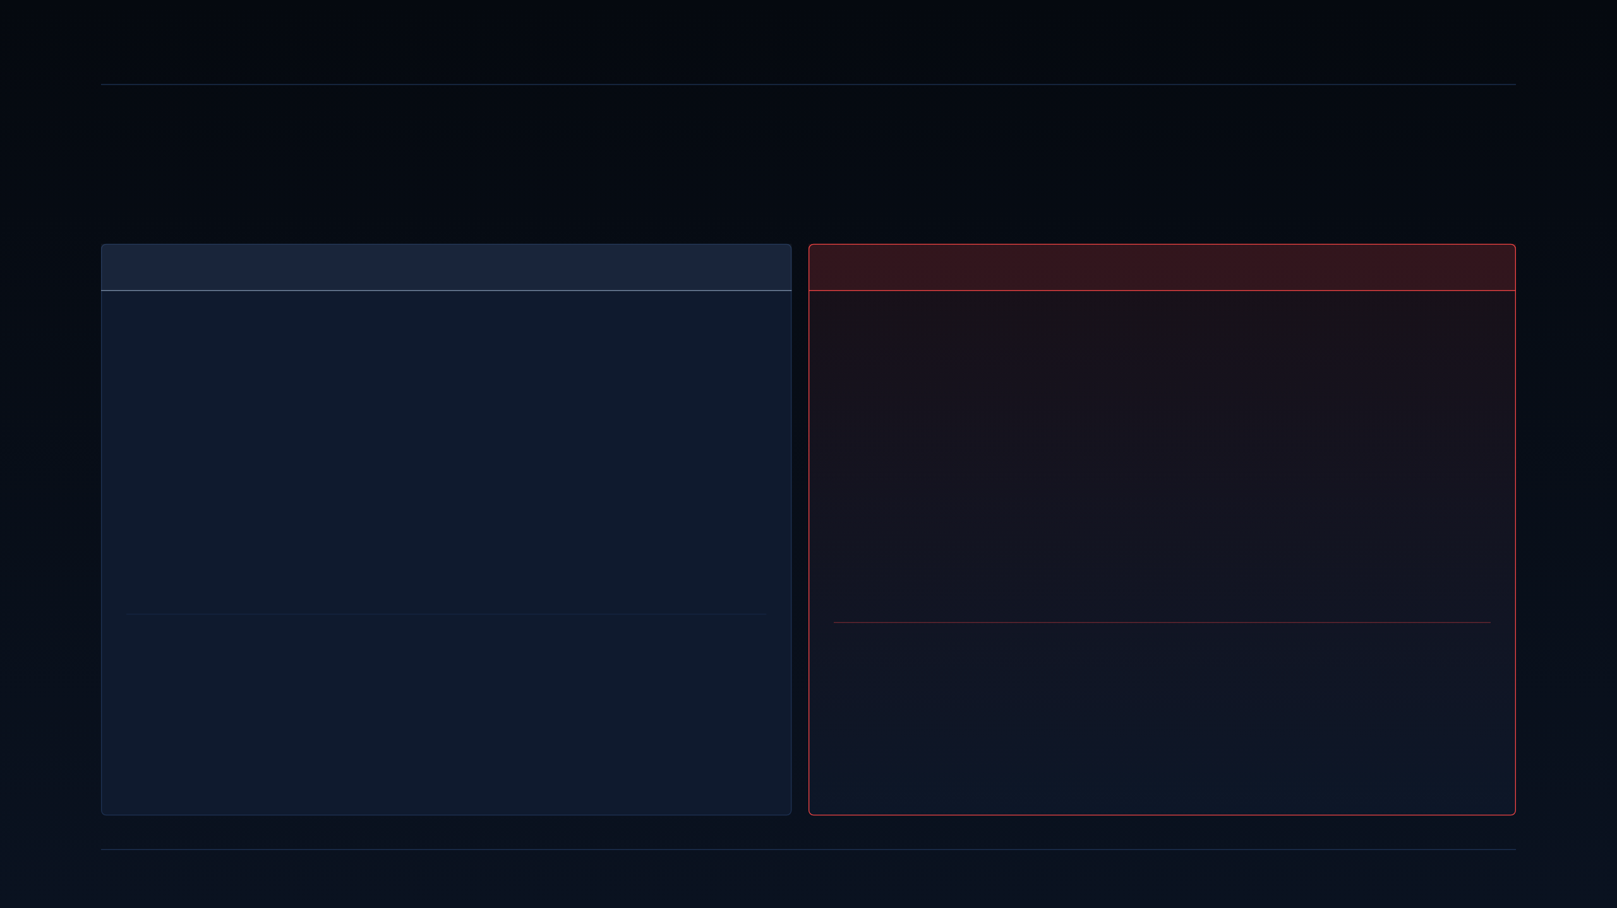
13 · DEFERRED & ANTI-ICP
DEEPGRID SEMI · PRE-SERIES A
The two segments we are explicitly not selling to.
One is a "later, and only via partner". One is a "never as a direct customer".
DEFERRED · REVISIT PHASE 3
46.4%
ANTI-ICP · LOWEST SCORE
43.0%
Automobile OEM / Tier-1
Commercial Motor Insurers
WHAT "DEFERRED" MEANS OPERATIONALLY
WHY WE ARE LABELLING THIS "NEVER A DIRECT CUSTOMER"
Not killed — timed. This is where the volume lives once the chip has a Tier-1 sponsor and an OEM SOP.
Direct OEM effort is paused until at least one of: (a) a signed Tier-1 co-development agreement is in hand, or (b) the Fleet retrofit pilot proves the compute node in field conditions on the same vehicle classes OEMs care about.
The one exception: sovereign OEMs (Tata Advanced Systems, Mahindra Defence) — addressed through the Defense track, not through automotive BD.
Lowest score across every segment. The whole insurer thesis in the founder's original draft rested on an unsupported "premium-reduction %" claim. There is no measured accident-reduction data behind it, no actuarial partnership, no signed data-share agreement.
The model has zero insurer-revenue rows. There is no line item to defend.
Insurers may eventually be an evidence partner — a channel we help underwrite fleet-side ROI — but under no circumstances are they a direct customer of the chip in this plan.
TRIGGER TO REACTIVATE
TRIGGER TO REVISIT AS EVIDENCE PARTNER (NOT CUSTOMER)
→ Any Tier-1 signs a binding co-development agreement with NRE terms.
→ OR — a sovereign OEM specifies DGrid Alpha for a defence-adjacent platform.
→ OR — the Fleet retrofit generates a public field-safety dataset the OEM can cite in its own homologation package.
→ Fleet pilot generates a measured accident-reduction dataset with an insurer already on-record willing to underwrite it.
→ Only then does an insurer channel deserve pipeline effort — and even then it is a data-sharing motion, not a sales motion.
SECTION 2 · ICP & GTM STRATEGY
13 / 37

Slide 14

14 · ICP SELECTION SYNTHESIS
DEEPGRID SEMI · PRE-SERIES A
Defense first, Fleet in parallel. Not a pivot — a sequence.
The synthesis of the scorecard, red-team, and the roadmap already in the original pitch.
THE TENSION
THE SYNTHESIS
THE STRONGEST COUNTER-CASE
Defense wins the scorecard — but flunks repeatability.
Two-track: Defense as resourced primary, Fleet as experiment.
A defence-first motion risks the fundraising narrative.
Defense scores 5/5 on evidence, 5/5 on budget, 5/5 on fit — but 2/5 on repeatability.
Defense contracts are lumpy. Two won contracts don't imply twenty. They do not scale into the ~88% systems-revenue business that the ₹55 Cr raise is built to fund.
Fleet, meanwhile, is a repeatable-by-design segment (5/5 repeatability) — but has 1/5 evidence.
You cannot ship the deck as "Defense company" and you cannot ship it as "Fleet company either." One has revenue, the other has volume physics.
Months 0–6. Defense runs as resourced primary. Objective: get the second signed contract that turns "1 CR revenue" into a customer signal, and generate the field data Fleet needs to close its first pilot.
In parallel, months 0–3. Fleet runs as a 20-interview discovery experiment against the paid-pilot kill criterion.
Month 6 gate. Re-score both segments with fresh evidence. If Fleet passed its kill criterion, it becomes co-primary. If not, Defense stays primary and Fleet drops to watch-only.
This confirms — not invents — the original pitch's three-phase roadmap.
Investors are being asked to fund a chip business, priced against a 5M+ commercial-vehicle TAM. A defense-only story does not clear that hurdle.
So this only holds together as a sequenced two-track plan — never as a flat pivot.
External framing rule (Condition 4, slide 37). Every deck, one-pager, and investor email must present the plan as Defense-sequenced-then-Fleet, not Defense-only. Any external doc that reads as "pivot to defense" gets pulled.
Internal escalation rule. If the day-90 checkpoint shows Fleet failing AND Defense-2 not signed, this becomes a Board-level re-plan, not a marketing tweak.
THE ONE-LINE SYNTHESIS
Run Defense as resourced primary for 6 months — the fastest way to generate the missing Fleet evidence — while Fleet runs in parallel as a secondary, kill-criterion-gated experiment.
SECTION 2 · ICP & GTM STRATEGY
14 / 37

Slide 15
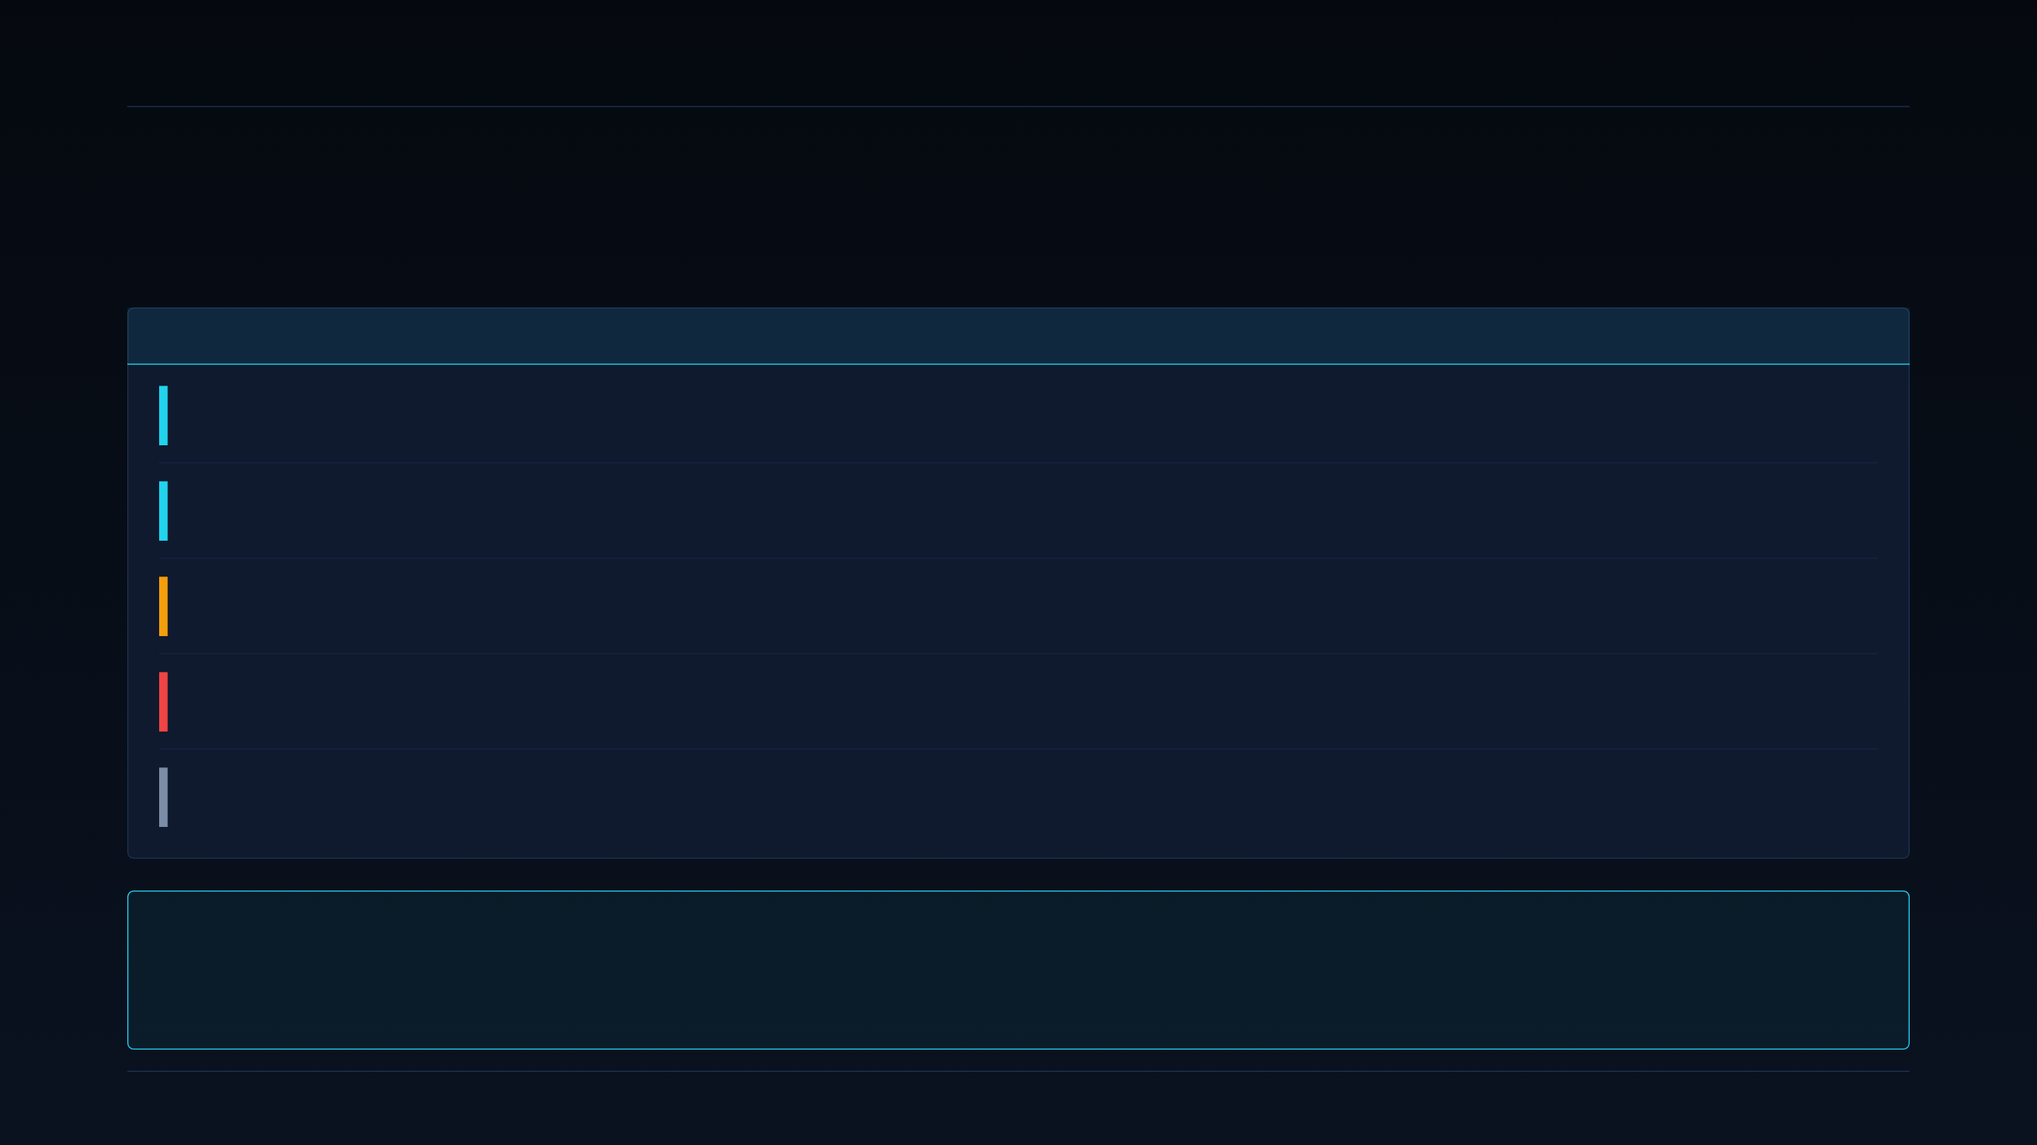
15 · BUYER COMMITTEE — TACTICAL DEFENSE
DEEPGRID SEMI · PRE-SERIES A
Who has to sign, and what each one is afraid of.
Defense & port-authority buying committee — roles, fears, and what will lose the deal.
ROLE
WHO THEY ARE
PRIMARY FEAR
WHAT WE BRING TO THEIR TABLE
Economic
buyer
Defense procurement officer / port authority
Vendor lock-in on foreign silicon; being unable to audit the supply chain if geopolitics turn.
Made-in-India die + full IP ownership + reference design.
Technical
buyer
Systems-integration engineer at prime / lab
Undocumented failure modes; a chip they can't debug in a black-flag environment.
Full BSP + JTAG + lockstep-fault documentation, on-site FAE.
Champion
not yet identified
Program manager on a UGV / border / AGV program
Delivery slip; being blamed for a program held up by a novel vendor.
FPGA-ready hardware ships now; ASIC drop-in with pin-compatible carrier.
Blocker
Security clearance / compliance office
Data exfiltration through any component with an off-die firmware update path.
D100 HSM — signed boot chain, keys never leave die, air-gap update mode.
End user
UGV / AGV operator, control-room staff
Missed detections; a false-negative in a live sortie.
Redundant sensor fusion (R100 + T100) + confidence-graded outputs.
MINIMUM PROOF TO ADVANCE THE DEFENSE TRACK
Either a second signed defense contract, or an audited third-party confirmation that the existing ₹1 Cr revenue is a commercial sale (not a grant / R&D subsidy). Whichever comes first — within Month 6.
SECTION 2 · ICP & GTM STRATEGY
15 / 37

Slide 16
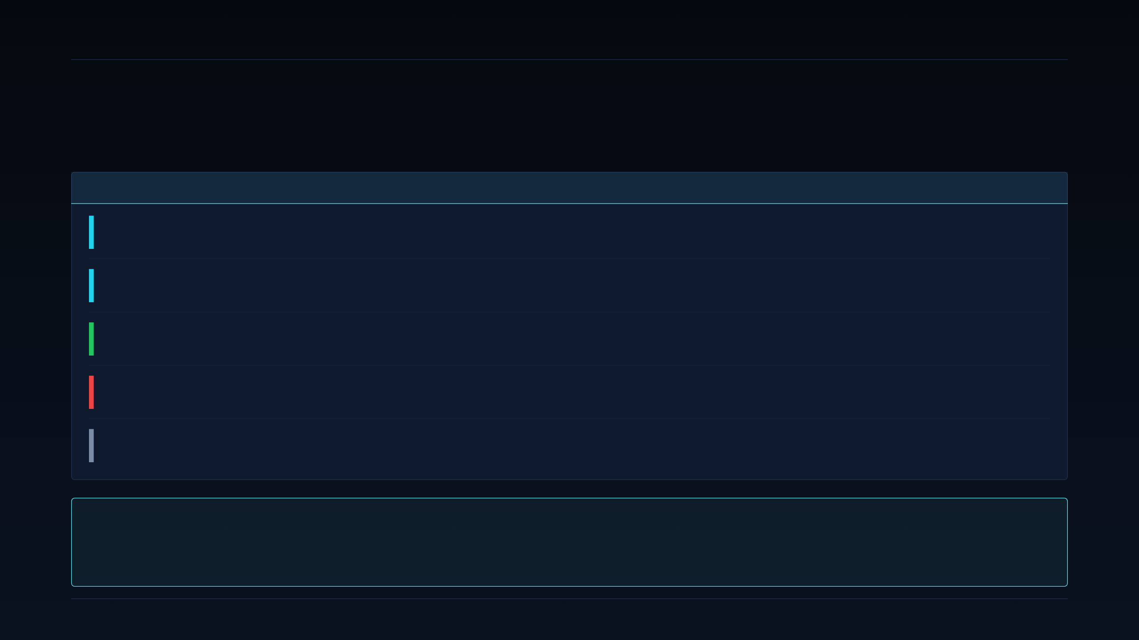
16 · BUYER COMMITTEE — 3PL / FLEET
DEEPGRID SEMI · PRE-SERIES A
Fleet buying committee — a different animal entirely.
ROI-first buyer, mandate-driven champion, and the compliance officer is the one actually pushing.
ROLE
WHO THEY ARE
PRIMARY FEAR
WHAT WE BRING TO THEIR TABLE
Economic
buyer
Fleet owner / operator (CEO of a 200+ truck 3PL)
Unproven ROI — paying ₹2 L per truck for a device whose accident-reduction is not yet measured on their duty cycle.
Money-back pilot on N vehicles + measured baseline & delta on their fleet.
Technical
buyer
Fleet maintenance / telematics manager
One more black box on a truck already carrying an AIS-140 tracker, an FMS, and a dashcam.
S100 subsumes tracker & telematics — net devices per truck goes down, not up.
Champion
Safety / compliance officer — the one with a mandate deadline
Missing the AIS-184/188 enforcement date and losing route contracts because trucks fail inspection.
One kit that covers the four mandated functions (DMS + AEBS + LDW + BSD).
Blocker
Procurement / vehicle owner (attached-fleet model)
Capex on a vehicle they lease out; unclear who pays if the truck gets sold with the kit installed.
Owner-transferable license; kit reassignable on ownership change.
End user
Driver
Being surveilled and disciplined by the DMS; every camera as a monitoring device.
On-die inference — alerts stay in-cab; only aggregate events uploaded.
MINIMUM PROOF TO ADVANCE THE FLEET TRACK
One signed paid pilot from the first 20 buyer discovery interviews — converted within 90 days of first contact. Same kill criterion as slide 11.
SECTION 2 · ICP & GTM STRATEGY
16 / 37

Slide 17
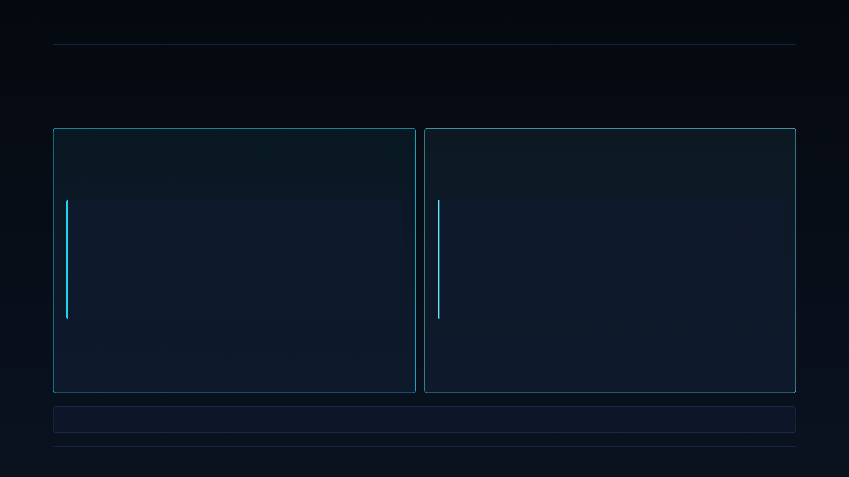
17 · POSITIONING — TWO TRACKS
DEEPGRID SEMI · PRE-SERIES A
Two positioning statements. Not one blurred one.
Different buyers, different fears, different proof burden — positioning cannot be laundered into a single sentence.
TRACK A · TACTICAL DEFENSE + OFF-HIGHWAY
TRACK B · 3PL / DEDICATED FLEET RETROFIT
Positioning statement
Positioning statement · PENDING VALIDATION
“For sovereign UGV, border-surveillance and port-AGV programs where data cannot leave Indian soil, DGrid Alpha is the only Indian-designed combo-die whose on-die HSM makes data-exfil physically impossible — shipping today on FPGA, ASIC drop-in next.”
“For N2/N3 fleet operators facing 2027–28 ADAS mandate deadlines, DGrid Alpha ships one retrofit kit that satisfies AEBS, LDW, DMS and BSD at roughly 1/3 the imported-stack price — pending first paid pilot.”
KILL CRITERION
KILL CRITERION
Track drops from primary if Month 6 arrives without EITHER a second signed contract OR audited confirmation of the ₹1 Cr revenue's commercial nature.
Statement is retracted (from decks, site, sales collateral) if the first 20 buyer interviews fail to produce one paid pilot in 90 days.
Positioning discipline: the retrofit-price line does not appear in a defense deck; the sovereign-data line does not appear in a fleet deck. Buyers hear one story at a time.
SECTION 2 · ICP & GTM STRATEGY
17 / 37

Slide 18

18 · FIVE CLAIMS TO STOP USING
DEEPGRID SEMI · PRE-SERIES A
Words we will not use in front of a buyer or investor.
Every one of these is either unreconciled math, unmeasured effect, or forecast confused with demand.
#
BANNED CLAIM
WHY IT IS WRONG / UNSUPPORTED
USE INSTEAD
01
“84% ASIC-stage gross margin”
Unreconciled arithmetic. Given $3.876 die + ASP assumptions, the segment margin actually implies ~92–93%, which is either right (and 84% understates) or wrong (and everything is off). We retract until reconciled.
"Chip-level margin curve on slide 33; blended systems margin FY32 88%. We publish the arithmetic, not the headline."
02
Any insurance-premium-reduction %
No actuarial partnership, no signed data-share, no measured baseline. Any "12% / 20% / 30% premium reduction" claim is invented.
Silence — until a Fleet pilot produces a measured accident-reduction delta an insurer will co-sign.
03
“Mandate-ready” for AD2
Unvalidated. AD2 requirements have not been mapped 1:1 to DGrid Alpha chiplets in a public homologation document.
"AIS-184/186/187/188 addressable by design; AIS-140 native via S100." Point to slide 05.
04
Any accident-reduction %
Nothing measured. FPGA has not been in a fleet long enough to produce a baseline / delta.
"Pilot design targets a measurable delta; measurement plan on slide 20."
05
“5M+ truck TAM” as pipeline
Forecast confused with demand. TAM ≠ SAM ≠ SOM ≠ pipeline.
"TAM 5M+; addressable at our BOM ~1.2M; pipeline is what has a name."
SECTION 2 · ICP & GTM STRATEGY
18 / 37

Slide 19

19 · PRICING LOGIC & CHANNEL
DEEPGRID SEMI · PRE-SERIES A
Pricing is a data-collection plan, not a price sheet.
Manufacturing false price precision is worse than admitting we are still measuring.
PRICING LOGIC
CHANNEL STRATEGY
Fleet retrofit — AD2 kit
CHANNEL
VERDICT
CONDITION TO UNLOCK
₹2–2.5 Lakh is a roadmap figure, not a validated price. Bottom-up cost build ($200 BOM) plus mandate-driven willingness-to-pay assumption, neither externally tested.
Direct — Defense
RECOMMENDED
In place. Ships today.
WHAT WE COLLECT IN THE FIRST 20 INTERVIEWS
Direct — Fleet (pilot)
→ Ceiling: max ₹ the fleet has ever paid per truck for a safety add-on.
→ Payback horizon they will underwrite (months, not years).
→ Whether pricing is per-truck, per-fleet, or subscription.
→ Fault attribution — who pays if a truck with the kit has an incident.
→ Attached-fleet vs owner-operated split — who has budget authority.
RECOMMENDED
Founder-led first 20 buyers.
System integrator (SI)
NOT YET
No named partner today.
Indian defense primes
CONDITIONAL
Only after 2+ Defense contracts.
Defense — contract-negotiated
Tier-1 / OEM
No public price. Sovereign buyers negotiate line-item against program budget. NRE reimbursement + per-unit + support & spares tail.
Discipline: we never publish a defense price. We publish a chip technology envelope. Program-specific pricing lives in the RFP response.
DEFERRED
Only after signed Tier-1 co-dev.
Insurer channel
NEVER (SALES)
Evidence partner only.
SECTION 2 · ICP & GTM STRATEGY
19 / 37

Slide 20

20 · 90-DAY EXECUTION PLAN
DEEPGRID SEMI · PRE-SERIES A
13 weeks. Three phases. One hard gate.
Every activity has a deliverable an outsider can verify.
PHASE / WEEKS
DEFENSE TRACK
FLEET TRACK
DELIVERABLE
Phase 1
WEEKS 1–4
Evidence gathering
→ Third-party audit of ₹1 Cr revenue nature.
→ Add Indian defense primes (BEL, BDL, Tata, Mahindra) to benchmark.
→ Named-account list: 3 UGV / border, 2 seaport AGV.
→ 10 fleet-owner discovery calls using 27-question guide.
→ Attached vs owner-operated segmentation.
→ No commercial ask yet.
Signed revenue-nature attestation.
Named-account tracker.
Interview verbatims log.
Phase 2
WEEKS 5–9
Conversion attempts
→ Technical evaluation advances at ≥1 UGV lab.
→ RFP submission for one border-surveillance program.
→ Port-AGV site visit + demonstrator install plan.
→ Complete interviews 11–20.
→ First paid pilot term sheet issued.
→ Pilot design: N vehicles, baseline / delta measurement, exit clause.
Countersigned RFP.
Signed pilot MSA (or documented refusal).
20-interview readout.
Phase 3
WEEKS 10–13
Governance & re-score
→ Working-capital model against 90–180 day govt payment cycles.
→ Defense-primes competitive slide baked into all decks.
→ Pilot data ingest & measurement baseline.
→ Fleet track goes co-primary OR drops to watch-only.
Day-90 re-scoring memo — same 10-dim rubric, fresh evidence, Board-visible.
STOP-DOING LIST — WHERE WE WILL NOT SPEND THE NEXT 90 DAYS
× No OEM GTM spend until a Tier-1 partner signs.
× No insurer-facing sales motion — ever, under this plan.
× No unevidenced external claims (the five on slide 18).
× No AD0 owner-operator resourcing pending evidence check.
SECTION 2 · ICP & GTM STRATEGY
20 / 37

Slide 21
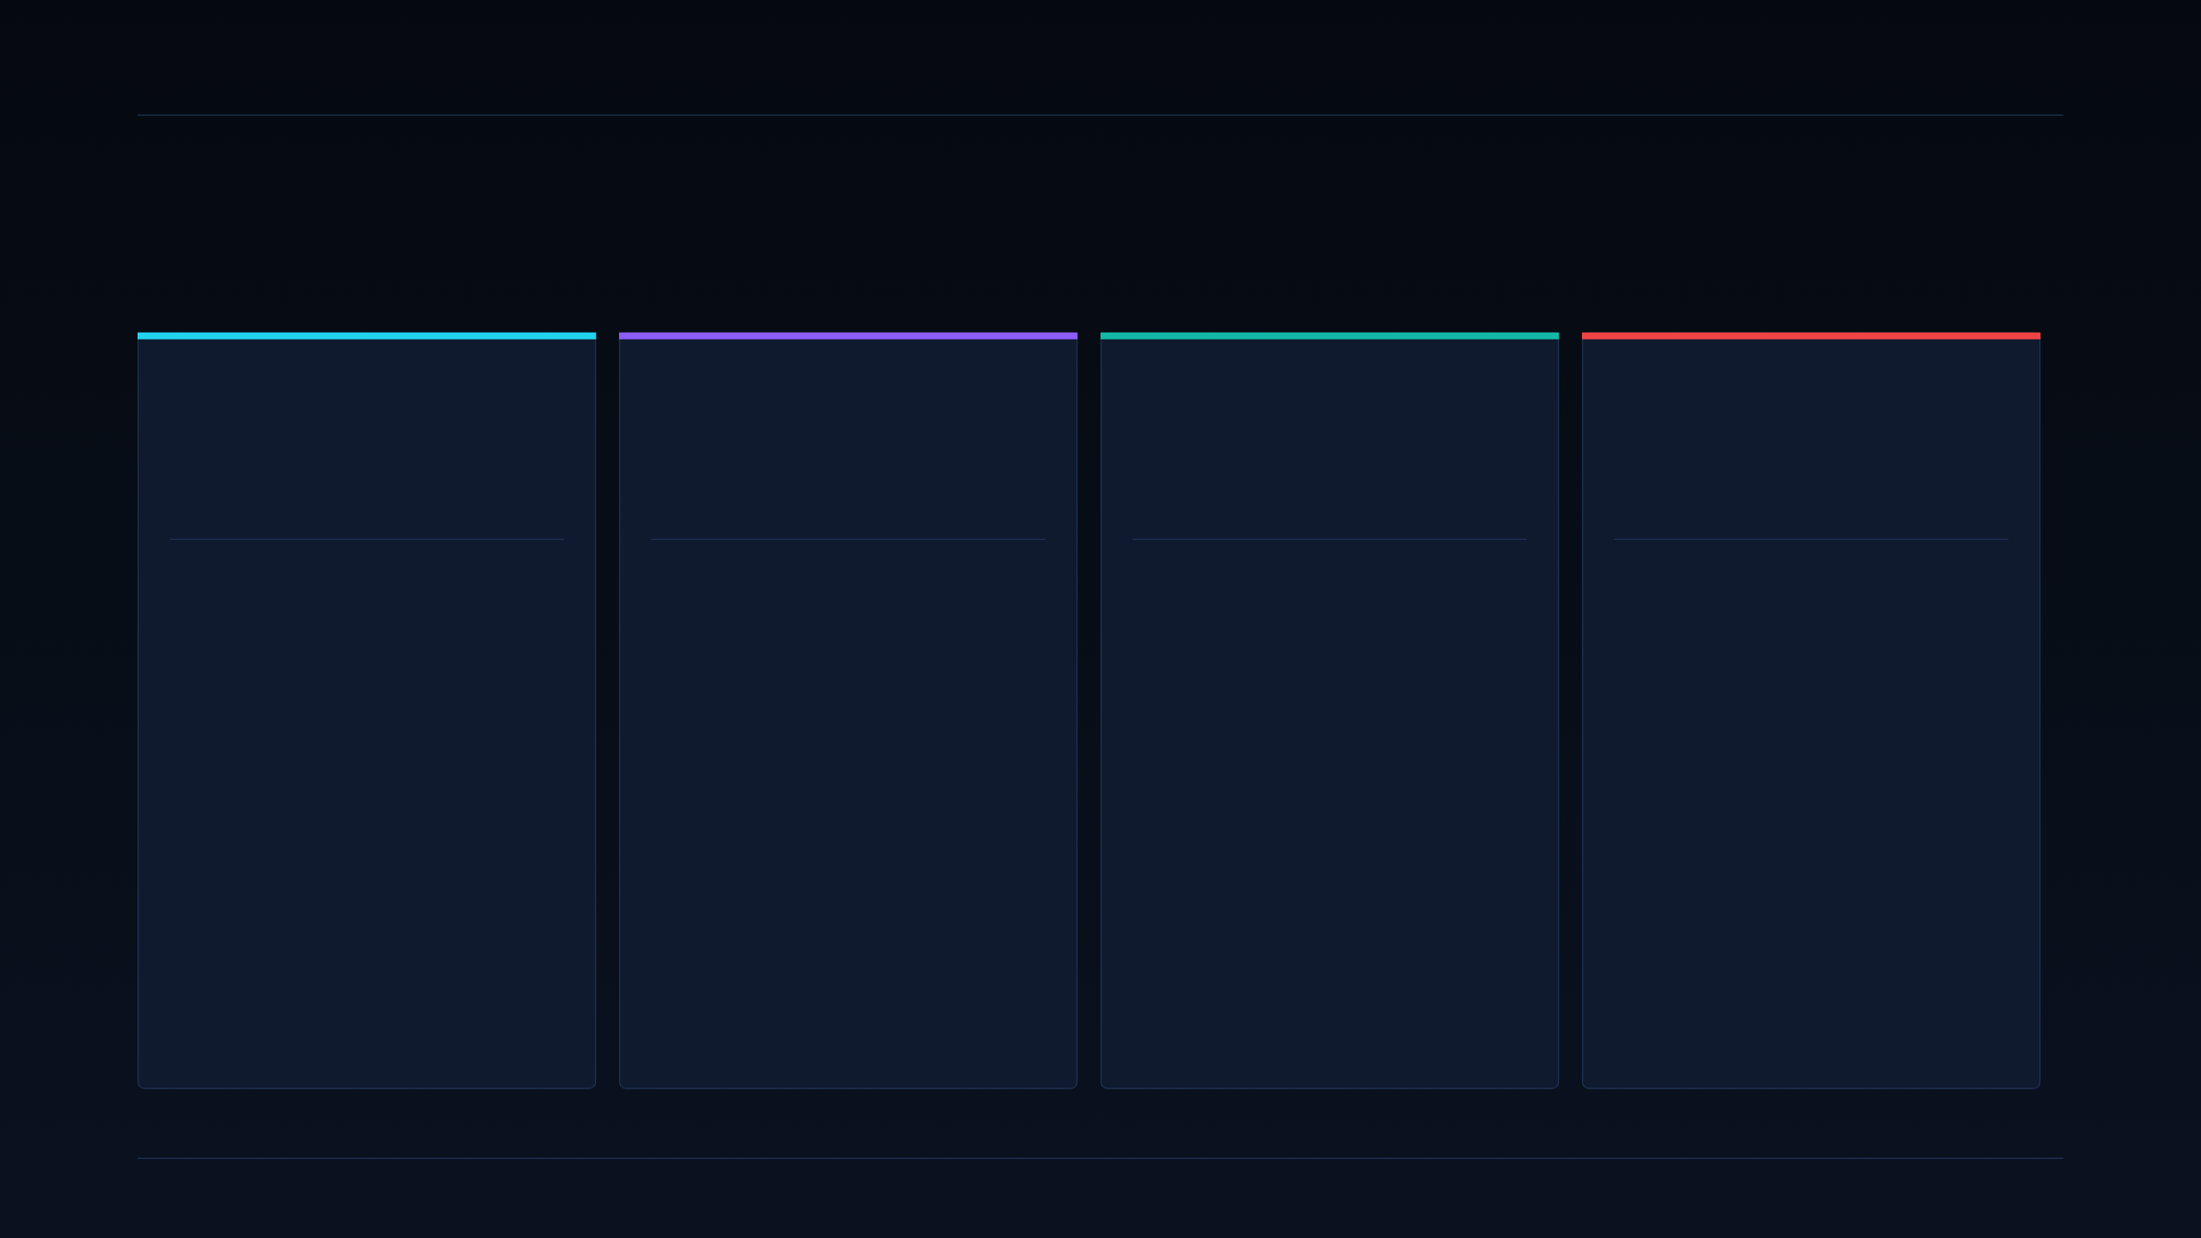
21 · GLOBAL COMPETITOR PLAYBOOKS
DEEPGRID SEMI · PRE-SERIES A
Every credible autonomy playbook picks one lane.
Aurora, Kodiak, Gatik, DeepWay — four coherent bets, none at our BOM.
USA · HEAVY OEM
USA · DUAL-USE
USA · CONSTRAINED ODD
CHINA · DOMESTIC FLEET
Aurora
Kodiak Robotics
Gatik
DeepWay
Long-haul Class-8 highway trucks.
Highway freight + DoD contracts.
Middle-mile fixed routes, box trucks.
“Xingtu” L4 electric trucks.
SILICON
SILICON
SILICON
SILICON
Dual NVIDIA DRIVE Thor
Ambarella CV3-AD685
NVIDIA DRIVE AGX Orin
High-compute NPU + Baidu Apollo
COMPUTE BOM
COMPUTE BOM
COMPUTE BOM
COMPUTE BOM
$6,000+
~$2,500–3,500
~$2,000
~$4,000+
PARTNERSHIP
PARTNERSHIP
PARTNERSHIP
PARTNERSHIP
Continental (Tier-1)
US DoD (autonomy)
Isuzu · Walmart · Kroger
Baidu (autonomy stack)
BET
BET
BET
BET
Highway freight L4 is a big-enough market to amortise a $6k+ compute node. Sells to Class-8 OEMs, not to fleet operators.
Cross-subsidise commercial R&D with defense revenue. Same architectural pattern we propose — but at 100× our BOM.
Fixed-route middle mile keeps ODD entropy tiny. Ship the vehicle, sell the mile. Software company that also owns the truck.
Vertically integrated at the truck level, subsidised by Chinese logistics demand. Not export-viable to India / GCC on cost or sanctions.
LESSON — NO INCUMBENT RUNS DEFENSE + FLEET + OEM SIMULTANEOUSLY AT DEEPGRID'S ~$30 BOM.
21 / 37

Slide 22
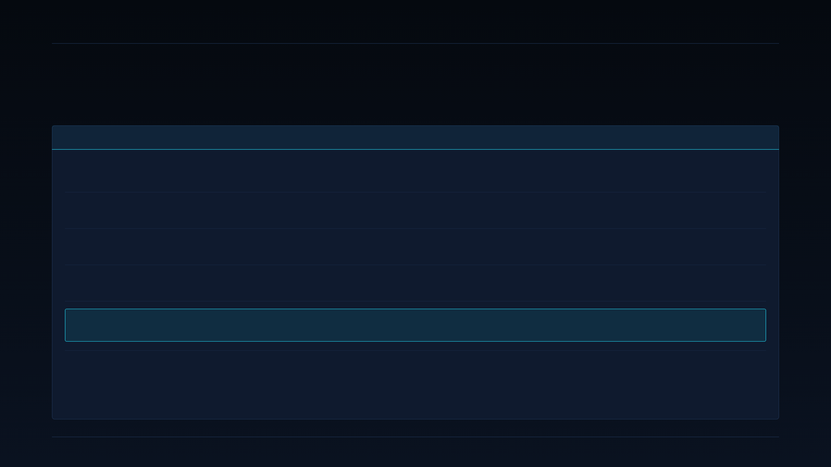
22 · SEMICONDUCTOR DEPENDENCY MATRIX
DEEPGRID SEMI · PRE-SERIES A
Everyone else is renting silicon. We own ours.
Silicon partner, compute model, and BOM cost across the same five companies.
COMPANY
SILICON PARTNER
COMPUTE MODEL
CHIP DEPENDENCY
COMPUTE BOM
MULTIPLE VS DGRID
Aurora
NVIDIA
Merchant SoC (dual Thor)
Full — sole-source
$6,000+
200×
Kodiak Robotics
Ambarella
Merchant SoC (CV3-AD685)
Full — sole-source
~$2.5–3.5k
83–117×
Gatik
NVIDIA
Merchant SoC (Orin)
Full — sole-source
~$2,000
67×
DeepWay
Baidu / Chinese NPU vendors
Vertically-integrated via Baidu
Partial — stack partner
~$4,000+
133×
DeepGrid Semi
None — own die
Custom 28 nm combo-die
Zero
~$30 (board)
baseline
Read this table twice. Column 4 (chip dependency) is the moat — not column 5 (BOM). Any of the top four could pass a NVIDIA-supply or Chinese-export shock straight to the customer. DeepGrid's dependency is TSMC-fab access and its own tape-out cadence — concentrated risk, but not on a third party's product roadmap.
SECTION 3 · COMPETITIVE LANDSCAPE
22 / 37

Slide 23

23 · INDIAN SEMICONDUCTOR WAVE
DEEPGRID SEMI · PRE-SERIES A
India's chip wave is real. And a year behind us.
Three well-funded domestic fabless startups — none has commercial autonomous-CV silicon revenue yet.
FABLESS · VISION SOC
FABLESS · RISC-V MCU
FABLESS · GAN POWER / RF
Netrasemi
Mindgrove
Agnit Semiconductors
A2000 vision SoC on TSMC 12 nm.
RISC-V MCU on TSMC 28 nm.
GaN devices for defense radar.
FUNDING
LAUNCH
FUNDING
PARTNER
FUNDING
STATUS
₹125 Cr
Mid-2027
$10.3M
Bosch MoU
$7.47M
Defense pilots
POSITIONING
POSITIONING
POSITIONING
General-purpose vision SoC. Broadest but least ADAS-specific of the three. 12 nm node is more expensive per die than our 28 nm — different bet on where value lives.
MCU-class chip, not an inference-class one. Bosch MoU is genuinely interesting but is a supply agreement for MCU sockets, not a competing ADAS SoC. Adjacent, not overlapping.
Complements rather than competes — GaN power devices sit alongside our R100 digital radar DSP. Potential collaboration for defense radar programs.
READ OF THE DOMESTIC WAVE
The wave is real and well-funded. But DeepGrid is the only Indian fabless startup with commercial autonomous-CV silicon revenue today. Netrasemi ships mid-2027; Mindgrove is MCU-class; Agnit is a partner, not a competitor.
SECTION 3 · COMPETITIVE LANDSCAPE
23 / 37

Slide 24

24 · SOFTWARE-FIRST AUTONOMY COMPETITORS
DEEPGRID SEMI · PRE-SERIES A
Great algorithms. Wrong cost structure.
India's three most-cited autonomy competitors are hardware-agnostic — they inherit merchant-silicon economics regardless of algorithm quality.
MINUS ZERO
SWAAYATT ROBOTS
ROSHAI
True-vision autonomy stack
Indian-road negotiation AI
Fleet-safety AI
SILICON
SILICON
SILICON
Merchant — NVIDIA / Qualcomm class
Merchant — hardware-agnostic
Merchant — commodity dashcam class
STRATEGY
STRATEGY
STRATEGY
Camera-only perception, deep-learning-heavy stack. Differentiation is the model, not the chip.
Motion-planning for Indian traffic entropy. Strong research pedigree, dependent on whatever compute the OEM specs.
DMS + telematics platform on commodity dashcam hardware. Software-as-service revenue, not chip revenue.
INHERITED COST
INHERITED COST
INHERITED COST
Whatever the SoC vendor charges — they don't control it.
Same — algorithmic edge doesn't compress BOM.
Dashcam hardware margin belongs to somebody else.
THE STRUCTURAL POINT
Software-first competitors can win on algorithm quality. They cannot win on BOM. Their unit economics converge to whatever the merchant SoC vendor charges — and that is the Squeeze Zone (slide 3) by definition.
SECTION 3 · COMPETITIVE LANDSCAPE
24 / 37

Slide 25
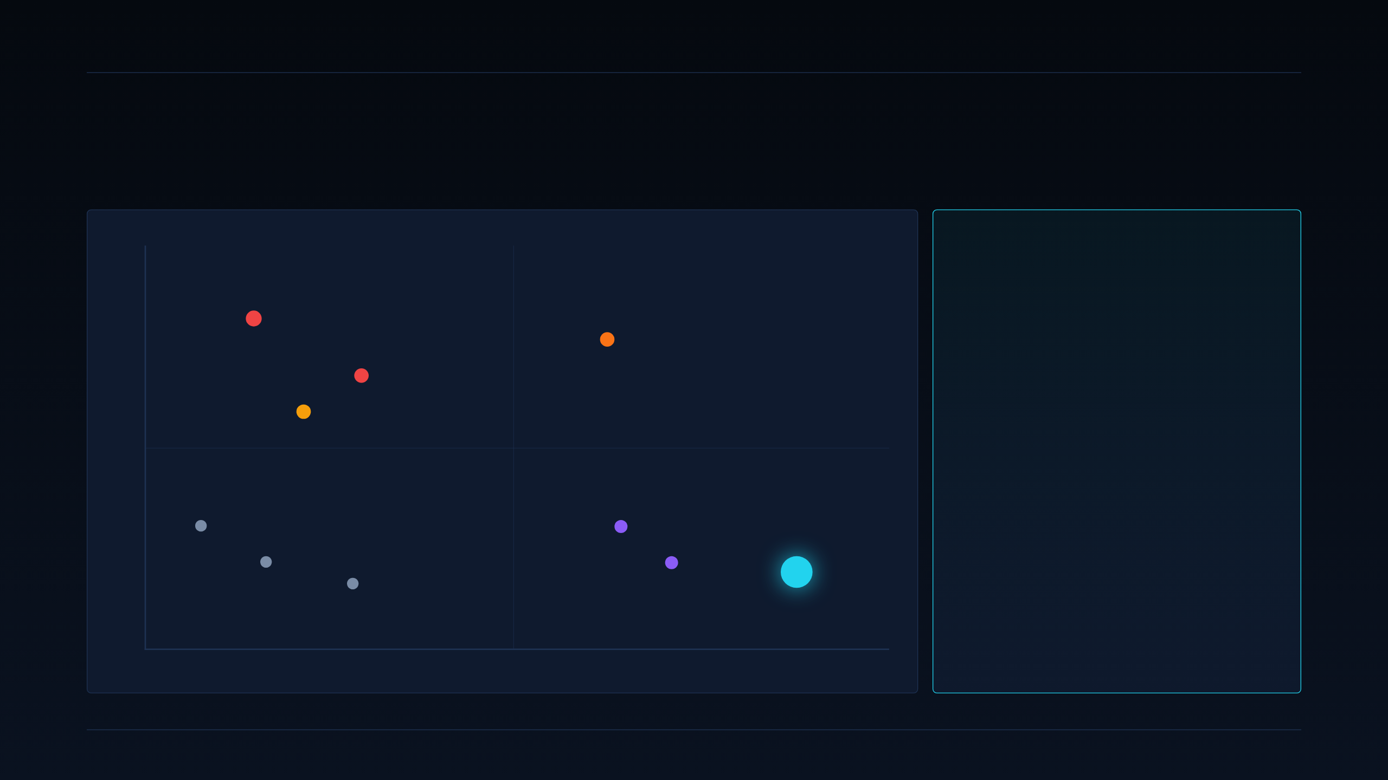
25 · COMPETITIVE POSITIONING SYNTHESIS
DEEPGRID SEMI · PRE-SERIES A
The whitespace, mapped.
Vertical integration on x-axis, BOM discipline on y-axis. DeepGrid occupies the top-right quadrant — alone, for now.
THE SYNTHESIS
HIGH BOM · LOW INTEGRATION
HIGH BOM · VERTICAL
DeepGrid is the only Indian startup shipping a vertically-integrated, single-die ADAS combo-die at a disruptive price.
Aurora $6k+
DeepWay ~$4k
Kodiak ~$3k
Top-right is empty by construction. Merchant-silicon incumbents can't shrink to ~$30 — they'd cannibalise their core margin. Software-first competitors can't move right — no tape-out cadence.
Indian semi peers occupy adjacent tiles. Netrasemi and Mindgrove are on the vertical-integration axis but haven't shipped ADAS revenue yet. Agnit is a complement.
The whitespace has a shelf life. By 2027–28 at least one of them will be a real competitor. The 30-month runway is what buys the head-start.
Gatik ~$2k
BOM DISCIPLINE →
LOW BOM · SOFTWARE-INHERITED
LOW BOM · VERTICAL (WHITESPACE)
Minus Zero
Netrasemi (2027)
Swaayatt Robots
Mindgrove (MCU)
RoshAI
DG
DeepGrid Semi
~$30 · own die
VERTICAL INTEGRATION →
SECTION 3 · COMPETITIVE LANDSCAPE
25 / 37

Slide 26

26 · GTM ROADMAP · PHASE 1
DEEPGRID SEMI · PRE-SERIES A
Phase 1 — Tactical & Off-Highway Wedge.
STATUS · MONTH
0 → 6
Months 0–6 · The only phase currently generating revenue.
OBJECTIVES & MOTION
TRACTION TO DATE — ON-SLIDE FACT
1. Direct FPGA field deployments.
~₹35,000 FPGA validation board is uneconomic at fleet scale, but fine for defense-pilot volumes. Ship what we have.
2. Tactical defense positioning.
Lead with the D100 secure-enclave narrative. Never lead with BOM cost in defense conversations — it's a category error.
3. Off-highway / port cross-sell.
Same SKU addresses container-terminal AGV compute. Mundra, Chennai, Jebel Ali on the target list.
4. Second contract as gate.
Second signed defense contract by Month 6 unlocks Phase 2 resource ramp.
5. Institutional groundwork.
File MeitY DLI application — Phase 2 funding depends on it landing before capital is deployed on tape-out.
~₹1 Cr
Non-dilutive contract revenue already booked through Phase 1 activity. This is the only externally-verifiable customer signal we hold today.
Real revenue. Real customer. One open question flagged below ↓
⚑ OPEN QUESTION — DO NOT SKIP
Nature of the ₹1 Cr — commercial sale, grant, or R&D subsidy?
Commercial sale → repeatable customer signal → Phase 2 gets full resourcing.
Grant / subsidy → not a customer signal → Defense and Fleet re-score as evidence-equal.
Third-party revenue attestation is Condition 1 (slide 37) — due within one week.
SECTION 4 · GTM ROADMAP + REGULATORY
26 / 37

Slide 27
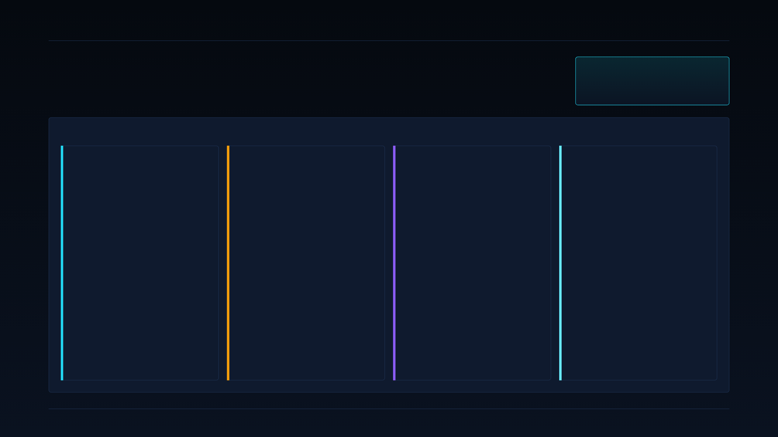
27 · GTM ROADMAP · PHASE 2
DEEPGRID SEMI · PRE-SERIES A
Phase 2 — Regulatory Aftermarket Volume.
MONTHS
6 → 18
Months 6–18 · The phase this ₹55 Cr raise actually funds.
FOUR WORKSTREAMS — PARALLEL
01 · CAPITAL
02 · SUBSIDY
03 · SILICON
04 · PRODUCT
Close the ₹55 Cr blended raise
MeitY DLI approval landed
TSMC 28 nm HPC+ MPW tape-out
Retrofit kit launched
₹45 Cr CCPS equity + ₹10 Cr CGTMSE-backed debt.
Equity funds tape-out NRE + 30-month runway. Debt covers working-capital exposure to 90–180 day government payment cycles.
Blended cost of capital materially lower than a pure-equity round of the same size.
Product-linked DLI up to 50% NRE reimbursement (capped ₹15 Cr).
Deployment-linked incentive at 4–6% of net sales (capped ₹30 Cr).
ChipIN Centre EDA / IP support in parallel.
Sequenced before tape-out spend commits so we capture reimbursement.
Multi-project wafer shuttle. Shared reticle, no full-mask commit — the reason NRE lands at $3.17M, not $8M.
First-silicon target month 14. Characterisation and PSR targeted month 18.
Pin-compatible carrier with the FPGA validation board — early customers migrate without redesigning their platform.
₹2–2.5 L target price — still unconverted at this point of the plan.
Launch is conditional on the Phase 1 Fleet kill-criterion passing: at least one paid pilot from the first 20 buyer discovery interviews.
If not, this workstream slips to Phase 3 and 01/02/03 continue on Defense track only.
SECTION 4 · GTM ROADMAP + REGULATORY
27 / 37

Slide 28
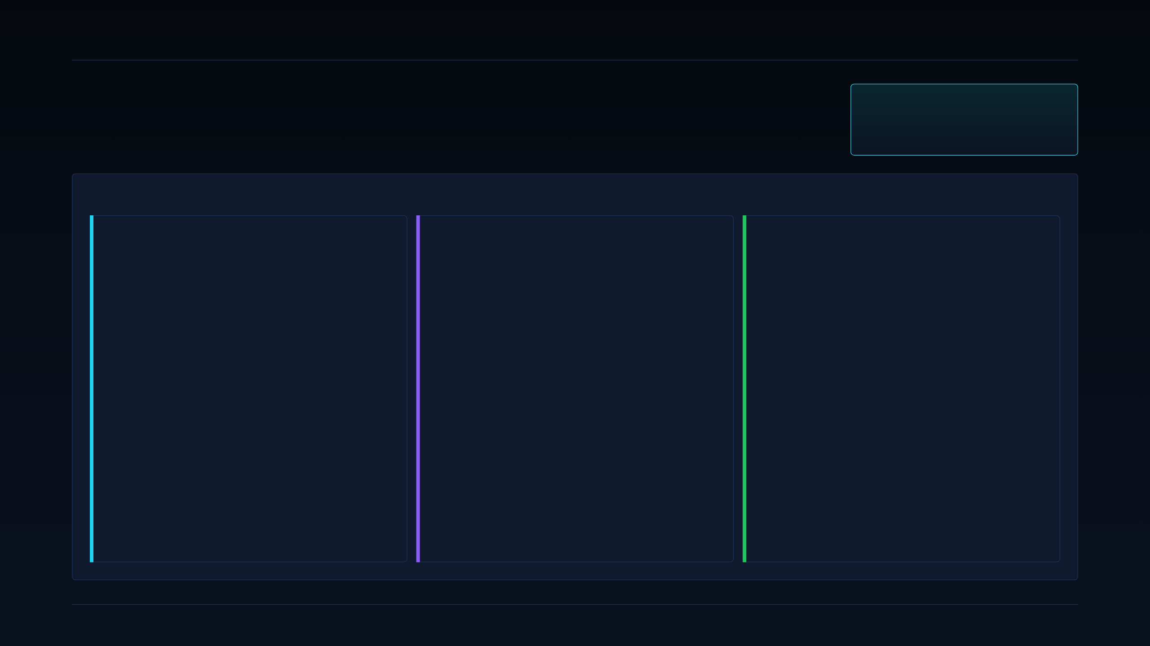
28 · GTM ROADMAP · PHASE 3
DEEPGRID SEMI · PRE-SERIES A
Phase 3 — OEM & Tier-1 integration.
MONTHS
18 → 36
Months 18–36 · Where recurring revenue and OEM scale unlock — only after Phase 2 lands.
THREE REVENUE LANES COME ONLINE
01 · TIER-1 ALLIANCES
02 · SOVEREIGN OEM WINS
03 · RECURRING SAAS
Uno Minda · Spark Minda · Bosch India
Line-fit at sovereign OEMs
Shift to recurring, sovereign data moat
Co-development agreement with at least one named Tier-1 by month 24. Not an MoU — a binding NRE-reimbursement co-dev.
Tier-1 amortises ISO 26262 / AEC-Q100 audit cost across its existing OEM portfolio; we ride that audit trail.
This is the one door into automotive OEM sales that is defensible for a fabless startup.
Tata Advanced Systems & Mahindra Defence: defense-adjacent platforms first.
This is where the Phase 1 Defense credentials compound. The D100 secure-enclave story that won the first contracts becomes the sole-source justification for design-in wins.
Real long-term chip volume lives here, not in the aftermarket.
Every deployed chip becomes a S100-anchored telematics endpoint; SaaS tiers layer on top (slide 34).
Cabin, fleet-safety, and cross-mandate anonymised data stays in-country by design — on-die inference means only aggregate events reach cloud.
Compounding data moat as installed base grows. FY32 SaaS margin drives 88% blended (slide 33).
SECTION 4 · GTM ROADMAP + REGULATORY
28 / 37

Slide 29

29 · REGULATORY MANDATE — INDIA
DEEPGRID SEMI · PRE-SERIES A
India AIS mandates — mapped to our chiplets.
One retrofit kit satisfies four mandated functions plus telematics native.
AIS #
FUNCTION
CHIPLET COVERAGE
SEGMENT IMPLICATION
⚠ CORRECTION — OPERATIVE DATES
AIS-184
DMS — driver monitoring
A100 + H100
Fleet retrofit + insurer evidence path
EARLIER DRAFT (RETRACT): 2026 DATES
AIS-186
LDW — lane departure
A100
Fleet + OEM line-fit
RECONCILED — USE THESE
1 Oct 2027
AIS-187
BSD — blind spot
A100 + R100
Fleet + OEM line-fit
AEBS + ESC mandatory
on new N2/N3 vehicles.
AIS-188
AEBS — autonomous braking
A100 + R100
Fleet + OEM line-fit
AIS-140 / 162
Telematics + emergency btn
S100 (native)
Kills secondary tracker — SaaS anchor
1 Jan 2028
AIS-189 / 190
Night / low-light perception
A100 + T100
Off-highway / defense edge
All four functions mandatory
(AEBS + LDW + BSD + DMS).
READ OF THE MANDATE CALENDAR
Any deck, one-pager, or investor email still citing the earlier 2026 date should be withdrawn.
A retrofit kit that ships in Phase 2 (months 14–18 first silicon) has 12–18 months of runway before the enforcement date — enough to convert a paid pilot into commercial volume.
SECTION 4 · GTM ROADMAP + REGULATORY
29 / 37

Slide 30
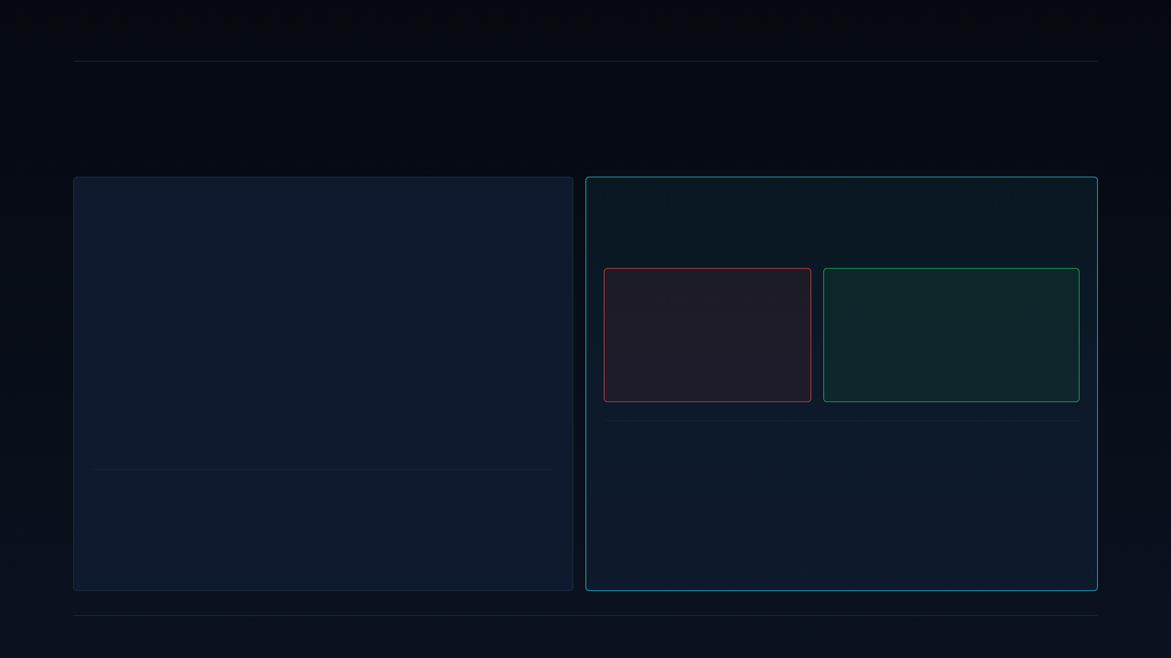
30 · REGULATORY MANDATE — GCC
DEEPGRID SEMI · PRE-SERIES A
GCC — Saudi TGA / WASL is the primary door.
Second addressable market — enters via Phase 2 export; the S100 chiplet is the wedge.
SAUDI TGA / WASL MANDATE
WHY S100 CHANGES THE BUYER CONVERSATION
Every commercial vehicle operating in KSA must be registered on WASL.
Two devices → one device.
Transport General Authority (TGA) requires certified GPS + telematics tracker approved for WASL data ingest.
Fleet operators today install a secondary tracker in addition to any safety hardware — ~$60–120 per vehicle in BOM plus install.
Our S100 chiplet is designed as a WASL-compatible endpoint, so ADAS + telematics ship in one BOM slot.
TODAY — IMPORTED STACK
WITH DGRID ALPHA
ADAS box (imported SoC) + secondary WASL tracker + installation of both.
2 devices, 2 antennas, 2 SIMs.
S100 handles WASL telematics natively while A100+R100 handle ADAS on the same die.
1 device, 1 antenna, 1 SIM.
SALES-MOTION CONSEQUENCE
In GCC we lead with the "kill the tracker" narrative, not the "cheap ADAS" narrative. The buyer's existing pain is the redundant tracker they already resent paying for.
ADAS savings become the second-order benefit rather than the pitch — same positioning discipline as slide 17.
ADJACENT GCC MARKETS
UAE (RTA fleet-safety framework), Oman (ROP transport mandate), and Kuwait (MOI fleet registration) trail the Saudi model. S100 firmware profiles are portable across all four with configuration changes.
SECTION 4 · GTM ROADMAP + REGULATORY
30 / 37

Slide 31

31 · HARDWARE UNIT ECONOMICS
DEEPGRID SEMI · PRE-SERIES A
Bottom-up cost build. Every line traceable.
Die cost at 1M chips + full retrofit kit BOM + one clean cost-advantage comparison.
DIE COST BUILD @ 1M CHIPS · 28NM HPC+
RETROFIT KIT BOM (FLEET-FACING SKU)
Wafer share (~20mm²)
$2.180
DGrid Alpha ASIC + board
$30
Package (WLCSP + substrate)
$0.820
Radar (4× corner)
$100
Test + burn-in
$0.460
Cameras (6–8×)
$50
Yield-loss provision (@ ~85% yield)
$0.416
Enclosure + wiring
$20
Total die cost / chip
$3.876
Total kit BOM
$200
CORRECTION on-slide: earlier "~$3" claim retracted. Reconciled figure is $3.876 — still under $4. The 12.9× cost advantage vs Mobileye ASP $50 still holds; the retracted 774× multiplier does not.
Same functional envelope as an imported $6,000+ L2+ stack. Kit ASP target ₹2–2.5 L (still unvalidated — slide 19). Do NOT repeat "84% gross margin" — segment margin implies ~92–93%.
APPLES-TO-APPLES COST ADVANTAGE — COMPUTE NODE ONLY
$3.876 vs Mobileye reference ASP $50 = 12.9× advantage. That is the honest number, and it is enough — we do not need the retracted 774×.
SECTION 5 · FINANCIALS
31 / 37

Slide 32
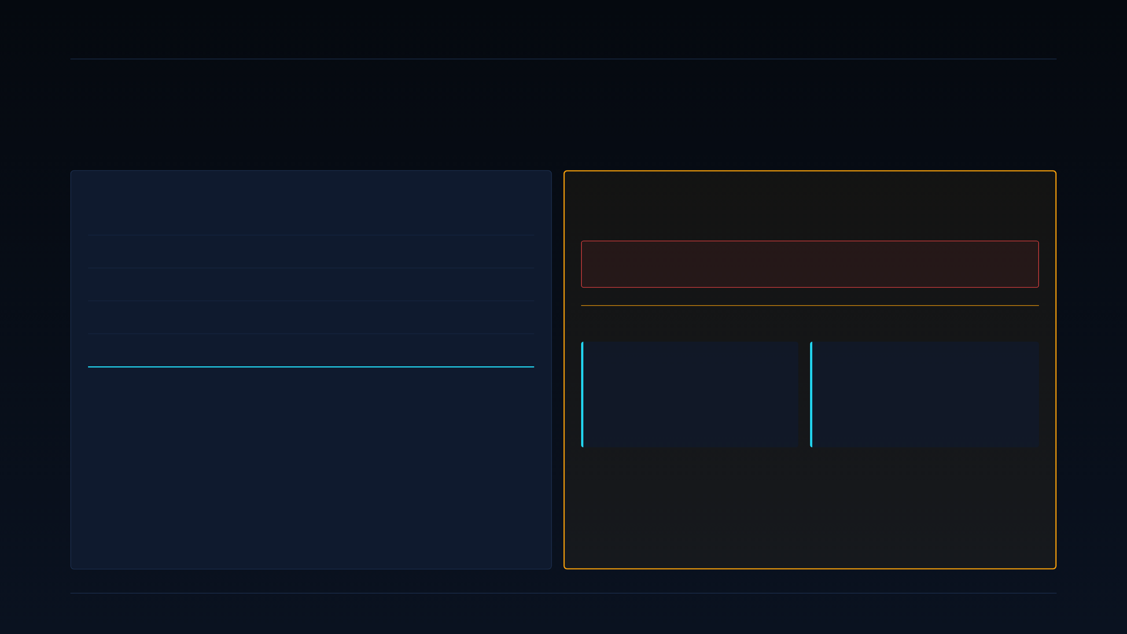
32 · COST CURVES & BREAK-EVEN
DEEPGRID SEMI · PRE-SERIES A
NRE phasing + honest break-even.
$3.17M NRE phased against the MPW shuttle. Break-even ~174,908 chips — crossing FY2032.
MPW TAPE-OUT NRE PHASING — $3.17M TOTAL
⚠ MARQUEE CORRECTION — BREAK-EVEN
RTL freeze + verification
M0–4
$0.78M
EARLIER DRAFT (RETRACT ENTIRELY)
Physical design + DRC/LVS
M4–9
$0.66M
$8M NRE · 3,636-unit break-even
MPW shuttle slot + mask share
M10
$1.15M
Silicon bring-up + characterisation
M14–17
$0.38M
RECONCILED — USE THESE NUMBERS
EDA + IP + tooling
continuous
$0.20M
NRE
BREAK-EVEN UNITS
Total NRE
$3.17M
$3.17M
~174,908
Full phasing at left. Not $8M.
Chips, crossing FY2032. Not 3,636.
Full phasing. Chunked against the MPW shuttle timeline — not a lump-sum commit at day zero. The MeitY P-DLI reimbursement (up to 50%) reduces cash outflow on M4–M17 line items, subject to acceptance testing.
The retracted 3,636-unit figure was calculated against a board-level margin, not the chip-level cost structure, and ignored fully-loaded opex. It is not a smaller-model version of this number — it is the wrong number. Do not repeat it in any external doc.
SECTION 5 · FINANCIALS
32 / 37

Slide 33
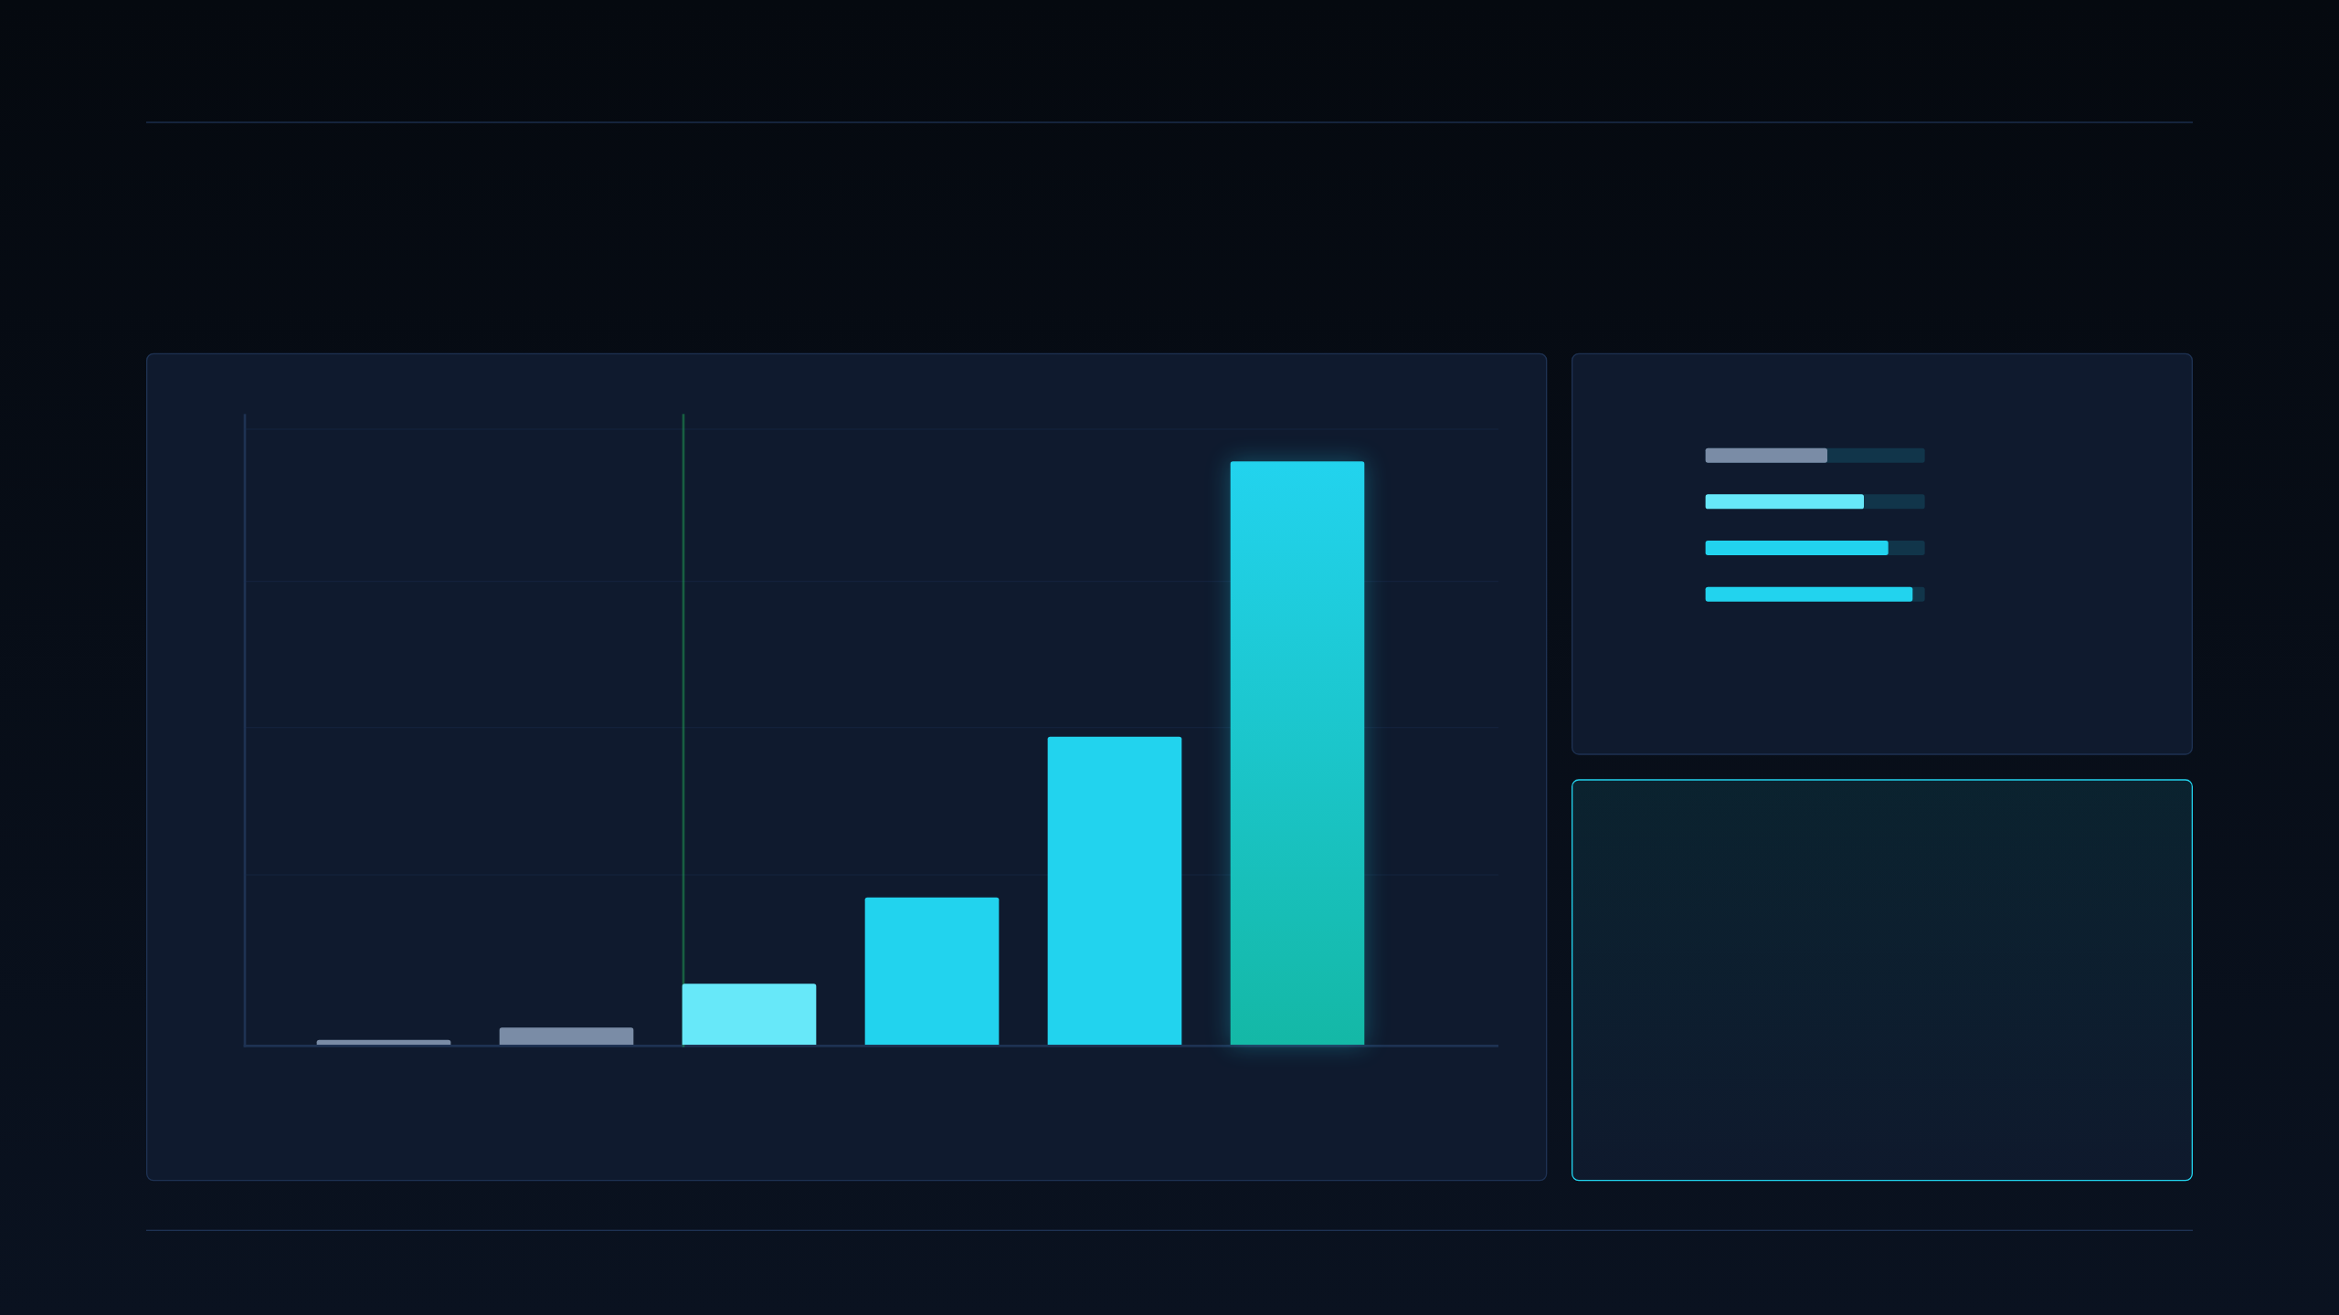
33 · REVENUE TRAJECTORY
DEEPGRID SEMI · PRE-SERIES A
6-year revenue trajectory.
Management projection · unaudited · assumes Phase 2 tape-out lands and Fleet pilot converts to volume.
₹ CR · MANAGEMENT PROJECTION
GROSS MARGIN CURVE (SYSTEMS)
1,500
NET INCOME +
₹1,387.95
FY27
53%
FY29
70%
FY31
82%
1,000
FY32
88%
Blended (chip + retrofit + SaaS) systems margin. Do NOT repeat "84% ASIC margin" — segment implies ~92–93%; reconciled blended figure is 88%.
500
₹731.54
FY32 EXIT STACK
₹351.35
Revenue
₹1,387.95 Cr
₹144.73
EBITDA
₹41.17
₹536.63 Cr (~39%)
₹6
0
First profitable year
FY27
FY28
FY29
FY30
FY31
FY32
FY2029
FISCAL YEAR
Net income positive from FY29 onwards.
SECTION 5 · FINANCIALS · MANAGEMENT PROJECTION
33 / 37

Slide 34

34 · SaaS MONETIZATION
DEEPGRID SEMI · PRE-SERIES A
Recurring revenue tiers. Sovereign-data moat.
Three annual tiers per vehicle — the FY31–32 margin curve above 82% comes from here.
TIER 01 · BASE
TIER 02 · ADVANCED
TIER 03 · PREMIUM
Base
Advanced
Premium
₹10,000 /yr
₹15,000 /yr
₹25,000 /yr
PER VEHICLE
PER VEHICLE
PER VEHICLE
→ AIS-140 telematics + emergency-button ingest
→ Basic geo-fencing
→ Trip / driver report
→ 30-day event log retention
→ Everything in Base
→ DMS event stream (drowsy / distraction / phone)
→ Lane / following distance analytics
→ Fleet-safety dashboard
→ 180-day retention + video snippet on trigger
→ Everything in Advanced
→ ADAS event stream (AEBS / LDW / BSD) analytics
→ Model over-the-air update channel
→ Sovereign data enclave — data never leaves geography
→ API access for fleet / insurer integrations
WHY THE MOAT COMPOUNDS
The D100 + S100 combo keeps event data in-country by design. Every deployed vehicle is a data endpoint for the next model iteration — without exporting raw video / trip data across borders. Sovereign-data compliance is not a feature — it is the reason SaaS attach rate scales.
SECTION 5 · FINANCIALS
34 / 37

Slide 35
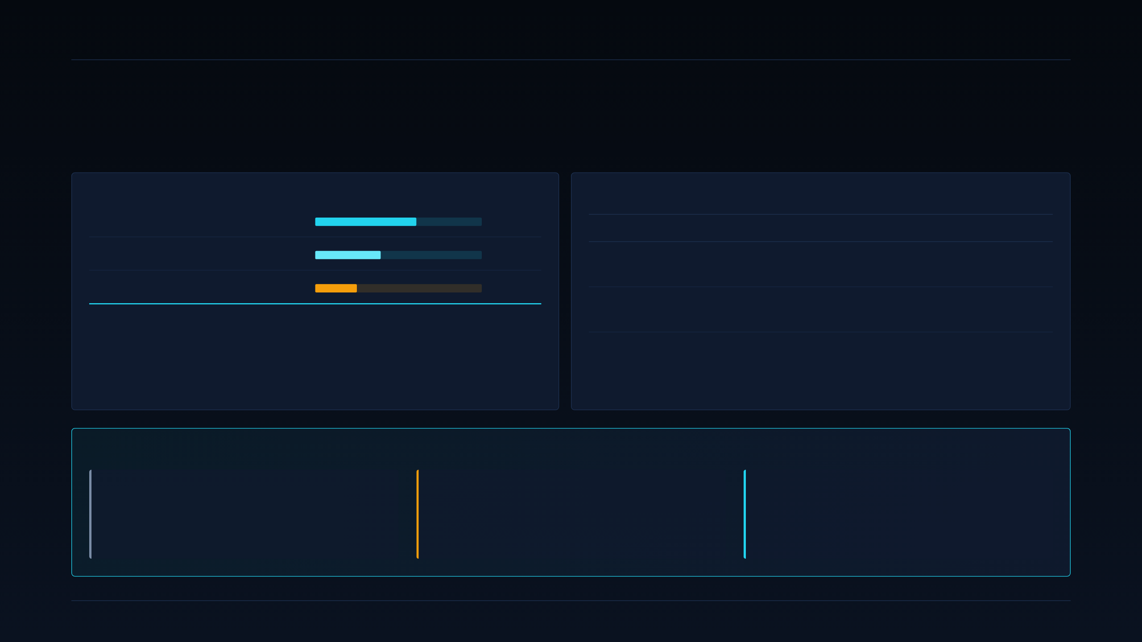
35 · CAPITAL EFFICIENCY & SUBSIDIES
DEEPGRID SEMI · PRE-SERIES A
Use of funds. Sized against ₹55 Cr blended, not ₹25 Cr.
Institutional subsidy stack sequenced before capital deployment — every rupee stretched.
BLENDED ₹55 CR — USE OF FUNDS
NON-DILUTIVE SUBSIDY STACK
Tape-out NRE ($3.17M)
~₹27 Cr
PROGRAMME
INSTRUMENT
CAP
Team & opex (30-month runway)
~₹18 Cr
MeitY P-DLI
50% NRE reimbursement
₹15 Cr
Working capital (CGTMSE debt)
₹10 Cr
Deployment-Linked Incentive
4–6% of net sales
₹30 Cr
Total blended raise
₹55 Cr
ChipIN Centre
EDA / IP tool support
in-kind
Blended cost of capital materially lower than an equivalent ₹55 Cr pure-equity round. Debt tranche exists to buffer government payment cycles (see slide 36 — working-capital risk).
Sequenced before capital deploys on NRE so we capture reimbursement, not absorb it.
EFFECTIVE RAISE, AFTER SUBSIDIES
GROSS ASK
NON-DILUTIVE OFFSET
EFFECTIVE NET CAPITAL COST
₹55 Cr
up to ₹45 Cr
as low as ₹10 Cr
CCPS equity + CGTMSE debt.
P-DLI + DLI, subject to acceptance testing.
If both subsidy programmes hit full cap.
SECTION 5 · FINANCIALS
35 / 37

Slide 36
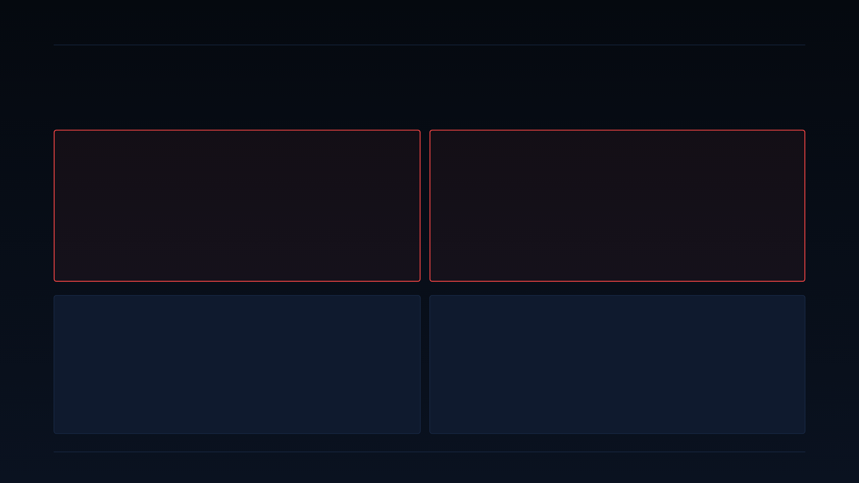
36 · RED TEAM & RISK
DEEPGRID SEMI · PRE-SERIES A
Two real gaps, two structural risks. Named, not hidden.
Red-team Stage 5 output — these are the things a bad investor question would find first.
GAP #1 · COMPETITIVE BENCHMARK BLIND SPOT
GAP #2 · EVIDENCE PEDIGREE
Indian defense primes were never assessed as competitors.
Nature of the ₹1 Cr revenue is unconfirmed.
Competitive slides 21–25 benchmark against Aurora / Kodiak / Netrasemi / Minus Zero. But for the Defense track the relevant competitor is a BEL / BDL / Tata Advanced Systems / Mahindra Defence with existing security clearance, existing UGV programs, and 30+ years of MoD relationships.
A startup vs an established cleared incumbent is a fundamentally different competitive problem than vs Netrasemi. Fix in Phase 1, Weeks 1–4 (slide 20).
Everything in the deck — the ICP scorecard, the Defense-primary decision, the resourcing plan — depends on the ₹1 Cr being a commercial sale.
If it turns out to be a grant, subsidy, or R&D contract, Defense re-scores as evidence-equal to Fleet and the "Defense-first sequence" argument reopens. Third-party audit within one week is Condition 1 (slide 37).
STRUCTURAL RISK · CIRCULAR EVIDENCE
STRUCTURAL RISK · WORKING CAPITAL & RUNWAY
Defense scores 5/5 on evidence because of the ₹1 Cr.
₹2.48 Cr raised to date vs ₹55 Cr ask.
If Gap #2 resolves against us, the evidence score drops from 5/5 to 1/5, and Defense's weighted score collapses from 3.96 to ~3.20. That still beats Fleet on the other dimensions — but the primary-ICP decision is no longer default-obvious, and the day-90 checkpoint (Condition 5) becomes a real re-plan gate.
Government + Defense payment cycles run 90–180+ days. On the current cash position, a single delayed invoice can compress the runway inside a quarter. The ₹10 Cr CGTMSE debt exists specifically to buffer this — but only if the raise closes on schedule. Condition 3 mandates modelling this before external commitments.
SECTION 6 · RISK, RED TEAM, DECISION, CLOSE
36 / 37

Slide 37

37 · DECISION & CLOSE
DEEPGRID SEMI · PRE-SERIES A
Proceed with
Conditions.
Not an unconditional go. Five conditions, priority-ordered, all measurable.
FIVE CONDITIONS TO PROCEED — PRIORITY ORDER
A DEFENSIBLE, EVIDENCE-LED ASK
01
Confirm ₹1 Cr revenue nature within 1 week. Third-party audited attestation: commercial sale vs grant / subsidy.
Four pillars.
Add Indian defense primes to competitive benchmark. BEL, BDL, Tata Advanced Systems, Mahindra Defence. Fix Gap #1 by Week 4.
01 Eliminating the hardware squeeze zone.
$3.876 die, ~$30 board, 12.9× compute-node advantage.
02
Model working-capital exposure to 90–180 day payment cycles. Before any external commitment on CGTMSE debt drawdown.
02 De-risked technical validation.
39.3 TOPS on FPGA. One open commercial question, publicly flagged.
03
Every external doc frames this as sequenced two-track plan. Never a flat pivot narrative. Any deck / one-pager reading as "Defense-only" gets pulled.
03 Non-discretionary mandate capture.
AIS-184/186/187/188 chiplet-mapped, dated enforcement 2027–28.
04
04 Capital-efficient engineering.
$3.17M NRE, MPW-phased, evidence-gated at day-90.
05
Day-90 checkpoint is a HARD re-scoring gate. Not a status review. Same 10-dim rubric, fresh evidence, Board-visible go / no-go on Fleet co-primary.
All five conditions are dated, owned, and instrumented. Missing any of them re-opens the decision.
₹55 CR · 79.2% · 5 CONDITIONS · FY29 PROFITABLE
SECTION 6 · CONFIDENTIAL · NOT AN OFFER TO SELL SECURITIES
37 / 37

