Slide 1

DEEPGRID · SEMI
PRE-SERIES A · CONFIDENTIAL
INVESTOR + GTM STRATEGY
Vertically integrated
edge-AI silicon for
commercial vehicles.
DGRID
ALPHA / 28nm
Fabless custom-ASIC combo-die for autonomous and ADAS commercial fleets in India and the GCC. FPGA-validated architecture, a 28 nm ASIC path to a ~$30 board, and an evidence-led go-to-market plan built to survive contact with buyers.
BLENDED ASK
PRIMARY ICP SCORE
COST REDUCTION
GTM DECISION
₹55 Cr
79.2%
3–7×
Proceed with
Conditions
₹45 Cr CCPS equity + ₹10 Cr CGTMSE debt (~$4.79M)
Tactical Defense & Off-Highway/Port, 3.96/5 weighted
vs imported ADAS stacks at equivalent function
5 conditions, day-90 re-scoring gate
01 · COVER
Not an offer to sell securities · For discussion only

Slide 2

02 · EXECUTIVE SUMMARY
DEEPGRID SEMI · PRE-SERIES A
The architecture works. The board economics don't.
FPGA silicon proved the compute. It also proved the board cost has to come down by two orders of magnitude.
01 · VALIDATED
02 · THE PROBLEM
03 · THE FIX
04 · OUTCOME
Compute proven
FPGA board cost
28 nm ASIC die
Board BOM
39.3
₹35,000
$3.876
~$30
TOPS INT8 measured on FPGA. 64 × 512 MAC lattice, dual-issue at 600 MHz.
Per unit. Uneconomic at any fleet volume — this is why the tapeout is the ask.
At 1M chips on TSMC 28 nm HPC+. Under four dollars, supplier-quoted.
Once six functions collapse onto one combo-die. The squeeze zone stops being ours.
A validated architecture on an uneconomic board is a research result, not a product. The raise converts one into the other.
02 · EXEC SUMMARY
Not an offer to sell securities · For discussion only

Slide 3
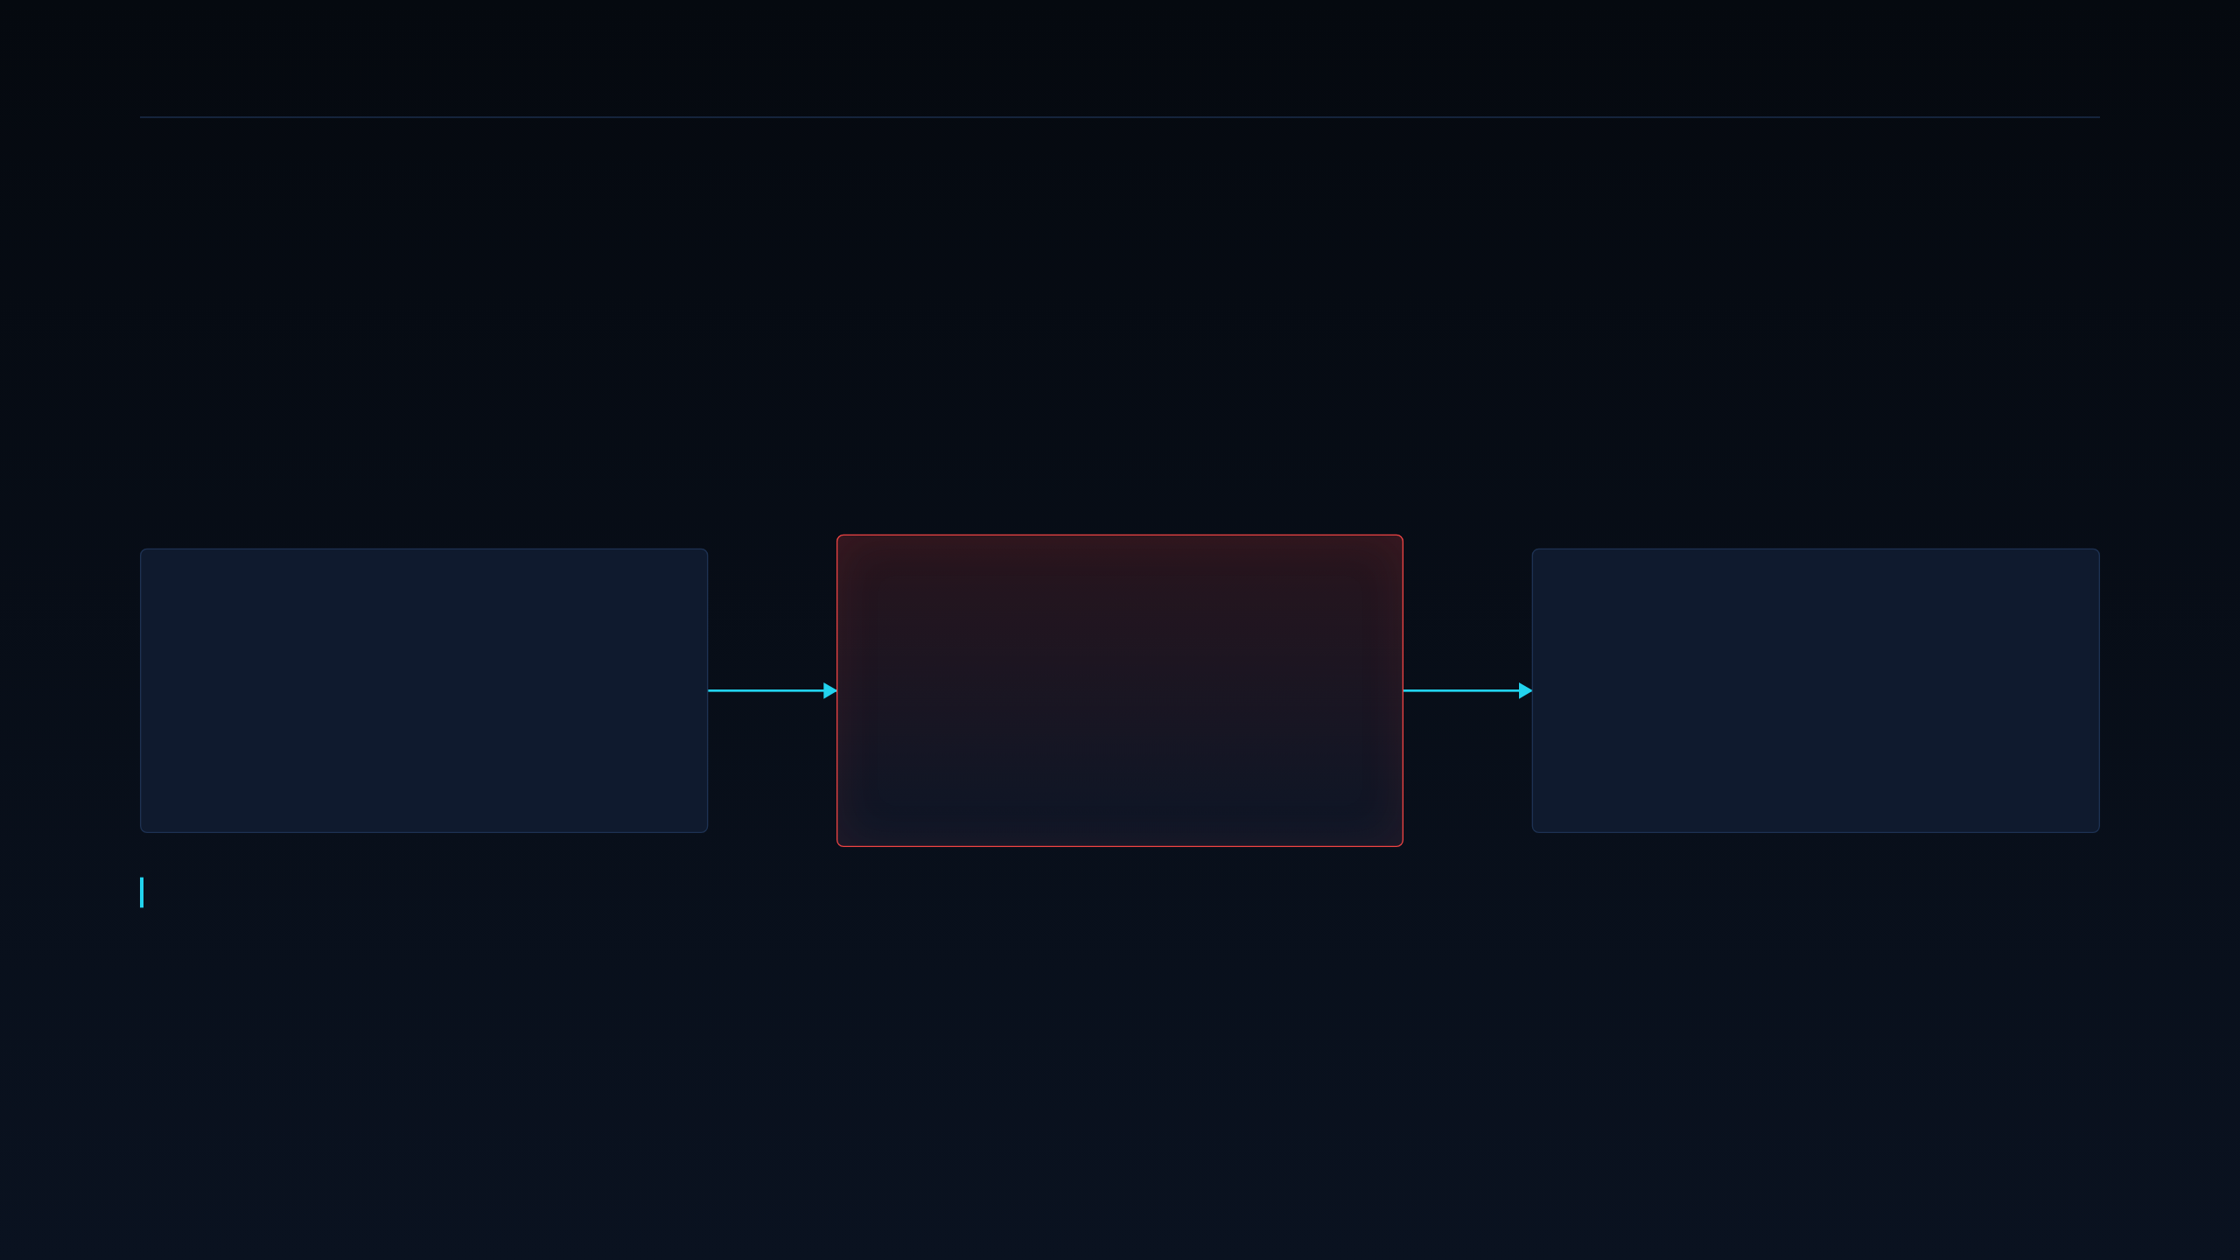
03 · CORE PROBLEM
DEEPGRID SEMI · PRE-SERIES A
The Squeeze Zone.
Every pure-play autonomy stack in India inherits merchant-silicon economics — and prices itself out of its own market.
LAYER 1 · SOFTWARE PLAYERS
LAYER 2 · WHERE VALUE LEAKS
LAYER 3 · MARKET OUTCOME
Pure-Play
AI Software
The Squeeze
Zone
Sales limited
to rich fleets.
Minus Zero, Swaayatt Robots, RoshAI — algorithm-first and hardware-agnostic. Excellent perception IP, but silicon is treated as a black-box commodity.
Merchant silicon (NVIDIA DRIVE, Ambarella, Mobileye, Qualcomm) drives per-vehicle BOM past $6,000. Add radar, cameras, enclosure and integration and the stack cannot land under fleet payback thresholds.
Only US, EU and GCC logistics majors can amortise that cost. Indian and cost-sensitive GCC fleets are shut out of the safety-mandate wave entirely.
The constraint is structural, not algorithmic. No amount of model quality moves a $6,000 bill of materials — only owning the die does.
03 · CORE PROBLEM
Not an offer to sell securities · For discussion only

Slide 4

04 · SOLUTION
DEEPGRID SEMI · PRE-SERIES A
DGrid Alpha — a single combo-die closes the BOM gap.
Four proven engineering choices, one BOM slot, ~$30 board cost.
01 · COMPUTE FABRIC
02 · FIRMWARE
03 · INTEGRATION
04 · COST OUTCOME
3D Systolic
Tensor Cube
Batch-dispatch
scheduler
Six chiplets,
one combo-die
~$30 board
BOM at scale
Micro-batches perception ops across camera and radar streams for a measured ~200× utilisation gain over naive per-frame dispatch on the same silicon.
The reason the MAC array reaches its TOPS ceiling.
ADAS, radar DSP, thermal and LiDAR DSP, secure enclave, telematics and driver-health in one package on 28 nm HPC+.
Replaces the four-to-six chip stack most Tier-1 designs still ship.
64 × 512 MAC lattice, dual-issue at 600 MHz → measured 39.3 TOPS INT8.
Sized for one 8MP camera cluster plus 4-corner radar without off-chip DRAM thrash.
Die at $3.876, board around $30 — against a merchant tier that starts near $3,500 and runs past $6,000.
04 · SOLUTION
Not an offer to sell securities · For discussion only

Slide 5

05 · ARCHITECTURE
DEEPGRID SEMI · PRE-SERIES A
Six chiplets on one 28 nm combo-die.
Roughly 57.1 mm² of die on TSMC 28 nm HPC+, with a predicted 96.7% yield.
A100
R100
T100
ADAS & AI
Radar DSP
Thermal & LiDAR DSP
The inference engine. 39.3 TOPS INT8 across perception, fusion and planning.
77 GHz radar signal processing on-die. Removes the discrete radar DSP from the kit.
Thermal camera and LiDAR front-end processing for low-visibility and night operation.
D100
S100
H100
Secure enclave
SDV telematics
Driver health
Lockstep RISC-V safety island. The basis of the sovereign data-security argument.
AIS-140-class telematics on-die, so the retrofit kit needs no secondary tracker.
Bio-ADC front end for drowsiness and fatigue detection, feeding the mandate functions.
Two of these six — D100 and S100 — are what no merchant ADAS SoC bundles. They are the sovereignty and the no-second-tracker arguments.
05 · ARCHITECTURE
Not an offer to sell securities · For discussion only

Slide 6

06 · WHAT THE MONEY BUYS
DEEPGRID SEMI · PRE-SERIES A
The die cost is quoted. The yield is not proven.
This is the single technical risk the raise exists to retire.
NODE
WHAT HAS TO BE TRUE
TSMC 28 nm HPC+, roughly 57.1 mm² of die
Multi-project-wafer silicon confirms the FPGA-validated compute and the 28 nm yield model, so the $3.876 die cost survives contact with real wafers.
DIE COST
$3.876 at 1M chips — supplier-quoted, under $4
WHAT PROVES IT WRONG
PREDICTED YIELD
The full-die shuttle misses timing, power or yield. $370K is committed before that gate clears — 11.7% of the total tapeout budget.
96.7% — a model output, not a measurement
06 · TAPEOUT
Not an offer to sell securities · For discussion only

Slide 7
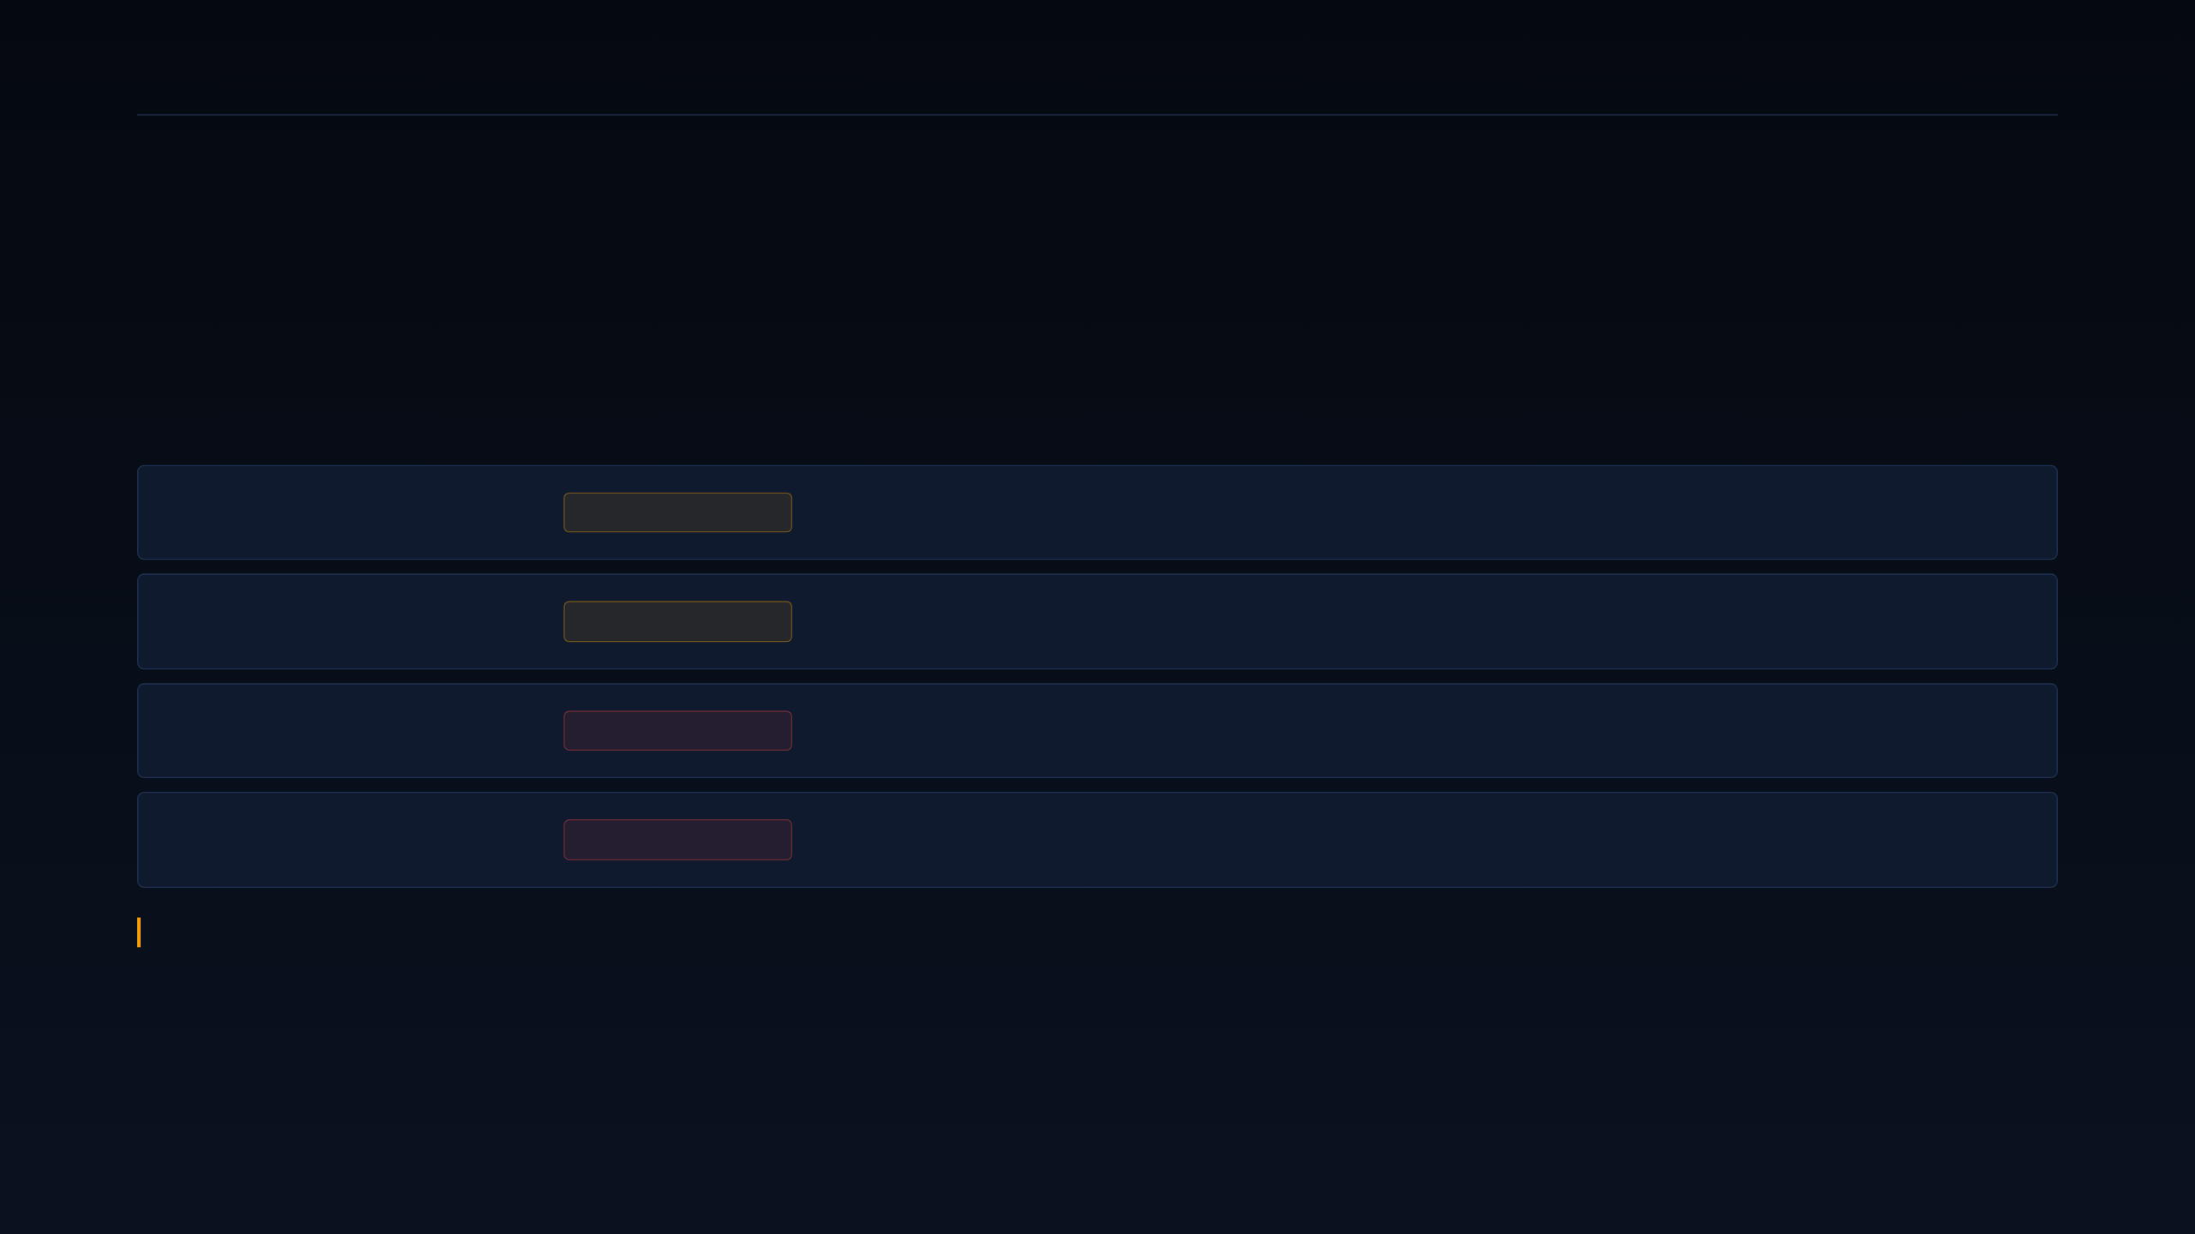
07 · CORRECTIONS LEDGER
DEEPGRID SEMI · PRE-SERIES A
Four figures from earlier materials are retracted.
Stated here rather than quietly swapped, because an investor who finds the discrepancy later discounts everything else.
“₹25 Cr ask”
SUPERSEDED
Reconciled against Use of Funds: ₹45 Cr equity CCPS + ₹10 Cr CGTMSE debt = ₹55 Cr blended.
“Under $3 die”
SUPERSEDED
The quoted die cost is $3.876 at 1M chips — under four dollars, not three.
“774× advantage”
RETRACTED
Unsourced: it divided an unsourced $3,000 by our own cost. The sourced comparison is 12.9×.
“$8M NRE”
RETRACTED
The line-item build-up totals $3.17M. The 3,636-unit break-even that figure implied is void.
Every correction appears on a slide, labelled, beside the figure it replaces. No number in this deck is a silent swap.
07 · CORRECTIONS
Not an offer to sell securities · For discussion only

Slide 8
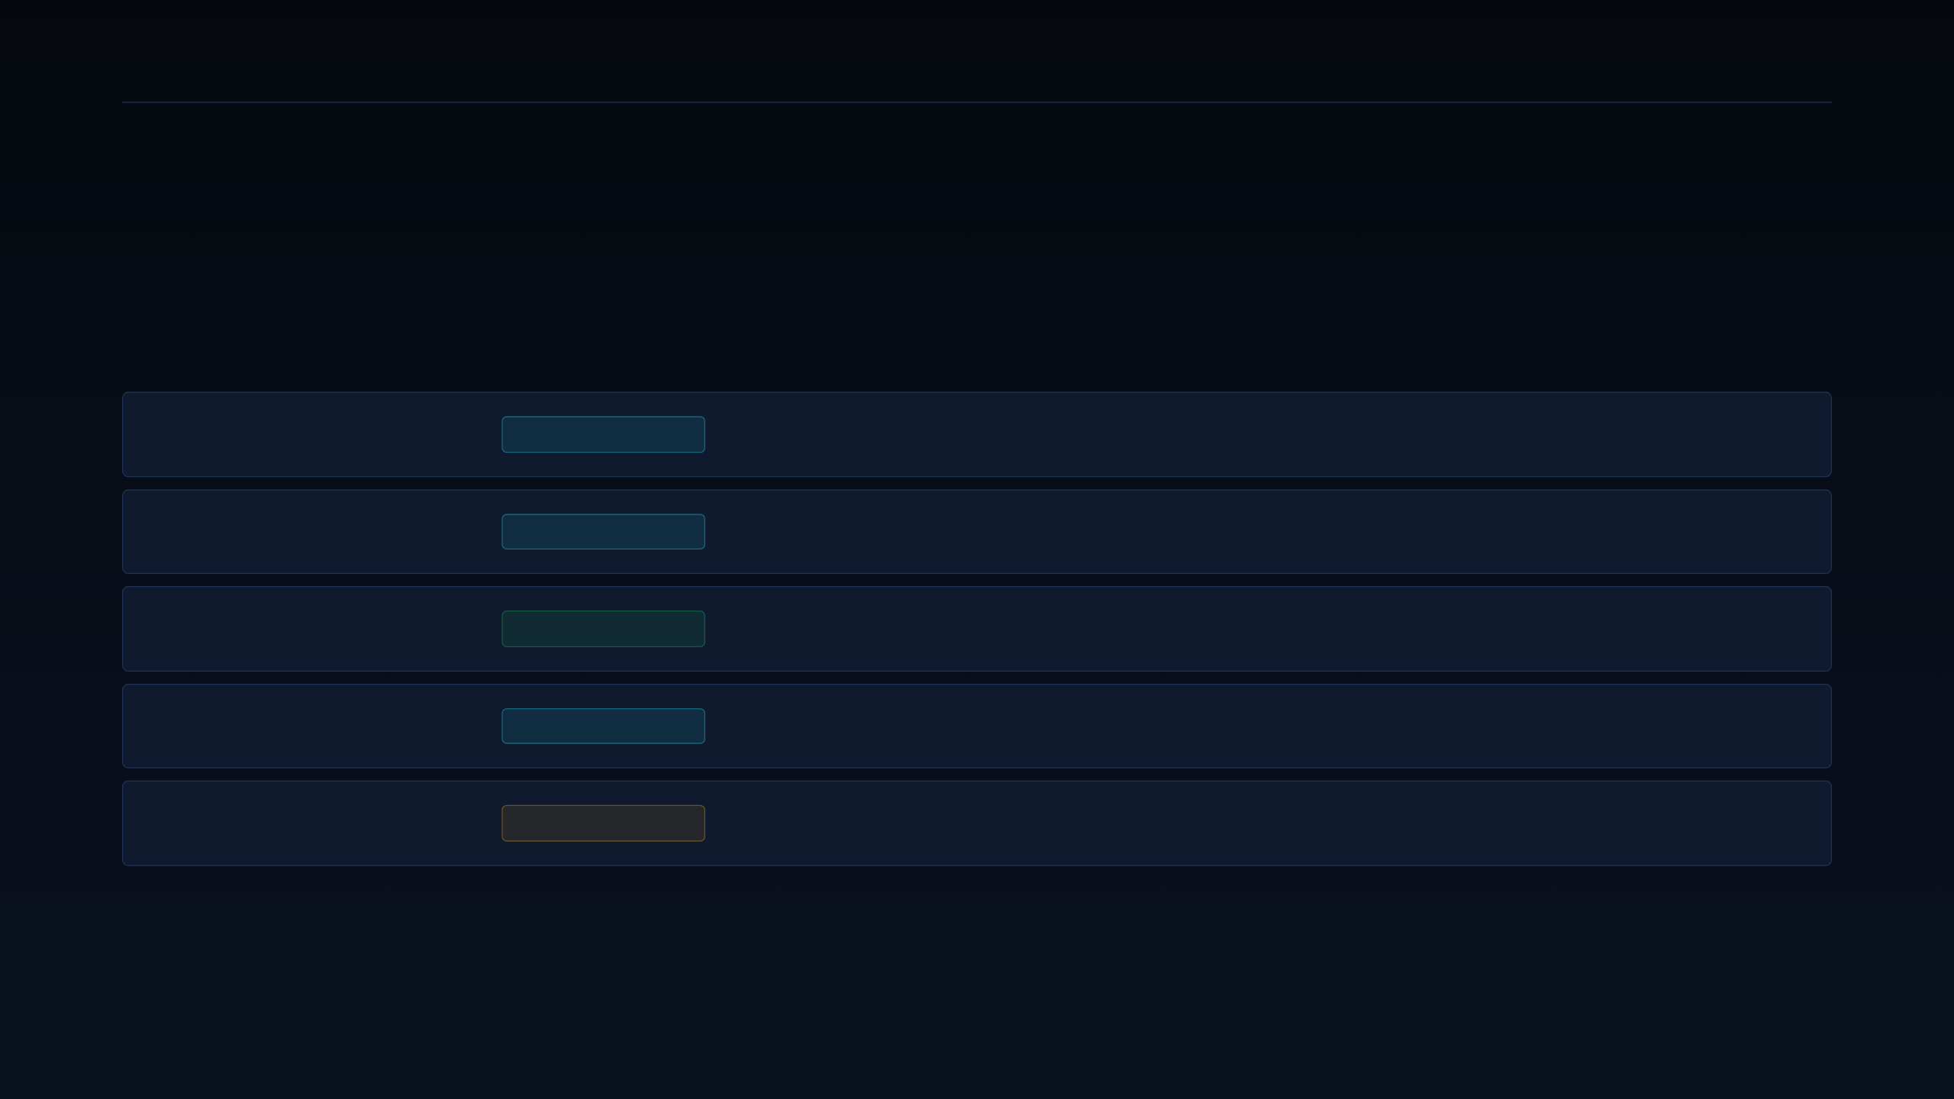
08 · HOW THE SEGMENT WAS CHOSEN
DEEPGRID SEMI · PRE-SERIES A
The beachhead was scored, not picked.
Ten weighted dimensions, five candidate segments, and an adversarial pass that found two real gaps.
Source intake
COMPLETE
34 claims classified fact, claim, inference or unknown before any scoring began.
Segment scoring
COMPLETE
Ten weighted dimensions applied independently to five candidate segments.
Approval gate
PASSED
Scorecard signed off before any go-to-market design work started.
Validation design
COMPLETE
A 27-question buyer discovery guide and a paid-pilot charter.
Challenge review
2 GAPS OPEN
An adversarial pass found two real gaps. Both are still open and both are named in this deck.
08 · METHOD
Not an offer to sell securities · For discussion only

Slide 9

09 · SCORING DIMENSIONS · 1 OF 2
DEEPGRID SEMI · PRE-SERIES A
Five dimensions decide whether a segment can buy.
These are the qualifying gates — fail one badly and the segment cannot transact at all.
01
02
03
04
05
Regulatory compulsion
Certification friction
Price elasticity
Sales cycle
ODD entropy
Is the purchase mandated or discretionary? Mandates convert cost-sensitive buyers into deadline-driven ones.
How much homologation and integration sits between a working part and a shipped vehicle.
The BOM ceiling the segment actually clears — not the price we would like to charge.
Months from first contact to signed order. Long cycles burn a pre-revenue balance sheet.
How unconstrained the operating domain is. Constrained domains ship years earlier.
09 · DIMENSIONS 1/2
Not an offer to sell securities · For discussion only

Slide 10

10 · SCORING DIMENSIONS · 2 OF 2
DEEPGRID SEMI · PRE-SERIES A
Five more decide whether it compounds.
These separate a segment that can buy once from a segment that builds a business.
06
07
08
09
10
Budget authority
Competitive pressure
Unit-economics margin
Repeatability
Evidence strength
Whether a win is a template or a one-off. Lumpy revenue does not compound.
Whether the person with the problem also controls the money to fix it.
How contested the segment already is, and by whom.
Gross margin the segment supports at the price it will actually clear.
What we have actually observed in this segment, as opposed to modelled.
Weights — problem 15% · urgency 15% · budget 12% · fit 12% · certification friction 10% · sales cycle 10% · competitive pressure 8% · margin 8% · repeatability 5% · evidence 5%.
10 · DIMENSIONS 2/2
Not an offer to sell securities · For discussion only

Slide 11

11 · WEIGHTED SCORECARD · 5 SEGMENTS
DEEPGRID SEMI · PRE-SERIES A
Defense scores highest on evidence, not enthusiasm.
The founder's preferred segment came second — which is the point of scoring before choosing.
Tactical Defense & Port
3.96 · 79.2%
Wins evidence strength, budget authority and technical fit. Ships on FPGA today.
3PL & Fleet Retrofit
3.40 · 68.0%
The scale story, and the working hypothesis. Zero signed customers.
AD0 Owner-Operator
2.62 · 52.4%
Below threshold. Fragmented buying, no consolidated budget authority.
OEM & Tier-1
2.32 · 46.4%
Worst certification friction and sales cycle of any segment scored.
Commercial Insurers
2.15 · 43.0%
Lowest score. Carries an unverified premium-reduction claim.
11 · SCORECARD
Not an offer to sell securities · For discussion only

Slide 12

12 · PRIMARY ICP · 79.2%
DEEPGRID SEMI · PRE-SERIES A
Defense is the only segment with revenue on the board.
Cost-insensitive, sovereignty-driven, and reachable with the silicon that already exists.
TARGETS
WHAT HAS TO BE TRUE
Sovereign UGVs, border surveillance, seaport AGVs
Sovereign buyers pay for sovereignty rather than price, and an on-die enclave is a differentiator they cannot satisfy with imported compute.
WHY IT BUYS
Cost-insensitive; buys data sovereignty via the D100 lockstep enclave
WHAT PROVES IT WRONG
SCORE
The ₹1 Cr already booked turns out to be grant or subsidy, not a commercial sale. Defense and Fleet then become evidence-equal.
3.96 / 5 — evidence 5/5, budget 5/5, fit 5/5
12 · ICP A · DEFENSE
Not an offer to sell securities · For discussion only

Slide 13

13 · SECONDARY EXPERIMENT · 68.0%
DEEPGRID SEMI · PRE-SERIES A
Fleet carries the scale story and none of the evidence.
This is the segment the FY32 model depends on, and it has not yet sold a single unit.
TARGETS
WHAT HAS TO BE TRUE
Medium and heavy N2/N3 trucks, aftermarket retrofit
Mandate deadlines turn a cost-sensitive retrofit buyer into a non-discretionary one, and ₹2–2.5 Lakh clears their ceiling.
PRICE POINT
₹2–2.5 Lakh — a roadmap figure carried as an assumption
SCORE
WHAT PROVES IT WRONG
3.40 / 5 — strongest on scale, weakest on evidence
Fewer than one of the first 20 buyer interviews converts to a paid pilot inside 90 days. Fleet then stays secondary.
13 · ICP B · FLEET
Not an offer to sell securities · For discussion only

Slide 14

14 · DEFERRED · 46.4%
DEEPGRID SEMI · PRE-SERIES A
OEM line-fit is the real scale, at the worst timing.
Right destination, wrong sequence — and the friction scores say so unambiguously.
TARGETS
WHAT HAS TO BE TRUE
OEM factory line-fit and Tier-1 module embedding
A signed Tier-1 partnership shortcuts both the homologation burden and the sales cycle, because the partner already carries both.
FRICTION
Certification 1/5 and sales cycle 1/5 — worst of any segment
SCORE
WHAT PROVES IT WRONG
2.32 / 5 — real long-term scale, wrong sequence
No Tier-1 signs. Any OEM go-to-market spend before that signature is dead capital, and the lane stays closed.
14 · ICP C · OEM
Not an offer to sell securities · For discussion only

Slide 15
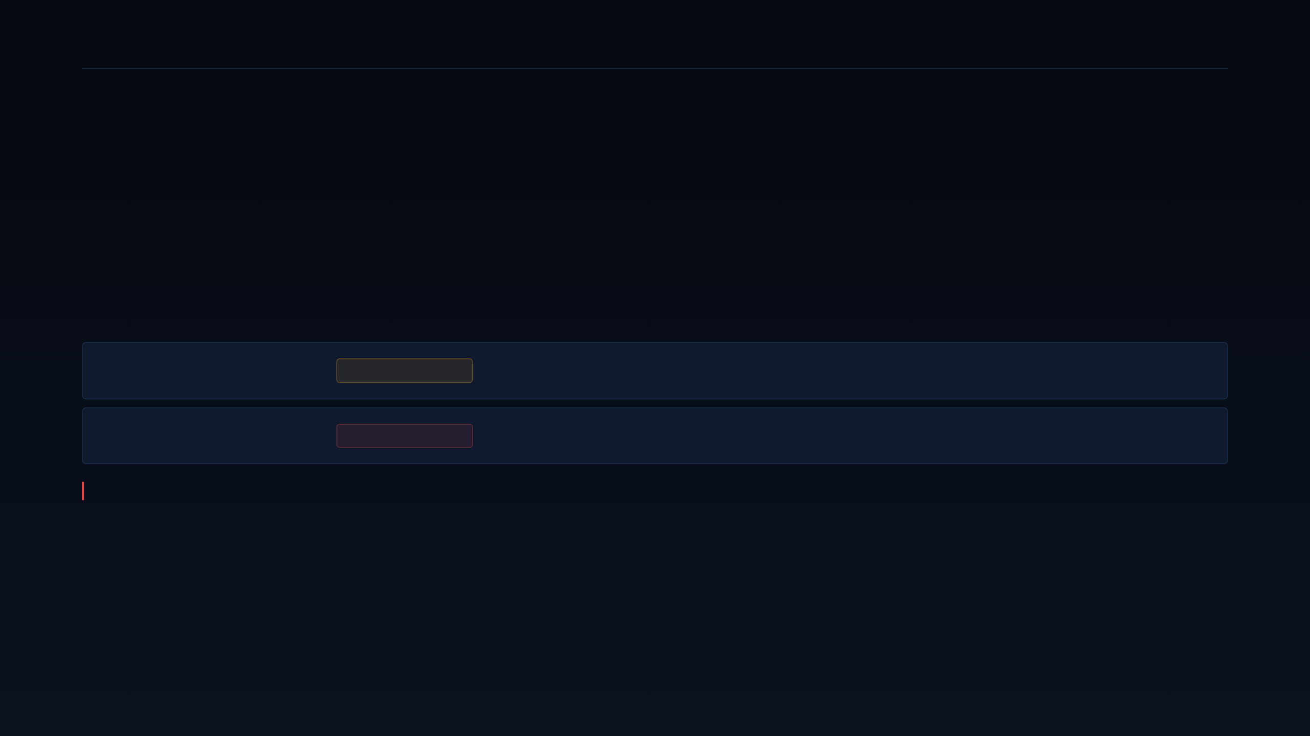
15 · DEFERRED AND ANTI-ICP
DEEPGRID SEMI · PRE-SERIES A
One segment is not a customer. It's a partner test.
Naming an anti-ICP is what stops a plausible-sounding segment from absorbing a year of runway.
OEM & Tier-1
DEFERRED
Real long-term scale, worst near-term friction. No go-to-market spend until a Tier-1 partnership is signed.
Commercial Insurers
ANTI-ICP
Lowest score of the five. The premium-reduction benefit is unverified, and the financial model carries zero insurer revenue rows.
Insurers may be an evidence partner — never a direct customer — until a pilot proves the premium mechanism against observed loss data. Partners until they pay.
15 · ANTI-ICP
Not an offer to sell securities · For discussion only

Slide 16
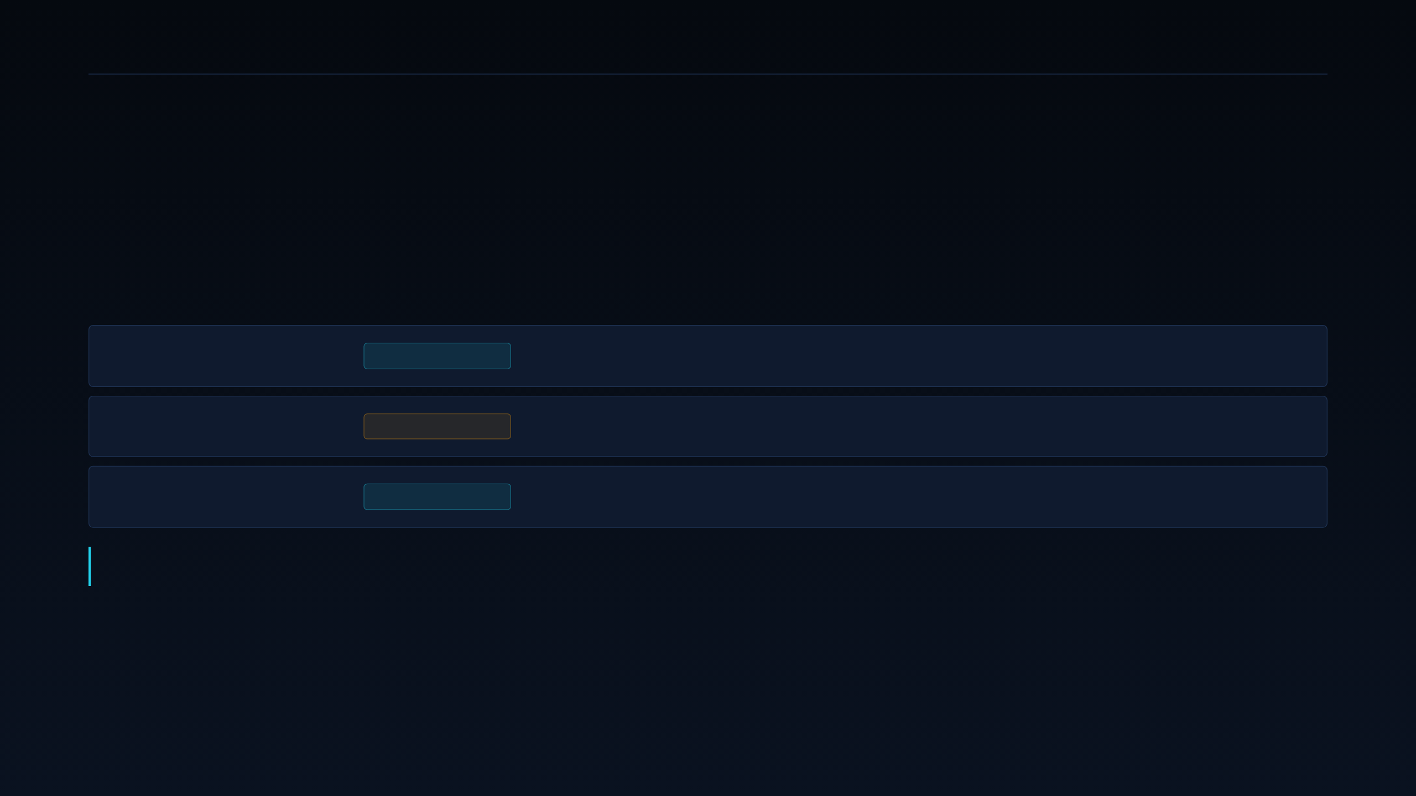
16 · SELECTION SYNTHESIS
DEEPGRID SEMI · PRE-SERIES A
Defense wins six months. It cannot win the decade.
Both segments are right about different things, which is why this resolves as a sequence rather than a choice.
Evidence · budget · fit
DEFENSE 5/5
Booked revenue, cost-insensitive buyers, and silicon that ships on FPGA today.
Repeatability
DEFENSE 2/5
Defense contracts are lumpy. They do not compound into the systems-revenue business the raise is built on.
Market scale
FLEET WINS
The multi-million-truck market is where FY32 revenue comes from — and it has no signed customer yet.
Run Defense as resourced primary for six months to generate the missing Fleet evidence, with Fleet funded in parallel as an experiment. This is a sequenced two-track plan, not a pivot. The strongest counter-case — that a defense-first motion undercuts a narrative built on fleet scale — is exactly why the sequencing must stay explicit in every document.
16 · SYNTHESIS
Not an offer to sell securities · For discussion only

Slide 17
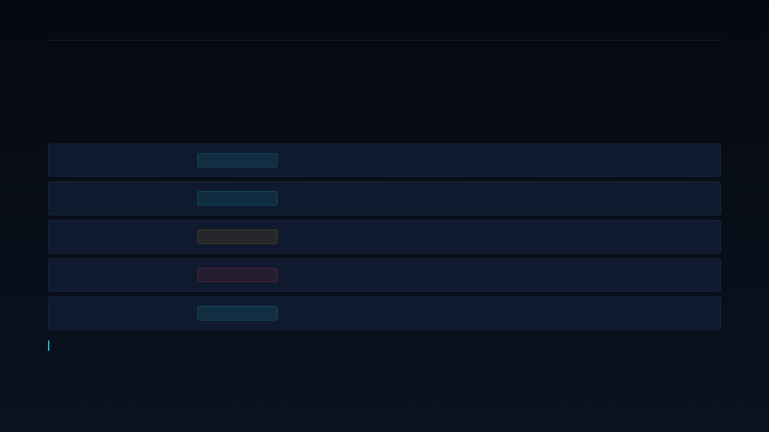
17 · BUYING COMMITTEE · DEFENSE
DEEPGRID SEMI · PRE-SERIES A
In Defense, the blocker outranks the champion.
Five roles, and the one that can stop the deal is not the one that wants it.
Economic buyer
PROCUREMENT
Defense procurement or port authority. Fears vendor lock-in.
Technical buyer
INTEGRATOR
Systems integration engineer. Fears undocumented failure modes.
Champion
UNIDENTIFIED
Program manager — not yet named in any account. A gap, not a role.
Blocker
COMPLIANCE
Security clearance and compliance office. A mandatory gate with no workaround.
End user
OPERATOR
UGV and AGV operators. Judge reliability in the field.
Minimum proof to advance: a second signed contract, or an audited confirmation of the ₹1 Cr already booked.
17 · BUYERS · DEFENSE
Not an offer to sell securities · For discussion only

Slide 18
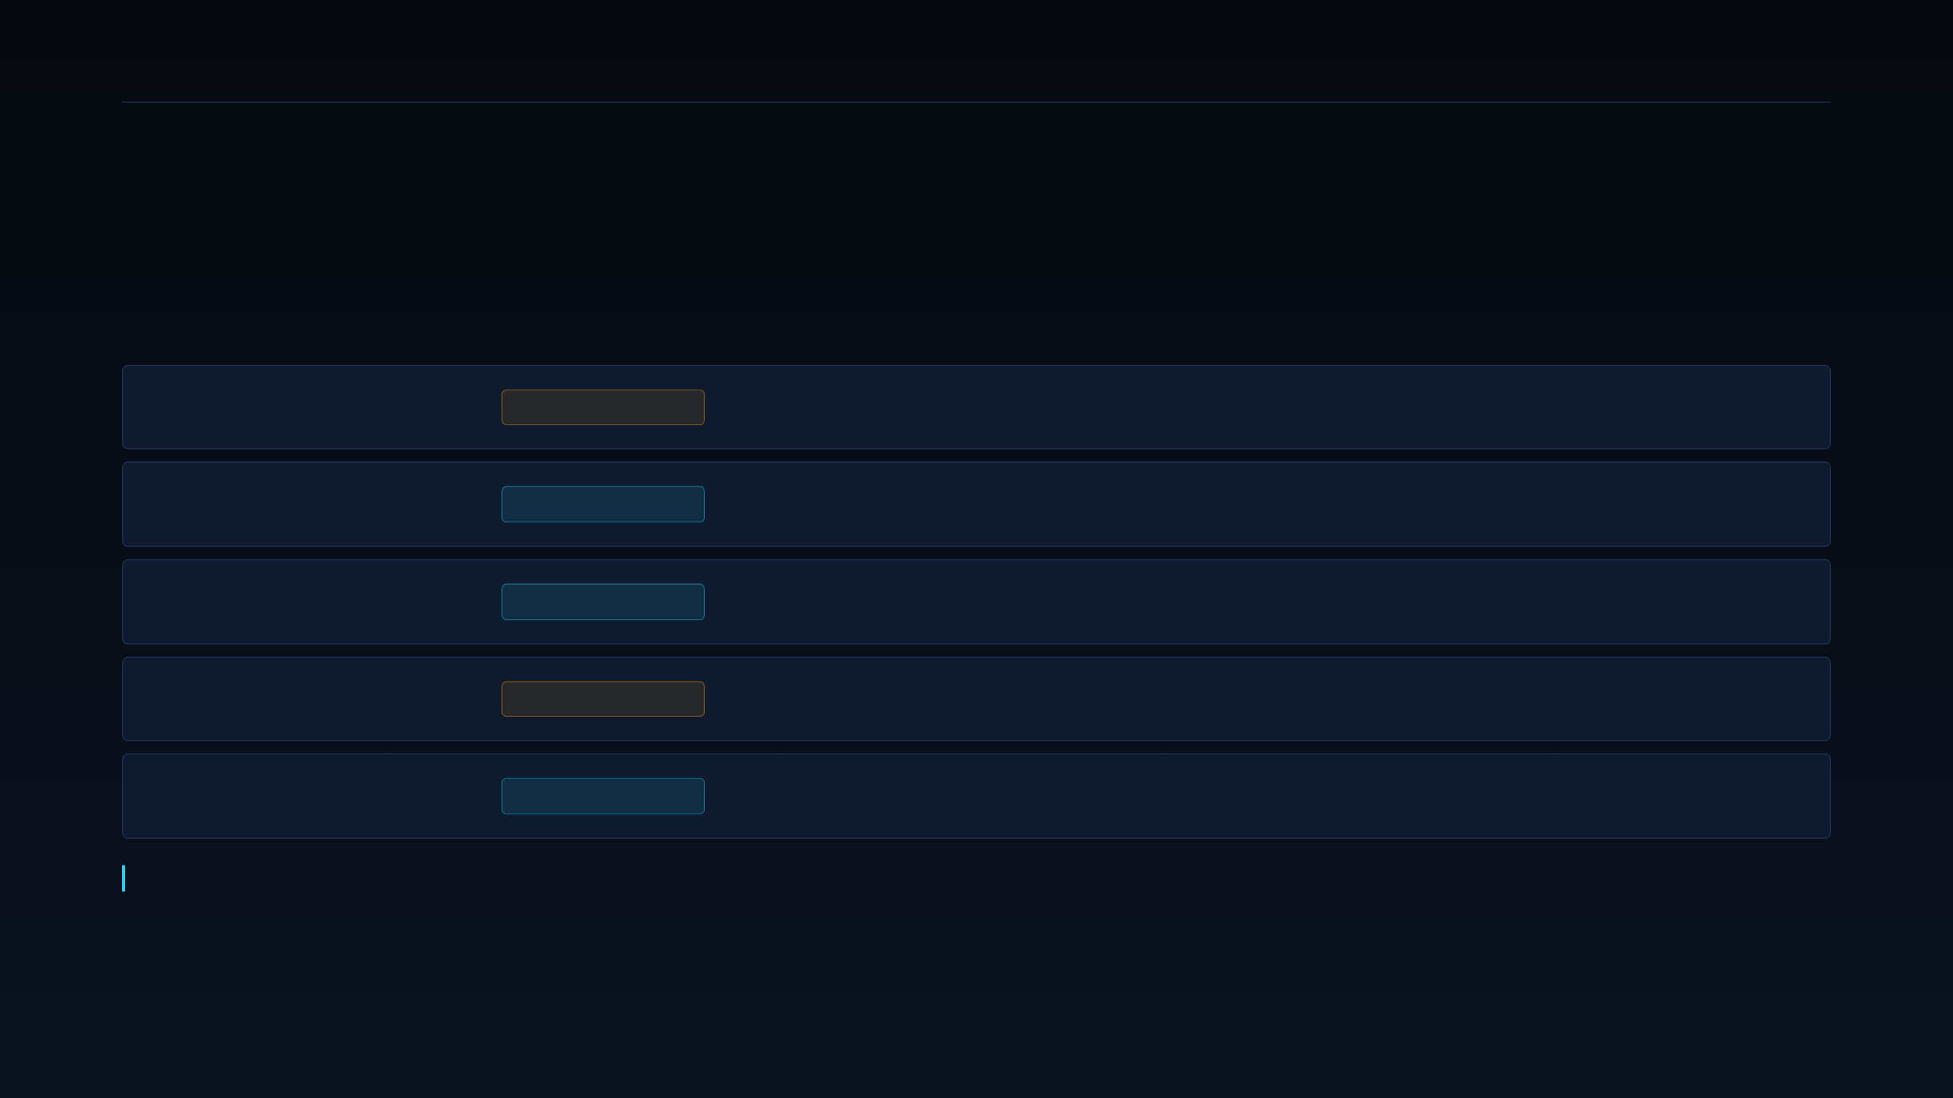
18 · BUYING COMMITTEE · FLEET
DEEPGRID SEMI · PRE-SERIES A
In Fleet, the mandate deadline is the champion.
The safety officer facing an AIS deadline is the only role with a reason to move first.
Economic buyer
FLEET OWNER
Fleet owner or operator. Fears unproven return and payback.
Technical buyer
TELEMATICS
Maintenance and telematics manager. Fears integration downtime.
Champion
COMPLIANCE
Safety officer facing the AIS mandate deadline. The natural ally.
Blocker
PROCUREMENT
Procurement, or the vehicle owner on attached fleets.
End user
DRIVER
Cabin reliability and tolerance for false positives.
Minimum proof to advance: one signed paid pilot from the first twenty discovery interviews.
18 · BUYERS · FLEET
Not an offer to sell securities · For discussion only

Slide 19
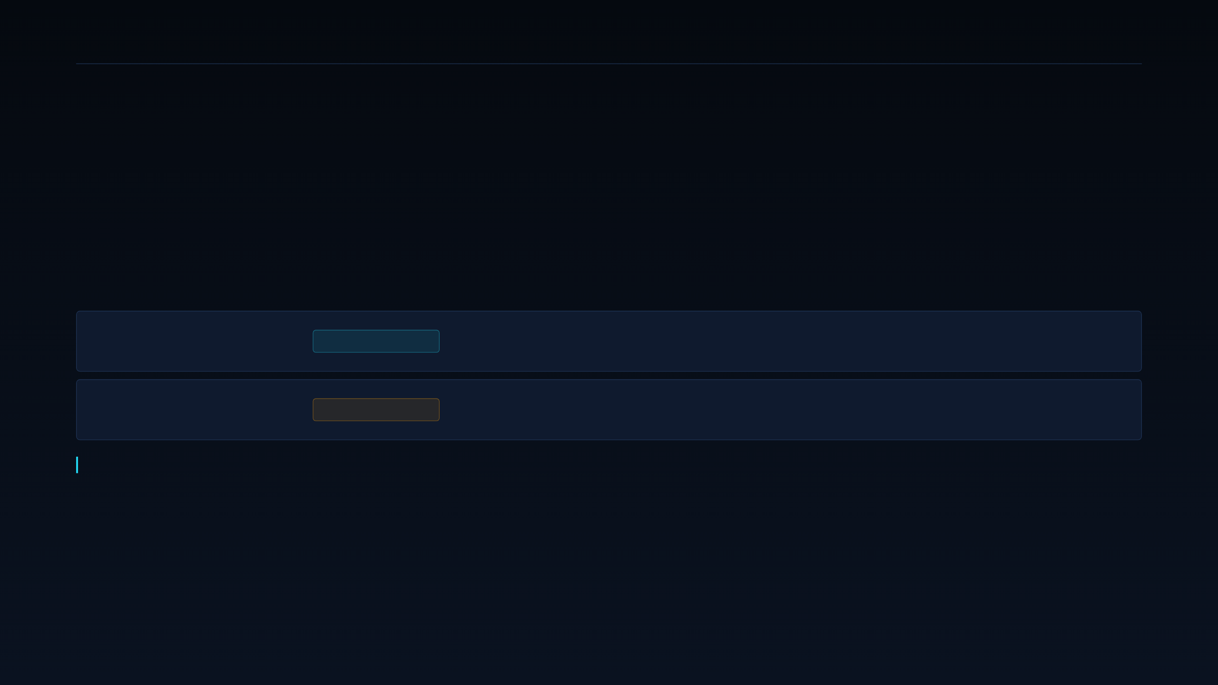
19 · POSITIONING · TWO TRACKS
DEEPGRID SEMI · PRE-SERIES A
Two tracks, two sentences, two kill criteria.
Each statement ships with the condition that would disprove it.
Defense
SOVEREIGNTY
“Sovereign edge-AI silicon with an on-die lockstep security enclave — no imported compute inside the trust boundary.” Kill criterion: a second signed contract, or the ₹1 Cr audited.
Fleet
PRICE · PENDING
“Mandate-ready ADAS retrofit at a domestic price point.” Carried as pending validation. Kill criterion: one paid pilot from the first twenty interviews.
Neither statement leaves the building without its kill criterion attached. A positioning claim with no disproof condition is marketing, not strategy.
19 · POSITIONING
Not an offer to sell securities · For discussion only

Slide 20

20 · CLAIM DISCIPLINE
DEEPGRID SEMI · PRE-SERIES A
Five claims come off the slides today.
Each one is either unreconciled, unmeasured, or a forecast being presented as demand.
STOP
STOP
STOP
STOP
STOP
“84% ASIC margin”
“Premium cut 10–15%”
“Mandate-ready”
“Accident reduction %”
“5M+ trucks”
Unreconciled, and the surrounding text implies 92–93%. Use the modelled FY32 gross margin of 88%.
Unverified. The model carries zero insurer revenue rows. State the partner test, not a benefit.
Unvalidated against the operative dates. State the target date, not readiness against it.
A market forecast, not demand. Real pipeline is twenty interviews and one pilot gate.
Nothing has been measured. No vehicle trial has been run or published.
20 · CLAIMS TO STOP
Not an offer to sell securities · For discussion only

Slide 21

21 · PRICING LOGIC
DEEPGRID SEMI · PRE-SERIES A
We don't have a price. We have a plan to find one.
Manufacturing false precision here would be the fastest way to lose credibility in diligence.
FLEET
WHAT HAS TO BE TRUE
₹2–2.5 Lakh is a roadmap figure, not a quote or a tested band
Willingness-to-pay questions inside the discovery guide return a defensible price band within the first twenty interviews.
DEFENSE
Contract-negotiated per sovereign buyer
WHAT PROVES IT WRONG
KIT BUILD-UP
Interviews return a ceiling below the kit's landed cost. The retrofit lane then needs a different configuration, not a different price.
~$200: ASIC $30 · radar $100 · cameras $50 · enclosure $20
21 · PRICING
Not an offer to sell securities · For discussion only

Slide 22

22 · CHANNEL STRATEGY
DEEPGRID SEMI · PRE-SERIES A
Direct, until a partner earns the margin.
Every indirect channel stays closed until there is a reason — and a signature — to open it.
Direct · Defense
NOW
Recommended primary motion. Sovereign buyers expect a direct technical relationship.
Direct · Fleet
PILOT ONLY
Recommended for the pilot phase, to keep discovery signal unfiltered by a reseller.
System integrators
NOT YET
No partner identified. Revisit once the retrofit configuration is frozen.
Defense primes
AFTER 2 WINS
Considered only after two signed Defense contracts of our own.
22 · CHANNEL
Not an offer to sell securities · For discussion only

Slide 23

23 · EXECUTION · NEXT 90 DAYS
DEEPGRID SEMI · PRE-SERIES A
Ninety days to turn evidence into a decision.
Three phases, one hard gate, and a stop-doing list that protects the runway.
WEEKS 1–4
WEEKS 5–9
WEEKS 10–13
Evidence
Conversion
Governance
Audit the ₹1 Cr revenue back to its contract. Run 10 buyer interviews. Name 3 target accounts.
Sell one paid Fleet pilot. Advance one Defense technical evaluation. Open the second contract.
Re-score both segments against the same scorecard. Hard gate on Fleet at day 90.
Stop-doing list — no OEM go-to-market spend until a Tier-1 signs · no insurer-facing sales motion · no AD0 resourcing pending the evidence check · no external claim that is not on the sourced list.
23 · 90-DAY PLAN
Not an offer to sell securities · For discussion only

Slide 24
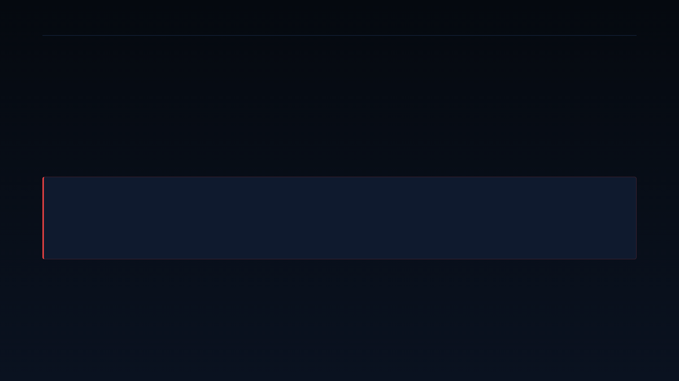
24 · ONE DISCIPLINE NOTE
DEEPGRID SEMI · PRE-SERIES A
One kill switch governs both tracks.
Stated now, so that failing it later is a decision rather than a drift.
If the ₹1 Cr is not a commercial sale and no Fleet pilot converts by day 90 —
then neither track has evidence, and the ₹55 Cr case rests on a forecast alone. The honest response is to raise a smaller bridge against the tapeout only — funding the three MPW shuttles that de-risk the die — rather than a growth round against a market we have not yet sold into.
What we should not do is fund a two-segment go-to-market motion after both segments have failed their own test.
24 · KILL SWITCH
Not an offer to sell securities · For discussion only

Slide 25

25 · STRATEGIC PLAYBOOKS
DEEPGRID SEMI · PRE-SERIES A
Every credible player picks one lane.
None of them runs all three motions, and none of them does it at a ~$30 board cost.
USA
USA · DOD
USA
CHINA
INDIA
Aurora
Kodiak
Gatik
DeepWay
DeepGrid
Heavy-OEM, long-haul Class-8. Dual NVIDIA DRIVE Thor. Board BOM past $6,000. Continental industrialises it.
Dual-use: highway freight plus DoD contracts. Ambarella CV3-AD685 as the compute.
Constrained middle-mile only. NVIDIA DRIVE AGX Orin. Isuzu box trucks for Walmart and Kroger.
China domestic fleets. High-compute NPU with Baidu Apollo, in “Xingtu” L4 electric trucks.
Own 28 nm combo-die at ~$30 board BOM. The only lane choice not set by a chip vendor.
25 · PLAYBOOKS
Not an offer to sell securities · For discussion only

Slide 26
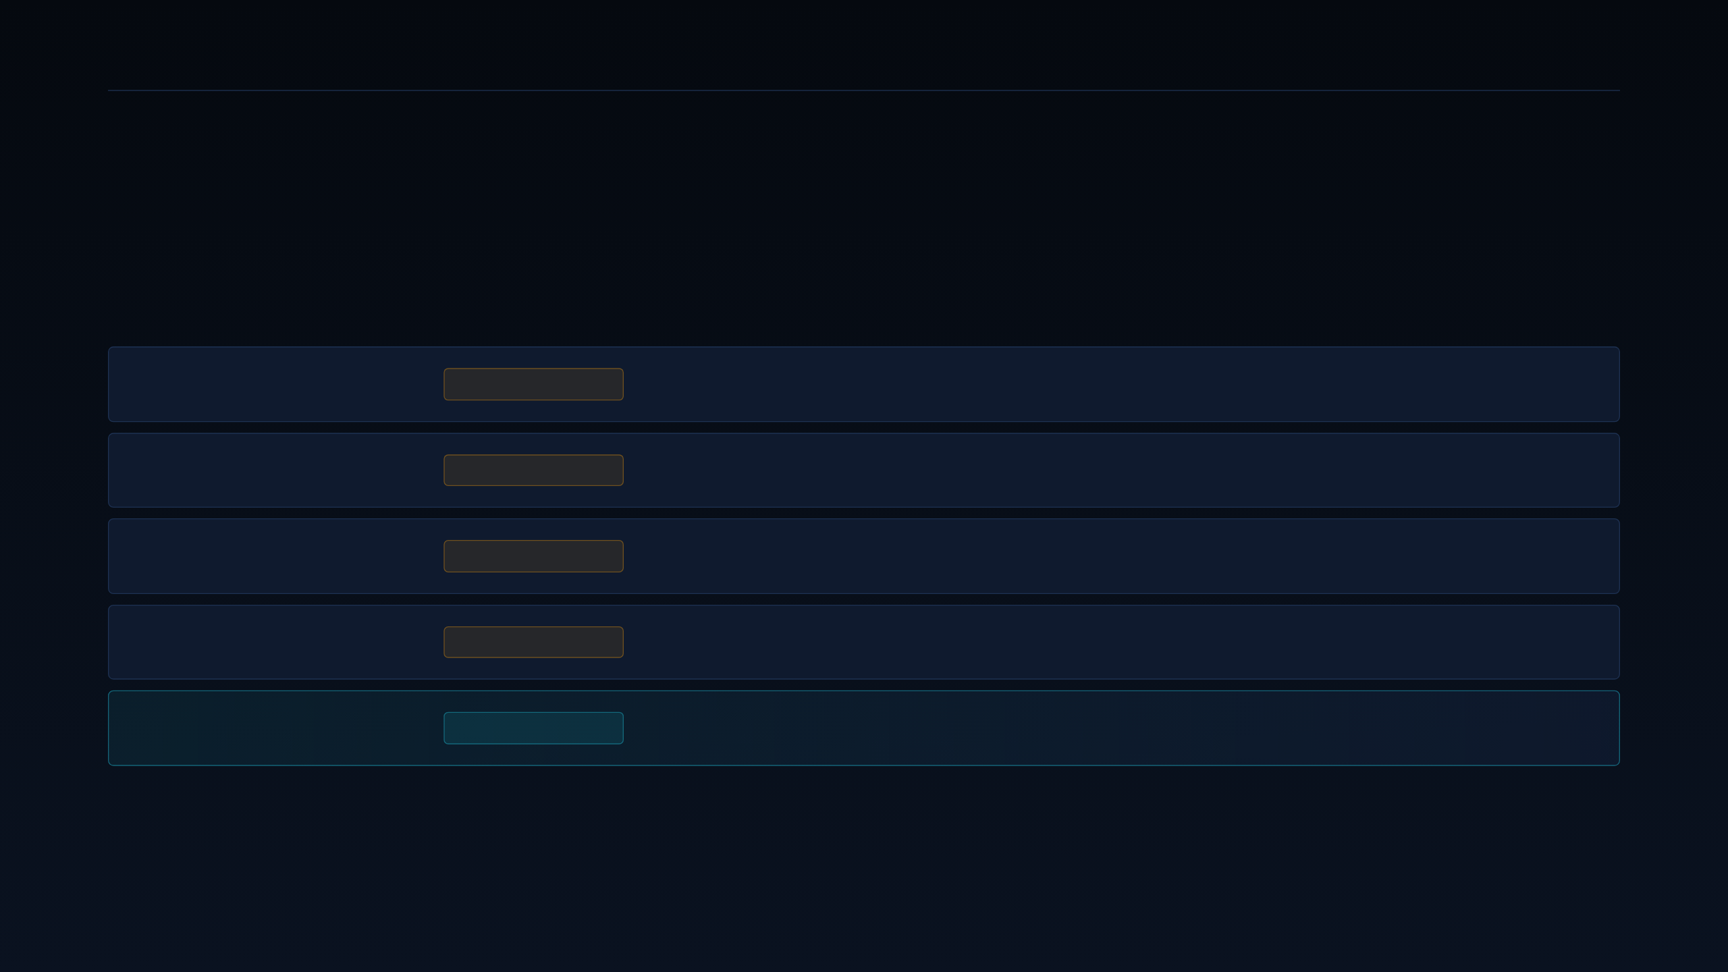
26 · SILICON DEPENDENCY
DEEPGRID SEMI · PRE-SERIES A
Four of five rent their compute.
Whoever owns the die owns the cost structure — and everyone else inherits it.
Aurora
NVIDIA
Two DRIVE Thor parts. BOM past $6,000. The roadmap moves when NVIDIA's does.
Kodiak
AMBARELLA
CV3-AD685. Single-vendor dependency on a merchant ADAS SoC.
Gatik
NVIDIA
DRIVE AGX Orin. Margin structure set by someone else's die price.
DeepWay
BAIDU · NPU
Domestic Chinese stack. Vertically closer, but not export-positioned.
DeepGrid
NONE
Own 28 nm combo-die. No chip vendor anywhere in the cost structure.
26 · DEPENDENCY
Not an offer to sell securities · For discussion only

Slide 27

27 · COST ADVANTAGE
DEEPGRID SEMI · PRE-SERIES A
Twelve-point-nine times, on a sourced comparison.
The number that replaced the retracted 774× claim — and where each half of it comes from.
DIE LEVEL
KIT LEVEL
OUR DIE
OUR BOARD
vs Mobileye ASP
vs imported ADAS
At 1M chips
After integration
12.9×
3–7×
$3.876
~$30
Mobileye's $50 ASP divided by our $3.876 die cost at 1M chips.
Against company-stated import bands of ₹5–18 Lakh for equivalent function.
TSMC 28 nm HPC+, roughly 57.1 mm². Supplier-quoted.
Six functions on one die removes four vendors' parts from the BOM.
The retracted 774× figure divided an unsourced $3,000 by our own cost. That is not a comparison — and it is not used anywhere in this deck.
27 · COST STRUCTURE
Not an offer to sell securities · For discussion only

Slide 28

28 · DOMESTIC LANDSCAPE
DEEPGRID SEMI · PRE-SERIES A
India's silicon wave is real, and a year behind.
A genuine lead, but a perishable one — the window is roughly twelve months wide.
VISION SOC
RISC-V MCU
GAN RF
Netrasemi
Mindgrove
Agnit
A2000 SoC on TSMC 12 nm. ₹125 Cr raised. Launch expected mid-2027.
RISC-V microcontroller on TSMC 28 nm. Bosch MoU signed. $10.3M raised.
GaN devices for RF and power. Defense radar pilots running. $7.47M raised.
None is shipping an ADAS combo-die today. The nearest domestic ASIC competitor reaches launch roughly twelve months behind DeepGrid's current position — a lead that is real but not durable.
28 · INDIA WAVE
Not an offer to sell securities · For discussion only

Slide 29
29 · SOFTWARE-FIRST AUTONOMY
DEEPGRID SEMI · PRE-SERIES A
Better algorithms don't change the die price.
Three credible Indian autonomy teams, all inheriting the same cost structure.
PERCEPTION IP
RESEARCH-LED
MIDDLEWARE
Minus Zero
Swaayatt Robots
RoshAI
Hardware-agnostic autonomy stack. Inherits whatever the merchant SoC costs.
Constrained-route autonomy research. No silicon position of its own.
Fleet autonomy middleware. Runs on standard parts at standard prices.
Hardware-agnostic autonomy inherits the squeeze zone by construction. Algorithm quality is a product advantage; it is not a cost-structure advantage — and this market is decided on cost structure.
29 · SOFTWARE-FIRST
Not an offer to sell securities · For discussion only

Slide 30

30 · COMPETITIVE SYNTHESIS
DEEPGRID SEMI · PRE-SERIES A
One position nobody else occupies.
The claim is structural, and it is the only one worth defending in diligence.
Vertical integration
ONLY ONE
The only Indian company with a single-die ADAS combo-die of its own design.
Cost structure
12.9×
A ~$30 board BOM against a merchant tier that starts near $3,500 and runs past $6,000.
Timing
~12 MONTHS
First mover on retrofittable, mandate-targeted ADAS for India and the GCC.
The defensible claim is structural, not performance-based. We are not asserting better perception than Mobileye. We are asserting a different cost structure than anyone else selling into this market — and cost structure is what this market decides on.
30 · COMPETITIVE
Not an offer to sell securities · For discussion only

Slide 31

31 · ROADMAP · THREE PHASES
DEEPGRID SEMI · PRE-SERIES A
Three phases, each gated on the last one's evidence.
The original pitch already sequenced Defense first. The scorecard confirms that sequence rather than inventing it.
MONTHS 0–6
MONTHS 6–18
MONTHS 18–36
Phase 1 · Wedge
Phase 2 · Volume
Phase 3 · Scale
Tactical and off-highway deployments. Audit and confirm the ₹1 Cr already booked. Open the second contract.
Close the ₹55 Cr blended raise. TSMC 28 nm MPW tape-out. Launch the retrofit kit.
Tier-1 alliances and OEM line-fit. Shift toward recurring per-vehicle software revenue.
Each phase has a named gate. Phase 2 does not start until the ₹1 Cr is audited; Phase 3 does not start until a Tier-1 signs.
31 · ROADMAP
Not an offer to sell securities · For discussion only

Slide 32
32 · PHASE 2 GATE · THE TAPEOUT
DEEPGRID SEMI · PRE-SERIES A
Only $370K is at risk before the yield gate.
Three shuttles de-risk the die before the expensive 88% of the budget is committed.
AT RISK PRE-VALIDATION
WHAT HAS TO BE TRUE
$370K — 11.7% of the $3.17M total
Three shuttles de-risk the die before the mask set is ordered, so the expensive 88% of the budget only spends after silicon proves out.
MPW PHASING
$69K A100 · $69K R100 · $232K full-die shuttle
COMMITTED AFTER THE GATE
WHAT PROVES IT WRONG
$1.0M backend to GDSII · $1.0M mask · $800K IP and PHY
The full-die shuttle misses timing, power or yield. The programme then stops at $370K rather than at $3.17M.
32 · TAPEOUT PHASING
Not an offer to sell securities · For discussion only

Slide 33
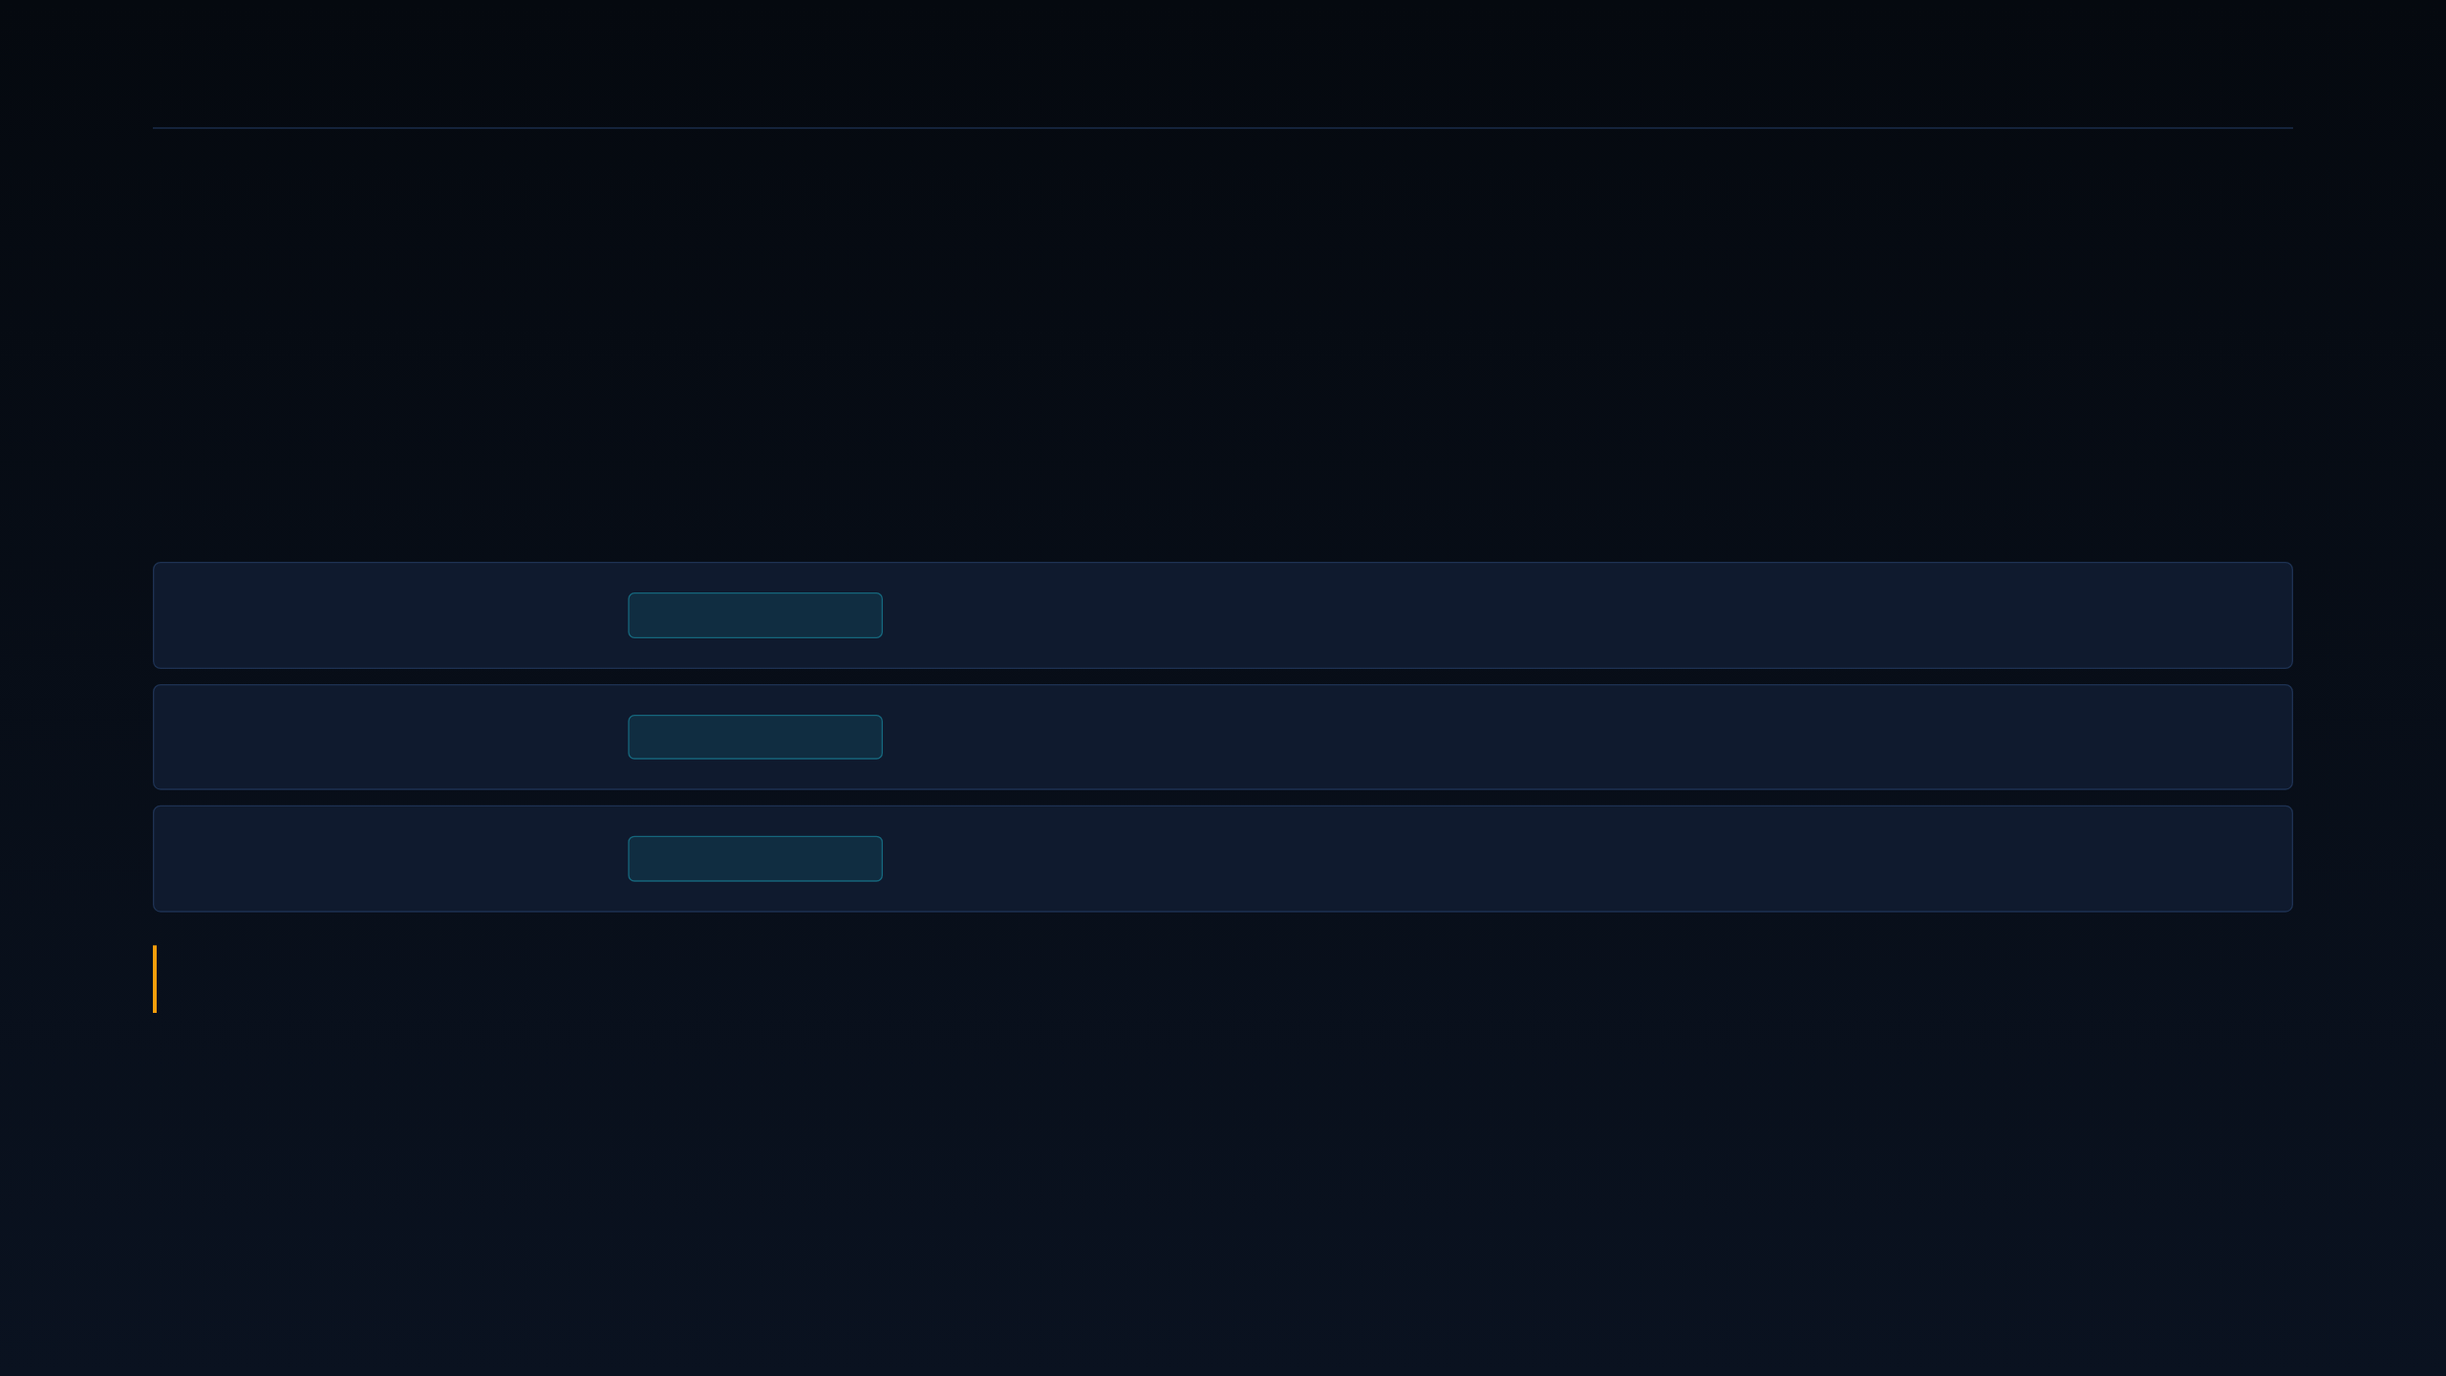
33 · REGULATORY · INDIA
DEEPGRID SEMI · PRE-SERIES A
The mandate dates in earlier materials were wrong.
This matters because the entire Fleet timing argument is built on them.
AIS-184 · AEBS
1 OCT 2027
Autonomous emergency braking. Served by A100 compute with the R100 radar DSP.
AIS-186 · ESC
1 OCT 2027
Electronic stability control. A100 with the D100 lockstep safety enclave.
AIS-187 to 190
1 JAN 2028
Lane keeping, curve speed, fatigue detection and telematics. A100 with S100 and H100.
Earlier materials carried Apr/Oct 2026 dates. The operative dates are 1 October 2027 for AEBS and ESC, and 1 January 2028 for all four functions. Both must be confirmed against the final MoRTH Gazette before either is presented as settled.
33 · INDIA MANDATE
Not an offer to sell securities · For discussion only

Slide 34

34 · REGULATORY · GCC
DEEPGRID SEMI · PRE-SERIES A
The GCC needs one chiplet we already have.
S100 turns a compliance requirement into a bill-of-materials advantage.
SAUDI ARABIA
WHAT HAS TO BE TRUE
TGA safety requirements plus the WASL fleet-tracking mandate
Removing a discrete tracker is a real BOM and installation-time advantage in a mandate-driven GCC fleet tender.
THE S100 ADVANTAGE
On-die telematics removes the secondary tracker from the kit
WHAT PROVES IT WRONG
TIMING
GCC homologation treats an integrated tracker as non-compliant and requires a separately certified standalone unit anyway.
Phase 3. The beachhead stays India
34 · GCC MANDATE
Not an offer to sell securities · For discussion only

Slide 35

35 · REVENUE · MANAGEMENT MODEL
DEEPGRID SEMI · PRE-SERIES A
Six years to ₹1,388 Cr on the model.
Management projection, unaudited. This is model output, not observed data.
FY28
FY29
FY30
FY31
FY32
₹41.17 Cr
₹144.73 Cr
₹351.35 Cr
₹731.54 Cr
₹1,387.95 Cr
Volume ramp against the mandate deadlines.
EBITDA ₹536.63 Cr at 39% of revenue.
First full year of retrofit-kit revenue.
Net income turns positive this year.
OEM line-fit begins contributing.
FY27 opens the ramp at ₹6.0 Cr. FY32 revenue was previously misstated as ₹1,128 Cr on a cover slide; the reconciled figure is ₹1,387.95 Cr, confirmed seven times in the workbook.
35 · REVENUE
Not an offer to sell securities · For discussion only

Slide 36

36 · GROSS MARGIN WALK
DEEPGRID SEMI · PRE-SERIES A
Margin expands because the die gets cheaper.
Not because the retrofit price goes up — it stays inside the same band throughout the model.
+35 pt
88%
53%
The walk is 53 → 74 → 79 → 82 → 85 → 88%. It is driven by wafer volume and test automation — not by raising the retrofit price, which stays inside the ₹2–2.5 Lakh band throughout the model.
FY32 EBITDA is ₹536.63 Cr, or 39% of revenue. Net income ₹381.37 Cr, positive from FY2029.
FY27 gross margin
first silicon, low volume
FY32 gross margin
at volume on 28 nm
36 · MARGIN WALK
Not an offer to sell securities · For discussion only

Slide 37

37 · BREAK-EVEN
DEEPGRID SEMI · PRE-SERIES A
Break-even lands in the final year of the model.
Said plainly, because the earlier figure made it look four years earlier than it is.
TOTAL NRE
VOLUME TO RECOVER
CROSSING YEAR
PRE-GATE RISK
Tapeout cost
Chips at $18.12 margin
Break-even
Committed early
$3.17M
174,908
FY2032
11.7%
From the line-item build-up, with MPW phasing inside it.
Per the reviewed analysis recomputation.
The final year of the six-year model.
Only $370K spends before the yield gate.
The earlier “$8M NRE and 3,636-unit break-even” pairing is void in both halves and is not used anywhere in this deck.
37 · BREAK-EVEN
Not an offer to sell securities · For discussion only

Slide 38

38 · RECURRING REVENUE
DEEPGRID SEMI · PRE-SERIES A
Software is the second half of the model.
Per-vehicle subscription revenue, priced off a sovereignty constraint rather than a feature list.
Base · ₹10,000/yr
TELEMETRY
Per vehicle. Telemetry capture and a basic fleet dashboard.
Advanced · ₹15,000/yr
COMPLIANCE
Adds mandate compliance reporting and an insurer data interface.
Premium · ₹25,000/yr
ANALYTICS
Adds fleet analytics, over-the-air updates and data-governance controls.
Behavioural data stays on-device inside the D100 enclave rather than leaving the vehicle. The sovereignty constraint is the pricing argument — not a compliance cost to be absorbed.
38 · SOFTWARE
Not an offer to sell securities · For discussion only

Slide 39
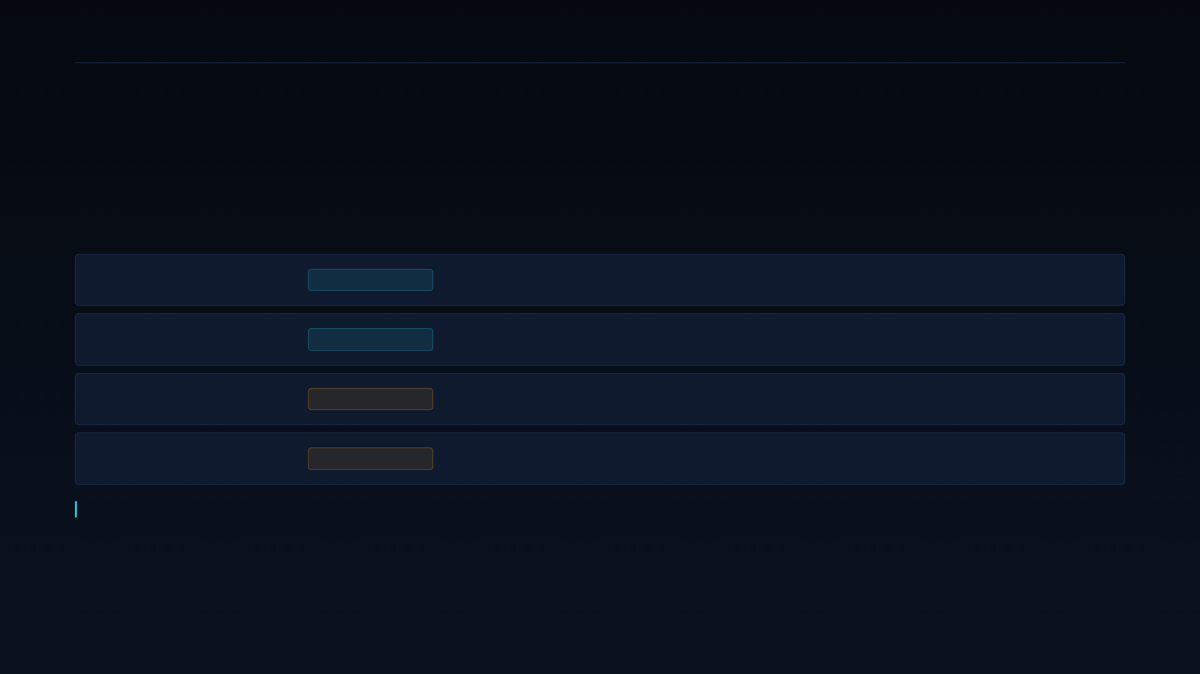
39 · CAPITAL STRUCTURE
DEEPGRID SEMI · PRE-SERIES A
₹55 Cr blended. Subsidies are upside, not the plan.
Sized to stand alone, so that no incentive decision sits on the critical path.
Equity · ₹45 Cr
CCPS
Compulsorily convertible preference shares. Terms negotiable.
Debt · ₹10 Cr
CGTMSE
Drawn across the build; a 25% draw gives roughly ₹47.5 Cr funded.
P-DLI
UPSIDE
Up to 50% design-cost reimbursement, capped at ₹15 Cr.
Deployment incentive
UPSIDE
Four to six percent of net sales, capped at ₹30 Cr.
Capital raised to date is ₹2.48 Cr — ₹2 Cr angel, ₹0.36 Cr ARAI, ₹0.12 Cr HDFC. The raise is sized to stand alone at ₹55 Cr blended, with no incentive award assumed.
39 · CAPITAL
Not an offer to sell securities · For discussion only

Slide 40

40 · CHALLENGE FINDINGS
DEEPGRID SEMI · PRE-SERIES A
An adversarial pass found five problems.
Printed here rather than in an appendix, because two of them gate the decision.
GAP 1
GAP 2
METHOD
BALANCE SHEET
DATA
Primes unassessed
₹1 Cr unconfirmed
Circular evidence
Working capital
Yield disagreement
The workbook models 94.5%; the memorandum states 96.7%. Immaterial to die cost — but print only one.
Indian defense primes were never benchmarked. A cleared incumbent is a different problem than Netrasemi.
Commercial sale, or grant? If a grant, Defense and Fleet are evidence-equal and the sequencing argument fails.
The scorecard rates Defense highest partly on evidence that is itself the unconfirmed ₹1 Cr.
₹2.48 Cr raised against a ₹55 Cr ask, with government payment cycles of 90–180+ days.
40 · RED TEAM
Not an offer to sell securities · For discussion only

Slide 41

41 · THE DECISION
DEEPGRID SEMI · PRE-SERIES A
Proceed — with five conditions, in order.
Not an unconditional go. Two of the five are evidence gates that could reopen the segment choice.
CONDITION 1
CONDITIONS 4 AND 5
Confirm the nature of the ₹1 Cr revenue within one week
Keep every external document in sequenced two-track framing, never a flat pivot narrative. Treat the day-90 checkpoint as a hard re-scoring gate against the same scorecard.
CONDITION 2
Add Indian defense primes to the competitive benchmark
CONDITION 3
IF A CONDITION SLIPS
Model working-capital exposure to 90–180 day payment cycles
Any condition unmet at day 90 reopens the segment decision. The scorecard is re-run, not re-argued.
41 · DECISION
Not an offer to sell securities · For discussion only

Slide 42

42 · THE ASK
DEEPGRID SEMI · PRE-SERIES A
A defensible ask, on the record.
Four numbers, five conditions, and one thing we are actually asking you to fund.
BLENDED ASK
PRIMARY ICP SCORE
FIRST PROFITABLE YEAR
GTM DECISION
₹55 Cr
79.2%
FY2029
Proceed with
Conditions
₹45 Cr CCPS equity + ₹10 Cr CGTMSE debt (~$4.79M)
Tactical Defense & Off-Highway/Port, 3.96/5
Net income positive on the management model
5 conditions, day-90 re-scoring gate
We are not asking you to believe the forecast. We are asking you to fund the three MPW shuttles that test it — $370K of at-risk capital against a $3.17M programme, with a hard gate before the mask set is ordered.
42 · CLOSE
Not an offer to sell securities · For discussion only

Slide 43
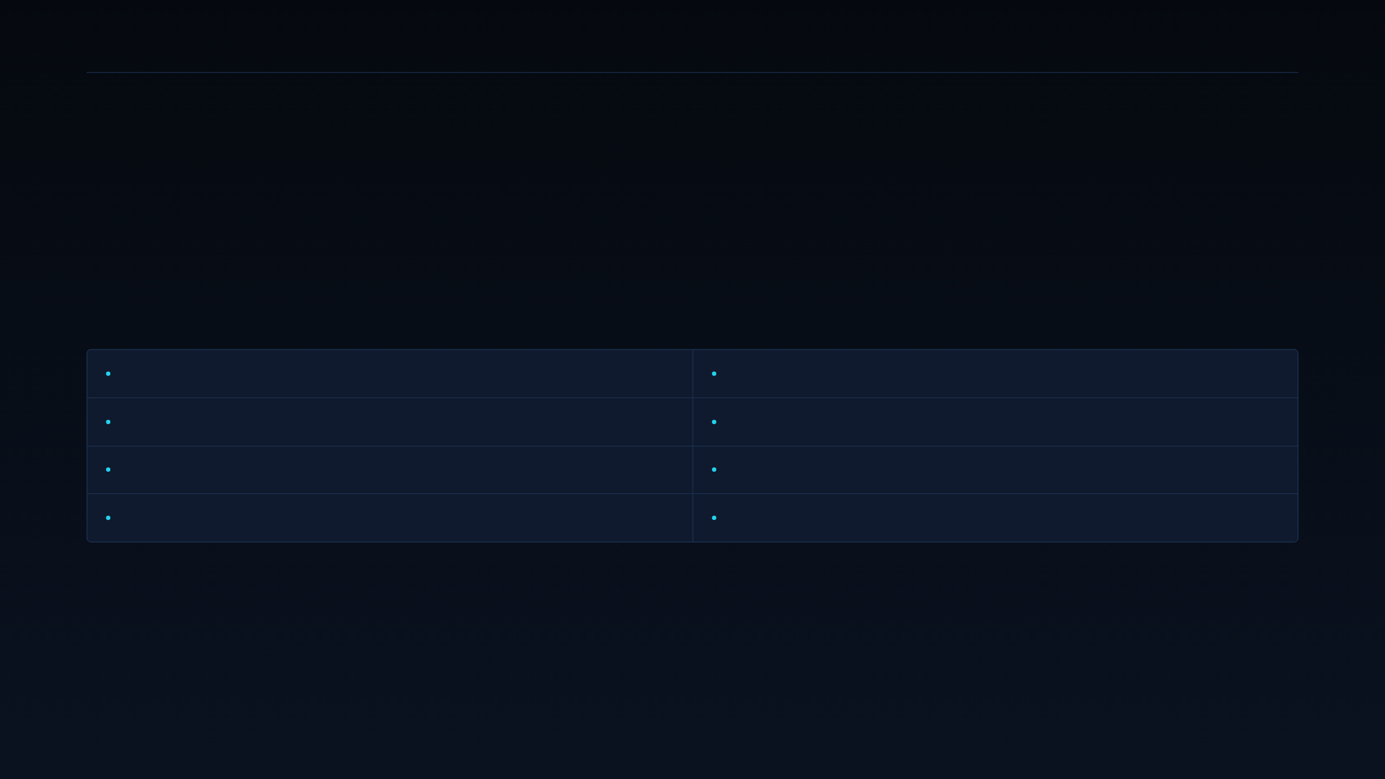
43 · SOURCES
DEEPGRID SEMI · PRE-SERIES A
Where the numbers come from.
Every figure in this deck traces to one of these; the evidence ledger carries the row-level detail.
Business Plan v2 workbook — P&L, Use of Funds, Assumptions, CGTMSE sheets
Reviewed Pre-Series A analysis — 132-row evidence ledger
Tapeout Expenses sheet — NRE line-item build-up and MPW phasing
Supplier die-cost quotation — TSMC 28 nm HPC+ at 1M chips
Information Memorandum, July 2026 — architecture, team, mandate dates
MoRTH AIS standards — AIS-184, 186, 187, 188, 189, 190
Competitor public disclosures — Aurora, Kodiak, Gatik, DeepWay
Domestic semiconductor funding announcements — Netrasemi, Mindgrove, Agnit
43 · SOURCES
Not an offer to sell securities · For discussion only

