Slide 1

EVE // OPS BRIEF
/
A PRODUCTION AGENT IS JUST A FOLDER OF FILES
01 / 13 · THESIS
VERDICT · 2026 · VERCEL SHIP LONDON
A production agent is now
just a folder of files.
Vercel’s Eve is “Next.js for agents” — Markdown for instructions and skills, TypeScript for tools, durable by default. eve build compiles a directory into a deployed service.
LICENSE
STATUS
LAUNCHED
REPO
STARS
Apache 2.0
Public beta
Jun 2026
github.com/vercel/eve
~3.8k
Open source
APIs still moving
Vercel Ship London
Public
Since launch
OPS BRIEF · CONFIDENTIAL
·
FOR TECHNICAL LEADERS EVALUATING AGENT STACKS
SLIDE 01

Slide 2

EVE // OPS BRIEF
/
THE SHIFT, UP FRONT
02 / 13
THE SHIFT, UP FRONT
Three ideas collapse the build‑vs‑reliability trade-off.
Filesystem‑first ease meets production‑grade rigor — without picking one.
01
02
03
The agent IS a directory.
One eve build wires it all.
Production ships in the box.
Instructions, skills, tools, subagents and channels are just files at conventional paths. agent/ IS the source of truth.
Discovers files, validates types, compiles a single manifest of tools, skills and channels. No imports. No registration. No glue.
Durability. Sandbox. Human approvals. Evals as a deploy gate. One vercel deploy — same directory, live over HTTP + Slack.
FILE-SYSTEM · CONVENTION
COMPILE · MANIFEST
DURABLE · GATED · DEPLOYED
PATTERN > PRODUCT · DIRECTORY-AS-AGENT
SLIDE 02

Slide 3

EVE // OPS BRIEF
/
THE OLD TRADE-OFF
03 / 13
BEFORE EVE
You picked easy or you picked production.
You didn’t get both.
OPTION A · FILESYSTEM-FIRST
OPTION B · PRODUCTION FRAMEWORK
Easy. Personal‑scale.
Reliable. Heavy to wire.
A folder of files. Add a Markdown file, get a capability. Great on a laptop.
Real durability and controls — if you accept the vendor’s runtime, SDKs and lock‑in.
WHAT’S MISSING
WHAT YOU PAY IN
✕ Durability
✕ Sandbox
• Registration boilerplate
• Runtime lock‑in
✕ Approvals
✕ Evals
• SDK sprawl
• Ops config
✕ Deploy target
✕ Multi‑channel
• Weeks of glue
• Migration risk
Eve’s move: keep the ease of the folder — put the production layer in the box. The trade-off is gone.
DIAGNOSIS · WHY BUILDERS HAD TO CHOOSE
SLIDE 03

Slide 4
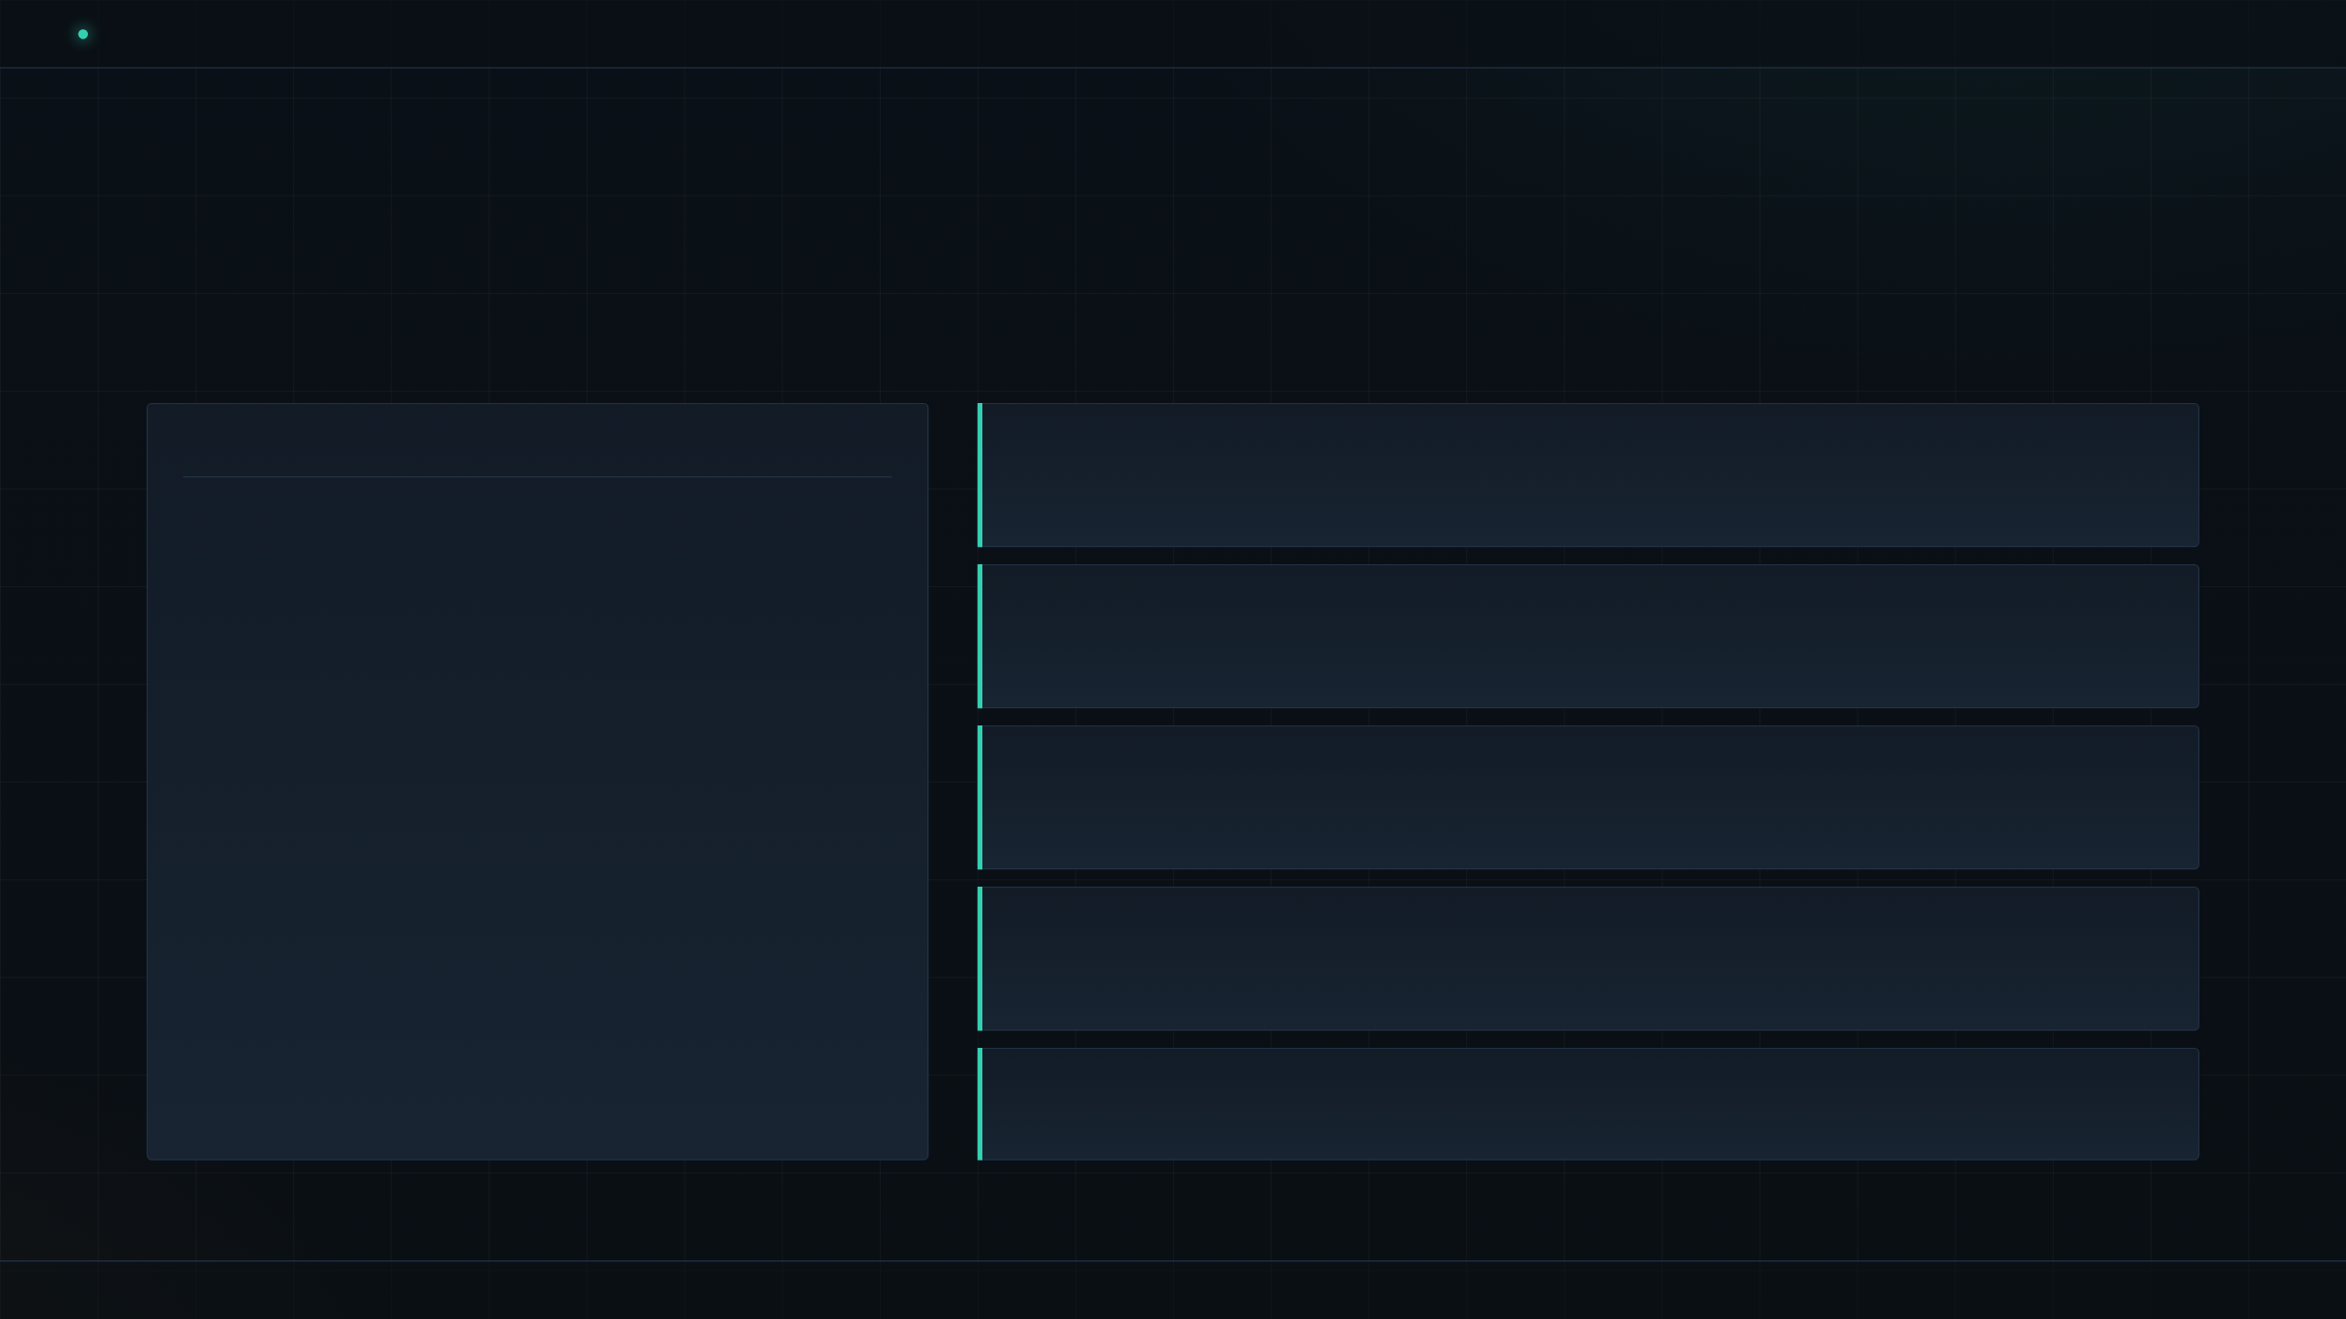
EVE // OPS BRIEF
/
THE AGENT IS A DIRECTORY
04 / 13
MODEL · CONVENTION OVER CONFIGURATION
Each capability is a file at a known path.
AGENT/ — SOURCE OF TRUTH
instructions.md
Always‑on system prompt
agent/
├── instructions.md # always-on prompt
├── tools/
│ ├── run_sql.ts # => tool "run_sql"
│ ├── list_orders.ts
│ └── post_to_slack.ts
├── skills/
│ ├── refund-policy.md # on-demand playbook
│ └── sql-style-guide.md
├── subagents/
│ └── reviewer.ts # own context
└── channels/
├── http.ts
├── slack.ts
├── discord.ts
└── github.ts
The agent’s identity, rules and defaults — one Markdown file.
tools/*.ts
One typed TypeScript function per file
Filename becomes the tool name. run_sql.ts ⇒ tool run_sql. Nothing to register.
skills/*.md
Markdown playbooks, loaded on demand
Domain knowledge kept out of the base prompt — pulled in when it’s needed.
subagents/*.ts
Child agents with their own context
Delegate scoped work — a reviewer, a planner — without polluting the parent’s window.
channels/*.ts
Entry points: HTTP · Slack · Discord · GitHub
PATH = CAPABILITY · FILENAME = NAME
SLIDE 04

Slide 5

EVE // OPS BRIEF
/
ONE BUILD WIRES IT
05 / 13
COMPILE STEP
eve build discovers, validates, compiles — one manifest.
INPUT
STEP
OUTPUT
The agent/ directory
$ eve build
One manifest
agent/
├─ instructions.md
├─ tools/ (N files)
├─ skills/ (N files)
├─ subagents/ (N files)
└─ channels/ (N files)
01
Discover — walk conventional paths
{
"tools": [ … ],
"skills": [ … ],
"channels": [ … ],
"subagents":[ … ]
}
02
Validate — TypeScript types + schemas
03
Compile — emit one wired manifest
04
Bind — channels → tools → skills
FILES ON DISK
WIRED & TYPED
CONVENTION OVER CONFIGURATION
File location = capability
Filename = tool name
No imports to keep in sync
No glue to maintain
ZERO REGISTRATION · ZERO CEREMONY
SLIDE 05

Slide 6
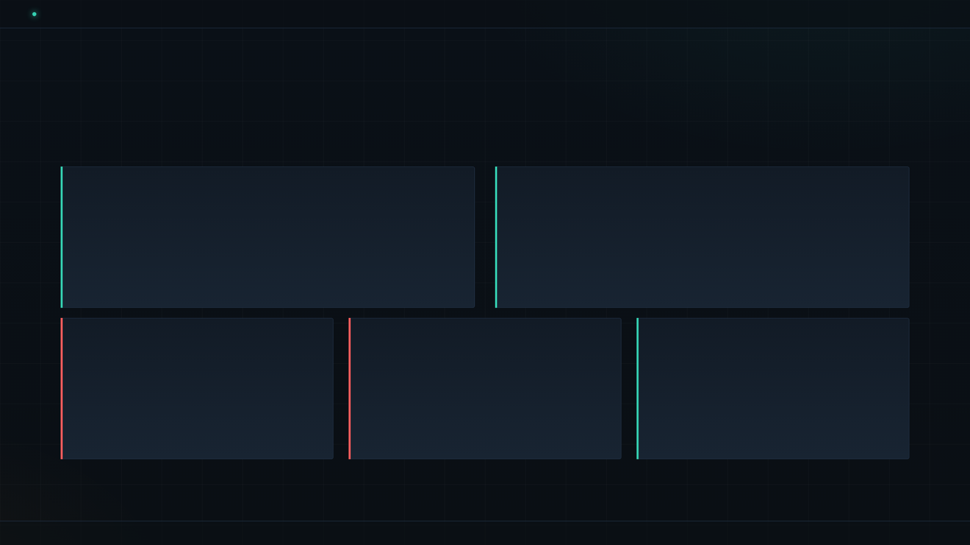
EVE // OPS BRIEF
/
PRODUCTION IN THE BOX
06 / 13
RUNTIME · DEPLOY
The reliability layer ships with the framework.
01 · DURABLE SESSIONS
02 · VERCEL SANDBOX
Checkpointed workflow — survives crashes and redeploys.
Agent‑written code runs isolated — off your machine.
Restarts resume exactly where they stopped. Long-running agents stop being fragile.
Untrusted code stays in a controlled runtime, not your laptop or a shared shell.
03 · APPROVALS
04 · EVALS
05 · ONE DEPLOY
Human-in-the-loop, native.
Deploy gate, not an afterthought.
vercel deploy — live over HTTP & Slack.
Risky tool calls pause and wait for a human Allow. Built in, not bolted on.
Evals sit on the deploy path. Regressions stop the release before users see them.
Same directory, prod.
Net: the operational surface an internal team actually needs — delivered as defaults, not homework.
DURABLE · SANDBOXED · GATED · EVALUATED · DEPLOYED
SLIDE 06

Slide 7
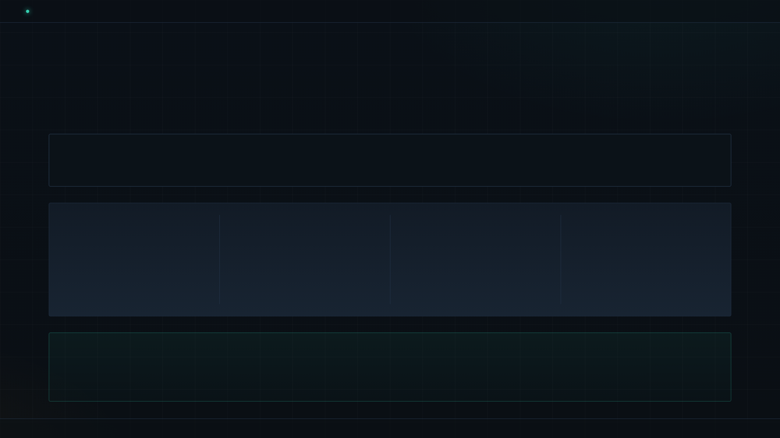
EVE // OPS BRIEF
/
YOU DON’T HAND-CODE IT
07 / 13
AUTHOR WORKFLOW · CODING AGENT AS BUILDER
Scaffold, build, test, deploy — by prompting.
ONE COMMAND
$ npx plugins add vercel/vercel-plugin
KNOWLEDGE
DELEGATION
ERGONOMICS
CORRECTNESS
47+
3
5
Real-time
Code validation
Skills
Specialist agents
Slash commands
Wrong shapes fail as you type — before you ship.
Over a relational knowledge graph of Eve’s APIs and patterns.
Scoped sub‑agents your coding assistant can hand work to.
Shortcuts for the common scaffold‑test‑ship loop.
VERDICT
One plugin turns your coding agent into an Eve builder. The framework isn’t what you learn — it’s what your assistant already knows.
PROMPT > TYPE · META‑TOOLING IN THE BOX
SLIDE 07

Slide 8
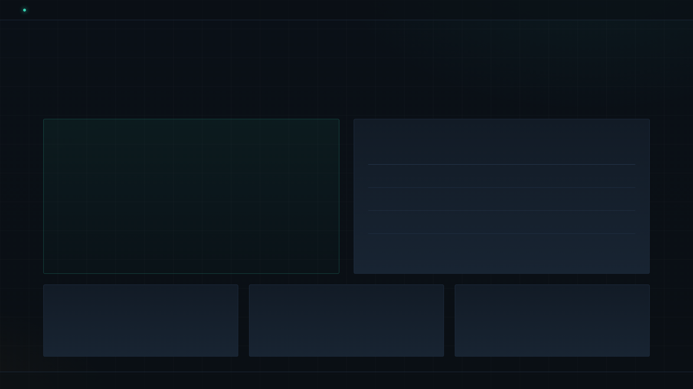
EVE // OPS BRIEF
/
PROOF · THE EVE-ANALYST
08 / 13
PROOF POINT · BUILT BY PROMPT
A production‑shaped data agent — built by prompting.
ANSWER · RUN_SQL(…)
WAREHOUSE — ROW COUNTS
Total all-time revenue
Net of refunds · Test accounts excluded · Paid/fulfilled only
TABLE
ROWS
customers
14
$17,057.90
products
10
orders
96
Auditable: the agent showed the exact SQL it ran to get here.
order_items
194
MODEL
TOOL
SYSTEM PROMPT
Claude Sonnet 5
run_sql is read-only
“Always show the SQL you ran so the answer is auditable.”
Chosen per agent — not the framework.
Single SELECT only. No writes. Ever.
PROOF · SMALL DATA, PRODUCTION SHAPE
SLIDE 08

Slide 9
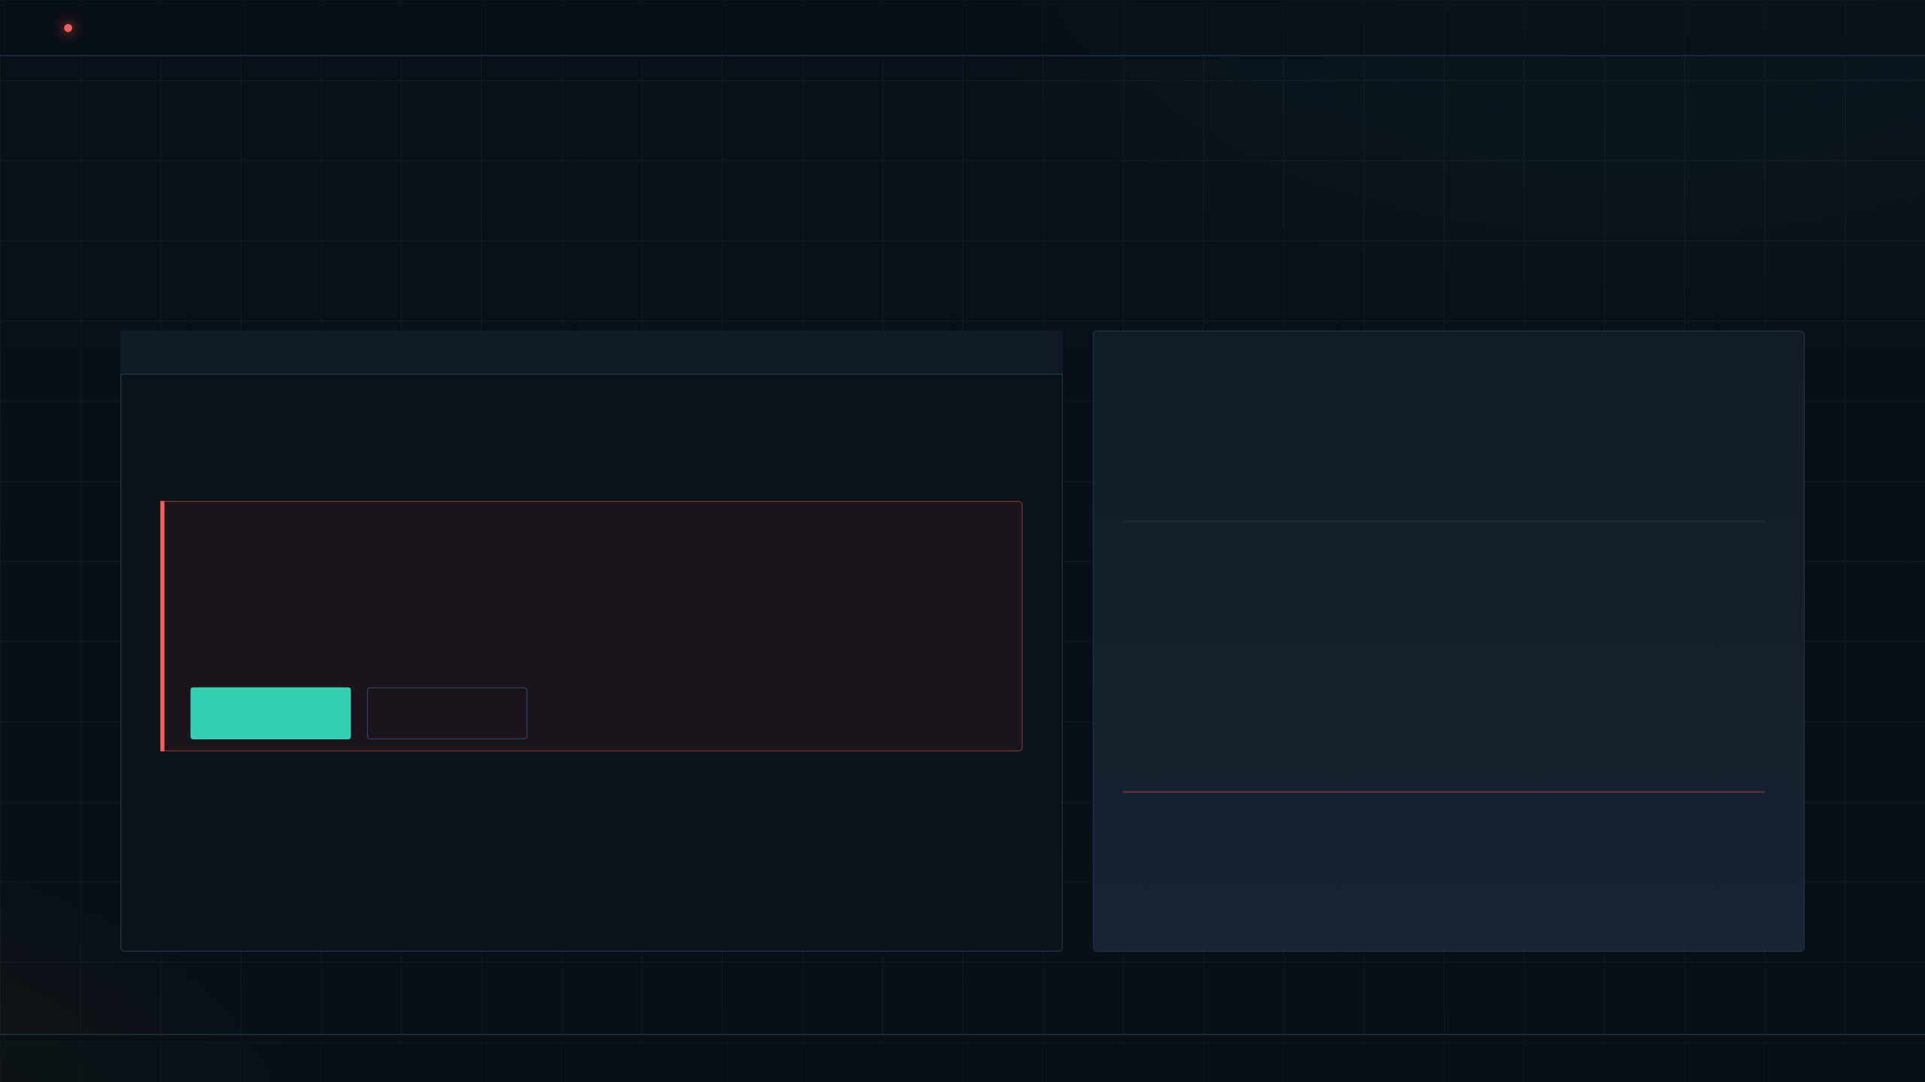
EVE // OPS BRIEF
/
HUMAN IN THE LOOP
09 / 13
GATE · TRUST BOUNDARY
Full power — gated exactly where it counts.
#ANALYTICS · EVE‑ANALYST · SLACK
THE TRUST BOUNDARY
@dana · 10:42
The setup that lets an internal team trust an agent in production.
run SELECT * FROM order_items
⚠ APPROVAL REQUIRED
✓
Risky tool calls pause automatically
Full-table scan detected on order_items (194 rows)
query: SELECT * FROM order_items;
✓
Approval happens in the channel — not a console
Waiting for a human Allow before running. Nothing has executed.
✓
Workflow resumes exactly where it paused
ALLOW
DENY
✓
The reviewer — and the decision — is logged
status: PENDING · workflow paused · durable checkpoint held
DISCIPLINE
Locking the agent down so it cannot act is safe — and useless.
Approvals let you keep the power on, and put a human on the trigger where it matters.
APPROVAL AS FIRST‑CLASS PRIMITIVE
SLIDE 09

Slide 10
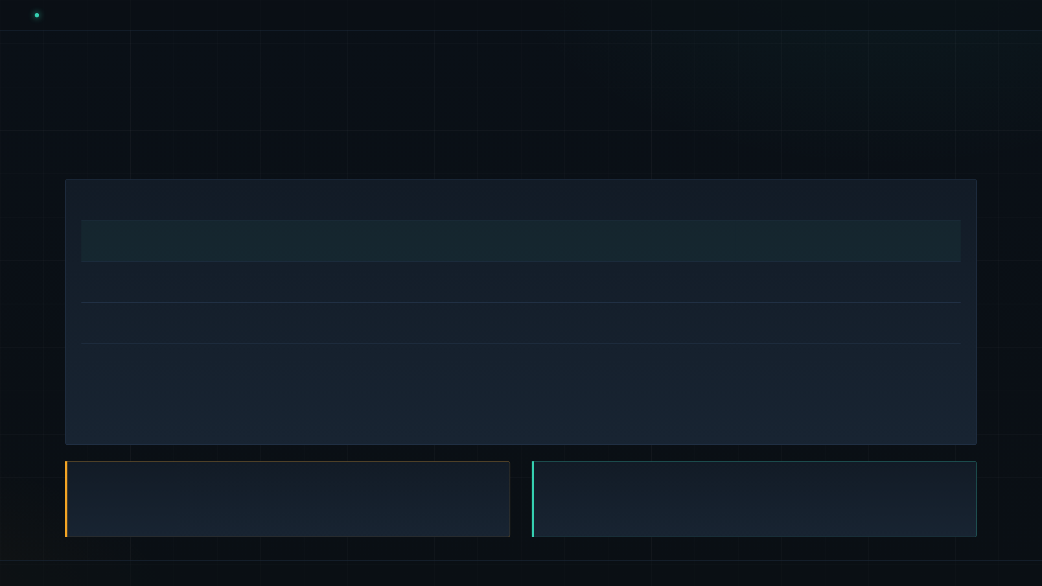
EVE // OPS BRIEF
/
WHERE EVE SITS
10 / 13
LANDSCAPE · FILESYSTEM-FIRST BET
A filesystem‑first bet in a fast‑filling field.
FRAMEWORK
LANGUAGE
RUNTIME
DURABILITY
POSITION
Eve / Vercel
TypeScript
Vercel-only
Default
Deep Vercel integration
Mastra
TypeScript
Any host
Add-on
Platform‑agnostic
LangGraph
Python
Any host
Configurable
Most established
Inngest AgentKit
TypeScript
Any host
Default
Durable workflows
THE COST
THE BET
Eve trades portability for integration.
The directory‑as‑agent pattern is the bet — not necessarily Eve itself.
Vercel-only today. Rivals run anywhere.
Adopt the pattern; keep the vendor decision reversible.
PATTERN OVER PRODUCT
SLIDE 10

Slide 11
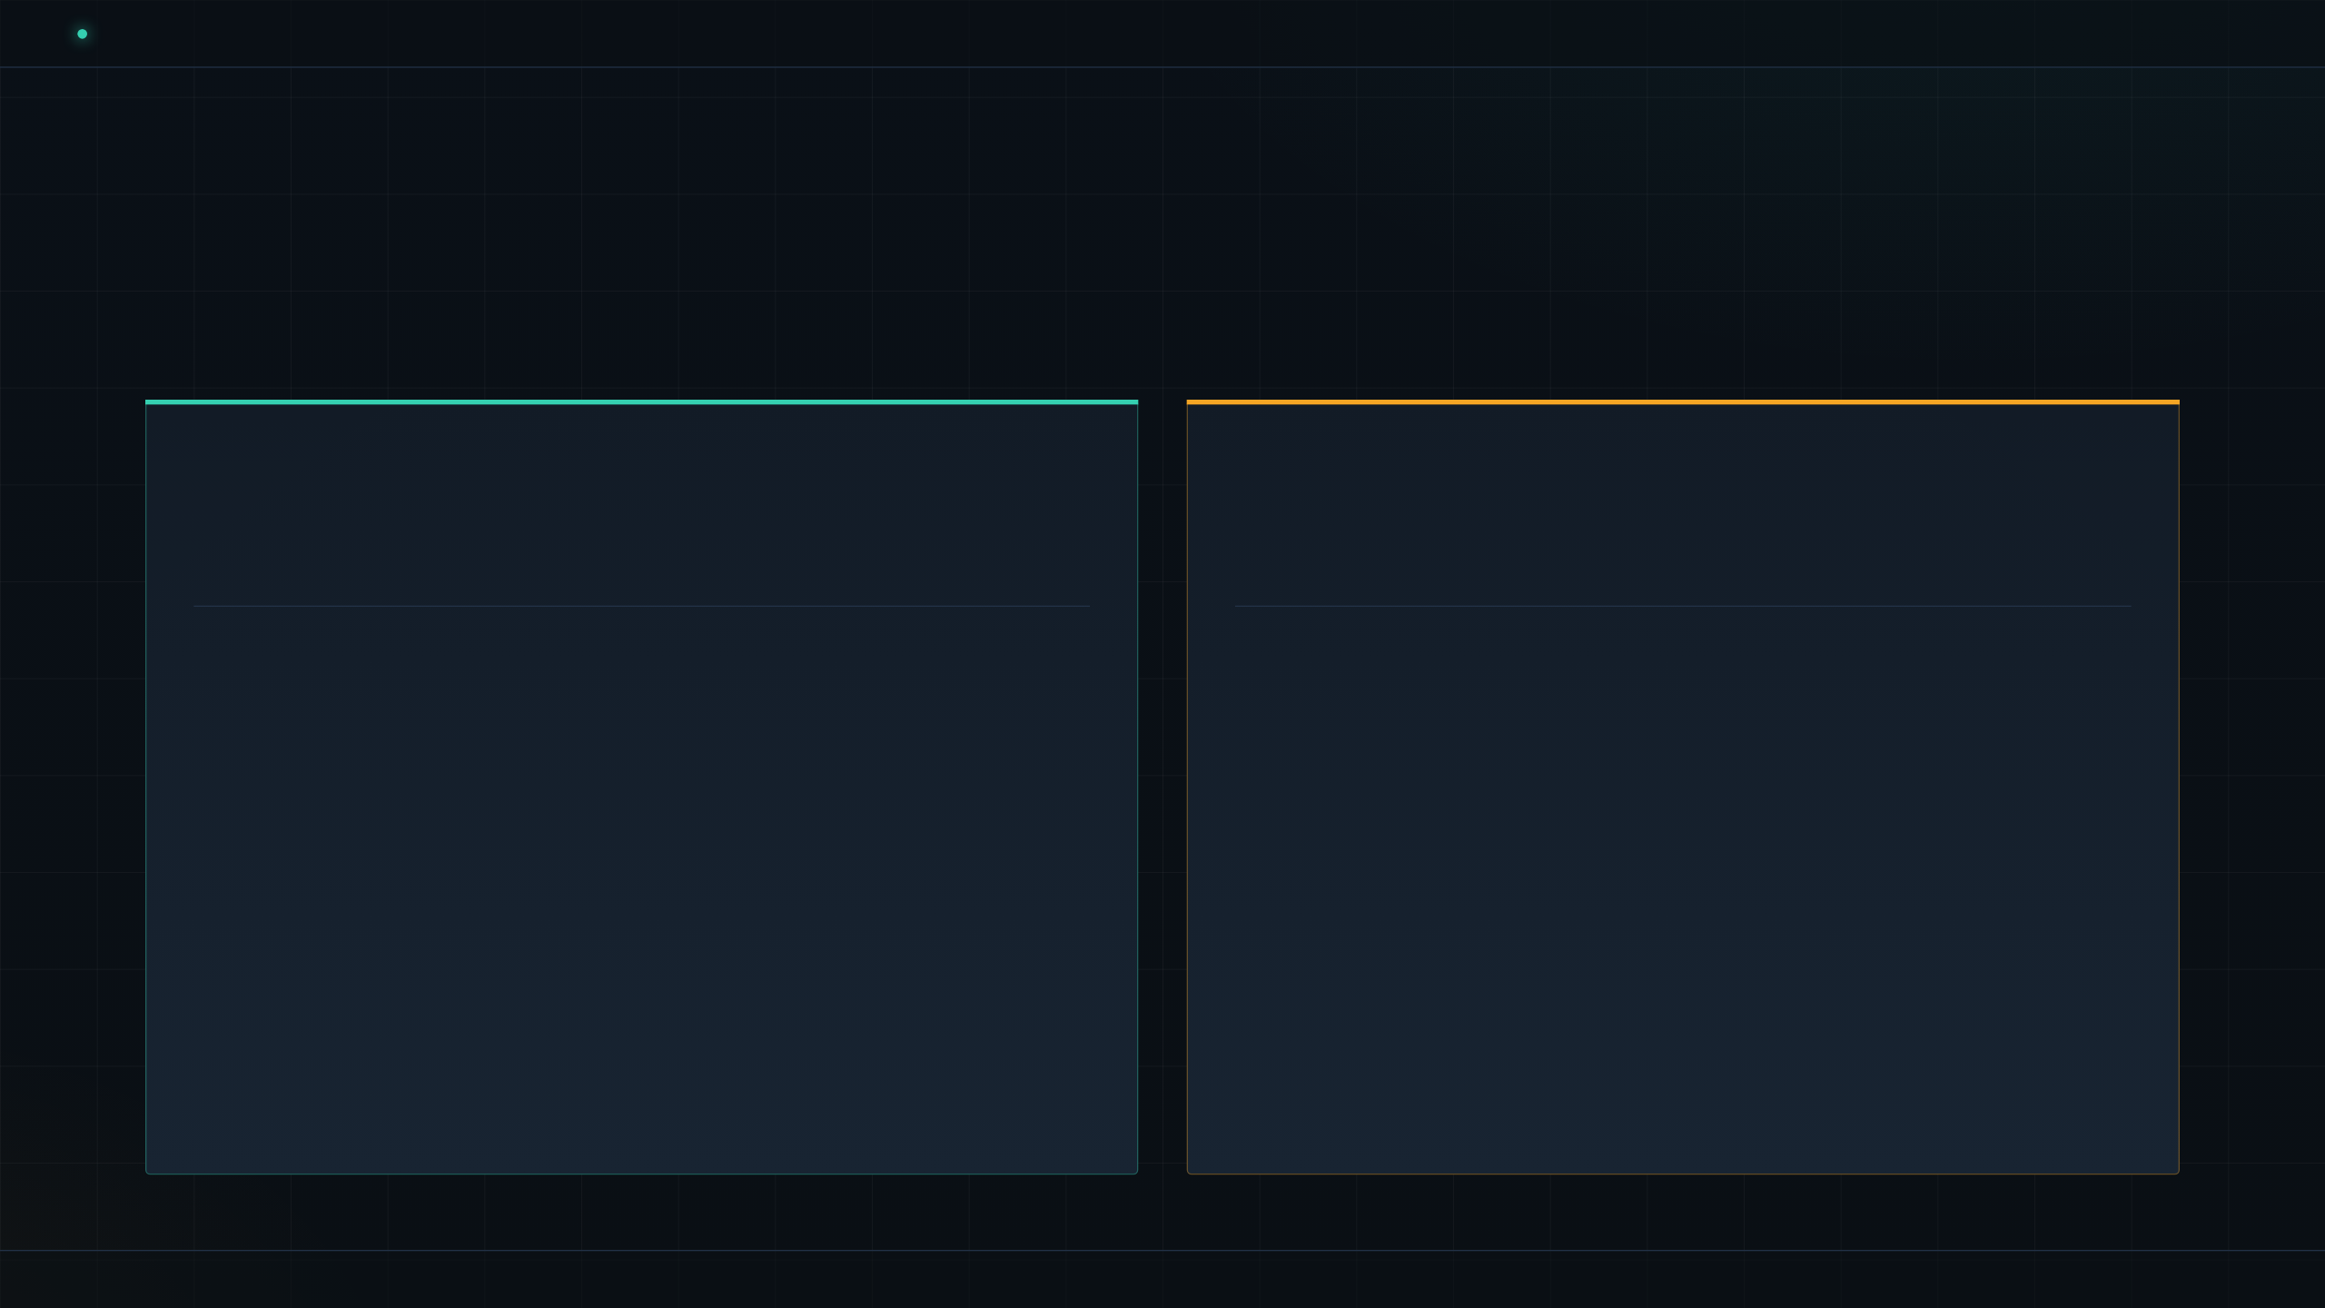
EVE // OPS BRIEF
/
READ THE FINE PRINT
11 / 13
TIMING CALL
Move now — or wait? Both cases are real.
MOVE NOW
WAIT
The pattern will win.
Beta receipts to read.
✓
Where production agents are heading.
Directory-as-agent is the direction of travel.
!
Vercel-only at launch.
No other runtime today — portability isn’t on offer.
✓
Reliability layer is genuinely in the box.
Durability, sandbox, approvals, evals — defaults, not homework.
!
Public beta with moving APIs.
Expect churn between releases.
✓
One plugin makes it fast to try.
Prompt your coding agent into a working Eve app.
!
“Scale” is design intent, not a benchmark.
No published load or SLO numbers yet.
!
Launch coverage was vendor-framed.
Independent field reports are still thin.
NO HEDGING — JUST THE TWO LEDGERS
SLIDE 11

Slide 12
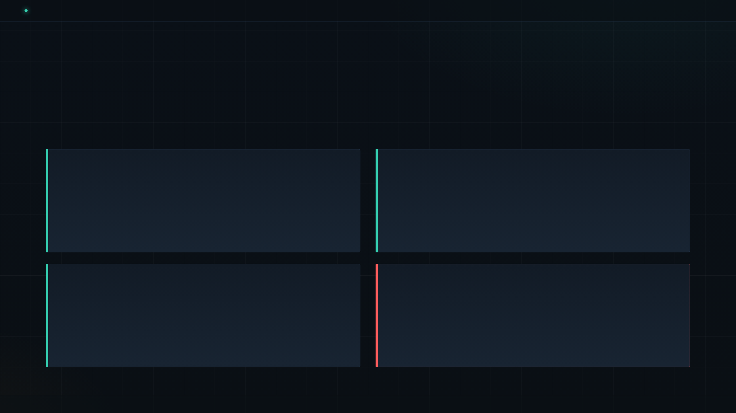
EVE // OPS BRIEF
/
THE MOVE
12 / 13
PLAYBOOK
Pilot the pattern on one bounded workflow.
Clear owner. Slack surface. Rules encoded as skills. Risky calls gated by approvals and evals.
01
PICK
02
BUILD
One bounded internal workflow.
Instructions + typed tools + one skill.
Clear owner. Real users. Slack as the surface. Not a customer-facing agent — yet.
instructions.md + a few tools/*.ts + one skills/*.md. Let the plugin scaffold.
03
ENCODE
04
GATE & WIDEN
Rules that must stay consistent → Markdown.
Approvals + eval suite before widening access.
Refund policy, SQL style, escalation path. One .md per rule — readable, review-able, diffable.
Risky actions require a human click. An eval suite blocks regressions on deploy. Then open the door.
Ship a pilot in weeks, not a platform in quarters.
ONE OWNER · ONE SURFACE · ONE GATE
SLIDE 12

Slide 13
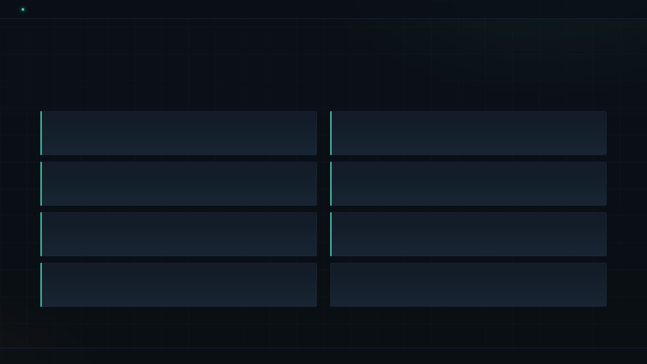
EVE // OPS BRIEF
/
SOURCES
13 / 13
REFERENCES
Sources.
01
05
Vercel — “Introducing eve”
GitHub — vercel/eve
Launch blog and changelog — the framework announcement.
Repo, releases, README — the primary source of truth.
vercel.com/blog
github.com/vercel/eve
02
06
Vercel Docs — eve reference
eve.dev — landing page
API surface, conventions, deployment model.
Positioning, quickstart, screenshots.
vercel.com/docs/eve
eve.dev
03
07
The New Stack — “Vercel launches eve”
eve-analyst — product walkthrough
Independent write-up: agents as directories.
Reference agent shown in the launch; source of the $17,057.90 figure.
thenewstack.io
vercel/eve — examples/eve-analyst
04
NOTE
Morningstar / BusinessWire — Vercel Ship
Figures reflect the brief provided for this deck; verify against live docs and the eve.dev landing before external use.
Ship London 2026 announcement coverage.
morningstar.com · businesswire.com
END OF BRIEF · EVE — A PRODUCTION AGENT IS JUST A FOLDER OF FILES
SLIDE 13

