Slide 1
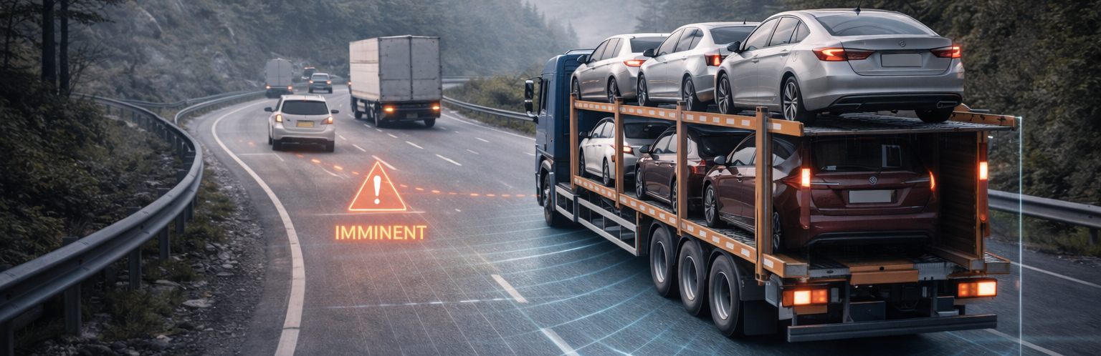
EXECUTIVE SUMMARY
The immediate India field competitor—and the most plausible radar-fusion partner
Starkenn · management posture: PARTNER + COUNTER
WHY IT MATTERS
Company reports 2,500+ vehicles and deployment across mining, fleet and commercial use
WHERE IT WINS
Government · mining · retrofit
WHAT IS NOT PROVEN
AIS-162 type approval and independent homologation remain unverified
PARTNER + COUNTER
Partner for radar and field access; counter only where vision VRU proof and lifecycle economics are visible
DEEPGRID POSITION
EXECUTIVE DECISION
PARTNER + COUNTER · Evidence confidence: MEDIUM · Release resources only against a named buyer, proof metric and dated gate.
DEEPGRID SEMI · INDIA ADAS COMPETITOR DOSSIER · CONFIDENTIAL
01
Notes:
Executive summary for Starkenn. Verdict: The immediate India field competitor—and the most plausible radar-fusion partner. Evidence: starkenn.com/brakesafe · starkenn.com/mining · company claims, accessed Aug 2026. Boundary: AIS-162 type approval and independent homologation remain unverified

Slide 2
COMPETITOR PROFILE
Starkenn owns the strongest India field narrative—but not the perception-silicon control point
Starkenn · strongest arena: Government · mining · retrofit
WHAT THEY SELL
Radar-led BrakeSafe AEBS plus mining safety and fleet analytics
OPERATING PROOF
Company reports 2,500+ vehicles and deployment across mining, fleet and commercial use
BUYER ARENA
Government · mining · retrofit
EVIDENCE BOUNDARY
AIS-162 type approval and independent homologation remain unverified
SOURCE-DERIVED VISUAL
starkenn.com/brakesafe · starkenn.com/mining · company claims, accessed Aug 2026
DEEPGRID RESPONSE
Partner for radar and field access; counter only where vision VRU proof and lifecycle economics are visible
THREAT
HIGH
DEEPGRID SEMI · INDIA ADAS COMPETITOR DOSSIER · CONFIDENTIAL
02
Notes:
Evidence status and sources: starkenn.com/brakesafe · starkenn.com/mining · company claims, accessed Aug 2026
Boundary: AIS-162 type approval and independent homologation remain unverified
Response: Partner for radar and field access; counter only where vision VRU proof and lifecycle economics are visible

Slide 3
COMPETITOR ANATOMY
Starkenn connects radar-led AEB to fleet operations—field integration is its advantage
What it does · customer focus · technology stack · operating model
TECHNOLOGY & DELIVERY STACK
WHAT IT IS
OPERATING PROOF
India-native vehicle-safety integrator built around retrofit collision mitigation for heavy vehicles, with mining and government fleets as its most visible beachhead.
01
77 GHz / long-range radar sensing
Company reports 2,500+ fitted vehicles and deployments spanning mining, fleet and commercial use.
↓
02
BrakeSafe collision logic and AEB intervention
↓
CUSTOMER & USE-CASE FOCUS
03
Vehicle CAN / brake interface and retrofit fitment
Commercial vehicles, mine haulage, buses and fleet operators that need a locally installed safety layer without waiting for a new-vehicle programme.
↓
04
Attention DMS, Terralock and load / alcohol modules
WHAT REMAINS UNKNOWN
↓
05
Stark-I fleet telemetry and analytics
Independent AIS-162 type approval, production-grade safety architecture and named OEM nomination are not evidenced.
HOW IT MAKES MONEY / SCALES
Sell a fitted system plus adjacent fleet-safety modules; use field access, installation capability and local service to expand account value.
SO WHAT FOR DEEPGRID
Partner for radar and field access; counter only where vision VRU proof and lifecycle economics are visible
DEEPGRID SEMI · INDIA ADAS COMPETITOR DOSSIER · CONFIDENTIAL
03
Notes:
Detailed competitor narrative for Starkenn. Source basis: starkenn.com/brakesafe · starkenn.com/mining · company claims, accessed Aug 2026. Company-attributed claims remain bounded by: Independent AIS-162 type approval, production-grade safety architecture and named OEM nomination are not evidenced.

Slide 4
THREAT MECHANISM
Starkenn wins only if its control point becomes the buyer’s deciding criterion
Threat mechanism → falsifier → management action
01
02
03
BUYER DECISION Government · mining · retrofit
CONTROL POINT
→
CONVERSION MECHANISM
→
DISPLACEMENT RISK
150 m radar → Fleet analytics
Government · mining · retrofit
DeepGrid sits outside the chosen programme boundary
The threat becomes material only when this arena—not standalone perception—sets the supplier decision.
WHY THIS MATTERS
The buyer can prefer Starkenn when government · mining · retrofit matters more than standalone perception ownership.
FALSIFIER
AIS-162 type approval and independent homologation remain unverified
MANAGEMENT ACTION
Partner for radar and field access; counter only where vision VRU proof and lifecycle economics are visible
DEEPGRID SEMI · INDIA ADAS COMPETITOR DOSSIER · CONFIDENTIAL
04
Notes:
Threat mechanism for Starkenn. Fact boundary: AIS-162 type approval and independent homologation remain unverified. Source: starkenn.com/brakesafe · starkenn.com/mining · company claims, accessed Aug 2026

Slide 5
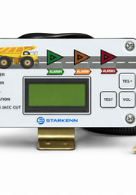
PRODUCT & CONTROL POINTS
Starkenn packages five control points—but only some create a defensible moat
Follow the system from sensing to the buyer relationship
01
02
03
04
05
150 m radar
→
BrakeSafe AEBS
→
Vehicle integration
→
Mining safety stack
→
Fleet analytics
WHERE VALUE ACCRUES
Radar-led BrakeSafe AEBS plus mining safety and fleet analytics
DEEPGRID OPENING
Partner for radar and field access; counter only where vision VRU proof and lifecycle economics are visible
SALES MESSAGE
Do not sell against the whole stack; isolate the control point that Starkenn cannot defend economically or locally.
DEEPGRID SEMI · INDIA ADAS COMPETITOR DOSSIER · CONFIDENTIAL
05
Notes:
Product chain synthesis for Starkenn. Source: starkenn.com/brakesafe · starkenn.com/mining · company claims, accessed Aug 2026. Interpretation is bounded by: AIS-162 type approval and independent homologation remain unverified

Slide 6
BUYER BATTLECARD
Starkenn wins on india field access—and breaks at three proof or control boundaries
Sales battlecard: concede what is true, then move the buying criterion
CONCEDE
CHALLENGE
01
India field access
01
Homologation not evidenced
02
Harsh-environment radar
02
Merchant-silicon economics
03
Retrofit installation
03
No disclosed OEM nomination
EVIDENCE BOUNDARY
AIS-162 type approval and independent homologation remain unverified
REFRAME
Partner for radar and field access; counter only where vision VRU proof and lifecycle economics are visible
DEEPGRID SEMI · INDIA ADAS COMPETITOR DOSSIER · CONFIDENTIAL
06
Notes:
Sales battlecard for Starkenn. Concessions are evidence-aligned. Challenges must not be stated as disqualifications without buyer validation. Source: starkenn.com/brakesafe · starkenn.com/mining · company claims, accessed Aug 2026

Slide 7
SALES PLAY
DeepGrid can change the Starkenn conversation with three persona-specific moves
Lead with the buyer’s objective; end with a measurable proof request
BUSINESS / PROCUREMENT
HSE: add vision-classified VRUs
PROOF ASK
Lifecycle cost + local support
CHIEF ENGINEER
Engineering: fuse camera + radar
PROOF ASK
Same-ODD benchmark + integration effort
PROGRAMME / SAFETY
Procurement: compare lifecycle compute
PROOF ASK
Named responsibility matrix + release gate
STOP / ESCALATE
Escalate only when the buyer values DeepGrid’s bounded perception advantage and accepts the evidence plan.
NEXT MEETING OUTPUT
A named owner, a vehicle or programme, the comparison metric, data rights and a dated go / no-go gate.
DEEPGRID SEMI · INDIA ADAS COMPETITOR DOSSIER · CONFIDENTIAL
07
Notes:
Persona sales play for Starkenn. Response: Partner for radar and field access; counter only where vision VRU proof and lifecycle economics are visible. Evidence boundary: AIS-162 type approval and independent homologation remain unverified

Slide 8
USE-CASE CONCLUSION
Starkenn is differentiated in three use cases—but each creates a specific DeepGrid opening
Close the competitor discussion with a use-case choice, not a generic threat label
01
MINING AEBS
02
GOVT / PSU RETROFIT
03
CV VRU PROTECTION
BUYER PROBLEM
BUYER PROBLEM
BUYER PROBLEM
Dust, vibration and low visibility
Fast fitment and local service
Pedestrian and cyclist risk
UNIQUE SOLUTION
UNIQUE SOLUTION
UNIQUE SOLUTION
Radar-led BrakeSafe + fleet controls
Made-in-India radar AEBS stack
Radar base; vision remains attach opportunity
WHERE DEEPGRID FITS
Partner for radar and field access; counter only where vision VRU proof and lifecycle economics are visible
COMMERCIAL TEST
Select one named government · mining · retrofit use case; agree the buyer metric, responsibility boundary and 90-day stop / scale gate.
DEEPGRID SEMI · INDIA ADAS COMPETITOR DOSSIER · CONFIDENTIAL
08
Notes:
Use-case conclusion for Starkenn. Use cases: [('MINING AEBS', 'Dust, vibration and low visibility', 'Radar-led BrakeSafe + fleet controls'), ('GOVT / PSU RETROFIT', 'Fast fitment and local service', 'Made-in-India radar AEBS stack'), ('CV VRU PROTECTION', 'Pedestrian and cyclist risk', 'Radar base; vision remains attach opportunity')]. DeepGrid response: Partner for radar and field access; counter only where vision VRU proof and lifecycle economics are visible. Source: starkenn.com/brakesafe · starkenn.com/mining · company claims, accessed Aug 2026

Slide 9
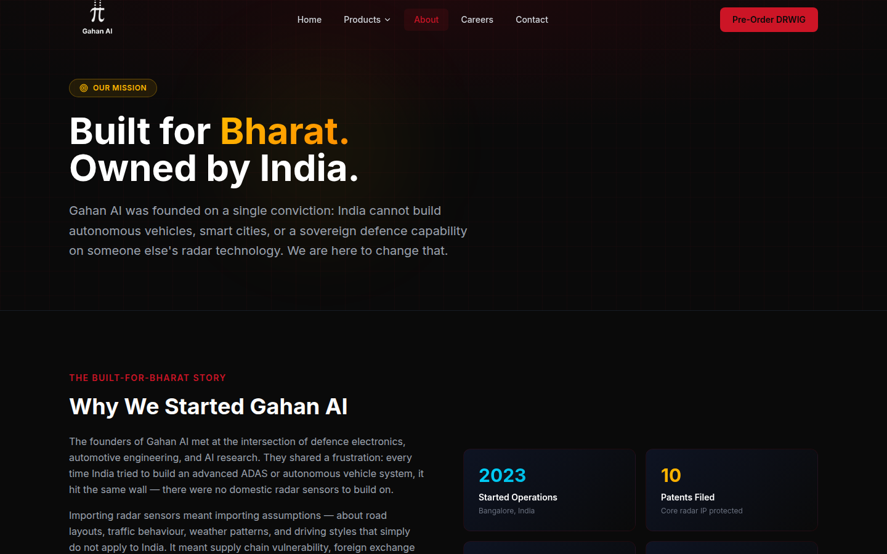
EXECUTIVE SUMMARY
A high-potential domestic radar challenger whose qualification claims must clear diligence
Gahan AI · management posture: VERIFY + BENCHMARK
WHY IT MATTERS
Company claims TRL-8, AEC-Q100 completion, TI partnership and OEM pilots
WHERE IT WINS
OEM qualification · defence · infrastructure
WHAT IS NOT PROVEN
Certificate scope, qualified component and named programme status are not independently evidenced
VERIFY + BENCHMARK
Verify first; benchmark radar weather performance and OEM qualification gates
DEEPGRID POSITION
EXECUTIVE DECISION
VERIFY + BENCHMARK · Evidence confidence: LOW–MED · Release resources only against a named buyer, proof metric and dated gate.
DEEPGRID SEMI · INDIA ADAS COMPETITOR DOSSIER · CONFIDENTIAL
09
Notes:
Executive summary for Gahan AI. Verdict: A high-potential domestic radar challenger whose qualification claims must clear diligence. Evidence: gahanai.com/about · claims are company-attributed, accessed Aug 2026. Boundary: Certificate scope, qualified component and named programme status are not independently evidenced

Slide 10
COMPETITOR PROFILE
Gahan could become the domestic radar benchmark—but its qualification narrative needs primary proof
Gahan AI · strongest arena: OEM qualification · defence · infrastructure
WHAT THEY SELL
DRWIG indigenous 77 GHz radar platform on TI mmWave silicon
OPERATING PROOF
Company claims TRL-8, AEC-Q100 completion, TI partnership and OEM pilots
BUYER ARENA
OEM qualification · defence · infrastructure
EVIDENCE BOUNDARY
Certificate scope, qualified component and named programme status are not independently evidenced
SOURCE-DERIVED VISUAL
gahanai.com/about · claims are company-attributed, accessed Aug 2026
DEEPGRID RESPONSE
Verify first; benchmark radar weather performance and OEM qualification gates
THREAT
HIGH
DEEPGRID SEMI · INDIA ADAS COMPETITOR DOSSIER · CONFIDENTIAL
10
Notes:
Evidence status and sources: gahanai.com/about · claims are company-attributed, accessed Aug 2026
Boundary: Certificate scope, qualified component and named programme status are not independently evidenced
Response: Verify first; benchmark radar weather performance and OEM qualification gates

Slide 11
COMPETITOR ANATOMY
Gahan links indigenous 77 GHz radar to OEM applications—but qualification is the conversion gate
What it does · customer focus · technology stack · operating model
TECHNOLOGY & DELIVERY STACK
WHAT IT IS
OPERATING PROOF
Bengaluru radar venture positioning indigenous automotive sensing as a sovereign alternative for mobility, two-wheelers, infrastructure and defence.
01
TI mmWave radar silicon
Company states TRL-8 maturity, OEM pilots, TI collaboration and automotive qualification progress.
↓
02
DRWIG 77 GHz radar hardware
↓
CUSTOMER & USE-CASE FOCUS
03
Range / velocity / angle and micro-Doppler processing
OEM and strategic programmes that value all-weather ranging, India-owned radar IP and a domestic engineering relationship.
↓
04
Radar perception and object-tracking software
WHAT REMAINS UNKNOWN
↓
05
Vehicle, two-wheeler and infrastructure interfaces
Certificate holder, qualified component, AEC-Q100 scope and named production nomination require primary verification.
HOW IT MAKES MONEY / SCALES
Develop radar modules and perception IP, then convert pilots and qualification claims into OEM or strategic programme design-ins.
SO WHAT FOR DEEPGRID
Verify first; benchmark radar weather performance and OEM qualification gates
DEEPGRID SEMI · INDIA ADAS COMPETITOR DOSSIER · CONFIDENTIAL
11
Notes:
Detailed competitor narrative for Gahan AI. Source basis: gahanai.com/about · claims are company-attributed, accessed Aug 2026. Company-attributed claims remain bounded by: Certificate holder, qualified component, AEC-Q100 scope and named production nomination require primary verification.

Slide 12
THREAT MECHANISM
Gahan AI wins only if its control point becomes the buyer’s deciding criterion
Threat mechanism → falsifier → management action
01
02
03
BUYER DECISION OEM qualification · defence · infrastructure
CONTROL POINT
→
CONVERSION MECHANISM
→
DISPLACEMENT RISK
TI mmWave SoC → Defence / mobility routes
OEM qualification · defence · infrastructure
DeepGrid sits outside the chosen programme boundary
The threat becomes material only when this arena—not standalone perception—sets the supplier decision.
WHY THIS MATTERS
The buyer can prefer Gahan AI when oem qualification · defence · infrastructure matters more than standalone perception ownership.
FALSIFIER
Certificate scope, qualified component and named programme status are not independently evidenced
MANAGEMENT ACTION
Verify first; benchmark radar weather performance and OEM qualification gates
DEEPGRID SEMI · INDIA ADAS COMPETITOR DOSSIER · CONFIDENTIAL
12
Notes:
Threat mechanism for Gahan AI. Fact boundary: Certificate scope, qualified component and named programme status are not independently evidenced. Source: gahanai.com/about · claims are company-attributed, accessed Aug 2026

Slide 13
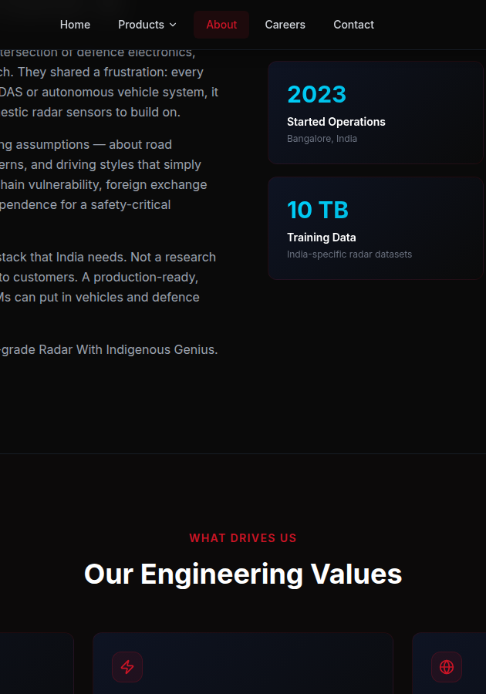
PRODUCT & CONTROL POINTS
Gahan AI packages five control points—but only some create a defensible moat
Follow the system from sensing to the buyer relationship
01
02
03
04
05
TI mmWave SoC
→
DRWIG radar
→
Radar perception
→
OEM qualification claim
→
Defence / mobility routes
WHERE VALUE ACCRUES
DRWIG indigenous 77 GHz radar platform on TI mmWave silicon
DEEPGRID OPENING
Verify first; benchmark radar weather performance and OEM qualification gates
SALES MESSAGE
Do not sell against the whole stack; isolate the control point that Gahan AI cannot defend economically or locally.
DEEPGRID SEMI · INDIA ADAS COMPETITOR DOSSIER · CONFIDENTIAL
13
Notes:
Product chain synthesis for Gahan AI. Source: gahanai.com/about · claims are company-attributed, accessed Aug 2026. Interpretation is bounded by: Certificate scope, qualified component and named programme status are not independently evidenced

Slide 14
BUYER BATTLECARD
Gahan AI wins on indigenous radar narrative—and breaks at three proof or control boundaries
Sales battlecard: concede what is true, then move the buying criterion
CONCEDE
CHALLENGE
01
Indigenous radar narrative
01
Qualification scope unclear
02
Weather resilience
02
No public production nomination
03
Claimed OEM pilots
03
Claims mostly self-published
EVIDENCE BOUNDARY
Certificate scope, qualified component and named programme status are not independently evidenced
REFRAME
Verify first; benchmark radar weather performance and OEM qualification gates
DEEPGRID SEMI · INDIA ADAS COMPETITOR DOSSIER · CONFIDENTIAL
14
Notes:
Sales battlecard for Gahan AI. Concessions are evidence-aligned. Challenges must not be stated as disqualifications without buyer validation. Source: gahanai.com/about · claims are company-attributed, accessed Aug 2026

Slide 15
SALES PLAY
DeepGrid can change the Gahan AI conversation with three persona-specific moves
Lead with the buyer’s objective; end with a measurable proof request
BUSINESS / PROCUREMENT
OEM: verify certificate scope
PROOF ASK
Lifecycle cost + local support
CHIEF ENGINEER
Engineering: benchmark monsoon clutter
PROOF ASK
Same-ODD benchmark + integration effort
PROGRAMME / SAFETY
Board: monitor qualification conversion
PROOF ASK
Named responsibility matrix + release gate
STOP / ESCALATE
Escalate only when the buyer values DeepGrid’s bounded perception advantage and accepts the evidence plan.
NEXT MEETING OUTPUT
A named owner, a vehicle or programme, the comparison metric, data rights and a dated go / no-go gate.
DEEPGRID SEMI · INDIA ADAS COMPETITOR DOSSIER · CONFIDENTIAL
15
Notes:
Persona sales play for Gahan AI. Response: Verify first; benchmark radar weather performance and OEM qualification gates. Evidence boundary: Certificate scope, qualified component and named programme status are not independently evidenced

Slide 16
USE-CASE CONCLUSION
Gahan AI is differentiated in three use cases—but each creates a specific DeepGrid opening
Close the competitor discussion with a use-case choice, not a generic threat label
01
OEM FRONT RADAR
02
TWO-WHEELER SAFETY
03
DEFENCE / INFRA
BUYER PROBLEM
BUYER PROBLEM
BUYER PROBLEM
All-weather ranging
Dense mixed traffic
Sovereign sensing
UNIQUE SOLUTION
UNIQUE SOLUTION
UNIQUE SOLUTION
DRWIG 77 GHz radar platform
Micro-Doppler and proximity claims
India-owned radar narrative
WHERE DEEPGRID FITS
Verify first; benchmark radar weather performance and OEM qualification gates
COMMERCIAL TEST
Select one named oem qualification · defence · infrastructure use case; agree the buyer metric, responsibility boundary and 90-day stop / scale gate.
DEEPGRID SEMI · INDIA ADAS COMPETITOR DOSSIER · CONFIDENTIAL
16
Notes:
Use-case conclusion for Gahan AI. Use cases: [('OEM FRONT RADAR', 'All-weather ranging', 'DRWIG 77 GHz radar platform'), ('TWO-WHEELER SAFETY', 'Dense mixed traffic', 'Micro-Doppler and proximity claims'), ('DEFENCE / INFRA', 'Sovereign sensing', 'India-owned radar narrative')]. DeepGrid response: Verify first; benchmark radar weather performance and OEM qualification gates. Source: gahanai.com/about · claims are company-attributed, accessed Aug 2026

Slide 17
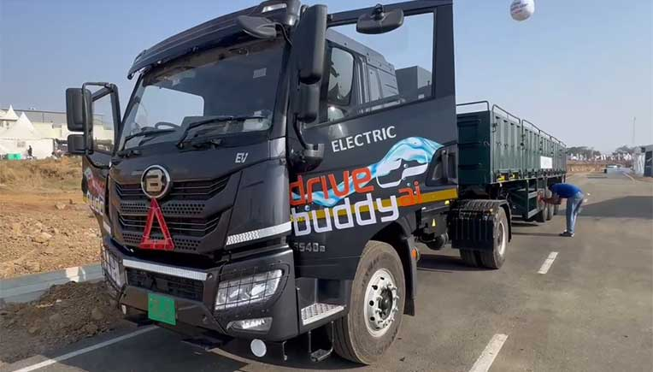
EXECUTIVE SUMMARY
The strongest integrated DMS and fleet-data proposition—not yet proven as an AEBS system owner
drivebuddyAI · management posture: DILIGENCE
WHY IT MATTERS
ARAI-certified AIS-184 DMS; company reports 1bn km data and live HCV demonstrations at ADAS Test City
WHERE IT WINS
Fleet · compliance · HCV demonstration
WHAT IS NOT PROVEN
DMS certification does not establish AEBS type approval or braking accountability
DILIGENCE
Diligence OEM integration and fusion performance; avoid conflating DMS proof with AEBS readiness
DEEPGRID POSITION
EXECUTIVE DECISION
DILIGENCE · Evidence confidence: MED–HIGH · Release resources only against a named buyer, proof metric and dated gate.
DEEPGRID SEMI · INDIA ADAS COMPETITOR DOSSIER · CONFIDENTIAL
17
Notes:
Executive summary for drivebuddyAI. Verdict: The strongest integrated DMS and fleet-data proposition—not yet proven as an AEBS system owner. Evidence: Roadzen investor release · ARAI update · drivebuddyAI demonstration, 2024–2026. Boundary: DMS certification does not establish AEBS type approval or braking accountability

Slide 18
COMPETITOR PROFILE
drivebuddyAI converts Indian-road data into a credible integrated compliance platform
drivebuddyAI · strongest arena: Fleet · compliance · HCV demonstration
WHAT THEY SELL
Camera–radar ADAS, DMS and fleet intelligence in one operating stack
OPERATING PROOF
ARAI-certified AIS-184 DMS; company reports 1bn km data and live HCV demonstrations at ADAS Test City
BUYER ARENA
Fleet · compliance · HCV demonstration
EVIDENCE BOUNDARY
DMS certification does not establish AEBS type approval or braking accountability
SOURCE-DERIVED VISUAL
Roadzen investor release · ARAI update · drivebuddyAI demonstration, 2024–2026
DEEPGRID RESPONSE
Diligence OEM integration and fusion performance; avoid conflating DMS proof with AEBS readiness
THREAT
MEDIUM
DEEPGRID SEMI · INDIA ADAS COMPETITOR DOSSIER · CONFIDENTIAL
18
Notes:
Evidence status and sources: Roadzen investor release · ARAI update · drivebuddyAI demonstration, 2024–2026
Boundary: DMS certification does not establish AEBS type approval or braking accountability
Response: Diligence OEM integration and fusion performance; avoid conflating DMS proof with AEBS readiness

Slide 19
COMPETITOR ANATOMY
drivebuddyAI unifies road sensing, DMS and fleet analytics around an India-data loop
What it does · customer focus · technology stack · operating model
TECHNOLOGY & DELIVERY STACK
WHAT IT IS
OPERATING PROOF
India-focused ADAS and driver-intelligence platform combining camera, radar, DMS and fleet analytics around a continuously learning road-data layer.
01
Road-facing cameras and radar
ARAI-certified AIS-184 DMS, reported large-scale road-data corpus, HCV demonstrations and a reported multi-thousand-truck contract.
↓
02
Cabin-facing DMS sensing
↓
CUSTOMER & USE-CASE FOCUS
03
ADAS / DMS perception and sensor fusion
Heavy commercial fleets and OEMs seeking driver monitoring, warning functions, compliance evidence and operational risk reduction in one platform.
↓
04
Driver-risk scoring and event analytics
WHAT REMAINS UNKNOWN
↓
05
Cloud fleet portal, coaching and OEM interfaces
AEBS type approval, brake-actuation responsibility and exact OEM series-production boundary remain unproven.
HOW IT MAKES MONEY / SCALES
Deploy hardware into fleets, capture Indian-road data, monetize analytics and use operating proof to move upstream toward OEM integration.
SO WHAT FOR DEEPGRID
Diligence OEM integration and fusion performance; avoid conflating DMS proof with AEBS readiness
DEEPGRID SEMI · INDIA ADAS COMPETITOR DOSSIER · CONFIDENTIAL
19
Notes:
Detailed competitor narrative for drivebuddyAI. Source basis: Roadzen investor release · ARAI update · drivebuddyAI demonstration, 2024–2026. Company-attributed claims remain bounded by: AEBS type approval, brake-actuation responsibility and exact OEM series-production boundary remain unproven.

Slide 20
THREAT MECHANISM
drivebuddyAI wins only if its control point becomes the buyer’s deciding criterion
Threat mechanism → falsifier → management action
01
02
03
BUYER DECISION Fleet · compliance · HCV demonstration
CONTROL POINT
→
CONVERSION MECHANISM
→
DISPLACEMENT RISK
Camera + radar → Fleet / OEM interface
Fleet · compliance · HCV demonstration
DeepGrid sits outside the chosen programme boundary
The threat becomes material only when this arena—not standalone perception—sets the supplier decision.
WHY THIS MATTERS
The buyer can prefer drivebuddyAI when fleet · compliance · hcv demonstration matters more than standalone perception ownership.
FALSIFIER
DMS certification does not establish AEBS type approval or braking accountability
MANAGEMENT ACTION
Diligence OEM integration and fusion performance; avoid conflating DMS proof with AEBS readiness
DEEPGRID SEMI · INDIA ADAS COMPETITOR DOSSIER · CONFIDENTIAL
20
Notes:
Threat mechanism for drivebuddyAI. Fact boundary: DMS certification does not establish AEBS type approval or braking accountability. Source: Roadzen investor release · ARAI update · drivebuddyAI demonstration, 2024–2026

Slide 21
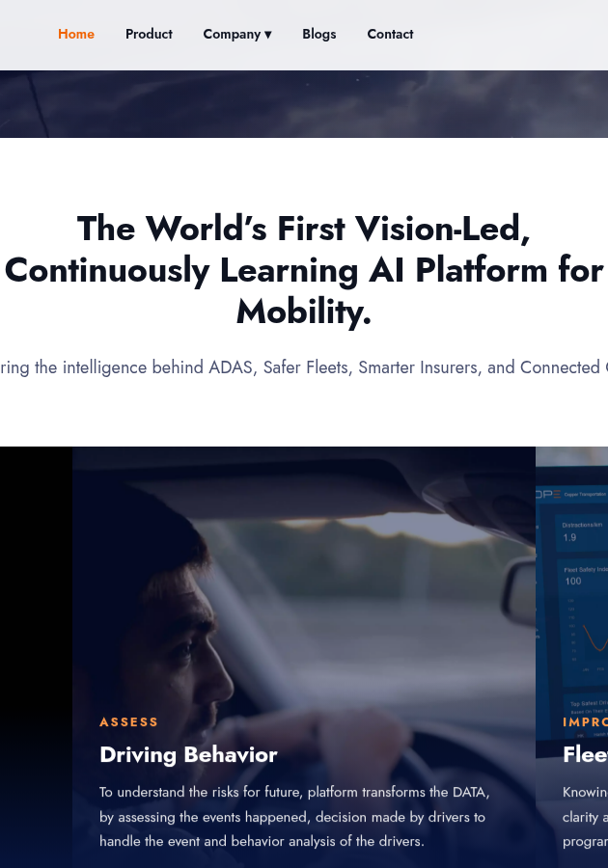
PRODUCT & CONTROL POINTS
drivebuddyAI packages five control points—but only some create a defensible moat
Follow the system from sensing to the buyer relationship
01
02
03
04
05
Camera + radar
→
ADAS / DMS fusion
→
Driver-risk analytics
→
ARAI AIS-184 proof
→
Fleet / OEM interface
WHERE VALUE ACCRUES
Camera–radar ADAS, DMS and fleet intelligence in one operating stack
DEEPGRID OPENING
Diligence OEM integration and fusion performance; avoid conflating DMS proof with AEBS readiness
SALES MESSAGE
Do not sell against the whole stack; isolate the control point that drivebuddyAI cannot defend economically or locally.
DEEPGRID SEMI · INDIA ADAS COMPETITOR DOSSIER · CONFIDENTIAL
21
Notes:
Product chain synthesis for drivebuddyAI. Source: Roadzen investor release · ARAI update · drivebuddyAI demonstration, 2024–2026. Interpretation is bounded by: DMS certification does not establish AEBS type approval or braking accountability

Slide 22
BUYER BATTLECARD
drivebuddyAI wins on indian-road data—and breaks at three proof or control boundaries
Sales battlecard: concede what is true, then move the buying criterion
CONCEDE
CHALLENGE
01
Indian-road data
01
DMS ≠ AEBS approval
02
Certified DMS
02
Braking boundary unclear
03
Live HCV demonstration
03
OEM nomination undisclosed
EVIDENCE BOUNDARY
DMS certification does not establish AEBS type approval or braking accountability
REFRAME
Diligence OEM integration and fusion performance; avoid conflating DMS proof with AEBS readiness
DEEPGRID SEMI · INDIA ADAS COMPETITOR DOSSIER · CONFIDENTIAL
22
Notes:
Sales battlecard for drivebuddyAI. Concessions are evidence-aligned. Challenges must not be stated as disqualifications without buyer validation. Source: Roadzen investor release · ARAI update · drivebuddyAI demonstration, 2024–2026

Slide 23
SALES PLAY
DeepGrid can change the drivebuddyAI conversation with three persona-specific moves
Lead with the buyer’s objective; end with a measurable proof request
BUSINESS / PROCUREMENT
Fleet: lead with risk analytics
PROOF ASK
Lifecycle cost + local support
CHIEF ENGINEER
OEM: separate DMS and AEBS gates
PROOF ASK
Same-ODD benchmark + integration effort
PROGRAMME / SAFETY
Engineering: test false interventions
PROOF ASK
Named responsibility matrix + release gate
STOP / ESCALATE
Escalate only when the buyer values DeepGrid’s bounded perception advantage and accepts the evidence plan.
NEXT MEETING OUTPUT
A named owner, a vehicle or programme, the comparison metric, data rights and a dated go / no-go gate.
DEEPGRID SEMI · INDIA ADAS COMPETITOR DOSSIER · CONFIDENTIAL
23
Notes:
Persona sales play for drivebuddyAI. Response: Diligence OEM integration and fusion performance; avoid conflating DMS proof with AEBS readiness. Evidence boundary: DMS certification does not establish AEBS type approval or braking accountability

Slide 24
USE-CASE CONCLUSION
drivebuddyAI is differentiated in three use cases—but each creates a specific DeepGrid opening
Close the competitor discussion with a use-case choice, not a generic threat label
01
DMS / DDAWS
02
FLEET RISK
03
HCV COMPLIANCE
BUYER PROBLEM
BUYER PROBLEM
BUYER PROBLEM
Fatigue and distraction
Driver behaviour and coaching
Multiple warning functions
UNIQUE SOLUTION
UNIQUE SOLUTION
UNIQUE SOLUTION
ARAI-certified AIS-184 DMS
Continuously learning analytics
Camera–radar integrated platform
WHERE DEEPGRID FITS
Diligence OEM integration and fusion performance; avoid conflating DMS proof with AEBS readiness
COMMERCIAL TEST
Select one named fleet · compliance · hcv demonstration use case; agree the buyer metric, responsibility boundary and 90-day stop / scale gate.
DEEPGRID SEMI · INDIA ADAS COMPETITOR DOSSIER · CONFIDENTIAL
24
Notes:
Use-case conclusion for drivebuddyAI. Use cases: [('DMS / DDAWS', 'Fatigue and distraction', 'ARAI-certified AIS-184 DMS'), ('FLEET RISK', 'Driver behaviour and coaching', 'Continuously learning analytics'), ('HCV COMPLIANCE', 'Multiple warning functions', 'Camera–radar integrated platform')]. DeepGrid response: Diligence OEM integration and fusion performance; avoid conflating DMS proof with AEBS readiness. Source: Roadzen investor release · ARAI update · drivebuddyAI demonstration, 2024–2026

Slide 25

EXECUTIVE SUMMARY
The reference system partner because it controls braking, validation and OEM accountability
ZF CVCS India · management posture: ATTACH
WHY IT MATTERS
Two disclosed Indian CV OEM ADAS nominations; India validation and production-readiness evidence
WHERE IT WINS
N2/N3 OEM programmes
WHAT IS NOT PROVEN
Programme customer, volumes and unit economics remain undisclosed
ATTACH
Attach DGS001 as a bounded camera-perception subsystem; do not compete for the full safety case
DEEPGRID POSITION
EXECUTIVE DECISION
ATTACH · Evidence confidence: HIGH · Release resources only against a named buyer, proof metric and dated gate.
DEEPGRID SEMI · INDIA ADAS COMPETITOR DOSSIER · CONFIDENTIAL
25
Notes:
Executive summary for ZF CVCS India. Verdict: The reference system partner because it controls braking, validation and OEM accountability. Evidence: ZF CVCS India exchange filings, 3 Dec 2025 and 31 Mar 2026. Boundary: Programme customer, volumes and unit economics remain undisclosed

Slide 26
COMPETITOR PROFILE
ZF’s advantage is not perception alone—it already owns the braking channel and OEM safety case
ZF CVCS India · strongest arena: N2/N3 OEM programmes
WHAT THEY SELL
Integrated CV ADAS tied to braking, actuation, validation and homologation
OPERATING PROOF
Two disclosed Indian CV OEM ADAS nominations; India validation and production-readiness evidence
BUYER ARENA
N2/N3 OEM programmes
EVIDENCE BOUNDARY
Programme customer, volumes and unit economics remain undisclosed
SOURCE-DERIVED VISUAL
ZF CVCS India exchange filings, 3 Dec 2025 and 31 Mar 2026
DEEPGRID RESPONSE
Attach DGS001 as a bounded camera-perception subsystem; do not compete for the full safety case
THREAT
HIGH
DEEPGRID SEMI · INDIA ADAS COMPETITOR DOSSIER · CONFIDENTIAL
26
Notes:
Evidence status and sources: ZF CVCS India exchange filings, 3 Dec 2025 and 31 Mar 2026
Boundary: Programme customer, volumes and unit economics remain undisclosed
Response: Attach DGS001 as a bounded camera-perception subsystem; do not compete for the full safety case

Slide 27
COMPETITOR ANATOMY
ZF connects sensing to braking and homologation—owning the complete CV safety boundary
What it does · customer focus · technology stack · operating model
TECHNOLOGY & DELIVERY STACK
WHAT IT IS
OPERATING PROOF
Commercial-vehicle systems Tier-1 that joins perception to braking, actuation, validation and OEM release responsibility.
01
Radar, camera and vehicle sensors
Two disclosed Indian CV OEM ADAS nominations, extensive India validation and a stated multi-feature safety suite.
↓
02
CV ADAS perception and decision software
↓
CUSTOMER & USE-CASE FOCUS
03
Electronic braking / actuation control
N2/N3 OEM programmes that require multiple mandated safety functions, system-level homologation and a supplier able to own the braking interface.
↓
04
Vehicle integration and India validation
WHAT REMAINS UNKNOWN
↓
05
Homologation, production release and lifecycle supply
Customers, unit economics, programme volumes and the precise external perception-supplier boundary are undisclosed.
HOW IT MAKES MONEY / SCALES
Win platform nominations by bundling safety functions with entrenched braking relationships and programme-level engineering accountability.
SO WHAT FOR DEEPGRID
Attach DGS001 as a bounded camera-perception subsystem; do not compete for the full safety case
DEEPGRID SEMI · INDIA ADAS COMPETITOR DOSSIER · CONFIDENTIAL
27
Notes:
Detailed competitor narrative for ZF CVCS India. Source basis: ZF CVCS India exchange filings, 3 Dec 2025 and 31 Mar 2026. Company-attributed claims remain bounded by: Customers, unit economics, programme volumes and the precise external perception-supplier boundary are undisclosed.

Slide 28
THREAT MECHANISM
ZF CVCS India wins only if its control point becomes the buyer’s deciding criterion
Threat mechanism → falsifier → management action
01
02
03
BUYER DECISION N2/N3 OEM programmes
CONTROL POINT
→
CONVERSION MECHANISM
→
DISPLACEMENT RISK
Radar + camera → OEM series programme
N2/N3 OEM programmes
DeepGrid sits outside the chosen programme boundary
The threat becomes material only when this arena—not standalone perception—sets the supplier decision.
WHY THIS MATTERS
The buyer can prefer ZF CVCS India when n2/n3 oem programmes matters more than standalone perception ownership.
FALSIFIER
Programme customer, volumes and unit economics remain undisclosed
MANAGEMENT ACTION
Attach DGS001 as a bounded camera-perception subsystem; do not compete for the full safety case
DEEPGRID SEMI · INDIA ADAS COMPETITOR DOSSIER · CONFIDENTIAL
28
Notes:
Threat mechanism for ZF CVCS India. Fact boundary: Programme customer, volumes and unit economics remain undisclosed. Source: ZF CVCS India exchange filings, 3 Dec 2025 and 31 Mar 2026

Slide 29
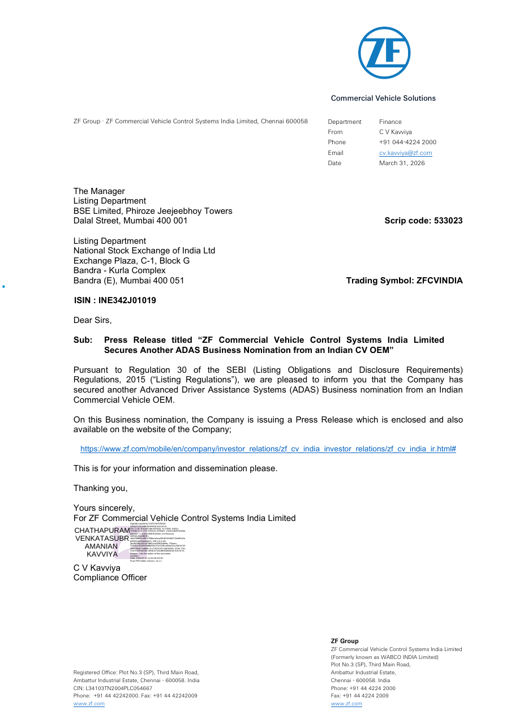
PRODUCT & CONTROL POINTS
ZF CVCS India packages five control points—but only some create a defensible moat
Follow the system from sensing to the buyer relationship
01
02
03
04
05
Radar + camera
→
ADAS software
→
Brake actuation
→
Homologation
→
OEM series programme
WHERE VALUE ACCRUES
Integrated CV ADAS tied to braking, actuation, validation and homologation
DEEPGRID OPENING
Attach DGS001 as a bounded camera-perception subsystem; do not compete for the full safety case
SALES MESSAGE
Do not sell against the whole stack; isolate the control point that ZF CVCS India cannot defend economically or locally.
DEEPGRID SEMI · INDIA ADAS COMPETITOR DOSSIER · CONFIDENTIAL
29
Notes:
Product chain synthesis for ZF CVCS India. Source: ZF CVCS India exchange filings, 3 Dec 2025 and 31 Mar 2026. Interpretation is bounded by: Programme customer, volumes and unit economics remain undisclosed

Slide 30
BUYER BATTLECARD
ZF CVCS India wins on braking-system control—and breaks at three proof or control boundaries
Sales battlecard: concede what is true, then move the buying criterion
CONCEDE
CHALLENGE
01
Braking-system control
01
Closed supplier architecture
02
Disclosed nominations
02
Economics undisclosed
03
India validation stack
03
Perception source not differentiating
EVIDENCE BOUNDARY
Programme customer, volumes and unit economics remain undisclosed
REFRAME
Attach DGS001 as a bounded camera-perception subsystem; do not compete for the full safety case
DEEPGRID SEMI · INDIA ADAS COMPETITOR DOSSIER · CONFIDENTIAL
30
Notes:
Sales battlecard for ZF CVCS India. Concessions are evidence-aligned. Challenges must not be stated as disqualifications without buyer validation. Source: ZF CVCS India exchange filings, 3 Dec 2025 and 31 Mar 2026

Slide 31
SALES PLAY
DeepGrid can change the ZF CVCS India conversation with three persona-specific moves
Lead with the buyer’s objective; end with a measurable proof request
BUSINESS / PROCUREMENT
OEM: attach, do not replace
PROOF ASK
Lifecycle cost + local support
CHIEF ENGINEER
Engineering: offer bounded perception
PROOF ASK
Same-ODD benchmark + integration effort
PROGRAMME / SAFETY
Purchasing: prove cost-down curve
PROOF ASK
Named responsibility matrix + release gate
STOP / ESCALATE
Escalate only when the buyer values DeepGrid’s bounded perception advantage and accepts the evidence plan.
NEXT MEETING OUTPUT
A named owner, a vehicle or programme, the comparison metric, data rights and a dated go / no-go gate.
DEEPGRID SEMI · INDIA ADAS COMPETITOR DOSSIER · CONFIDENTIAL
31
Notes:
Persona sales play for ZF CVCS India. Response: Attach DGS001 as a bounded camera-perception subsystem; do not compete for the full safety case. Evidence boundary: Programme customer, volumes and unit economics remain undisclosed

Slide 32
USE-CASE CONCLUSION
ZF CVCS India is differentiated in three use cases—but each creates a specific DeepGrid opening
Close the competitor discussion with a use-case choice, not a generic threat label
01
SERIES AEBS
02
BSIS / MOIS
03
OEM HOMOLOGATION
BUYER PROBLEM
BUYER PROBLEM
BUYER PROBLEM
N2/N3 braking intervention
VRU protection around trucks
Programme-level release
UNIQUE SOLUTION
UNIQUE SOLUTION
UNIQUE SOLUTION
Integrated ADAS + brake actuation
Multi-sensor CV safety suite
Validation and safety-case ownership
WHERE DEEPGRID FITS
Attach DGS001 as a bounded camera-perception subsystem; do not compete for the full safety case
COMMERCIAL TEST
Select one named n2/n3 oem programmes use case; agree the buyer metric, responsibility boundary and 90-day stop / scale gate.
DEEPGRID SEMI · INDIA ADAS COMPETITOR DOSSIER · CONFIDENTIAL
32
Notes:
Use-case conclusion for ZF CVCS India. Use cases: [('SERIES AEBS', 'N2/N3 braking intervention', 'Integrated ADAS + brake actuation'), ('BSIS / MOIS', 'VRU protection around trucks', 'Multi-sensor CV safety suite'), ('OEM HOMOLOGATION', 'Programme-level release', 'Validation and safety-case ownership')]. DeepGrid response: Attach DGS001 as a bounded camera-perception subsystem; do not compete for the full safety case. Source: ZF CVCS India exchange filings, 3 Dec 2025 and 31 Mar 2026

Slide 33
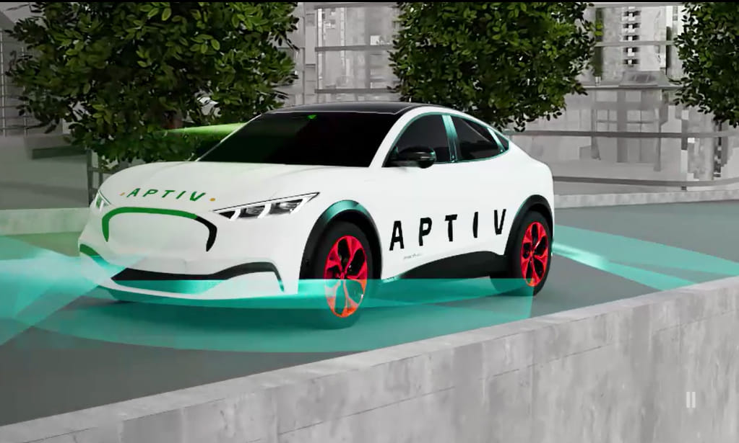
EXECUTIVE SUMMARY
A turn-key platform benchmark already converting India regulation into multi-model OEM rollout
Aptiv · management posture: ATTACH / BENCHMARK
WHY IT MATTERS
Official selection by a leading commercial-vehicle OEM for future trucks and buses in India
WHERE IT WINS
OEM platform · 14 models / 30+ variants
WHAT IS NOT PROVEN
Named OEM, production economics and DeepGrid-comparable perception metrics are not public
ATTACH / BENCHMARK
Treat as benchmark and potential attach route; win on local data, bounded cost and integration speed
DEEPGRID POSITION
EXECUTIVE DECISION
ATTACH / BENCHMARK · Evidence confidence: HIGH · Release resources only against a named buyer, proof metric and dated gate.
DEEPGRID SEMI · INDIA ADAS COMPETITOR DOSSIER · CONFIDENTIAL
33
Notes:
Executive summary for Aptiv. Verdict: A turn-key platform benchmark already converting India regulation into multi-model OEM rollout. Evidence: Aptiv official release, 6 Jan 2026. Boundary: Named OEM, production economics and DeepGrid-comparable perception metrics are not public

Slide 34
COMPETITOR PROFILE
Aptiv has converted a scalable global platform into an India commercial-vehicle design win
Aptiv · strongest arena: OEM platform · 14 models / 30+ variants
WHAT THEY SELL
Gen 6 radar, smart camera, STRADVISION vision and modular ADAS software
OPERATING PROOF
Official selection by a leading commercial-vehicle OEM for future trucks and buses in India
BUYER ARENA
OEM platform · 14 models / 30+ variants
EVIDENCE BOUNDARY
Named OEM, production economics and DeepGrid-comparable perception metrics are not public
SOURCE-DERIVED VISUAL
Aptiv official release, 6 Jan 2026
DEEPGRID RESPONSE
Treat as benchmark and potential attach route; win on local data, bounded cost and integration speed
THREAT
HIGH
DEEPGRID SEMI · INDIA ADAS COMPETITOR DOSSIER · CONFIDENTIAL
34
Notes:
Evidence status and sources: Aptiv official release, 6 Jan 2026
Boundary: Named OEM, production economics and DeepGrid-comparable perception metrics are not public
Response: Treat as benchmark and potential attach route; win on local data, bounded cost and integration speed

Slide 35
COMPETITOR ANATOMY
Aptiv turns modular sensing and software into a multi-model OEM platform
What it does · customer focus · technology stack · operating model
TECHNOLOGY & DELIVERY STACK
WHAT IT IS
OPERATING PROOF
Global ADAS platform supplier bringing a modular Gen 6 sensing, compute and software stack into a broad Indian commercial-vehicle rollout.
01
Gen 6 radar and smart-camera sensors
Official India CV OEM selection covering 14 models and more than 30 variants.
↓
02
STRADVISION SVNet vision software
↓
CUSTOMER & USE-CASE FOCUS
03
Sensor fusion and modular ADAS applications
Large OEM platforms that need one architecture reused across many truck and bus models while meeting future safety requirements.
↓
04
Vehicle network / compute integration
WHAT REMAINS UNKNOWN
↓
05
Global validation, manufacturing and programme support
Named customer, certification status, production pricing and directly comparable India-ODD performance are not public.
HOW IT MAKES MONEY / SCALES
Reuse a standardized platform across high-variant OEM portfolios, localize it through India engineering and deliver at automotive scale.
SO WHAT FOR DEEPGRID
Treat as benchmark and potential attach route; win on local data, bounded cost and integration speed
DEEPGRID SEMI · INDIA ADAS COMPETITOR DOSSIER · CONFIDENTIAL
35
Notes:
Detailed competitor narrative for Aptiv. Source basis: Aptiv official release, 6 Jan 2026. Company-attributed claims remain bounded by: Named customer, certification status, production pricing and directly comparable India-ODD performance are not public.

Slide 36
THREAT MECHANISM
Aptiv wins only if its control point becomes the buyer’s deciding criterion
Threat mechanism → falsifier → management action
01
02
03
BUYER DECISION OEM platform · 14 models / 30+ variants
CONTROL POINT
→
CONVERSION MECHANISM
→
DISPLACEMENT RISK
Gen 6 radar → Multi-model OEM rollout
OEM platform · 14 models / 30+ variants
DeepGrid sits outside the chosen programme boundary
The threat becomes material only when this arena—not standalone perception—sets the supplier decision.
WHY THIS MATTERS
The buyer can prefer Aptiv when oem platform · 14 models / 30+ variants matters more than standalone perception ownership.
FALSIFIER
Named OEM, production economics and DeepGrid-comparable perception metrics are not public
MANAGEMENT ACTION
Treat as benchmark and potential attach route; win on local data, bounded cost and integration speed
DEEPGRID SEMI · INDIA ADAS COMPETITOR DOSSIER · CONFIDENTIAL
36
Notes:
Threat mechanism for Aptiv. Fact boundary: Named OEM, production economics and DeepGrid-comparable perception metrics are not public. Source: Aptiv official release, 6 Jan 2026

Slide 37

PRODUCT & CONTROL POINTS
Aptiv packages five control points—but only some create a defensible moat
Follow the system from sensing to the buyer relationship
01
02
03
04
05
Gen 6 radar
→
Smart camera
→
STRADVISION vision
→
Modular ADAS stack
→
Multi-model OEM rollout
WHERE VALUE ACCRUES
Gen 6 radar, smart camera, STRADVISION vision and modular ADAS software
DEEPGRID OPENING
Treat as benchmark and potential attach route; win on local data, bounded cost and integration speed
SALES MESSAGE
Do not sell against the whole stack; isolate the control point that Aptiv cannot defend economically or locally.
DEEPGRID SEMI · INDIA ADAS COMPETITOR DOSSIER · CONFIDENTIAL
37
Notes:
Product chain synthesis for Aptiv. Source: Aptiv official release, 6 Jan 2026. Interpretation is bounded by: Named OEM, production economics and DeepGrid-comparable perception metrics are not public

Slide 38
BUYER BATTLECARD
Aptiv wins on turn-key platform—and breaks at three proof or control boundaries
Sales battlecard: concede what is true, then move the buying criterion
CONCEDE
CHALLENGE
01
Turn-key platform
01
Named OEM undisclosed
02
Indian CV design win
02
Global-stack cost burden
03
Global industrial scale
03
Local-data advantage contestable
EVIDENCE BOUNDARY
Named OEM, production economics and DeepGrid-comparable perception metrics are not public
REFRAME
Treat as benchmark and potential attach route; win on local data, bounded cost and integration speed
DEEPGRID SEMI · INDIA ADAS COMPETITOR DOSSIER · CONFIDENTIAL
38
Notes:
Sales battlecard for Aptiv. Concessions are evidence-aligned. Challenges must not be stated as disqualifications without buyer validation. Source: Aptiv official release, 6 Jan 2026

Slide 39
SALES PLAY
DeepGrid can change the Aptiv conversation with three persona-specific moves
Lead with the buyer’s objective; end with a measurable proof request
BUSINESS / PROCUREMENT
OEM: sell faster local tuning
PROOF ASK
Lifecycle cost + local support
CHIEF ENGINEER
Engineering: benchmark accuracy/watt
PROOF ASK
Same-ODD benchmark + integration effort
PROGRAMME / SAFETY
Purchasing: quantify subsystem savings
PROOF ASK
Named responsibility matrix + release gate
STOP / ESCALATE
Escalate only when the buyer values DeepGrid’s bounded perception advantage and accepts the evidence plan.
NEXT MEETING OUTPUT
A named owner, a vehicle or programme, the comparison metric, data rights and a dated go / no-go gate.
DEEPGRID SEMI · INDIA ADAS COMPETITOR DOSSIER · CONFIDENTIAL
39
Notes:
Persona sales play for Aptiv. Response: Treat as benchmark and potential attach route; win on local data, bounded cost and integration speed. Evidence boundary: Named OEM, production economics and DeepGrid-comparable perception metrics are not public

Slide 40
USE-CASE CONCLUSION
Aptiv is differentiated in three use cases—but each creates a specific DeepGrid opening
Close the competitor discussion with a use-case choice, not a generic threat label
01
MULTI-MODEL CV ADAS
02
REGULATORY COMPLIANCE
03
INDIA ODD
BUYER PROBLEM
BUYER PROBLEM
BUYER PROBLEM
14 models / 30+ variants
2027 safety functions
Mixed roads and traffic
UNIQUE SOLUTION
UNIQUE SOLUTION
UNIQUE SOLUTION
Modular Gen 6 platform
Radar + smart camera + software
Localized platform tuning
WHERE DEEPGRID FITS
Treat as benchmark and potential attach route; win on local data, bounded cost and integration speed
COMMERCIAL TEST
Select one named oem platform · 14 models / 30+ variants use case; agree the buyer metric, responsibility boundary and 90-day stop / scale gate.
DEEPGRID SEMI · INDIA ADAS COMPETITOR DOSSIER · CONFIDENTIAL
40
Notes:
Use-case conclusion for Aptiv. Use cases: [('MULTI-MODEL CV ADAS', '14 models / 30+ variants', 'Modular Gen 6 platform'), ('REGULATORY COMPLIANCE', '2027 safety functions', 'Radar + smart camera + software'), ('INDIA ODD', 'Mixed roads and traffic', 'Localized platform tuning')]. DeepGrid response: Treat as benchmark and potential attach route; win on local data, bounded cost and integration speed. Source: Aptiv official release, 6 Jan 2026

Slide 41
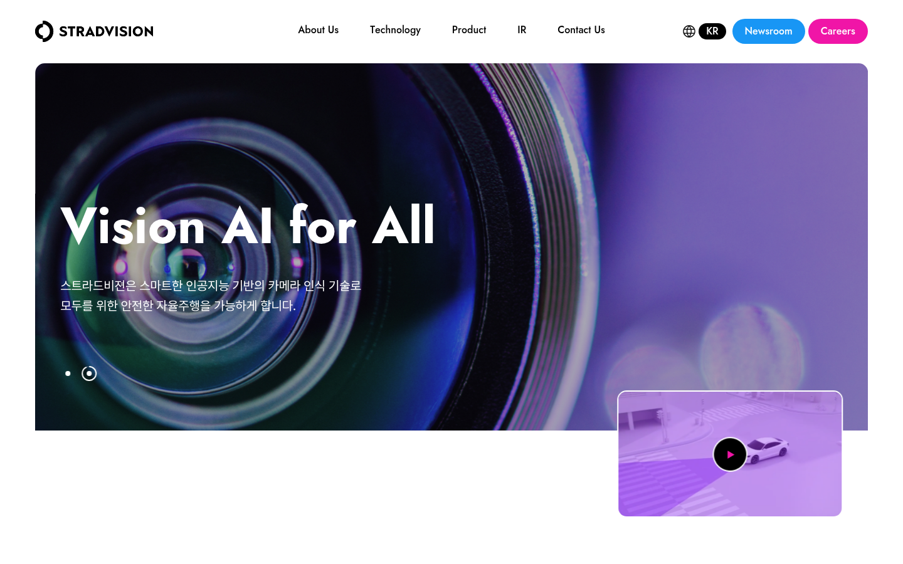
EXECUTIVE SUMMARY
The closest software-layer substitute for DeepGrid on constrained automotive compute
STRADVISION · management posture: BENCHMARK
WHY IT MATTERS
Official India commercial-vehicle supply programme with a global OEM
WHERE IT WINS
OEM perception software
WHAT IS NOT PROVEN
India programme volumes, hardware bill and customer identity are undisclosed
BENCHMARK
Benchmark accuracy-per-watt and Indian ODD; defend with owned compute economics only after measured proof
DEEPGRID POSITION
EXECUTIVE DECISION
BENCHMARK · Evidence confidence: HIGH · Release resources only against a named buyer, proof metric and dated gate.
DEEPGRID SEMI · INDIA ADAS COMPETITOR DOSSIER · CONFIDENTIAL
41
Notes:
Executive summary for STRADVISION. Verdict: The closest software-layer substitute for DeepGrid on constrained automotive compute. Evidence: STRADVISION newsroom, 16 Apr 2026. Boundary: India programme volumes, hardware bill and customer identity are undisclosed

Slide 42
COMPETITOR PROFILE
STRADVISION attacks DeepGrid’s core layer: efficient vision software on constrained automotive compute
STRADVISION · strongest arena: OEM perception software
WHAT THEY SELL
SVNet perception software designed for scalable, resource-constrained hardware
OPERATING PROOF
Official India commercial-vehicle supply programme with a global OEM
BUYER ARENA
OEM perception software
EVIDENCE BOUNDARY
India programme volumes, hardware bill and customer identity are undisclosed
SOURCE-DERIVED VISUAL
STRADVISION newsroom, 16 Apr 2026
DEEPGRID RESPONSE
Benchmark accuracy-per-watt and Indian ODD; defend with owned compute economics only after measured proof
THREAT
MED–HIGH
DEEPGRID SEMI · INDIA ADAS COMPETITOR DOSSIER · CONFIDENTIAL
42
Notes:
Evidence status and sources: STRADVISION newsroom, 16 Apr 2026
Boundary: India programme volumes, hardware bill and customer identity are undisclosed
Response: Benchmark accuracy-per-watt and Indian ODD; defend with owned compute economics only after measured proof

Slide 43
COMPETITOR ANATOMY
STRADVISION supplies the efficient vision layer inside a partner-owned vehicle stack
What it does · customer focus · technology stack · operating model
TECHNOLOGY & DELIVERY STACK
WHAT IT IS
OPERATING PROOF
Automotive perception-software specialist selling deployable vision intelligence rather than a complete sensor-to-brake system.
01
Camera image ingestion
Official commercial-vehicle India supply programme and production use through global automotive partners.
↓
02
SVNet neural-network perception
↓
CUSTOMER & USE-CASE FOCUS
03
Objects, lanes, freespace and VRU outputs
OEMs and Tier-1s needing production-grade camera perception on low-cost or resource-constrained automotive compute.
↓
04
Hardware abstraction and SoC optimization
WHAT REMAINS UNKNOWN
↓
05
Safety process, tooling and OEM integration
India volumes, compute bill, local data depth and same-hardware performance versus DeepGrid are undisclosed.
HOW IT MAKES MONEY / SCALES
License and integrate perception software across hardware platforms; scale through Tier-1 and OEM production programmes.
SO WHAT FOR DEEPGRID
Benchmark accuracy-per-watt and Indian ODD; defend with owned compute economics only after measured proof
DEEPGRID SEMI · INDIA ADAS COMPETITOR DOSSIER · CONFIDENTIAL
43
Notes:
Detailed competitor narrative for STRADVISION. Source basis: STRADVISION newsroom, 16 Apr 2026. Company-attributed claims remain bounded by: India volumes, compute bill, local data depth and same-hardware performance versus DeepGrid are undisclosed.

Slide 44
THREAT MECHANISM
STRADVISION wins only if its control point becomes the buyer’s deciding criterion
Threat mechanism → falsifier → management action
01
02
03
BUYER DECISION OEM perception software
CONTROL POINT
→
CONVERSION MECHANISM
→
DISPLACEMENT RISK
Camera input → OEM production integration
OEM perception software
DeepGrid sits outside the chosen programme boundary
The threat becomes material only when this arena—not standalone perception—sets the supplier decision.
WHY THIS MATTERS
The buyer can prefer STRADVISION when oem perception software matters more than standalone perception ownership.
FALSIFIER
India programme volumes, hardware bill and customer identity are undisclosed
MANAGEMENT ACTION
Benchmark accuracy-per-watt and Indian ODD; defend with owned compute economics only after measured proof
DEEPGRID SEMI · INDIA ADAS COMPETITOR DOSSIER · CONFIDENTIAL
44
Notes:
Threat mechanism for STRADVISION. Fact boundary: India programme volumes, hardware bill and customer identity are undisclosed. Source: STRADVISION newsroom, 16 Apr 2026

Slide 45
PRODUCT & CONTROL POINTS
STRADVISION packages five control points—but only some create a defensible moat
Follow the system from sensing to the buyer relationship
01
02
03
04
05
Camera input
→
SVNet perception
→
Hardware abstraction
→
Safety-certified software
→
OEM production integration
WHERE VALUE ACCRUES
SVNet perception software designed for scalable, resource-constrained hardware
DEEPGRID OPENING
Benchmark accuracy-per-watt and Indian ODD; defend with owned compute economics only after measured proof
SALES MESSAGE
Do not sell against the whole stack; isolate the control point that STRADVISION cannot defend economically or locally.
DEEPGRID SEMI · INDIA ADAS COMPETITOR DOSSIER · CONFIDENTIAL
45
Notes:
Product chain synthesis for STRADVISION. Source: STRADVISION newsroom, 16 Apr 2026. Interpretation is bounded by: India programme volumes, hardware bill and customer identity are undisclosed

Slide 46
BUYER BATTLECARD
STRADVISION wins on efficient vision software—and breaks at three proof or control boundaries
Sales battlecard: concede what is true, then move the buying criterion
CONCEDE
CHALLENGE
01
Efficient vision software
01
No owned sensor/actuation
02
Automotive process maturity
02
Depends on compute partner
03
India supply programme
03
India economics undisclosed
EVIDENCE BOUNDARY
India programme volumes, hardware bill and customer identity are undisclosed
REFRAME
Benchmark accuracy-per-watt and Indian ODD; defend with owned compute economics only after measured proof
DEEPGRID SEMI · INDIA ADAS COMPETITOR DOSSIER · CONFIDENTIAL
46
Notes:
Sales battlecard for STRADVISION. Concessions are evidence-aligned. Challenges must not be stated as disqualifications without buyer validation. Source: STRADVISION newsroom, 16 Apr 2026

Slide 47
SALES PLAY
DeepGrid can change the STRADVISION conversation with three persona-specific moves
Lead with the buyer’s objective; end with a measurable proof request
BUSINESS / PROCUREMENT
Engineering: benchmark on same silicon
PROOF ASK
Lifecycle cost + local support
CHIEF ENGINEER
OEM: contrast local ODD corpus
PROOF ASK
Same-ODD benchmark + integration effort
PROGRAMME / SAFETY
Board: defend only measured advantage
PROOF ASK
Named responsibility matrix + release gate
STOP / ESCALATE
Escalate only when the buyer values DeepGrid’s bounded perception advantage and accepts the evidence plan.
NEXT MEETING OUTPUT
A named owner, a vehicle or programme, the comparison metric, data rights and a dated go / no-go gate.
DEEPGRID SEMI · INDIA ADAS COMPETITOR DOSSIER · CONFIDENTIAL
47
Notes:
Persona sales play for STRADVISION. Response: Benchmark accuracy-per-watt and Indian ODD; defend with owned compute economics only after measured proof. Evidence boundary: India programme volumes, hardware bill and customer identity are undisclosed

Slide 48
USE-CASE CONCLUSION
STRADVISION is differentiated in three use cases—but each creates a specific DeepGrid opening
Close the competitor discussion with a use-case choice, not a generic threat label
01
FRONT VISION
02
LOW-COST COMPUTE
03
OEM SCALE
BUYER PROBLEM
BUYER PROBLEM
BUYER PROBLEM
Objects, lanes and VRUs
Resource-constrained ECUs
Cross-platform deployment
UNIQUE SOLUTION
UNIQUE SOLUTION
UNIQUE SOLUTION
SVNet perception software
Optimized software architecture
Automotive process and integration stack
WHERE DEEPGRID FITS
Benchmark accuracy-per-watt and Indian ODD; defend with owned compute economics only after measured proof
COMMERCIAL TEST
Select one named oem perception software use case; agree the buyer metric, responsibility boundary and 90-day stop / scale gate.
DEEPGRID SEMI · INDIA ADAS COMPETITOR DOSSIER · CONFIDENTIAL
48
Notes:
Use-case conclusion for STRADVISION. Use cases: [('FRONT VISION', 'Objects, lanes and VRUs', 'SVNet perception software'), ('LOW-COST COMPUTE', 'Resource-constrained ECUs', 'Optimized software architecture'), ('OEM SCALE', 'Cross-platform deployment', 'Automotive process and integration stack')]. DeepGrid response: Benchmark accuracy-per-watt and Indian ODD; defend with owned compute economics only after measured proof. Source: STRADVISION newsroom, 16 Apr 2026

Slide 49
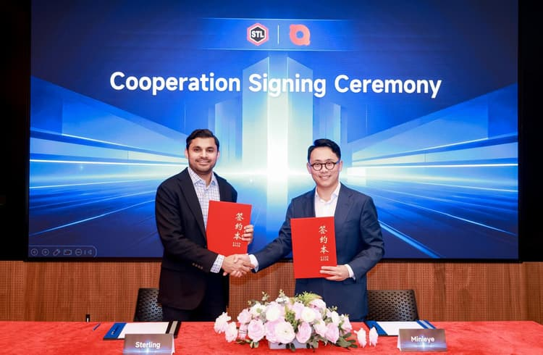
EXECUTIVE SUMMARY
A credible local-channel vehicle for proven foreign ADAS IP—but still at MOU stage in India
Sterling Tools × MINIEYE · management posture: TRACK CONVERSION
WHY IT MATTERS
Formal MOU disclosed to NSE/BSE; covers passenger and commercial vehicles
WHERE IT WINS
OEM channel · localization
WHAT IS NOT PROVEN
MOU is market entry—not a disclosed India design win or production nomination
TRACK CONVERSION
Track conversion from MOU to programme; counter through faster local proof and braking-channel partners
DEEPGRID POSITION
EXECUTIVE DECISION
TRACK CONVERSION · Evidence confidence: HIGH · Release resources only against a named buyer, proof metric and dated gate.
DEEPGRID SEMI · INDIA ADAS COMPETITOR DOSSIER · CONFIDENTIAL
49
Notes:
Executive summary for Sterling Tools × MINIEYE. Verdict: A credible local-channel vehicle for proven foreign ADAS IP—but still at MOU stage in India. Evidence: Sterling Tools NSE/BSE filing and MINIEYE HKEX announcement, Jan 2026. Boundary: MOU is market entry—not a disclosed India design win or production nomination

Slide 50
COMPETITOR PROFILE
Sterling–MINIEYE combines production ADAS IP with a local Tier-1 route into Indian OEMs
Sterling Tools × MINIEYE · strongest arena: OEM channel · localization
WHAT THEY SELL
Full-stack ADAS/DMS from MINIEYE; localization and OEM engagement from Sterling
OPERATING PROOF
Formal MOU disclosed to NSE/BSE; covers passenger and commercial vehicles
BUYER ARENA
OEM channel · localization
EVIDENCE BOUNDARY
MOU is market entry—not a disclosed India design win or production nomination
SOURCE-DERIVED VISUAL
Sterling Tools NSE/BSE filing and MINIEYE HKEX announcement, Jan 2026
DEEPGRID RESPONSE
Track conversion from MOU to programme; counter through faster local proof and braking-channel partners
THREAT
MEDIUM
DEEPGRID SEMI · INDIA ADAS COMPETITOR DOSSIER · CONFIDENTIAL
50
Notes:
Evidence status and sources: Sterling Tools NSE/BSE filing and MINIEYE HKEX announcement, Jan 2026
Boundary: MOU is market entry—not a disclosed India design win or production nomination
Response: Track conversion from MOU to programme; counter through faster local proof and braking-channel partners

Slide 51
COMPETITOR ANATOMY
Sterling–MINIEYE joins production ADAS IP to an Indian Tier-1 route to market
What it does · customer focus · technology stack · operating model
TECHNOLOGY & DELIVERY STACK
WHAT IT IS
OPERATING PROOF
Market-entry alliance pairing MINIEYE’s production ADAS / DMS portfolio with Sterling’s India Tier-1 relationships, localization and manufacturing route.
01
MINIEYE cameras, radar and DMS hardware
Formal exchange-disclosed MOU covering ADAS and DMS for Indian passenger and commercial vehicles.
↓
02
Perception, fusion and driver-monitoring software
↓
CUSTOMER & USE-CASE FOCUS
03
India calibration and application engineering
Indian passenger- and commercial-vehicle OEMs seeking established ADAS IP with a domestic commercial and industrial interface.
↓
04
Sterling manufacturing / supply-chain interface
WHAT REMAINS UNKNOWN
↓
05
OEM integration and commercial account access
The MOU has not yet established a disclosed India design win, localized product baseline or production certification.
HOW IT MAKES MONEY / SCALES
Import proven technology and localize engineering, sourcing and customer access through an established Indian component supplier.
SO WHAT FOR DEEPGRID
Track conversion from MOU to programme; counter through faster local proof and braking-channel partners
DEEPGRID SEMI · INDIA ADAS COMPETITOR DOSSIER · CONFIDENTIAL
51
Notes:
Detailed competitor narrative for Sterling Tools × MINIEYE. Source basis: Sterling Tools NSE/BSE filing and MINIEYE HKEX announcement, Jan 2026. Company-attributed claims remain bounded by: The MOU has not yet established a disclosed India design win, localized product baseline or production certification.

Slide 52
THREAT MECHANISM
Sterling Tools × MINIEYE wins only if its control point becomes the buyer’s deciding criterion
Threat mechanism → falsifier → management action
01
02
03
BUYER DECISION OEM channel · localization
CONTROL POINT
→
CONVERSION MECHANISM
→
DISPLACEMENT RISK
MINIEYE ADAS/DMS → OEM commercialisation
OEM channel · localization
DeepGrid sits outside the chosen programme boundary
The threat becomes material only when this arena—not standalone perception—sets the supplier decision.
WHY THIS MATTERS
The buyer can prefer Sterling Tools × MINIEYE when oem channel · localization matters more than standalone perception ownership.
FALSIFIER
MOU is market entry—not a disclosed India design win or production nomination
MANAGEMENT ACTION
Track conversion from MOU to programme; counter through faster local proof and braking-channel partners
DEEPGRID SEMI · INDIA ADAS COMPETITOR DOSSIER · CONFIDENTIAL
52
Notes:
Threat mechanism for Sterling Tools × MINIEYE. Fact boundary: MOU is market entry—not a disclosed India design win or production nomination. Source: Sterling Tools NSE/BSE filing and MINIEYE HKEX announcement, Jan 2026

Slide 53
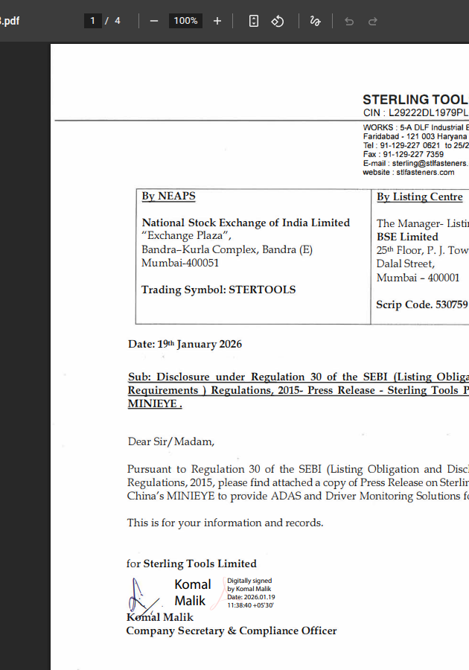
PRODUCT & CONTROL POINTS
Sterling Tools × MINIEYE packages five control points—but only some create a defensible moat
Follow the system from sensing to the buyer relationship
01
02
03
04
05
MINIEYE ADAS/DMS
→
India perception tuning
→
Sterling application engineering
→
Local manufacturing route
→
OEM commercialisation
WHERE VALUE ACCRUES
Full-stack ADAS/DMS from MINIEYE; localization and OEM engagement from Sterling
DEEPGRID OPENING
Track conversion from MOU to programme; counter through faster local proof and braking-channel partners
SALES MESSAGE
Do not sell against the whole stack; isolate the control point that Sterling Tools × MINIEYE cannot defend economically or locally.
DEEPGRID SEMI · INDIA ADAS COMPETITOR DOSSIER · CONFIDENTIAL
53
Notes:
Product chain synthesis for Sterling Tools × MINIEYE. Source: Sterling Tools NSE/BSE filing and MINIEYE HKEX announcement, Jan 2026. Interpretation is bounded by: MOU is market entry—not a disclosed India design win or production nomination

Slide 54
BUYER BATTLECARD
Sterling Tools × MINIEYE wins on existing oem relationships—and breaks at three proof or control boundaries
Sales battlecard: concede what is true, then move the buying criterion
CONCEDE
CHALLENGE
01
Existing OEM relationships
01
MOU not design win
02
Production-grade foreign IP
02
India tuning still ahead
03
Local industrial footprint
03
Partner dependency
EVIDENCE BOUNDARY
MOU is market entry—not a disclosed India design win or production nomination
REFRAME
Track conversion from MOU to programme; counter through faster local proof and braking-channel partners
DEEPGRID SEMI · INDIA ADAS COMPETITOR DOSSIER · CONFIDENTIAL
54
Notes:
Sales battlecard for Sterling Tools × MINIEYE. Concessions are evidence-aligned. Challenges must not be stated as disqualifications without buyer validation. Source: Sterling Tools NSE/BSE filing and MINIEYE HKEX announcement, Jan 2026

Slide 55
SALES PLAY
DeepGrid can change the Sterling Tools × MINIEYE conversation with three persona-specific moves
Lead with the buyer’s objective; end with a measurable proof request
BUSINESS / PROCUREMENT
OEM: ask programme status
PROOF ASK
Lifecycle cost + local support
CHIEF ENGINEER
Purchasing: expose imported-IP economics
PROOF ASK
Same-ODD benchmark + integration effort
PROGRAMME / SAFETY
BD: race to braking-channel alliance
PROOF ASK
Named responsibility matrix + release gate
STOP / ESCALATE
Escalate only when the buyer values DeepGrid’s bounded perception advantage and accepts the evidence plan.
NEXT MEETING OUTPUT
A named owner, a vehicle or programme, the comparison metric, data rights and a dated go / no-go gate.
DEEPGRID SEMI · INDIA ADAS COMPETITOR DOSSIER · CONFIDENTIAL
55
Notes:
Persona sales play for Sterling Tools × MINIEYE. Response: Track conversion from MOU to programme; counter through faster local proof and braking-channel partners. Evidence boundary: MOU is market entry—not a disclosed India design win or production nomination

Slide 56
USE-CASE CONCLUSION
Sterling Tools × MINIEYE is differentiated in three use cases—but each creates a specific DeepGrid opening
Close the competitor discussion with a use-case choice, not a generic threat label
01
OEM ADAS / DMS
02
INDIA LOCALIZATION
03
LOCAL SUPPLY
BUYER PROBLEM
BUYER PROBLEM
BUYER PROBLEM
Passenger and CV compliance
Mixed-traffic perception
OEM procurement access
UNIQUE SOLUTION
UNIQUE SOLUTION
UNIQUE SOLUTION
MINIEYE full-stack solutions
Sterling tuning and engineering
Tier-1 manufacturing relationships
WHERE DEEPGRID FITS
Track conversion from MOU to programme; counter through faster local proof and braking-channel partners
COMMERCIAL TEST
Select one named oem channel · localization use case; agree the buyer metric, responsibility boundary and 90-day stop / scale gate.
DEEPGRID SEMI · INDIA ADAS COMPETITOR DOSSIER · CONFIDENTIAL
56
Notes:
Use-case conclusion for Sterling Tools × MINIEYE. Use cases: [('OEM ADAS / DMS', 'Passenger and CV compliance', 'MINIEYE full-stack solutions'), ('INDIA LOCALIZATION', 'Mixed-traffic perception', 'Sterling tuning and engineering'), ('LOCAL SUPPLY', 'OEM procurement access', 'Tier-1 manufacturing relationships')]. DeepGrid response: Track conversion from MOU to programme; counter through faster local proof and braking-channel partners. Source: Sterling Tools NSE/BSE filing and MINIEYE HKEX announcement, Jan 2026

Slide 57
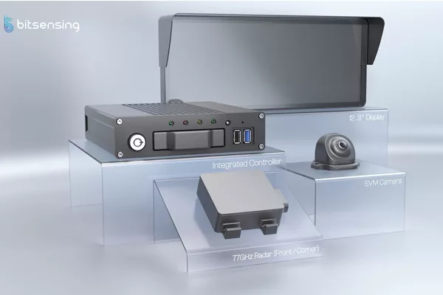
EXECUTIVE SUMMARY
A practical retrofit warning benchmark with limited direct overlap with certified AEBS
bitsensing · management posture: MONITOR
WHY IT MATTERS
Official 500+ bus expansion objective after Korea pilot; UNECE R151/R159 support
WHERE IT WINS
Aftermarket fleet warning
WHAT IS NOT PROVEN
No India deployment or automatic-braking responsibility evidenced
MONITOR
Use as demand and installation benchmark; monitor India entry rather than divert core OEM effort
DEEPGRID POSITION
EXECUTIVE DECISION
MONITOR · Evidence confidence: HIGH · Release resources only against a named buyer, proof metric and dated gate.
DEEPGRID SEMI · INDIA ADAS COMPETITOR DOSSIER · CONFIDENTIAL
57
Notes:
Executive summary for bitsensing. Verdict: A practical retrofit warning benchmark with limited direct overlap with certified AEBS. Evidence: bitsensing official launch, 5 Feb 2026. Boundary: No India deployment or automatic-braking responsibility evidenced

Slide 58
COMPETITOR PROFILE
bitsensing validates retrofit demand—but its warning-led kit stops short of an AEBS safety case
bitsensing · strongest arena: Aftermarket fleet warning
WHAT THEY SELL
Radar–camera commercial-vehicle ADAS kit with driver warnings and easy retrofit
OPERATING PROOF
Official 500+ bus expansion objective after Korea pilot; UNECE R151/R159 support
BUYER ARENA
Aftermarket fleet warning
EVIDENCE BOUNDARY
No India deployment or automatic-braking responsibility evidenced
SOURCE-DERIVED VISUAL
bitsensing official launch, 5 Feb 2026
DEEPGRID RESPONSE
Use as demand and installation benchmark; monitor India entry rather than divert core OEM effort
THREAT
LOW
DEEPGRID SEMI · INDIA ADAS COMPETITOR DOSSIER · CONFIDENTIAL
58
Notes:
Evidence status and sources: bitsensing official launch, 5 Feb 2026
Boundary: No India deployment or automatic-braking responsibility evidenced
Response: Use as demand and installation benchmark; monitor India entry rather than divert core OEM effort

Slide 59
COMPETITOR ANATOMY
bitsensing packages radar–camera warnings for rapid commercial-fleet retrofit
What it does · customer focus · technology stack · operating model
TECHNOLOGY & DELIVERY STACK
WHAT IT IS
OPERATING PROOF
Radar-specialist offering a practical camera–radar warning kit that modernizes existing commercial fleets without assuming the brake safety case.
01
NXP-based radar sensors
Official commercial-vehicle kit, Korean bus pilot and stated 500+ bus expansion objective; India channel relationship reported.
↓
02
Camera context and object classification
↓
CUSTOMER & USE-CASE FOCUS
03
Warning-level sensor fusion
Bus and fleet operators needing fast retrofit coverage for blind spots, forward collision and vulnerable-road-user warnings.
↓
04
Cab display / audible driver alerts
WHAT REMAINS UNKNOWN
↓
05
Retrofit controller, harness and installation kit
Automatic braking, India fleet deployments and OEM series-production responsibility are not evidenced.
HOW IT MAKES MONEY / SCALES
Sell through fleet and channel partners with low installation downtime; expand vehicle coverage through repeatable retrofit packages.
SO WHAT FOR DEEPGRID
Use as demand and installation benchmark; monitor India entry rather than divert core OEM effort
DEEPGRID SEMI · INDIA ADAS COMPETITOR DOSSIER · CONFIDENTIAL
59
Notes:
Detailed competitor narrative for bitsensing. Source basis: bitsensing official launch, 5 Feb 2026. Company-attributed claims remain bounded by: Automatic braking, India fleet deployments and OEM series-production responsibility are not evidenced.

Slide 60
THREAT MECHANISM
bitsensing wins only if its control point becomes the buyer’s deciding criterion
Threat mechanism → falsifier → management action
01
02
03
BUYER DECISION Aftermarket fleet warning
CONTROL POINT
→
CONVERSION MECHANISM
→
DISPLACEMENT RISK
NXP radar → Retrofit fleet deployment
Aftermarket fleet warning
DeepGrid sits outside the chosen programme boundary
The threat becomes material only when this arena—not standalone perception—sets the supplier decision.
WHY THIS MATTERS
The buyer can prefer bitsensing when aftermarket fleet warning matters more than standalone perception ownership.
FALSIFIER
No India deployment or automatic-braking responsibility evidenced
MANAGEMENT ACTION
Use as demand and installation benchmark; monitor India entry rather than divert core OEM effort
DEEPGRID SEMI · INDIA ADAS COMPETITOR DOSSIER · CONFIDENTIAL
60
Notes:
Threat mechanism for bitsensing. Fact boundary: No India deployment or automatic-braking responsibility evidenced. Source: bitsensing official launch, 5 Feb 2026

Slide 61
PRODUCT & CONTROL POINTS
bitsensing packages five control points—but only some create a defensible moat
Follow the system from sensing to the buyer relationship
01
02
03
04
05
NXP radar
→
Camera context
→
Warning fusion
→
Driver display
→
Retrofit fleet deployment
WHERE VALUE ACCRUES
Radar–camera commercial-vehicle ADAS kit with driver warnings and easy retrofit
DEEPGRID OPENING
Use as demand and installation benchmark; monitor India entry rather than divert core OEM effort
SALES MESSAGE
Do not sell against the whole stack; isolate the control point that bitsensing cannot defend economically or locally.
DEEPGRID SEMI · INDIA ADAS COMPETITOR DOSSIER · CONFIDENTIAL
61
Notes:
Product chain synthesis for bitsensing. Source: bitsensing official launch, 5 Feb 2026. Interpretation is bounded by: No India deployment or automatic-braking responsibility evidenced

Slide 62
BUYER BATTLECARD
bitsensing wins on simple installation—and breaks at three proof or control boundaries
Sales battlecard: concede what is true, then move the buying criterion
CONCEDE
CHALLENGE
01
Simple installation
01
Warning-led, not AEBS
02
Radar-camera package
02
No India operating proof
03
500-bus expansion plan
03
Actuation absent
EVIDENCE BOUNDARY
No India deployment or automatic-braking responsibility evidenced
REFRAME
Use as demand and installation benchmark; monitor India entry rather than divert core OEM effort
DEEPGRID SEMI · INDIA ADAS COMPETITOR DOSSIER · CONFIDENTIAL
62
Notes:
Sales battlecard for bitsensing. Concessions are evidence-aligned. Challenges must not be stated as disqualifications without buyer validation. Source: bitsensing official launch, 5 Feb 2026

Slide 63
SALES PLAY
DeepGrid can change the bitsensing conversation with three persona-specific moves
Lead with the buyer’s objective; end with a measurable proof request
BUSINESS / PROCUREMENT
Fleet: compare warning adoption
PROOF ASK
Lifecycle cost + local support
CHIEF ENGINEER
OEM: distinguish retrofit from series
PROOF ASK
Same-ODD benchmark + integration effort
PROGRAMME / SAFETY
Sales: use as market validation
PROOF ASK
Named responsibility matrix + release gate
STOP / ESCALATE
Escalate only when the buyer values DeepGrid’s bounded perception advantage and accepts the evidence plan.
NEXT MEETING OUTPUT
A named owner, a vehicle or programme, the comparison metric, data rights and a dated go / no-go gate.
DEEPGRID SEMI · INDIA ADAS COMPETITOR DOSSIER · CONFIDENTIAL
63
Notes:
Persona sales play for bitsensing. Response: Use as demand and installation benchmark; monitor India entry rather than divert core OEM effort. Evidence boundary: No India deployment or automatic-braking responsibility evidenced

Slide 64
USE-CASE CONCLUSION
bitsensing is differentiated in three use cases—but each creates a specific DeepGrid opening
Close the competitor discussion with a use-case choice, not a generic threat label
01
BUS RETROFIT
02
FLEET MODERNIZATION
03
URBAN VRU WARNING
BUYER PROBLEM
BUYER PROBLEM
BUYER PROBLEM
Blind spots and collision alerts
Minimal installation downtime
Pedestrians and motorcycles
UNIQUE SOLUTION
UNIQUE SOLUTION
UNIQUE SOLUTION
Radar–camera ADAS kit
Controller, display and sensors
BSIS, MOIS and surround warnings
WHERE DEEPGRID FITS
Use as demand and installation benchmark; monitor India entry rather than divert core OEM effort
COMMERCIAL TEST
Select one named aftermarket fleet warning use case; agree the buyer metric, responsibility boundary and 90-day stop / scale gate.
DEEPGRID SEMI · INDIA ADAS COMPETITOR DOSSIER · CONFIDENTIAL
64
Notes:
Use-case conclusion for bitsensing. Use cases: [('BUS RETROFIT', 'Blind spots and collision alerts', 'Radar–camera ADAS kit'), ('FLEET MODERNIZATION', 'Minimal installation downtime', 'Controller, display and sensors'), ('URBAN VRU WARNING', 'Pedestrians and motorcycles', 'BSIS, MOIS and surround warnings')]. DeepGrid response: Use as demand and installation benchmark; monitor India entry rather than divert core OEM effort. Source: bitsensing official launch, 5 Feb 2026

Slide 65
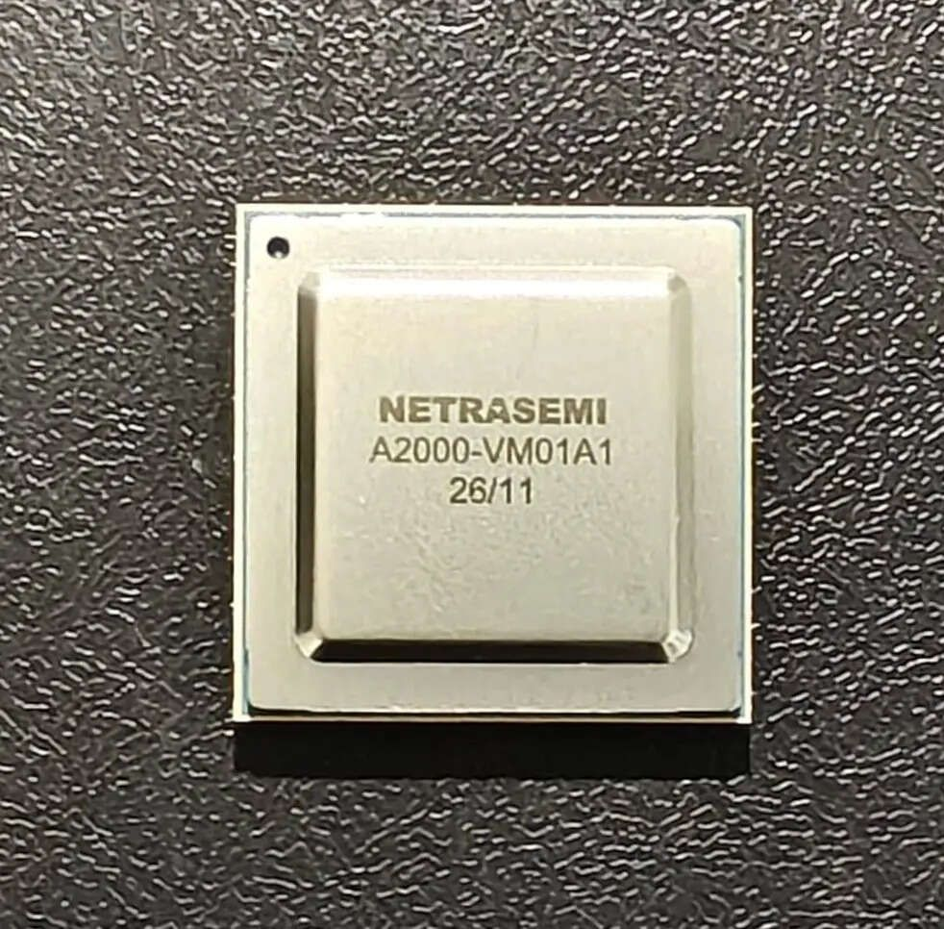
EXECUTIVE SUMMARY
A future indigenous compute alternative—not yet a commercial-vehicle ADAS competitor
Netrasemi · management posture: MONITOR QUALIFICATION
WHY IT MATTERS
Successful silicon bring-up; early customer trials reported in automotive and surveillance
WHERE IT WINS
Edge compute · component layer
WHAT IS NOT PROVEN
Automotive qualification, CV design win and 2027 production readiness remain open
MONITOR QUALIFICATION
Monitor qualification and production; compare silicon economics only when automotive proof emerges
DEEPGRID POSITION
EXECUTIVE DECISION
MONITOR QUALIFICATION · Evidence confidence: MEDIUM · Release resources only against a named buyer, proof metric and dated gate.
DEEPGRID SEMI · INDIA ADAS COMPETITOR DOSSIER · CONFIDENTIAL
65
Notes:
Executive summary for Netrasemi. Verdict: A future indigenous compute alternative—not yet a commercial-vehicle ADAS competitor. Evidence: Netrasemi official solutions and news pages, May 2026. Boundary: Automotive qualification, CV design win and 2027 production readiness remain open

Slide 66
COMPETITOR PROFILE
Netrasemi is a structural silicon option, not yet a proven India commercial-vehicle ADAS rival
Netrasemi · strongest arena: Edge compute · component layer
WHAT THEY SELL
A2000 indigenous edge-AI SoC for vision, DMS, surround view and fleet use cases
OPERATING PROOF
Successful silicon bring-up; early customer trials reported in automotive and surveillance
BUYER ARENA
Edge compute · component layer
EVIDENCE BOUNDARY
Automotive qualification, CV design win and 2027 production readiness remain open
SOURCE-DERIVED VISUAL
Netrasemi official solutions and news pages, May 2026
DEEPGRID RESPONSE
Monitor qualification and production; compare silicon economics only when automotive proof emerges
THREAT
LOW
DEEPGRID SEMI · INDIA ADAS COMPETITOR DOSSIER · CONFIDENTIAL
66
Notes:
Evidence status and sources: Netrasemi official solutions and news pages, May 2026
Boundary: Automotive qualification, CV design win and 2027 production readiness remain open
Response: Monitor qualification and production; compare silicon economics only when automotive proof emerges

Slide 67
COMPETITOR ANATOMY
Netrasemi provides indigenous edge-AI compute—not yet an automotive safety system
What it does · customer focus · technology stack · operating model
TECHNOLOGY & DELIVERY STACK
WHAT IT IS
OPERATING PROOF
Indian fabless edge-AI semiconductor company building general-purpose on-device vision compute that could enable automotive applications.
01
A2000 edge-AI SoC
Successful silicon bring-up, fundraising and company-reported early trials in automotive and surveillance use cases.
↓
02
CPU / AI acceleration and vision processing
↓
CUSTOMER & USE-CASE FOCUS
03
Multi-camera and on-device inference
OEMs and device makers seeking indigenous, low-latency AI compute for DMS, surround view, telematics and broader edge workloads.
↓
04
SDK, model deployment and application tooling
WHAT REMAINS UNKNOWN
↓
05
Board / module integration into customer products
AEC-Q100, ISO 26262 readiness, commercial-vehicle design wins and production ramp timing remain open.
HOW IT MAKES MONEY / SCALES
Sell silicon and development platforms to solution builders; convert engineering trials into volume programmes across several edge sectors.
SO WHAT FOR DEEPGRID
Monitor qualification and production; compare silicon economics only when automotive proof emerges
DEEPGRID SEMI · INDIA ADAS COMPETITOR DOSSIER · CONFIDENTIAL
67
Notes:
Detailed competitor narrative for Netrasemi. Source basis: Netrasemi official solutions and news pages, May 2026. Company-attributed claims remain bounded by: AEC-Q100, ISO 26262 readiness, commercial-vehicle design wins and production ramp timing remain open.

Slide 68
THREAT MECHANISM
Netrasemi wins only if its control point becomes the buyer’s deciding criterion
Threat mechanism → falsifier → management action
01
02
03
BUYER DECISION Edge compute · component layer
CONTROL POINT
→
CONVERSION MECHANISM
→
DISPLACEMENT RISK
A2000 edge SoC → 2027 production target
Edge compute · component layer
DeepGrid sits outside the chosen programme boundary
The threat becomes material only when this arena—not standalone perception—sets the supplier decision.
WHY THIS MATTERS
The buyer can prefer Netrasemi when edge compute · component layer matters more than standalone perception ownership.
FALSIFIER
Automotive qualification, CV design win and 2027 production readiness remain open
MANAGEMENT ACTION
Monitor qualification and production; compare silicon economics only when automotive proof emerges
DEEPGRID SEMI · INDIA ADAS COMPETITOR DOSSIER · CONFIDENTIAL
68
Notes:
Threat mechanism for Netrasemi. Fact boundary: Automotive qualification, CV design win and 2027 production readiness remain open. Source: Netrasemi official solutions and news pages, May 2026

Slide 69
PRODUCT & CONTROL POINTS
Netrasemi packages five control points—but only some create a defensible moat
Follow the system from sensing to the buyer relationship
01
02
03
04
05
A2000 edge SoC
→
Vision acceleration
→
Automotive use cases
→
Early customer trials
→
2027 production target
WHERE VALUE ACCRUES
A2000 indigenous edge-AI SoC for vision, DMS, surround view and fleet use cases
DEEPGRID OPENING
Monitor qualification and production; compare silicon economics only when automotive proof emerges
SALES MESSAGE
Do not sell against the whole stack; isolate the control point that Netrasemi cannot defend economically or locally.
DEEPGRID SEMI · INDIA ADAS COMPETITOR DOSSIER · CONFIDENTIAL
69
Notes:
Product chain synthesis for Netrasemi. Source: Netrasemi official solutions and news pages, May 2026. Interpretation is bounded by: Automotive qualification, CV design win and 2027 production readiness remain open

Slide 70
BUYER BATTLECARD
Netrasemi wins on india silicon narrative—and breaks at three proof or control boundaries
Sales battlecard: concede what is true, then move the buying criterion
CONCEDE
CHALLENGE
01
India silicon narrative
01
Qualification not public
02
Broad edge-AI applicability
02
No CV design win
03
Successful bring-up
03
Production ramp ahead
EVIDENCE BOUNDARY
Automotive qualification, CV design win and 2027 production readiness remain open
REFRAME
Monitor qualification and production; compare silicon economics only when automotive proof emerges
DEEPGRID SEMI · INDIA ADAS COMPETITOR DOSSIER · CONFIDENTIAL
70
Notes:
Sales battlecard for Netrasemi. Concessions are evidence-aligned. Challenges must not be stated as disqualifications without buyer validation. Source: Netrasemi official solutions and news pages, May 2026

Slide 71
SALES PLAY
DeepGrid can change the Netrasemi conversation with three persona-specific moves
Lead with the buyer’s objective; end with a measurable proof request
BUSINESS / PROCUREMENT
Engineering: compare toolchain
PROOF ASK
Lifecycle cost + local support
CHIEF ENGINEER
OEM: ask qualification roadmap
PROOF ASK
Same-ODD benchmark + integration effort
PROGRAMME / SAFETY
Board: monitor, do not overreact
PROOF ASK
Named responsibility matrix + release gate
STOP / ESCALATE
Escalate only when the buyer values DeepGrid’s bounded perception advantage and accepts the evidence plan.
NEXT MEETING OUTPUT
A named owner, a vehicle or programme, the comparison metric, data rights and a dated go / no-go gate.
DEEPGRID SEMI · INDIA ADAS COMPETITOR DOSSIER · CONFIDENTIAL
71
Notes:
Persona sales play for Netrasemi. Response: Monitor qualification and production; compare silicon economics only when automotive proof emerges. Evidence boundary: Automotive qualification, CV design win and 2027 production readiness remain open

Slide 72
USE-CASE CONCLUSION
Netrasemi is differentiated in three use cases—but each creates a specific DeepGrid opening
Close the competitor discussion with a use-case choice, not a generic threat label
01
DMS / OMS COMPUTE
02
SURROUND VIEW
03
FLEET EDGE AI
BUYER PROBLEM
BUYER PROBLEM
BUYER PROBLEM
On-device vision inference
Multi-camera processing
Local analytics and telematics
UNIQUE SOLUTION
UNIQUE SOLUTION
UNIQUE SOLUTION
A2000 edge-AI SoC
Integrated vision acceleration
Low-latency edge compute
WHERE DEEPGRID FITS
Monitor qualification and production; compare silicon economics only when automotive proof emerges
COMMERCIAL TEST
Select one named edge compute · component layer use case; agree the buyer metric, responsibility boundary and 90-day stop / scale gate.
DEEPGRID SEMI · INDIA ADAS COMPETITOR DOSSIER · CONFIDENTIAL
72
Notes:
Use-case conclusion for Netrasemi. Use cases: [('DMS / OMS COMPUTE', 'On-device vision inference', 'A2000 edge-AI SoC'), ('SURROUND VIEW', 'Multi-camera processing', 'Integrated vision acceleration'), ('FLEET EDGE AI', 'Local analytics and telematics', 'Low-latency edge compute')]. DeepGrid response: Monitor qualification and production; compare silicon economics only when automotive proof emerges. Source: Netrasemi official solutions and news pages, May 2026

Slide 73

EXECUTIVE SUMMARY
The structural OEM gatekeepers; DeepGrid must enter through their open subsystem boundaries
Incumbent Tier-1 cohort · management posture: ATTACH / BOUNDARY
WHY IT MATTERS
Bosch and Continental offer CV ADAS stacks; Valeo has an India CV nomination and localized VSS360 plan
WHERE IT WINS
OEM accountability · industrial scale
WHAT IS NOT PROVEN
Cohort view masks company-specific India programme differences
ATTACH / BOUNDARY
Do not displace the stack; attach at perception, data or cost control points with explicit safety boundaries
DEEPGRID POSITION
EXECUTIVE DECISION
ATTACH / BOUNDARY · Evidence confidence: HIGH · Release resources only against a named buyer, proof metric and dated gate.
DEEPGRID SEMI · INDIA ADAS COMPETITOR DOSSIER · CONFIDENTIAL
73
Notes:
Executive summary for Incumbent Tier-1 cohort. Verdict: The structural OEM gatekeepers; DeepGrid must enter through their open subsystem boundaries. Evidence: Bosch and Continental official CV pages · Valeo official India nomination, May 2026. Boundary: Cohort view masks company-specific India programme differences

Slide 74
COMPETITOR PROFILE
Bosch, Continental and Valeo win by controlling the complete OEM integration boundary
Incumbent Tier-1 cohort · strongest arena: OEM accountability · industrial scale
WHAT THEY SELL
Sensors, compute, software, braking/chassis integration, validation and global supply
OPERATING PROOF
Bosch and Continental offer CV ADAS stacks; Valeo has an India CV nomination and localized VSS360 plan
BUYER ARENA
OEM accountability · industrial scale
EVIDENCE BOUNDARY
Cohort view masks company-specific India programme differences
SOURCE-DERIVED VISUAL
Bosch and Continental official CV pages · Valeo official India nomination, May 2026
DEEPGRID RESPONSE
Do not displace the stack; attach at perception, data or cost control points with explicit safety boundaries
THREAT
STRUCTURAL
DEEPGRID SEMI · INDIA ADAS COMPETITOR DOSSIER · CONFIDENTIAL
74
Notes:
Evidence status and sources: Bosch and Continental official CV pages · Valeo official India nomination, May 2026
Boundary: Cohort view masks company-specific India programme differences
Response: Do not displace the stack; attach at perception, data or cost control points with explicit safety boundaries

Slide 75
COMPETITOR ANATOMY
Incumbent Tier-1s win by owning the complete sensor-to-actuation integration boundary
What it does · customer focus · technology stack · operating model
TECHNOLOGY & DELIVERY STACK
WHAT IT IS
OPERATING PROOF
Bosch, Continental and Valeo represent the full-stack incumbent model: sensors, compute, software, actuation and global programme accountability.
01
Radar, cameras and surround sensing
Established global CV safety portfolios, India engineering footprints and disclosed India-specific activity including Valeo’s CV nomination.
↓
02
Central / domain compute and ADAS software
↓
CUSTOMER & USE-CASE FOCUS
03
Vehicle network, braking and chassis interfaces
OEM platforms prioritizing one accountable supplier, validated safety functions, industrial capacity and worldwide lifecycle support.
↓
04
Simulation, validation and homologation
WHAT REMAINS UNKNOWN
↓
05
Global manufacturing, quality and OEM programme teams
Cohort-level comparison masks vendor-specific economics, architecture openness and exact India programme status.
HOW IT MAKES MONEY / SCALES
Bundle system breadth with embedded OEM relationships, amortize engineering across platforms and defend the integration boundary.
SO WHAT FOR DEEPGRID
Do not displace the stack; attach at perception, data or cost control points with explicit safety boundaries
DEEPGRID SEMI · INDIA ADAS COMPETITOR DOSSIER · CONFIDENTIAL
75
Notes:
Detailed competitor narrative for Incumbent Tier-1 cohort. Source basis: Bosch and Continental official CV pages · Valeo official India nomination, May 2026. Company-attributed claims remain bounded by: Cohort-level comparison masks vendor-specific economics, architecture openness and exact India programme status.

Slide 76
THREAT MECHANISM
Incumbent Tier-1 cohort wins only if its control point becomes the buyer’s deciding criterion
Threat mechanism → falsifier → management action
01
02
03
BUYER DECISION OEM accountability · industrial scale
CONTROL POINT
→
CONVERSION MECHANISM
→
DISPLACEMENT RISK
Multi-modal sensors → Global OEM accountability
OEM accountability · industrial scale
DeepGrid sits outside the chosen programme boundary
The threat becomes material only when this arena—not standalone perception—sets the supplier decision.
WHY THIS MATTERS
The buyer can prefer Incumbent Tier-1 cohort when oem accountability · industrial scale matters more than standalone perception ownership.
FALSIFIER
Cohort view masks company-specific India programme differences
MANAGEMENT ACTION
Do not displace the stack; attach at perception, data or cost control points with explicit safety boundaries
DEEPGRID SEMI · INDIA ADAS COMPETITOR DOSSIER · CONFIDENTIAL
76
Notes:
Threat mechanism for Incumbent Tier-1 cohort. Fact boundary: Cohort view masks company-specific India programme differences. Source: Bosch and Continental official CV pages · Valeo official India nomination, May 2026

Slide 77
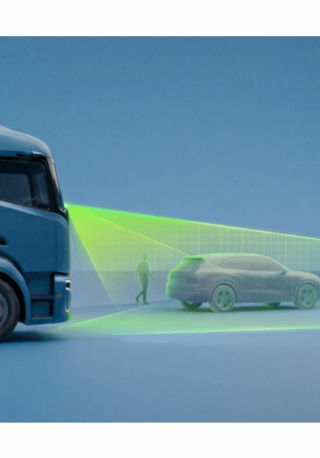
PRODUCT & CONTROL POINTS
Incumbent Tier-1 cohort packages five control points—but only some create a defensible moat
Follow the system from sensing to the buyer relationship
01
02
03
04
05
Multi-modal sensors
→
Central compute
→
ADAS software
→
Brake / chassis control
→
Global OEM accountability
WHERE VALUE ACCRUES
Sensors, compute, software, braking/chassis integration, validation and global supply
DEEPGRID OPENING
Do not displace the stack; attach at perception, data or cost control points with explicit safety boundaries
SALES MESSAGE
Do not sell against the whole stack; isolate the control point that Incumbent Tier-1 cohort cannot defend economically or locally.
DEEPGRID SEMI · INDIA ADAS COMPETITOR DOSSIER · CONFIDENTIAL
77
Notes:
Product chain synthesis for Incumbent Tier-1 cohort. Source: Bosch and Continental official CV pages · Valeo official India nomination, May 2026. Interpretation is bounded by: Cohort view masks company-specific India programme differences

Slide 78
BUYER BATTLECARD
Incumbent Tier-1 cohort wins on complete safety case—and breaks at three proof or control boundaries
Sales battlecard: concede what is true, then move the buying criterion
CONCEDE
CHALLENGE
01
Complete safety case
01
Higher organisational cost
02
Industrial capacity
02
Slower India-specific iteration
03
Entrenched OEM access
03
Closed-stack incentives
EVIDENCE BOUNDARY
Cohort view masks company-specific India programme differences
REFRAME
Do not displace the stack; attach at perception, data or cost control points with explicit safety boundaries
DEEPGRID SEMI · INDIA ADAS COMPETITOR DOSSIER · CONFIDENTIAL
78
Notes:
Sales battlecard for Incumbent Tier-1 cohort. Concessions are evidence-aligned. Challenges must not be stated as disqualifications without buyer validation. Source: Bosch and Continental official CV pages · Valeo official India nomination, May 2026

Slide 79
SALES PLAY
DeepGrid can change the Incumbent Tier-1 cohort conversation with three persona-specific moves
Lead with the buyer’s objective; end with a measurable proof request
BUSINESS / PROCUREMENT
OEM: sell the missing local layer
PROOF ASK
Lifecycle cost + local support
CHIEF ENGINEER
Tier-1: make integration bounded
PROOF ASK
Same-ODD benchmark + integration effort
PROGRAMME / SAFETY
Board: fund attach proof, not displacement
PROOF ASK
Named responsibility matrix + release gate
STOP / ESCALATE
Escalate only when the buyer values DeepGrid’s bounded perception advantage and accepts the evidence plan.
NEXT MEETING OUTPUT
A named owner, a vehicle or programme, the comparison metric, data rights and a dated go / no-go gate.
DEEPGRID SEMI · INDIA ADAS COMPETITOR DOSSIER · CONFIDENTIAL
79
Notes:
Persona sales play for Incumbent Tier-1 cohort. Response: Do not displace the stack; attach at perception, data or cost control points with explicit safety boundaries. Evidence boundary: Cohort view masks company-specific India programme differences

Slide 80
USE-CASE CONCLUSION
Incumbent Tier-1 cohort is differentiated in three use cases—but each creates a specific DeepGrid opening
Close the competitor discussion with a use-case choice, not a generic threat label
01
FULL CV ADAS
02
OEM ACCOUNTABILITY
03
LOCALIZED VSS360
BUYER PROBLEM
BUYER PROBLEM
BUYER PROBLEM
End-to-end safety functions
Global programme release
India CV safety suite
UNIQUE SOLUTION
UNIQUE SOLUTION
UNIQUE SOLUTION
Sensors, compute and actuation
Validation and industrial supply
Valeo one-box camera and radar architecture
WHERE DEEPGRID FITS
Do not displace the stack; attach at perception, data or cost control points with explicit safety boundaries
COMMERCIAL TEST
Select one named oem accountability · industrial scale use case; agree the buyer metric, responsibility boundary and 90-day stop / scale gate.
DEEPGRID SEMI · INDIA ADAS COMPETITOR DOSSIER · CONFIDENTIAL
80
Notes:
Use-case conclusion for Incumbent Tier-1 cohort. Use cases: [('FULL CV ADAS', 'End-to-end safety functions', 'Sensors, compute and actuation'), ('OEM ACCOUNTABILITY', 'Global programme release', 'Validation and industrial supply'), ('LOCALIZED VSS360', 'India CV safety suite', 'Valeo one-box camera and radar architecture')]. DeepGrid response: Do not displace the stack; attach at perception, data or cost control points with explicit safety boundaries. Source: Bosch and Continental official CV pages · Valeo official India nomination, May 2026

