Slide 1
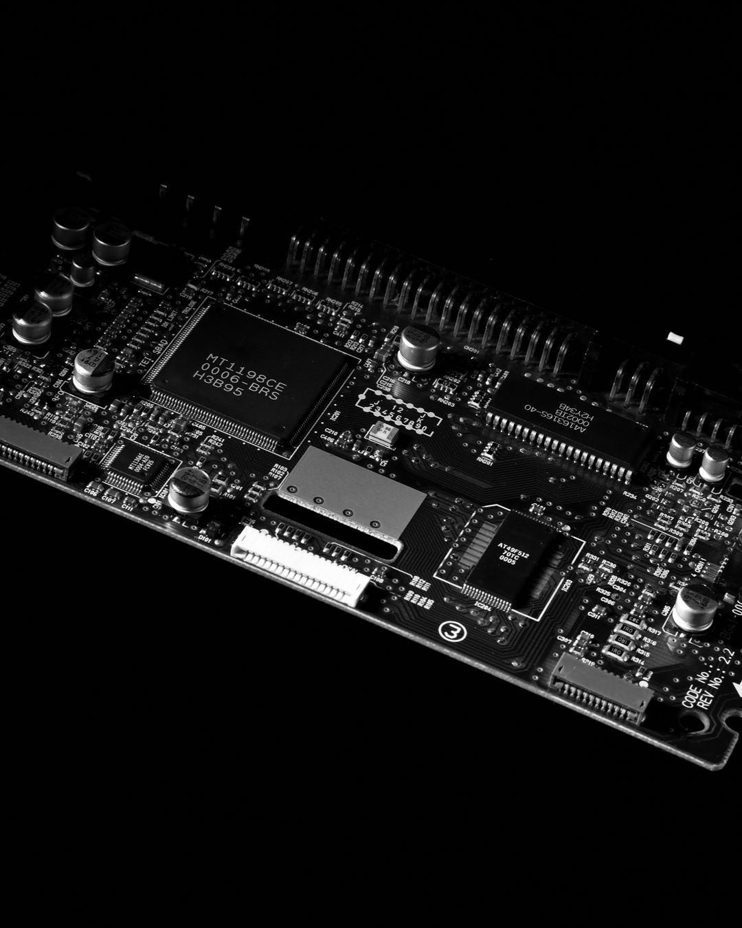
JUNE 2026
{{handle}}
{{tagline}}
Stop Overengineering Your Automation
The best solution has the fewest moving parts. Here's why.
→
SWIPE TO LEARN

Slide 2

JUNE 2026
{{handle}}
{{tagline}}
01
The Problem
Everyone wants the "scalable,
enterprise-ready, future-proof" version.
So they spend 3 months building
infrastructure instead of solving
the actual problem.
Meanwhile, a 20-line script
would've been done in 20 minutes.
20 lines. 20 minutes. Done.

Slide 3

JUNE 2026
{{handle}}
{{tagline}}
02
The Real Question
Here's the thing: before you pick
a framework, ask one question.
"Does a simple script solve this?"
If yes, you're done. Ship it.

Slide 4

JUNE 2026
{{handle}}
{{tagline}}
03
What Simple Looks Like
import requests
from bs4 import BeautifulSoup
page = requests.get(
"https://example.com/prices")
prices = [t.text for t in
BeautifulSoup(page.text)
.select(".price")]
Four lines. Runs anywhere.
No framework required.

Slide 5

JUNE 2026
{{handle}}
{{tagline}}
04
The Framework Trap
THE TRAP
THE FIX
Pick a framework first
Spend weeks on
infrastructure
Over-architect for
"future scale"
Never actually ship
Start with a script
Solve the actual
problem first
Add structure only
when it breaks
Ship today

Slide 6

JUNE 2026
{{handle}}
{{tagline}}
05
Dead Simple Test
01
Does it run?
02
Does it save someone time?
03
Can you explain it in one sentence?
If yes to all three — ship it. Stop adding things.

Slide 7

JUNE 2026
{{handle}}
{{tagline}}
The best scraper is the one that actually runs.
Not the one with the cleanest architecture,
the most tests, or the fanciest dashboard.
The one that runs. That's it.
{{brand_name}}
{{tagline}}

