Slide 1
EXECUTIVE STRATEGY DECK
MagicPath as a Pre-Sales Demo Accelerator
Compress the path from prospect brief to tailored clickable prototype by combining AI design generation, product capture, and coding-agent handoff.
Business Scenarios
POC Packaging
Sales Motion
Evidence Base
MagicPath Pre-Sales Demo Accelerator | June 2026
1 / 18

Slide 2
The Executive Thesis
MagicPath turns pre-sales from explanation into experience
MagicPath can materially compress the path from prospect brief to tailored clickable prototype by combining AI design generation, existing design/product capture, and coding-agent handoff into one workflow.
Buyer Problem
Sales Constraint
MagicPath Role
"Show me mine"
Demo gap
Same-cycle proof
Prospects need to see their workflow, data, systems, and operating language before they believe.
Generic demos undersell value; custom prototypes are usually too slow and expensive.
A tailored prototype becomes the artifact that converts discovery into scoped POC.
Commercial implication: the demo stops being a marketing asset and becomes the first implementation artifact.
MagicPath Pre-Sales Demo Accelerator | June 2026
2 / 18

Slide 3
The Pre-Sales Bottleneck
The moment deals slow down is the moment the prospect asks for relevance
Static mockup
Generic demo
Custom prototype
Looks polished but cannot prove the workflow, exception handling, or system fit.
Shows product capability but fails the buyer's mental test: would this work here?
High-conviction path, but often takes days or weeks of solution architect and developer time.
What needs to change
Move from 'we can explain the solution' to 'we can put a believable first version in the prospect's hands while the buying energy is still high.'
MagicPath Pre-Sales Demo Accelerator | June 2026
3 / 18

Slide 4
The MagicPath Acceleration Loop
A single workflow connects discovery, design, agent build, and demo
1
2
3
4
5
Prospect brief
→
MagicPath canvas
→
Agent handoff
→
Prototype build
→
Live demo
Industry, buyer, workflow, systems, metrics, objections
Prompt, Figma import, website capture, design systems
Codex / Claude Code / Cursor reads canvas context
Clickable flow, mock data, realistic states, integration placeholders
Prospect interacts; team captures changes as POC scope
Core operating principle: the design canvas becomes the sales spec, the coding agent becomes the demo builder, and the live prototype becomes the qualification artifact.
MagicPath Pre-Sales Demo Accelerator | June 2026
4 / 18

Slide 5
What Is Substantiated
Use source-backed claims with executives; avoid unbenchmarked promises
Shared human + agent canvas
MagicPath positions the product as a real-time canvas where humans and agents design together, with external agents including Claude Code, Codex, and Cursor.
MagicPath docs / homepage
Figma and web capture inputs
MagicPath documents Figma Connect and web/product capture paths, supporting the 'start from existing context' motion.
MagicPath Figma Connect; UX Tools
Code output and agent handoff
MagicPath describes code export and agent-driven workflows; recent Codex plugin messaging supports Codex as a design/build surface.
MagicPath docs; Codex plugin blog
Market validation of the pattern
Anthropic's Claude Design also validates the design-to-code handoff pattern through prototype generation and Claude Code handoff.
Anthropic Claude Design
Recommended wording: 'materially compress' and 'same-cycle prototype' are defensible; exact cost/time ratios should be based on internal benchmark runs.
MagicPath Pre-Sales Demo Accelerator | June 2026
5 / 18

Slide 6
Six Business Scenarios
Each demo turns a vertical workflow into a clickable proof-of-fit
1
Manufacturing
2
Legal
3
Healthcare
Buyer: VP Manufacturing / Plant VP
Buyer: Managing Partner / Legal Ops
Buyer: Practice Manager / COO
Predictive maintenance or quality dashboard with alerts, asset health, and SAP PM placeholder.
Contract review workspace with risk highlights, confidence, citations, and human approval.
Mobile intake flow plus staff dashboard with verification badges and EHR sync indicators.
Close signal: plant leader sees their downtime or scrap workflow.
Close signal: trust barrier drops because humans stay in control.
Close signal: ROI is obvious when intake time falls from minutes to seconds.
4
Financial Services
5
Construction
6
AI Readiness
Buyer: VP Mortgage Ops / Risk
Buyer: Project Director / Safety Lead
Buyer: CTO / Transformation Lead
Document processing console with extracted fields, source links, compliance checklist.
Site command center with progress, safety exceptions, imagery, and morning report.
Assessment portal with maturity radar, ranked use cases, ROI ranges, next-step CTAs.
Close signal: AI recommends; underwriter decides.
Close signal: current weekly reporting becomes daily operating intelligence.
Close signal: vague AI interest becomes three funded projects.
MagicPath Pre-Sales Demo Accelerator | June 2026
6 / 18

Slide 7
Scenario Playbook
What the sales team needs to prepare before the meeting
Scenario
Inputs
Prototype Moment
Next Commercial Step
Manufacturing
Plant layout, SAP PM/QM language, OEE/downtime metric
Asset health heatmap; alert-to-work-order flow
Predictive maintenance or quality POC
Legal
Template, clause taxonomy, review authority model
Upload → risk review → partner sign-off
Template-based review automation
Healthcare
Patient intake steps, insurance/EHR context, staffing pain
Mobile intake + staff verification dashboard
HIPAA-ready intake automation POC
Mortgage Ops
Borrower package, LOS context, underwriting checklist
Extraction review + compliance sign-off
Document AI + human adjudication POC
Construction
Site portfolio, reporting cadence, safety categories
Map → site drilldown → morning report
Computer vision and reporting POC
AI Readiness
Tech stack, data maturity, executive priorities
Wizard → recommendations → ROI cards
Paid discovery and roadmap sprint
MagicPath Pre-Sales Demo Accelerator | June 2026
7 / 18

Slide 8
Turn Demos Into Packaged POCs
The prototype should make the next purchase decision smaller and clearer
Lite
Focused POC
Production Pilot
$15K-$25K
$40K-$75K
$100K-$250K
2 weeks
4-6 weeks
8-12 weeks
Clickable prototype + workflow validation + data/integration plan
One workflow, one dataset, one operating dashboard, one success metric
Secure deployment, system integration, user testing, adoption workflow
Best for ambiguous AI readiness or early-stage prospects
Best default package after a vertical demo
Best when executive sponsor already owns budget
Pricing principle: MagicPath accelerates the demo, not the value. Charge for risk reduction, workflow specificity, and implementation confidence.
MagicPath Pre-Sales Demo Accelerator | June 2026
8 / 18

Slide 9
The Sales Operating Model
Define who does what so the workflow scales beyond founder-led demos
Account Exec
Owns discovery, buyer map, business pain, commercial next step
Solution Lead
Translates discovery into demo brief, workflow, metrics, data assumptions
MagicPath Operator
Creates canvas, imports context, refines screens, enforces brand/workflow realism
Coding Agent Lead
Turns canvas into clickable app, mock data, deployment, demo script
Repeatable artifact stack: discovery brief, MagicPath canvas, prototype repo, demo script, POC scope, post-demo decision memo.
MagicPath Pre-Sales Demo Accelerator | June 2026
9 / 18

Slide 10
ROI Logic For Sales Leaders
The business case is not only cheaper demos; it is higher conversion velocity
Cycle Compression
Qualification Quality
POC Conversion
Days, not weeks
Better mutual fit
Scoped next step
Earlier relevance reduces the dead zone after discovery.
Clickable workflows reveal integration, adoption, and sponsor gaps early.
The demo becomes the first draft of the POC statement of work.
Measure this motion with commercial metrics, not design metrics:
• Discovery-to-demo elapsed time
• Demo-to-POC conversion rate
• POC scope clarity at proposal stage
• Average sales cycle duration
• Solution architect hours per qualified demo
• Executive sponsor engagement after demo
MagicPath Pre-Sales Demo Accelerator | June 2026
10 / 18

Slide 11
Guardrails For Executive-Grade Demos
The prototype must feel specific without pretending to be production
1
Label assumptions
Mark mock data, placeholder integrations, and unverified AI outputs clearly.
2
Keep human approval visible
Legal, healthcare, finance, and safety demos should show review, override, and audit trails.
3
Use realistic domain language
Borrow the buyer's operating vocabulary: SAP PM, EHR sync, LOS, OEE, DTI, site safety.
4
Do not overclaim readiness
Demo acceleration does not remove security, compliance, integration, or change-management work.
5
Capture edits live
Every 'can it also do X?' becomes either a canvas update or a POC backlog item.
MagicPath Pre-Sales Demo Accelerator | June 2026
11 / 18

Slide 12
A 90-Second Demo Storyboard
Use the same narrative spine across every vertical
1. Open on pain
2. Reveal tailored UI
3. Click the exception
Show the exact workflow bottleneck the prospect described.
Use their language, systems, roles, and metrics.
Open an alert, flagged clause, intake issue, safety violation, or document mismatch.
4. Show human control
5. Create the next step
6. Ask for implementation data
Approve, reject, escalate, or assign; do not imply blind automation.
Generate work order, review queue, report, roadmap, or POC scope.
Shift from imagination to access: dataset, system, owner, timeline.
Rule: one interaction every 15 seconds. The buyer should touch the workflow, not watch a product tour.
MagicPath Pre-Sales Demo Accelerator | June 2026
12 / 18

Slide 13
Competitive Context
MagicPath wins when the demo motion needs multi-agent flexibility and external tooling
MagicPath-led motion
Claude Design pattern
Traditional custom demo
• Shared canvas for humans and agents
• Native Anthropic visual creation surface
• High control and production realism
• Figma import, web capture, prompt-to-design
• Prototype and handoff to Claude Code
• Slow and expensive for early-stage deals
• External agents: Codex, Claude Code, Cursor
• Validates the market direction
• Often requires scarce solution architect capacity
• Good fit for sales teams that need fast vertical prototypes
• Good fit when the team is standardized on Claude
• Best reserved for late-stage enterprise pursuits
MagicPath Pre-Sales Demo Accelerator | June 2026
13 / 18

Slide 14
30-Day Rollout Plan
Stand up the demo accelerator as a repeatable sales capability
Week 1
Build the demo library
Pick six vertical scenarios, define reusable prompts, components, mock datasets, and demo scripts.
Week 2
Create operating standards
Define intake brief, QA checklist, disclosure language, prototype repo structure, and handoff process.
Week 3
Pilot with live pursuits
Run 3-5 active opportunities through the workflow; measure elapsed time and buyer response.
Week 4
Package for scale
Convert best demos into reusable templates and align POC packages, pricing, and sales enablement.
Decision required: choose first three live opportunities and assign one MagicPath operator plus one coding-agent lead.
MagicPath Pre-Sales Demo Accelerator | June 2026
14 / 18

Slide 15
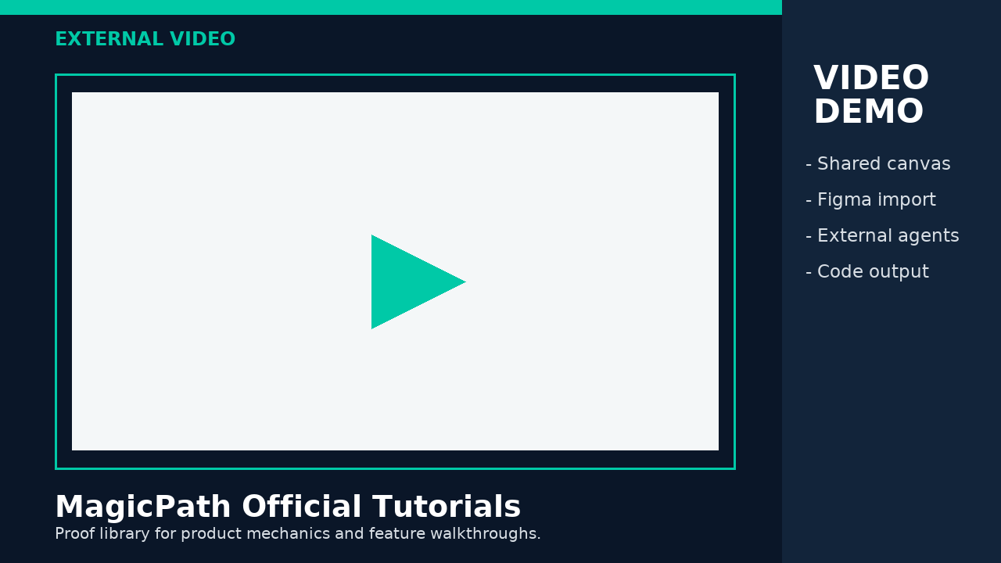
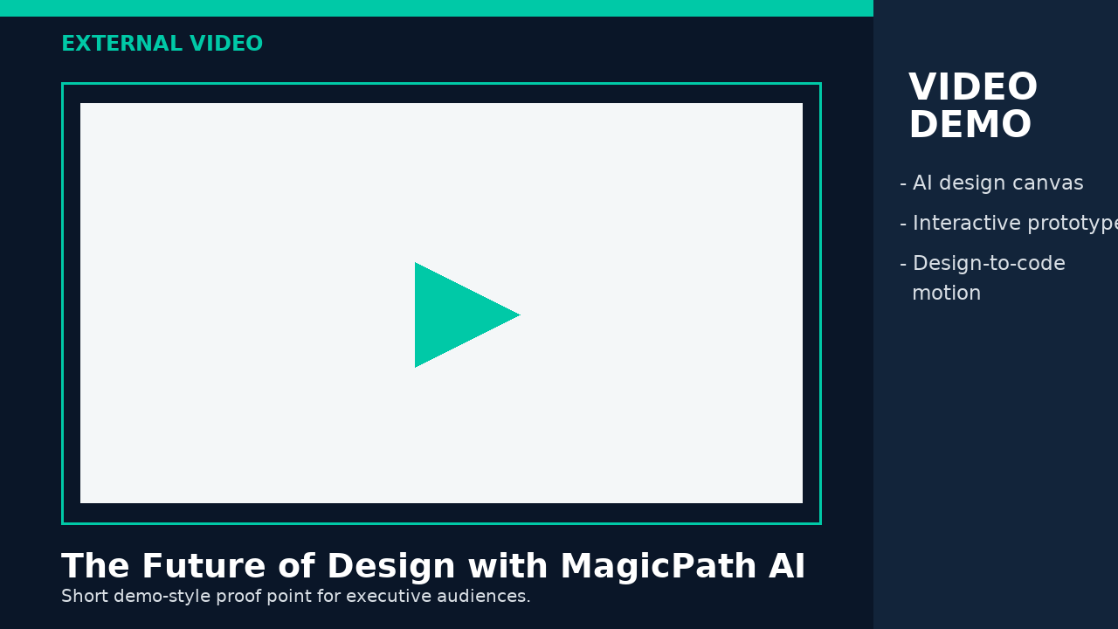
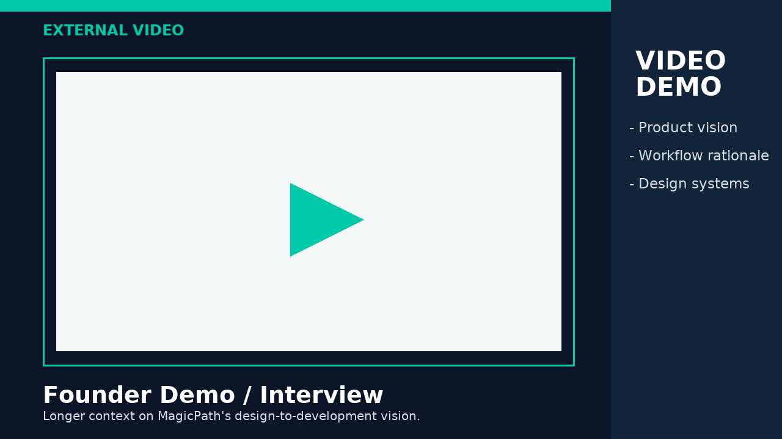
Short Demo Videos To Substantiate The Motion
External proof assets plus the talk track sales should use
MagicPath Official Tutorials
Pietro short demo
Founder demo/interview
Use this as the product proof library: canvas workflow, agent features, import/export mechanics.
Use this as the fast executive proof point: design surface to interactive prototype.
Use this when the buyer wants broader context on the design-to-development shift.
https://www.youtube.com/@MagicPathAI
https://www.youtube.com/watch?v=ZSOb2uijfSE
https://www.youtube.com/watch?v=LhCA5GzqbPU
Meeting usage: do not play long videos in full. Open 20-40 seconds, point to the workflow pattern, then switch to the tailored prospect demo.
MagicPath Pre-Sales Demo Accelerator | June 2026
15 / 18

Slide 16
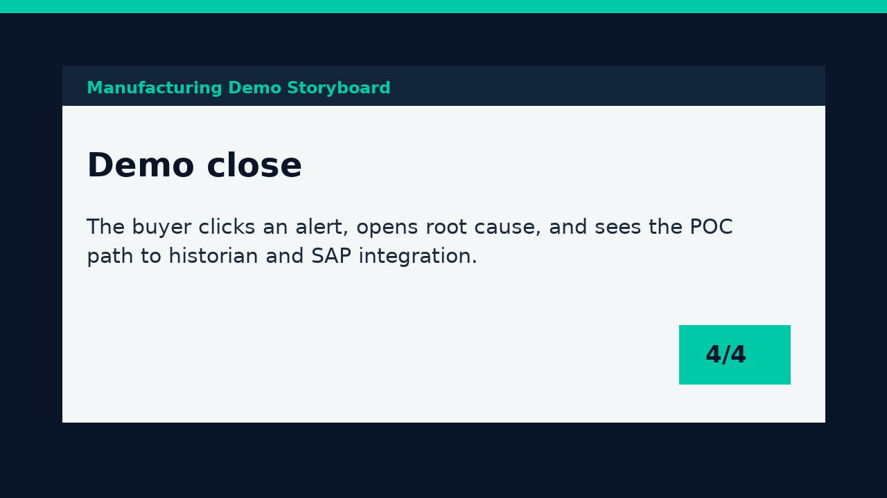
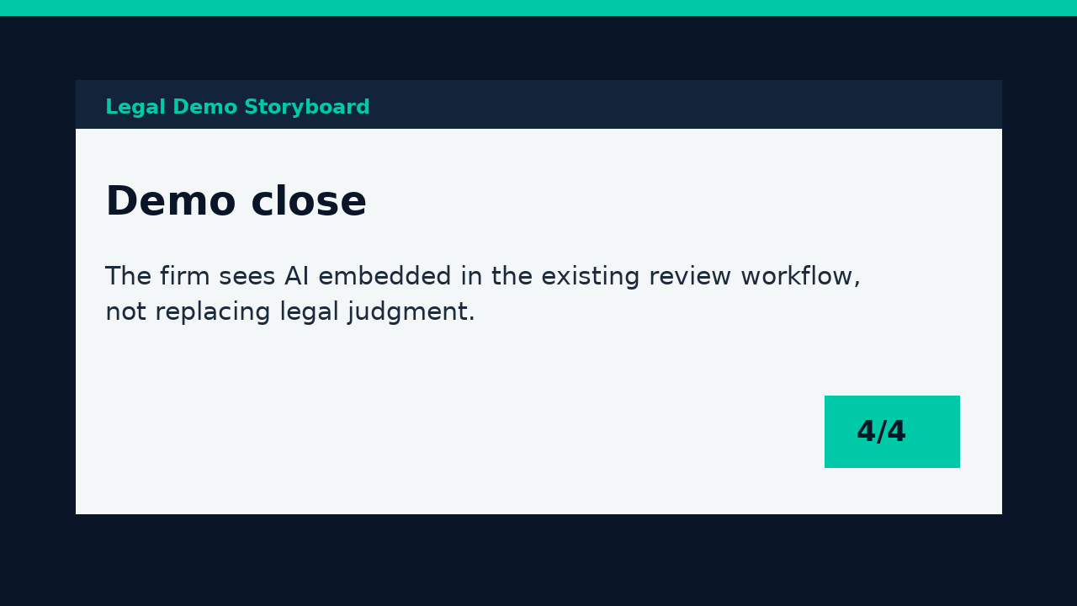

Short Demo Videos Built For This Deck
Local MP4 storyboards for the three highest-fit sales scenarios
Manufacturing
Legal
Healthcare
Alert-to-work-order demo for VP Manufacturing or Plant VP.
Contract-risk workflow for Managing Partner or Legal Ops.
Patient intake automation for Practice Manager or COO.
Local MP4: docs/reports/magicpath_presales_assets/manufacturing-demo-storyboard.mp4
Local MP4: docs/reports/magicpath_presales_assets/legal-demo-storyboard.mp4
Local MP4: docs/reports/magicpath_presales_assets/healthcare-demo-storyboard.mp4
These MP4s are short storyboard assets, not product recordings. Use them to tee up what the live MagicPath/Codex demo should prove.
MagicPath Pre-Sales Demo Accelerator | June 2026
16 / 18

Slide 17
How To Use Video In The Sales Meeting
A short video should accelerate belief, then hand off to the live tailored prototype
0:00-0:20
Pattern proof
Play a MagicPath clip showing design-to-prototype mechanics.
0:20-0:45
Vertical relevance
Show the local storyboard for the buyer's industry scenario.
0:45-1:30
Tailored demo
Switch to the prospect-specific clickable prototype and let the buyer drive.
1:30-2:00
POC bridge
Convert questions into data access, integration scope, owners, and success metrics.
Never let the video become the demo. The video validates the workflow pattern; the tailored prototype closes the relevance gap.
MagicPath Pre-Sales Demo Accelerator | June 2026
17 / 18

Slide 18
Sources And Recommended Proof Assets
Use these links to substantiate the deck and build the demo library
MagicPath documentation
https://www.magicpath.ai/documentation
Official product claims: shared canvas, agents, design systems, code export.
MagicPath homepage
https://www.magicpath.ai/
External agents and design-code workflow positioning.
MagicPath Figma Connect
https://www.magicpath.ai/documentation/features/figma-connect
Figma import / interactive prototype workflow.
MagicPath Codex plugin
https://www.magicpath.ai/blog/magicpath-official-codex-plugin
Codex plugin announcement and agentic app workflow.
UX Tools article
https://www.uxtools.co/blog/3-ways-magicpath-closes-the-design-to-code-gap
Third-party validation of Figma, live product, prompt, and code output paths.
Anthropic Claude Design
https://www.anthropic.com/news/claude-design-anthropic-labs
Market validation of prototype-to-Claude-Code handoff pattern.
MagicPath YouTube
https://www.youtube.com/@MagicPathAI
Tutorials and demo videos for sales enablement.
Deck status: reviewed after PPTX structural validation and preview render. Video-card slides link to external proof assets and local storyboard MP4s; claims requiring internal benchmarks are framed as hypotheses or recommended metrics.
MagicPath Pre-Sales Demo Accelerator | June 2026
18 / 18

