Slide 1
SEMICONDUCTOR STARTUP LANDSCAPE · JULY 2026
The 10 Coolest Semiconductor Startups of 2026
A public-evidence screen for channel, alliance, and ecosystem validation priorities
10 companies · 3 partner lenses · 44-slide decision deck
Based on CRN’s July 15, 2026 cohort; research updated through July 29, 2026.
Semiconductor Startup Landscape · 2026
1 / 44
Notes:
Speaker implication: A public-evidence screen for channel, alliance, and ecosystem validation priorities
Visible citation: Based on CRN’s July 15, 2026 cohort; research updated through July 29, 2026.
Evidence URLs:
- https://www.crn.com/news/computing/2026/the-10-coolest-semiconductor-startups-of-2026-so-far

Slide 2
EXECUTIVE SUMMARY
Public evidence supports a validation portfolio—not a named-partner recommendation
The CRN-selected cohort reveals partnerable wedges, but organization-specific fit still requires calibration.
ACT NOW
VALIDATE NEXT
MONITOR
Validate production-ready offers where software, supply, and deployment evidence are already visible.
Test technically compelling platforms whose partner motion depends on workload or ecosystem proof.
Track pre-scale bets until tape-out, availability, and reference-customer evidence improve.
BOTTOM LINE
Scope: CRN’s ten-company closed cohort; candidate archetype-readiness judgments, not an exhaustive market ranking.
CRN; Gartner; company announcements.
Semiconductor Startup Landscape · 2026
2 / 44
Notes:
Speaker implication: Public evidence can prioritize validation questions by partner archetype without claiming organization-specific right-to-win.
Visible citation: CRN; Gartner; company announcements.
Evidence URLs:
- https://www.crn.com/news/computing/2026/the-10-coolest-semiconductor-startups-of-2026-so-far
- https://www.gartner.com/en/newsroom/press-releases/2026-04-08-gartner-forecasts-worldwide-semiconductor-revenue-to-exceed-us-dollars-one-point-3-trillion-in-2026

Slide 3
STRATEGIC THESIS
The partner opportunity sits in heterogeneous infrastructure—not wholesale GPU replacement
Most wedges can enter beside incumbent accelerators, networks, or software stacks.
LAND
INTEGRATE
EXPAND
Solve one painful workload or link bottleneck
→
Coexist with GPUs, CPUs, fabrics, and cloud workflows
→
Broaden the system footprint after software and supply prove out
This favors partners that can provide integration, validation, deployment, and customer access—not just component resale.
Tenstorrent; d-Matrix; Cornelis; Lightmatter; Xsight Labs.
Semiconductor Startup Landscape · 2026
3 / 44
Notes:
Speaker implication: The cohort’s most plausible adoption paths complement existing infrastructure before displacing it.
Visible citation: Tenstorrent; d-Matrix; Cornelis; Lightmatter; Xsight Labs.
Evidence URLs:
- https://tenstorrent.com/newsroom/tenstorrent-sets-new-performance-records-launches-tt--ascalon-s
- https://www.d-matrix.ai/announcements/d-matrix-corsair-ai-inference-platform-enters-full-production-to-meet-customer-demand/
- https://lightmatter.co/press-release/lightmatter-unveils-passage-m1000-photonic-superchip-worlds-fastest-ai-interconnect/
- https://www.cornelis.com/
- https://xsightlabs.com/newsroom/announcements/xsight-labs-announces-x2-programmable-sdn-ethernet-switches-for-hyperscale-and-edge-data-centers-optimized-for-the-ai-factory-era

Slide 4
PARTNER PLAYBOOK
Adoption barriers create the partner value pool
The harder the integration, qualification, and operating transition, the more valuable a capable ecosystem becomes.
VALIDATE
INTEGRATE
Benchmark target workloads with transparent methods and incumbent baselines.
Package silicon with servers, networking, software, orchestration, and support.
DEPLOY
OPERATE
Build repeatable reference architectures for edge, inference, HPC, and AI fabrics.
Provide observability, lifecycle management, and workload migration services.
Implications derived from company go-to-market and product evidence.
Semiconductor Startup Landscape · 2026
4 / 44
Notes:
Speaker implication: Partners can create value through workload validation, system integration, deployment, and managed operations.
Visible citation: Implications derived from company go-to-market and product evidence.
Evidence URLs:
- https://axelera.ai/news/axelera-ai-secures-more-than-250-million-funding-on-global-commercial-growth
- https://tenstorrent.com/newsroom/tenstorrent-sets-new-performance-records-launches-tt--ascalon-s
- https://www.d-matrix.ai/announcements/d-matrix-corsair-ai-inference-platform-enters-full-production-to-meet-customer-demand/
- https://www.cornelis.com/
- https://lightmatter.co/press-release/lightmatter-unveils-passage-m1000-photonic-superchip-worlds-fastest-ai-interconnect/
- https://xsightlabs.com/newsroom/announcements/xsight-labs-announces-x2-programmable-sdn-ethernet-switches-for-hyperscale-and-edge-data-centers-optimized-for-the-ai-factory-era

Slide 5
COHORT MAP
Four bottlenecks define the closed-cohort market map
The strategic question is where each company inserts into the stack.
EDGE DEPLOYMENT
Axelera AI
Efficient inference + partner ecosystem
ADAPTABLE COMPUTE
Tenstorrent · NextSilicon
RISC-V/IP and runtime-reconfigurable dataflow
INFERENCE SPECIALISTS
Fractile · Etched · d-Matrix · MatX
Workload-specific latency, throughput, and memory
INTERCONNECT
Cornelis · Lightmatter · Xsight
Scale-out fabrics, photonics, and programmable Ethernet
CRN; company product pages.
Semiconductor Startup Landscape · 2026
5 / 44
Notes:
Speaker implication: The ten companies address edge deployment, compute architecture, inference economics, or scale-out connectivity.
Visible citation: CRN; company product pages.
Evidence URLs:
- https://www.crn.com/news/computing/2026/the-10-coolest-semiconductor-startups-of-2026-so-far

Slide 6
BUSINESS MODEL LENS
Four commercialization models translate architecture into revenue
The silicon is only one layer of the offer; control of software, systems, and distribution shapes the model.
CHIPS + SYSTEMS
IP + PLATFORM
Fractile · Etched · d-Matrix · MatX Capture value through accelerator cards, racks, and software optimized for a narrow workload.
Tenstorrent License CPU and AI cores while also selling complete developer and infrastructure systems.
COMPONENT + DESIGN-IN
PARTNER-LED DEPLOYMENT
Lightmatter · Xsight · Cornelis Win sockets inside packages, switches, and fabrics through long design and qualification cycles.
Axelera AI · ecosystem-capable peers Use OEMs, integrators, software vendors, and solution partners to reduce adoption friction.
Business-model synthesis from company product and partner evidence.
Semiconductor Startup Landscape · 2026
6 / 44
Notes:
Speaker implication: The cohort monetizes through chips and systems, licensable IP, infrastructure components, or partner-enabled platforms.
Visible citation: Business-model synthesis from company product and partner evidence.
Evidence URLs:
- https://axelera.ai/news/axelera-ai-secures-more-than-250-million-funding-on-global-commercial-growth
- https://tenstorrent.com/newsroom/tenstorrent-sets-new-performance-records-launches-tt--ascalon-s
- https://www.d-matrix.ai/announcements/d-matrix-corsair-ai-inference-platform-enters-full-production-to-meet-customer-demand/
- https://www.cornelis.com/
- https://lightmatter.co/press-release/lightmatter-unveils-passage-m1000-photonic-superchip-worlds-fastest-ai-interconnect/
- https://xsightlabs.com/newsroom/announcements/xsight-labs-announces-x2-programmable-sdn-ethernet-switches-for-hyperscale-and-edge-data-centers-optimized-for-the-ai-factory-era

Slide 7
IDEAL CUSTOMER PROFILES
The addressable buyer is defined by workload pain—not company size alone
Each ICP has a different proof threshold, buying center, and adoption clock.
HYPERSCALERS + FRONTIER LABS
HPC + RESEARCH
d-Matrix · Etched · MatX · Lightmatter · Xsight Inference economics, bandwidth density, custom scale
NextSilicon · Cornelis · Tenstorrent Irregular workloads, predictable fabrics, energy efficiency
SOVEREIGN + ENTERPRISE AI
EDGE OEMs + SOLUTION BUILDERS
Tenstorrent · d-Matrix · Axelera Control, programmability, deployment support
Axelera AI · selected Tenstorrent systems Low power, compact form factor, fast integration
ICP synthesis from company-stated target workloads and deployment models.
Semiconductor Startup Landscape · 2026
7 / 44
Notes:
Speaker implication: The cohort’s primary ICPs are hyperscalers/frontier labs, HPC institutions, sovereign and enterprise AI operators, and edge OEMs.
Visible citation: ICP synthesis from company-stated target workloads and deployment models.
Evidence URLs:
- https://axelera.ai/news/axelera-ai-secures-more-than-250-million-funding-on-global-commercial-growth
- https://tenstorrent.com/newsroom/tenstorrent-sets-new-performance-records-launches-tt--ascalon-s
- https://www.nextsilicon.com/insights/nextsilicon-breakthrough/
- https://www.d-matrix.ai/announcements/d-matrix-corsair-ai-inference-platform-enters-full-production-to-meet-customer-demand/
- https://www.cornelis.com/
- https://lightmatter.co/press-release/lightmatter-unveils-passage-m1000-photonic-superchip-worlds-fastest-ai-interconnect/
- https://xsightlabs.com/newsroom/announcements/xsight-labs-announces-x2-programmable-sdn-ethernet-switches-for-hyperscale-and-edge-data-centers-optimized-for-the-ai-factory-era

Slide 8
GO-TO-MARKET MOTIONS
Semiconductor GTM progresses from design influence to repeatable deployment
Revenue arrives after technical validation, software integration, and supply assurance—not after a strong benchmark alone.
01 LIGHTHOUSE
02 DESIGN-IN
Co-develop on a painful workload with a technically credible buyer.
Secure software, board, package, network, and supply-chain integration.
03 REFERENCE
04 REPLICATE
Publish repeatable architecture, benchmark method, and operating model.
Scale through OEM, cloud, integrator, and software ecosystem partners.
GTM synthesis from company availability, partner, and deployment evidence.
Semiconductor Startup Landscape · 2026
8 / 44
Notes:
Speaker implication: The most credible GTM sequence is lighthouse validation, design-in, reference deployment, and ecosystem replication.
Visible citation: GTM synthesis from company availability, partner, and deployment evidence.
Evidence URLs:
- https://axelera.ai/news/axelera-ai-secures-more-than-250-million-funding-on-global-commercial-growth
- https://tenstorrent.com/newsroom/tenstorrent-sets-new-performance-records-launches-tt--ascalon-s
- https://www.nextsilicon.com/insights/nextsilicon-breakthrough/
- https://www.d-matrix.ai/announcements/d-matrix-corsair-ai-inference-platform-enters-full-production-to-meet-customer-demand/
- https://lightmatter.co/press-release/lightmatter-unveils-passage-m1000-photonic-superchip-worlds-fastest-ai-interconnect/
- https://xsightlabs.com/newsroom/announcements/xsight-labs-announces-x2-programmable-sdn-ethernet-switches-for-hyperscale-and-edge-data-centers-optimized-for-the-ai-factory-era

Slide 9
PARTNER VALUE CHAIN
Partners compound value from workload proof through lifecycle operations
Each stage reduces a distinct adoption risk for the startup and the buyer.
PROVE
PACKAGE
REPLICATE
Benchmark a named workload with transparent baselines
→
Integrate silicon, systems, software, networking, and support
→
Deploy reference architectures and operate them repeatedly
The highest-leverage partner is the one that converts technical advantage into a repeatable production outcome.
Tenstorrent; d-Matrix; Cornelis; Lightmatter; Xsight Labs.
Semiconductor Startup Landscape · 2026
9 / 44
Notes:
Speaker implication: The cohort’s most plausible adoption paths complement existing infrastructure before displacing it.
Visible citation: Tenstorrent; d-Matrix; Cornelis; Lightmatter; Xsight Labs.
Evidence URLs:
- https://tenstorrent.com/newsroom/tenstorrent-sets-new-performance-records-launches-tt--ascalon-s
- https://www.d-matrix.ai/announcements/d-matrix-corsair-ai-inference-platform-enters-full-production-to-meet-customer-demand/
- https://lightmatter.co/press-release/lightmatter-unveils-passage-m1000-photonic-superchip-worlds-fastest-ai-interconnect/
- https://www.cornelis.com/
- https://xsightlabs.com/newsroom/announcements/xsight-labs-announces-x2-programmable-sdn-ethernet-switches-for-hyperscale-and-edge-data-centers-optimized-for-the-ai-factory-era

Slide 10
COHORT OVERVIEW
The ten startups span four wedges and uneven commercialization stages
The overview is a navigation aid—not a risk-adjusted ranking.
COMPANY | WEDGE | PUBLIC STAGE SIGNAL | LIKELY ENTRY MOTION
Axelera AI | Edge deployment | Shipping platform | Partner-led ecosystem
Tenstorrent | Open compute | Products + IP | Direct + licensing
NextSilicon | Adaptive dataflow | Product-volume claim | HPC design-in
Fractile | Frontier inference | Pre-scale | Lighthouse co-development
Etched | Transformer ASIC | Pre-scale | Hyperscale design-in
d-Matrix | In-memory inference | Full production | System validation
MatX | LLM accelerator | Pre-tape-out | Frontier-lab co-design
Cornelis | Cluster fabric | Commercial portfolio | HPC integration
Lightmatter | Photonic I/O | Reference platform | Packaging ecosystem
Xsight Labs | Ethernet silicon | Customer sampling | NOS/OEM design-in
CRN; official company product and financing announcements.
Semiconductor Startup Landscape · 2026
10 / 44
Notes:
Speaker implication: The ten companies differ more by insertion point and readiness evidence than by a single accelerator-versus-GPU frame.
Visible citation: CRN; official company product and financing announcements.
Evidence URLs:
- https://www.crn.com/news/computing/2026/the-10-coolest-semiconductor-startups-of-2026-so-far
- https://www.gartner.com/en/newsroom/press-releases/2026-04-08-gartner-forecasts-worldwide-semiconductor-revenue-to-exceed-us-dollars-one-point-3-trillion-in-2026
- https://axelera.ai/news/axelera-ai-secures-more-than-250-million-funding-on-global-commercial-growth
- https://tenstorrent.com/newsroom/tenstorrent-sets-new-performance-records-launches-tt--ascalon-s
- https://www.nextsilicon.com/insights/nextsilicon-breakthrough/
- https://www.fractile.ai/news/fractile-raises-220m-to-build-the-next-generation-of-inference-hardware
- https://www.etched.com/progress
- https://www.d-matrix.ai/announcements/d-matrix-corsair-ai-inference-platform-enters-full-production-to-meet-customer-demand/
- https://www.d-matrix.ai/announcements/d-matrix-raises-275-million-to-power-the-age-of-ai-inference/
- https://www.cornelis.com/
- https://www.cornelis.com/stories/cornelis-networks-announces-29m-series-b-funding-round
- https://lightmatter.co/press-release/lightmatter-unveils-passage-m1000-photonic-superchip-worlds-fastest-ai-interconnect/
- https://lightmatter.co/press-release/lightmatter-raises-400m-series-d-quadruples-valuation-to-4-4b-as-photonics-leader-for-next-gen-ai-data-centers/
- https://matx.com/research/series_b
- https://xsightlabs.com/newsroom/announcements/xsight-labs-announces-x2-programmable-sdn-ethernet-switches-for-hyperscale-and-edge-data-centers-optimized-for-the-ai-factory-era

Slide 11
SECTION 01 · COMPUTE
Seven companies are redesigning where and how AI computation happens
From efficient edge inference to transformer-only and memory-centric accelerators.
CRN cohort taxonomy.
Semiconductor Startup Landscape · 2026
11 / 44
Notes:
Speaker implication: The compute cohort spans broad programmable platforms and highly specialized inference systems.
Visible citation: CRN cohort taxonomy.
Evidence URLs:
- https://www.crn.com/news/computing/2026/the-10-coolest-semiconductor-startups-of-2026-so-far

Slide 12
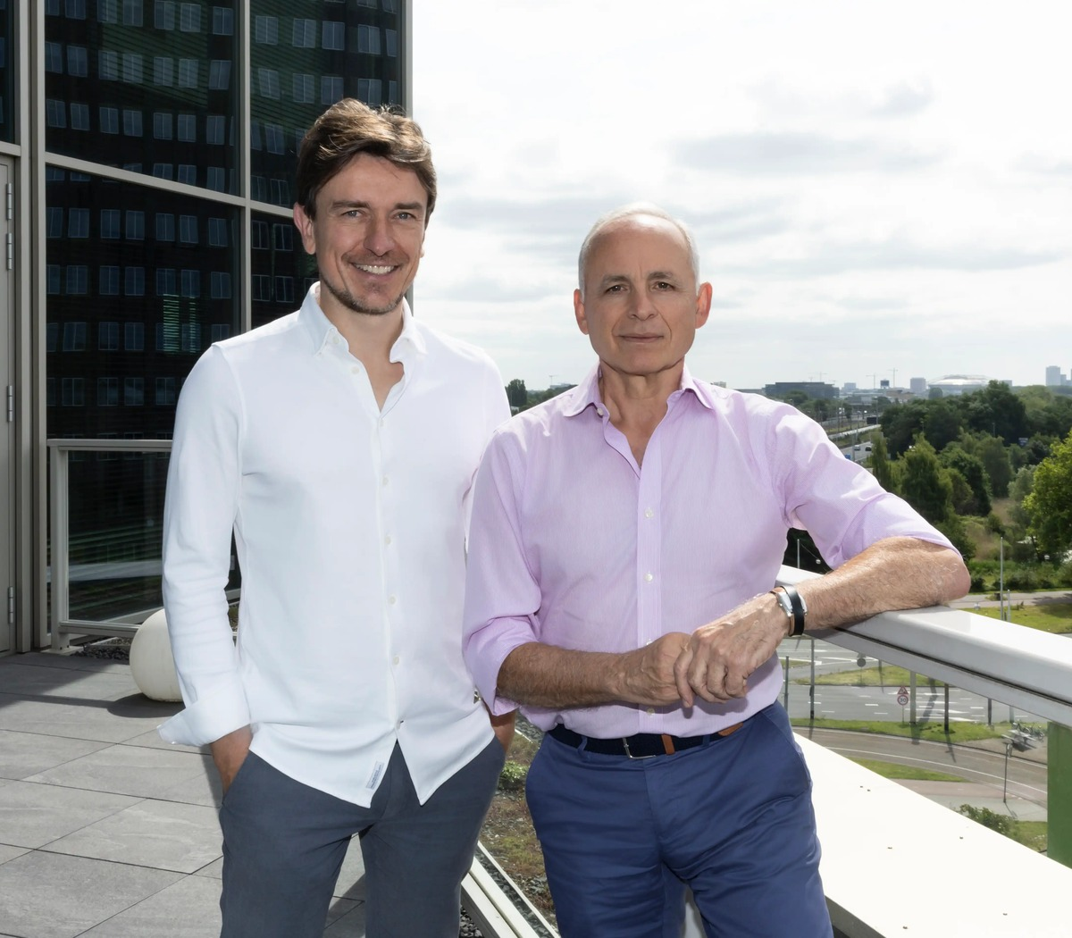
AXELERA AI
EDGE + ECOSYSTEM
Axelera turns edge acceleration into a deployment ecosystem
Efficient AI hardware is paired with software, systems, and a partner-led route to production.
WEDGE
PROOF
Purpose-built inference for computer vision and generative AI from edge systems toward data centers.
More than $250M raised in 2026; Metis platform shipping and broader manufacturing scale planned.
ICP + GTM
RISK
Partner Accelerator Network links software vendors, model makers, integrators, and solution providers.
Must translate funding and partner breadth into repeatable deployments and supply scale.
OFFICIAL SITE VISUAL · AXELERA AI
Axelera AI, Feb. 24, 2026.
Semiconductor Startup Landscape · 2026
12 / 44
Notes:
Speaker implication: Axelera’s differentiator combines edge-focused acceleration with an explicit partner network and more than $250 million of new funding.
Visible citation: Axelera AI, Feb. 24, 2026.
Evidence URLs:
- https://axelera.ai/news/axelera-ai-secures-more-than-250-million-funding-on-global-commercial-growth
- https://axelera.ai/news/axelera-ai-secures-more-than-250-million-funding-on-global-ai-demand

Slide 13
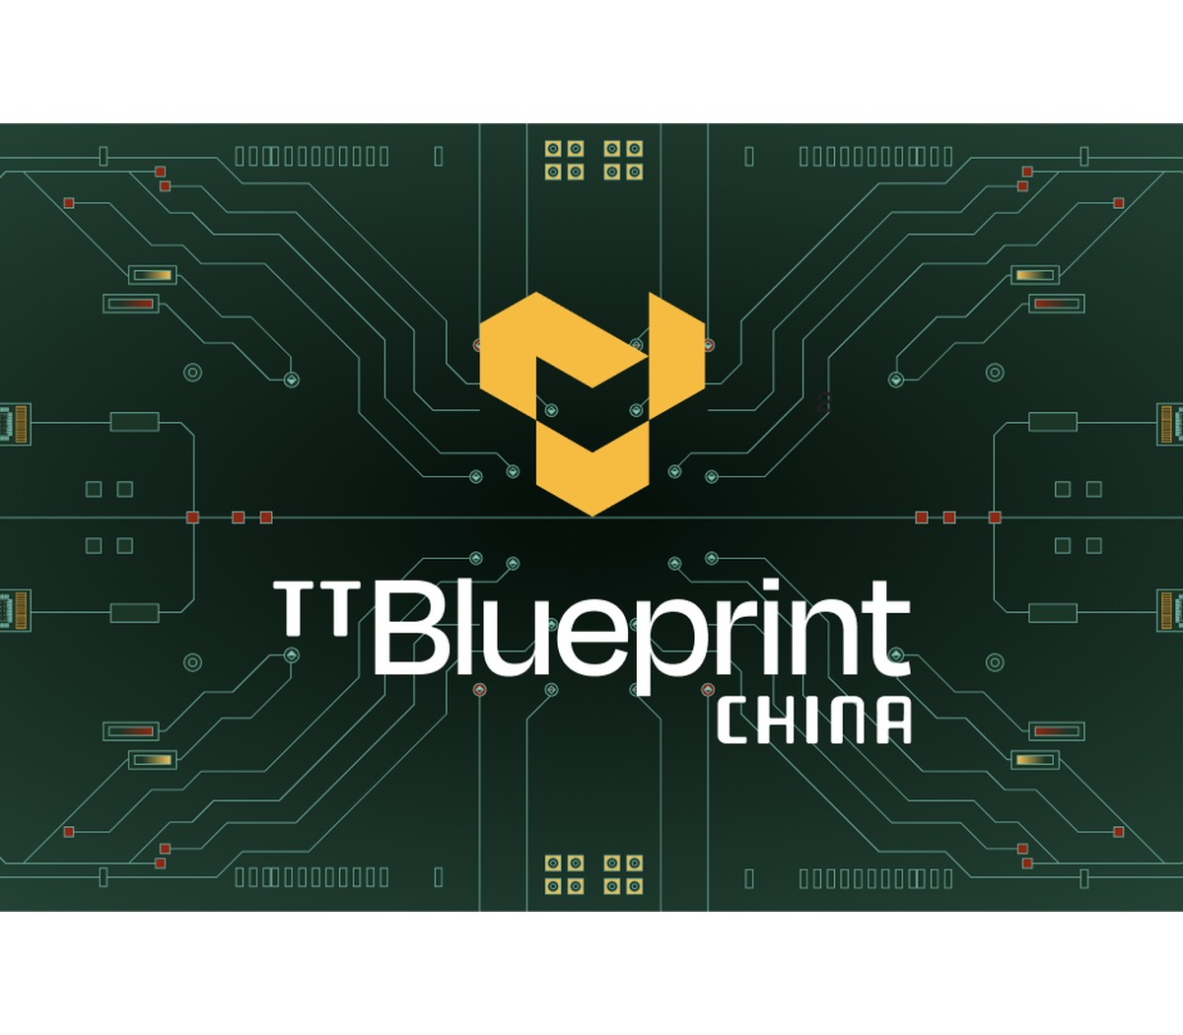
TENSTORRENT
OPEN COMPUTE
Tenstorrent attacks lock-in with a programmable system and licensable IP
Its portfolio spans AI processors, Galaxy systems, Tensix cores, and high-performance RISC-V.
WEDGE
PROOF
Open, programmable AI compute plus RISC-V CPU IP rather than a closed accelerator-only product.
TT-Ascalon S launched in June 2026; CRN reports more than $1B raised and global operations.
ICP + GTM
RISK
Sell systems, license CPU/AI cores, or deploy beside GPUs in sovereign and enterprise infrastructure.
Software maturity and ecosystem adoption must keep pace with a broad hardware portfolio.
OFFICIAL SITE VISUAL · TENSTORRENT
Tenstorrent, Jun. 30, 2026; CRN.
Semiconductor Startup Landscape · 2026
13 / 44
Notes:
Speaker implication: Tenstorrent’s TT-Ascalon S expands its open compute strategy into branch-heavy agentic workloads.
Visible citation: Tenstorrent, Jun. 30, 2026; CRN.
Evidence URLs:
- https://tenstorrent.com/newsroom/tenstorrent-sets-new-performance-records-launches-tt--ascalon-s
- https://www.crn.com/news/computing/2026/the-10-coolest-semiconductor-startups-of-2026-so-far
- https://tenstorrent.com/vision/tenstorrent-announces-availability-of-tt-ascalon

Slide 14
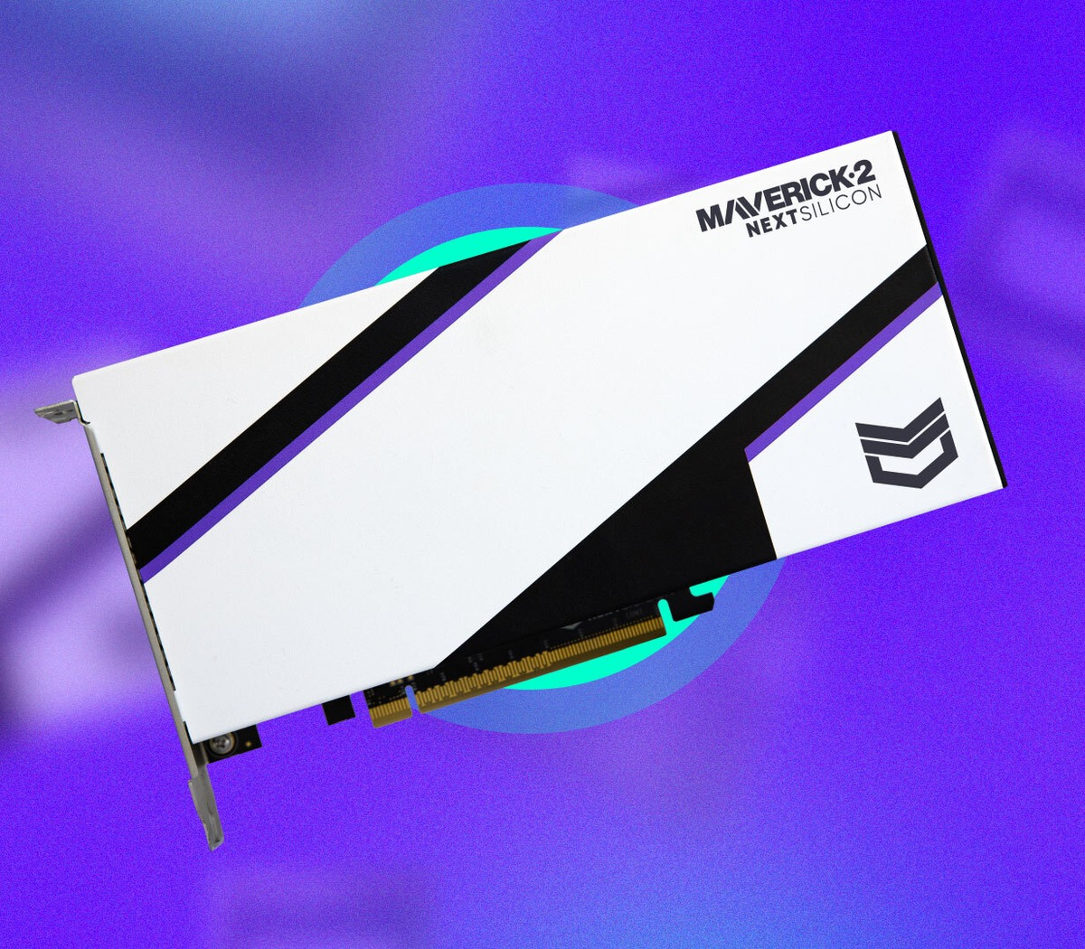
NEXTSILICON
ADAPTIVE DATAFLOW
NextSilicon makes the accelerator adapt to code at runtime
Maverick-2 targets irregular HPC and AI workloads without forcing application rewrites.
WEDGE
PROOF
A software-learning Intelligent Compute Architecture dynamically configures dataflow hardware.
$303M reported funding; product-volume availability and partner deployments announced.
ICP + GTM
RISK
Algorithmically complex HPC, AI, and vector workloads using existing C++, Python, or Fortran code.
Bold performance-per-watt claims need broad independent workload validation.
OFFICIAL SITE VISUAL · NEXTSILICON
NextSilicon, Oct. 22, 2025. Performance figures are vendor claims.
Semiconductor Startup Landscape · 2026
14 / 44
Notes:
Speaker implication: NextSilicon says Maverick-2 uses runtime-reconfigurable dataflow and was available in product volumes in Q4 2025.
Visible citation: NextSilicon, Oct. 22, 2025. Performance figures are vendor claims.
Evidence URLs:
- https://www.nextsilicon.com/insights/nextsilicon-breakthrough/
- https://www.nextsilicon.com/press-releases/maverick-2-powers-hpc-ai-breakthroughs

Slide 15
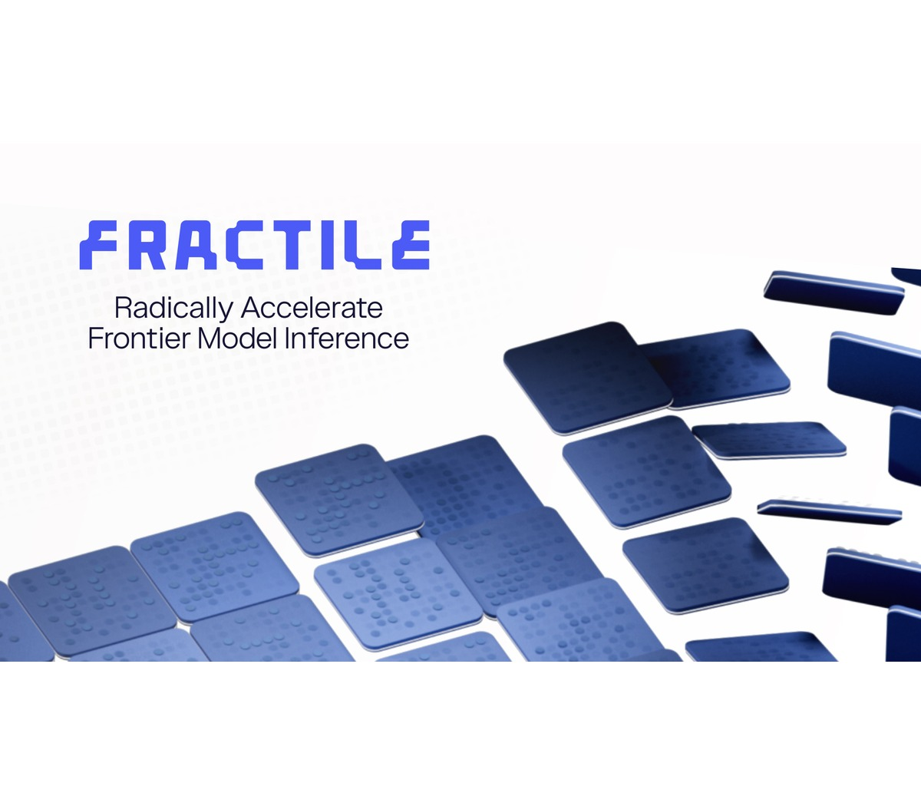
FRACTILE
FRONTIER INFERENCE
Fractile is designing the full stack around exploding inference token demand
The UK startup argues that reasoning workloads require a new cost-versus-latency curve.
WEDGE
PROOF
Co-design from AI research and compiler behavior through microarchitecture and foundry process.
$220M financing led by Accel, Factorial Funds, and Founders Fund.
ICP + GTM
RISK
High-token reasoning and frontier-model inference where latency and cost compound quickly.
Pre-scale execution: tape-out, software readiness, manufacturing, and customer validation remain ahead.
OFFICIAL SITE VISUAL · FRACTILE
Fractile, 2026.
Semiconductor Startup Landscape · 2026
15 / 44
Notes:
Speaker implication: Fractile raised $220 million to accelerate its path toward first chips and systems for frontier-model inference.
Visible citation: Fractile, 2026.
Evidence URLs:
- https://www.fractile.ai/news/fractile-raises-220m-to-build-the-next-generation-of-inference-hardware
- https://www.fractile.ai/

Slide 16
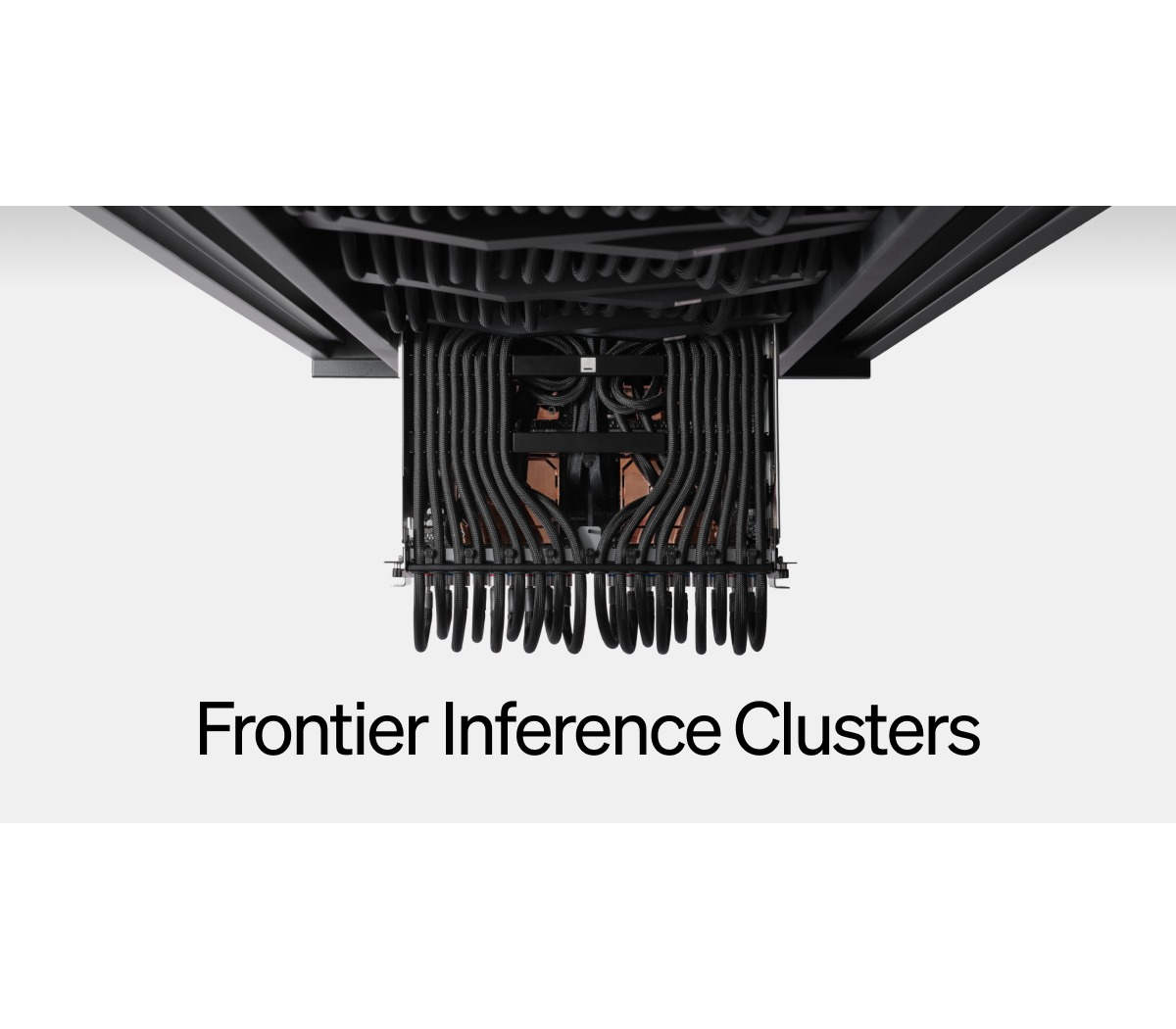
ETCHED
TRANSFORMER ASIC
Etched trades generality for a transformer-only performance ceiling
Sohu hardwires the dominant model architecture into chips, racks, and software.
WEDGE
PROOF
A transformer ASIC designed for throughput and interactivity rather than broad model coverage.
Company progress page reports a $300M financing milestone at a $10.3B valuation.
ICP + GTM
RISK
Large-scale inference systems where transformer workloads dominate utilization.
Architectural concentration creates upside if transformers persist—and exposure if model structures shift.
OFFICIAL SITE VISUAL · ETCHED
Etched product and progress pages, accessed Jul. 29, 2026.
Semiconductor Startup Landscape · 2026
16 / 44
Notes:
Speaker implication: Etched’s Sohu strategy is an extreme specialization bet on transformers remaining the dominant AI architecture.
Visible citation: Etched product and progress pages, accessed Jul. 29, 2026.
Evidence URLs:
- https://www.etched.com/progress
- https://www.etched.com/

Slide 17
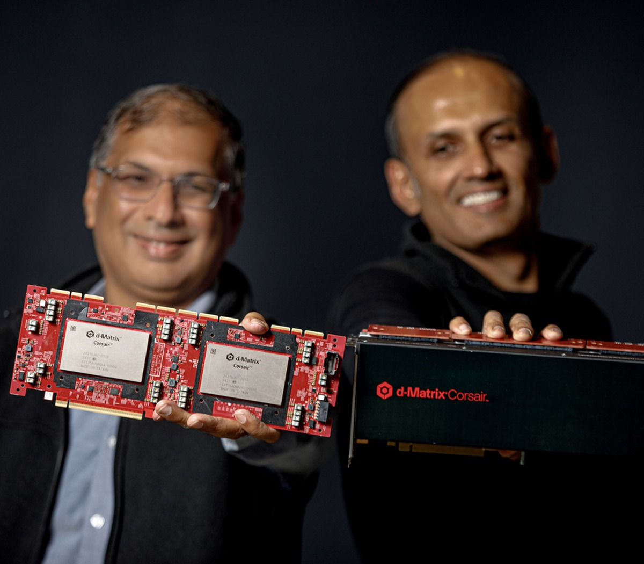
D-MATRIX
IN-MEMORY INFERENCE
d-Matrix moves inference compute closer to memory—and into production
Corsair integrates accelerators, networking, and software for latency-sensitive data-center inference.
WEDGE
PROOF
Digital in-memory compute reduces data movement for high-throughput, low-latency inference.
Corsair in full production; $450M total funding and a $2B valuation reported by the company.
ICP + GTM
RISK
Hyperscalers, neoclouds, and frontier labs; can pair with GPUs for heterogeneous inference.
Volume ramp, model coverage, and repeatable customer economics must prove beyond early priority accounts.
OFFICIAL SITE VISUAL · D-MATRIX
d-Matrix, Nov. 12, 2025 and Jun. 9, 2026.
Semiconductor Startup Landscape · 2026
17 / 44
Notes:
Speaker implication: d-Matrix announced Corsair full production in June 2026 after raising a $275 million Series C in late 2025.
Visible citation: d-Matrix, Nov. 12, 2025 and Jun. 9, 2026.
Evidence URLs:
- https://www.d-matrix.ai/announcements/d-matrix-corsair-ai-inference-platform-enters-full-production-to-meet-customer-demand/
- https://www.d-matrix.ai/announcements/d-matrix-raises-275-million-to-power-the-age-of-ai-inference/
- https://www.d-matrix.ai/d-matrix-corsair-ai-inference-platform-enters-full-production/

Slide 18

MATX
LLM-SPECIFIC
MatX designs the chip around LLM throughput and latency from first principles
MatX One combines SRAM-first latency with HBM support for long contexts.
WEDGE
PROOF
An LLM-specific architecture balancing high throughput, low latency, and long-context memory.
$500M Series B led by Jane Street and Situational Awareness LP.
ICP + GTM
RISK
Large-model training and inference where a narrow workload justifies custom silicon.
Tape-out and manufacturing scale are still ahead; software and real-system benchmarks must follow.
OFFICIAL SITE VISUAL · MATX
MatX, Feb. 24, 2026. Performance statements are vendor claims.
Semiconductor Startup Landscape · 2026
18 / 44
Notes:
Speaker implication: MatX raised a $500 million Series B to finish development and scale manufacturing, with tape-out planned in under a year.
Visible citation: MatX, Feb. 24, 2026. Performance statements are vendor claims.
Evidence URLs:
- https://matx.com/research/series_b
- https://matx.com/

Slide 19
COMPUTE COMPARISON
The compute challengers differentiate most clearly by breadth versus specialization
The broader the workload scope, the heavier the software and ecosystem burden.
COMPANY | WORKLOAD SCOPE | DESIGN PHILOSOPHY | 2026 STAGE
Axelera | Edge + inference | Platform + partners | Shipping / scaling
Tenstorrent | Broad AI + CPU IP | Programmable + licensable | Commercial portfolio
NextSilicon | HPC + irregular AI | Runtime-adaptive | Product volumes
Fractile | Frontier inference | Full-stack specialist | Pre-scale
Etched | Transformers | Fixed-function ASIC | Early systems
d-Matrix | Data-center inference | In-memory + full stack | Full production
MatX | LLM workloads | Purpose-built | Pre-tape-out
Company announcements; maturity is an analytical assessment.
Semiconductor Startup Landscape · 2026
19 / 44
Notes:
Speaker implication: Compute startups occupy different positions on workload breadth, programmability, and commercialization maturity.
Visible citation: Company announcements; maturity is an analytical assessment.
Evidence URLs:
- https://axelera.ai/news/axelera-ai-secures-more-than-250-million-funding-on-global-commercial-growth
- https://tenstorrent.com/newsroom/tenstorrent-sets-new-performance-records-launches-tt--ascalon-s
- https://www.nextsilicon.com/insights/nextsilicon-breakthrough/
- https://www.fractile.ai/news/fractile-raises-220m-to-build-the-next-generation-of-inference-hardware
- https://www.etched.com/progress
- https://www.d-matrix.ai/announcements/d-matrix-corsair-ai-inference-platform-enters-full-production-to-meet-customer-demand/
- https://matx.com/research/series_b

Slide 20
SECTION 02 · CONNECT
Three companies treat data movement as the next AI scaling frontier
Network fabrics, photonic links, and programmable Ethernet can unlock value without replacing compute.
Cornelis; Lightmatter; Xsight Labs.
Semiconductor Startup Landscape · 2026
20 / 44
Notes:
Speaker implication: The interconnect cohort competes on congestion, bandwidth density, power, and programmability.
Visible citation: Cornelis; Lightmatter; Xsight Labs.
Evidence URLs:
- https://www.cornelis.com/
- https://lightmatter.co/press-release/lightmatter-unveils-passage-m1000-photonic-superchip-worlds-fastest-ai-interconnect/
- https://xsightlabs.com/newsroom/announcements/xsight-labs-announces-x2-programmable-sdn-ethernet-switches-for-hyperscale-and-edge-data-centers-optimized-for-the-ai-factory-era

Slide 21

CORNELIS NETWORKS
SCALE-OUT FABRIC
Cornelis reopens a scale-out fabric alternative for AI and HPC
CN5000 extends Omni-Path into modern training, inference, and technical-computing clusters.
WEDGE
PROOF
Purpose-built scale-out networking focused on predictable throughput and congestion control.
Commercial CN5000 portfolio; $29M Series B disclosed to fund product expansion.
ICP + GTM
RISK
AI training, inference, and HPC clusters seeking an alternative fabric.
Must win ecosystem support and operational trust against entrenched Ethernet and InfiniBand choices.
OFFICIAL SITE VISUAL · CORNELIS NETWORKS
Cornelis Networks product page and Series B announcement.
Semiconductor Startup Landscape · 2026
21 / 44
Notes:
Speaker implication: Cornelis positions CN5000 Omni-Path as a lossless, interoperable fabric for AI and HPC workloads.
Visible citation: Cornelis Networks product page and Series B announcement.
Evidence URLs:
- https://www.cornelis.com/
- https://www.cornelis.com/stories/cornelis-networks-announces-29m-series-b-funding-round
- https://www.cornelisnetworks.com/stories/cornelis-cn5000-launches-rewiring-ai-and-hpc-networking-at-scale

Slide 22
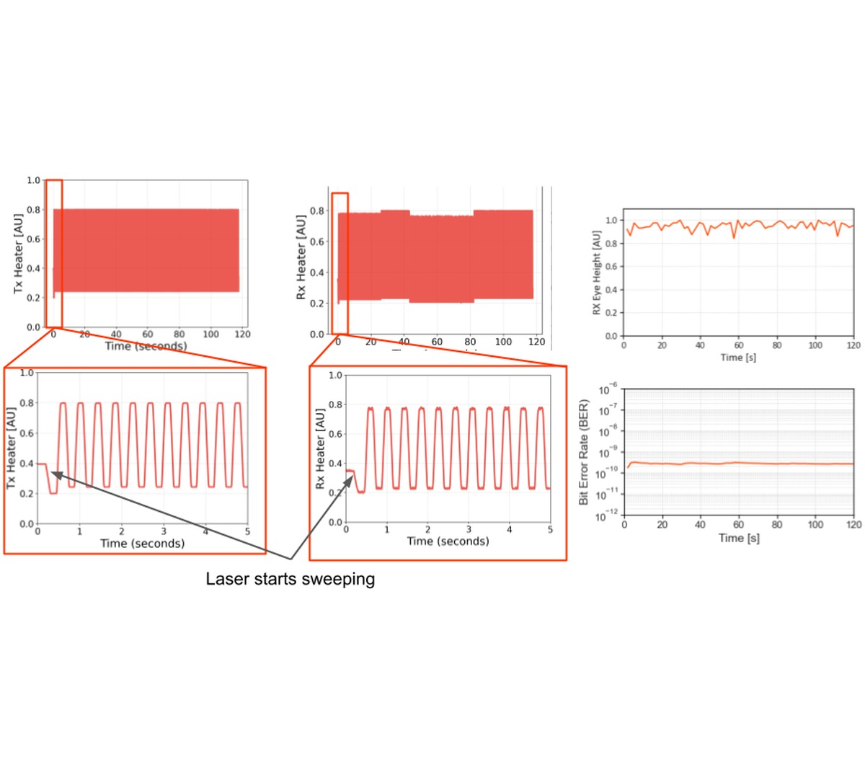
LIGHTMATTER
PHOTONIC I/O
Lightmatter uses photonics to break the electrical I/O bottleneck
Passage integrates optical connectivity across large AI packages and rack-scale systems.
WEDGE
PROOF
3D-stacked photonic interposers move data where electrical chip-edge I/O becomes limiting.
M1000 reference platform; $400M Series D and $850M total capital reported in 2024.
ICP + GTM
RISK
Hyperscaler and accelerator designs requiring high-bandwidth, energy-efficient scale-up links.
Packaging, manufacturing yield, standards, and partner integration determine time to volume.
OFFICIAL SITE VISUAL · LIGHTMATTER
Lightmatter product and funding announcements. Bandwidth is a vendor specification.
Semiconductor Startup Landscape · 2026
22 / 44
Notes:
Speaker implication: Lightmatter says the Passage M1000 reference platform provides 114 Tbps of total optical bandwidth.
Visible citation: Lightmatter product and funding announcements. Bandwidth is a vendor specification.
Evidence URLs:
- https://lightmatter.co/press-release/lightmatter-unveils-passage-m1000-photonic-superchip-worlds-fastest-ai-interconnect/
- https://lightmatter.co/press-release/lightmatter-raises-400m-series-d-quadruples-valuation-to-4-4b-as-photonics-leader-for-next-gen-ai-data-centers/
- https://lightmatter.co/blog/seeing-is-believing-a-technical-deep-dive-into-lightmatters-hardware/

Slide 23

XSIGHT LABS
PROGRAMMABLE ETHERNET
Xsight makes programmable Ethernet silicon an AI-factory control point
X2 targets hyperscale, edge, and private data centers with 100G SerDes and 800G fabric links.
WEDGE
PROOF
Programmable switching silicon with a documented hardware/software interface.
Second-generation X2 family sampling to customers; end-to-end connectivity roadmap.
ICP + GTM
RISK
Hyperscale IaaS, AI fabrics, edge networks, and private data centers.
Customer concentration, software tooling, and fast-moving Ethernet standards raise execution demands.
OFFICIAL SITE VISUAL · XSIGHT LABS
Xsight Labs X2 announcement.
Semiconductor Startup Landscape · 2026
23 / 44
Notes:
Speaker implication: Xsight announced X2 sampling as a fully programmable, low-power data-center switch for AI-factory networks.
Visible citation: Xsight Labs X2 announcement.
Evidence URLs:
- https://xsightlabs.com/newsroom/announcements/xsight-labs-announces-x2-programmable-sdn-ethernet-switches-for-hyperscale-and-edge-data-centers-optimized-for-the-ai-factory-era
- https://xsightlabs.com/switches/x2

Slide 24
INTERCONNECT COMPARISON
The three connectivity plays solve different layers of the same scaling problem
They are complements in some architectures and substitutes in others.
COMPANY | PRIMARY LAYER | CORE PROMISE | ADOPTION DEPENDENCY
Cornelis | Cluster fabric | Predictable lossless scale-out | Fabric ecosystem + operations
Lightmatter | Package / scale-up I/O | Bandwidth density + energy efficiency | Packaging + design partners
Xsight | Switch silicon | Programmability + lower-power Ethernet | NOS/tooling + hyperscaler adoption
Company product announcements.
Semiconductor Startup Landscape · 2026
24 / 44
Notes:
Speaker implication: Cornelis focuses on cluster fabric, Lightmatter on optical chip/package links, and Xsight on programmable switching silicon.
Visible citation: Company product announcements.
Evidence URLs:
- https://www.cornelis.com/
- https://lightmatter.co/press-release/lightmatter-unveils-passage-m1000-photonic-superchip-worlds-fastest-ai-interconnect/
- https://xsightlabs.com/newsroom/announcements/xsight-labs-announces-x2-programmable-sdn-ethernet-switches-for-hyperscale-and-edge-data-centers-optimized-for-the-ai-factory-era

Slide 25
SIX PARTNER MOTIONS
Six entry criteria determine which partner motion is credible
A motion is eligible only when the relevant technical and commercial gates have public or validated evidence.
01
DISTRIBUTE
02
INTEGRATE
Packaged offer, supply visibility, support model
APIs, software maturity, reference architecture
03
CO-SELL
04
DESIGN-IN
Named ICP, repeatable proof, commercial ownership
Roadmap alignment, qualification, capacity path
05
VALIDATE
06
OPERATE
Transparent benchmark method and workload access
Telemetry, lifecycle support, SLA accountability
Research-team diligence framework.
Semiconductor Startup Landscape · 2026
25 / 44
Notes:
Speaker implication: Commercial readiness requires evidence across workload proof, software, supply, reference customers, partners, and economics.
Visible citation: Research-team diligence framework.
Evidence URLs:
- https://www.crn.com/news/computing/2026/the-10-coolest-semiconductor-startups-of-2026-so-far
- https://axelera.ai/news/axelera-ai-secures-more-than-250-million-funding-on-global-commercial-growth
- https://www.nextsilicon.com/insights/nextsilicon-breakthrough/
- https://www.d-matrix.ai/announcements/d-matrix-corsair-ai-inference-platform-enters-full-production-to-meet-customer-demand/
- https://lightmatter.co/press-release/lightmatter-unveils-passage-m1000-photonic-superchip-worlds-fastest-ai-interconnect/
- https://xsightlabs.com/newsroom/announcements/xsight-labs-announces-x2-programmable-sdn-ethernet-switches-for-hyperscale-and-edge-data-centers-optimized-for-the-ai-factory-era

Slide 26
DISTRIBUTOR LENS
Distributor readiness is strongest where offers are packageable and supportable
Qualitative labels are provisional public-evidence judgments; validate locally before partner selection.
COMPANY | CANDIDATE FIT | PUBLIC SIGNAL | NEXT VALIDATION
Axelera AI | STRONG | Partner network + edge systems | Validate channel economics
Tenstorrent | EMERGING | Systems and developer products | Clarify support ownership
NextSilicon | VALIDATE | Product-volume claim | Confirm SKU + supply path
Fractile | MONITOR | Pre-scale platform | Wait for product availability
Etched | MONITOR | System ambition | Wait for production offer
d-Matrix | EMERGING | Full-production platform | Test repeatable packaging
MatX | MONITOR | Pre-tape-out | Track launch milestones
Cornelis | STRONG | Commercial fabric portfolio | Validate geographic coverage
Lightmatter | VALIDATE | Design-in component | Distributor role may be limited
Xsight Labs | VALIDATE | Sampling switch silicon | Confirm OEM/NOS support
Directional research judgment from public product, availability, and partner evidence.
Semiconductor Startup Landscape · 2026
26 / 44
Notes:
Speaker implication: Distribution fit rises with product packaging, supply visibility, enablement, and support clarity.
Visible citation: Directional research judgment from public product, availability, and partner evidence.
Evidence URLs:
- https://www.crn.com/news/computing/2026/the-10-coolest-semiconductor-startups-of-2026-so-far
- https://www.gartner.com/en/newsroom/press-releases/2026-04-08-gartner-forecasts-worldwide-semiconductor-revenue-to-exceed-us-dollars-one-point-3-trillion-in-2026
- https://axelera.ai/news/axelera-ai-secures-more-than-250-million-funding-on-global-commercial-growth
- https://tenstorrent.com/newsroom/tenstorrent-sets-new-performance-records-launches-tt--ascalon-s
- https://www.nextsilicon.com/insights/nextsilicon-breakthrough/
- https://www.fractile.ai/news/fractile-raises-220m-to-build-the-next-generation-of-inference-hardware
- https://www.etched.com/progress
- https://www.d-matrix.ai/announcements/d-matrix-corsair-ai-inference-platform-enters-full-production-to-meet-customer-demand/
- https://www.d-matrix.ai/announcements/d-matrix-raises-275-million-to-power-the-age-of-ai-inference/
- https://www.cornelis.com/
- https://www.cornelis.com/stories/cornelis-networks-announces-29m-series-b-funding-round
- https://lightmatter.co/press-release/lightmatter-unveils-passage-m1000-photonic-superchip-worlds-fastest-ai-interconnect/
- https://lightmatter.co/press-release/lightmatter-raises-400m-series-d-quadruples-valuation-to-4-4b-as-photonics-leader-for-next-gen-ai-data-centers/
- https://matx.com/research/series_b
- https://xsightlabs.com/newsroom/announcements/xsight-labs-announces-x2-programmable-sdn-ethernet-switches-for-hyperscale-and-edge-data-centers-optimized-for-the-ai-factory-era

Slide 27
SYSTEMS-INTEGRATOR LENS
SI readiness concentrates where integration complexity meets deployable product
Systems integrators create value when reference architecture and operating accountability are both real.
COMPANY | CANDIDATE FIT | PUBLIC SIGNAL | NEXT VALIDATION
Axelera AI | STRONG | Edge solution ecosystem | Build vertical reference offer
Tenstorrent | EMERGING | Broad programmable stack | Validate software operations
NextSilicon | EMERGING | HPC application compatibility | Prove porting effort
Fractile | VALIDATE | Full-stack thesis | Secure lighthouse workload
Etched | VALIDATE | Rack-scale specialization | Test workload durability
d-Matrix | STRONG | Production inference platform | Validate TCO + SLA
MatX | MONITOR | Pre-scale architecture | Wait for accessible system
Cornelis | STRONG | Cluster fabric integration | Package migration services
Lightmatter | VALIDATE | Packaging-level insertion | Clarify SI control point
Xsight Labs | EMERGING | Programmable Ethernet | Validate NOS/tooling
Directional research judgment from public product and deployment evidence.
Semiconductor Startup Landscape · 2026
27 / 44
Notes:
Speaker implication: SI fit rises when the startup exposes a deployable integration boundary and a repeatable customer outcome.
Visible citation: Directional research judgment from public product and deployment evidence.
Evidence URLs:
- https://www.crn.com/news/computing/2026/the-10-coolest-semiconductor-startups-of-2026-so-far
- https://www.gartner.com/en/newsroom/press-releases/2026-04-08-gartner-forecasts-worldwide-semiconductor-revenue-to-exceed-us-dollars-one-point-3-trillion-in-2026
- https://axelera.ai/news/axelera-ai-secures-more-than-250-million-funding-on-global-commercial-growth
- https://tenstorrent.com/newsroom/tenstorrent-sets-new-performance-records-launches-tt--ascalon-s
- https://www.nextsilicon.com/insights/nextsilicon-breakthrough/
- https://www.fractile.ai/news/fractile-raises-220m-to-build-the-next-generation-of-inference-hardware
- https://www.etched.com/progress
- https://www.d-matrix.ai/announcements/d-matrix-corsair-ai-inference-platform-enters-full-production-to-meet-customer-demand/
- https://www.d-matrix.ai/announcements/d-matrix-raises-275-million-to-power-the-age-of-ai-inference/
- https://www.cornelis.com/
- https://www.cornelis.com/stories/cornelis-networks-announces-29m-series-b-funding-round
- https://lightmatter.co/press-release/lightmatter-unveils-passage-m1000-photonic-superchip-worlds-fastest-ai-interconnect/
- https://lightmatter.co/press-release/lightmatter-raises-400m-series-d-quadruples-valuation-to-4-4b-as-photonics-leader-for-next-gen-ai-data-centers/
- https://matx.com/research/series_b
- https://xsightlabs.com/newsroom/announcements/xsight-labs-announces-x2-programmable-sdn-ethernet-switches-for-hyperscale-and-edge-data-centers-optimized-for-the-ai-factory-era

Slide 28
ECOSYSTEM LENS
Ecosystem-orchestrator readiness follows leverage across multiple complements
The strongest orchestration candidates can align OEMs, software, cloud, packaging, or network partners.
COMPANY | CANDIDATE FIT | PUBLIC SIGNAL | NEXT VALIDATION
Axelera AI | STRONG | Explicit partner network | Measure partner-sourced pipeline
Tenstorrent | STRONG | IP + systems + open stack | Test governance and overlap
NextSilicon | EMERGING | Code compatibility | Expand software proof
Fractile | VALIDATE | Full-stack co-design | Map foundry + system partners
Etched | VALIDATE | Transformer-specific stack | Test model ecosystem risk
d-Matrix | EMERGING | Heterogeneous inference | Map cloud/OEM replication
MatX | VALIDATE | LLM-specific platform | Validate launch ecosystem
Cornelis | EMERGING | Interoperable fabric | Test ecosystem breadth
Lightmatter | STRONG | Packaging + foundry dependency | Coordinate design partners
Xsight Labs | EMERGING | Programmable switch interface | Align NOS + OEM roadmap
Directional research judgment from public platform and partner evidence.
Semiconductor Startup Landscape · 2026
28 / 44
Notes:
Speaker implication: Orchestrator fit rises when partner coordination is essential to the product’s adoption and scale.
Visible citation: Directional research judgment from public platform and partner evidence.
Evidence URLs:
- https://www.crn.com/news/computing/2026/the-10-coolest-semiconductor-startups-of-2026-so-far
- https://www.gartner.com/en/newsroom/press-releases/2026-04-08-gartner-forecasts-worldwide-semiconductor-revenue-to-exceed-us-dollars-one-point-3-trillion-in-2026
- https://axelera.ai/news/axelera-ai-secures-more-than-250-million-funding-on-global-commercial-growth
- https://tenstorrent.com/newsroom/tenstorrent-sets-new-performance-records-launches-tt--ascalon-s
- https://www.nextsilicon.com/insights/nextsilicon-breakthrough/
- https://www.fractile.ai/news/fractile-raises-220m-to-build-the-next-generation-of-inference-hardware
- https://www.etched.com/progress
- https://www.d-matrix.ai/announcements/d-matrix-corsair-ai-inference-platform-enters-full-production-to-meet-customer-demand/
- https://www.d-matrix.ai/announcements/d-matrix-raises-275-million-to-power-the-age-of-ai-inference/
- https://www.cornelis.com/
- https://www.cornelis.com/stories/cornelis-networks-announces-29m-series-b-funding-round
- https://lightmatter.co/press-release/lightmatter-unveils-passage-m1000-photonic-superchip-worlds-fastest-ai-interconnect/
- https://lightmatter.co/press-release/lightmatter-raises-400m-series-d-quadruples-valuation-to-4-4b-as-photonics-leader-for-next-gen-ai-data-centers/
- https://matx.com/research/series_b
- https://xsightlabs.com/newsroom/announcements/xsight-labs-announces-x2-programmable-sdn-ethernet-switches-for-hyperscale-and-edge-data-centers-optimized-for-the-ai-factory-era

Slide 29
PORTFOLIO VIEW
Product maturity and partner readiness are related—but not interchangeable
A mature product can still lack a repeatable partner motion; an early product can merit targeted validation.
MatX
Etched
Lightmatter
d-Matrix
Fractile
MORE SPECIALIZED →
Xsight
NextSilicon
Axelera
Cornelis
Tenstorrent
MORE COMMERCIAL EVIDENCE →
Research-team assessment from public product and funding evidence.
Semiconductor Startup Landscape · 2026
29 / 44
Notes:
Speaker implication: More specialized architectures can promise stronger economics while carrying greater workload and execution concentration.
Visible citation: Research-team assessment from public product and funding evidence.
Evidence URLs:
- https://www.crn.com/news/computing/2026/the-10-coolest-semiconductor-startups-of-2026-so-far
- https://axelera.ai/news/axelera-ai-secures-more-than-250-million-funding-on-global-commercial-growth
- https://tenstorrent.com/newsroom/tenstorrent-sets-new-performance-records-launches-tt--ascalon-s
- https://www.nextsilicon.com/insights/nextsilicon-breakthrough/
- https://www.fractile.ai/news/fractile-raises-220m-to-build-the-next-generation-of-inference-hardware
- https://www.etched.com/progress
- https://www.d-matrix.ai/announcements/d-matrix-corsair-ai-inference-platform-enters-full-production-to-meet-customer-demand/
- https://www.cornelis.com/
- https://lightmatter.co/press-release/lightmatter-unveils-passage-m1000-photonic-superchip-worlds-fastest-ai-interconnect/
- https://matx.com/research/series_b
- https://xsightlabs.com/newsroom/announcements/xsight-labs-announces-x2-programmable-sdn-ethernet-switches-for-hyperscale-and-edge-data-centers-optimized-for-the-ai-factory-era

Slide 30
DISTRIBUTOR ECONOMICS
Distributor economics require packageability, margin room, and bounded support
A compelling chip is not channel-ready if every sale demands bespoke engineering.
SYSTEM SALE
High initial value
Inventory, support, and supply exposure
SILICON DESIGN-IN
Sticky volume revenue
Long qualification and concentration
IP LICENSE
Asset-light leverage
Customer implementation and royalty timing
SOFTWARE + SUPPORT
Recurring control layer
Requires developer adoption and model coverage
PARTNER ECOSYSTEM
Distribution leverage
Enablement cost and channel conflict
Directional business-model assessment; no company financial forecasts implied.
Semiconductor Startup Landscape · 2026
30 / 44
Notes:
Speaker implication: Business models with reusable software or IP leverage can scale differently from bespoke system and design-in models.
Visible citation: Directional business-model assessment; no company financial forecasts implied.
Evidence URLs:
- https://tenstorrent.com/newsroom/tenstorrent-sets-new-performance-records-launches-tt--ascalon-s
- https://axelera.ai/news/axelera-ai-secures-more-than-250-million-funding-on-global-commercial-growth
- https://www.d-matrix.ai/announcements/d-matrix-corsair-ai-inference-platform-enters-full-production-to-meet-customer-demand/
- https://lightmatter.co/press-release/lightmatter-unveils-passage-m1000-photonic-superchip-worlds-fastest-ai-interconnect/
- https://xsightlabs.com/newsroom/announcements/xsight-labs-announces-x2-programmable-sdn-ethernet-switches-for-hyperscale-and-edge-data-centers-optimized-for-the-ai-factory-era

Slide 31
SI ECONOMICS
SI economics improve when reusable integration exceeds one-off engineering
Prioritize offers that can become repeatable architectures, migration services, and managed operations.
ICP | REQUIRED PROOF | COMMERCIAL OFFER | PARTNER ROLE
HYPERSCALER / LAB | Rack-scale throughput, latency, power, reliability | Co-design + reserved capacity | Packaging, foundry, systems
HPC / RESEARCH | Real application benchmarks and fabric behavior | Reference cluster / early access | HPC integrator + software porting
ENTERPRISE AI | TCO on named models and SLAs | Integrated appliance / managed capacity | Cloud, OEM, SI, MLOps
EDGE OEM | Power, thermals, form factor, time-to-production | Module + SDK + certification | Distributor, ISV, embedded OEM
Engagement recommendations derived from company target markets.
Semiconductor Startup Landscape · 2026
31 / 44
Notes:
Speaker implication: GTM effectiveness improves when technical proof, commercial offer, and partner role are tailored to the buyer’s deployment context.
Visible citation: Engagement recommendations derived from company target markets.
Evidence URLs:
- https://axelera.ai/news/axelera-ai-secures-more-than-250-million-funding-on-global-commercial-growth
- https://www.nextsilicon.com/insights/nextsilicon-breakthrough/
- https://www.d-matrix.ai/announcements/d-matrix-corsair-ai-inference-platform-enters-full-production-to-meet-customer-demand/
- https://www.cornelis.com/
- https://lightmatter.co/press-release/lightmatter-unveils-passage-m1000-photonic-superchip-worlds-fastest-ai-interconnect/

Slide 32
ECOSYSTEM ECONOMICS
Ecosystem leverage comes from coordinating scarce complements
Orchestrators should focus where no single startup can complete the adoption path alone.
COMPUTE + SOFTWARE
SYSTEM + SUPPLY
Align models, compilers, runtimes, orchestration, and developer tooling.
Coordinate boards, memory, packaging, manufacturing, and service readiness.
NETWORK + OPERATIONS
CUSTOMER + PROOF
Integrate fabrics, NOS, telemetry, security, and lifecycle management.
Secure lighthouse workloads and publish repeatable evidence packages.
Strategic synthesis from the ten-company public-evidence set.
Semiconductor Startup Landscape · 2026
32 / 44
Notes:
Speaker implication: Ecosystem value grows when coordination removes adoption risk across multiple complements.
Visible citation: Strategic synthesis from the ten-company public-evidence set.
Evidence URLs:
- https://www.crn.com/news/computing/2026/the-10-coolest-semiconductor-startups-of-2026-so-far
- https://www.gartner.com/en/newsroom/press-releases/2026-04-08-gartner-forecasts-worldwide-semiconductor-revenue-to-exceed-us-dollars-one-point-3-trillion-in-2026
- https://axelera.ai/news/axelera-ai-secures-more-than-250-million-funding-on-global-commercial-growth
- https://tenstorrent.com/newsroom/tenstorrent-sets-new-performance-records-launches-tt--ascalon-s
- https://www.nextsilicon.com/insights/nextsilicon-breakthrough/
- https://www.fractile.ai/news/fractile-raises-220m-to-build-the-next-generation-of-inference-hardware
- https://www.etched.com/progress
- https://www.d-matrix.ai/announcements/d-matrix-corsair-ai-inference-platform-enters-full-production-to-meet-customer-demand/
- https://www.d-matrix.ai/announcements/d-matrix-raises-275-million-to-power-the-age-of-ai-inference/
- https://www.cornelis.com/
- https://www.cornelis.com/stories/cornelis-networks-announces-29m-series-b-funding-round
- https://lightmatter.co/press-release/lightmatter-unveils-passage-m1000-photonic-superchip-worlds-fastest-ai-interconnect/
- https://lightmatter.co/press-release/lightmatter-raises-400m-series-d-quadruples-valuation-to-4-4b-as-photonics-leader-for-next-gen-ai-data-centers/
- https://matx.com/research/series_b
- https://xsightlabs.com/newsroom/announcements/xsight-labs-announces-x2-programmable-sdn-ethernet-switches-for-hyperscale-and-edge-data-centers-optimized-for-the-ai-factory-era

Slide 33
PORTFOLIO POSTURE
The portfolio should separate action from validation and monitoring
Buckets represent the next diligence posture, not a company-quality ranking.
POSTURE | CANDIDATES | WHY | VALIDATE BEFORE CHANGE
ACT NOW | Axelera AI · d-Matrix · Cornelis | Deployable offer + visible ecosystem | Partner economics and repeatability
VALIDATE NEXT | Tenstorrent · NextSilicon · Lightmatter · Xsight | Strong wedge; motion-specific gaps | Software, design-in, and operating proof
MONITOR | Fractile · Etched · MatX | High potential; earlier commercialization | Tape-out, availability, references
Candidate public-evidence posture; requires Phase 0 calibration.
Semiconductor Startup Landscape · 2026
33 / 44
Notes:
Speaker implication: A staged portfolio prevents early technical promise from being mistaken for execution-ready partnership.
Visible citation: Candidate public-evidence posture; requires Phase 0 calibration.
Evidence URLs:
- https://www.crn.com/news/computing/2026/the-10-coolest-semiconductor-startups-of-2026-so-far
- https://www.gartner.com/en/newsroom/press-releases/2026-04-08-gartner-forecasts-worldwide-semiconductor-revenue-to-exceed-us-dollars-one-point-3-trillion-in-2026
- https://axelera.ai/news/axelera-ai-secures-more-than-250-million-funding-on-global-commercial-growth
- https://tenstorrent.com/newsroom/tenstorrent-sets-new-performance-records-launches-tt--ascalon-s
- https://www.nextsilicon.com/insights/nextsilicon-breakthrough/
- https://www.fractile.ai/news/fractile-raises-220m-to-build-the-next-generation-of-inference-hardware
- https://www.etched.com/progress
- https://www.d-matrix.ai/announcements/d-matrix-corsair-ai-inference-platform-enters-full-production-to-meet-customer-demand/
- https://www.d-matrix.ai/announcements/d-matrix-raises-275-million-to-power-the-age-of-ai-inference/
- https://www.cornelis.com/
- https://www.cornelis.com/stories/cornelis-networks-announces-29m-series-b-funding-round
- https://lightmatter.co/press-release/lightmatter-unveils-passage-m1000-photonic-superchip-worlds-fastest-ai-interconnect/
- https://lightmatter.co/press-release/lightmatter-raises-400m-series-d-quadruples-valuation-to-4-4b-as-photonics-leader-for-next-gen-ai-data-centers/
- https://matx.com/research/series_b
- https://xsightlabs.com/newsroom/announcements/xsight-labs-announces-x2-programmable-sdn-ethernet-switches-for-hyperscale-and-edge-data-centers-optimized-for-the-ai-factory-era

Slide 34
90-DAY VALIDATION
A 90-day plan should buy evidence—not commit the portfolio
Run bounded validation actions with explicit outputs and stop conditions.
0–30 DAYS · SCREEN
31–60 DAYS · TEST
Confirm offer, stage, ICP, partner boundary, and evidence owner for six shortlisted motions.
Run workload, integration, support, and commercial discovery with named hypotheses.
61–90 DAYS · DECIDE
OUTPUT
Advance, redesign, or stop each motion based on proof-package completion.
One evidence ledger, one archetype decision, and one next-action brief per shortlisted company.
Recommended validation sequence; no named-partner commitment implied.
Semiconductor Startup Landscape · 2026
34 / 44
Notes:
Speaker implication: The first 90 days should reduce uncertainty through bounded tests rather than make execution claims.
Visible citation: Recommended validation sequence; no named-partner commitment implied.
Evidence URLs:
- https://www.crn.com/news/computing/2026/the-10-coolest-semiconductor-startups-of-2026-so-far
- https://www.gartner.com/en/newsroom/press-releases/2026-04-08-gartner-forecasts-worldwide-semiconductor-revenue-to-exceed-us-dollars-one-point-3-trillion-in-2026
- https://axelera.ai/news/axelera-ai-secures-more-than-250-million-funding-on-global-commercial-growth
- https://tenstorrent.com/newsroom/tenstorrent-sets-new-performance-records-launches-tt--ascalon-s
- https://www.nextsilicon.com/insights/nextsilicon-breakthrough/
- https://www.fractile.ai/news/fractile-raises-220m-to-build-the-next-generation-of-inference-hardware
- https://www.etched.com/progress
- https://www.d-matrix.ai/announcements/d-matrix-corsair-ai-inference-platform-enters-full-production-to-meet-customer-demand/
- https://www.d-matrix.ai/announcements/d-matrix-raises-275-million-to-power-the-age-of-ai-inference/
- https://www.cornelis.com/
- https://www.cornelis.com/stories/cornelis-networks-announces-29m-series-b-funding-round
- https://lightmatter.co/press-release/lightmatter-unveils-passage-m1000-photonic-superchip-worlds-fastest-ai-interconnect/
- https://lightmatter.co/press-release/lightmatter-raises-400m-series-d-quadruples-valuation-to-4-4b-as-photonics-leader-for-next-gen-ai-data-centers/
- https://matx.com/research/series_b
- https://xsightlabs.com/newsroom/announcements/xsight-labs-announces-x2-programmable-sdn-ethernet-switches-for-hyperscale-and-edge-data-centers-optimized-for-the-ai-factory-era

Slide 35
12-MONTH WATCHLIST
Quarterly activation triggers should change posture only when evidence changes
Monitor stage transitions rather than treating funding announcements as progress by themselves.
PRE-SILICON / PRE-SCALE
Fractile · MatX
Tape-out, first silicon, compiler readiness
EARLY SYSTEMS / SAMPLES
Etched · Lightmatter · Xsight
Customer qualification, production benchmarks, design wins
PRODUCT / VOLUME RAMP
Axelera · NextSilicon · d-Matrix
Shipment growth, repeat deployments, supply execution
PORTFOLIO / ECOSYSTEM
Tenstorrent · Cornelis
Partner replication, software depth, installed-base expansion
Forward watchpoints inferred from publicly stated product stages.
Semiconductor Startup Landscape · 2026
35 / 44
Notes:
Speaker implication: The most decision-relevant next events are tape-outs, volume ramps, production benchmarks, design wins, and ecosystem expansion.
Visible citation: Forward watchpoints inferred from publicly stated product stages.
Evidence URLs:
- https://axelera.ai/news/axelera-ai-secures-more-than-250-million-funding-on-global-commercial-growth
- https://www.fractile.ai/news/fractile-raises-220m-to-build-the-next-generation-of-inference-hardware
- https://www.etched.com/progress
- https://www.d-matrix.ai/announcements/d-matrix-corsair-ai-inference-platform-enters-full-production-to-meet-customer-demand/
- https://lightmatter.co/press-release/lightmatter-unveils-passage-m1000-photonic-superchip-worlds-fastest-ai-interconnect/
- https://matx.com/research/series_b
- https://xsightlabs.com/newsroom/announcements/xsight-labs-announces-x2-programmable-sdn-ethernet-switches-for-hyperscale-and-edge-data-centers-optimized-for-the-ai-factory-era

Slide 36
CONFIDENCE & SENSITIVITY
Confidence—not false precision—should govern recommendation strength
Withdrawn evidence or failed hard gates can reverse a candidate posture even when the technical wedge remains compelling.
COVERAGE GAP
INDEPENDENCE GAP
Public evidence is uneven across supply, customers, support, economics, and partner-sourced traction.
Many performance and availability claims originate with vendors and need third-party or customer corroboration.
SENSITIVITY
REVERSAL RULE
Distributor, SI, and ecosystem lenses can produce different next actions for the same company.
A failed supply, production, security, or support gate overrides an otherwise attractive motion.
Candidate model logic from the CEO-reviewed implementation plan.
Semiconductor Startup Landscape · 2026
36 / 44
Notes:
Speaker implication: Recommendation strength should reflect evidence coverage, source independence, and hard-gate robustness.
Visible citation: Candidate model logic from the CEO-reviewed implementation plan.
Evidence URLs:
- https://www.crn.com/news/computing/2026/the-10-coolest-semiconductor-startups-of-2026-so-far
- https://www.gartner.com/en/newsroom/press-releases/2026-04-08-gartner-forecasts-worldwide-semiconductor-revenue-to-exceed-us-dollars-one-point-3-trillion-in-2026
- https://axelera.ai/news/axelera-ai-secures-more-than-250-million-funding-on-global-commercial-growth
- https://tenstorrent.com/newsroom/tenstorrent-sets-new-performance-records-launches-tt--ascalon-s
- https://www.nextsilicon.com/insights/nextsilicon-breakthrough/
- https://www.fractile.ai/news/fractile-raises-220m-to-build-the-next-generation-of-inference-hardware
- https://www.etched.com/progress
- https://www.d-matrix.ai/announcements/d-matrix-corsair-ai-inference-platform-enters-full-production-to-meet-customer-demand/
- https://www.d-matrix.ai/announcements/d-matrix-raises-275-million-to-power-the-age-of-ai-inference/
- https://www.cornelis.com/
- https://www.cornelis.com/stories/cornelis-networks-announces-29m-series-b-funding-round
- https://lightmatter.co/press-release/lightmatter-unveils-passage-m1000-photonic-superchip-worlds-fastest-ai-interconnect/
- https://lightmatter.co/press-release/lightmatter-raises-400m-series-d-quadruples-valuation-to-4-4b-as-photonics-leader-for-next-gen-ai-data-centers/
- https://matx.com/research/series_b
- https://xsightlabs.com/newsroom/announcements/xsight-labs-announces-x2-programmable-sdn-ethernet-switches-for-hyperscale-and-edge-data-centers-optimized-for-the-ai-factory-era

Slide 37
PROOF PACKAGES
Each partner motion needs a different proof package
Proof should answer the buyer’s adoption decision—not merely showcase a peak benchmark.
ICP | REQUIRED PROOF | COMMERCIAL OFFER | PARTNER ROLE
HYPERSCALER / LAB | Rack-scale throughput, latency, power, reliability | Co-design + reserved capacity | Packaging, foundry, systems
HPC / RESEARCH | Real application benchmarks and fabric behavior | Reference cluster / early access | HPC integrator + software porting
ENTERPRISE AI | TCO on named models and SLAs | Integrated appliance / managed capacity | Cloud, OEM, SI, MLOps
EDGE OEM | Power, thermals, form factor, time-to-production | Module + SDK + certification | Distributor, ISV, embedded OEM
Engagement recommendations derived from company target markets.
Semiconductor Startup Landscape · 2026
37 / 44
Notes:
Speaker implication: GTM effectiveness improves when technical proof, commercial offer, and partner role are tailored to the buyer’s deployment context.
Visible citation: Engagement recommendations derived from company target markets.
Evidence URLs:
- https://axelera.ai/news/axelera-ai-secures-more-than-250-million-funding-on-global-commercial-growth
- https://www.nextsilicon.com/insights/nextsilicon-breakthrough/
- https://www.d-matrix.ai/announcements/d-matrix-corsair-ai-inference-platform-enters-full-production-to-meet-customer-demand/
- https://www.cornelis.com/
- https://lightmatter.co/press-release/lightmatter-unveils-passage-m1000-photonic-superchip-worlds-fastest-ai-interconnect/

Slide 38
WHAT TO WATCH
Kill criteria protect the portfolio from impressive but non-deployable silicon
Stop or redesign a motion when critical evidence cannot be produced within the validation window.
01
SOFTWARE
Compiler maturity, frameworks, model coverage, and developer experience
02
SILICON
Tape-out, yield, packaging, memory availability, and manufacturing scale
03
PROOF
Independent benchmarks, production workloads, and total-cost evidence
04
CUSTOMERS
Design-win conversion, concentration, support burden, and renewal economics
05
DURABILITY
Whether the targeted workload or interconnect standard remains strategically important
Research-team risk synthesis from public company evidence.
Semiconductor Startup Landscape · 2026
38 / 44
Notes:
Speaker implication: Software, supply, independent benchmarks, customer concentration, and architecture durability are the central diligence risks.
Visible citation: Research-team risk synthesis from public company evidence.
Evidence URLs:
- https://www.crn.com/news/computing/2026/the-10-coolest-semiconductor-startups-of-2026-so-far
- https://www.nextsilicon.com/insights/nextsilicon-breakthrough/
- https://www.fractile.ai/news/fractile-raises-220m-to-build-the-next-generation-of-inference-hardware
- https://www.etched.com/progress
- https://www.d-matrix.ai/announcements/d-matrix-corsair-ai-inference-platform-enters-full-production-to-meet-customer-demand/
- https://lightmatter.co/press-release/lightmatter-unveils-passage-m1000-photonic-superchip-worlds-fastest-ai-interconnect/

Slide 39
CONCLUSION
Use the deck to select validation priorities—not to declare winners
The output is decision support for the next evidence-buying step.
PUBLIC EVIDENCE
PHASE 0
LOCAL PROFILE
Supports candidate archetype-readiness and focused questions.
Calibrates the rubric with independent raters and historical cases.
Required before named-partner fit or organization-specific right-to-win.
The decision is which uncertainty to reduce next—and which partner motion deserves that effort.
Conclusion based on the CRN cohort and primary-source review.
Semiconductor Startup Landscape · 2026
39 / 44
Notes:
Speaker implication: A bottleneck-first watchlist is more useful than treating all ten companies as direct accelerator competitors.
Visible citation: Conclusion based on the CRN cohort and primary-source review.
Evidence URLs:
- https://www.crn.com/news/computing/2026/the-10-coolest-semiconductor-startups-of-2026-so-far
- https://www.gartner.com/en/newsroom/press-releases/2026-04-08-gartner-forecasts-worldwide-semiconductor-revenue-to-exceed-us-dollars-one-point-3-trillion-in-2026

Slide 40
METHODOLOGY & LIMITATIONS
The method is a closed-cohort public-evidence screen
CRN selected the ten companies; the analysis does not claim exhaustive market coverage.
1
Cohort: the ten companies named by CRN on July 15, 2026.
2
Evidence: official product, availability, financing, and partner announcements retrieved through Level 2 livecrawl.
3
Judgments: qualitative partner-fit labels are provisional and retain explicit evidence gaps.
4
Boundary: no investment recommendation, named-partner selection, or organization-specific right-to-win.
Primary domains: crn.com · gartner.com · axelera.ai · tenstorrent.com · nextsilicon.com · fractile.ai · etched.com · d-matrix.ai · cornelis.com · lightmatter.co · matx.com · xsightlabs.com
CRN; Gartner; official company announcements. Accessed Jul. 29, 2026.
Semiconductor Startup Landscape · 2026
40 / 44
Notes:
Speaker implication: The research used CRN’s July 2026 list, Gartner market context, and official company announcements retrieved through Level 2 livecrawl.
Visible citation: CRN; Gartner; official company announcements. Accessed Jul. 29, 2026.
Evidence URLs:
- https://www.crn.com/news/computing/2026/the-10-coolest-semiconductor-startups-of-2026-so-far
- https://www.gartner.com/en/newsroom/press-releases/2026-04-08-gartner-forecasts-worldwide-semiconductor-revenue-to-exceed-us-dollars-one-point-3-trillion-in-2026
- https://axelera.ai/news/axelera-ai-secures-more-than-250-million-funding-on-global-commercial-growth
- https://tenstorrent.com/newsroom/tenstorrent-sets-new-performance-records-launches-tt--ascalon-s
- https://www.nextsilicon.com/insights/nextsilicon-breakthrough/
- https://www.fractile.ai/news/fractile-raises-220m-to-build-the-next-generation-of-inference-hardware
- https://www.etched.com/progress
- https://www.d-matrix.ai/announcements/d-matrix-corsair-ai-inference-platform-enters-full-production-to-meet-customer-demand/
- https://www.d-matrix.ai/announcements/d-matrix-raises-275-million-to-power-the-age-of-ai-inference/
- https://www.cornelis.com/
- https://www.cornelis.com/stories/cornelis-networks-announces-29m-series-b-funding-round
- https://lightmatter.co/press-release/lightmatter-unveils-passage-m1000-photonic-superchip-worlds-fastest-ai-interconnect/
- https://lightmatter.co/press-release/lightmatter-raises-400m-series-d-quadruples-valuation-to-4-4b-as-photonics-leader-for-next-gen-ai-data-centers/
- https://matx.com/research/series_b
- https://xsightlabs.com/newsroom/announcements/xsight-labs-announces-x2-programmable-sdn-ethernet-switches-for-hyperscale-and-edge-data-centers-optimized-for-the-ai-factory-era

Slide 41
SOURCES & FRESHNESS
Fifteen current sources anchor cohort, market, product, and financing claims
Official company sources are used for company-specific facts; vendor claims remain labeled as such.
EVIDENCE GROUP | PRIMARY SOURCE | FRESHNESS | USE
COHORT | CRN | Jul. 15, 2026 | Ten-company selection
MARKET | Gartner | Apr. 8, 2026 | 2026 semiconductor revenue context
COMPUTE | 7 official company sources | 2025–2026 | Products, funding, availability
CONNECTIVITY | 3 official company sources | 2024–2026 | Fabrics, photonics, switching
VISUALS | 10 official company sites | Accessed Jul. 29, 2026 | Product and brand assets
Full URLs and access context are embedded in speaker notes.
Semiconductor Startup Landscape · 2026
41 / 44
Notes:
Speaker implication: The evidence base combines one cohort source, one market source, and current primary company disclosures.
Visible citation: Full URLs and access context are embedded in speaker notes.
Evidence URLs:
- https://www.crn.com/news/computing/2026/the-10-coolest-semiconductor-startups-of-2026-so-far
- https://www.gartner.com/en/newsroom/press-releases/2026-04-08-gartner-forecasts-worldwide-semiconductor-revenue-to-exceed-us-dollars-one-point-3-trillion-in-2026
- https://axelera.ai/news/axelera-ai-secures-more-than-250-million-funding-on-global-commercial-growth
- https://tenstorrent.com/newsroom/tenstorrent-sets-new-performance-records-launches-tt--ascalon-s
- https://www.nextsilicon.com/insights/nextsilicon-breakthrough/
- https://www.fractile.ai/news/fractile-raises-220m-to-build-the-next-generation-of-inference-hardware
- https://www.etched.com/progress
- https://www.d-matrix.ai/announcements/d-matrix-corsair-ai-inference-platform-enters-full-production-to-meet-customer-demand/
- https://www.d-matrix.ai/announcements/d-matrix-raises-275-million-to-power-the-age-of-ai-inference/
- https://www.cornelis.com/
- https://www.cornelis.com/stories/cornelis-networks-announces-29m-series-b-funding-round
- https://lightmatter.co/press-release/lightmatter-unveils-passage-m1000-photonic-superchip-worlds-fastest-ai-interconnect/
- https://lightmatter.co/press-release/lightmatter-raises-400m-series-d-quadruples-valuation-to-4-4b-as-photonics-leader-for-next-gen-ai-data-centers/
- https://matx.com/research/series_b
- https://xsightlabs.com/newsroom/announcements/xsight-labs-announces-x2-programmable-sdn-ethernet-switches-for-hyperscale-and-edge-data-centers-optimized-for-the-ai-factory-era

Slide 42
SCORING RUBRIC
The rubric weights readiness evidence and applies hard gates before posture
Weights are candidate defaults; Phase 0 calibration precedes organization-specific use.
01
PRODUCT 20%
02
SOFTWARE 20%
Availability, qualification, roadmap credibility
Frameworks, tools, deployment, operations
03
CUSTOMER 20%
04
ECOSYSTEM 15%
Named proof, conversion, expansion, references
OEM, ISV, cloud, foundry, packaging leverage
05
ECONOMICS 15%
06
SUPPLY 10%
TCO, margin room, support burden, recurring control
Yield, capacity, packaging, memory, delivery assurance
Candidate default weights from the CEO-reviewed plan; hard gates override weighted posture.
Semiconductor Startup Landscape · 2026
42 / 44
Notes:
Speaker implication: Commercial readiness requires evidence across workload proof, software, supply, reference customers, partners, and economics.
Visible citation: Candidate default weights from the CEO-reviewed plan; hard gates override weighted posture.
Evidence URLs:
- https://www.crn.com/news/computing/2026/the-10-coolest-semiconductor-startups-of-2026-so-far
- https://axelera.ai/news/axelera-ai-secures-more-than-250-million-funding-on-global-commercial-growth
- https://www.nextsilicon.com/insights/nextsilicon-breakthrough/
- https://www.d-matrix.ai/announcements/d-matrix-corsair-ai-inference-platform-enters-full-production-to-meet-customer-demand/
- https://lightmatter.co/press-release/lightmatter-unveils-passage-m1000-photonic-superchip-worlds-fastest-ai-interconnect/
- https://xsightlabs.com/newsroom/announcements/xsight-labs-announces-x2-programmable-sdn-ethernet-switches-for-hyperscale-and-edge-data-centers-optimized-for-the-ai-factory-era

Slide 43
EVIDENCE LEDGER
The evidence ledger makes every posture traceable to a gap and next question
This snapshot shows the operating grain; the full ledger should be maintained outside PowerPoint.
COMPANY / GROUP | STRONGEST ANCHOR | DECISIVE GAP | NEXT QUESTION
Axelera AI | Partner ecosystem + funding | Partner-sourced pipeline | Validate distributor/SI economics
d-Matrix | Production platform | Independent TCO + references | Validate repeatable SI offer
Cornelis | Commercial fabric | Channel coverage + migration proof | Package integration motion
Tenstorrent | Broad products + IP | Support ownership + adoption | Choose licensing vs systems motion
Lightmatter | Reference photonic platform | Qualification + design wins | Map orchestrator role
Fractile / Etched / MatX | Capital + architecture thesis | Availability + customer proof | Monitor milestone triggers
Illustrative public-evidence snapshot; not the authoritative scorecard.
Semiconductor Startup Landscape · 2026
43 / 44
Notes:
Speaker implication: A useful ledger links each company to its strongest anchor, decisive gap, and next validation action.
Visible citation: Illustrative public-evidence snapshot; not the authoritative scorecard.
Evidence URLs:
- https://www.crn.com/news/computing/2026/the-10-coolest-semiconductor-startups-of-2026-so-far
- https://www.gartner.com/en/newsroom/press-releases/2026-04-08-gartner-forecasts-worldwide-semiconductor-revenue-to-exceed-us-dollars-one-point-3-trillion-in-2026
- https://axelera.ai/news/axelera-ai-secures-more-than-250-million-funding-on-global-commercial-growth
- https://tenstorrent.com/newsroom/tenstorrent-sets-new-performance-records-launches-tt--ascalon-s
- https://www.nextsilicon.com/insights/nextsilicon-breakthrough/
- https://www.fractile.ai/news/fractile-raises-220m-to-build-the-next-generation-of-inference-hardware
- https://www.etched.com/progress
- https://www.d-matrix.ai/announcements/d-matrix-corsair-ai-inference-platform-enters-full-production-to-meet-customer-demand/
- https://www.d-matrix.ai/announcements/d-matrix-raises-275-million-to-power-the-age-of-ai-inference/
- https://www.cornelis.com/
- https://www.cornelis.com/stories/cornelis-networks-announces-29m-series-b-funding-round
- https://lightmatter.co/press-release/lightmatter-unveils-passage-m1000-photonic-superchip-worlds-fastest-ai-interconnect/
- https://lightmatter.co/press-release/lightmatter-raises-400m-series-d-quadruples-valuation-to-4-4b-as-photonics-leader-for-next-gen-ai-data-centers/
- https://matx.com/research/series_b
- https://xsightlabs.com/newsroom/announcements/xsight-labs-announces-x2-programmable-sdn-ethernet-switches-for-hyperscale-and-edge-data-centers-optimized-for-the-ai-factory-era

Slide 44
INTERVIEW & CALIBRATION
The interview protocol tests evidence, repeatability, and partner boundaries
Use two independent raters per lens before the candidate model is treated as calibrated.
PRODUCT + SOFTWARE
CUSTOMER + ECONOMICS
What is shipping, supported, observable, and repeatable on a named workload today?
Which paid deployments converted, expanded, and met TCO or SLA expectations?
PARTNER BOUNDARY
ADJUDICATION
What must a distributor, SI, or orchestrator own—and what remains with the startup?
Where do raters disagree, what evidence would resolve it, and which hard gate controls posture?
Phase 0 protocol from the CEO-reviewed implementation plan.
Semiconductor Startup Landscape · 2026
44 / 44
Notes:
Speaker implication: Calibration requires independent ratings, documented disagreement, and evidence-led adjudication.
Visible citation: Phase 0 protocol from the CEO-reviewed implementation plan.
Evidence URLs:
- https://www.crn.com/news/computing/2026/the-10-coolest-semiconductor-startups-of-2026-so-far
- https://www.gartner.com/en/newsroom/press-releases/2026-04-08-gartner-forecasts-worldwide-semiconductor-revenue-to-exceed-us-dollars-one-point-3-trillion-in-2026
- https://axelera.ai/news/axelera-ai-secures-more-than-250-million-funding-on-global-commercial-growth
- https://tenstorrent.com/newsroom/tenstorrent-sets-new-performance-records-launches-tt--ascalon-s
- https://www.nextsilicon.com/insights/nextsilicon-breakthrough/
- https://www.fractile.ai/news/fractile-raises-220m-to-build-the-next-generation-of-inference-hardware
- https://www.etched.com/progress
- https://www.d-matrix.ai/announcements/d-matrix-corsair-ai-inference-platform-enters-full-production-to-meet-customer-demand/
- https://www.d-matrix.ai/announcements/d-matrix-raises-275-million-to-power-the-age-of-ai-inference/
- https://www.cornelis.com/
- https://www.cornelis.com/stories/cornelis-networks-announces-29m-series-b-funding-round
- https://lightmatter.co/press-release/lightmatter-unveils-passage-m1000-photonic-superchip-worlds-fastest-ai-interconnect/
- https://lightmatter.co/press-release/lightmatter-raises-400m-series-d-quadruples-valuation-to-4-4b-as-photonics-leader-for-next-gen-ai-data-centers/
- https://matx.com/research/series_b
- https://xsightlabs.com/newsroom/announcements/xsight-labs-announces-x2-programmable-sdn-ethernet-switches-for-hyperscale-and-edge-data-centers-optimized-for-the-ai-factory-era

