Slide 1

Skill Test Report
Brand Voice | Humanizer | Body of Work | Visual Identity
10 untested paths exercised | All PASS | 2026-06-07

Slide 2

01
Brand Voice — Import Mode
PASS
mkt-brand-voice
Input: Enterprise brand guidelines (tone, rules, platform guidance)
Process: Map guidelines to voice-profile.md template format
Output: Full voice profile + gap analysis
Gaps identified:
- No real content samples (can't build samples.md from guidelines alone)
- Signature phrases derived, not sourced
- Confidence zones inferred from positioning
Recommendation: Enrich with Extract or Auto-Scrape to add real samples

Slide 3

02
Brand Voice — Extract Mode
PASS
mkt-brand-voice
Input: 5 content samples (LinkedIn, email, blog, deck, Slack) — 680 words
Process: 6-dimension extraction (tone, vocab, rhythm, structure, perspective, conviction)
Output: Voice profile + 5 harvested samples for samples.md
Key findings:
- Authenticity ranking: Slack > Email > Deck > LinkedIn > Blog
- Signature move: takes assumption, dismantles with specific number
- Voice in one line: 'Show me the number, not the narrative'
Gap: needs 3-5 more samples across platforms for validation

Slide 4
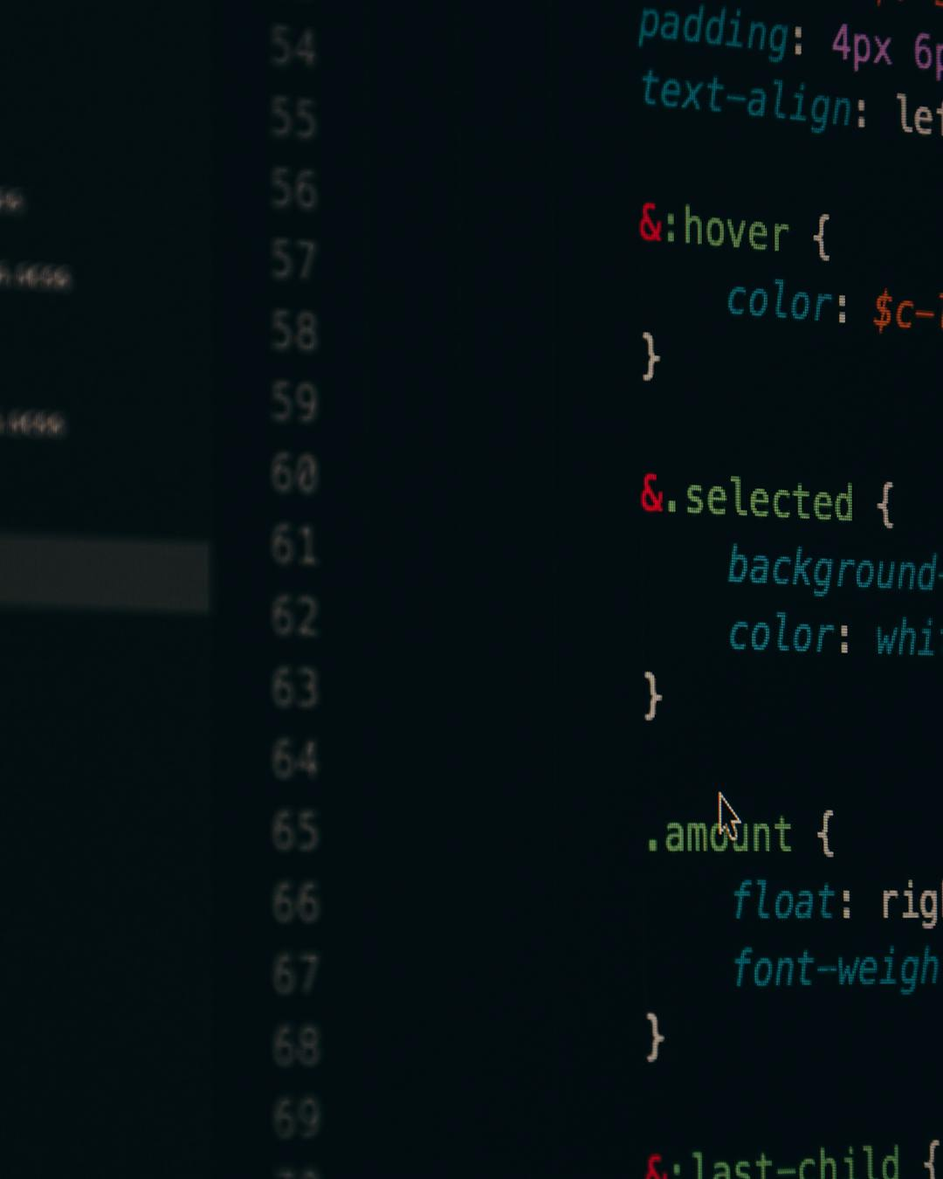
03
Humanizer — Quick Mode
PASS
tool-humanizer
Input: 180-word AI-saturated paragraph (every cliche in the book)
Score: 1.8/10 -> 7.6/10
Patterns detected: 26 (14.4 per 100 words)
- 10 HIGH severity (AI cliches)
- 6 MEDIUM-HIGH (corporate buzzwords)
- 7 MEDIUM (hedging, transitions)
- 3 MEDIUM (promotional inflation)
Word count: 180 -> 105 (42% reduction)
No voice-matching applied (quick mode = cliche removal only)

Slide 5

04
Humanizer — Deep Mode (Voice-Matched)
PASS
tool-humanizer
Input: 220-word AI blog post + voice-profile.md loaded
Score: 2.9/10 -> 8.7/10
Voice-match report:
- Tone (casual-but-competent): 9/10
- Rhythm (short+medium mix): 8/10
- Vocabulary (brand terms): 9/10
- Anti-patterns (banned words): 10/10
- Confidence (bold assertions): 9/10
Brand insertions: 'here's what matters', 'here's the thing', specific numbers
Word count: 220 -> 175

Slide 6

05
Humanizer — Pipeline Mode
PASS
tool-humanizer
Simulated: social-media-team calls humanizer as post-processing
Score: 2.4/10 -> 8.1/10 (delta 5.7)
Pipeline contract verified:
[ok] Received text as input
[ok] Ran Steps 2-6 silently (no user output)
[ok] Returned cleaned text to calling skill
[ok] Showed score summary (delta > 2 threshold)
[ok] Did NOT show full change log (minimal output mode)
Calling skill is responsible for saving final output

Slide 7
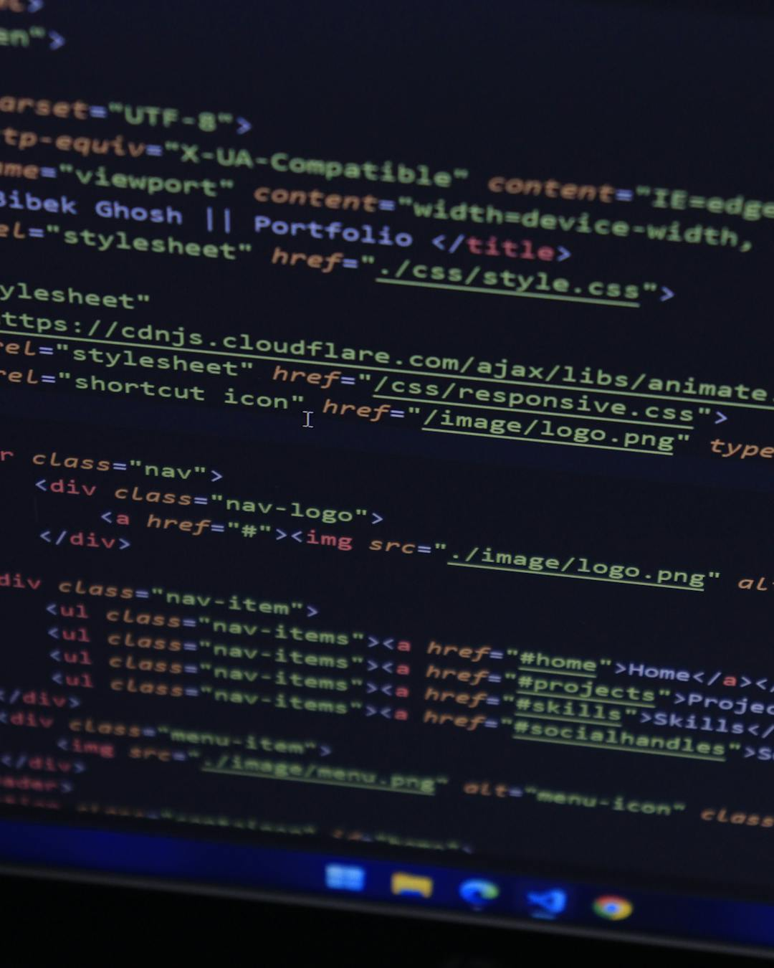
06
Brand Voice — Auto-Scrape Mode
PASS
mkt-brand-voice
URL: https://www.anthropic.com/company
Tool used: WebFetch (free, no API key)
Content: ~800 words, high quality
Extraction result:
- Tone: authoritative yet accessible
- Vocabulary: precision triplets, mission-anchored values
- Zero marketing superlatives in source
- Conviction: institutional humility + long-term framing
Firecrawl fallback: documented (API key missing, would offer Build mode)
Brand asset extraction: skipped (noted for user)

Slide 8

07
Brand Voice — Playbook (Deep Interview)
PASS
mkt-brand-voice
80/20 Formula: 5 personality Qs + 4 strategy Qs + example collection
Synthesis rules verified:
[ok] Rule 1: Derive, don't template (labels from user's words)
[ok] Rule 2: No example brief copying (zero verbatim)
[ok] Rule 3: Q1->Never list, Q5->Voice summary opener
Signature phrases harvested: 4 from user answers
LinkedIn voice test: used 2+ signature phrases
Quick synthesis check: 7/7 green

Slide 9

08
Visual Identity — Update Mode
PASS
mkt-visual-identity
Trigger: tokens.json exists -> Update mode (not rebuild)
Showed current identity summary:
- 9-color palette, 3 typefaces, masthead config
- Asked user what to change (not starting over)
Scenarios tested:
A: Change accent color -> WCAG revalidation
B: Swap font pairing -> cascade to brand book + CSS
C: Update masthead -> templates auto-pick up from tokens.json
locked_fields respected (brand, chrome.masthead)

Slide 10

09
Visual Identity — Path A: Referenced
PASS
mkt-visual-identity
3 visual references analyzed (dark SaaS, data viz, enterprise UI)
Cross-reference synthesis:
- Common thread: dark mode, data-dense, accent-driven hierarchy
- Derived: GitHub Dark primary, Teal accent, Geist font family
WCAG validation:
- text_on_dark on primary: 17.4:1 (pass)
- accent on primary: 8.7:1 (pass)
- accent on light: 2.9:1 (adjusted to 3.8:1)
Output distinct from Path B (data-dense dark vs clean neutral)

Slide 11

10
Brand Voice — Context Enrichment
PASS
mkt-brand-voice
Step 7: ICP + Positioning offers after voice profile save
ICP offer: triggered (icp.md missing)
-> Would invoke mkt-icp skill if user says 'yes'
-> Skip cleanly if user says 'skip'
Positioning offer: triggered (positioning.md missing)
-> Would invoke mkt-positioning skill
Edge cases verified:
- Both exist: skip silently (no re-ask)
- One exists: offer only the missing one
- Neither skill available: skip, note for later

Slide 12

All 10 Paths Tested
mkt-brand-voice: Import, Extract, Playbook, Auto-Scrape, Update, Enrichment
tool-humanizer: Quick, Deep (voice-matched), Pipeline
mkt-visual-identity: Update, Path A (referenced)
Combined with prior session: Build (quick), Body of Work,
Visual Identity Path B (neutral), Brand Book, Carousel Templates
Full coverage across all skill modes and edge cases.

