Slide 1
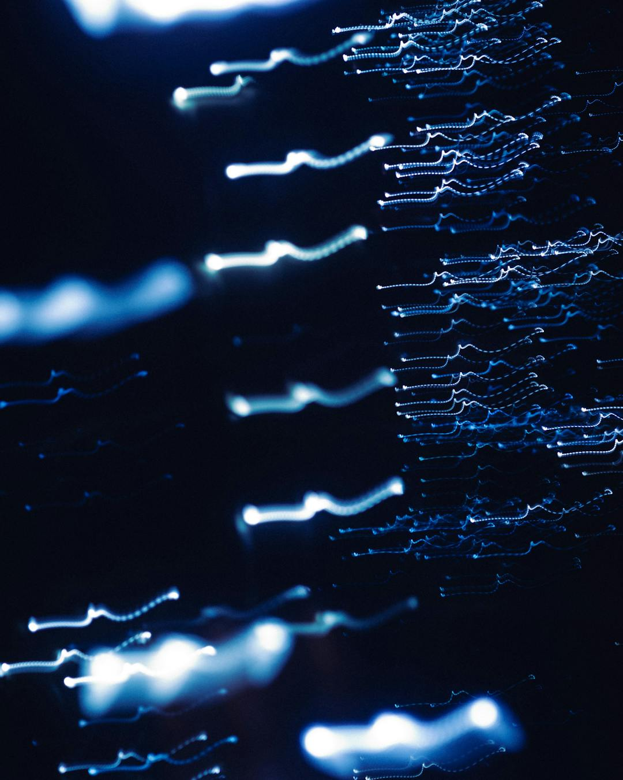
AI Use Cases That Actually Ship
18 Production Deployments Across 8 Industries
Real numbers. Real stacks. No "transformational AI" nonsense.
8 Industries
18 Use Cases
Avg 73% efficiency gain
6-week ROI proof
Every use case here is in production. Measured in months, not "transformational journeys."
The pattern is the same everywhere: automate the boring part, keep humans on judgment calls.
Start small. Prove ROI in weeks. Expand from evidence, not roadmaps.
{{brand_name}}

Slide 2

01
Financial Services
Claims Processing Automation
AML Alert Triage
14 days → 3 days cycle time
False positives: 95% → 60%
73% auto-approved
Analyst productivity: 4x
Error rate: 12% → 2.1%
Investigation: 4hrs → 45min
They didn't try to automate everything.
The 73% that's straightforward gets
auto-processed. The 27% that's complicated
still goes to a human — but now that human
isn't buried under the easy stuff.
The old system flagged everything.
Analysts spent 95% of their time on nothing.
The model doesn't replace the analyst —
it tells them where to look first.
That's the actual work.

Slide 3

02
Healthcare & Life Sciences
Radiology Pre-Read Prioritization
Prior Authorization Automation
11hrs → 38min critical turnaround
62% auto-approved (no human)
Missed findings: 3.2% → 0.4%
5 days → 4 hours approval
Same volume, right order
$2.1M saved/year per facility
Nobody asked the AI to diagnose anything.
It just sorts the pile. The patient with a
collapsed lung gets seen in 38 minutes
instead of 11 hours. That's the difference
between walking out and not.
Prior auth is a bureaucratic bottleneck,
not a clinical one. Most requests meet
criteria — someone just needs to check
the boxes. The AI checks the boxes.
Edge cases still go to a nurse.

Slide 4
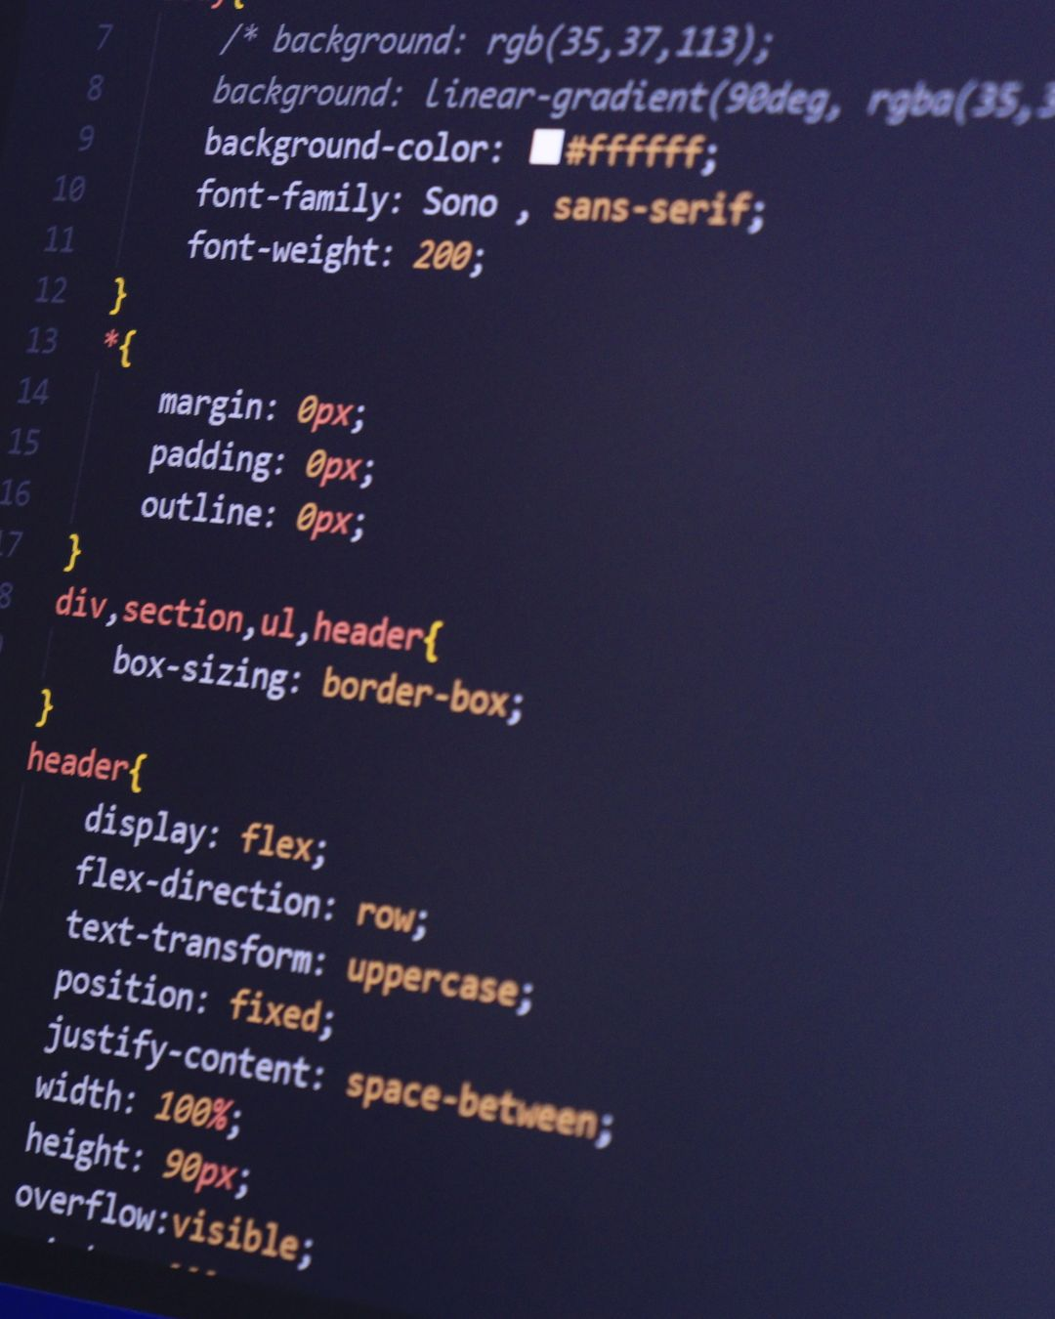
03
Manufacturing & Industrial
Predictive Maintenance
Visual Quality Inspection
Unplanned downtime: −42%
Detection: 99.7% (vs 87% human)
Maintenance costs: −28%
200ms per unit (vs 4s manual)
$3.8M saved/year (1 plant)
Warranty claims: −38%
They started with the 12 machines that
caused 80% of downtime. Instrumented those.
Proved ROI in 6 weeks. Then expanded.
That's how you survive the pilot.
Human inspectors get tired after 2 hours.
Accuracy drops to 72% by hour 6.
The camera doesn't get tired. But they kept
humans for the 0.3% the camera wasn't sure
about. Best of both.

Slide 5

04
Retail & E-commerce
Dynamic Pricing Optimization
Returns Prediction & Prevention
Revenue/visitor: +12%
Return rate: 28% → 19%
Margin: +3.2 pts
$15-33 saved per prevented return
Markdown waste: −23%
$22M/year savings
50K SKUs, one person, once a month.
The math doesn't work. The model runs
continuously. The category manager now sets
strategy and guardrails — min margins,
brand rules. Better job. Better outcomes.
Returns aren't a logistics problem. They're a
"customer got the wrong thing" problem.
Fix the information gap before the purchase
and the return never happens.

Slide 6
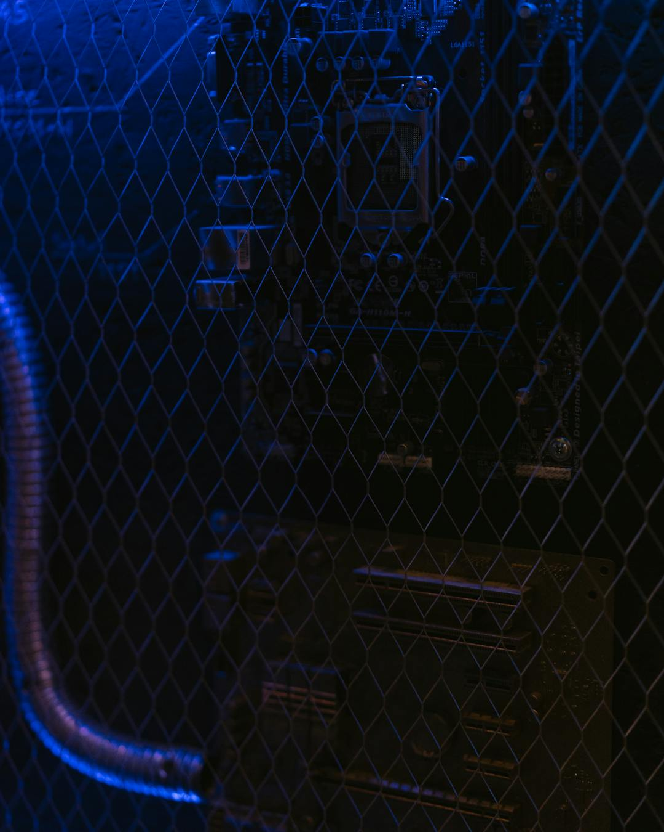
05
Logistics & Supply Chain
Demand Forecasting + Inventory
Last-Mile Route Optimization
Forecast accuracy: 63% → 82%
Deliveries/route: +18%
Stockouts: −35% | Overstock: −28%
Fuel costs: −14% | On-time: 97%
Working capital freed: $12M
$8.2M saved/yr (1,200 vehicles)
The old model was a moving average plus
"gut feel." The real win was trusting
the model enough to automate replenishment.
Automate the boring orders, let buyers
handle exceptions. That's where the money is.
A dispatcher planning 200 routes manually
is solving an NP-hard problem with a
whiteboard. The optimizer finds a route 18%
better than humans can — in 4 minutes
instead of 4 hours.

Slide 7

06
Energy & Utilities
Grid Load Forecasting
Pipeline Leak Detection
Peak demand: −8-12%
72hrs → 15min detection
Balancing costs: −$4.7M/yr
False alarms: 34% → 2.1%
Renewable waste: −22%
$23M in fines avoided (yr 1)
The grid doesn't have a storage problem —
it has a prediction problem. Know tomorrow's
peak within 2%, and you pre-position resources.
Off by 15%? Gas peaker plant. The AI gets it
within 2.3%. Cheap vs expensive electrons.
Old system had 34% false alarm rate.
Crews stopped trusting it. Started ignoring
alerts. New model: 2.1% false alarms.
When it says leak, there's a leak.
Trust drives action. Dead simple.

Slide 8

07
Legal & Professional Services
Contract Review & Risk Extraction
M&A Due Diligence
4 hours → 26 minutes (90% faster)
6 weeks → 8 days
Risk accuracy: 94%
14K docs in 72 hours
Outside counsel: −32%
Found 3 risks humans missed
Lawyers weren't spending 4 hours on judgment.
They spent 3 hours finding clauses and
1 hour on judgment. The AI handles finding.
The lawyer handles judgment. Everyone does
what they're actually good at.
14,000 documents. 12 associates. 4 weeks.
Someone's going to miss something on page
8,247 of exhibit C. The AI reads every page
with the same attention. Partners still make
the call. That's still judgment. Still human.

Slide 9
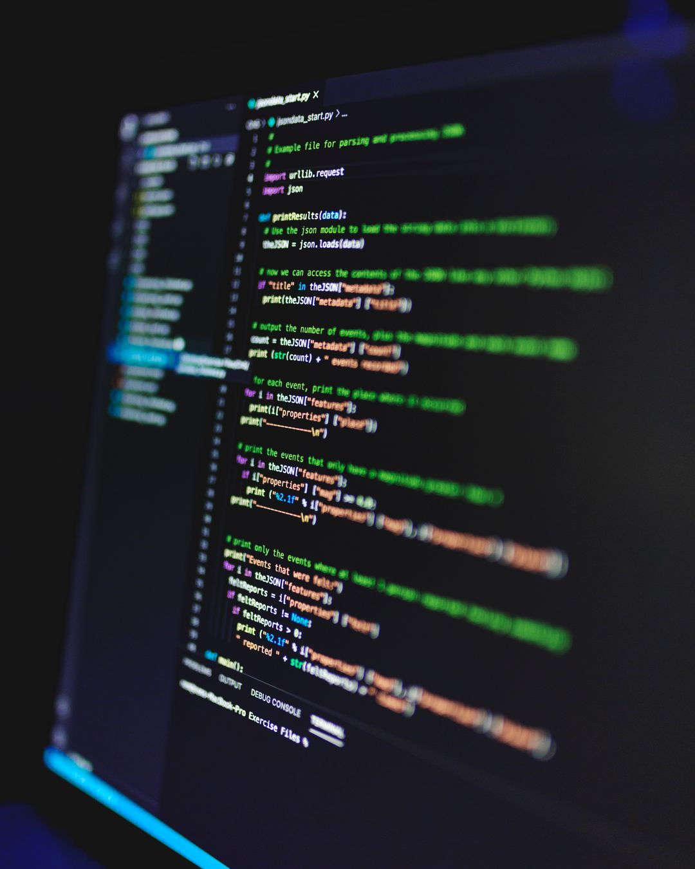
08
Real Estate & Construction
Property Valuation at Scale
Construction Progress Monitoring
Accuracy: within 4.2% of appraisal
Deviations caught 3 weeks earlier
3 months → 2 weeks
Safety violations: +340% detected
$340M in mispriced assets found
Rework costs: −21%
They didn't replace appraisers for deals.
The model handles portfolio monitoring.
The appraiser handles the transaction.
Right tool, right job.
The superintendent walks the site once a day.
The drone sees everything. Every floor, every
corner, every missing guardrail. The super now
acts on data instead of generating it.
Faster decisions, fewer surprises.

Slide 10

What the Winners Have in Common
01
Define the number before writing code
Not "improve efficiency." A specific metric, a specific target, a specific timeline.
02
Automate the boring part, not the judgment
Every winning use case keeps humans for decisions. AI handles extraction, matching, triage.
03
Start with 12 machines, not 1,200
One document type, one product category, one process. Prove it. Then expand from evidence.
04
Measure in weeks, not quarters
If you can't show ROI in 6 weeks, your scope is wrong. Not your model.
05
Trust the model enough to act on it
A forecast nobody acts on is a screensaver. Automate the action. That's where the money lives.
{{brand_name}}

