Slide 1
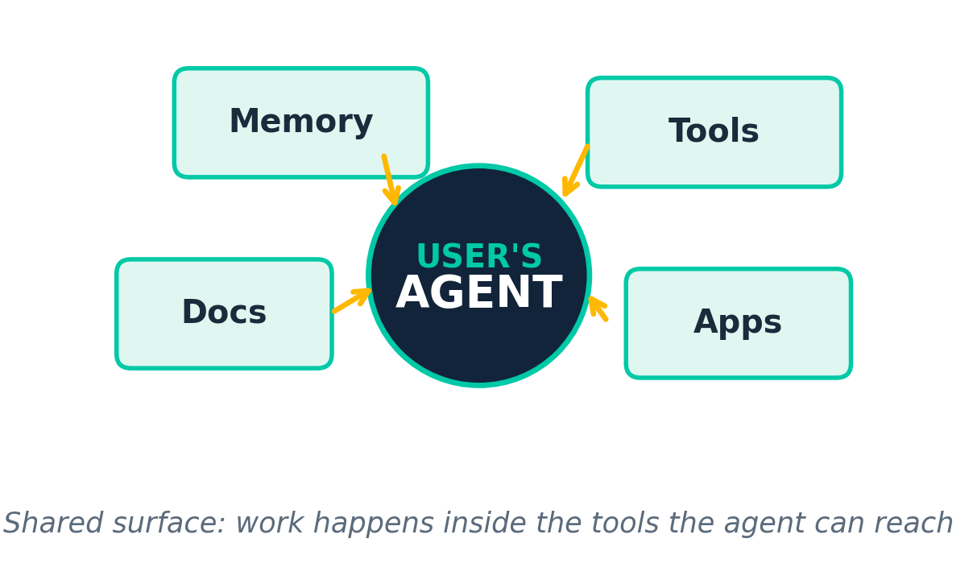
VIDEO-TO-STRATEGY DECK | 22-SLIDE BRIEF
The BEST New AI Opportunity Nobody Is Talking About
Why agent-native apps win when users bring their own agent into tools like Cursor and Codex
Source: YouTube transcript, Chris / June 2026
Context-rich apps
BYO-agent model
Super-app surfaces
MCP / CLI / API
Agent-Native Opportunity Brief | June 2026
1 / 22
Notes:
This deck translates the transcript into a practical product thesis. The core claim is that the next opportunity is not another app with a chatbot inside it; it is an app built so the user's own agent can use it as a shared surface. The deck frames the model shift, the operating implications, the five-step build process, and the kinds of products that fit the pattern. The goal is to turn a video idea into a concise strategy artifact that can be reused in internal discussion or founder planning.

Slide 2
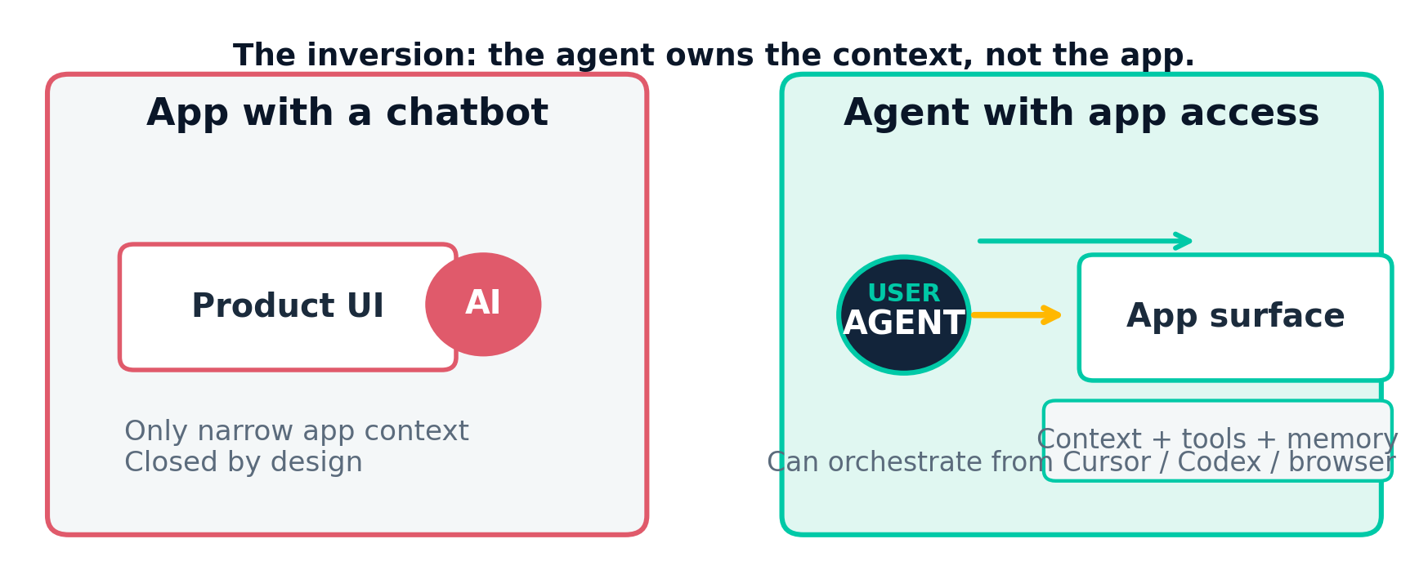
The model inverted
App with an agent vs. agent with an app
Implication: the moat moves from embedded AI features to external context, tool access, and shared workflow design.
Agent-Native Opportunity Brief | June 2026
2 / 22
Notes:
The transcript contrasts two software patterns. In the old pattern, the app embeds an agent. That gives the product a narrow kind of intelligence, but the context remains trapped inside the application. In the newer pattern, the user's own agent sits outside the app and uses the app as a surface. That changes the buying center, the product architecture, and the value proposition: the product now has to work well with the user's broader context rather than only its own database.

Slide 3
Why this matters now
Three forces make agent-native apps viable
Super-app workbenches
Cursor and Codex are becoming the places where knowledge work happens.
Context wins
Local files, memories, and project context shape better outcomes than app-only memory.
Tool connectivity
MCP, CLI, and API access let an external agent actually do the work in the app.
Visual feedback loop
Users can watch the agent act inside the surface and correct it immediately.
Agent-Native Opportunity Brief | June 2026
3 / 22
Notes:
The timing argument in the transcript is simple. First, the work surface is shifting into super-apps like Cursor and Codex. Second, the winning context no longer lives only inside a product; it lives in local files, project memory, and connected tools. Third, agent-native apps are practical because there are now standard ways for an agent to connect to an app through MCP, CLI, or API. The result is a new product category in which the app is designed to be used by the user's agent, not just by the user directly.

Slide 4
Agent-native app anatomy
Detailed use-case realization
Challenge
Solution
How it works
Users want an app that can work across their full project context, not just the content stored inside one product.
Design the app for the user's own agent. Let the app expose a shared surface that works inside Cursor, Codex, or another orchestrator.
The agent reads local markdown, assets, and memory, then uses the app through browser, CLI, or API while the user watches the result.
Stack: local context + shared surface + tool connectivity + persistent memory
Users: founders, designers, operators, analysts
Organizations: teams that need real context
Surface: browser, canvas, sheet, doc, or dashboard
Agent-Native Opportunity Brief | June 2026
4 / 22
Notes:
This slide captures the product anatomy implied by the transcript. The challenge is that users need the product to reflect project-specific context that goes beyond the app. The solution is to make the app a shared surface for the user's agent, not a closed system. The implementation model is straightforward: the agent reads local documentation, assets, and memory, then connects to the app through browser control, CLI, or API. The user stays in the loop and can inspect the work as it happens.

Slide 5
Five steps to start building
The transcript's build playbook
1
1. Pick the job to be done
Define the outcome the user and agent achieve together.
2
2. Define the shared surface
Choose the canvas both sides collaborate on at the same time.
3
3. Build for BYO agent
Make the app usable from any agent host, not just your own.
4
4. Start from your expertise
Choose a domain you already know deeply.
5
5. Plan MCP / CLI / tools early
Scope integrations on day one so the collaboration is real.
Agent-Native Opportunity Brief | June 2026
5 / 22
Notes:
The five-step framework is the practical takeaway from the video. Step one is to define the job to be done in terms of a joint outcome for user and agent. Step two is to define the shared surface where the collaboration happens. Step three is to build for the bring-your-own-agent model rather than embedding your own agent in a closed box. Step four is to start where your own expertise gives you a strong wedge. Step five is to decide the MCP, CLI, and tool list at the beginning so the app can actually work with agents from day one.

Slide 6
Where the opportunity is
Examples of agent-native surfaces already visible
Miro / canvas tools
Notion
MagicPath / Paper
Shared whiteboards with agent-readable artifacts.
Knowledge stores external agents can read and write.
Visual design canvases for agent-led composition.
Google Sheets
Adobe-class tools
Structured data surfaces with connectors.
Incumbents still have room for an agent-native workflow.
Opportunity: every surface that already holds context can be agent-native
Agent-Native Opportunity Brief | June 2026
6 / 22
Notes:
The transcript names examples that already show the pattern. Miro is shifting toward shared canvases with markdown, Mermaid diagrams, and HTML prototypes. Notion already supports MCP-style connectivity and browser access. MagicPath and similar tools let an agent work directly on a design canvas. Google Sheets is an obvious structured-data surface with connectors. The broader opportunity is larger than these examples: any incumbent tool with a surface and an integration path can be recast as agent-native.

Slide 7
What to build
A concise decision filter
Build if
Avoid if
Product rule
• The user already works in an existing surface
• Your domain knowledge is better than generic tooling
• The app can expose MCP, CLI, or API access
• You need a closed system to feel valuable
• The agent has no real external tools
• The workflow cannot benefit from project context
The app should be useful to the user's agent even when the product's own agent layer is minimal or absent.
Bottom line: the opportunity is software redesigned for the user's own agent.
Agent-Native Opportunity Brief | June 2026
7 / 22
Notes:
This slide converts the talk into a decision rule. Build where the user already has a surface, where your domain expertise is real, where the agent can connect through MCP, CLI, or API, and where local context and memory matter. Avoid products that only work when closed around their own mini-agent. The product should be useful to the user's agent even if your embedded AI features are deliberately small. That is the strategic difference the video is arguing for.

Slide 8
Strategic takeaway
Agent-native apps are the new wedge
Design for the user's agent, not just the user
Summary
The opportunity is to make products that live inside Cursor, Codex, and similar super-apps, with context and tool access designed in from the start.
Agent-Native Opportunity Brief | June 2026
8 / 22
Notes:
This is a summary checkpoint rather than the end of the deck. The opportunity is not another AI feature. It is a product designed so the user's own agent can bring local context, memory, and tools to the app. That shifts the product from isolated automation to collaborative workflow. For founders and product teams, the practical next step is to pick a domain you know well, identify the shared surface, and map the MCP, CLI, or API surface before you build the first version.

Slide 9
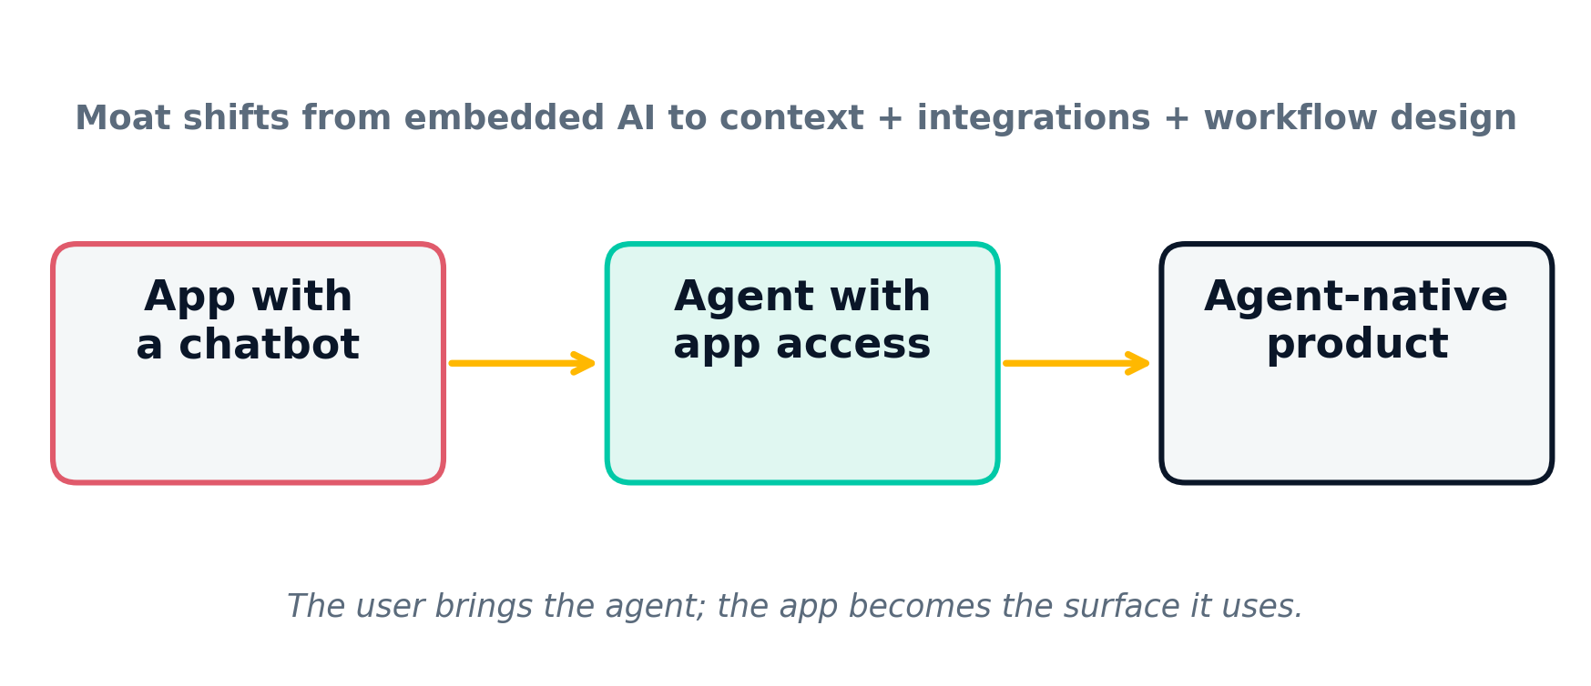
The thesis in one diagram
From embedded AI to agent-native surfaces
Moat moves outward: context, integrations, workflow design, and shared surfaces matter more than embedded AI alone.
Agent-Native Opportunity Brief | June 2026
9 / 22
Notes:
This slide captures the core inversion in the transcript. The old model puts a chatbot inside software. The new model assumes the user's own agent will use software as a surface. That changes where value accumulates: not in a thin AI layer, but in the context the app can share, the tools it can expose, and the way the workflow is designed around the agent's actions.

Slide 10
What agent-native means
Six hallmarks that show up in the transcript
Shared surface
BYO agent
Project context
A canvas, doc, sheet, or dashboard both user and agent can see.
It works inside Cursor, Codex, or another orchestrator.
Local files and artifacts matter as much as app data.
Tool access
Live correction
Persistent memory
MCP, CLI, API, or browser access lets the agent act.
The human can watch the work and steer it immediately.
The workflow does not reset every time the session ends.
If these six are true, the app is genuinely agent-native.
Agent-Native Opportunity Brief | June 2026
10 / 22
Notes:
The transcript keeps returning to a small set of conditions. The product has to expose a shared surface, allow the user's own agent to enter, carry project context, accept tools, support live correction, and preserve memory across sessions. Those six conditions are a useful shorthand for deciding whether a product is actually agent-native or just AI-colored.

Slide 11
Why super-app workbenches matter
Cursor and Codex become the new front door to work
What changes
What that means for teams
• People begin work in the agent host, not in your product.
• The host carries the broader context and chooses which app to invoke.
• The app becomes one surface inside a larger workflow, not the center of gravity.
• Optimize handoff: docs, permissions, and context sharing.
• Design for orchestrators like Cursor and Codex, not only for the end user.
• Assume the app will be used by an agent even when the UI is not the starting point.
Super-apps are the new interface layer for knowledge work
Agent-Native Opportunity Brief | June 2026
11 / 22
Notes:
The transcript names Cursor and Codex as examples of super-apps where knowledge work is increasingly happening. That matters because the product no longer owns the full working session. It is now a tool that has to earn a place inside a broader agent-driven workbench. For founders, this means the product's first job is to make itself useful to the orchestrator.

Slide 12
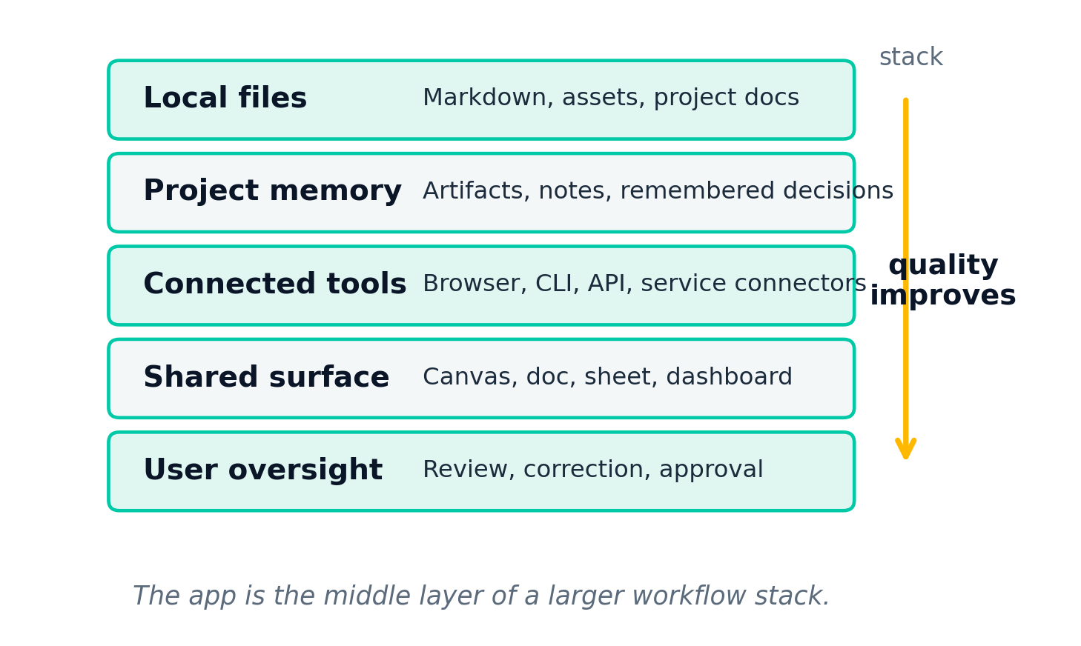
The context stack
The agent's quality comes from more than one database
Why it matters
The transcript argues that local project context and connected tools outperform app-only memory. The app becomes more useful when it can combine what lives on disk, what the team remembers, and what the agent can reach.
Think of the product as the middle layer of a larger workflow stack, not the whole stack.
Agent-Native Opportunity Brief | June 2026
12 / 22
Notes:
A major point in the transcript is that the winning context is not only inside the app. It lives in local files, memories, and connected tools. The app should therefore be designed as part of a context stack: the agent can bring information from outside, act on the app's surface, and leave useful artifacts behind for future sessions.

Slide 13
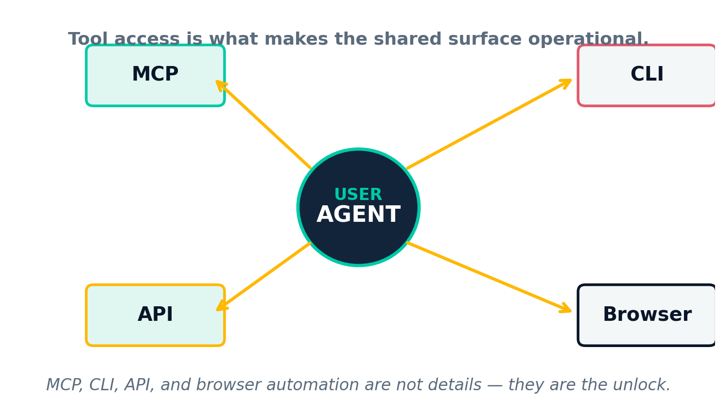
Tool access is the unlock
MCP, CLI, API, and browser access make the app usable
No tool access means no agent-native workflow.
The transcript treats integrations as foundational, not optional.
Give the agent at least one reliable way to act.
Agent-Native Opportunity Brief | June 2026
13 / 22
Notes:
The agent-native idea only works if the agent can actually do something in the product. That is why the transcript keeps mentioning MCP, CLI, API, and browser access. These are not implementation details; they are what make the shared surface operational rather than symbolic.

Slide 14
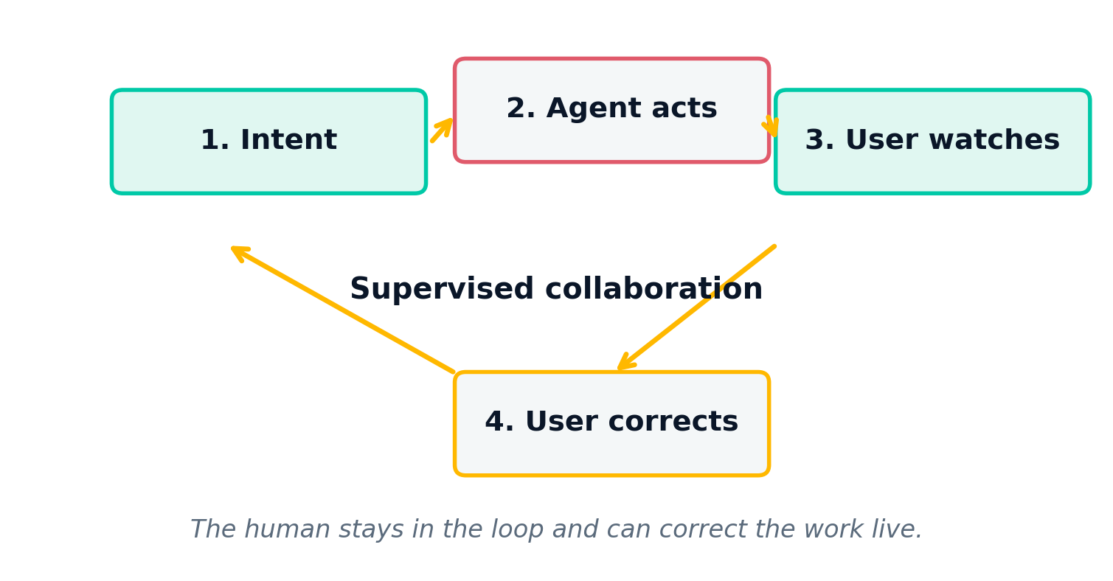
The human stays in the loop
The visual feedback loop is part of the product
This is supervised collaboration, not invisible automation.
Agent-Native Opportunity Brief | June 2026
14 / 22
Notes:
The transcript is clear that users should be able to watch the agent work and correct it live. That makes the feedback loop part of the product. The app is not trying to hide the machine; it is trying to make the machine legible and steerable inside a shared surface.

Slide 15
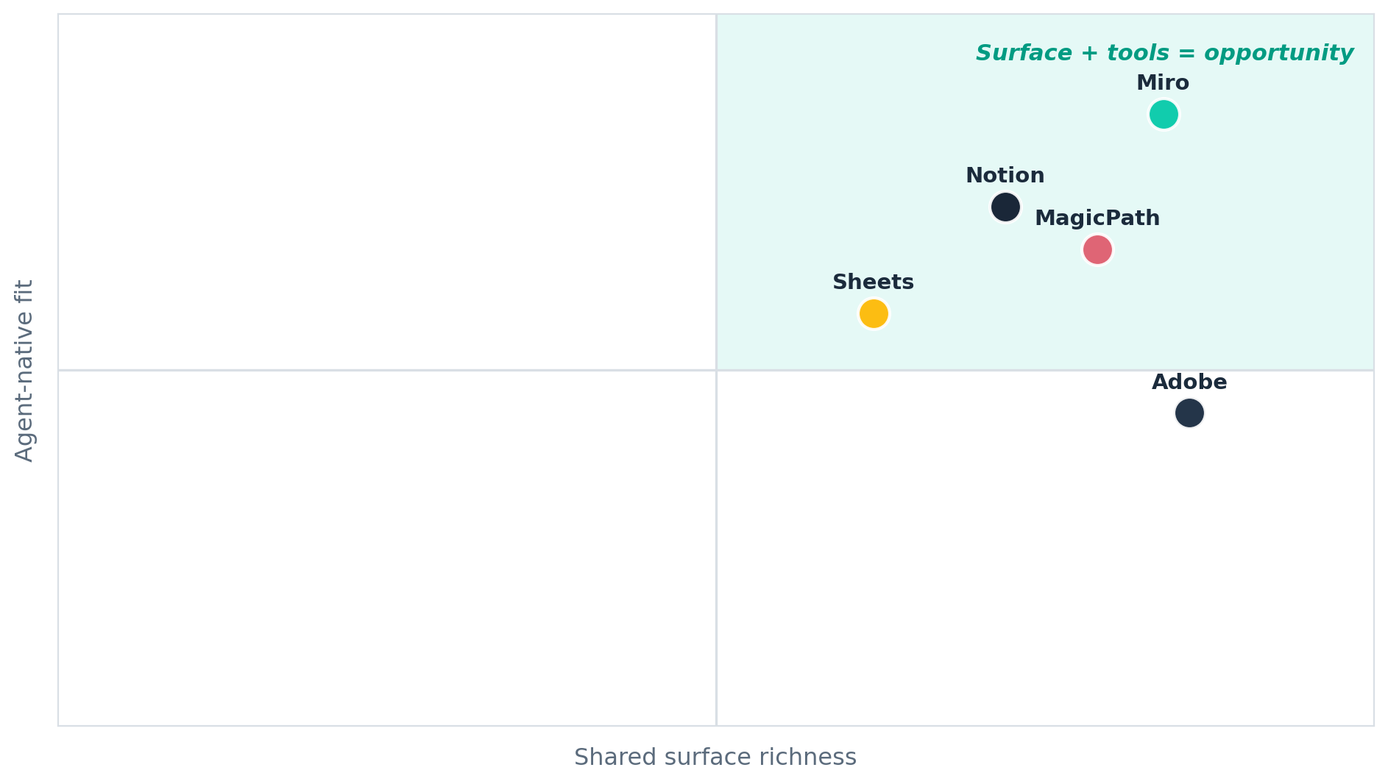
Where the opportunity shows up
The transcript points to surfaces that already hold context
Collaborative surfaces
Canvas and knowledge tools sit in the high-fit quadrant because they already hold project context.
Structured surfaces
Tables and creative suites are strong because the agent can transform, organize, and refine work.
The common pattern: a surface already holds context, and an external agent can now use it directly.
Agent-Native Opportunity Brief | June 2026
15 / 22
Notes:
The opportunity map is not just a list of random products. It is a set of surface types that already carry project context and can therefore be recast as agent-native. The transcript keeps returning to these kinds of environments because they are already where work happens.

Slide 16
Miro / canvas tools
Shared whiteboards with agent-readable artifacts
What exists
Why it fits
Agent behavior
A shared canvas that can hold markdown, Mermaid diagrams, and HTML prototypes.
The board is already a collaboration surface, so an external agent can contribute to it visibly.
Generate, edit, and refine visual artifacts on the canvas while the user watches and corrects.
Canvas tools are one of the clearest examples of software becoming a shared agent surface.
Agent-Native Opportunity Brief | June 2026
16 / 22
Notes:
The transcript explicitly calls out Miro-style tools. The key detail is that these systems can hold markdown, diagrams, and prototypes, which makes them readable and editable by an agent. The result is a shared visual workspace rather than a locked-in whiteboard.

Slide 17
Notion
Knowledge stores external agents can read and write
What exists
Why it fits
Agent behavior
A knowledge base that already stores the team's docs, tasks, and project memory.
The transcript notes MCP-connected access and browser-based use, which makes it easy for agents to work with it.
Read pages, update task context, and keep the team's project memory in sync across sessions.
Agent-Native Opportunity Brief | June 2026
17 / 22
Notes:
Notion is a strong example because it already sits on top of project memory. The transcript specifically references MCP-connected access and browser use, which means an external agent can read and write in the knowledge layer rather than being trapped inside a separate chatbot.

Slide 18
MagicPath / Paper
Visual design canvases for agent-led composition
What exists
Why it fits
Agent behavior
Design-oriented surfaces where visual composition is the primary interaction pattern.
The transcript treats these as an obvious place for an external agent to shape the canvas visually.
Generate layouts, move elements, and refine compositions while the designer supervises the result.
Agent-Native Opportunity Brief | June 2026
18 / 22
Notes:
The transcript mentions MagicPath and Paper as examples of design surfaces where an external agent can shape the canvas visually. This is a different category from a generic text app: the value is in composition and visual judgment, which makes the feedback loop central.

Slide 19
Google Sheets
Structured data surfaces with existing connectors
What exists
Why it fits
Agent behavior
A structured table with familiar formulas, rows, and connector-friendly workflows.
The transcript treats Sheets as the obvious case where agents can manipulate structured project data.
Populate, clean, transform, and validate tables while leaving the human free to inspect changes.
Agent-Native Opportunity Brief | June 2026
19 / 22
Notes:
Google Sheets appears in the transcript as a simple but powerful example: it is already a structured data surface with obvious connections to the rest of the workflow. That makes it an easy place for an external agent to do useful work without requiring a new interaction model.

Slide 20
Adobe-class tools
Large incumbents still have room for an agent-native workflow
What exists
Why it fits
Agent behavior
Deep creative suites with rich assets, repeated workflows, and many approval checkpoints.
The transcript argues that even incumbents still have room for an agent-native version of the workflow.
Assist with asset handling, repetitive edits, layout variations, and review cycles inside a familiar suite.
Agent-Native Opportunity Brief | June 2026
20 / 22
Notes:
The transcript does not claim that incumbents disappear. Instead, it says there is still room for an agent-native version of the workflow inside large creative suites. That is a valuable signal for founders because it shows how big the surface area still is, even inside mature categories.

Slide 21
A practical founder filter
Ask these questions before you build
1. Where does the user already work?
If the answer is nowhere, the product may be trying to create a behavior that doesn't exist.
2. What context lives outside the app?
Agent-native products win when the real project context is broader than one database.
3. Which tools must the agent reach?
MCP, CLI, API, or browser access should be explicit from the start.
4. How will the human correct it?
If the user cannot see and steer the work, the product loses the feedback loop.
If you cannot answer all four, the wedge is probably not ready yet.
Agent-Native Opportunity Brief | June 2026
21 / 22
Notes:
This slide turns the transcript into a real decision test. The key questions are whether a user already works in a surface, whether the important context sits outside the app, whether the agent can reach the necessary tools, and whether a human can inspect and correct the work.

Slide 22
The next move
Build for the user's agent
Design the app as a shared surface inside Cursor, Codex, and similar workbenches.
Summary
The best new AI opportunity is software that becomes useful to the user's own agent: context-aware, tool-connected, and designed around a visible workflow.
Choose a domain you know
Map the shared surface
Expose tools early
Agent-Native Opportunity Brief | June 2026
22 / 22
Notes:
The closing message is simple: the opportunity is software redesigned for the user's own agent. For founders, the practical path is to choose a domain you understand, define the shared surface, and map the tools before shipping the first version.

