Slide 1
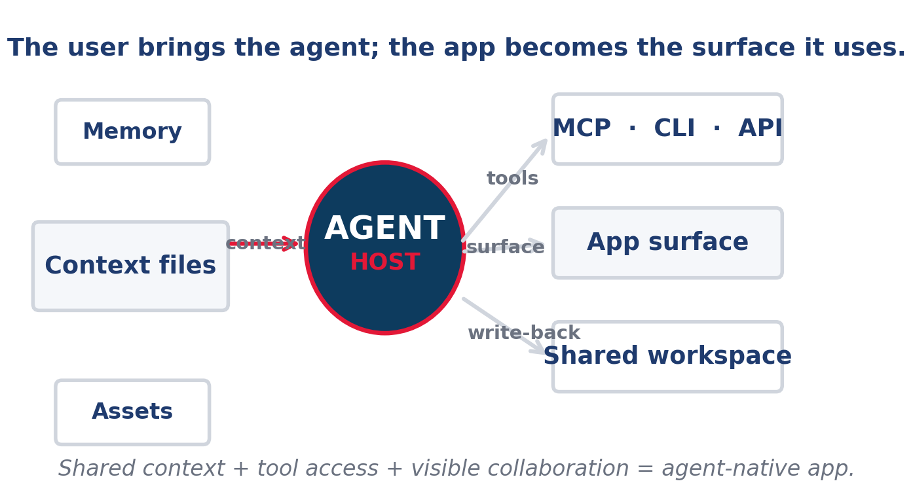
ARCHITECTURE BRIEF
Agent-Native Apps
Software designed for the user's own agent.
Cursor + Codex + shared context + tool access
Build for the user's agent, not just the user.
Agent-Native Apps | Architecture Brief | June 2026
1 / 21
Notes:
This title slide frames the opportunity as an architecture problem: the user, context, tools, and surface must all line up.

Slide 2
The thesis
The workflow changes when the agent owns the loop
Old model
New model
What changes
App embeds a chatbot. The model sees only local app context, so it can answer questions but cannot finish the job. Result: the user still does the hard part outside the app.
The user's agent owns the context and uses the app as one surface among many. Result: the app becomes a place where work actually gets done, with the user's broader memory attached.
Moat shifts to shared context, tool access, workflow design, and persistent memory. If those four pieces are weak, the model layer is just decoration.
If the app is not usable by the user's agent, it is only partially agent-native.
The architecture is a loop, not a router.
Agent-Native Apps | Architecture Brief | June 2026
2 / 21
Notes:
Use this slide to explain the inversion and the strategic implication.

Slide 3
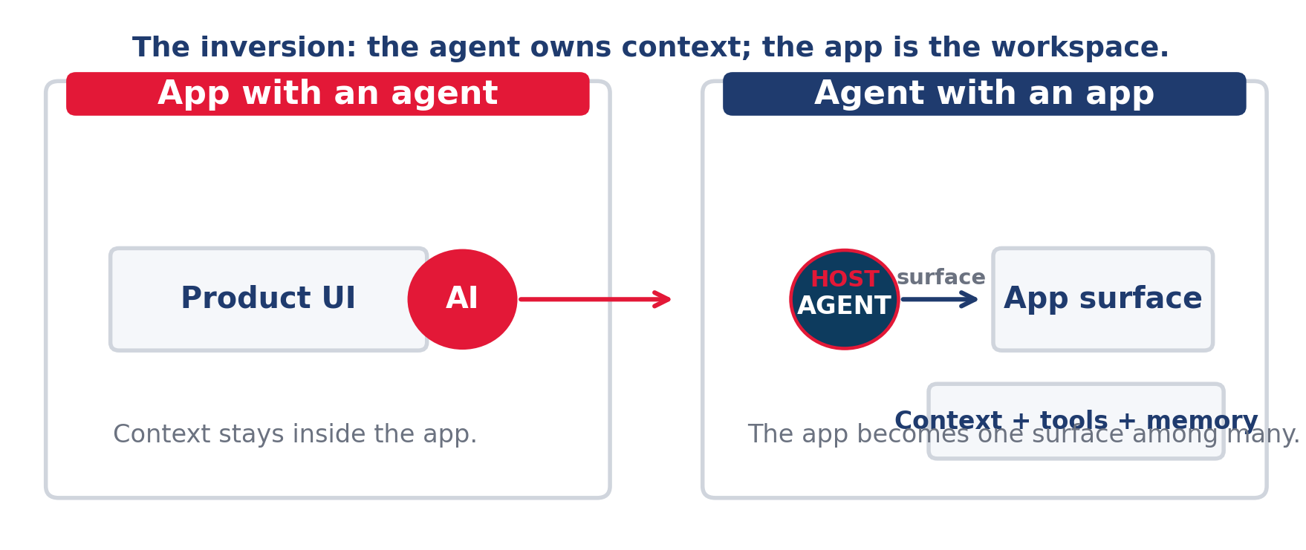
Model inversion
App with an agent vs. agent with an app
Old model: the app contains the agent. New model: the agent contains the app surface and brings its own context.
Agent-Native Apps | Architecture Brief | June 2026
3 / 21
Notes:
The left side is the old pattern. The right side is the agent-native pattern.

Slide 4
Five principles
The checklist that separates real agent-native systems from AI-colored software
Parity
Granularity
Composability
Emergent capability
Improvement over time
Anything the user can do in UI, the agent can do through tools. If parity is missing, the agent is only a suggestion engine.
Tools are atomic primitives. Features come from prompt-defined outcomes. Keep the actions small so agents can combine them.
New capabilities come from new prompt + tool combinations. The product gets smarter when the same pieces work in new sequences.
The system should handle requests you did not pre-script. That is the difference between automation and a real agent surface.
Context and memory should make the system better with use. If it does not learn from the workspace, it will not compound value.
If the product cannot satisfy these five checks, it is still too constrained.
Agent-Native Apps | Architecture Brief | June 2026
4 / 21

Slide 5
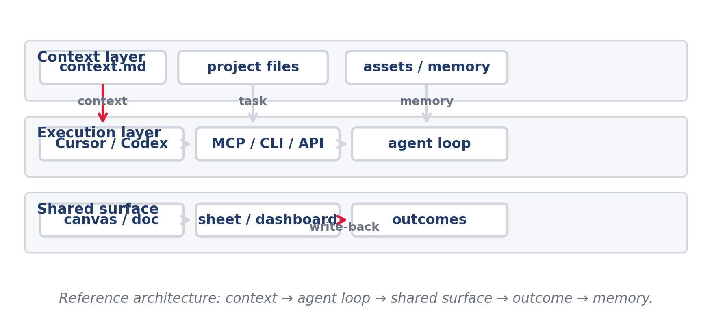
Reference architecture
Context → agent loop → shared surface → outcome → memory
Read left to right: context feeds the agent, tools move it into the app, and write-back turns output into future context.
Agent-Native Apps | Architecture Brief | June 2026
5 / 21

Slide 6
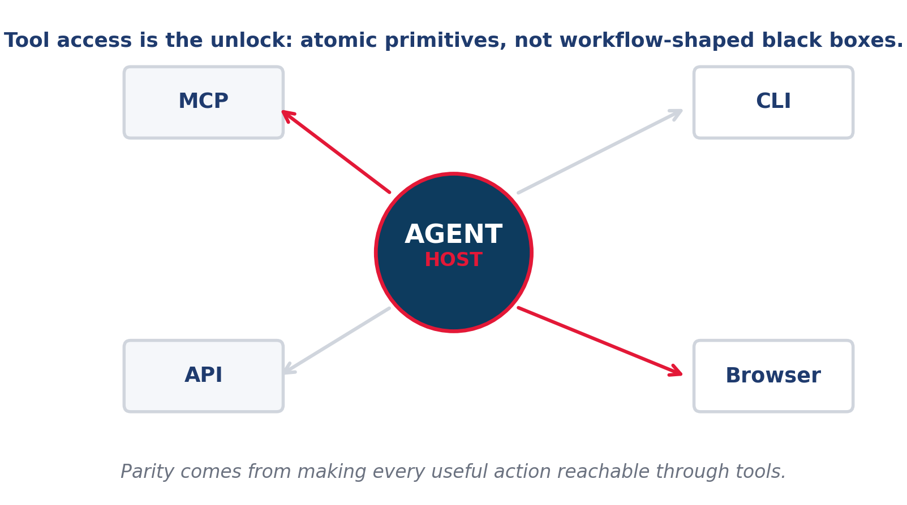
Tool layer
MCP, CLI, API, and browser access are the unlock
Parity
If a user can do it, the agent needs a path to do it too. Without that path, the feature is just a demo.
Granularity
Expose primitives; keep domain logic in the agent loop. That is what lets any agent chain actions together.
CRUD completeness
Every entity needs create, read, update, and delete. If delete is missing, the agent cannot safely clean up its own work.
Tool access is a product decision, not an implementation detail.
Agent-Native Apps | Architecture Brief | June 2026
6 / 21

Slide 7
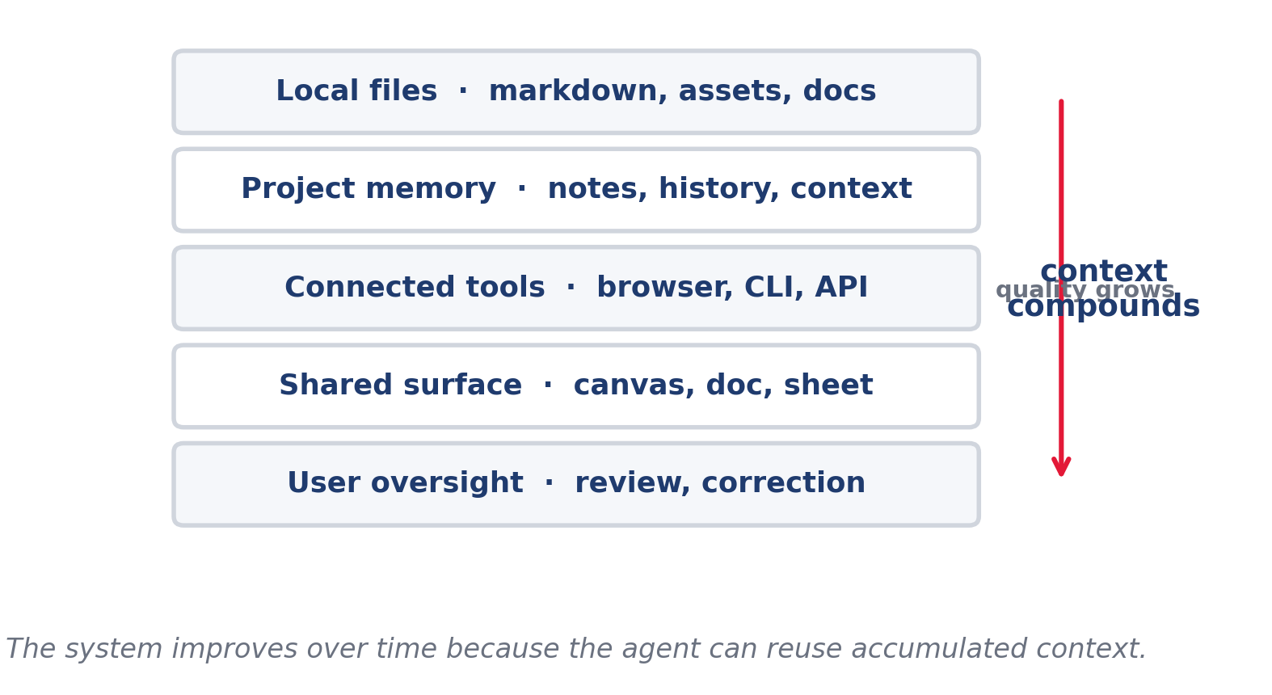
Context layer
Local files, project memory, and workspace state compound over time
Shared workspace
The agent and user work in the same files and see the same state. That shared state is what makes collaboration legible.
context.md pattern
Write accumulated knowledge into files the agent can re-read. Examples: brand rules, architecture notes, prior decisions, and approved defaults.
Improvement over time
Better memory makes the system smarter without shipping code. The product improves because the workspace remembers what good looks like.
Context is the moat. It compounds.
Agent-Native Apps | Architecture Brief | June 2026
7 / 21

Slide 8
Anti-patterns
The common ways teams build something that is not actually agent-native
Agent as router
The agent only chooses which fixed function to call. That means it can route work, but it cannot reason through it.
Workflow-shaped tools
A single tool hides judgment and prevents composability. You want primitives, not a black box with a nicer prompt.
Sandbox split-brain
Agent output goes to a separate workspace the user doesn't see. If the user cannot verify state, trust breaks down fast.
Silent actions
State changes do not show up in the UI immediately. Visible feedback is how humans know the agent did the right thing.
Heuristic completion
The system guesses the task is done instead of signaling it. Completion needs explicit status, not vibes.
If the code already solved the interesting part, the agent is just a caller.
Agent-Native Apps | Architecture Brief | June 2026
8 / 21

Slide 9
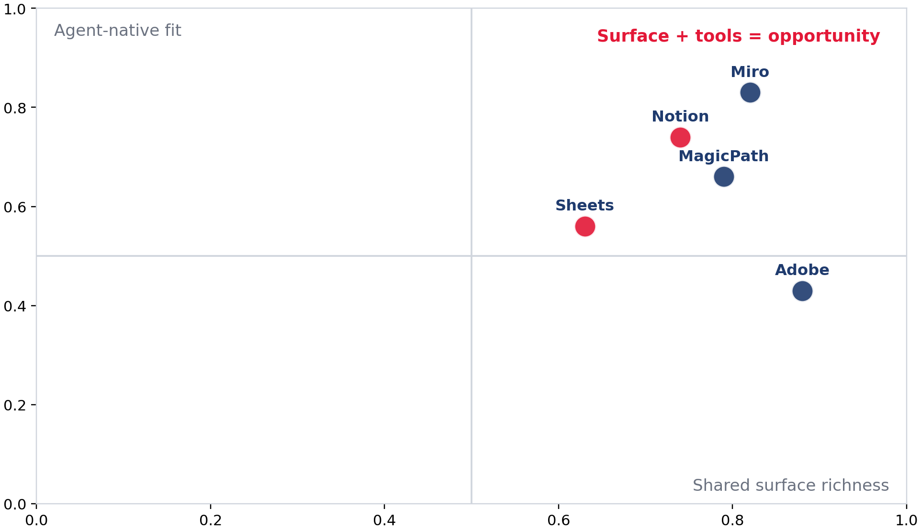
Where the opportunity is
Surfaces that already carry context are best positioned
Miro / canvas tools
Shared boards can hold markdown, diagrams, and prototypes.
Notion / docs / Sheets
Knowledge bases and structured tables are easy to connect.
Adobe-class suites
Large incumbents still have room for agent-native workflows. They already own expensive, repeatable work where better context matters.
Best first wedges: canvas tools, docs, sheets, CRM/ops work, and design workflows.
The surface is the product. The agent only makes it useful.
Agent-Native Apps | Architecture Brief | June 2026
9 / 21

Slide 10
Why now
Three shifts make agent-native software viable today
User agents are real
Apps expose tools
Context is portable
People are already working inside Cursor, Codex, and similar hosts. OpenAI's Codex CLI can read, change, and run code locally.
MCP, CLI, API, and browser access make external action practical. Notion MCP can read and write workspace content with permissions.
Files, docs, assets, and memory can live outside a single product. Codex's in-app browser gives a shared view of rendered pages.
The category opens when the agent can bring its own context into an app, not just consume the app's AI.
Evidence: OpenAI Codex CLI, OpenAI Codex app browser, and Notion MCP show the workflow is already here.
The opportunity is a workspace designed for the user's agent.
Agent-Native Apps | Architecture Brief | June 2026
10 / 21

Slide 11
How to build
Five steps to find and ship an agent-native app
1
1. Pick the job
Define the outcome the user and agent achieve together.
2
2. Define the surface
Choose the canvas or workspace both can work on.
3
3. Build for BYO agent
Make the app useful inside Cursor/Codex-style hosts.
4
4. Start from expertise
Choose a domain you already know deeply.
5
5. Plan tools early
Scope MCP / CLI / API access on day one.
The product changes when you start with the shared surface and the tool surface together.
Agent-Native Apps | Architecture Brief | June 2026
11 / 21

Slide 12
Step 1. Pick the job
Start with one outcome the user and agent should achieve together
Job to be done
Success criteria
Decision rule
A good wedge is narrow enough to evaluate and broad enough to repeat. Examples: • design a page • update a CRM record • reconcile a sheet
The user can see the result, approve it, and correct it quickly.
Choose a job that already lives in a tool-rich workflow. The best jobs are repeated, visible, and easy to verify.
What the agent needs
Inputs, permissions, and a visible surface that matches the task.
Failure mode
If the agent cannot complete the work end-to-end, the job is too large.
Do not start with a model feature. Start with a repeated job.
Agent-Native Apps | Architecture Brief | June 2026
12 / 21

Slide 13
Step 2. Define the surface
Pick the shared workspace both sides can edit
Canvas
Doc
Sheet
Browser
Use when the task is visual or spatial.
Use when the task is narrative or collaborative.
Use when the task is structured and tabular.
Use when the task needs live app interaction.
The shared surface is where the user watches the agent work, not where the model hides the work.
The surface should make the collaboration obvious.
Agent-Native Apps | Architecture Brief | June 2026
13 / 21

Slide 14
Step 3. Build for BYO agent
Design for external agents first, not an embedded chatbot
No lock-in
Do not depend on a proprietary agent living inside the app.
Tool first
Expose actions through MCP, CLI, API, and browser flows.
Shared context
Let the agent inherit local files, notes, and memory.
The app should be the place the agent works, not the place it gets trapped.
Agent-Native Apps | Architecture Brief | June 2026
14 / 21

Slide 15
Step 4. Start from expertise
Use a domain you understand deeply enough to judge output quality
Your advantage
Good wedges
What to avoid
You know the workflow, the failure cases, the language, and the acceptable tradeoffs.
Product design Operations Marketing Finance Support
A generic productivity app with no domain truth. If you cannot tell good from bad output, the feedback loop will be weak.
Expertise is what lets you define the right shape for the agent.
Agent-Native Apps | Architecture Brief | June 2026
15 / 21

Slide 16
Step 5. Plan tools early
Scope MCP / CLI / API before you build the UI around them
MCP
Best when the product needs structured tool access across clients.
CLI
Best when local agents need a simple command-line control path.
API / browser
Best when the agent must operate inside the same surface as the human.
If you cannot draw the tool map on day one, the product is still under-scoped.
Agent-Native Apps | Architecture Brief | June 2026
16 / 21

Slide 17
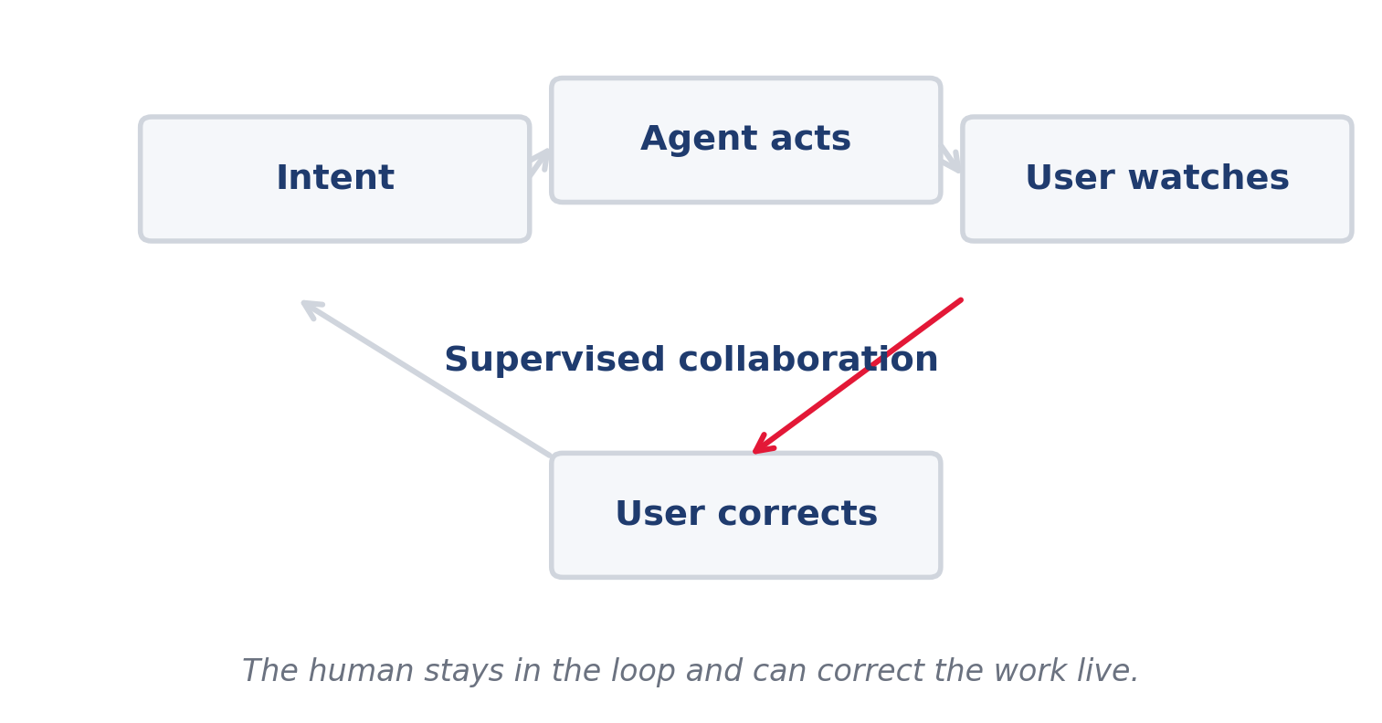
Human-in-the-loop
The collaboration loop is part of the product
Watch
The user sees what the agent is doing in real time.
Correct
The user can steer the outcome before the work is locked in.
Compound
Corrections become context the agent can reuse on the next run.
Visible feedback is what turns automation into collaboration.
Agent-Native Apps | Architecture Brief | June 2026
17 / 21

Slide 18
Examples worth studying
The strongest candidates already have shared context and shared surfaces
Miro
Notion
Sheets / Adobe
Canvas-first workspaces can hold diagrams, markdown, and prototypes.
Docs plus MCP make it easy to move between knowledge and action.
Structured tables and design suites already have rich user workflows.
The best opportunities sit where the surface already has meaning.
Agent-Native Apps | Architecture Brief | June 2026
18 / 21

Slide 19
Launch checklist
Use this before you commit to the wedge
Can the user work here today?
If not, you are asking for behavior change first.
Can the agent reach the tools?
There must be a real tool path, not a prompt illusion.
Can both see the same state?
Shared surface means shared visibility.
Can the system improve with use?
If context cannot compound, the product will stall.
If any answer is no, the idea needs more architecture before it needs more code.
Agent-Native Apps | Architecture Brief | June 2026
19 / 21

Slide 20
Go / no-go filter
The founder checklist for this category
User already works here?
If no one works in this surface today, you may be creating behavior from scratch.
Context exists outside the app?
Agent-native wins when the real project context is broader than one database.
Can the agent reach tools?
MCP, CLI, API, or browser access should be explicit.
Can humans watch/correct?
The visible feedback loop must be part of the product.
If you cannot answer yes to all four, the wedge is probably not ready.
Agent-Native Apps | Architecture Brief | June 2026
20 / 21

Slide 21
Bottom line
The best new AI opportunity is software redesigned for the user's agent
Build for the user's agent, not just the user.
Design a shared surface, expose the tools, and let the agent improve with context.
The opportunity is not another chatbot. It is software that becomes useful to an external agent.
Choose a domain you know
Map the shared surface
Expose the tools early
Agent-native apps are the next wedge because they compound context, not just clicks.
Agent-Native Apps | Architecture Brief | June 2026
21 / 21

