Slide 1
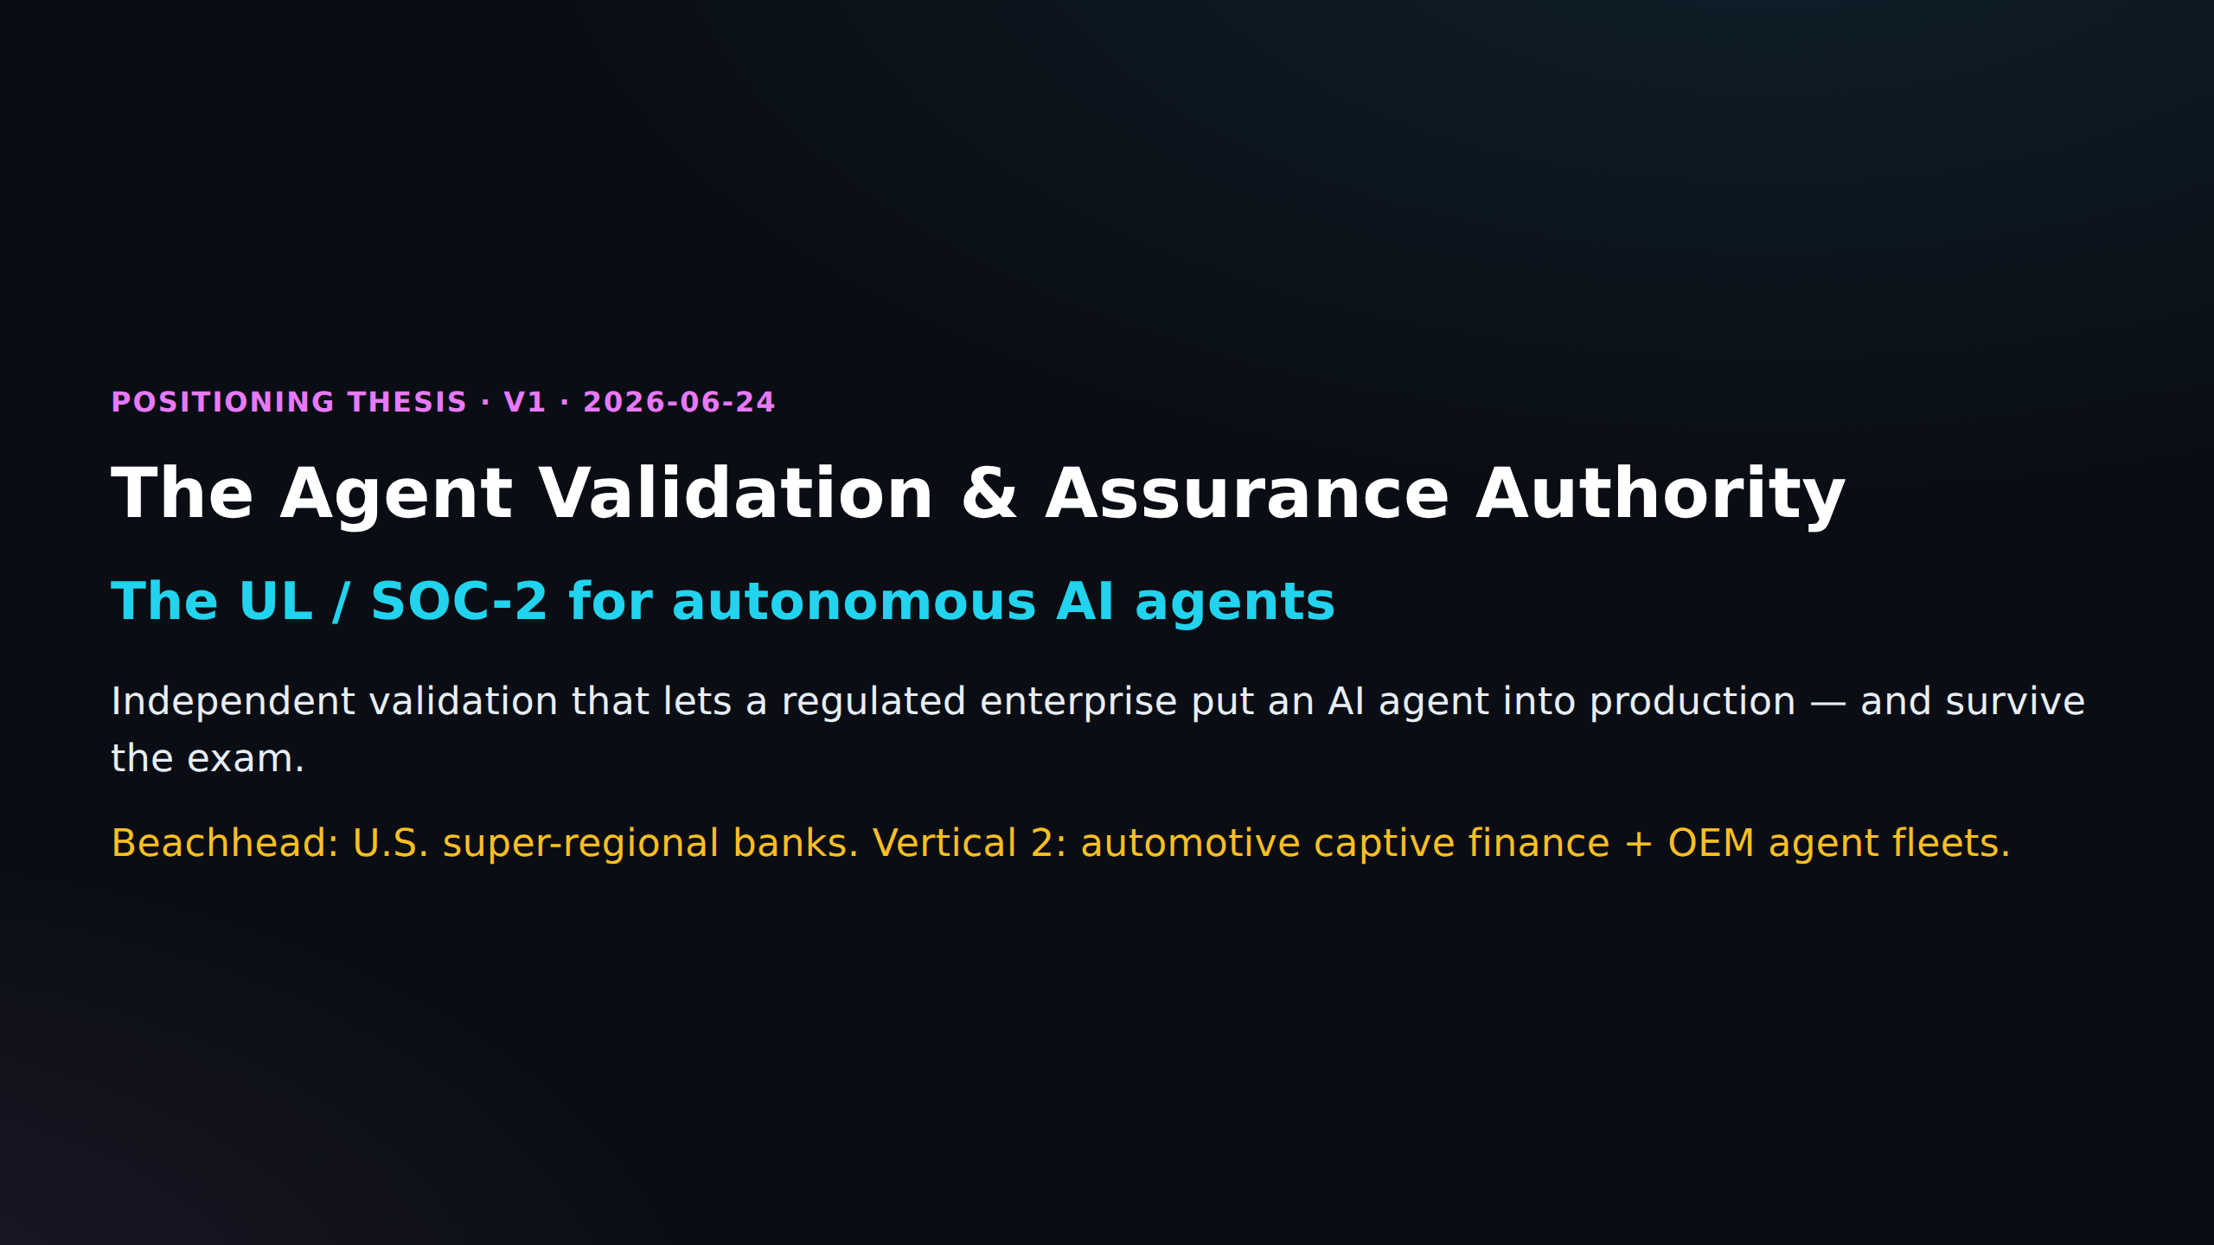

Slide 2
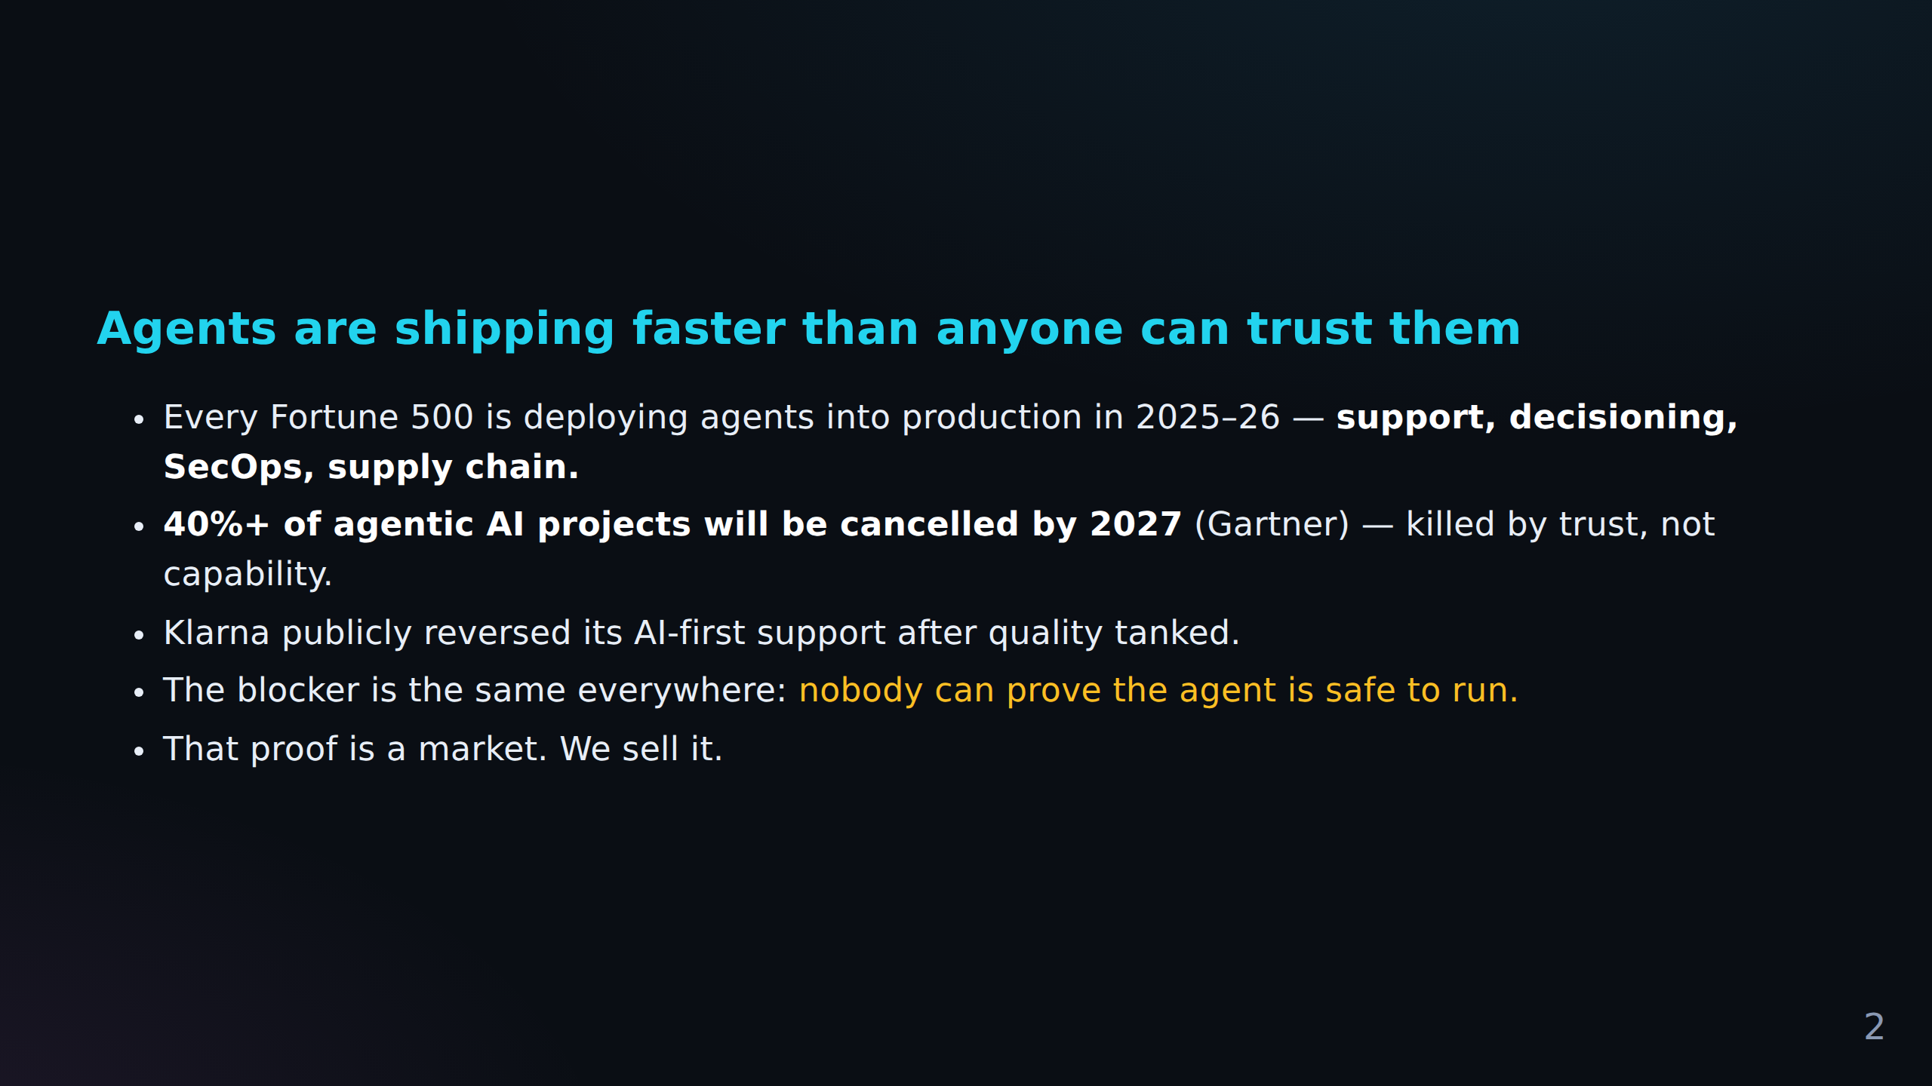
FACT CHECK
C-001 Pending Reddit evidence (pending)
Klarna publicly reversed its AI-first support after quality tanked.
C-002 Pending Reddit evidence (pending)
The blocker is the same everywhere: *nobody can prove the agent is safe to run.* That proof...

Slide 3
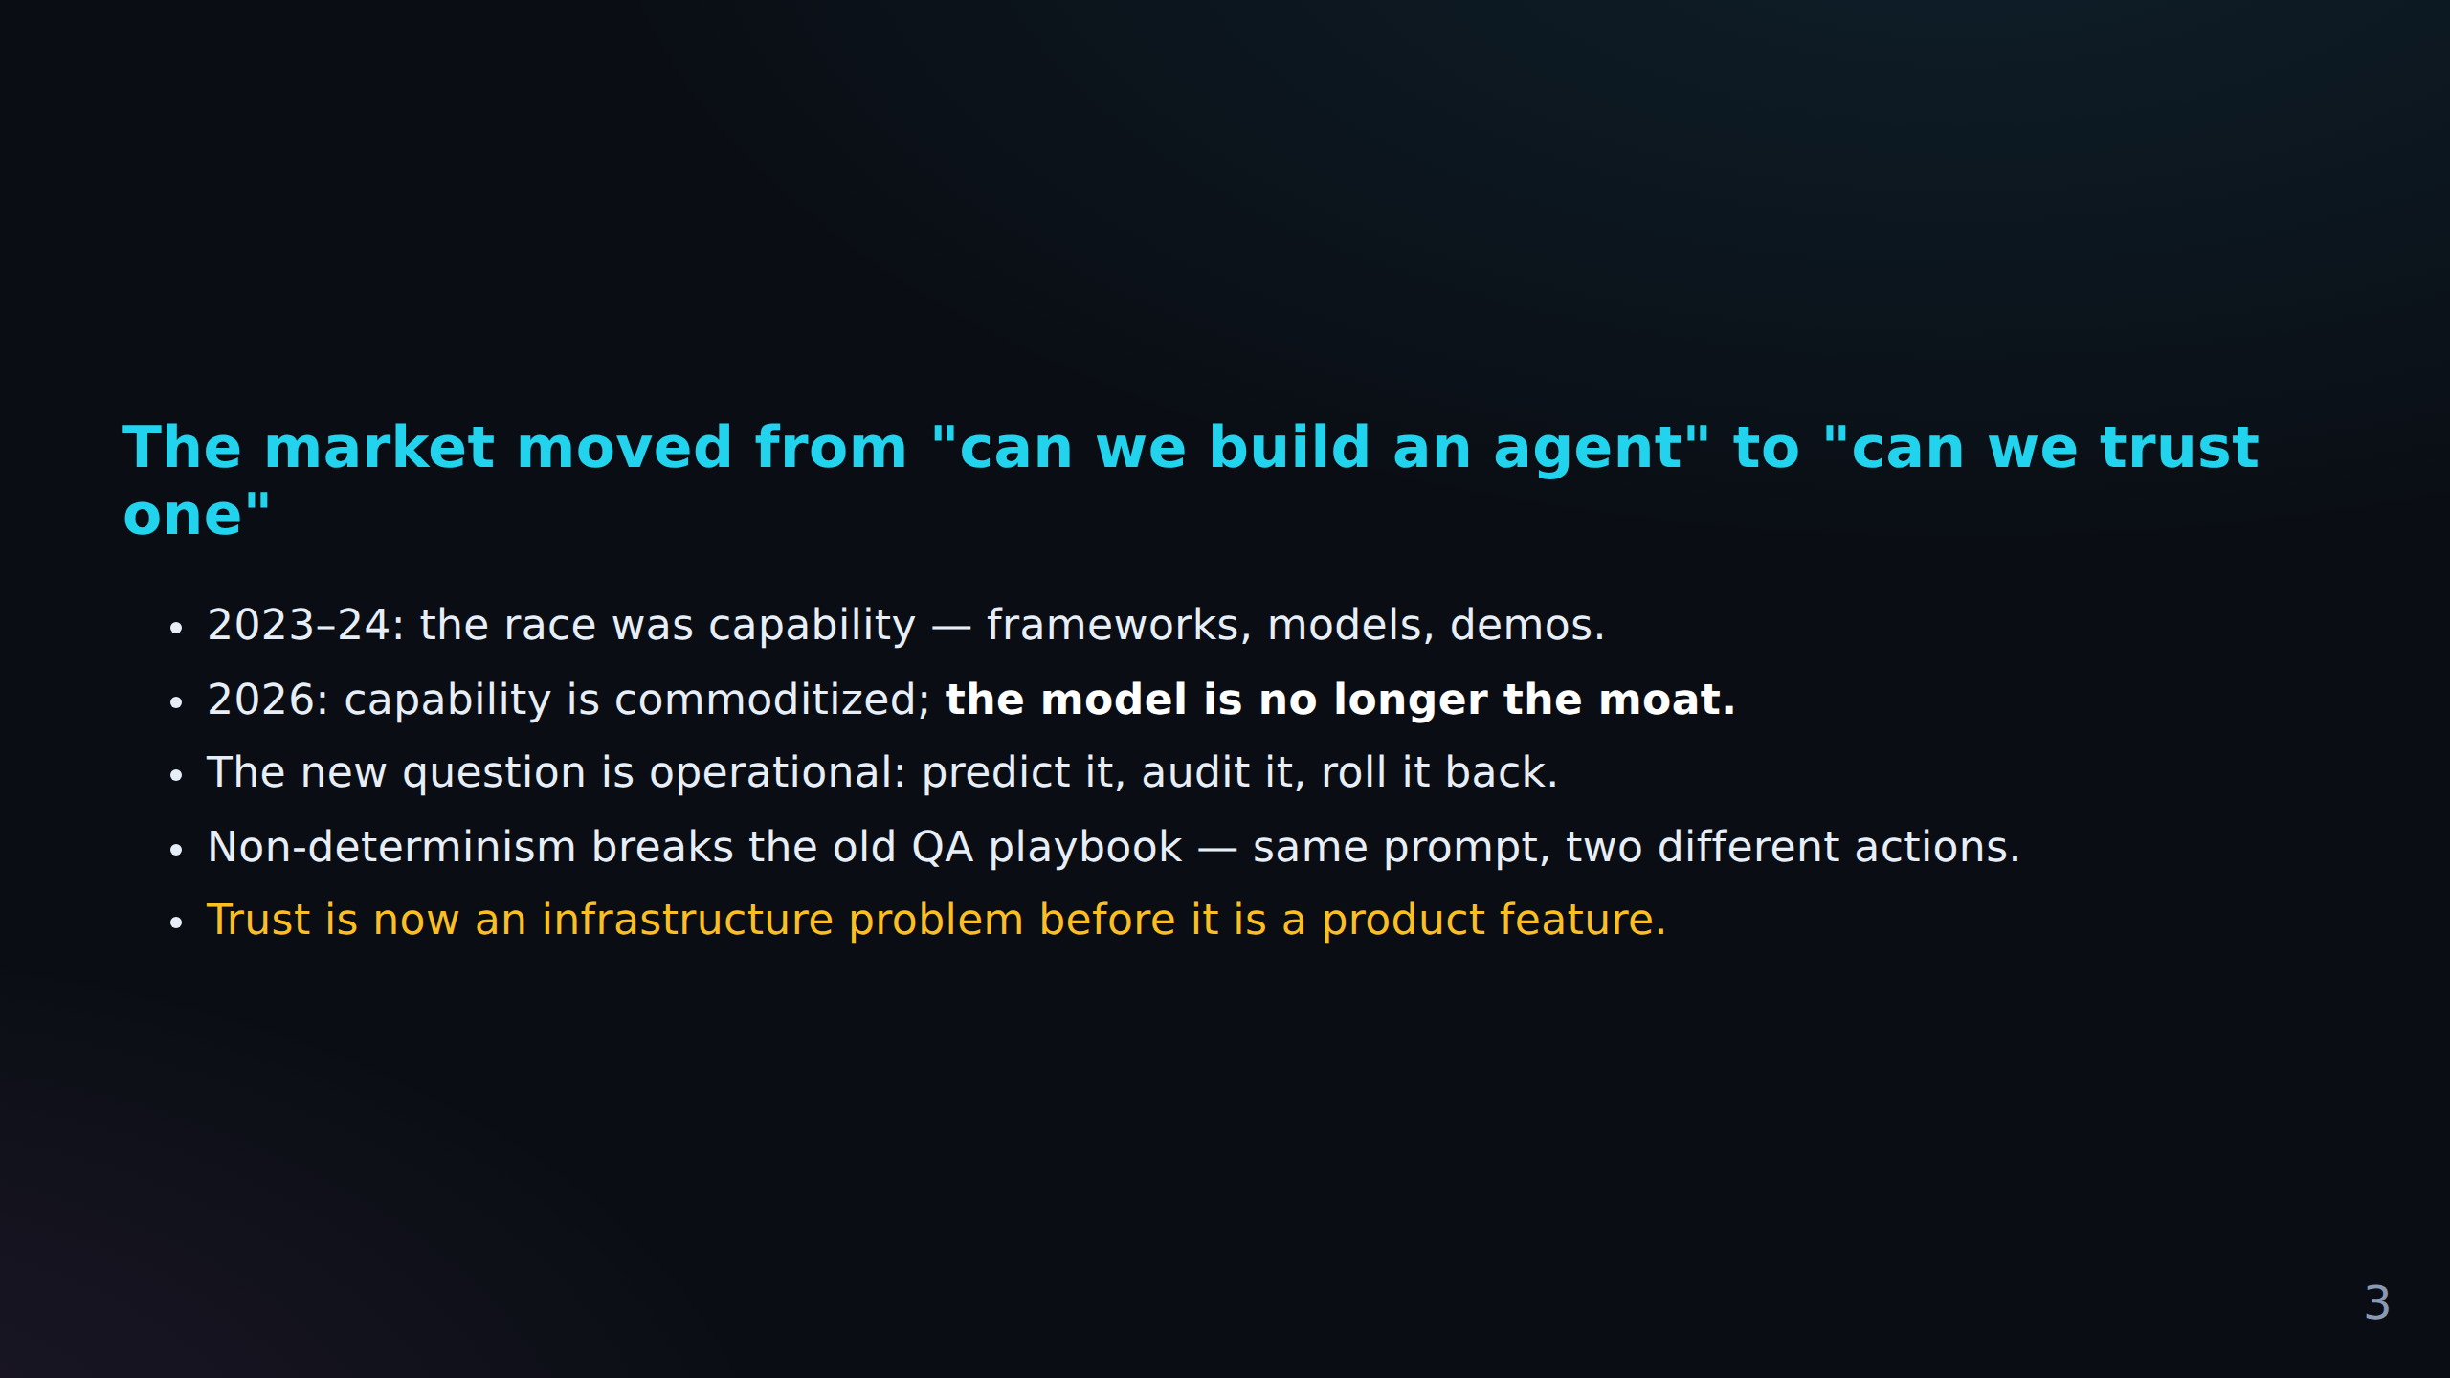
FACT CHECK
C-003 Primary source required (source)
The market moved from "can we build an agent" to "can we trust one" 2023–24: the race was c...
C-004 Primary source required (source)
2026: capability is commoditized; **the model is no longer the moat.** The new question is...
C-005 Pending Reddit evidence (pending)
*Trust is now an infrastructure problem before it is a product feature.*

Slide 4
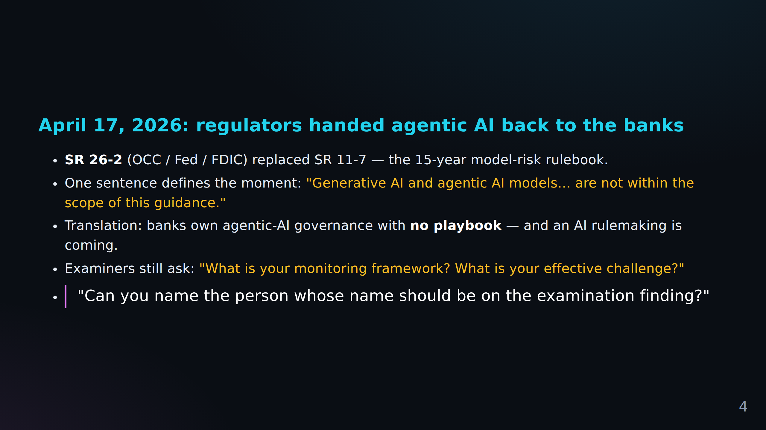
FACT CHECK
C-006 Primary source required (source)
April 17, 2026: regulators handed agentic AI back to the banks **SR 26-2** (OCC / Fed / FDI...
C-007 Pending Reddit evidence (pending)
One sentence defines the moment: *"Generative AI and agentic AI models… are not within the...
C-008 Pending Reddit evidence (pending)
Examiners still ask: *"What is your monitoring framework?
+ 1 more in Fact Check Notes

Slide 5
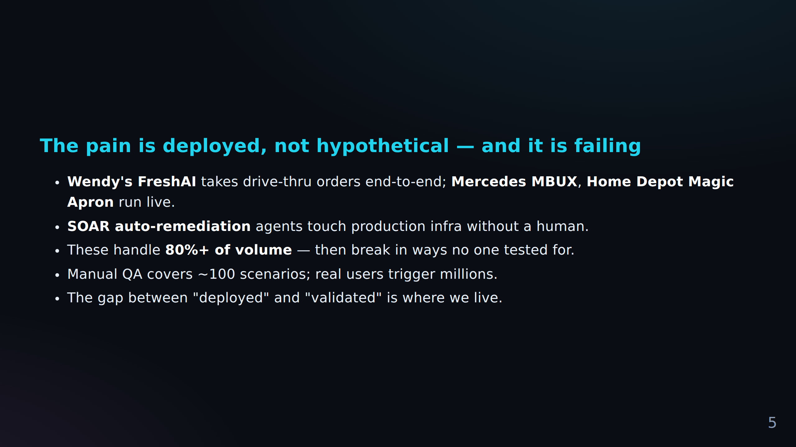
FACT CHECK
C-010 Pending Reddit evidence (pending)
The pain is deployed, not hypothetical — and it is failing **Wendy's FreshAI** takes drive-...
C-011 Pending Reddit evidence (pending)
Manual QA covers ~100 scenarios; real users trigger millions.
C-012 Pending Reddit evidence (pending)
The gap between "deployed" and "validated" is where we live.

Slide 6
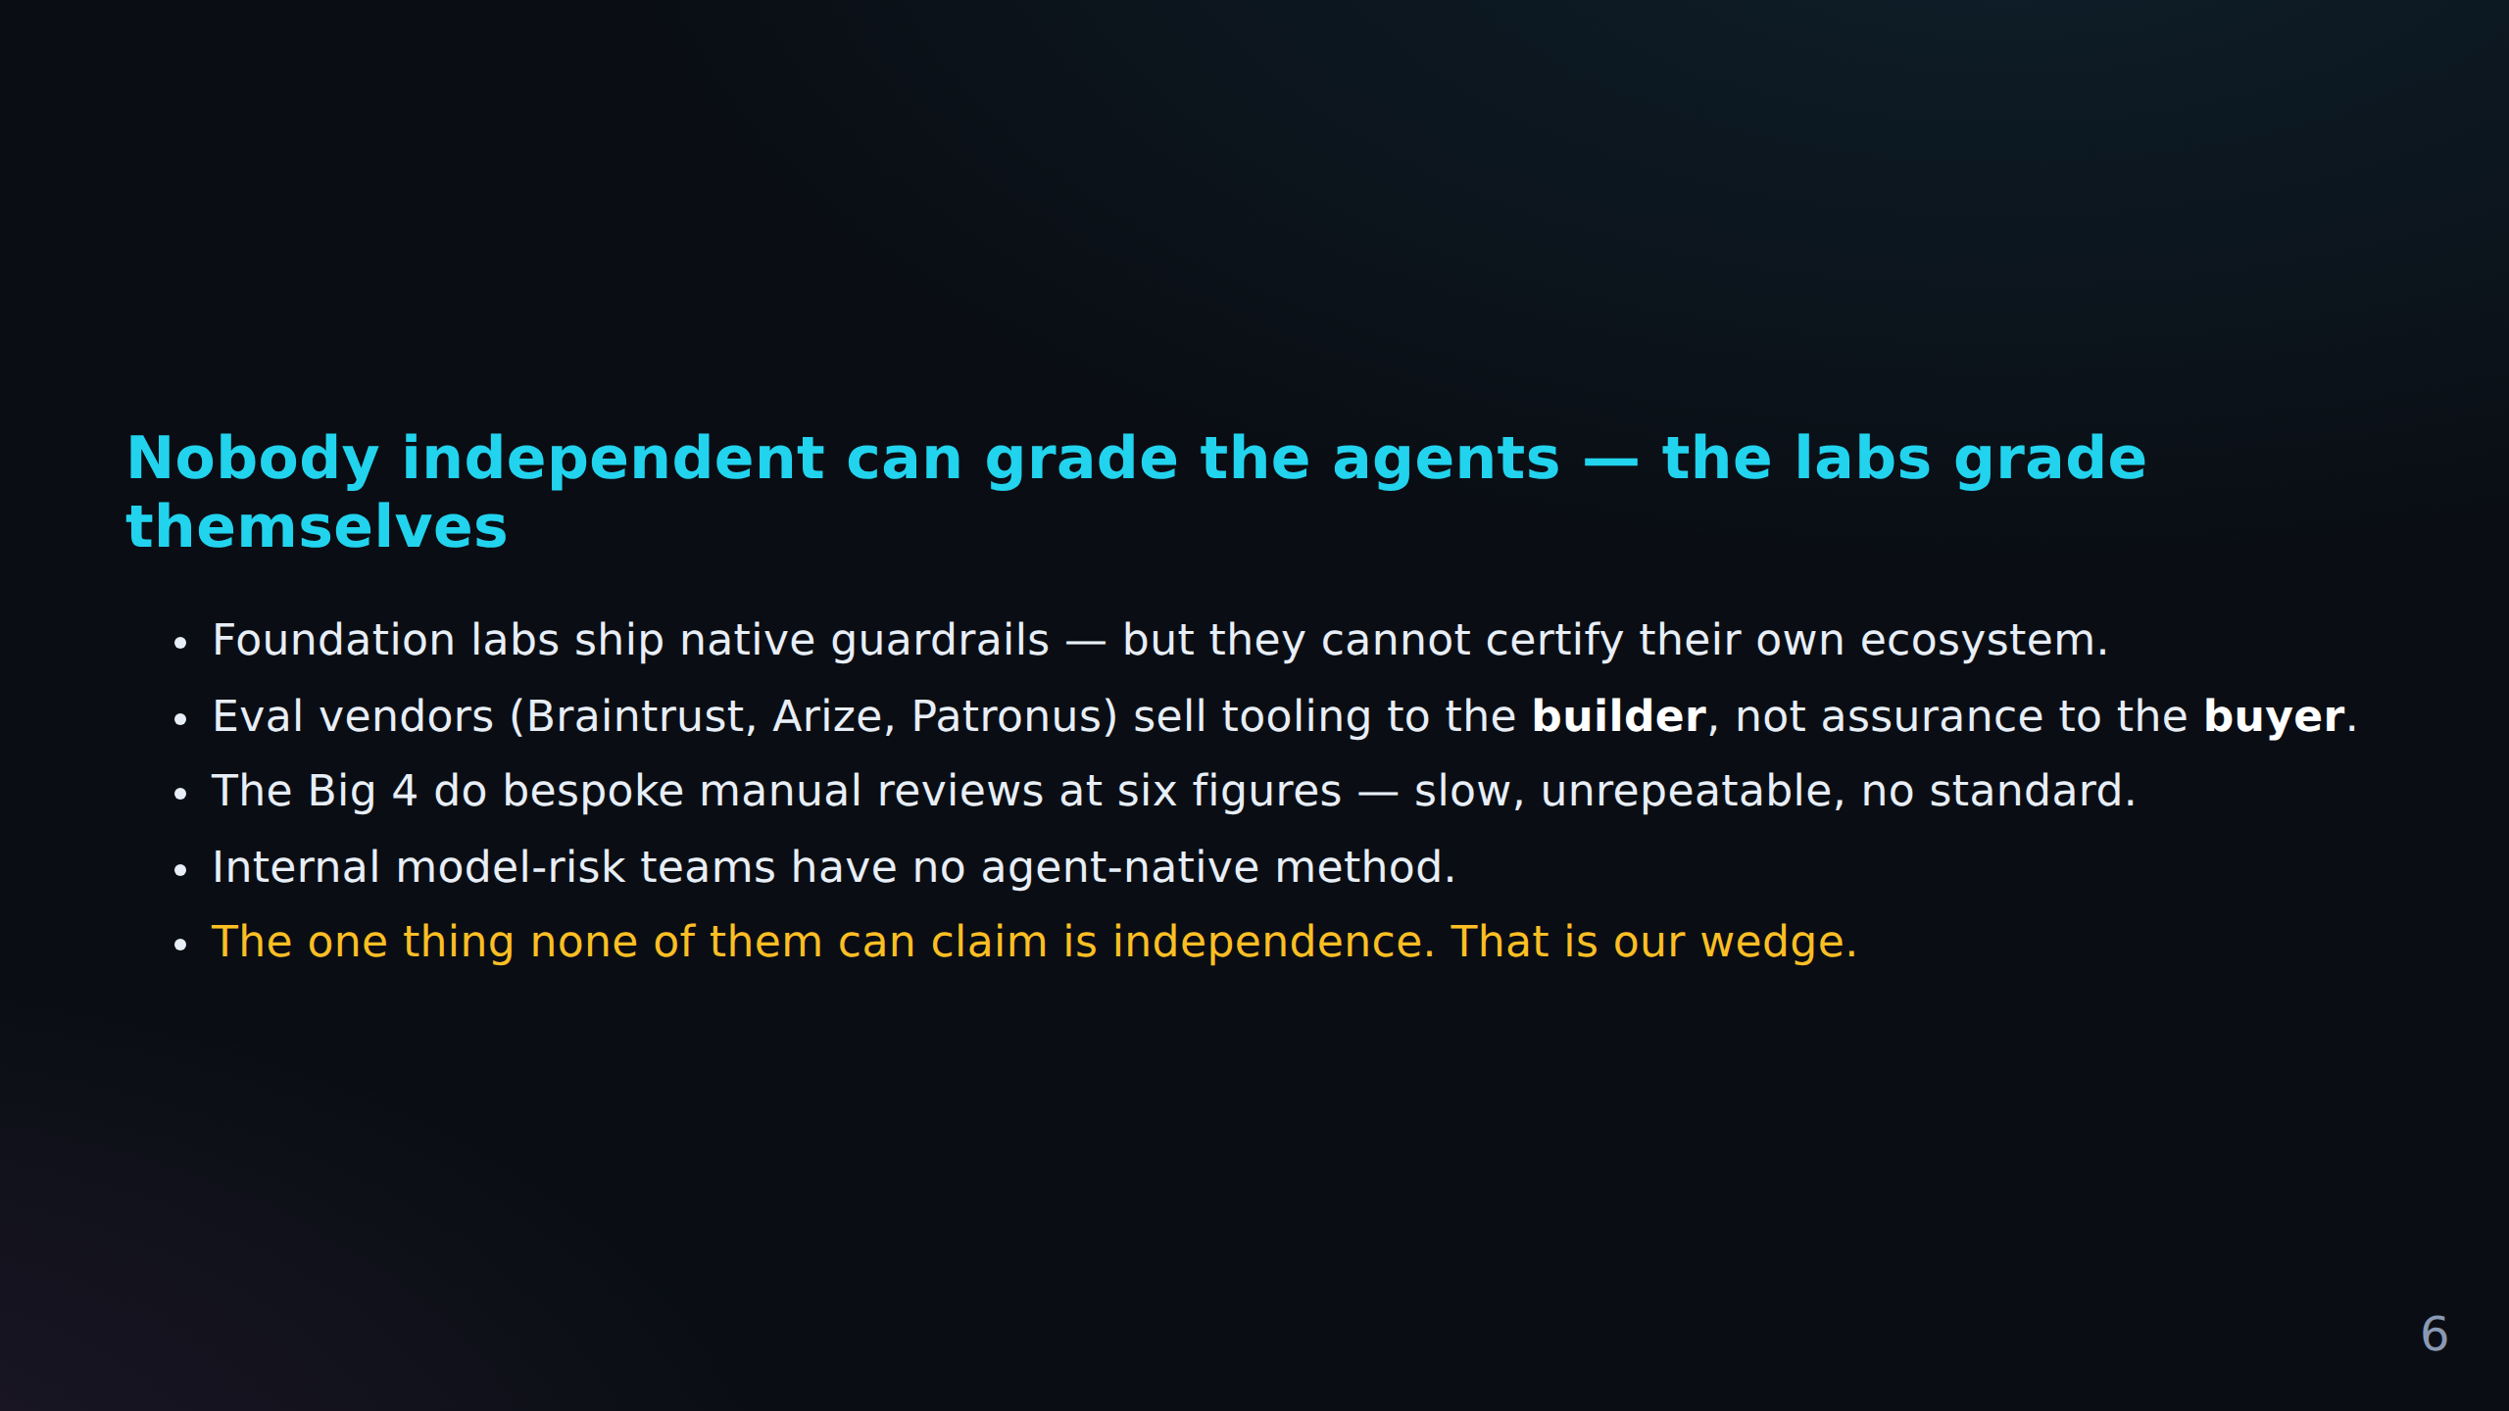
FACT CHECK
C-013 Pending Reddit evidence (pending)
Nobody independent can grade the agents — the labs grade themselves Foundation labs ship na...
C-014 Pending Reddit evidence (pending)
Eval vendors (Braintrust, Arize, Patronus) sell tooling to the **builder**, not assurance t...
C-015 Pending Reddit evidence (pending)
Internal model-risk teams have no agent-native method.
+ 1 more in Fact Check Notes

Slide 7
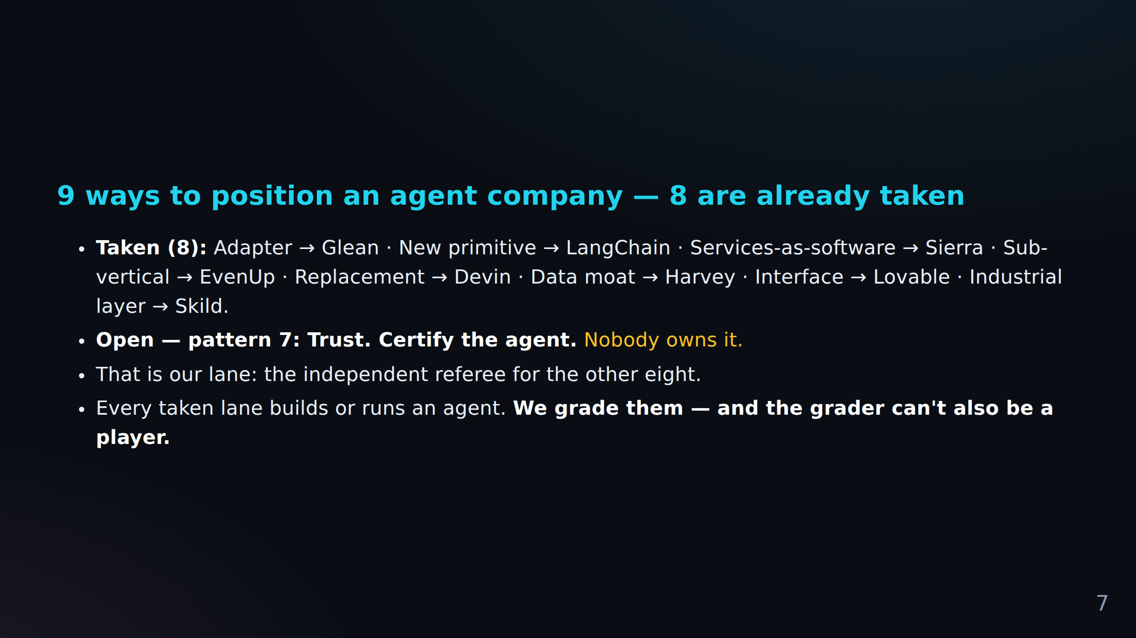
FACT CHECK
C-017 Pending Reddit evidence (pending)
Certify the agent.** *Nobody owns it.* That is our lane: the independent referee for the ot...

Slide 8
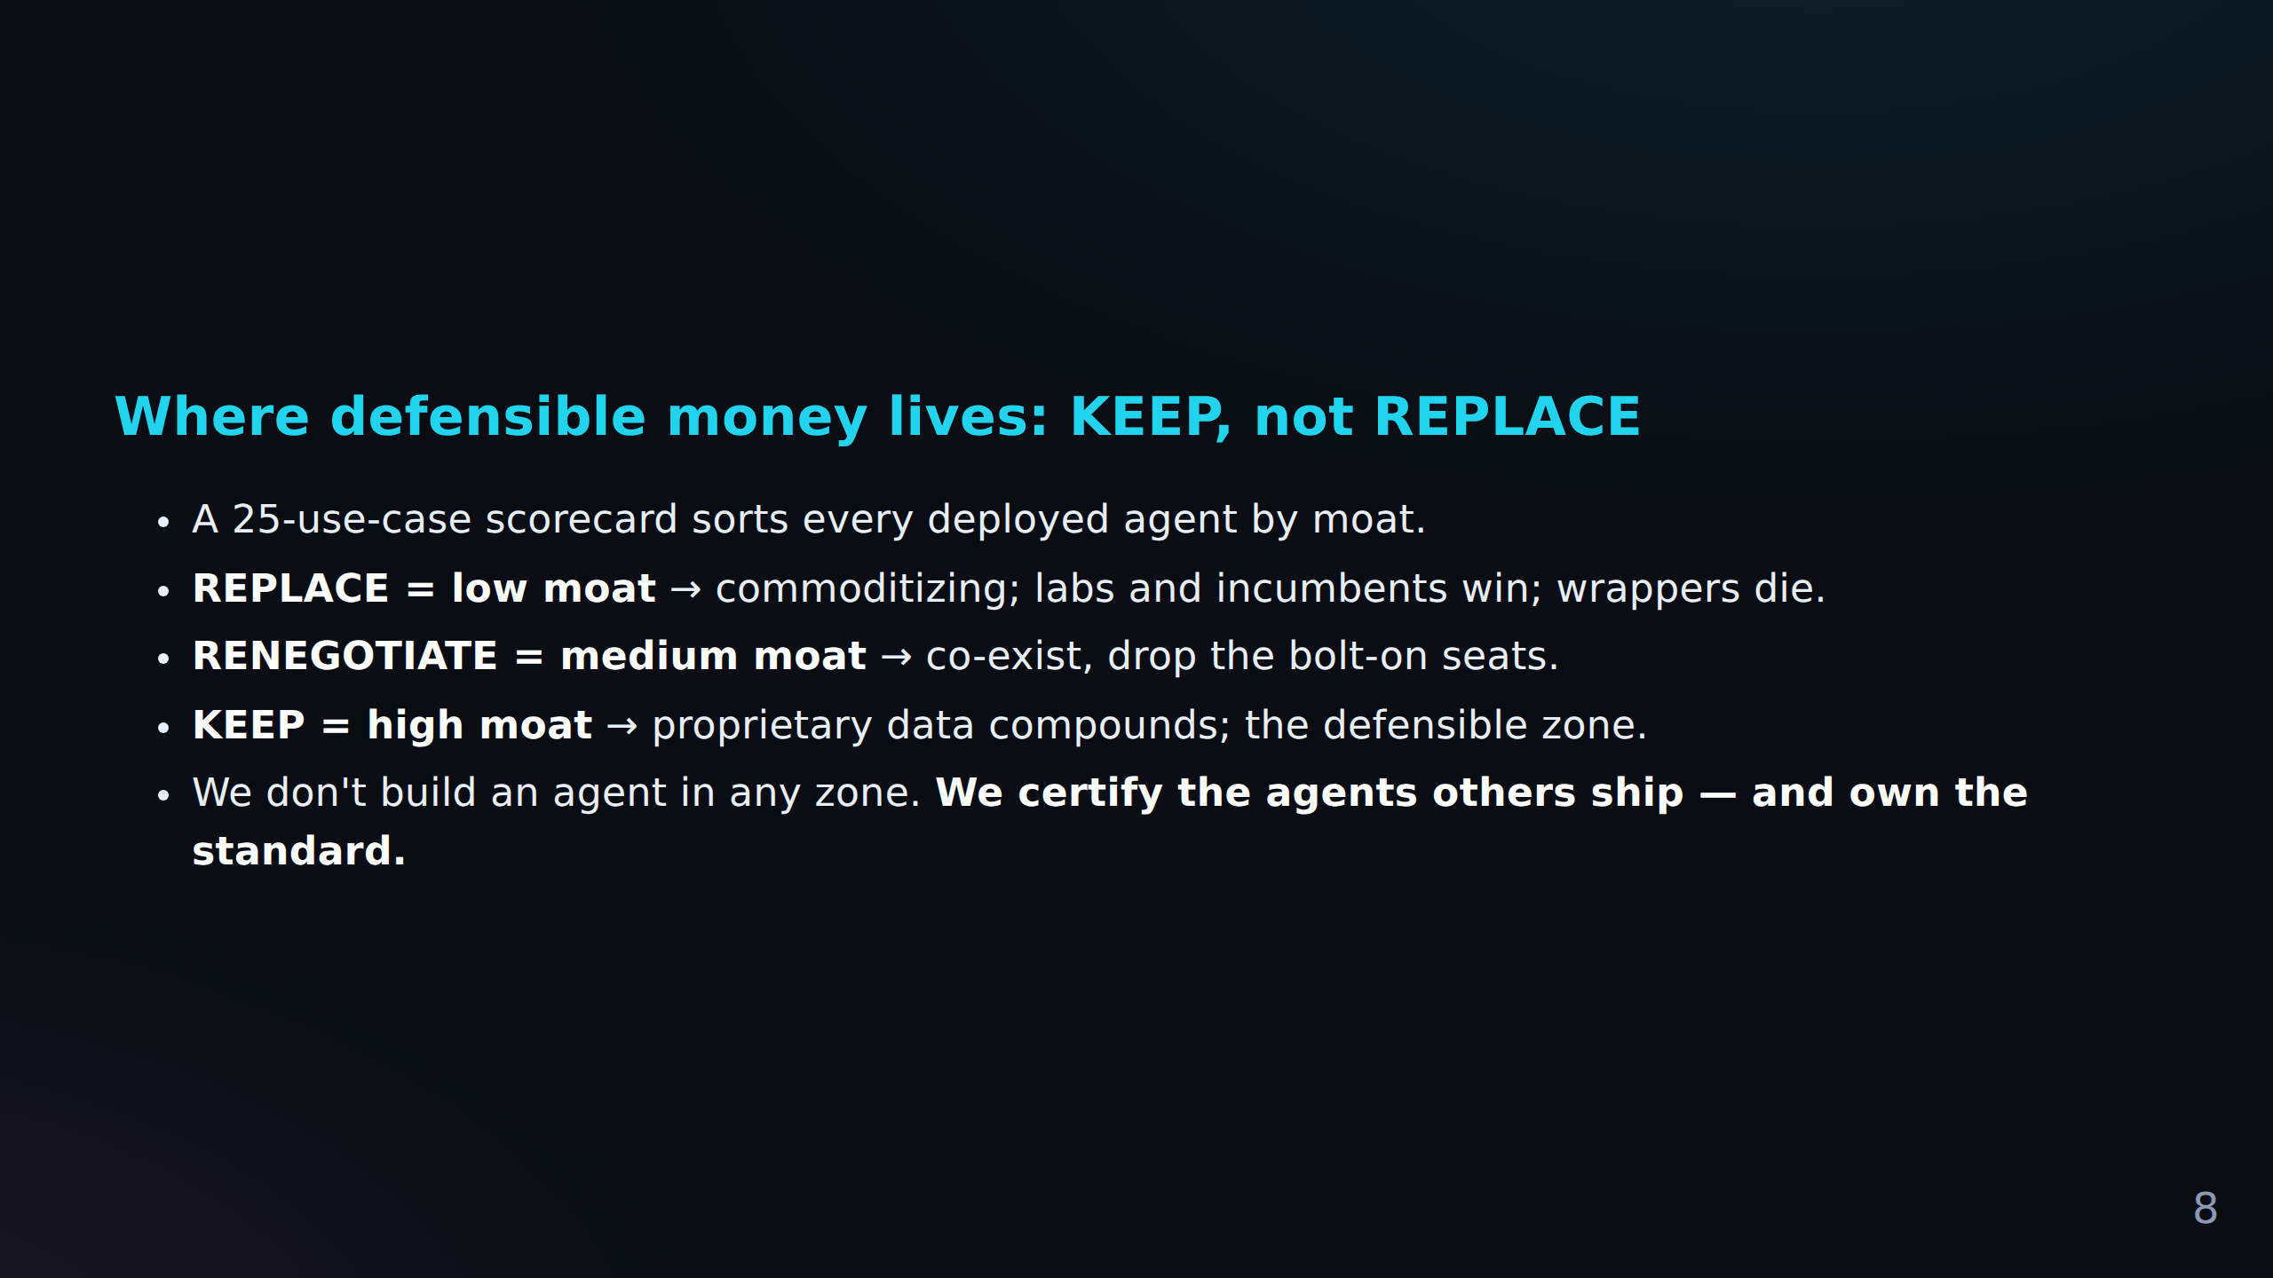

Slide 9
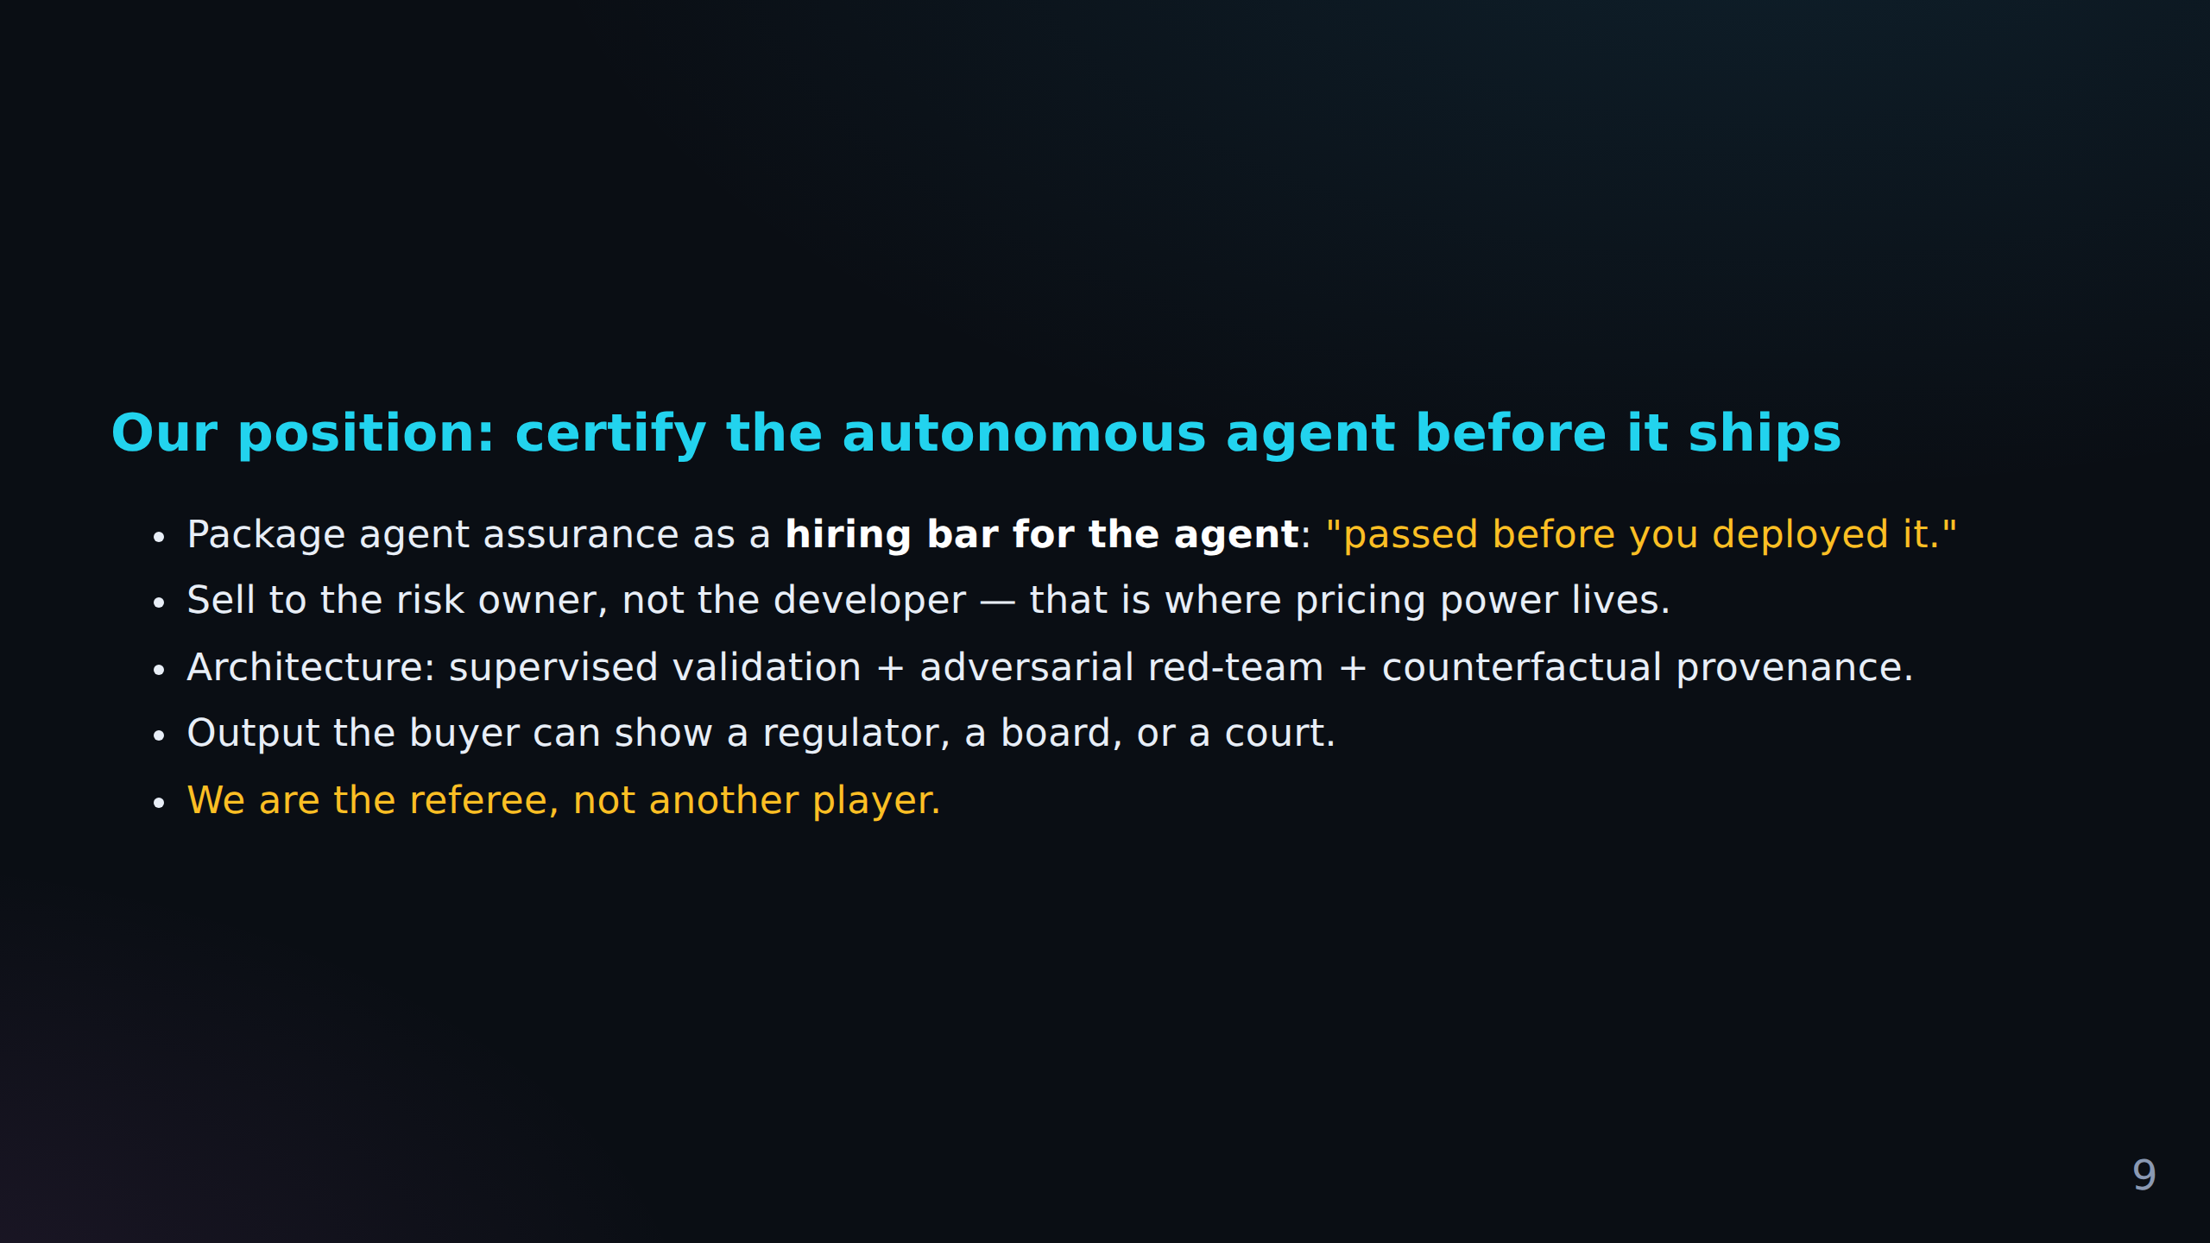
FACT CHECK
C-018 Pending Reddit evidence (pending)
Our position: certify the autonomous agent before it ships Package agent assurance as a **h...
C-019 Pending Reddit evidence (pending)
Output the buyer can show a regulator, a board, or a court.

Slide 10
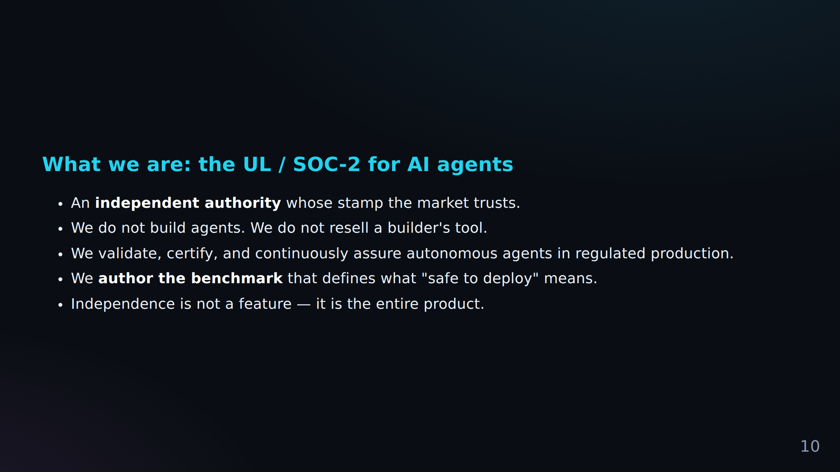
FACT CHECK
C-020 Pending Reddit evidence (pending)
What we are: the UL / SOC-2 for AI agents An **independent authority** whose stamp the mark...
C-021 Pending Reddit evidence (pending)
Independence is not a feature — it is the entire product.

Slide 11
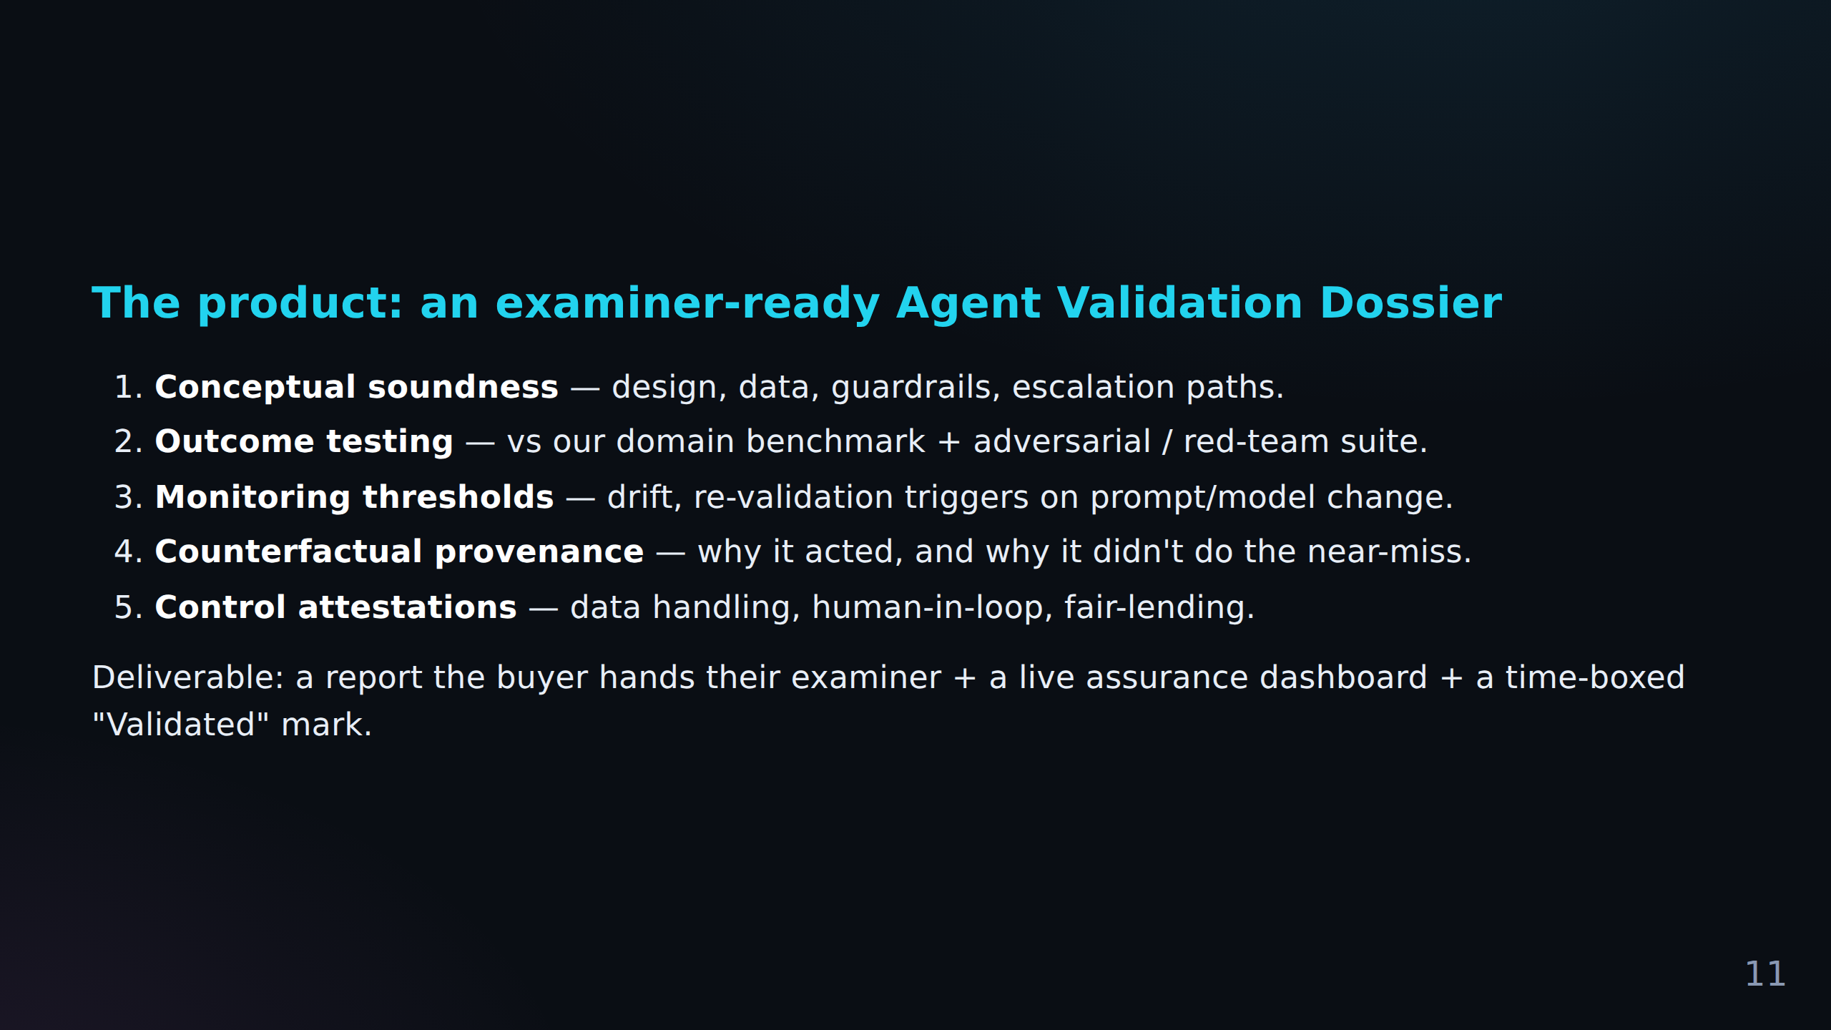
FACT CHECK
C-022 Pending Reddit evidence (pending)
Deliverable: a report the buyer hands their examiner + a live assurance dashboard + a time-...

Slide 12
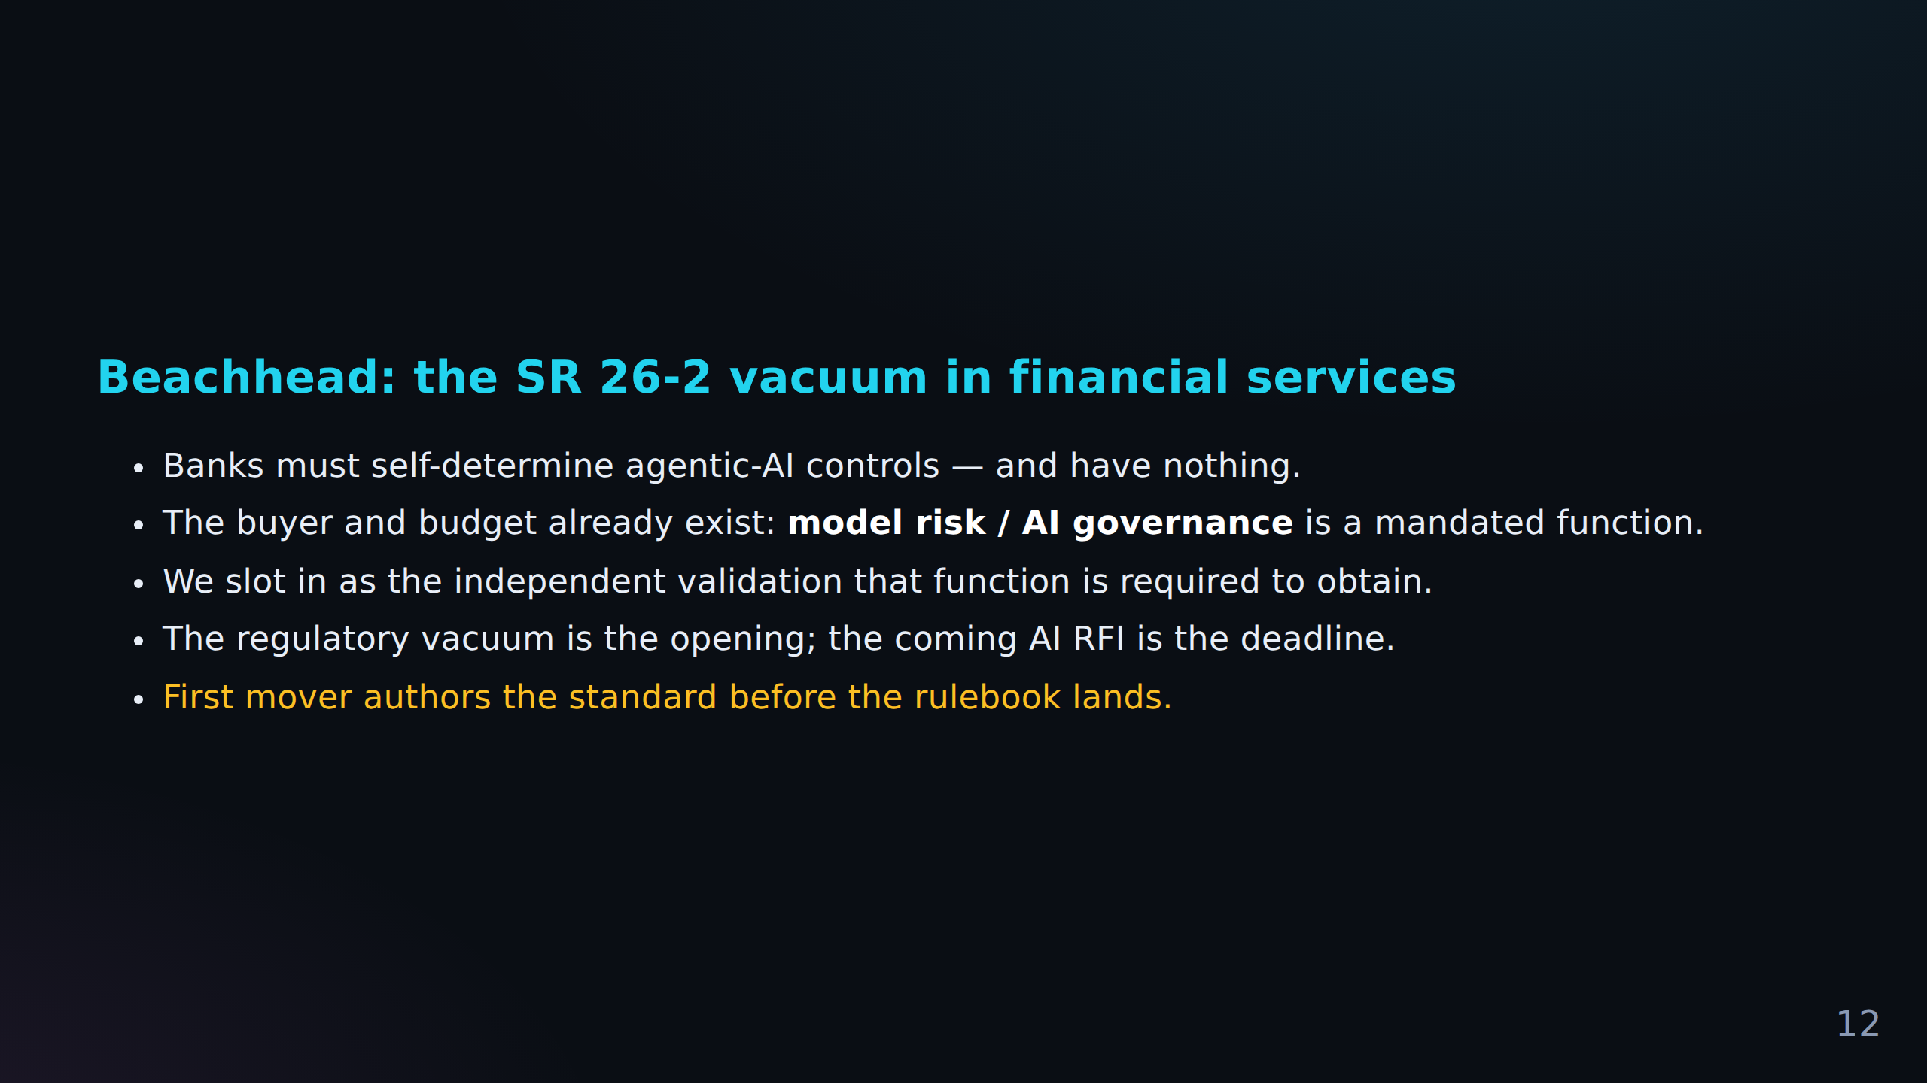
FACT CHECK
C-023 Primary source required (source)
Beachhead: the SR 26-2 vacuum in financial services Banks must self-determine agentic-AI co...
C-024 Pending Reddit evidence (pending)
The buyer and budget already exist: **model risk / AI governance** is a mandated function.
C-025 Pending Reddit evidence (pending)
The regulatory vacuum is the opening; the coming AI RFI is the deadline.

Slide 13
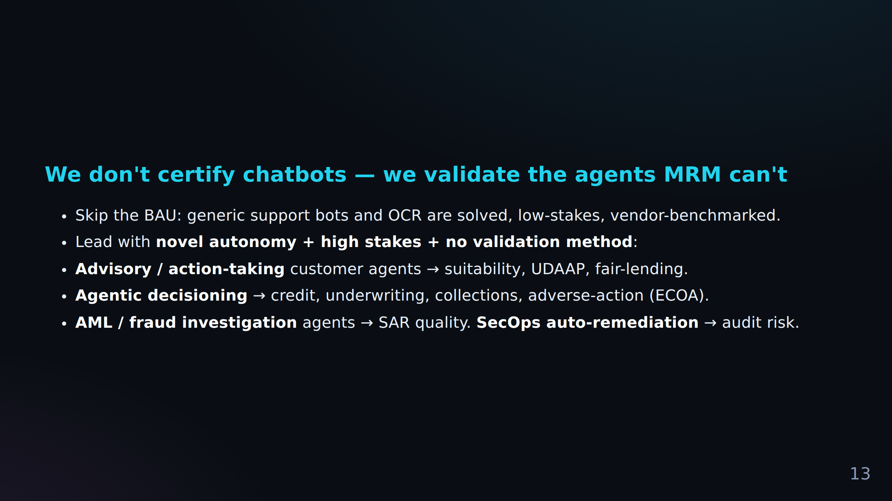
FACT CHECK
C-026 Pending Reddit evidence (pending)
We don't certify chatbots — we validate the agents MRM can't Skip the BAU: generic support...
C-027 Pending Reddit evidence (pending)
**AML / fraud investigation** agents → SAR quality.
C-028 Pending Reddit evidence (pending)
**SecOps auto-remediation** → audit risk.

Slide 14
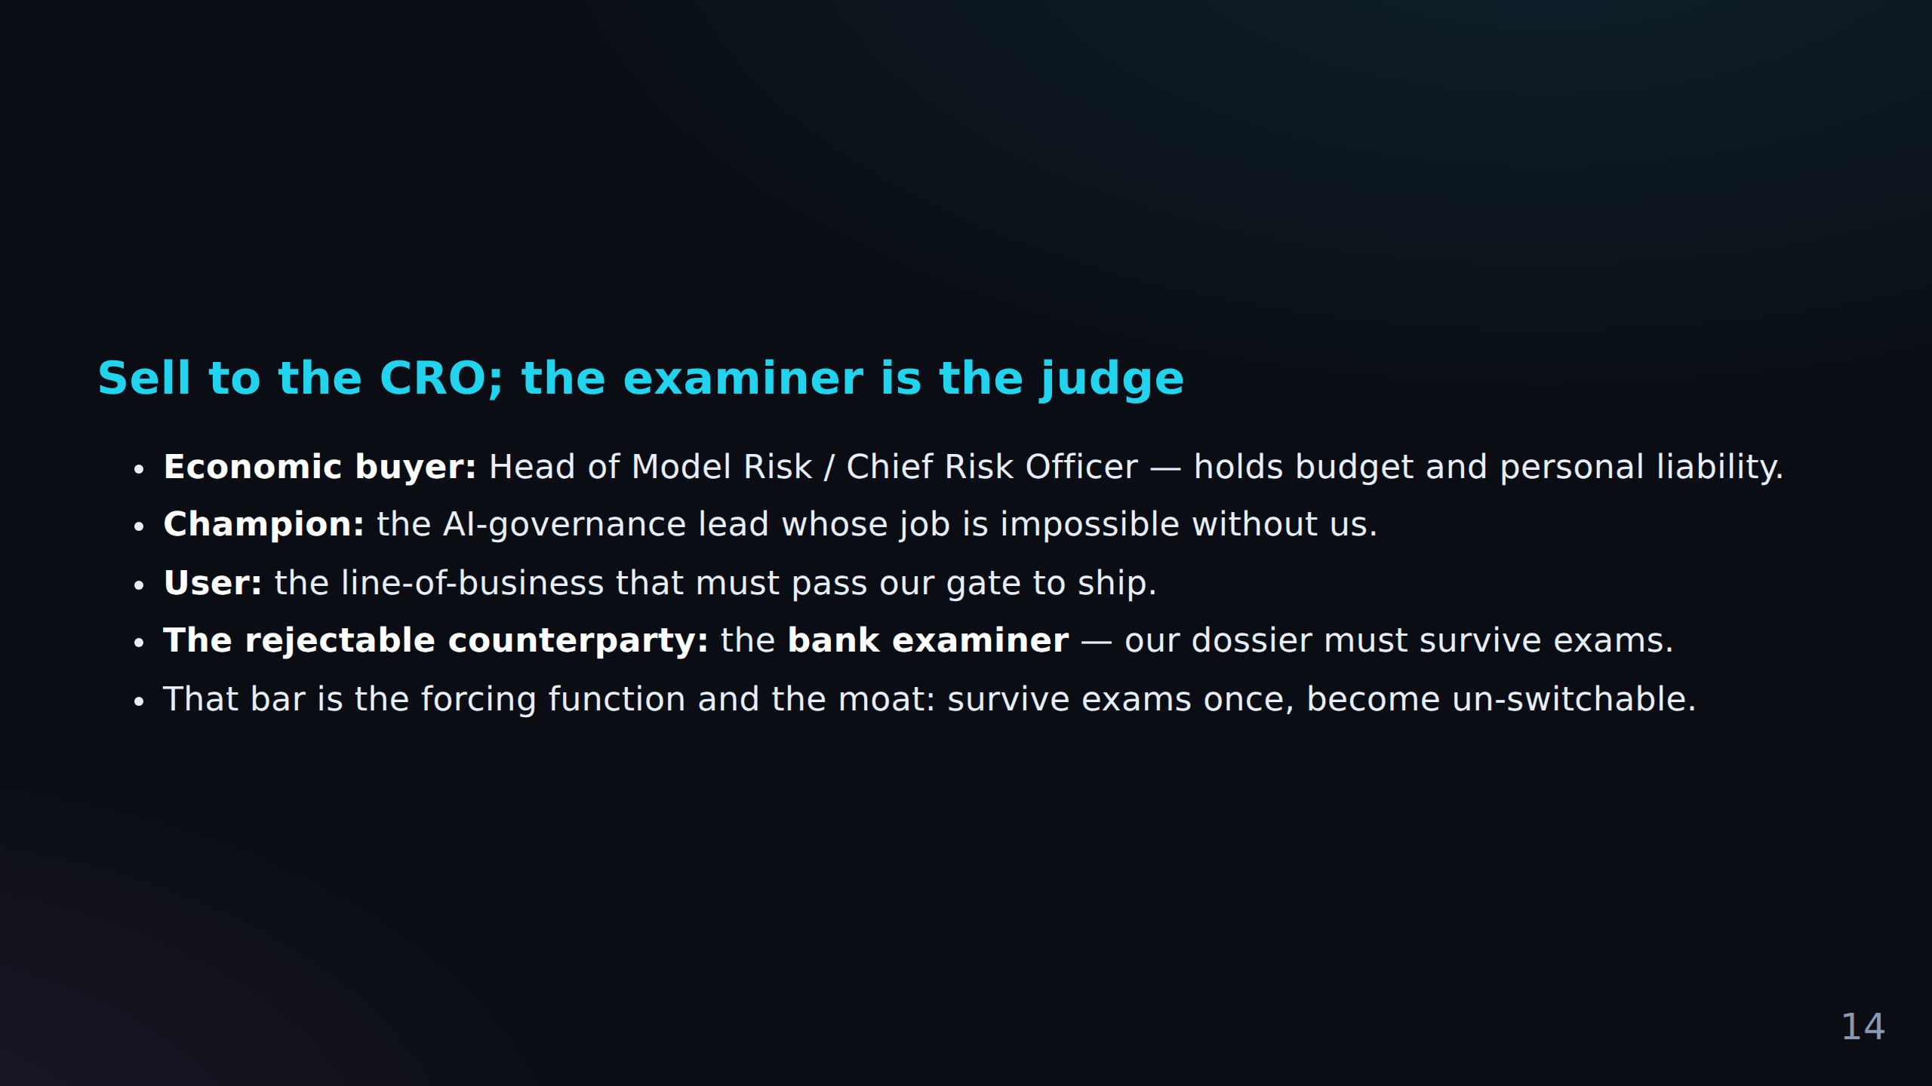
FACT CHECK
C-029 Pending Reddit evidence (pending)
Sell to the CRO; the examiner is the judge **Economic buyer:** Head of Model Risk / Chief R...
C-030 Pending Reddit evidence (pending)
**Champion:** the AI-governance lead whose job is impossible without us.
C-031 Pending Reddit evidence (pending)
**User:** the line-of-business that must pass our gate to ship.
+ 2 more in Fact Check Notes

Slide 15
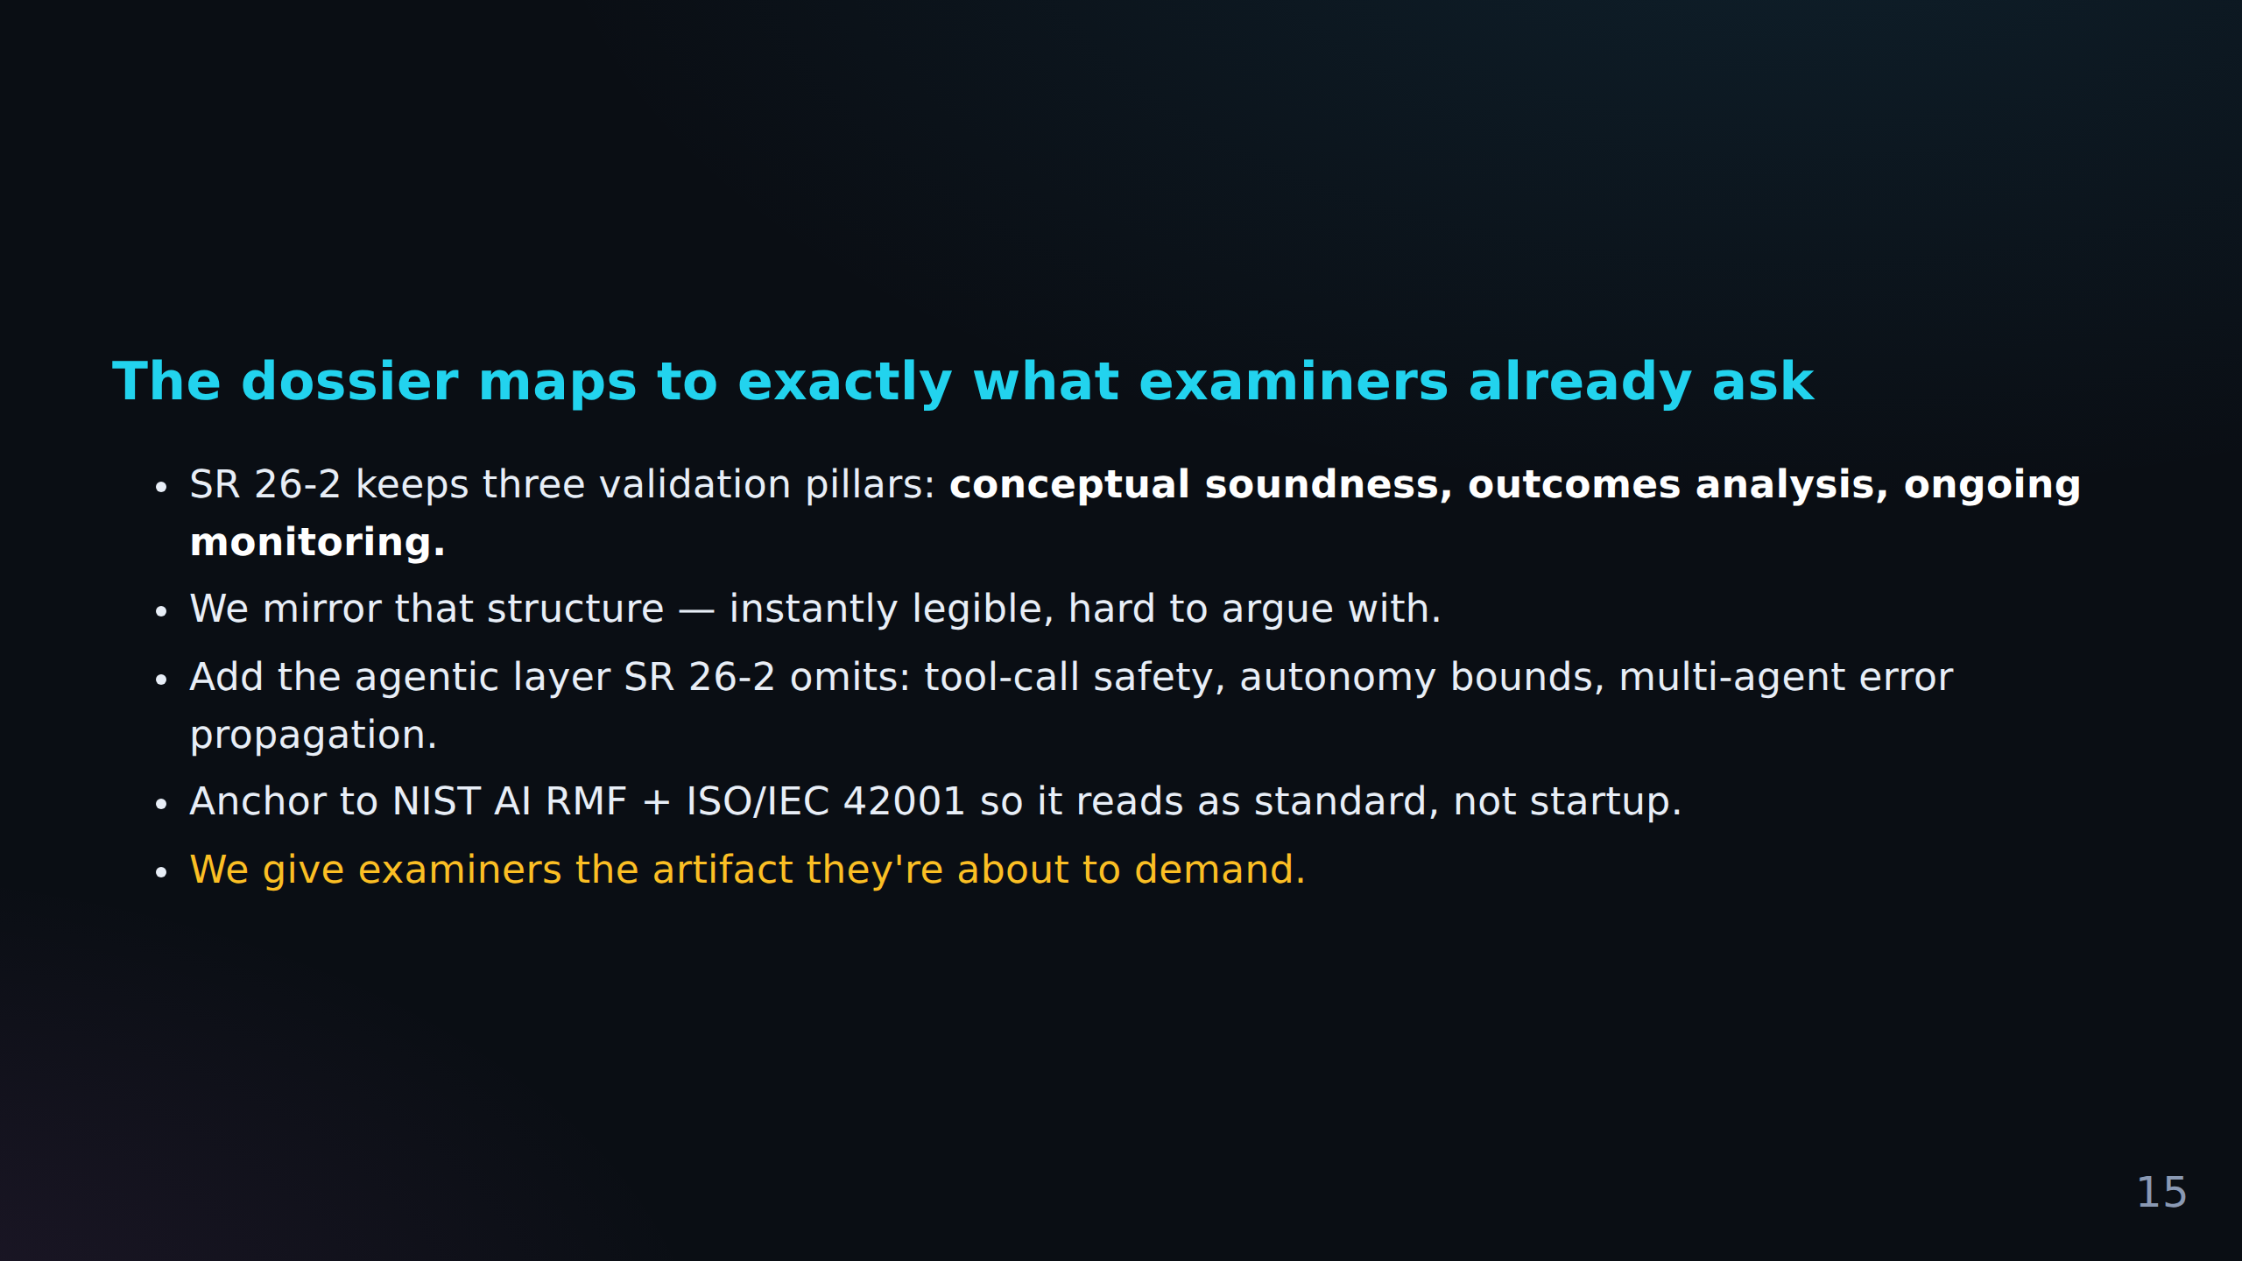
FACT CHECK
C-034 Primary source required (source)
The dossier maps to exactly what examiners already ask SR 26-2 keeps three validation pilla...
C-035 Primary source required (source)
Add the agentic layer SR 26-2 omits: tool-call safety, autonomy bounds, multi-agent error p...
C-036 Primary source required (source)
Anchor to NIST AI RMF + ISO/IEC 42001 so it reads as standard, not startup.
+ 1 more in Fact Check Notes

Slide 16
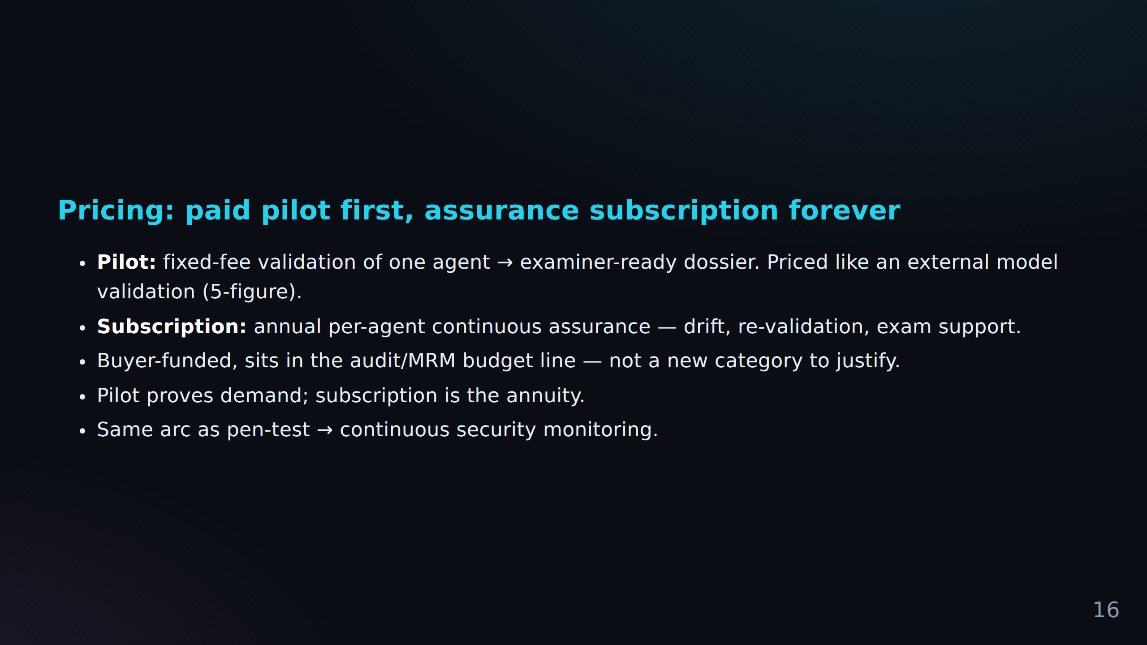
FACT CHECK
C-038 Pending Reddit evidence (pending)
**Subscription:** annual per-agent continuous assurance — drift, re-validation, exam suppor...
C-039 Pending Reddit evidence (pending)
Buyer-funded, sits in the audit/MRM budget line — not a new category to justify.
C-040 Pending Reddit evidence (pending)
Pilot proves demand; subscription is the annuity.

Slide 17
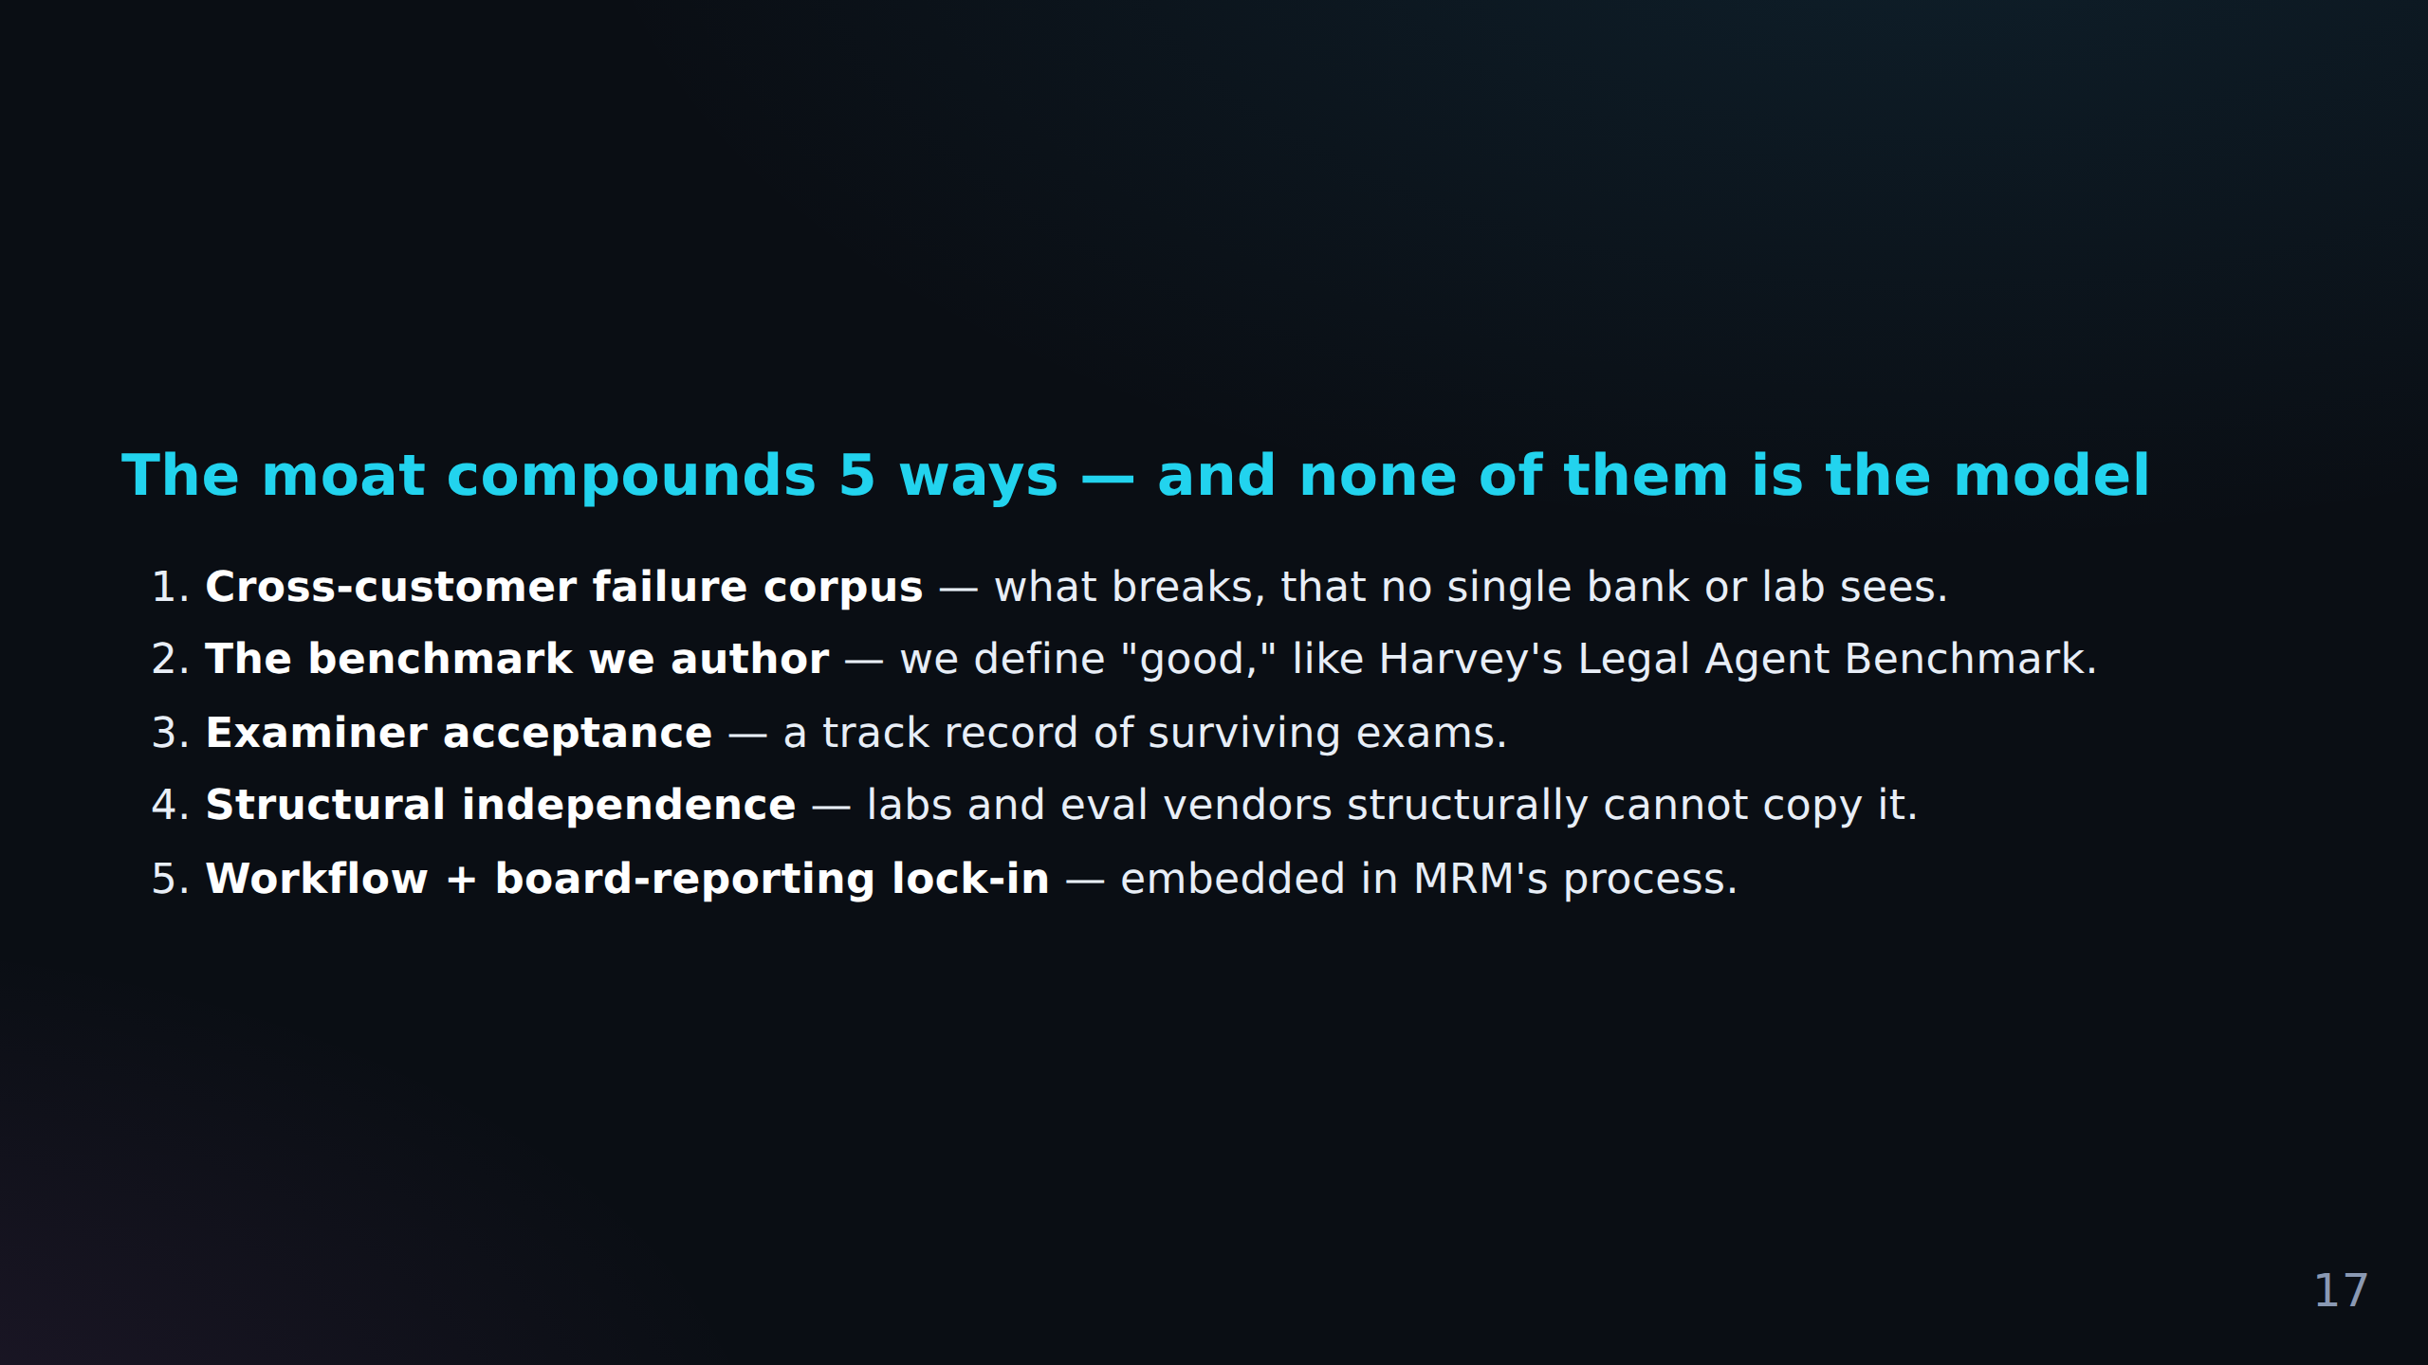

Slide 18
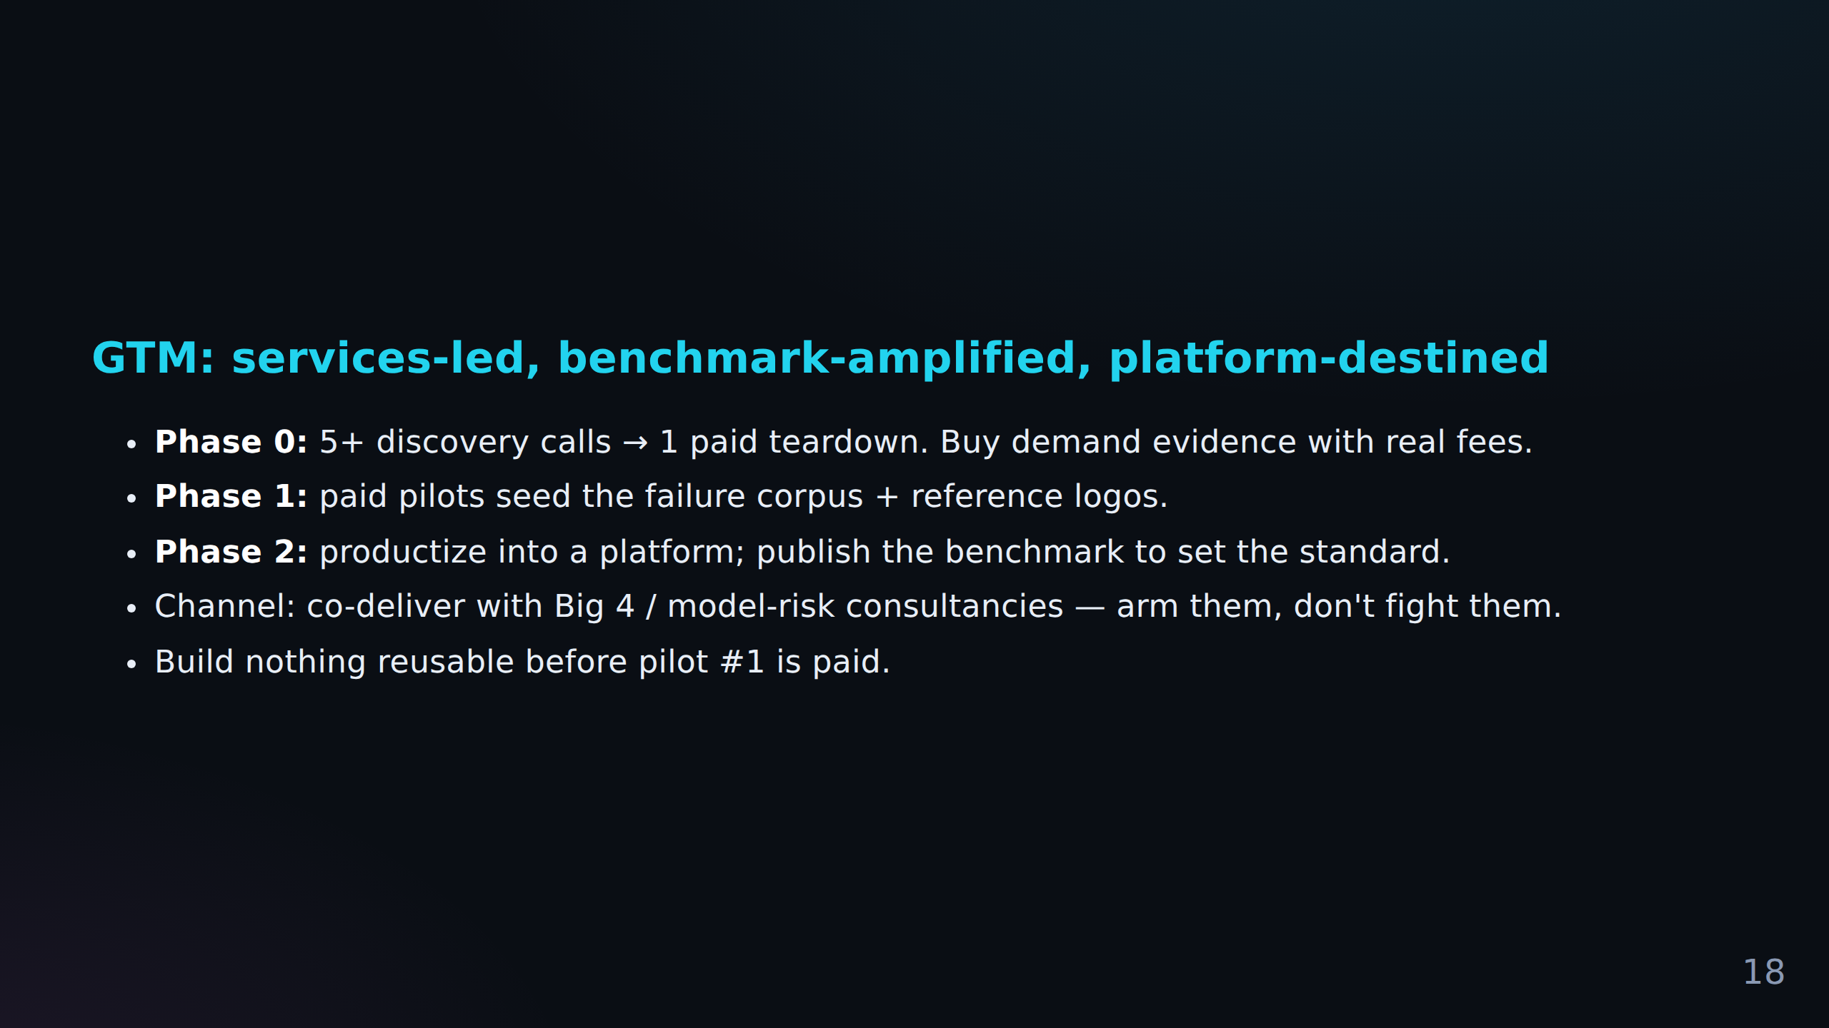

Slide 19
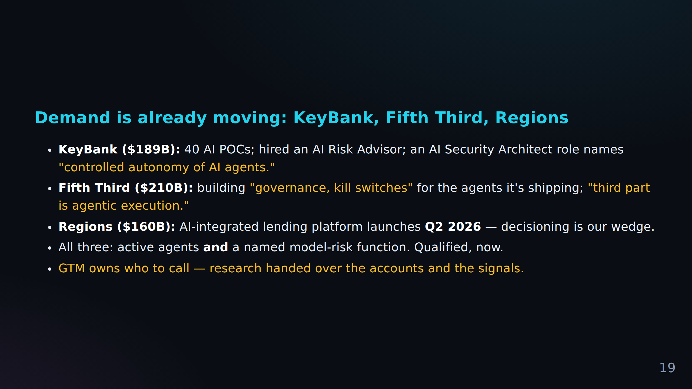

Slide 20
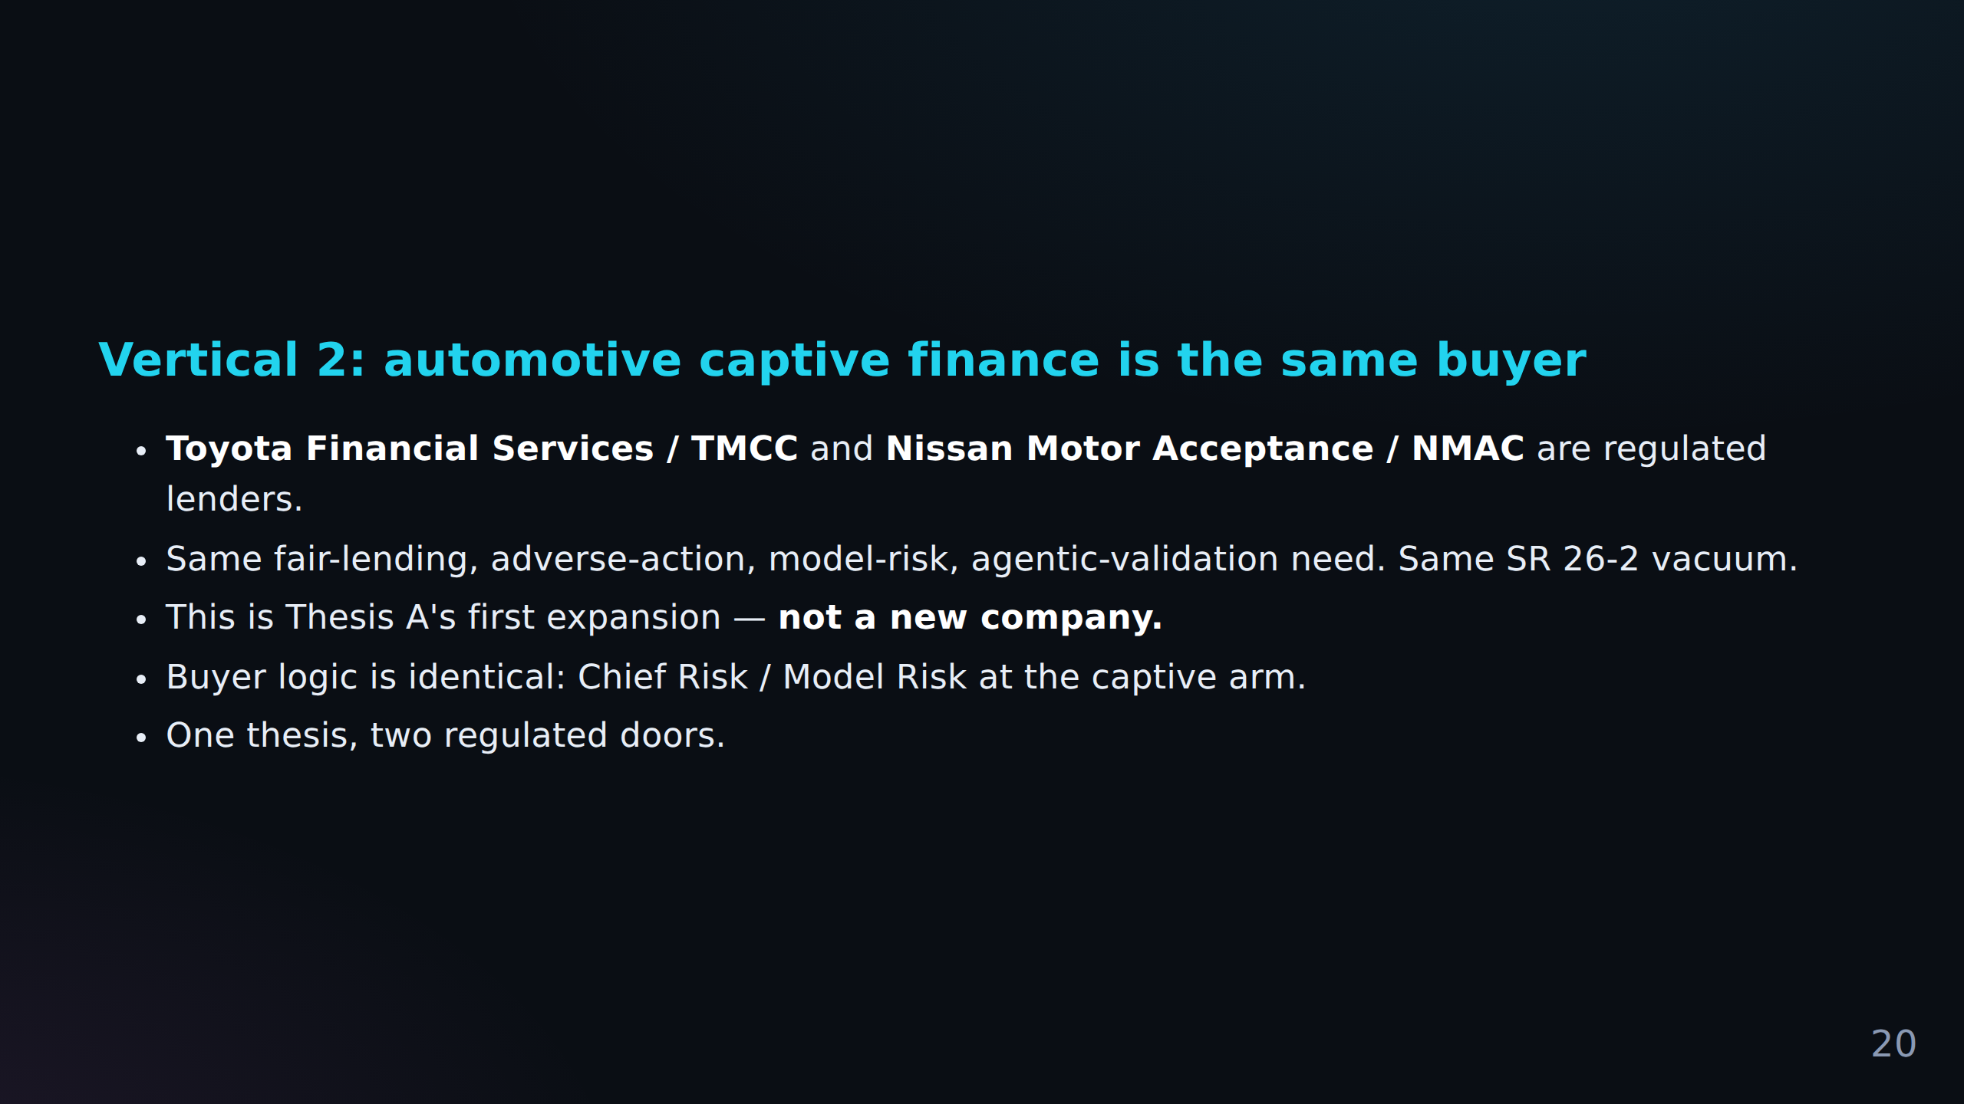

Slide 21
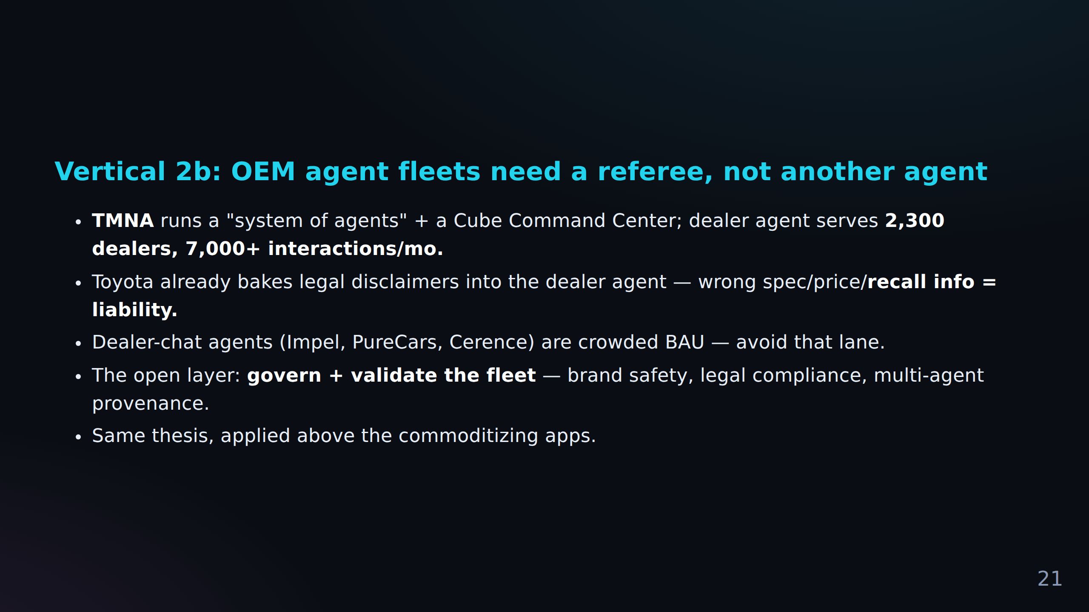

Slide 22
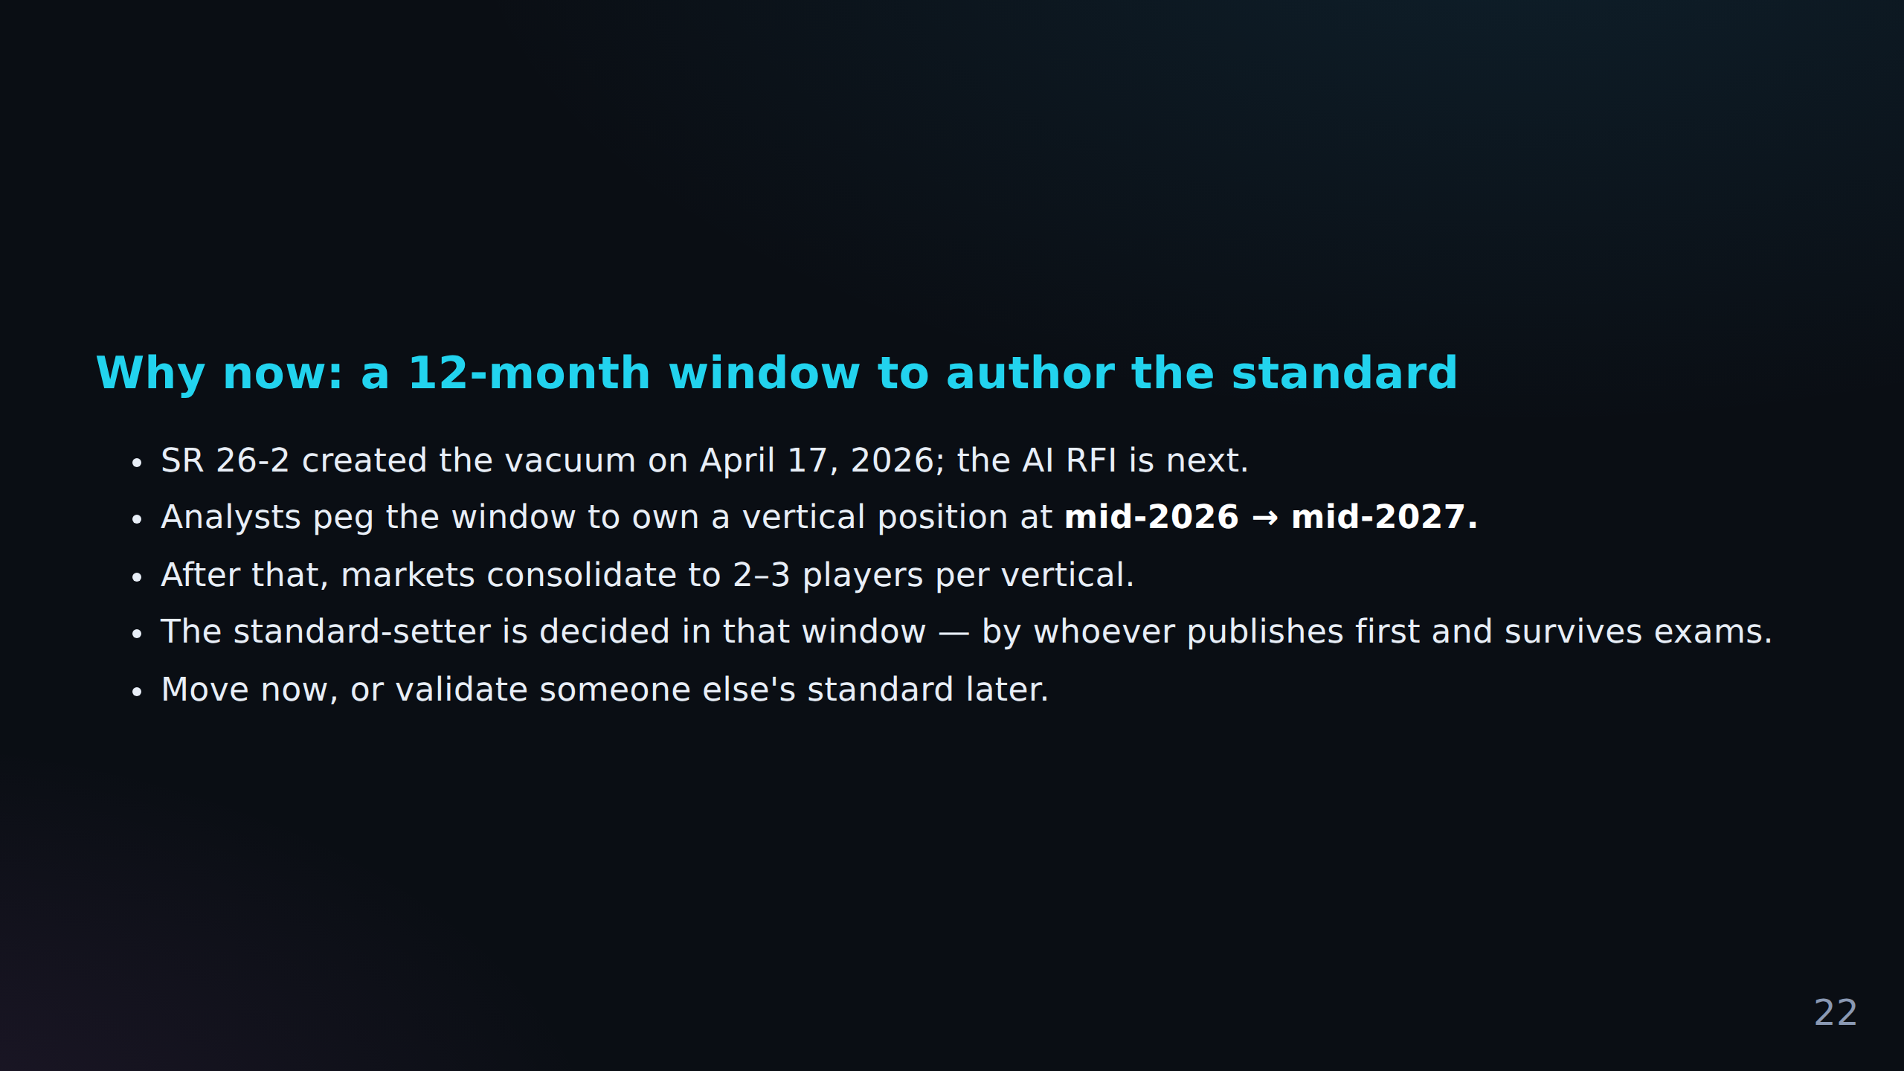

Slide 23
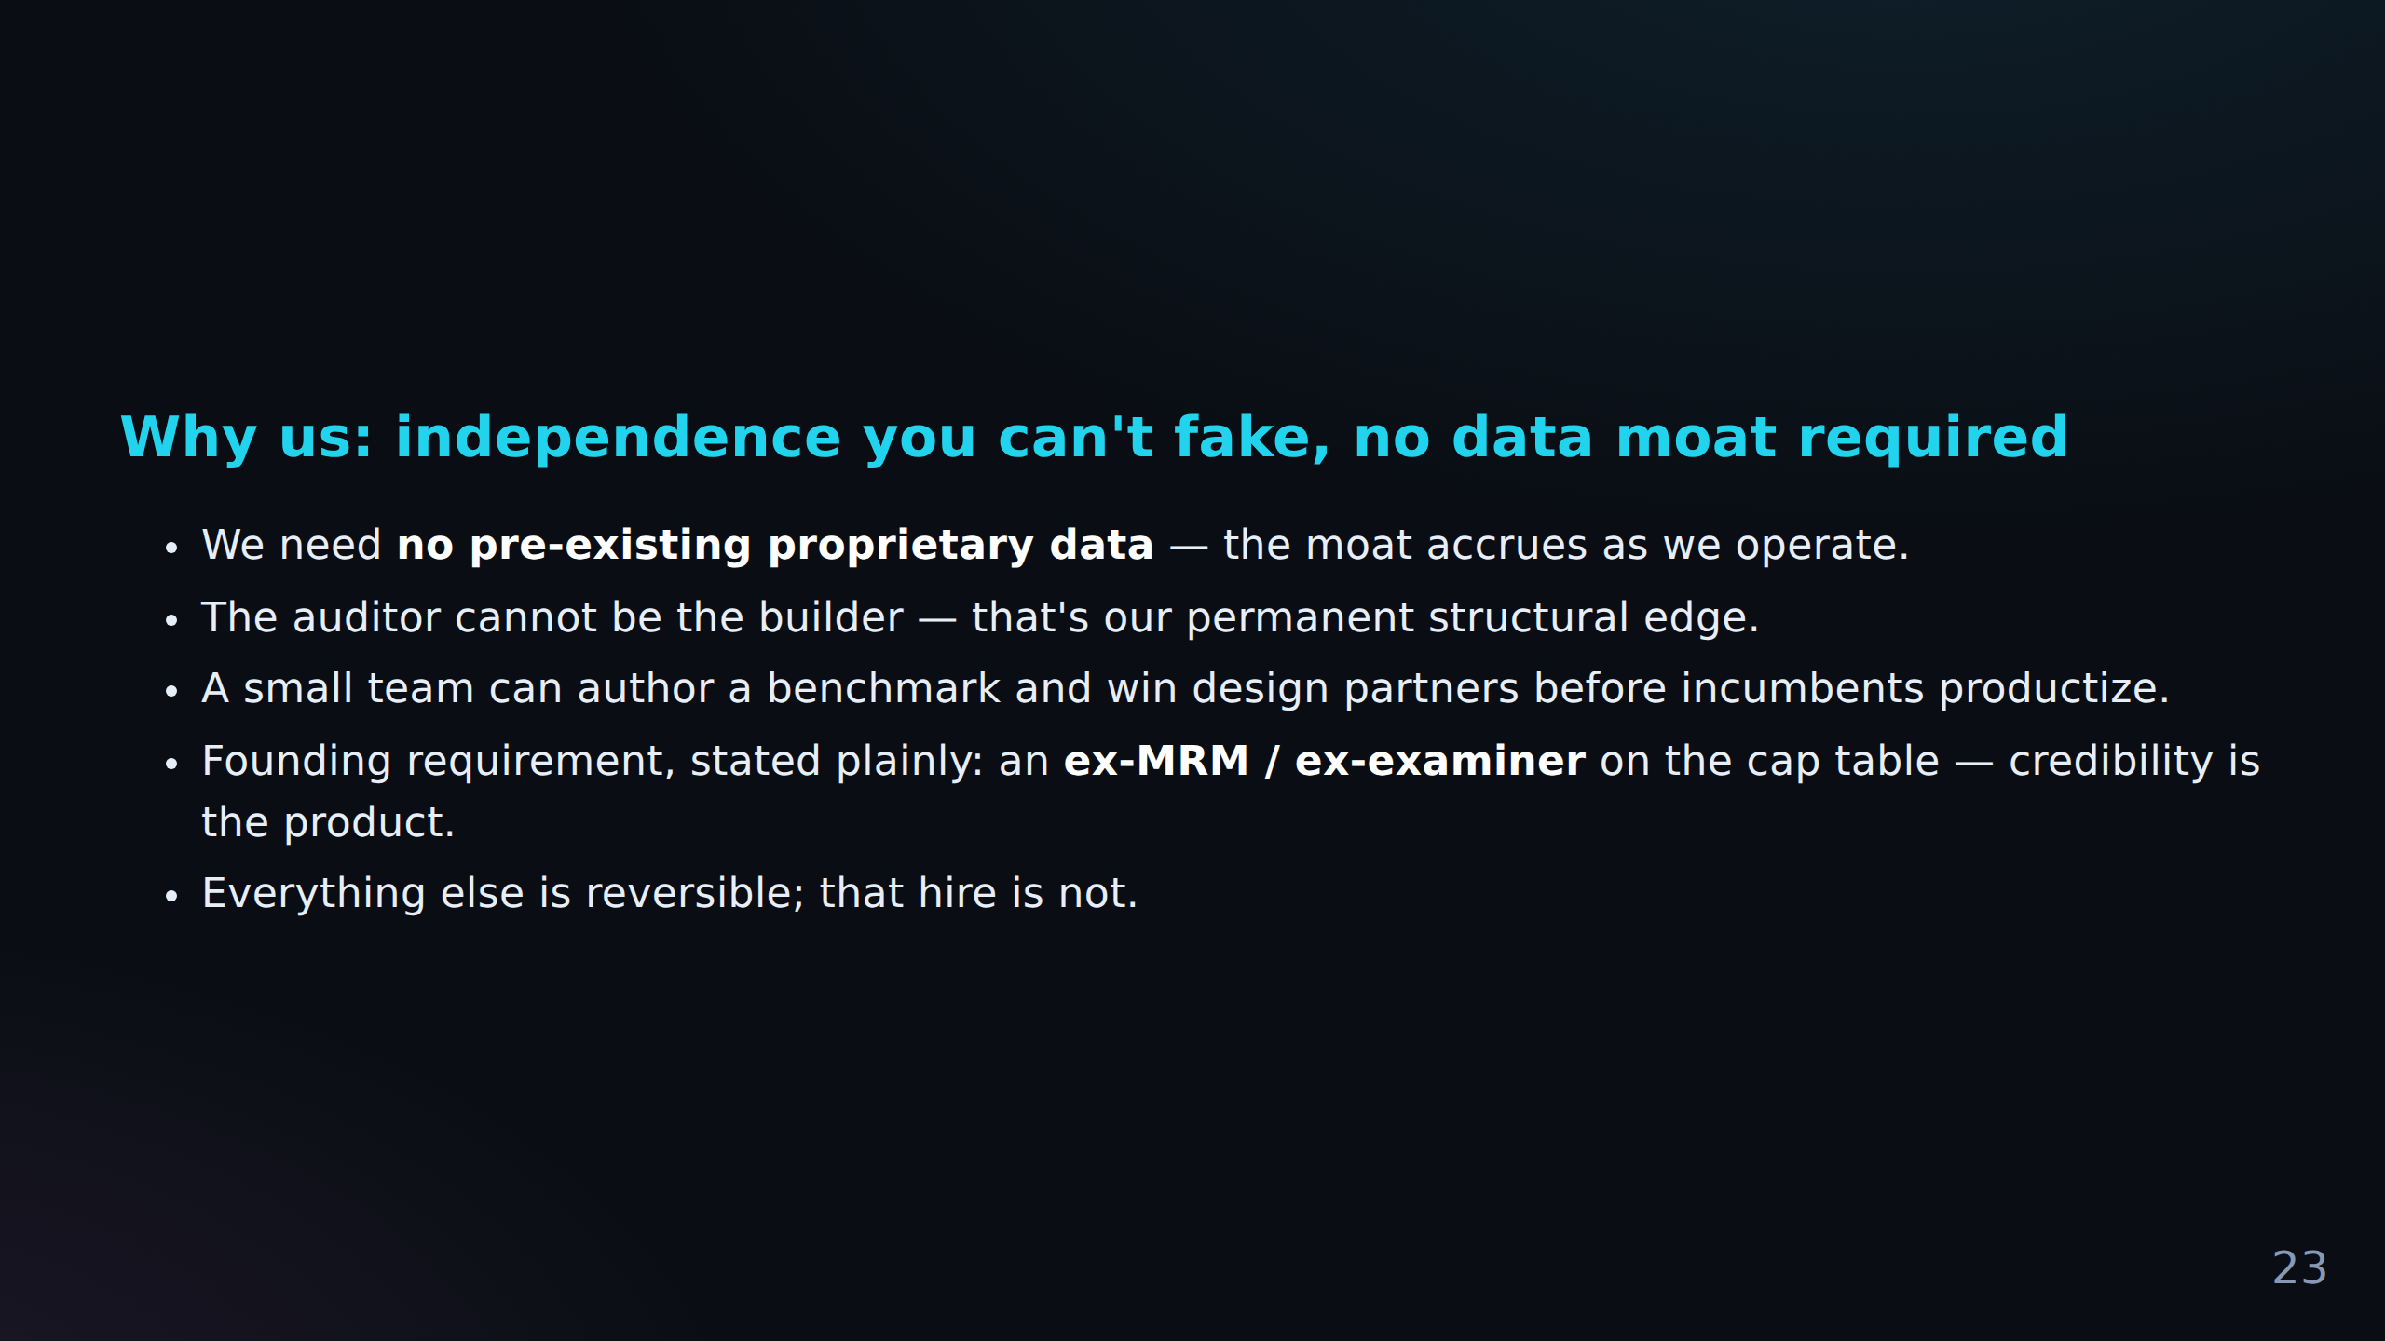

Slide 24
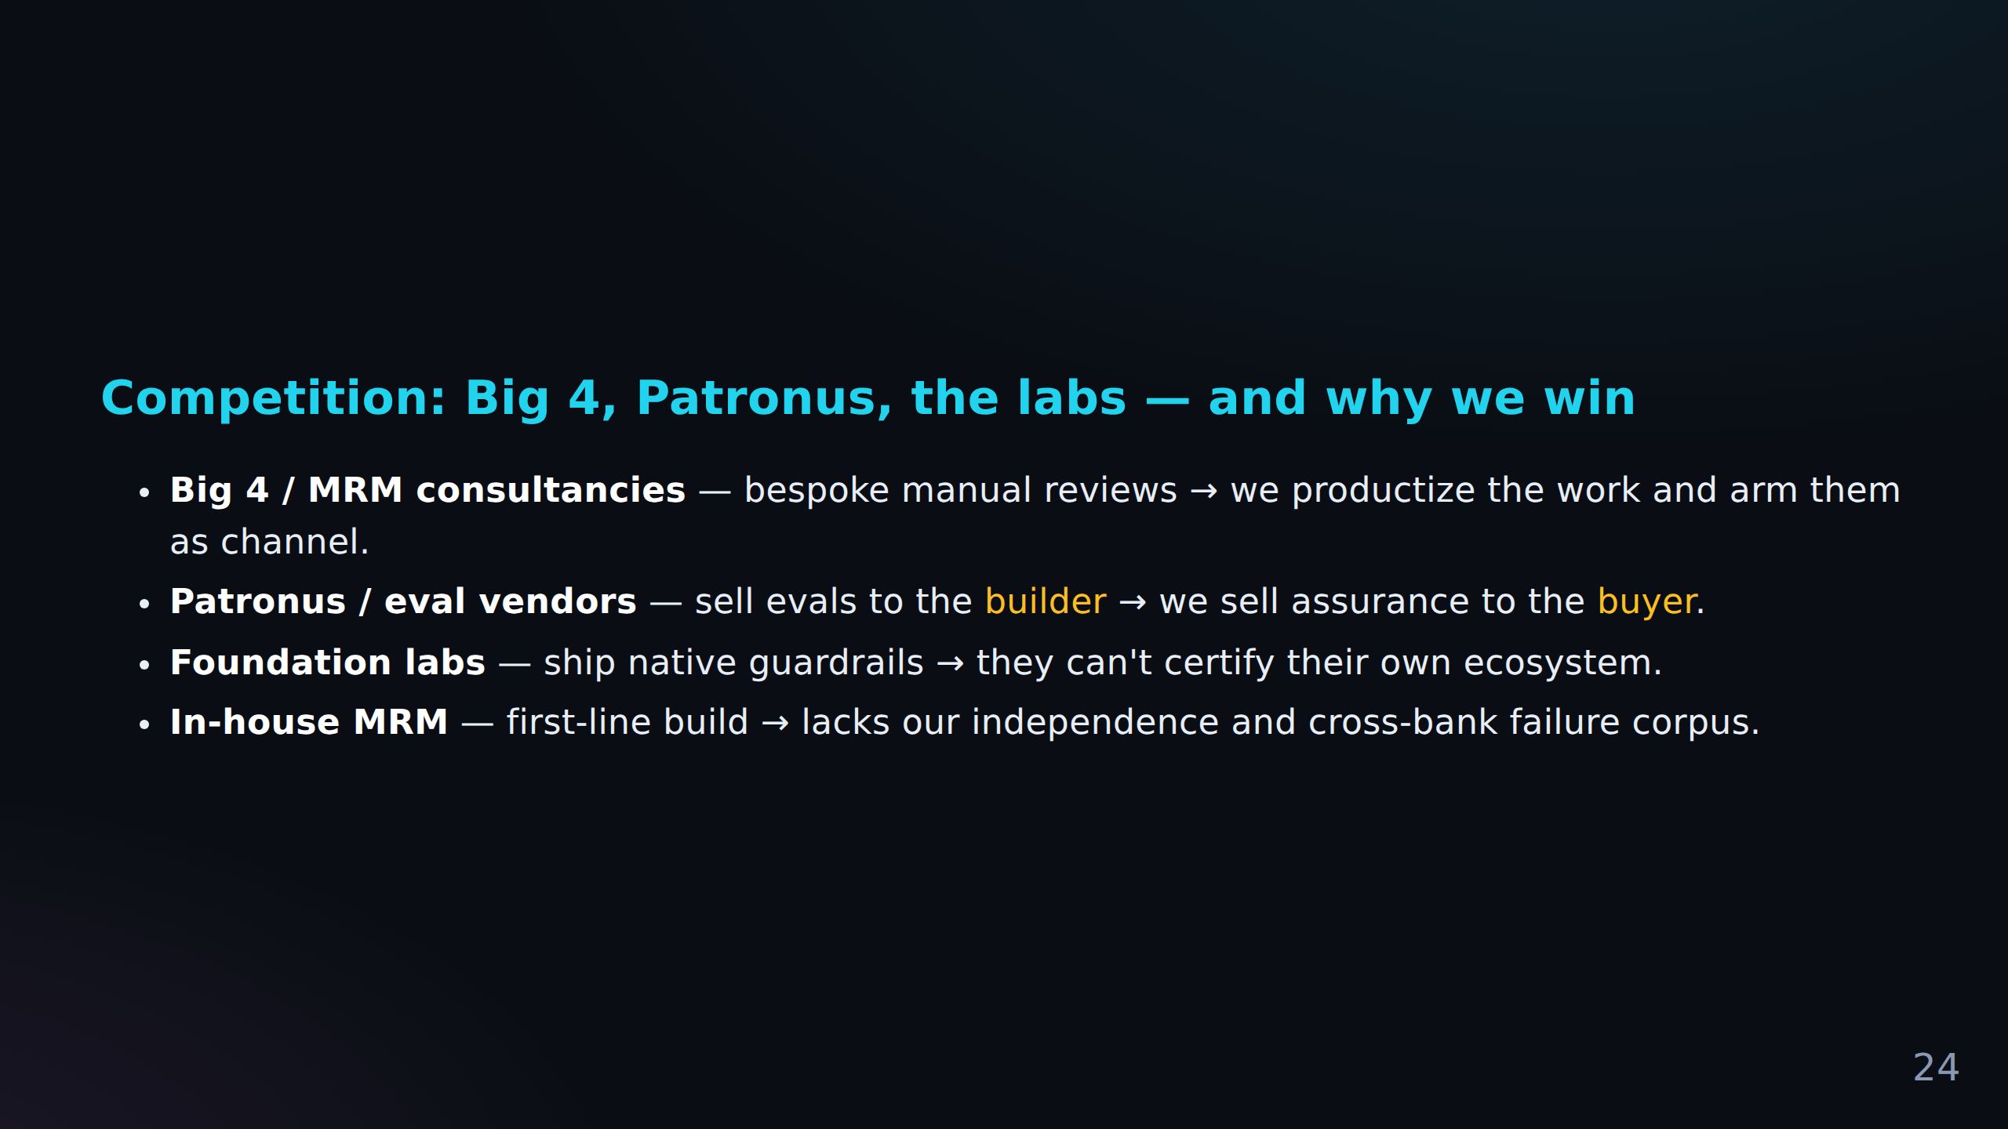

Slide 25
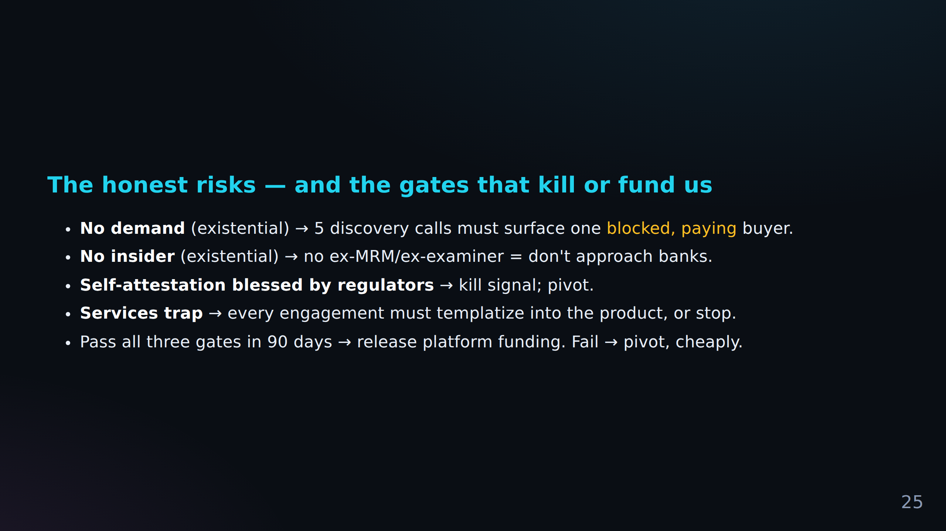

Slide 26
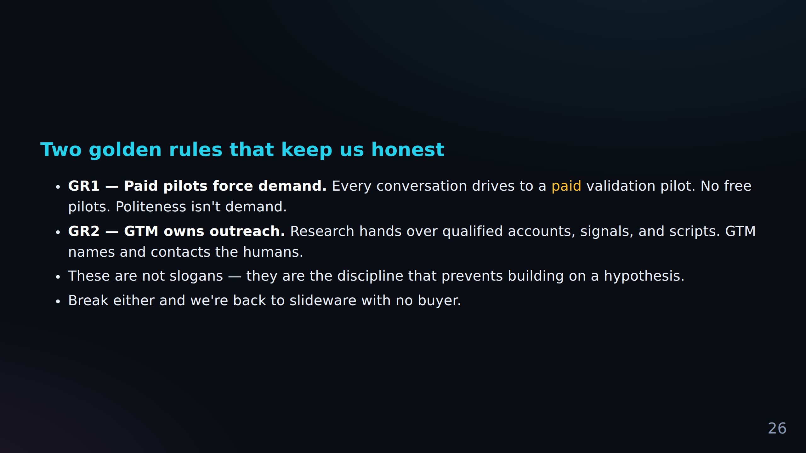

Slide 27
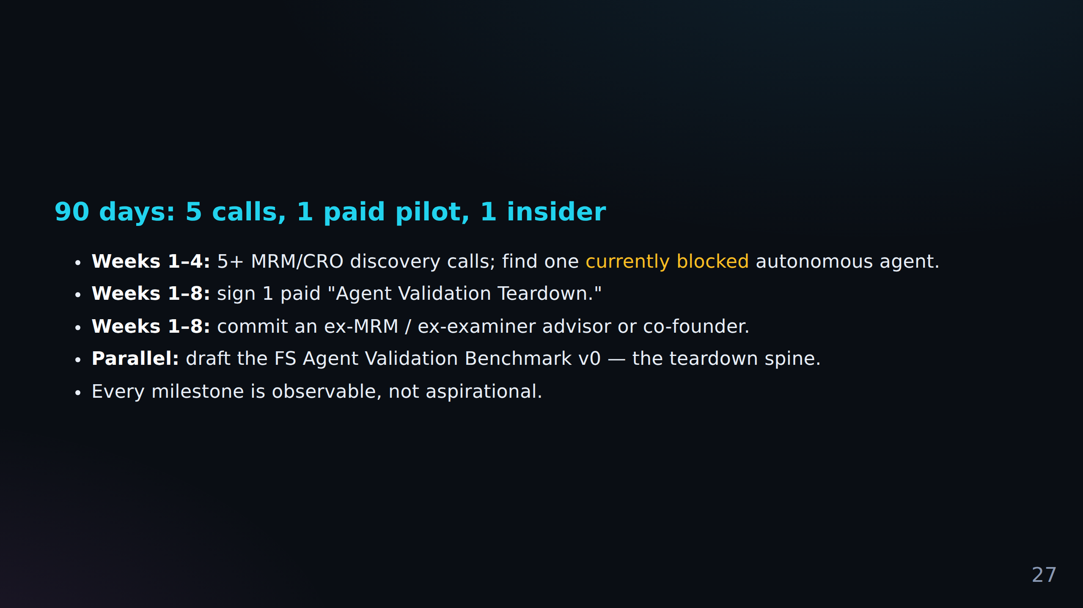

Slide 28
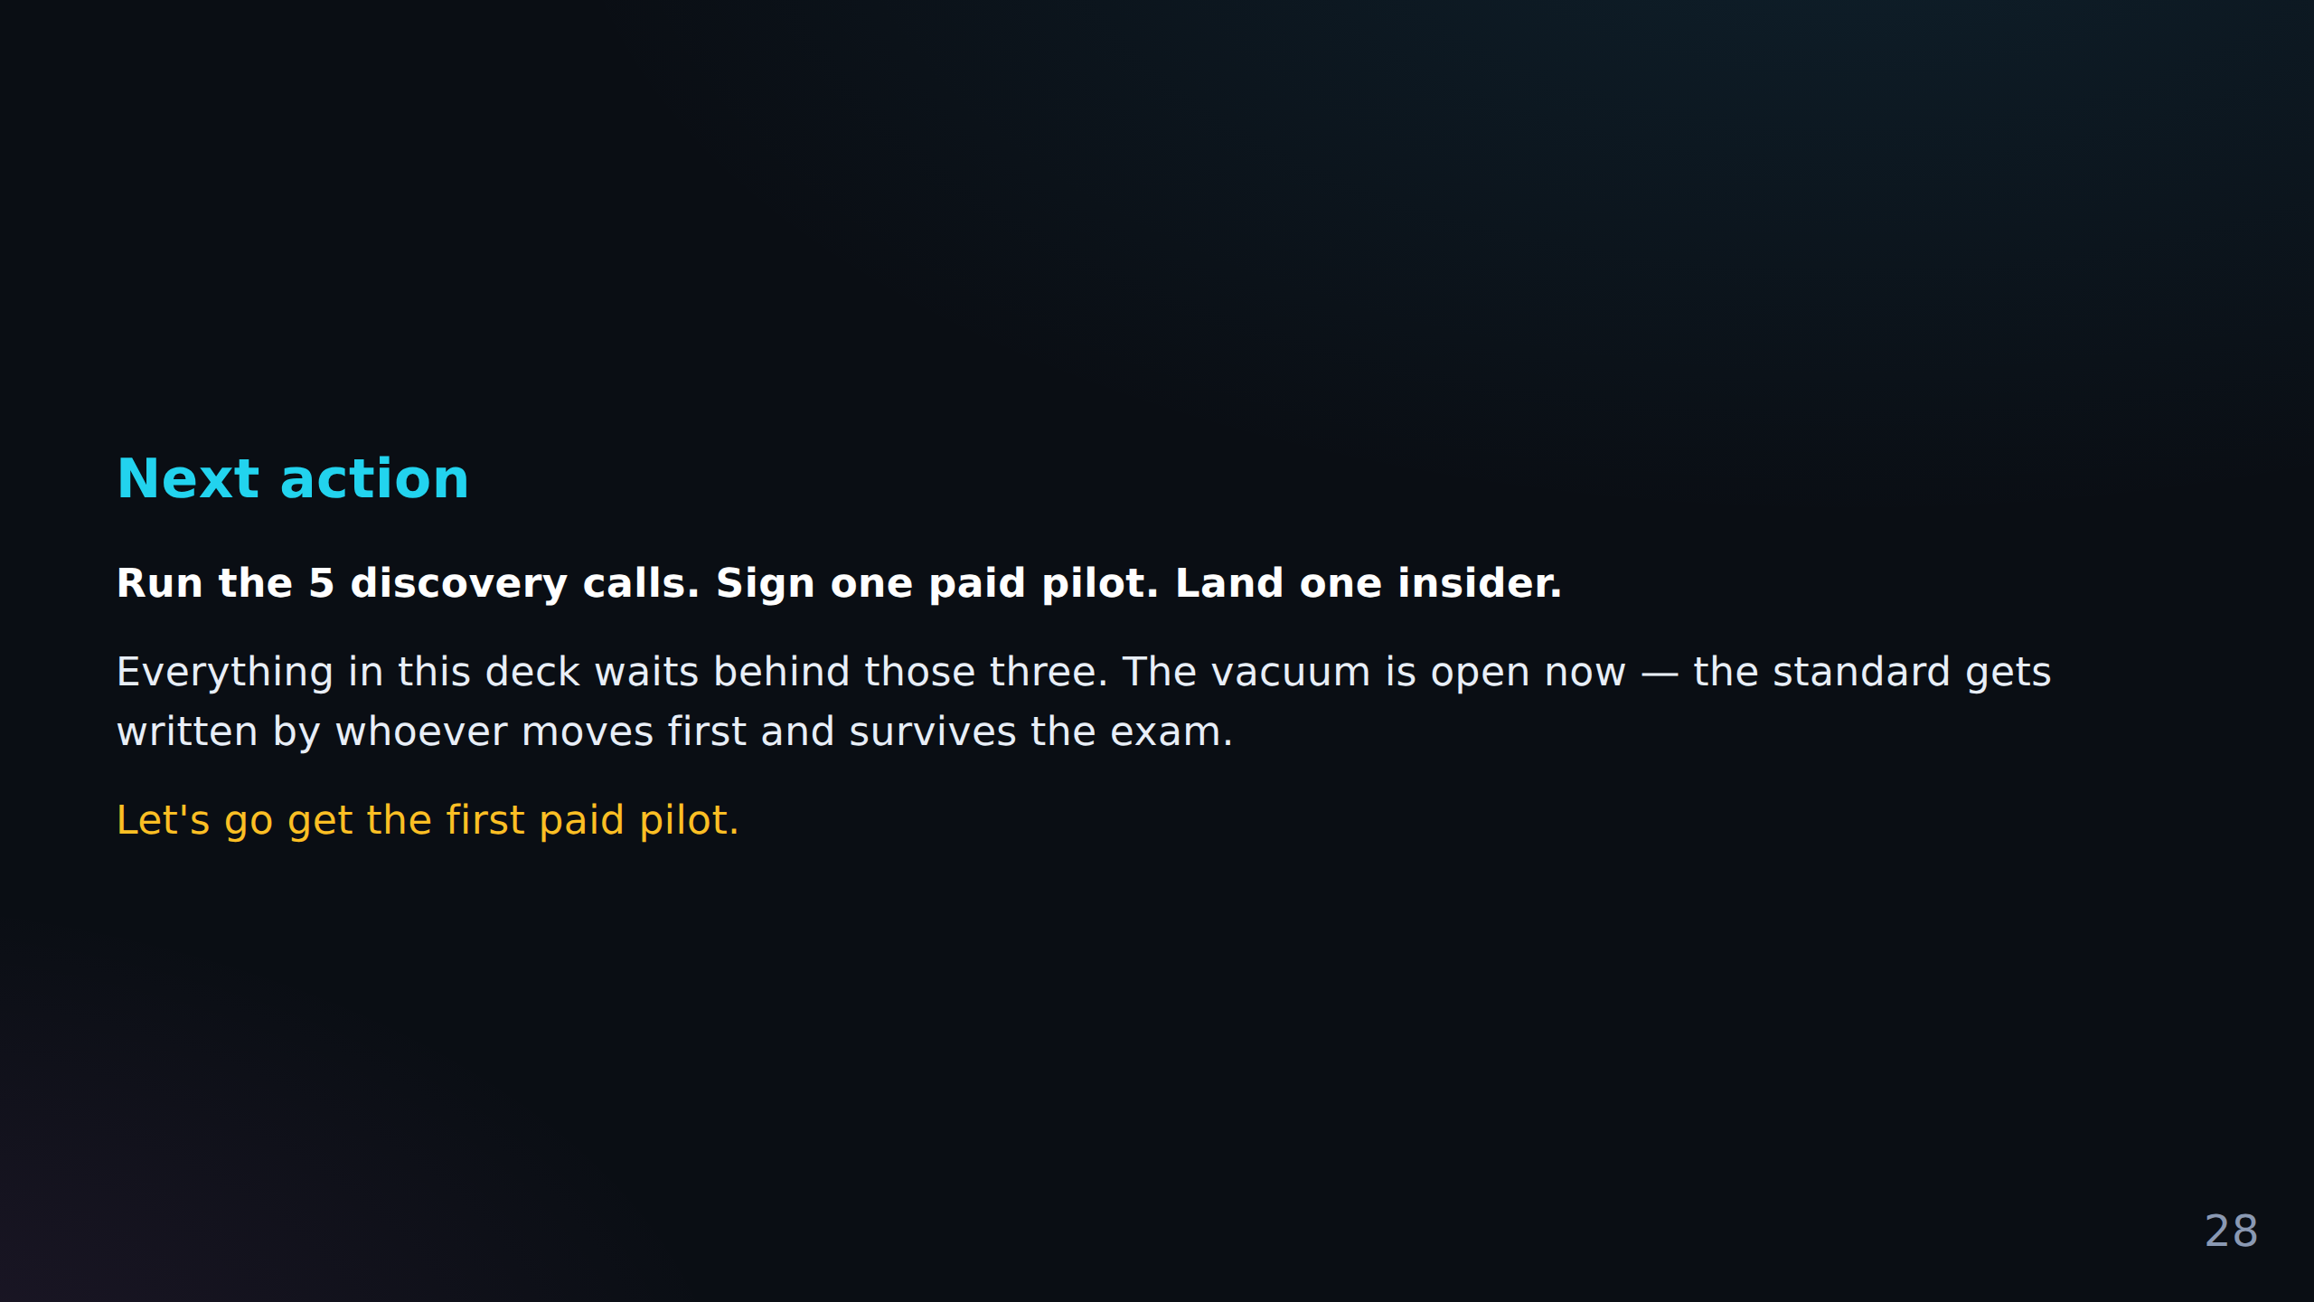

Slide 29
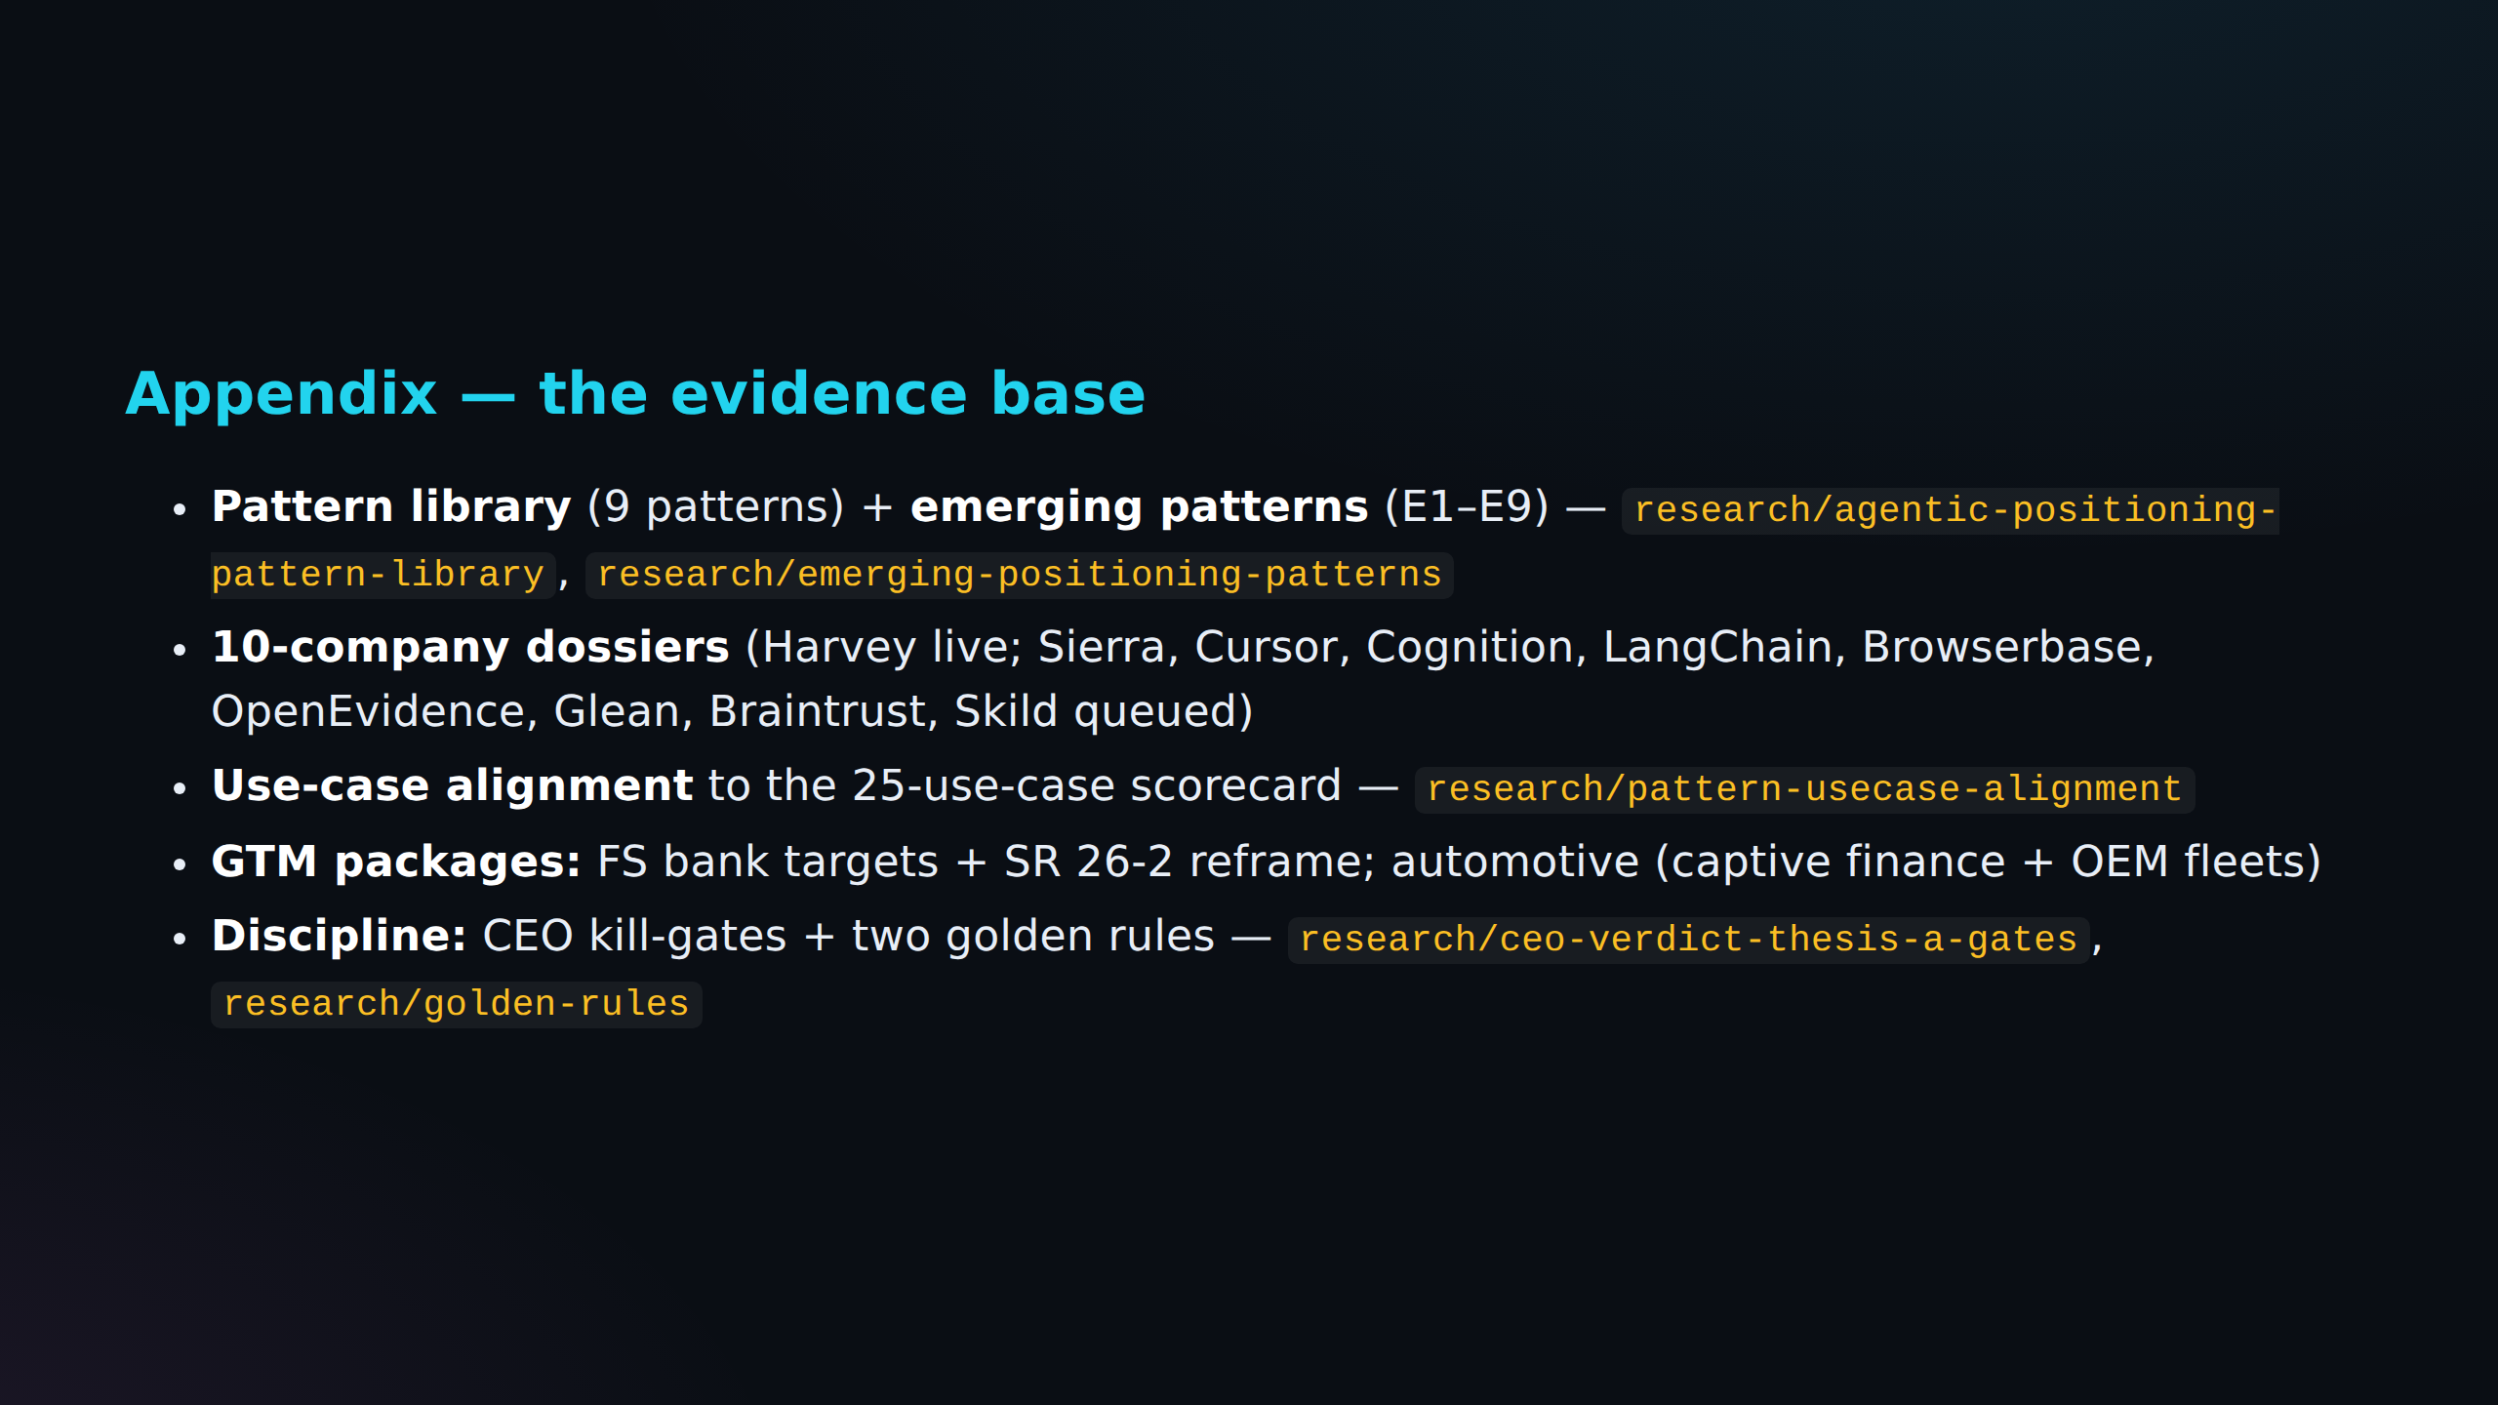

Slide 30
Fact Check Notes - Source Slide 2
C-001: Pending Reddit evidence (pending)
Klarna publicly reversed its AI-first support after quality tanked.
Reddit query: agent validation authority klarna publicly reversed ai-first support quality tanked
No scored Reddit evidence is attached yet.
C-002: Pending Reddit evidence (pending)
The blocker is the same everywhere: *nobody can prove the agent is safe to run.* That proof is a market.
Reddit query: agent validation authority blocker same everywhere nobody prove safe run proof market
No scored Reddit evidence is attached yet.

Slide 31
Fact Check Notes - Source Slide 3
C-003: Primary source required (source)
The market moved from "can we build an agent" to "can we trust one" 2023–24: the race was capability — frameworks, models, demos.
Reddit query: agent validation authority market moved build trust one race was capability frameworks models demos
Reddit can provide community signal; this claim still needs a primary source.
C-004: Primary source required (source)
2026: capability is commoditized; **the model is no longer the moat.** The new question is operational: predict it, audit it, roll it back.
Reddit query: agent validation authority capability commoditized model longer moat new question operational predict audit roll
Reddit can provide community signal; this claim still needs a primary source.
C-005: Pending Reddit evidence (pending)
*Trust is now an infrastructure problem before it is a product feature.*
Reddit query: agent validation authority trust now infrastructure problem product feature
No scored Reddit evidence is attached yet.

Slide 32
Fact Check Notes - Source Slide 4
C-006: Primary source required (source)
April 17, 2026: regulators handed agentic AI back to the banks **SR 26-2** (OCC / Fed / FDIC) replaced SR 11-7 — the 15-year model-risk rulebook.
Reddit query: agent validation authority april regulators handed agentic back banks occ fed fdic replaced year
Reddit can provide community signal; this claim still needs a primary source.
C-007: Pending Reddit evidence (pending)
One sentence defines the moment: *"Generative AI and agentic AI models… are not within the scope of this guidance."* Translation: banks own agentic-AI governance with **no playbook** —...
Reddit query: agent validation authority one sentence defines moment generative agentic models within scope guidance translation
No scored Reddit evidence is attached yet.
C-008: Pending Reddit evidence (pending)
Examiners still ask: *"What is your monitoring framework?
Reddit query: agent validation authority examiners still ask what your monitoring framework
No scored Reddit evidence is attached yet.
C-009: Pending Reddit evidence (pending)
What is your effective challenge?"* > "Can you name the person whose name should be on the examination finding?"
Reddit query: agent validation authority what your effective challenge you name person whose examination finding
No scored Reddit evidence is attached yet.

Slide 33
Fact Check Notes - Source Slide 5
C-010: Pending Reddit evidence (pending)
The pain is deployed, not hypothetical — and it is failing **Wendy's FreshAI** takes drive-thru orders end-to-end; **Mercedes MBUX**, **Home Depot Magic Apron** run live.
Reddit query: agent validation authority pain deployed hypothetical failing wendy freshai takes drive-thru orders end-to-end mercedes
No scored Reddit evidence is attached yet.
C-011: Pending Reddit evidence (pending)
Manual QA covers ~100 scenarios; real users trigger millions.
Reddit query: agent validation authority manual covers scenarios real users trigger millions
No scored Reddit evidence is attached yet.
C-012: Pending Reddit evidence (pending)
The gap between "deployed" and "validated" is where we live.
Reddit query: agent validation authority gap deployed validated where live
No scored Reddit evidence is attached yet.

Slide 34
Fact Check Notes - Source Slide 6
C-013: Pending Reddit evidence (pending)
Nobody independent can grade the agents — the labs grade themselves Foundation labs ship native guardrails — but they cannot certify their own ecosystem.
Reddit query: agent validation authority nobody independent grade agents labs themselves foundation ship native guardrails they
No scored Reddit evidence is attached yet.
C-014: Pending Reddit evidence (pending)
Eval vendors (Braintrust, Arize, Patronus) sell tooling to the **builder**, not assurance to the **buyer**.
Reddit query: agent validation authority eval vendors braintrust arize patronus sell tooling builder assurance buyer
No scored Reddit evidence is attached yet.
C-015: Pending Reddit evidence (pending)
Internal model-risk teams have no agent-native method.
Reddit query: agent validation authority internal model-risk teams agent-native method
No scored Reddit evidence is attached yet.
C-016: Pending Reddit evidence (pending)
*The one thing none of them can claim is independence.
Reddit query: agent validation authority one thing none claim independence
No scored Reddit evidence is attached yet.

Slide 35
Fact Check Notes - Source Slide 7
C-017: Pending Reddit evidence (pending)
Certify the agent.** *Nobody owns it.* That is our lane: the independent referee for the other eight.
Reddit query: agent validation authority certify nobody owns lane independent referee for other eight
No scored Reddit evidence is attached yet.

Slide 36
Fact Check Notes - Source Slide 9
C-018: Pending Reddit evidence (pending)
Our position: certify the autonomous agent before it ships Package agent assurance as a **hiring bar for the agent**: *"passed before you deployed it."* Sell to the risk owner, not the...
Reddit query: agent validation authority position certify autonomous ships package assurance hiring bar for passed you
No scored Reddit evidence is attached yet.
C-019: Pending Reddit evidence (pending)
Output the buyer can show a regulator, a board, or a court.
Reddit query: agent validation authority output buyer show regulator board court
No scored Reddit evidence is attached yet.

Slide 37
Fact Check Notes - Source Slide 10
C-020: Pending Reddit evidence (pending)
What we are: the UL / SOC-2 for AI agents An **independent authority** whose stamp the market trusts.
Reddit query: agent validation authority what soc-2 for agents independent whose stamp market trusts
No scored Reddit evidence is attached yet.
C-021: Pending Reddit evidence (pending)
Independence is not a feature — it is the entire product.
Reddit query: agent validation authority independence feature entire product
No scored Reddit evidence is attached yet.

Slide 38
Fact Check Notes - Source Slide 11
C-022: Pending Reddit evidence (pending)
Deliverable: a report the buyer hands their examiner + a live assurance dashboard + a time-boxed "Validated" mark.
Reddit query: agent validation authority deliverable report buyer hands examiner live assurance dashboard time-boxed validated mark
No scored Reddit evidence is attached yet.

Slide 39
Fact Check Notes - Source Slide 12
C-023: Primary source required (source)
Beachhead: the SR 26-2 vacuum in financial services Banks must self-determine agentic-AI controls — and have nothing.
Reddit query: agent validation authority beachhead vacuum financial services banks self-determine agentic-ai controls nothing
Reddit can provide community signal; this claim still needs a primary source.
C-024: Pending Reddit evidence (pending)
The buyer and budget already exist: **model risk / AI governance** is a mandated function.
Reddit query: agent validation authority buyer budget exist model risk governance mandated function
No scored Reddit evidence is attached yet.
C-025: Pending Reddit evidence (pending)
The regulatory vacuum is the opening; the coming AI RFI is the deadline.
Reddit query: agent validation authority regulatory vacuum opening coming rfi deadline
No scored Reddit evidence is attached yet.

Slide 40
Fact Check Notes - Source Slide 13
C-026: Pending Reddit evidence (pending)
We don't certify chatbots — we validate the agents MRM can't Skip the BAU: generic support bots and OCR are solved, low-stakes, vendor-benchmarked.
Reddit query: agent validation authority don certify chatbots validate agents mrm skip bau generic support bots
No scored Reddit evidence is attached yet.
C-027: Pending Reddit evidence (pending)
**AML / fraud investigation** agents → SAR quality.
Reddit query: agent validation authority aml fraud investigation agents sar quality
No scored Reddit evidence is attached yet.
C-028: Pending Reddit evidence (pending)
**SecOps auto-remediation** → audit risk.
Reddit query: agent validation authority secops auto-remediation audit risk
No scored Reddit evidence is attached yet.

Slide 41
Fact Check Notes - Source Slide 14
C-029: Pending Reddit evidence (pending)
Sell to the CRO; the examiner is the judge **Economic buyer:** Head of Model Risk / Chief Risk Officer — holds budget and personal liability.
Reddit query: agent validation authority sell cro examiner judge economic buyer head model risk chief officer
No scored Reddit evidence is attached yet.
C-030: Pending Reddit evidence (pending)
**Champion:** the AI-governance lead whose job is impossible without us.
Reddit query: agent validation authority champion ai-governance lead whose job impossible
No scored Reddit evidence is attached yet.
C-031: Pending Reddit evidence (pending)
**User:** the line-of-business that must pass our gate to ship.
Reddit query: agent validation authority user line-of-business pass gate ship
No scored Reddit evidence is attached yet.
C-032: Pending Reddit evidence (pending)
**The rejectable counterparty:** the **bank examiner** — our dossier must survive exams.
Reddit query: agent validation authority rejectable counterparty bank examiner dossier survive exams
No scored Reddit evidence is attached yet.

Slide 42
Fact Check Notes - Source Slide 14
C-033: Pending Reddit evidence (pending)
That bar is the forcing function and the moat: survive exams once, become un-switchable.
Reddit query: agent validation authority bar forcing function moat survive exams once become un-switchable
No scored Reddit evidence is attached yet.

Slide 43
Fact Check Notes - Source Slide 15
C-034: Primary source required (source)
The dossier maps to exactly what examiners already ask SR 26-2 keeps three validation pillars: **conceptual soundness, outcomes analysis, ongoing monitoring.** We mirror that structure...
Reddit query: agent validation authority dossier maps exactly what examiners ask keeps three pillars conceptual soundness
Reddit can provide community signal; this claim still needs a primary source.
C-035: Primary source required (source)
Add the agentic layer SR 26-2 omits: tool-call safety, autonomy bounds, multi-agent error propagation.
Reddit query: agent validation authority add agentic layer omits tool-call safety autonomy bounds multi-agent error propagation
Reddit can provide community signal; this claim still needs a primary source.
C-036: Primary source required (source)
Anchor to NIST AI RMF + ISO/IEC 42001 so it reads as standard, not startup.
Reddit query: agent validation authority anchor nist rmf iso iec reads standard startup
Reddit can provide community signal; this claim still needs a primary source.
C-037: Pending Reddit evidence (pending)
*We give examiners the artifact they're about to demand.*
Reddit query: agent validation authority give examiners artifact they demand
No scored Reddit evidence is attached yet.

Slide 44
Fact Check Notes - Source Slide 16
C-038: Pending Reddit evidence (pending)
**Subscription:** annual per-agent continuous assurance — drift, re-validation, exam support.
Reddit query: agent validation authority subscription annual per-agent continuous assurance drift re-validation exam support
No scored Reddit evidence is attached yet.
C-039: Pending Reddit evidence (pending)
Buyer-funded, sits in the audit/MRM budget line — not a new category to justify.
Reddit query: agent validation authority buyer-funded sits audit mrm budget line new category justify
No scored Reddit evidence is attached yet.
C-040: Pending Reddit evidence (pending)
Pilot proves demand; subscription is the annuity.
Reddit query: agent validation authority pilot proves demand subscription annuity
No scored Reddit evidence is attached yet.

