Slide 1
Fact Check Summary
Reddit evidence has been attached. Hard facts still need official-source review.
15
Reddit-supported
6
Weak Reddit support
12
No Reddit evidence
6
Primary required
8 Reddit threads parsed
482 comments scored
Evidence is strongest for operator pain, objections, and governance language.
C-002 Reddit-Supported
The blocker is the same everywhere: *nobody can prove the agent is safe to run.* That proof is a market.
C-003 Reddit + Primary
The market moved from "can we build an agent" to "can we trust one" 2023–24: the race was capability — fram...
C-004 Primary Required
2026: capability is commoditized; **the model is no longer the moat.** The new question is operational: pre...
C-005 Reddit-Supported
*Trust is now an infrastructure problem before it is a product feature.*
C-008 Reddit-Supported
Examiners still ask: *"What is your monitoring framework?

Slide 2
What Changed In The Deck
The source deck is annotated slide-by-slide, and the first slides summarize the verdict mix.
Strong Reddit support
Weak / no Reddit evidence
Primary-source required
C-002
The blocker is the same everywhere: *nobo...
C-001
Klarna publicly reversed its AI-first sup...
C-003
The market moved from "can we build an ag...
Reddit-Supported
No Reddit Evidence
Reddit + Primary
C-005
*Trust is now an infrastructure problem b...
C-007
One sentence defines the moment: *"Genera...
C-004
2026: capability is commoditized; **the m...
Reddit-Supported
No Reddit Evidence
Primary Required
C-008
Examiners still ask: *"What is your monit...
C-010
The pain is deployed, not hypothetical —...
C-006
April 17, 2026: regulators handed agentic...
Reddit-Supported
Weak Reddit Support
Primary Required
C-009
What is your effective challenge?"* > "Ca...
C-011
Manual QA covers ~100 scenarios; real use...
C-023
Beachhead: the SR 26-2 vacuum in financia...
Reddit-Supported
No Reddit Evidence
Primary Required
Slides 3+ preserve the original deck structure with rails and notes appended where claims need detail.

Slide 3
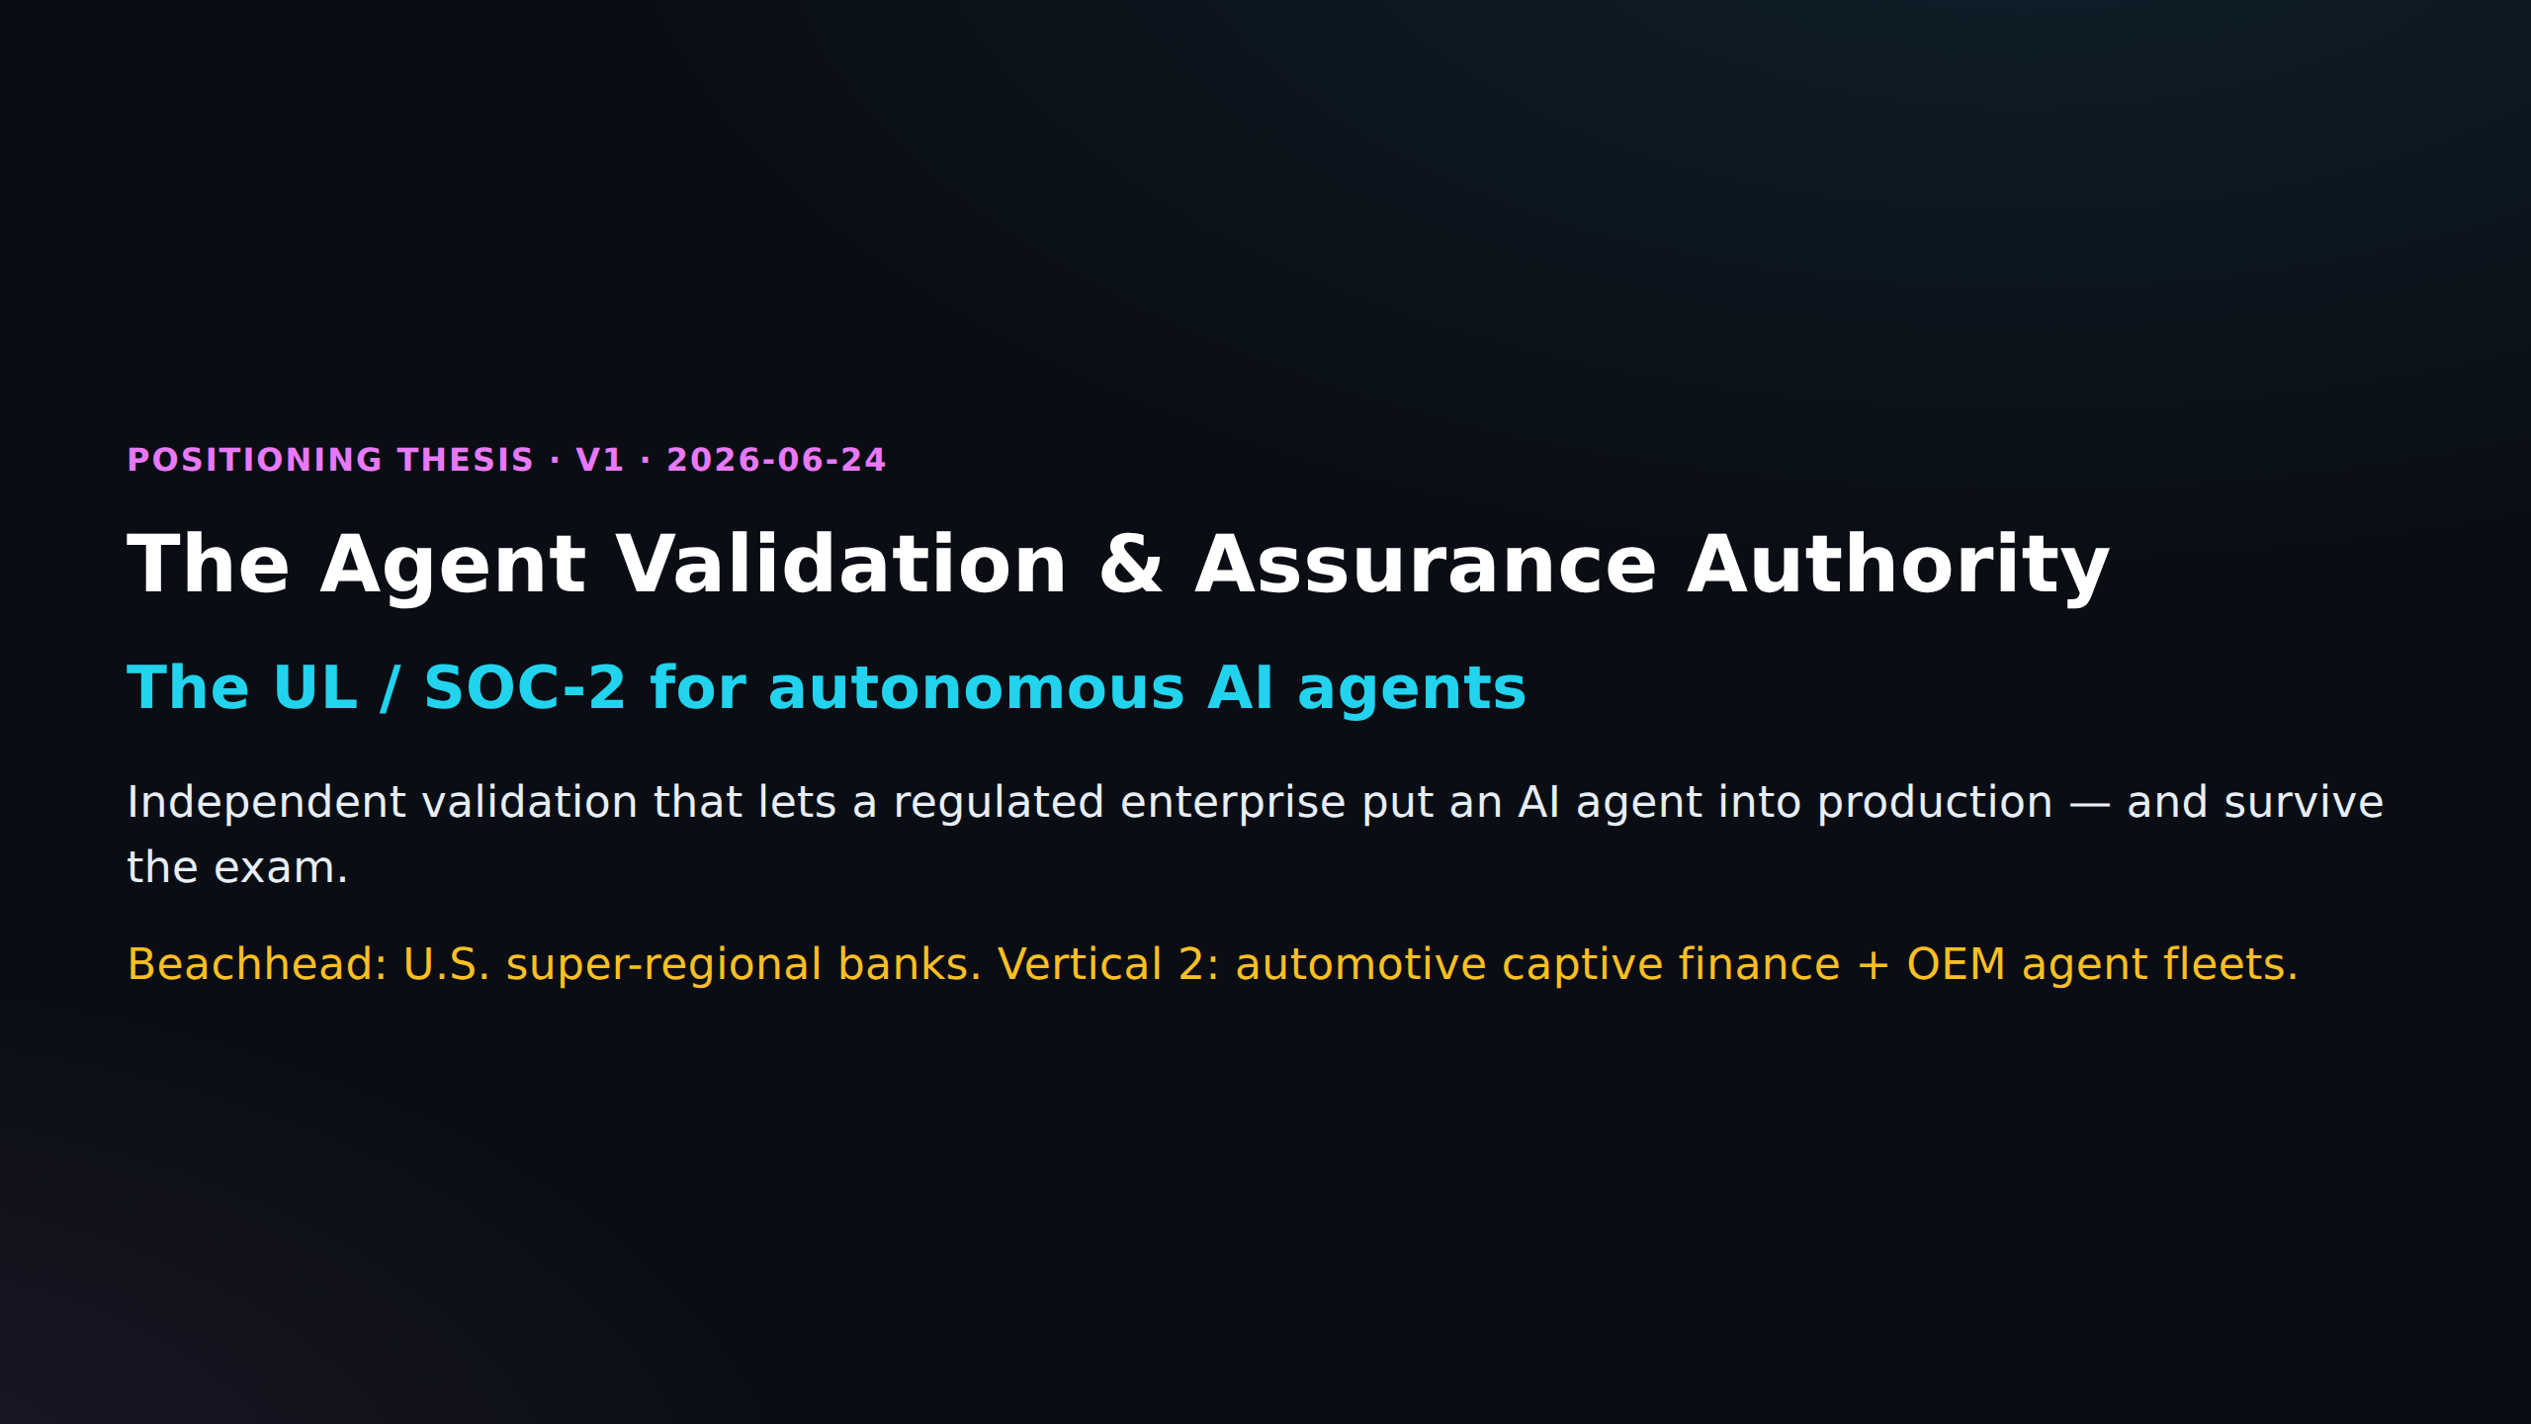

Slide 4
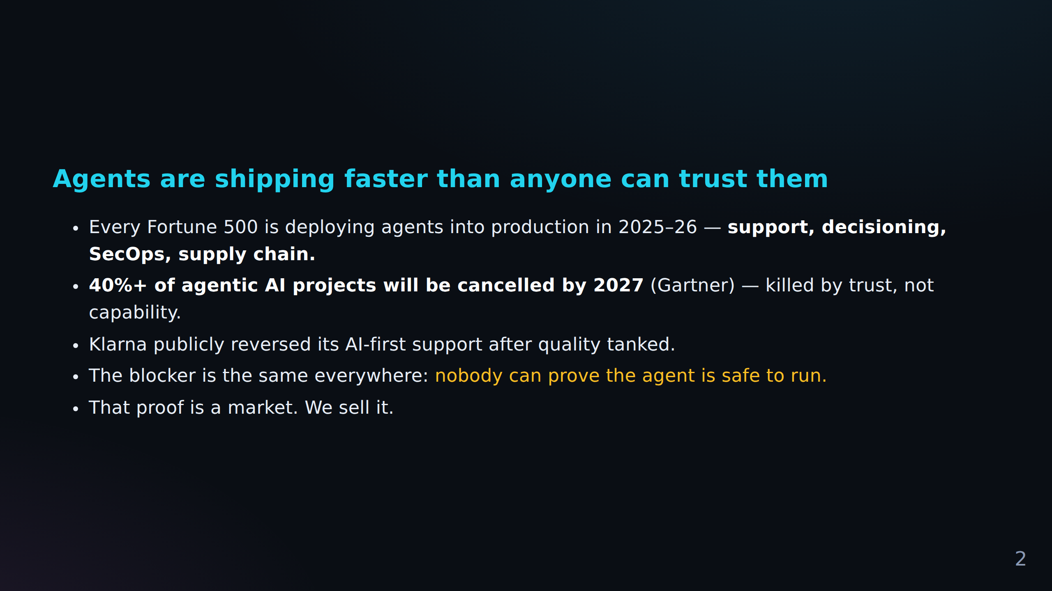
FACT CHECK
C-001 No Reddit evidence (low)
Klarna publicly reversed its AI-first support after quality tanked.
C-002 Reddit-supported (high)
The blocker is the same everywhere: *nobody can prove the agent is safe to run.* That proof...

Slide 5
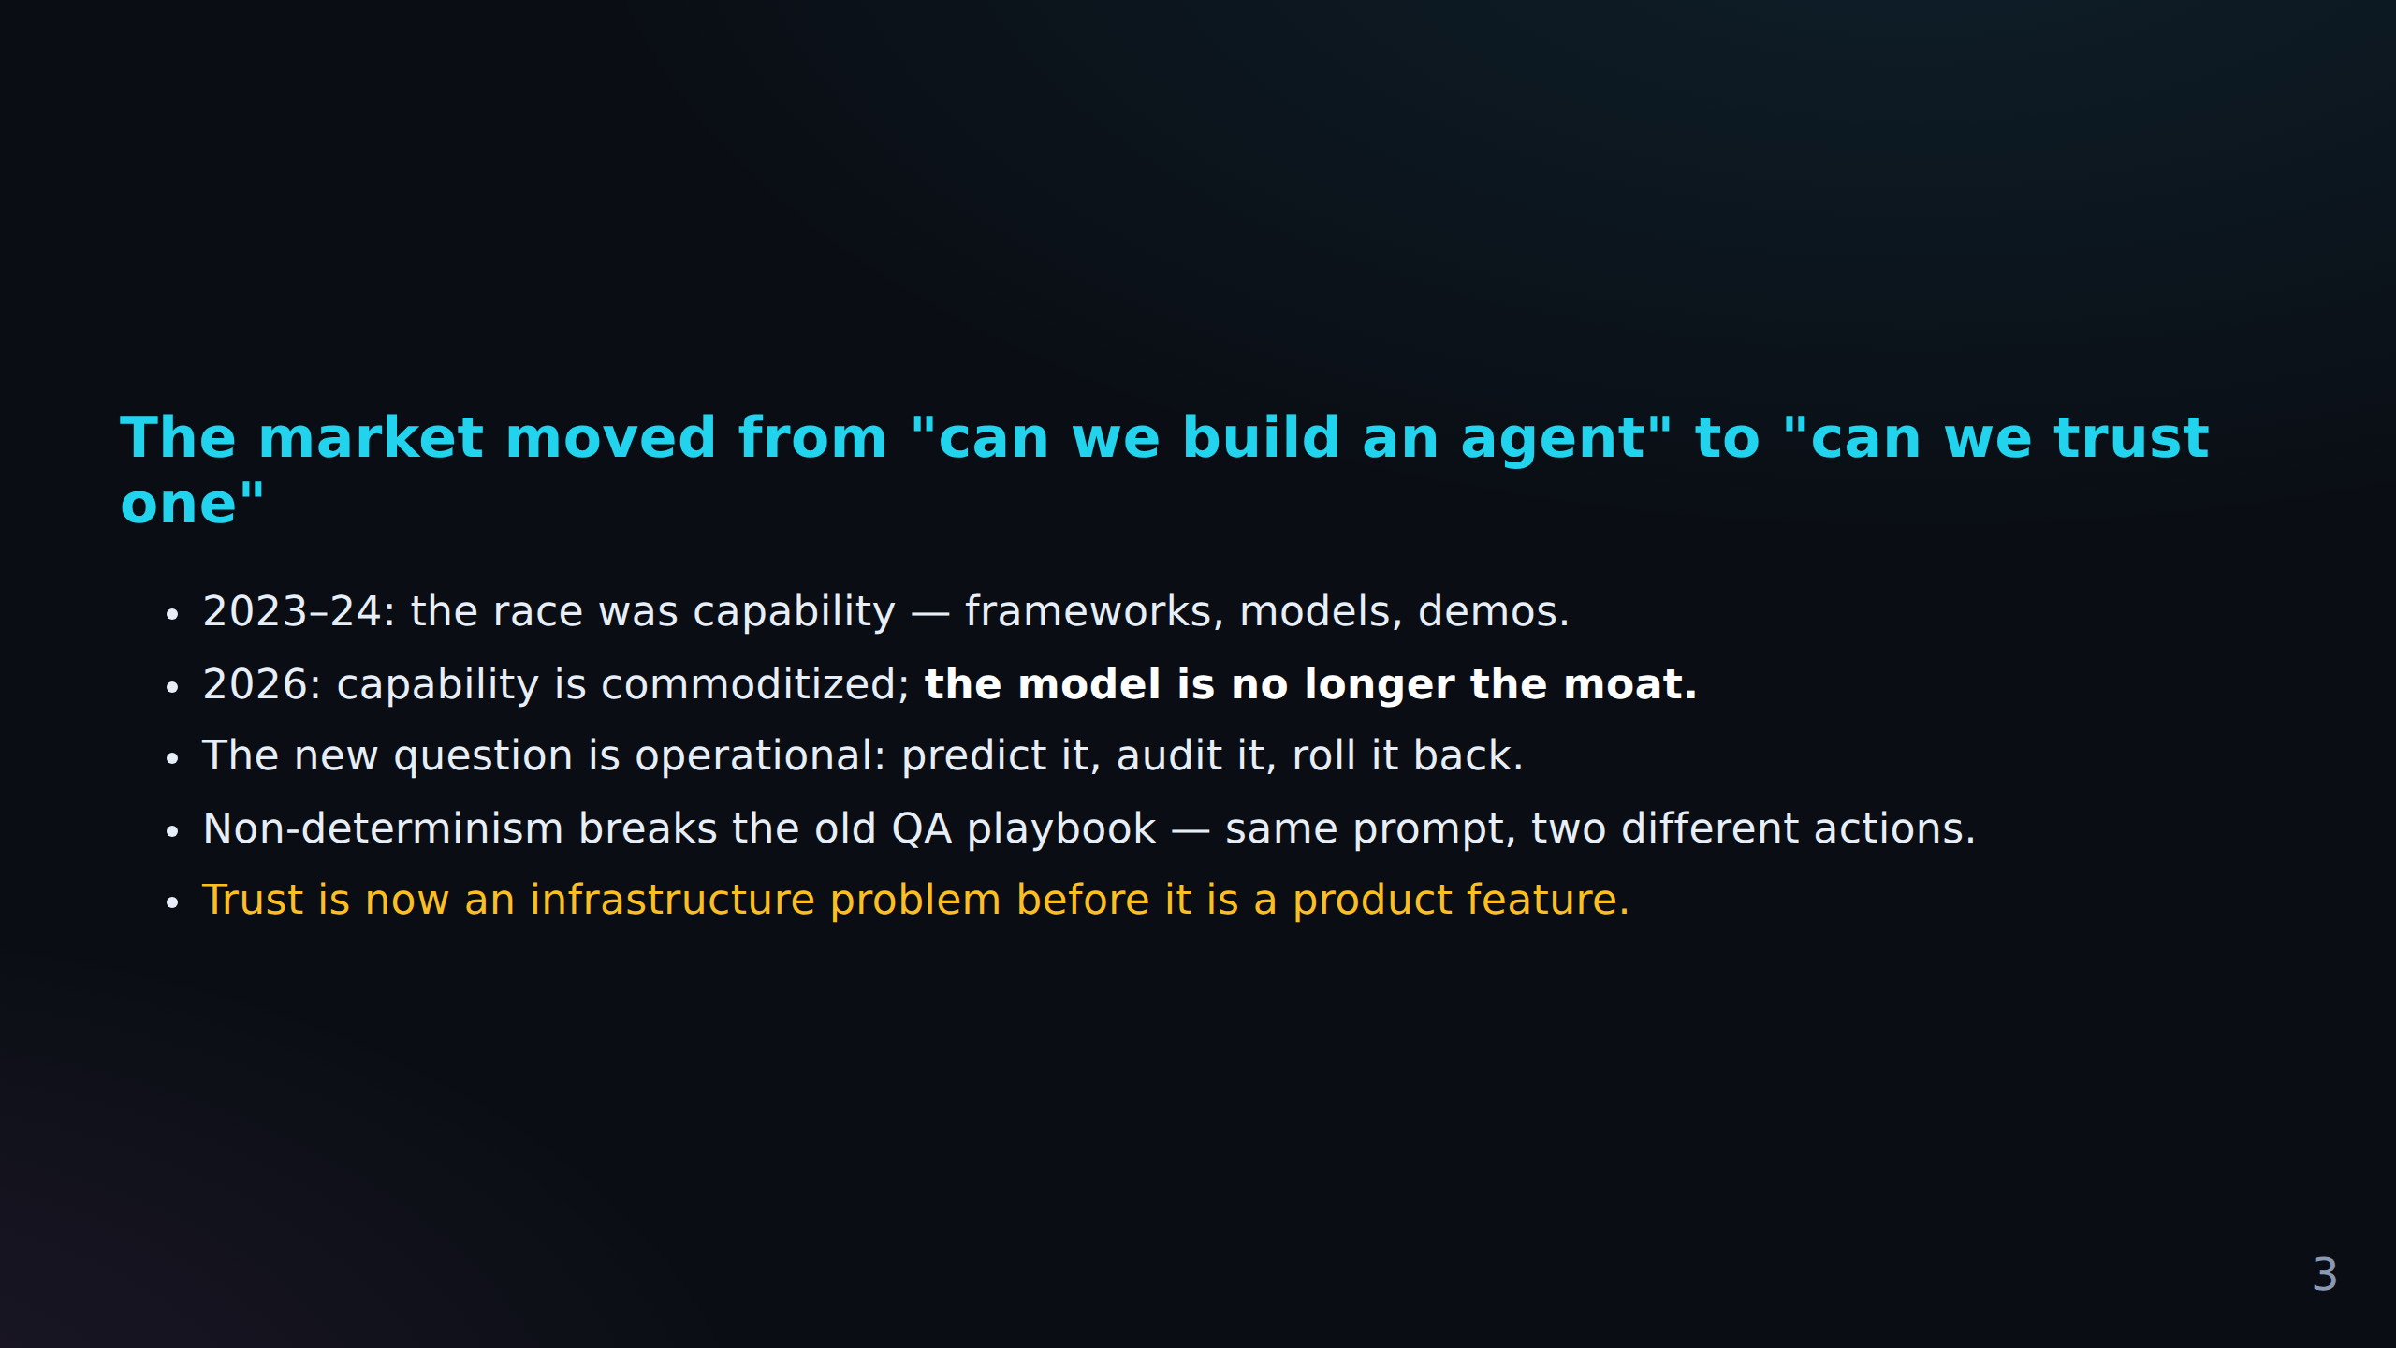
FACT CHECK
C-003 Reddit signal + primary source (mixed)
The market moved from "can we build an agent" to "can we trust one" 2023–24: the race was c...
C-004 Primary source required (source)
2026: capability is commoditized; **the model is no longer the moat.** The new question is...
C-005 Reddit-supported (high)
*Trust is now an infrastructure problem before it is a product feature.*

Slide 6
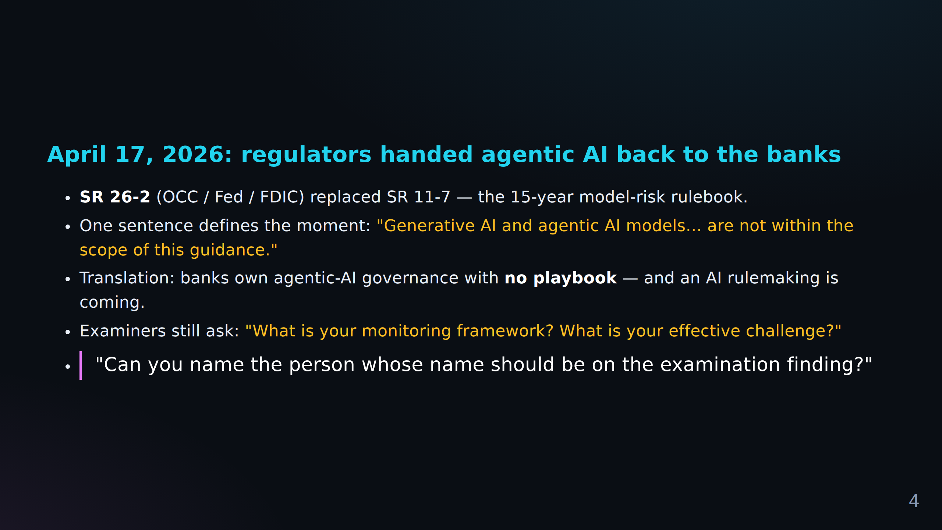
FACT CHECK
C-006 Primary source required (source)
April 17, 2026: regulators handed agentic AI back to the banks **SR 26-2** (OCC / Fed / FDI...
C-007 No Reddit evidence (low)
One sentence defines the moment: *"Generative AI and agentic AI models… are not within the...
C-008 Reddit-supported (high)
Examiners still ask: *"What is your monitoring framework?
+ 1 more in Fact Check Notes

Slide 7
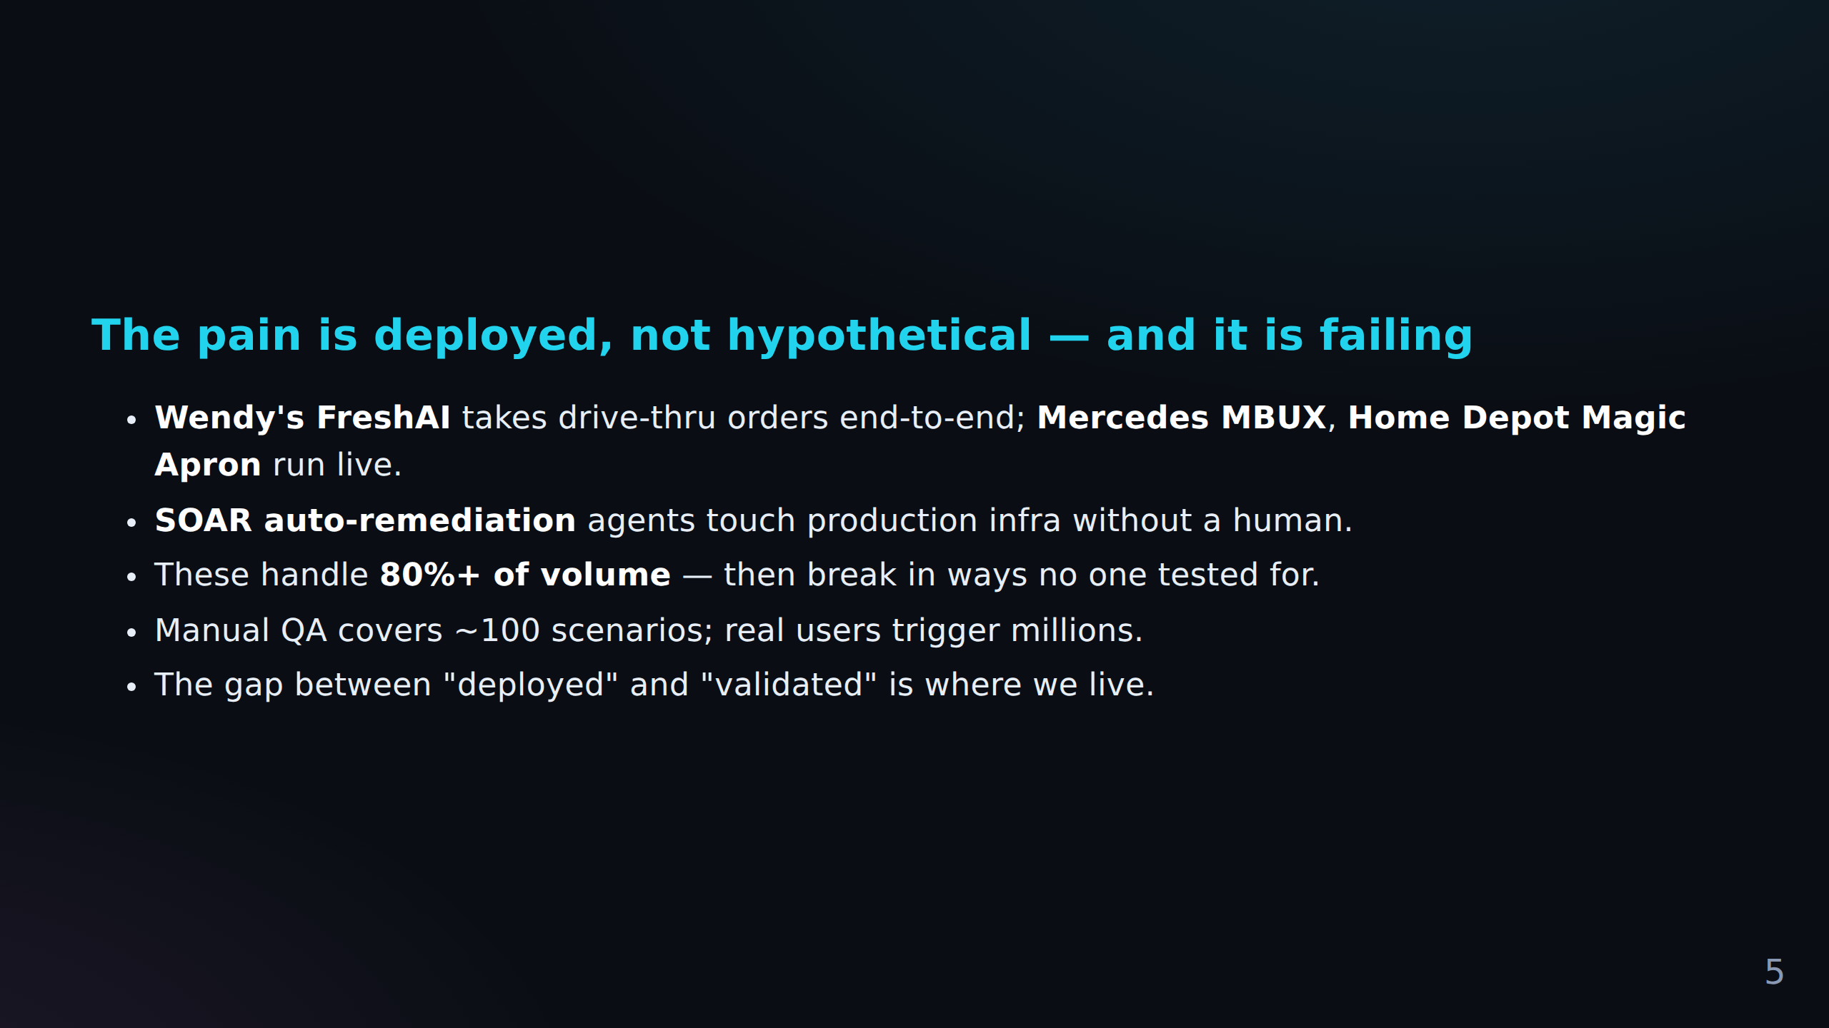
FACT CHECK
C-010 Weak Reddit support (low)
The pain is deployed, not hypothetical — and it is failing **Wendy's FreshAI** takes drive-...
C-011 No Reddit evidence (low)
Manual QA covers ~100 scenarios; real users trigger millions.
C-012 Reddit-supported (high)
The gap between "deployed" and "validated" is where we live.

Slide 8
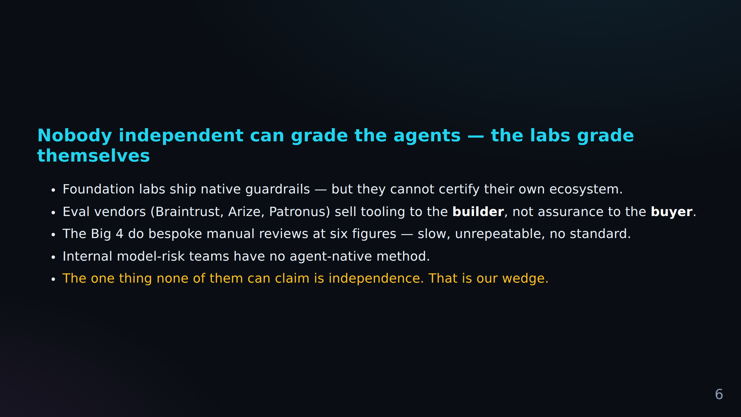
FACT CHECK
C-013 Weak Reddit support (low)
Nobody independent can grade the agents — the labs grade themselves Foundation labs ship na...
C-014 No Reddit evidence (low)
Eval vendors (Braintrust, Arize, Patronus) sell tooling to the **builder**, not assurance t...
C-015 Reddit-supported (medium)
Internal model-risk teams have no agent-native method.
+ 1 more in Fact Check Notes

Slide 9
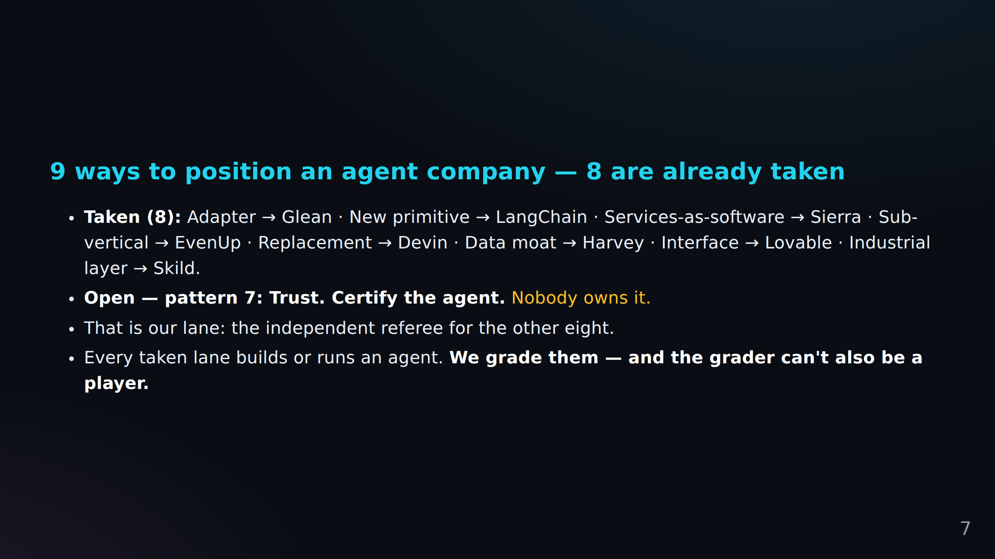
FACT CHECK
C-017 Reddit-supported (high)
Certify the agent.** *Nobody owns it.* That is our lane: the independent referee for the ot...

Slide 10
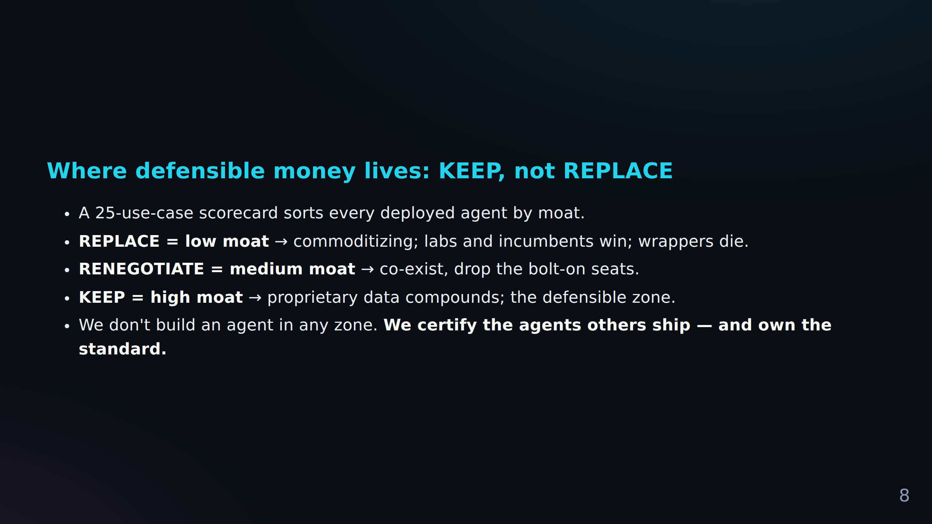

Slide 11
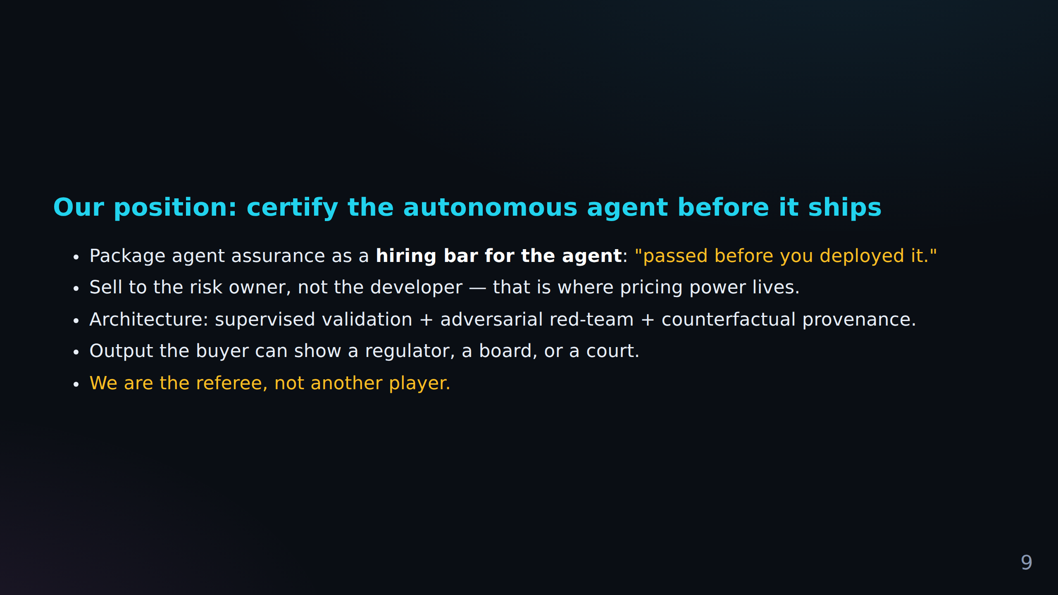
FACT CHECK
C-018 No Reddit evidence (low)
Our position: certify the autonomous agent before it ships Package agent assurance as a **h...
C-019 Reddit-supported (high)
Output the buyer can show a regulator, a board, or a court.

Slide 12
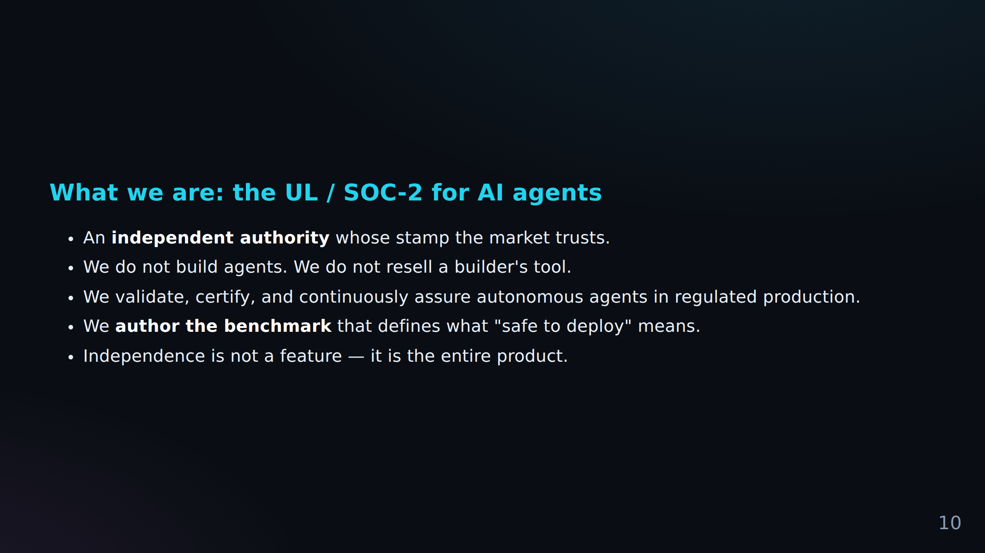
FACT CHECK
C-020 Reddit-supported (medium)
What we are: the UL / SOC-2 for AI agents An **independent authority** whose stamp the mark...
C-021 Weak Reddit support (low)
Independence is not a feature — it is the entire product.

Slide 13
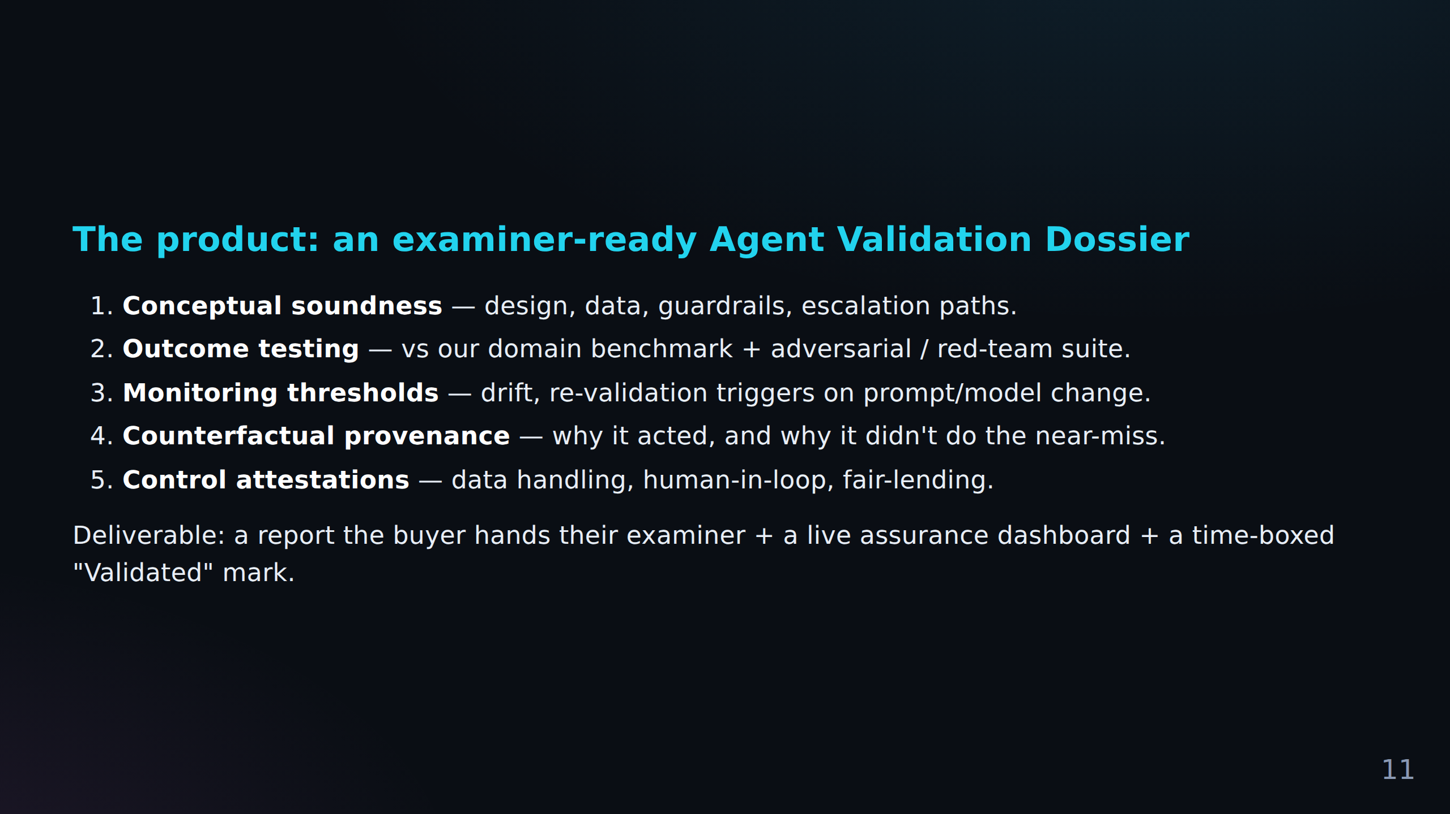
FACT CHECK
C-022 Reddit-supported (high)
Deliverable: a report the buyer hands their examiner + a live assurance dashboard + a time-...

Slide 14
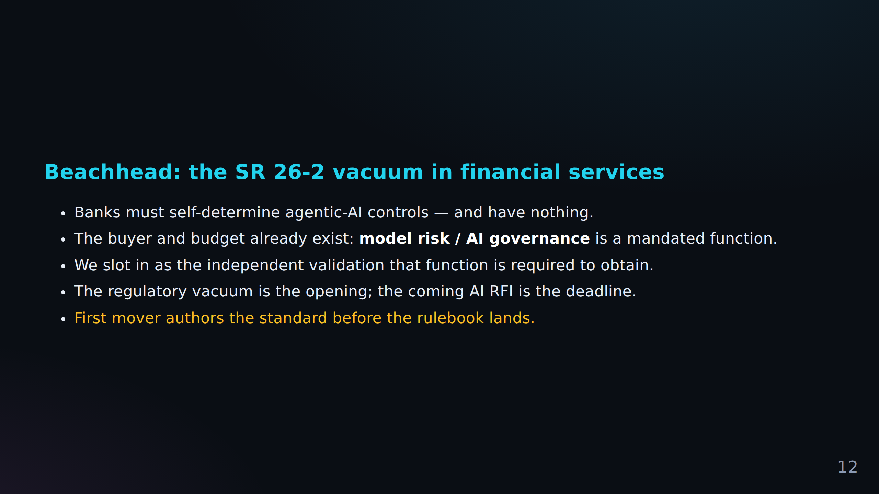
FACT CHECK
C-023 Primary source required (source)
Beachhead: the SR 26-2 vacuum in financial services Banks must self-determine agentic-AI co...
C-024 Reddit-supported (high)
The buyer and budget already exist: **model risk / AI governance** is a mandated function.
C-025 No Reddit evidence (low)
The regulatory vacuum is the opening; the coming AI RFI is the deadline.

Slide 15
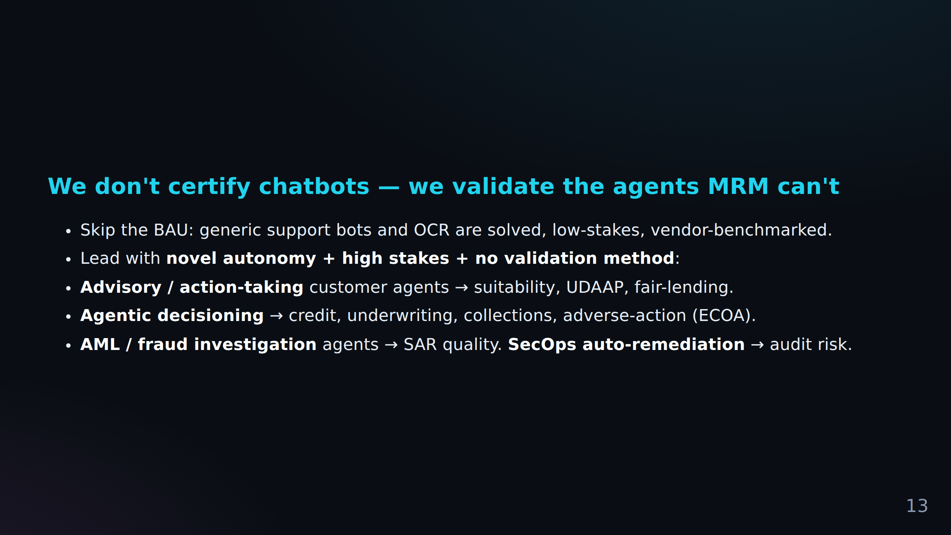
FACT CHECK
C-026 No Reddit evidence (low)
We don't certify chatbots — we validate the agents MRM can't Skip the BAU: generic support...
C-027 No Reddit evidence (low)
**AML / fraud investigation** agents → SAR quality.
C-028 Reddit-supported (medium)
**SecOps auto-remediation** → audit risk.

Slide 16
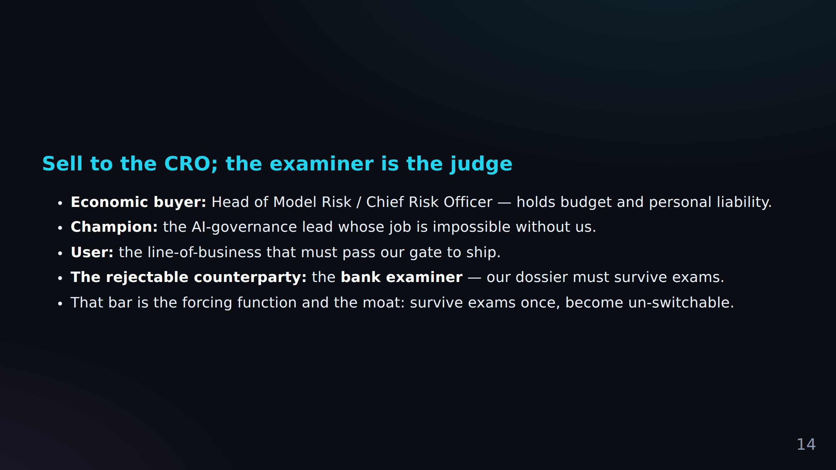
FACT CHECK
C-029 Reddit-supported (high)
Sell to the CRO; the examiner is the judge **Economic buyer:** Head of Model Risk / Chief R...
C-030 No Reddit evidence (low)
**Champion:** the AI-governance lead whose job is impossible without us.
C-031 No Reddit evidence (low)
**User:** the line-of-business that must pass our gate to ship.
+ 2 more in Fact Check Notes

Slide 17
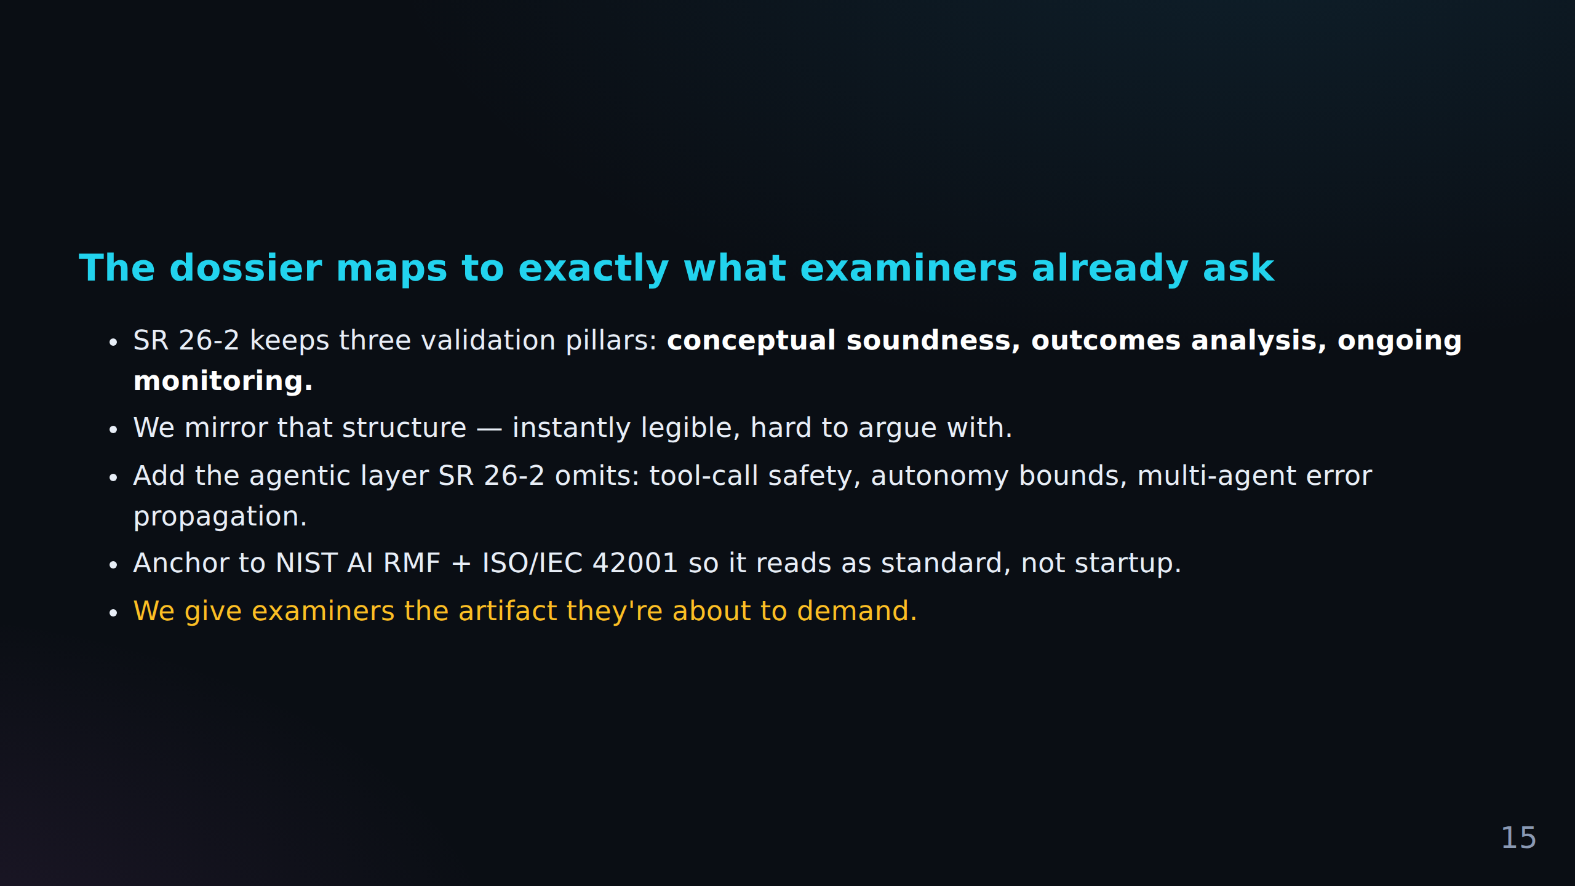
FACT CHECK
C-034 Primary source required (source)
The dossier maps to exactly what examiners already ask SR 26-2 keeps three validation pilla...
C-035 Primary source required (source)
Add the agentic layer SR 26-2 omits: tool-call safety, autonomy bounds, multi-agent error p...
C-036 Primary source required (source)
Anchor to NIST AI RMF + ISO/IEC 42001 so it reads as standard, not startup.
+ 1 more in Fact Check Notes

Slide 18
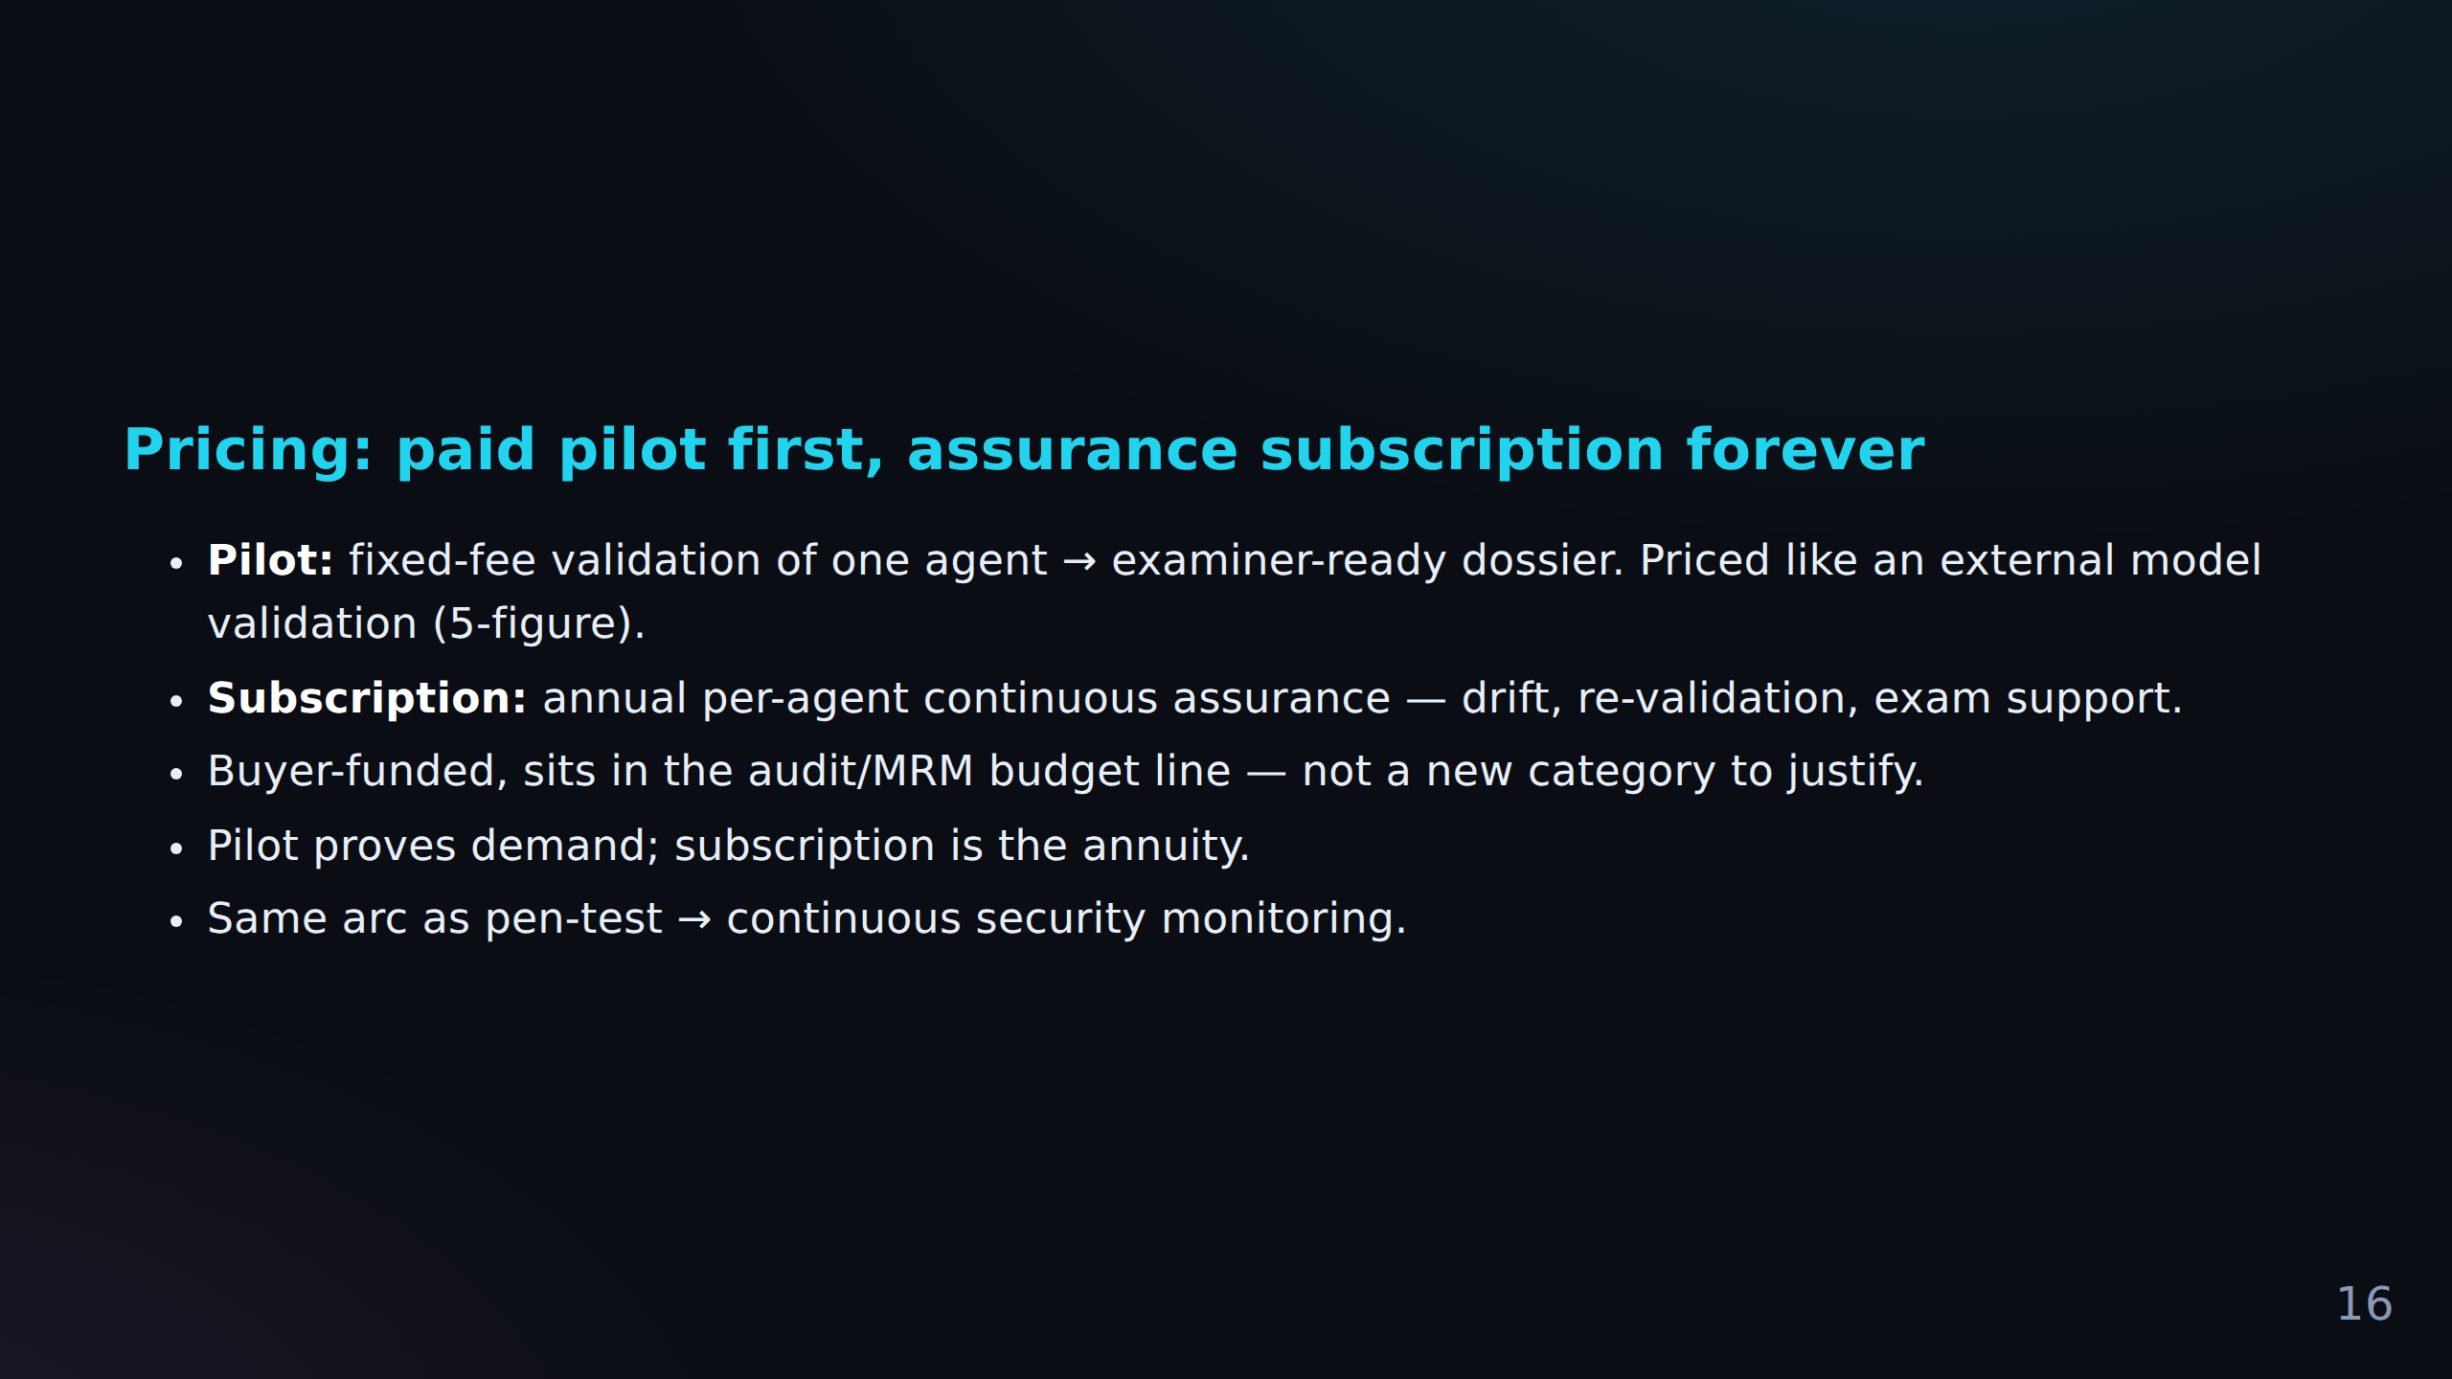
FACT CHECK
C-038 Weak Reddit support (low)
**Subscription:** annual per-agent continuous assurance — drift, re-validation, exam suppor...
C-039 No Reddit evidence (low)
Buyer-funded, sits in the audit/MRM budget line — not a new category to justify.
C-040 No Reddit evidence (low)
Pilot proves demand; subscription is the annuity.

Slide 19
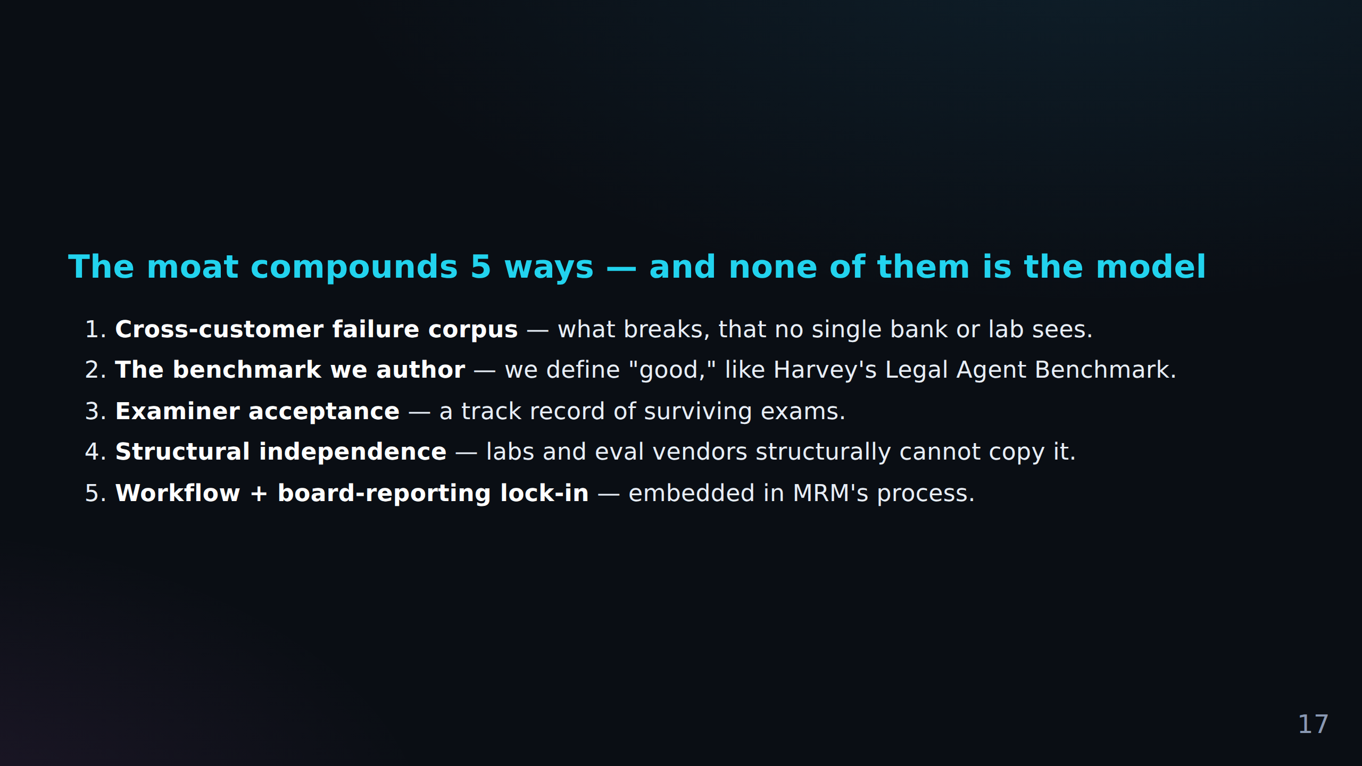

Slide 20
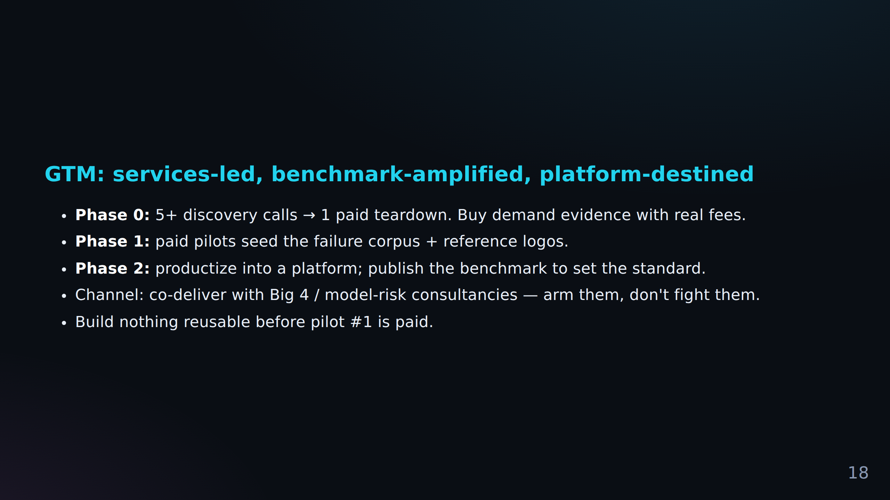

Slide 21
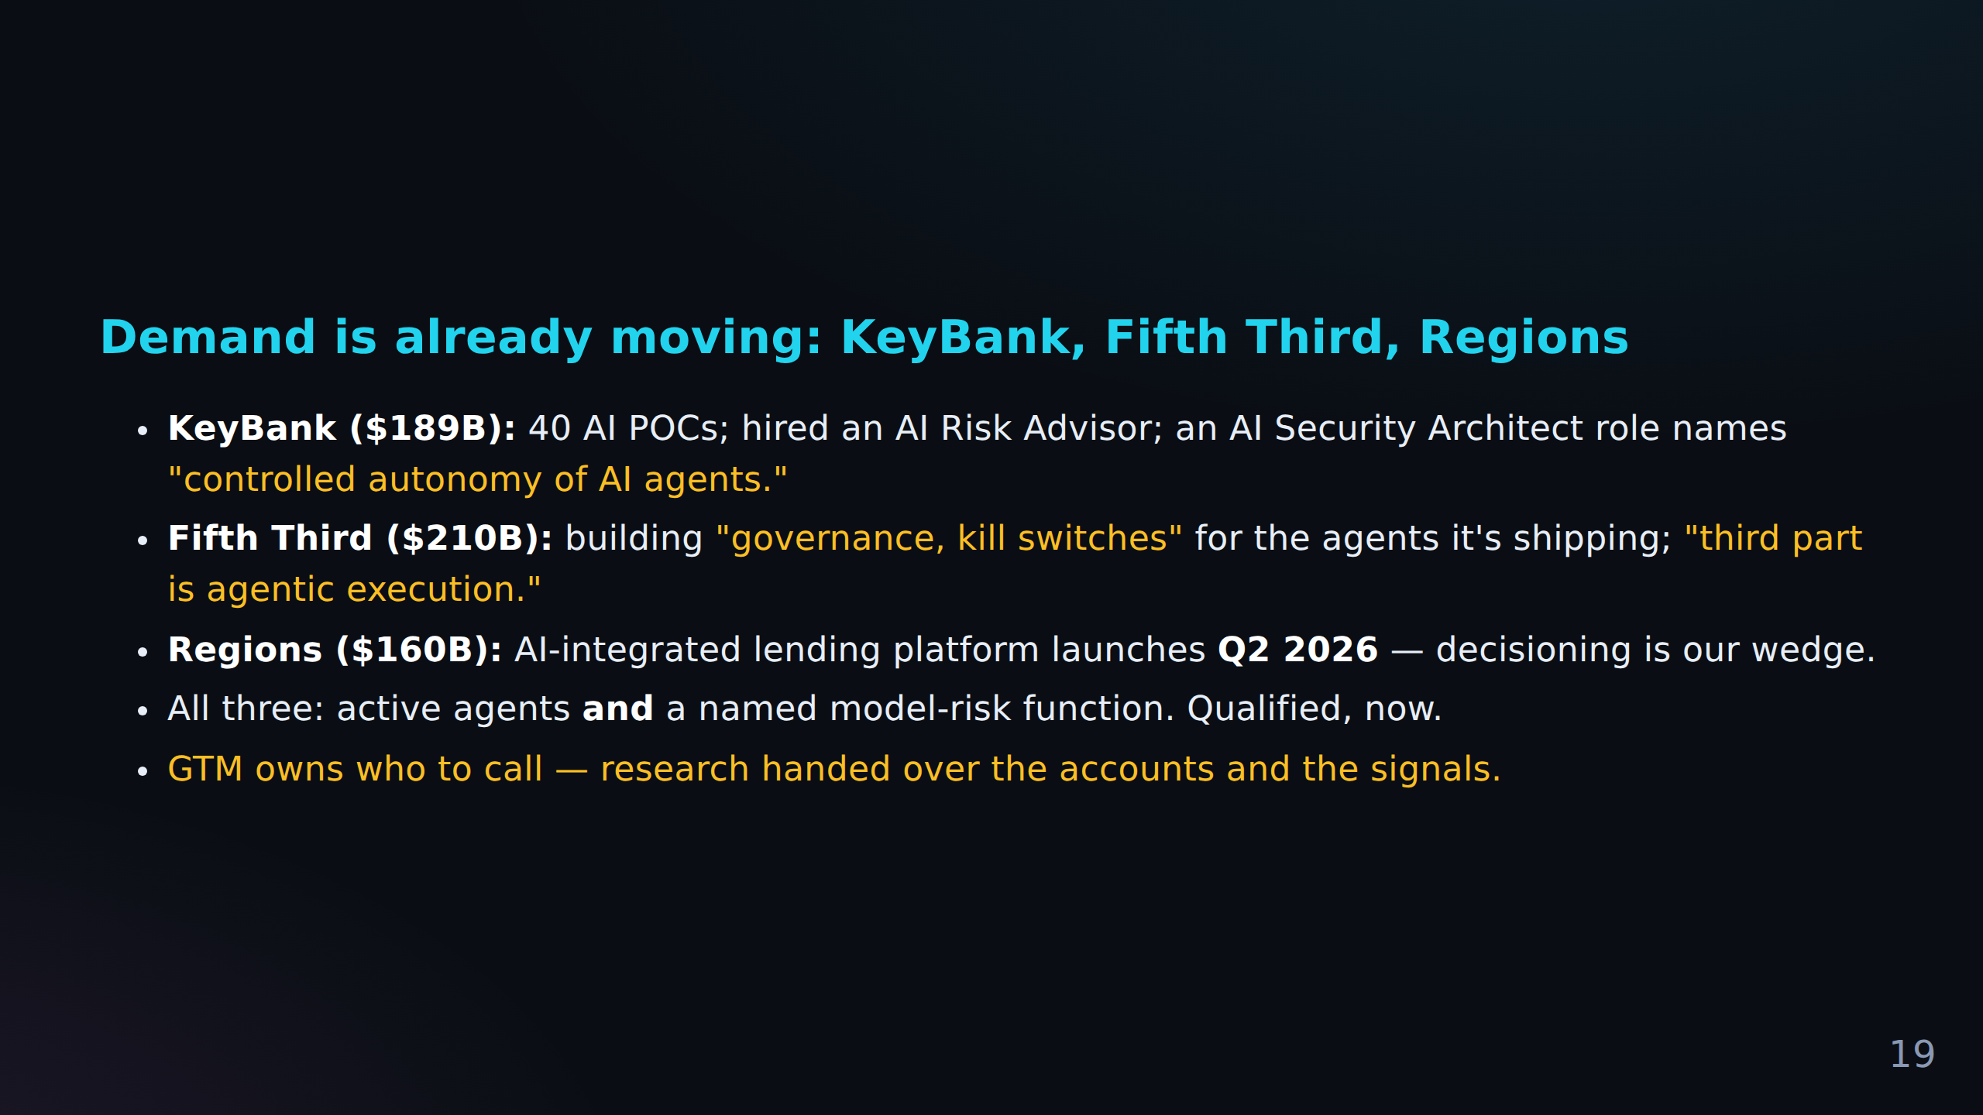

Slide 22
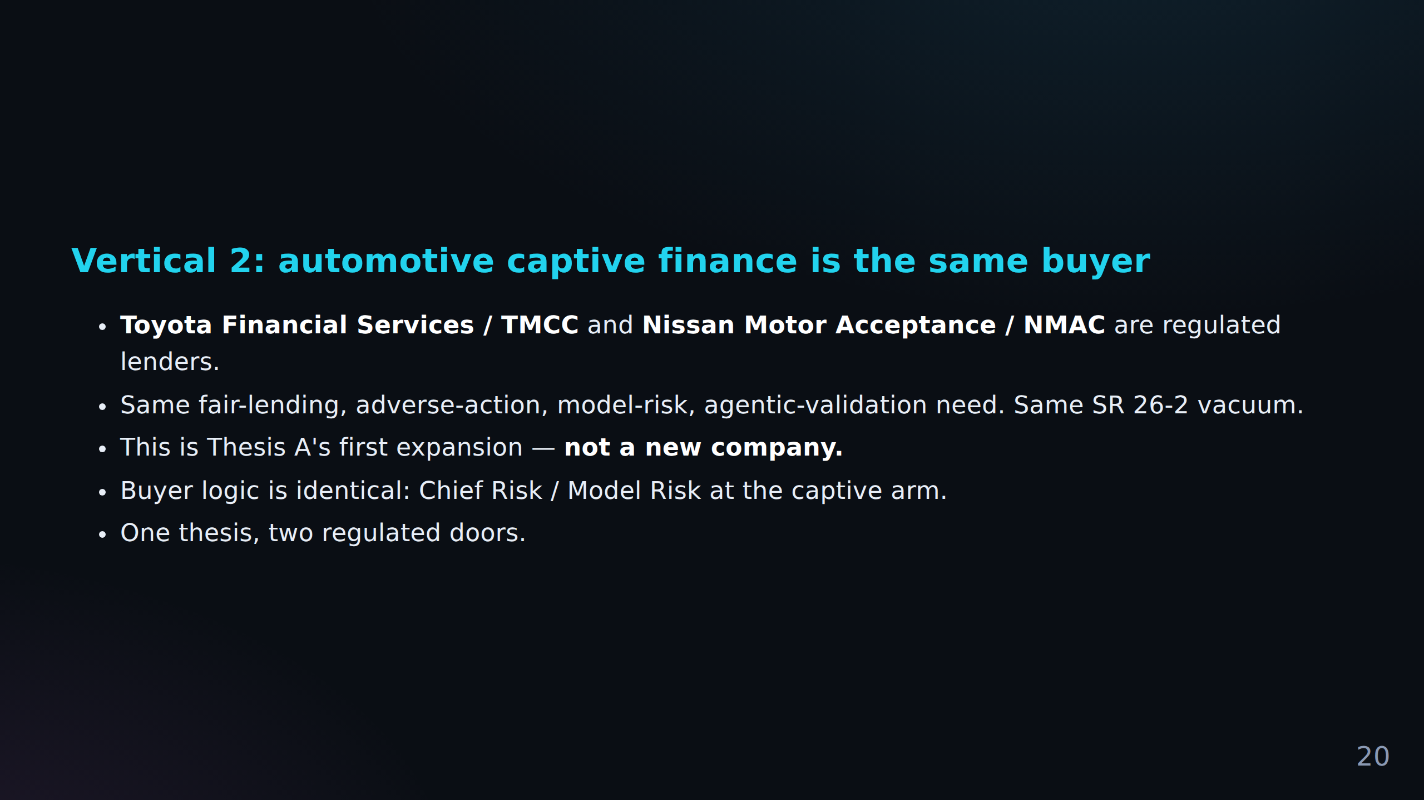

Slide 23
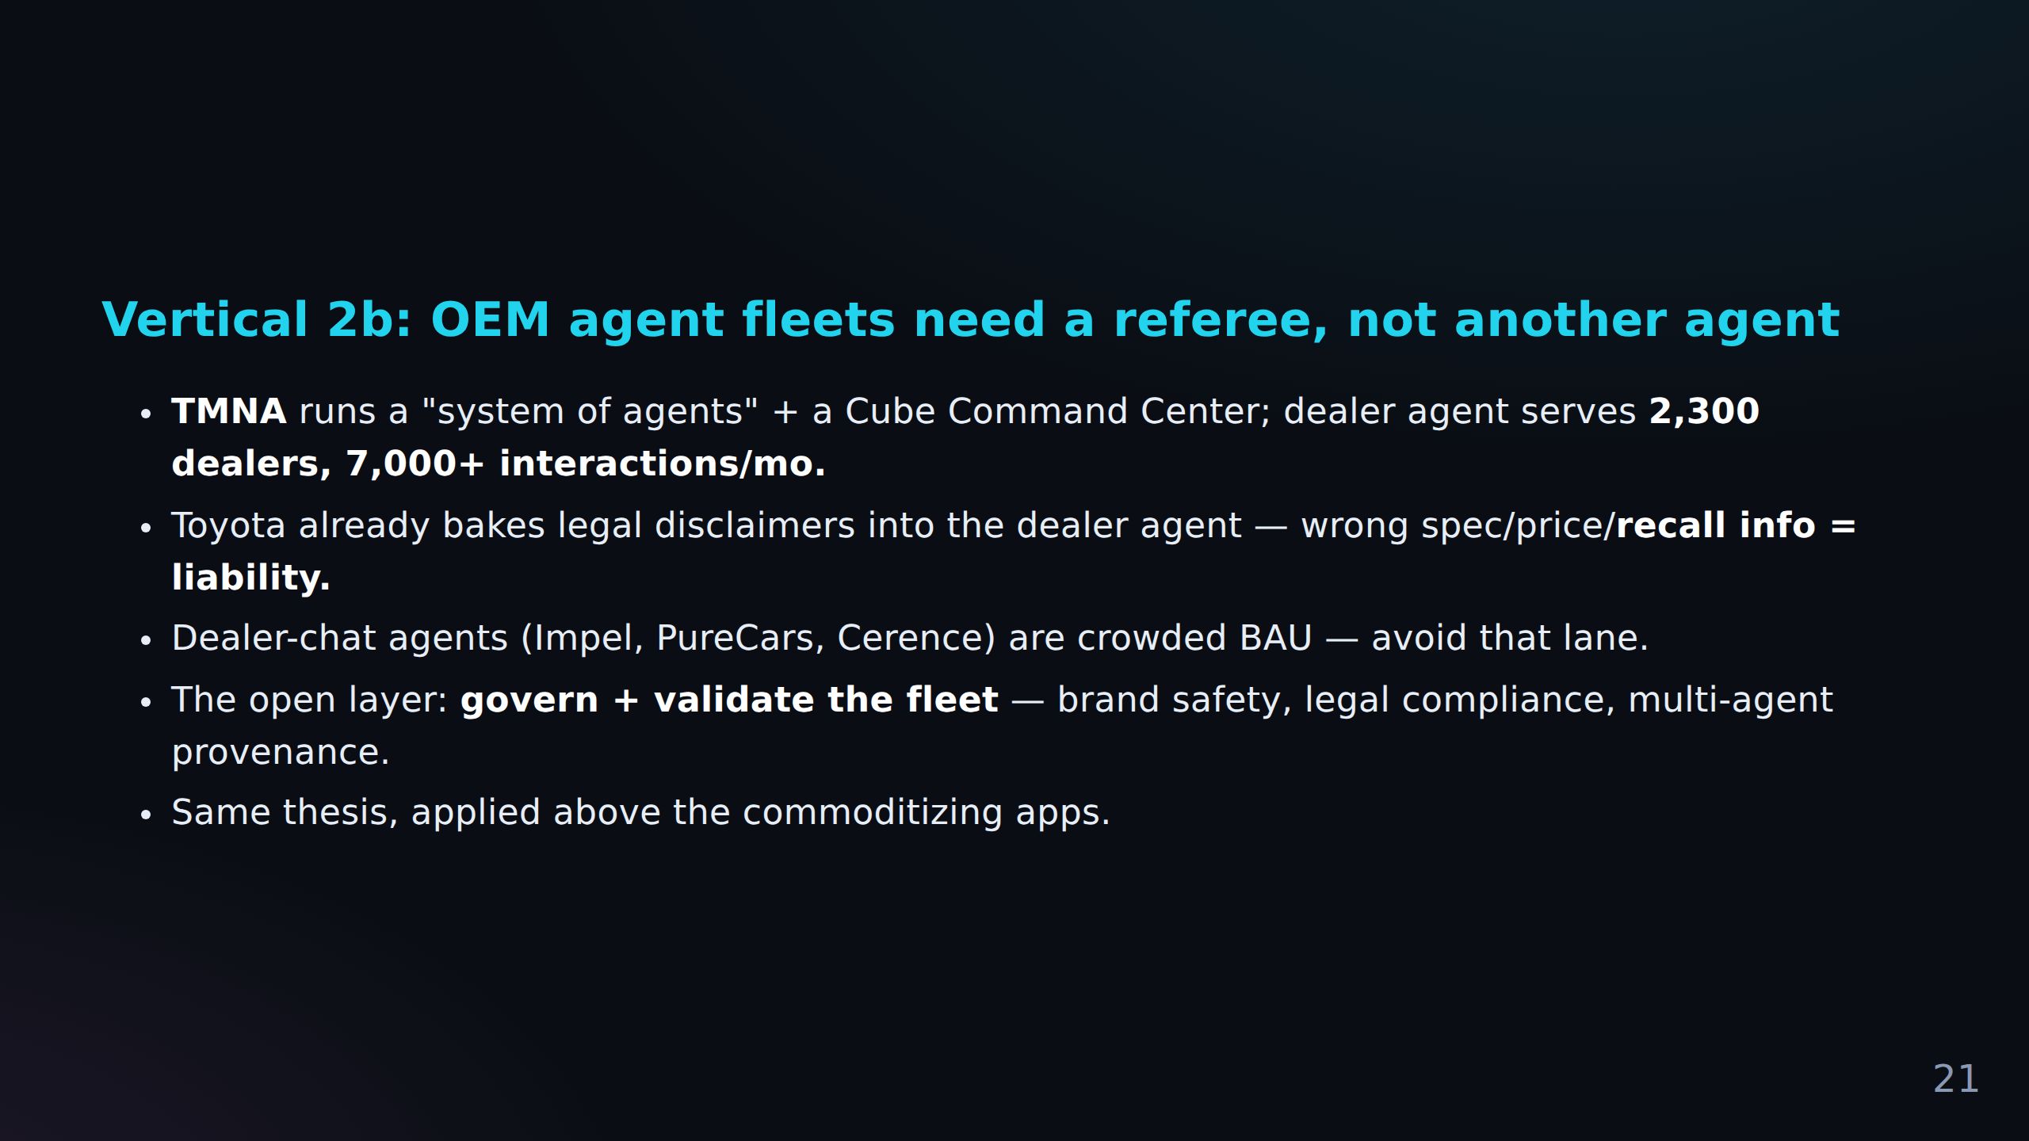

Slide 24
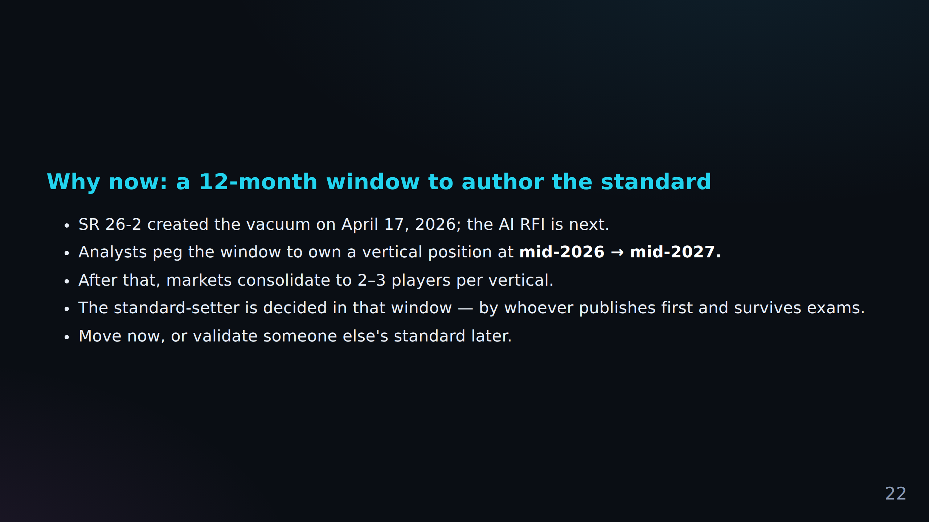

Slide 25
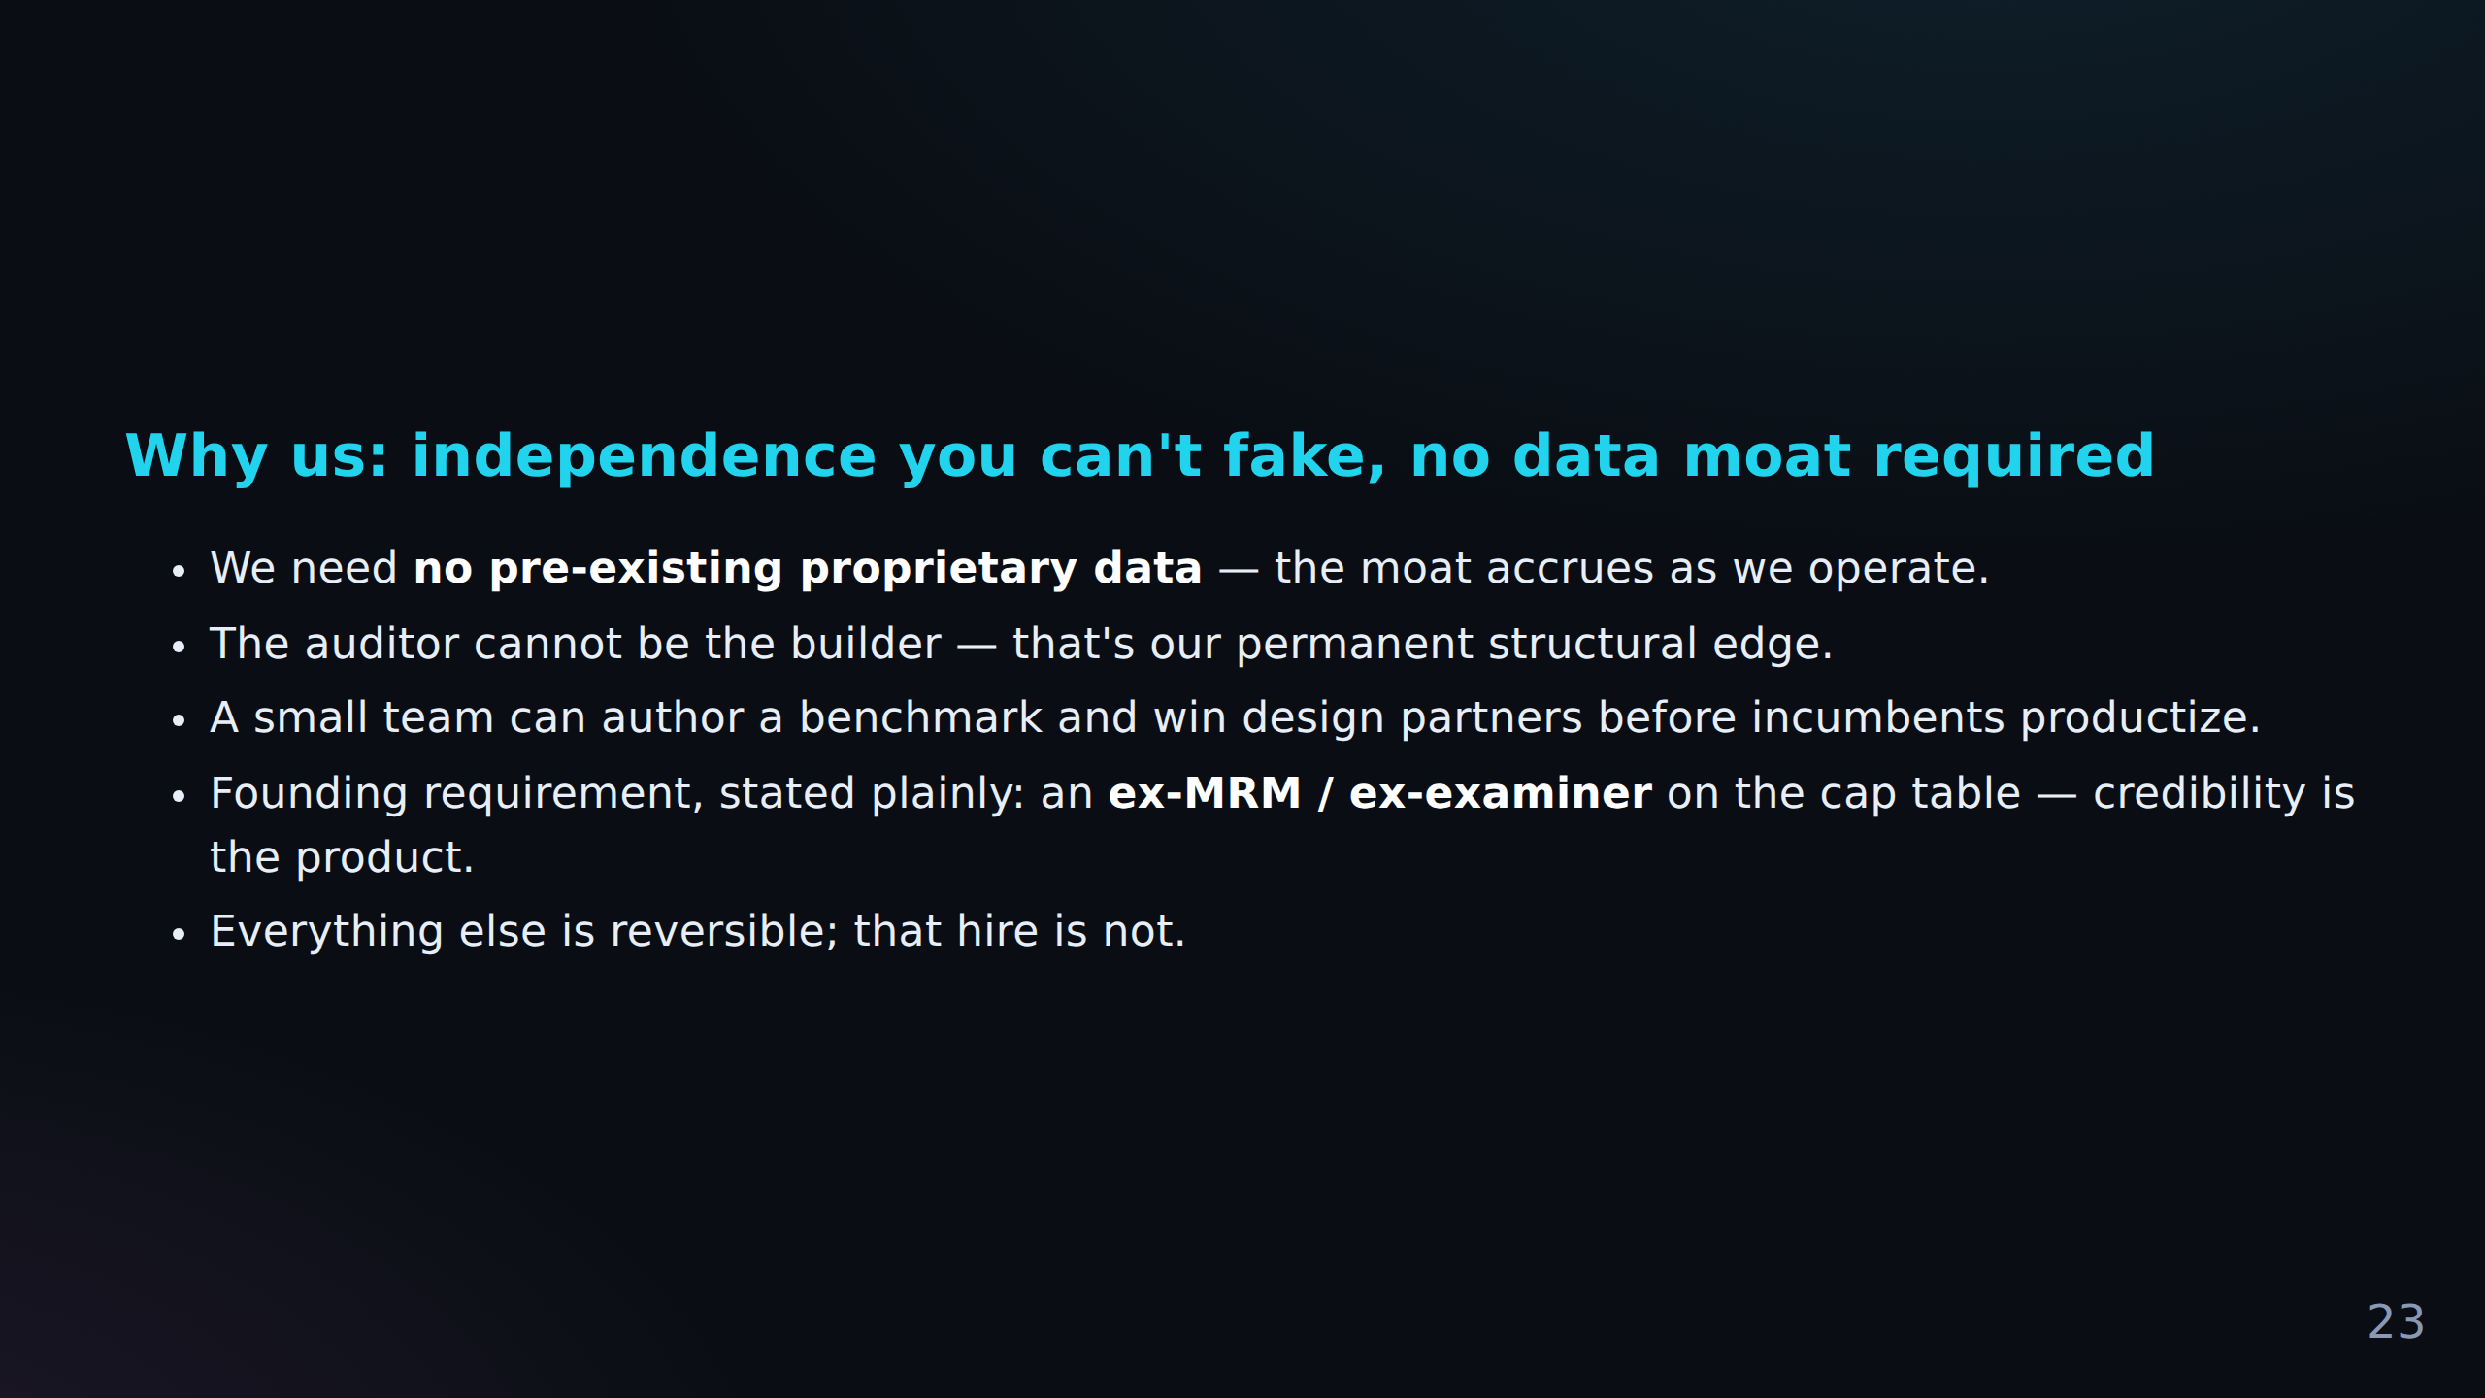

Slide 26
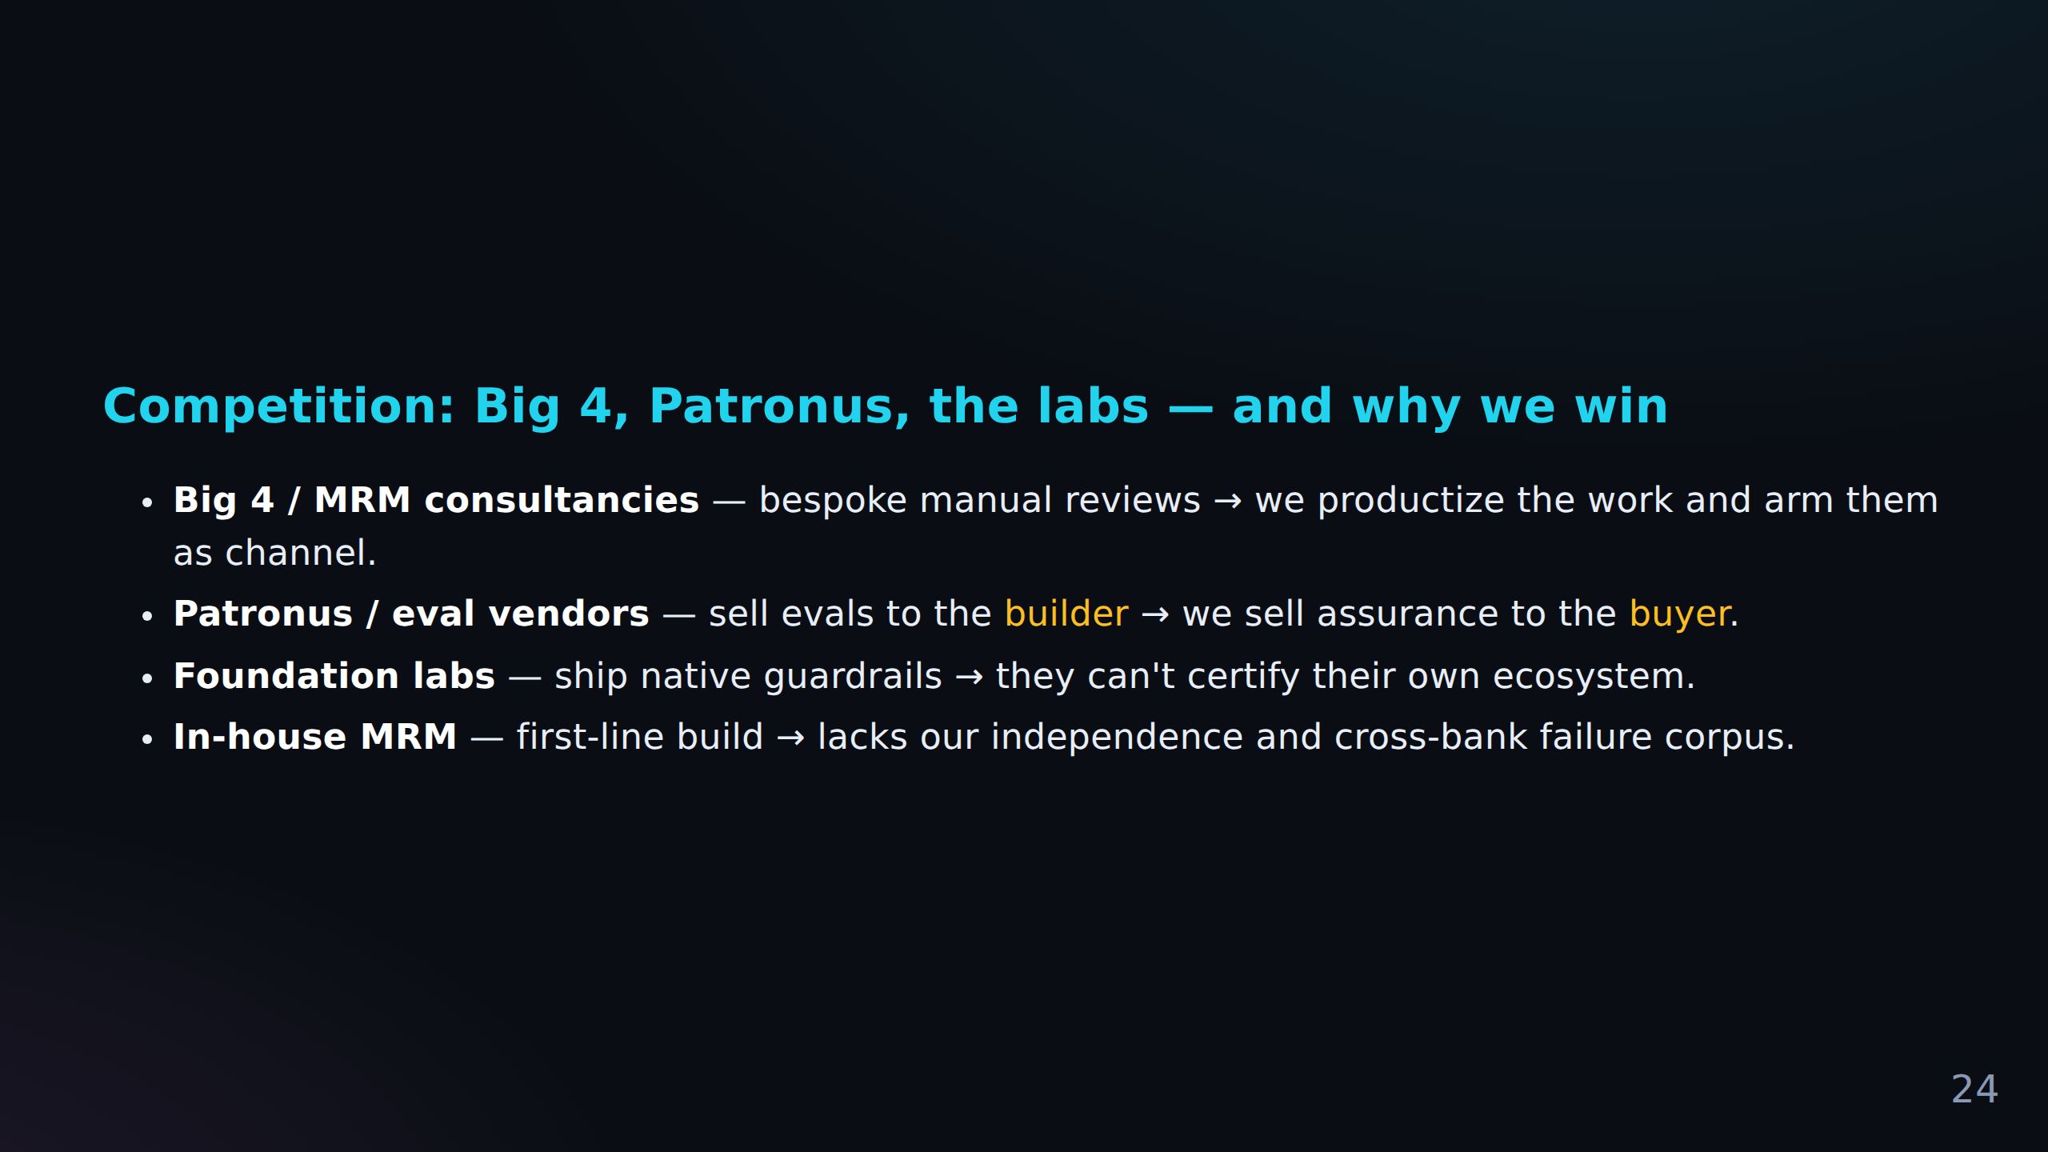

Slide 27
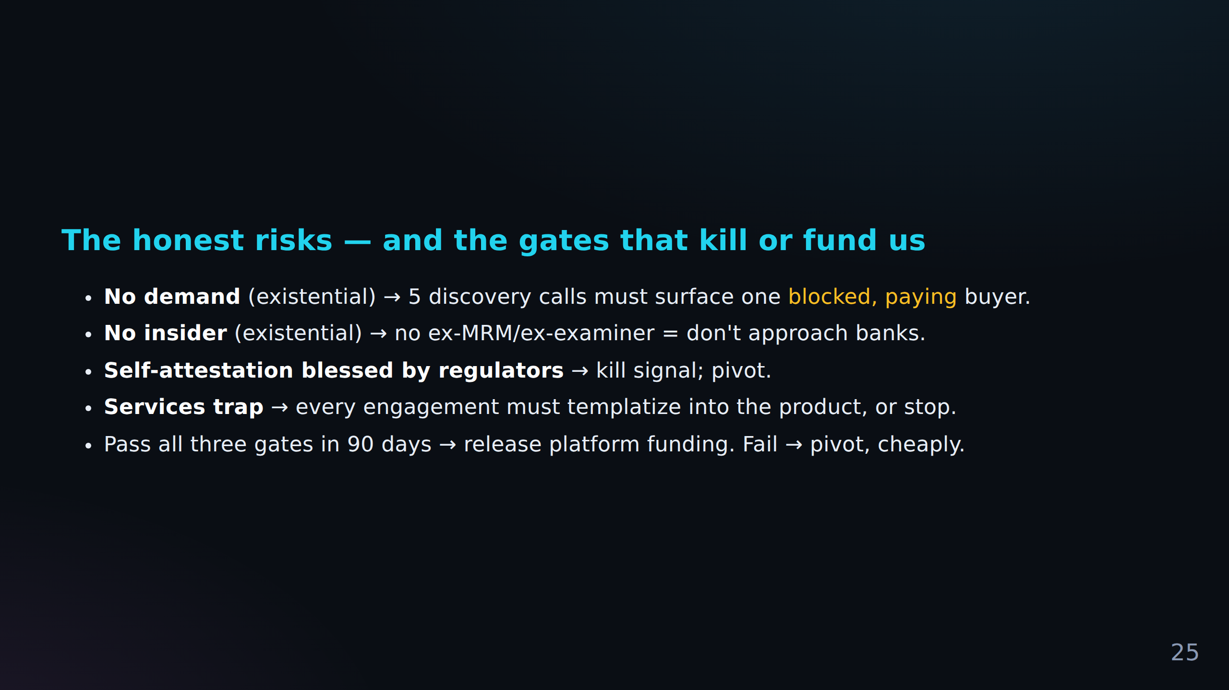

Slide 28
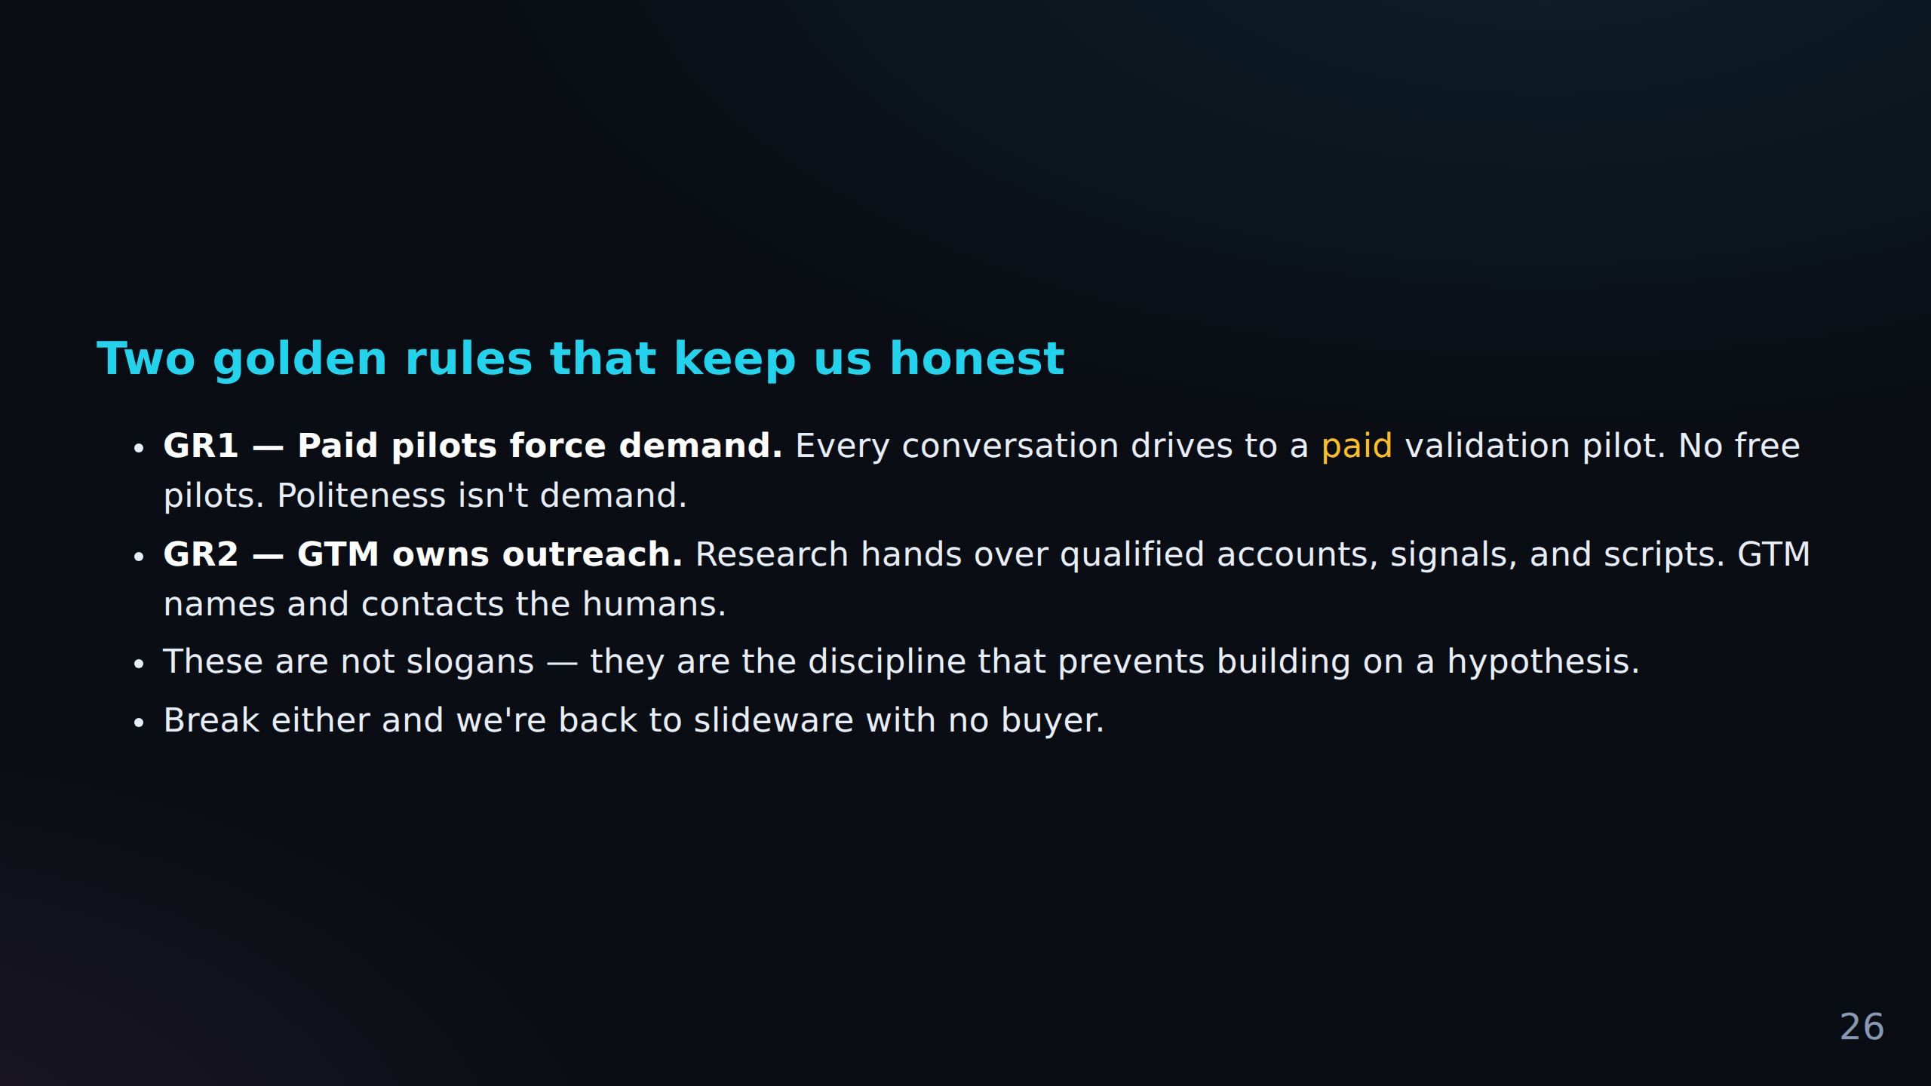

Slide 29
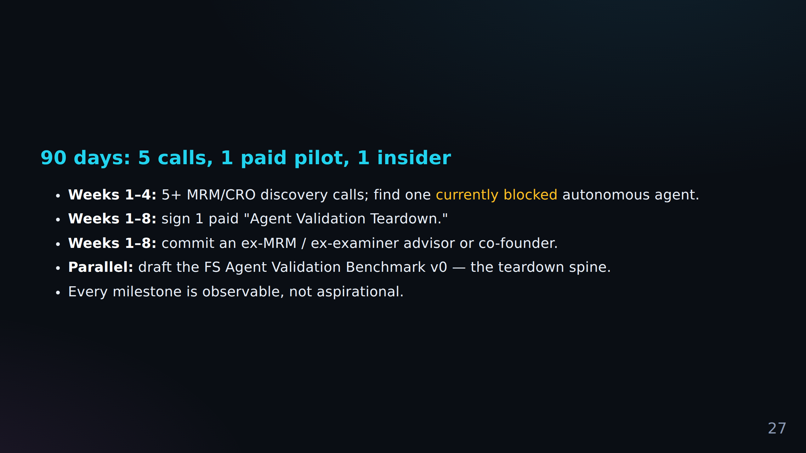

Slide 30
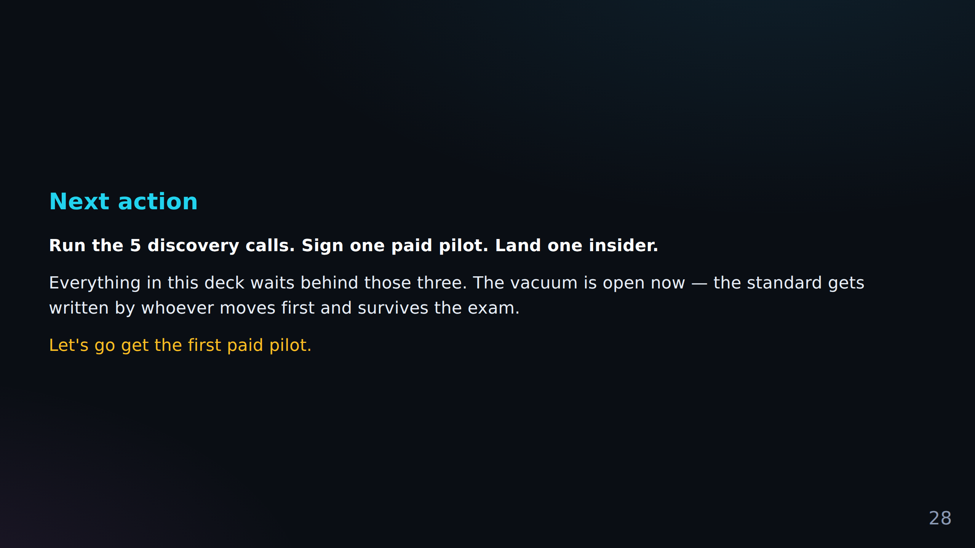

Slide 31
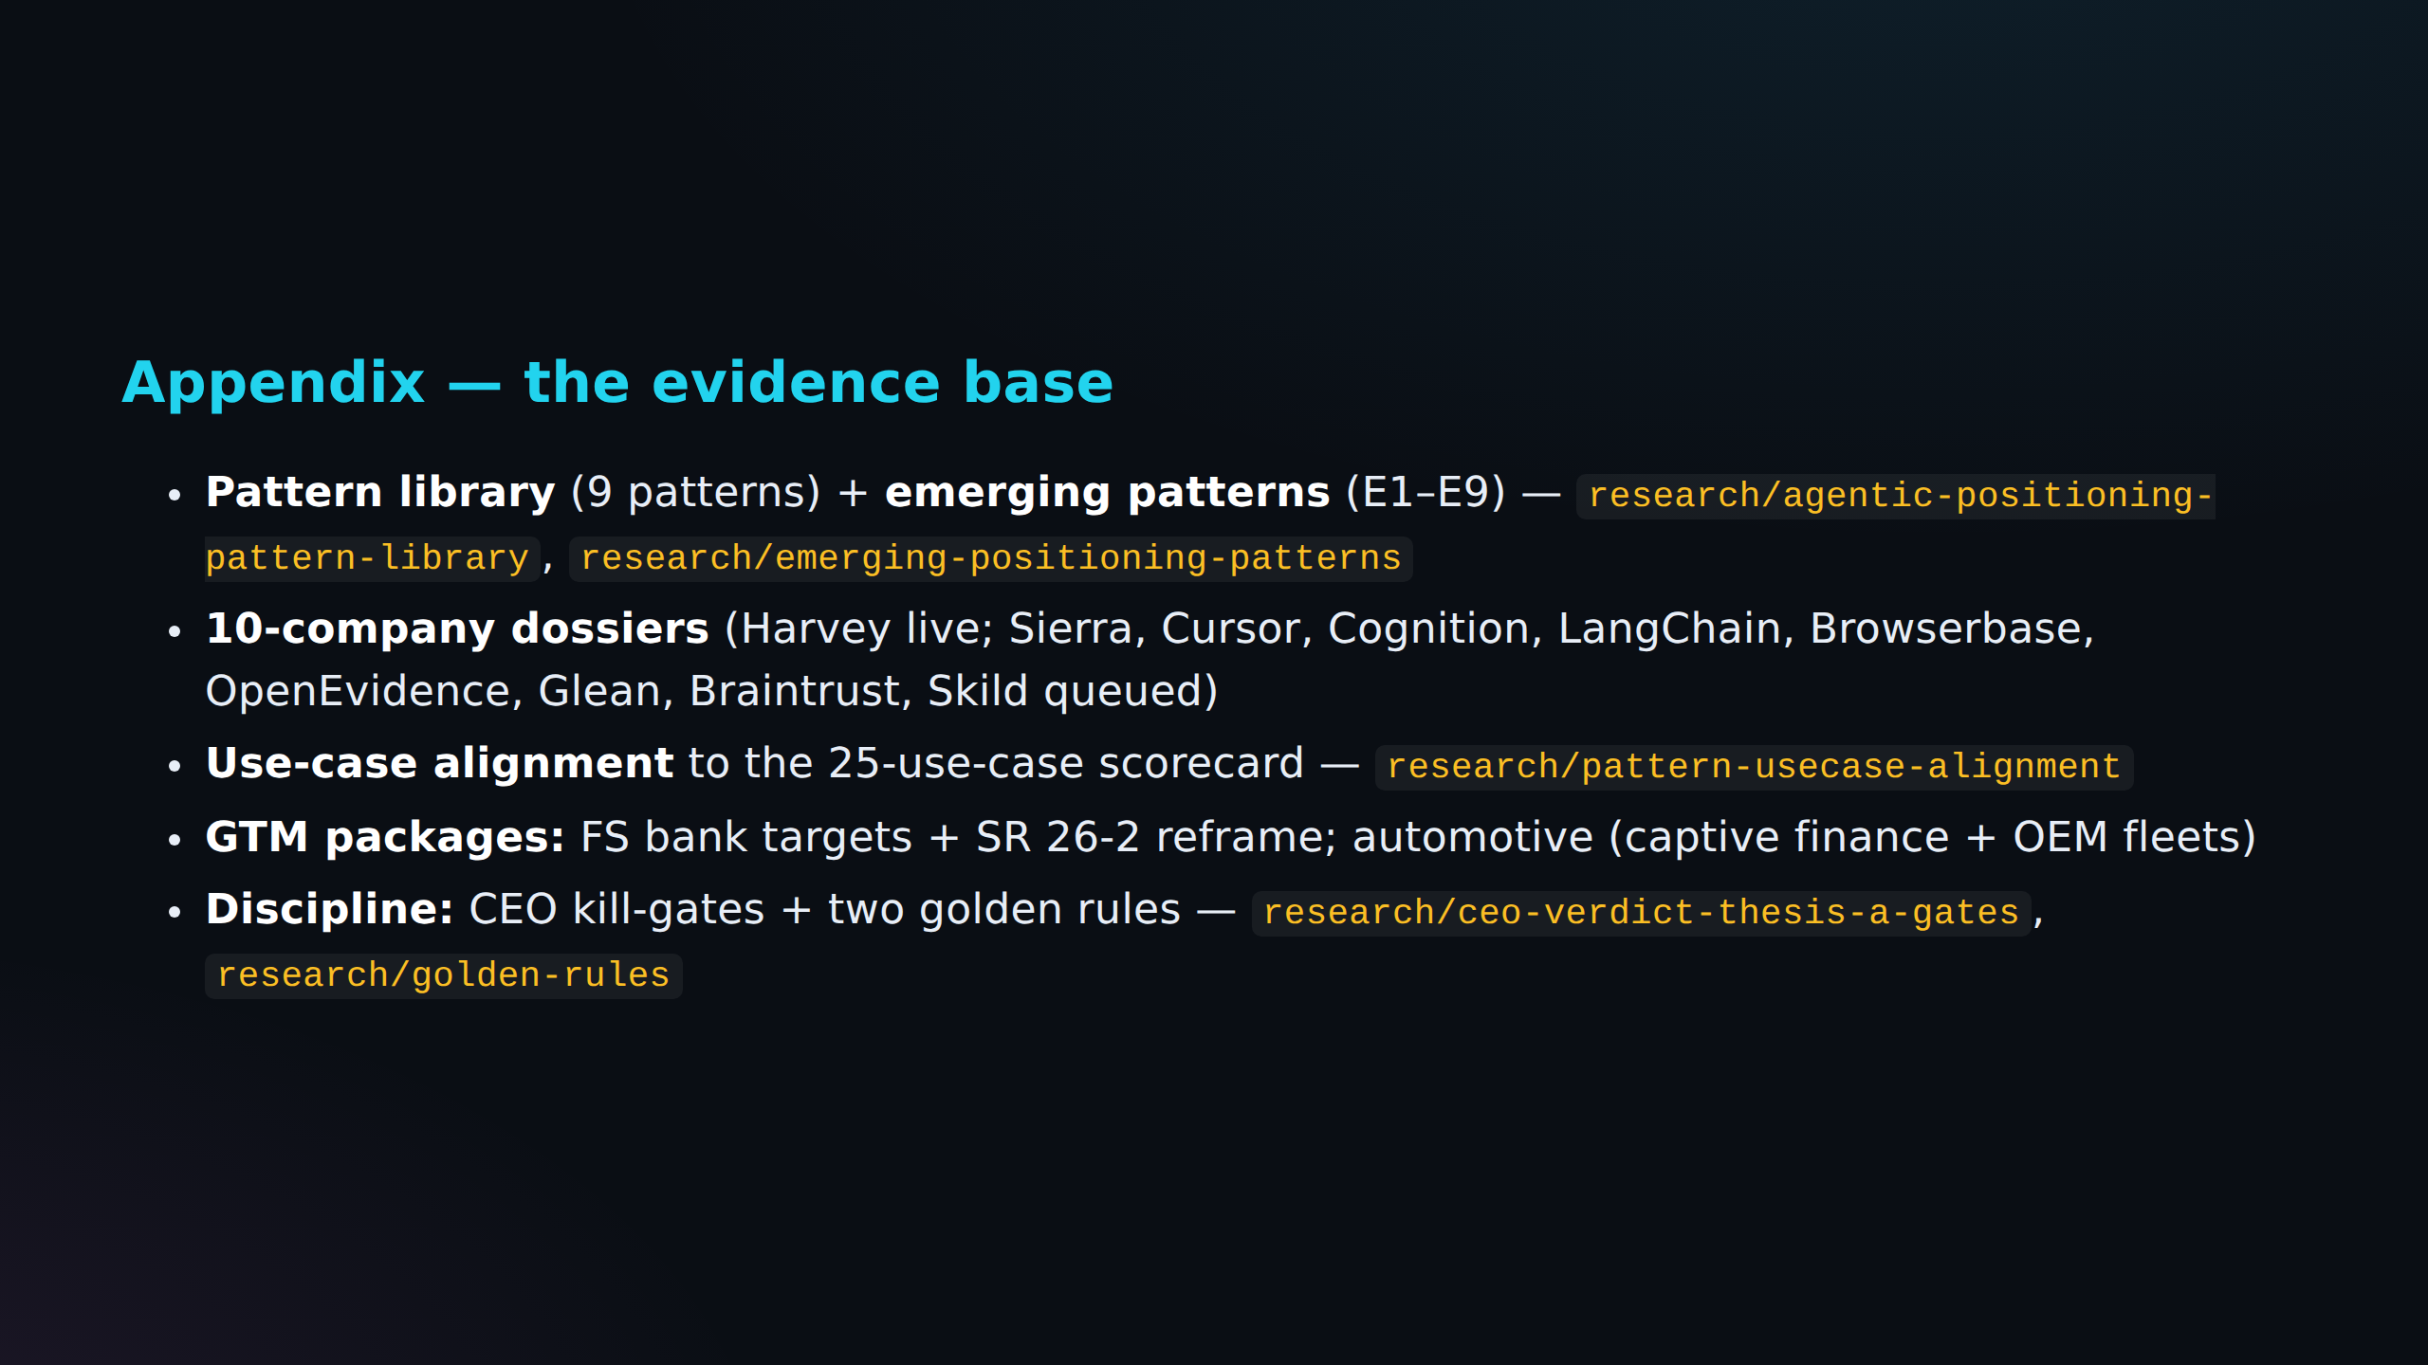

Slide 32
Fact Check Notes - Source Slide 2
C-001: No Reddit evidence (low)
Klarna publicly reversed its AI-first support after quality tanked.
Reddit query: klarna publicly reversed ai-first support quality tanked
No scored Reddit evidence is attached yet.
C-002: Reddit-supported (high)
The blocker is the same everywhere: *nobody can prove the agent is safe to run.* That proof is a market.
Reddit query: blocker same everywhere nobody prove safe run proof market
Top Reddit evidence: AI AGENTS today are far more DANGEROUS that you think I know it's a long post, but I think this is something AI industry needs to talk about more. I'd love to hear...
Source: runs/2026-06-24-reddit-factcheck-agent-validation-authority/reddit-evidence-raw/reddit-thread-02.json

Slide 33
Fact Check Notes - Source Slide 3
C-003: Reddit signal + primary source (mixed)
The market moved from "can we build an agent" to "can we trust one" 2023–24: the race was capability — frameworks, models, demos.
Reddit query: market moved build trust one race was capability frameworks models demos
Top Reddit evidence: AI AGENTS today are far more DANGEROUS that you think I know it's a long post, but I think this is something AI industry needs to talk about more. I'd love to hear...
Source: runs/2026-06-24-reddit-factcheck-agent-validation-authority/reddit-evidence-raw/reddit-thread-02.json
C-004: Primary source required (source)
2026: capability is commoditized; **the model is no longer the moat.** The new question is operational: predict it, audit it, roll it back.
Reddit query: capability commoditized model longer moat new question operational predict audit roll back
Top Reddit evidence: You're right that none of the individual techniques are new. OSINT practitioners have been doing all of this manually for years and data aggregators have been runni...
Source: runs/2026-06-24-reddit-factcheck-agent-validation-authority/reddit-evidence-raw/reddit-thread-02.json
C-005: Reddit-supported (high)
*Trust is now an infrastructure problem before it is a product feature.*
Reddit query: trust now infrastructure problem product feature
Top Reddit evidence: I built an airgapped agent governance system in a week by changing how I use LLMs I want to share a concrete example of what 100% AI-native workflows can accomplish...
Source: runs/2026-06-24-reddit-factcheck-agent-validation-authority/reddit-evidence-raw/reddit-thread-06.json

Slide 34
Fact Check Notes - Source Slide 4
C-006: Primary source required (source)
April 17, 2026: regulators handed agentic AI back to the banks **SR 26-2** (OCC / Fed / FDIC) replaced SR 11-7 — the 15-year model-risk rulebook.
Reddit query: april regulators handed back banks occ fed fdic replaced year model-risk rulebook
Reddit can provide community signal; this claim still needs a primary source.
C-007: No Reddit evidence (low)
One sentence defines the moment: *"Generative AI and agentic AI models… are not within the scope of this guidance."* Translation: banks own agentic-AI governance with **no playbook** —...
Reddit query: one sentence defines moment generative models within scope guidance translation banks own agentic-ai governance
No scored Reddit evidence is attached yet.
C-008: Reddit-supported (high)
Examiners still ask: *"What is your monitoring framework?
Reddit query: examiners still ask what your monitoring framework
Top Reddit evidence: What are the real challenges of automating with AI agents? Automating with Agentic AI can get messy behind the scenes. Maybe a workflow breaks without context. Mayb...
Source: runs/2026-06-24-reddit-factcheck-agent-validation-authority/reddit-evidence-raw/reddit-thread-03.json
C-009: Reddit-supported (high)
What is your effective challenge?"* > "Can you name the person whose name should be on the examination finding?"
Reddit query: what your effective challenge you name person whose examination finding
Top Reddit evidence: AI AGENTS today are far more DANGEROUS that you think I know it's a long post, but I think this is something AI industry needs to talk about more. I'd love to hear...
Source: runs/2026-06-24-reddit-factcheck-agent-validation-authority/reddit-evidence-raw/reddit-thread-02.json

Slide 35
Fact Check Notes - Source Slide 5
C-010: Weak Reddit support (low)
The pain is deployed, not hypothetical — and it is failing **Wendy's FreshAI** takes drive-thru orders end-to-end; **Mercedes MBUX**, **Home Depot Magic Apron** run live.
Reddit query: pain deployed hypothetical failing wendy freshai takes drive-thru orders end-to-end mercedes mbux home depot
Top Reddit evidence: AI AGENTS today are far more DANGEROUS that you think I know it's a long post, but I think this is something AI industry needs to talk about more. I'd love to hear...
Source: runs/2026-06-24-reddit-factcheck-agent-validation-authority/reddit-evidence-raw/reddit-thread-02.json
C-011: No Reddit evidence (low)
Manual QA covers ~100 scenarios; real users trigger millions.
Reddit query: manual covers scenarios real users trigger millions
No scored Reddit evidence is attached yet.
C-012: Reddit-supported (high)
The gap between "deployed" and "validated" is where we live.
Reddit query: gap deployed where live
Top Reddit evidence: AI AGENTS today are far more DANGEROUS that you think I know it's a long post, but I think this is something AI industry needs to talk about more. I'd love to hear...
Source: runs/2026-06-24-reddit-factcheck-agent-validation-authority/reddit-evidence-raw/reddit-thread-02.json

Slide 36
Fact Check Notes - Source Slide 6
C-013: Weak Reddit support (low)
Nobody independent can grade the agents — the labs grade themselves Foundation labs ship native guardrails — but they cannot certify their own ecosystem.
Reddit query: nobody independent grade labs themselves foundation ship native guardrails they certify own ecosystem
Top Reddit evidence: Most of you shouldnt build an AI agent and heres why After watching another client spend $80k on an AI agent they shut down three months later, I need to say this o...
Source: runs/2026-06-24-reddit-factcheck-agent-validation-authority/reddit-evidence-raw/reddit-thread-08.json
C-014: No Reddit evidence (low)
Eval vendors (Braintrust, Arize, Patronus) sell tooling to the **builder**, not assurance to the **buyer**.
Reddit query: eval vendors braintrust arize patronus sell tooling builder assurance buyer
No scored Reddit evidence is attached yet.
C-015: Reddit-supported (medium)
Internal model-risk teams have no agent-native method.
Reddit query: internal model-risk teams agent-native method
Top Reddit evidence: AI AGENTS today are far more DANGEROUS that you think I know it's a long post, but I think this is something AI industry needs to talk about more. I'd love to hear...
Source: runs/2026-06-24-reddit-factcheck-agent-validation-authority/reddit-evidence-raw/reddit-thread-02.json
C-016: Reddit-supported (high)
*The one thing none of them can claim is independence.
Reddit query: one thing none claim independence
Top Reddit evidence: Most of you shouldnt build an AI agent and heres why After watching another client spend $80k on an AI agent they shut down three months later, I need to say this o...
Source: runs/2026-06-24-reddit-factcheck-agent-validation-authority/reddit-evidence-raw/reddit-thread-08.json

Slide 37
Fact Check Notes - Source Slide 7
C-017: Reddit-supported (high)
Certify the agent.** *Nobody owns it.* That is our lane: the independent referee for the other eight.
Reddit query: certify nobody owns lane independent referee for other eight
Top Reddit evidence: AI AGENTS today are far more DANGEROUS that you think I know it's a long post, but I think this is something AI industry needs to talk about more. I'd love to hear...
Source: runs/2026-06-24-reddit-factcheck-agent-validation-authority/reddit-evidence-raw/reddit-thread-02.json

Slide 38
Fact Check Notes - Source Slide 9
C-018: No Reddit evidence (low)
Our position: certify the autonomous agent before it ships Package agent assurance as a **hiring bar for the agent**: *"passed before you deployed it."* Sell to the risk owner, not the...
Reddit query: position certify autonomous ships package assurance hiring bar for passed you deployed sell risk
No scored Reddit evidence is attached yet.
C-019: Reddit-supported (high)
Output the buyer can show a regulator, a board, or a court.
Reddit query: output buyer show regulator board court
Top Reddit evidence: AI AGENTS today are far more DANGEROUS that you think I know it's a long post, but I think this is something AI industry needs to talk about more. I'd love to hear...
Source: runs/2026-06-24-reddit-factcheck-agent-validation-authority/reddit-evidence-raw/reddit-thread-02.json

Slide 39
Fact Check Notes - Source Slide 10
C-020: Reddit-supported (medium)
What we are: the UL / SOC-2 for AI agents An **independent authority** whose stamp the market trusts.
Reddit query: what soc-2 for independent whose stamp market trusts
Top Reddit evidence: Completely agree on designing HITL in from the start, retrofitting governance onto an existing agent stack is painful and usually incomplete. The EU AI Act deadline...
Source: runs/2026-06-24-reddit-factcheck-agent-validation-authority/reddit-evidence-raw/reddit-thread-04.json
C-021: Weak Reddit support (low)
Independence is not a feature — it is the entire product.
Reddit query: independence feature entire product
Top Reddit evidence: I Tested OpenAI's $20/month “Agent” So You Don’t Have To. It Can’t Shop, Book, or Reserve Anything Spent my afternoon stress-testing the new “Agent” feature that’s...
Source: runs/2026-06-24-reddit-factcheck-agent-validation-authority/reddit-evidence-raw/reddit-thread-01.json

Slide 40
Fact Check Notes - Source Slide 11
C-022: Reddit-supported (high)
Deliverable: a report the buyer hands their examiner + a live assurance dashboard + a time-boxed "Validated" mark.
Reddit query: deliverable report buyer hands examiner live assurance dashboard time-boxed mark
Top Reddit evidence: Most of you shouldnt build an AI agent and heres why After watching another client spend $80k on an AI agent they shut down three months later, I need to say this o...
Source: runs/2026-06-24-reddit-factcheck-agent-validation-authority/reddit-evidence-raw/reddit-thread-08.json

Slide 41
Fact Check Notes - Source Slide 12
C-023: Primary source required (source)
Beachhead: the SR 26-2 vacuum in financial services Banks must self-determine agentic-AI controls — and have nothing.
Reddit query: beachhead vacuum financial services banks self-determine agentic-ai controls nothing
Reddit can provide community signal; this claim still needs a primary source.
C-024: Reddit-supported (high)
The buyer and budget already exist: **model risk / AI governance** is a mandated function.
Reddit query: buyer budget exist model risk governance mandated function
Top Reddit evidence: That’s a really elegant way to frame it... latency as a function of risk. So you basically turn your governance layer into a high-pass filter rather than a bottlene...
Source: runs/2026-06-24-reddit-factcheck-agent-validation-authority/reddit-evidence-raw/reddit-thread-06.json
C-025: No Reddit evidence (low)
The regulatory vacuum is the opening; the coming AI RFI is the deadline.
Reddit query: regulatory vacuum opening coming rfi deadline
No scored Reddit evidence is attached yet.

Slide 42
Fact Check Notes - Source Slide 13
C-026: No Reddit evidence (low)
We don't certify chatbots — we validate the agents MRM can't Skip the BAU: generic support bots and OCR are solved, low-stakes, vendor-benchmarked.
Reddit query: don certify chatbots mrm skip bau generic support bots ocr solved low-stakes vendor-benchmarked
No scored Reddit evidence is attached yet.
C-027: No Reddit evidence (low)
**AML / fraud investigation** agents → SAR quality.
Reddit query: aml fraud investigation sar quality
No scored Reddit evidence is attached yet.
C-028: Reddit-supported (medium)
**SecOps auto-remediation** → audit risk.
Reddit query: secops auto-remediation audit risk
Top Reddit evidence: I built an airgapped agent governance system in a week by changing how I use LLMs I want to share a concrete example of what 100% AI-native workflows can accomplish...
Source: runs/2026-06-24-reddit-factcheck-agent-validation-authority/reddit-evidence-raw/reddit-thread-06.json

Slide 43
Fact Check Notes - Source Slide 14
C-029: Reddit-supported (high)
Sell to the CRO; the examiner is the judge **Economic buyer:** Head of Model Risk / Chief Risk Officer — holds budget and personal liability.
Reddit query: sell cro examiner judge economic buyer head model risk chief officer holds budget personal
Top Reddit evidence: AI AGENTS today are far more DANGEROUS that you think I know it's a long post, but I think this is something AI industry needs to talk about more. I'd love to hear...
Source: runs/2026-06-24-reddit-factcheck-agent-validation-authority/reddit-evidence-raw/reddit-thread-02.json
C-030: No Reddit evidence (low)
**Champion:** the AI-governance lead whose job is impossible without us.
Reddit query: champion ai-governance lead whose job impossible
No scored Reddit evidence is attached yet.
C-031: No Reddit evidence (low)
**User:** the line-of-business that must pass our gate to ship.
Reddit query: user line-of-business pass gate ship
No scored Reddit evidence is attached yet.
C-032: Weak Reddit support (low)
**The rejectable counterparty:** the **bank examiner** — our dossier must survive exams.
Reddit query: rejectable counterparty bank examiner dossier survive exams
Top Reddit evidence: AI AGENTS today are far more DANGEROUS that you think I know it's a long post, but I think this is something AI industry needs to talk about more. I'd love to hear...
Source: runs/2026-06-24-reddit-factcheck-agent-validation-authority/reddit-evidence-raw/reddit-thread-02.json

Slide 44
Fact Check Notes - Source Slide 14
C-033: Weak Reddit support (low)
That bar is the forcing function and the moat: survive exams once, become un-switchable.
Reddit query: bar forcing function moat survive exams once become un-switchable
Top Reddit evidence: How to Actually Build an AI Agent: A Complete Step-by-Step Guide for 2026 Artificial Intelligence is evolving rapidly, and AI agents are becoming one of the most tr...
Source: runs/2026-06-24-reddit-factcheck-agent-validation-authority/reddit-evidence-raw/reddit-thread-10.json

Slide 45
Fact Check Notes - Source Slide 15
C-034: Primary source required (source)
The dossier maps to exactly what examiners already ask SR 26-2 keeps three validation pillars: **conceptual soundness, outcomes analysis, ongoing monitoring.** We mirror that structure...
Reddit query: dossier maps exactly what examiners ask keeps three pillars conceptual soundness outcomes analysis ongoing
Reddit can provide community signal; this claim still needs a primary source.
C-035: Primary source required (source)
Add the agentic layer SR 26-2 omits: tool-call safety, autonomy bounds, multi-agent error propagation.
Reddit query: add layer omits tool-call safety autonomy bounds multi-agent error propagation
Reddit can provide community signal; this claim still needs a primary source.
C-036: Primary source required (source)
Anchor to NIST AI RMF + ISO/IEC 42001 so it reads as standard, not startup.
Reddit query: anchor nist rmf iso iec reads standard startup
Reddit can provide community signal; this claim still needs a primary source.
C-037: Reddit-supported (high)
*We give examiners the artifact they're about to demand.*
Reddit query: give examiners artifact they demand
Top Reddit evidence: AI AGENTS today are far more DANGEROUS that you think I know it's a long post, but I think this is something AI industry needs to talk about more. I'd love to hear...
Source: runs/2026-06-24-reddit-factcheck-agent-validation-authority/reddit-evidence-raw/reddit-thread-02.json

Slide 46
Fact Check Notes - Source Slide 16
C-038: Weak Reddit support (low)
**Subscription:** annual per-agent continuous assurance — drift, re-validation, exam support.
Reddit query: subscription annual per-agent continuous assurance drift re-validation exam support
Top Reddit evidence: How to Actually Build an AI Agent: A Complete Step-by-Step Guide for 2026 Artificial Intelligence is evolving rapidly, and AI agents are becoming one of the most tr...
Source: runs/2026-06-24-reddit-factcheck-agent-validation-authority/reddit-evidence-raw/reddit-thread-10.json
C-039: No Reddit evidence (low)
Buyer-funded, sits in the audit/MRM budget line — not a new category to justify.
Reddit query: buyer-funded sits audit mrm budget line new category justify
No scored Reddit evidence is attached yet.
C-040: No Reddit evidence (low)
Pilot proves demand; subscription is the annuity.
Reddit query: pilot proves demand subscription annuity
No scored Reddit evidence is attached yet.

