Slide 1

Evidence pending
REDDIT FACT-CHECK DOSSIER
Agent Validation & Assurance Authority
Reddit JSON is not attached yet.
No final verdict is claimed.
Use reviewed only after source QA.
Client-ready draft built from the branded Canva template. The source deck has a separate annotated review copy; this deck summarizes claim risk and evidence requirements.
40 extracted claims
33 need Reddit evidence
7 need primary-source handling
Built 2026-06-24 | Status: DRAFT
DRAFT
Reddit fact-check dossier | confidential
1 / 8

Slide 2

Executive Verdict
Client use
The deck is ready for evidence collection, not final fact approval.
40
claims extracted
33
Reddit-evidence claims
5
primary-source claims
2
mixed evidence claims
Decision summary
Claim-risk triage
- The input deck has a generated annotated review copy with claim rails and Fact Check Notes slides.
- Reddit is the right source for operator language, demand signals, objections, and lived product pain.
- Regulatory, numeric, dated, and named-company claims still need primary-source corroboration.
- This deck must stay draft until Reddit thread JSON and primary sources are attached.
Evidence collection roadmap
DRAFT
Reddit fact-check dossier | confidential
2 / 8

Slide 3
Reddit Evidence Has Clear Limits
Rule
Reddit can support
Reddit cannot prove alone
Output standard
Use Reddit as community evidence.
- Operator pain
- Practitioner language
- Vendor complaints
- Objections and demand
- Market-size numbers
- Regulatory meaning
- Funding or headcount
- Named-company facts
- Claim IDs
- Source metadata
- Short rationale
- No opinion-only labels
Use official sources for hard facts.
Label gaps explicitly.
DRAFT
Reddit fact-check dossier | confidential
3 / 8

Slide 4
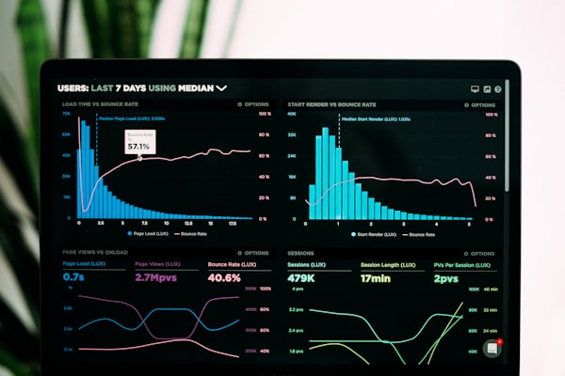
Claim Triage Prioritizes Reddit Review
Signal
The biggest review load sits in market-language and operator-pain claims.
S2
2 | R2 M0 P0
S3
3 | R1 M1 P1
Teal/navy bars show Reddit review load.
S4
4 | R3 M1 P0
S5
3 | R3 M0 P0
Coral marks primary-source risk.
S6
4 | R4 M0 P0
S7
1 | R1 M0 P0
Amber means mixed evidence.
S9
2 | R2 M0 P0
S10
2 | R2 M0 P0
S11
1 | R1 M0 P0
S12
3 | R2 M0 P1
S13
3 | R3 M0 P0
S14
5 | R5 M0 P0
S15
4 | R1 M0 P3
S16
3 | R3 M0 P0
DRAFT
Reddit fact-check dossier | confidential
4 / 8

Slide 5
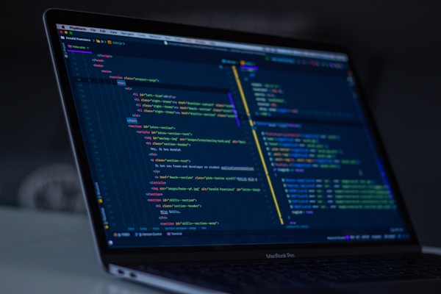
Priority Checks Before Reviewed Status
Gate
C-003
The market moved from "can we build an agent" to "can we tr...
Section 3 | Mixed
Do not publish as reviewed until these are sourced.
C-006
April 17, 2026: regulators handed agentic AI back to the ba...
Section 4 | Mixed
Attach official sources for numbers and rules.
C-004
2026: capability is commoditized; the model is no longer th...
Section 3 | Primary source
C-023
Beachhead: the SR 26-2 vacuum in financial services Banks m...
Section 12 | Primary source
C-034
The dossier maps to exactly what examiners already ask SR 2...
Section 15 | Primary source
DRAFT
Reddit fact-check dossier | confidential
5 / 8

Slide 6
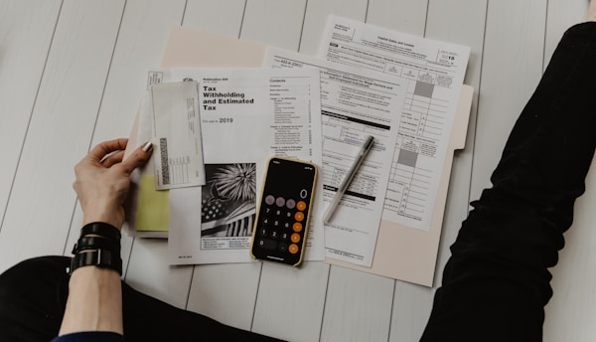
Next
Reddit Discovery Pack
Start with generated claim queries, then extract selected threads into JSON.
Capture Reddit URLs
Run thread extractor
C-001
agent validation authority klarna publicly reversed ai-first support qualit...
C-002
agent validation authority blocker same everywhere nobody prove safe run pr...
Score evidence pack
C-003
agent validation authority market moved build trust one race was capability...
Regenerate reviewed deck
C-005
agent validation authority trust now infrastructure problem product feature
C-006
agent validation authority april regulators handed agentic back banks occ f...
C-007
agent validation authority one sentence defines moment generative agentic m...
C-008
agent validation authority examiners still ask what your monitoring framewo...
DRAFT
Reddit fact-check dossier | confidential
6 / 8

Slide 7

Delivery Artifacts
Use case
Annotated source deck
Original review copy with claim rails and Fact Check Notes.
PPTX
Source deck: editing
Dossier: executive readout
Evidence report
Markdown audit trail with claims, queries, and limitations.
MD
JSON: reproducibility
Machine artifacts
JSON source for repeatable scoring and regeneration.
JSON
DRAFT
Reddit fact-check dossier | confidential
7 / 8

Slide 8
DECISION
Reviewed when
Move From Claim Extraction To Evidence Review
Reddit evidence captured
- Keep the annotated source deck as the working edit layer.
- Attach Reddit thread JSON and official sources for high-risk claims.
- Regenerate reviewed outputs only after evidence inspection and PPTX QA.
Primary facts sourced
Deck QA passed
Current status: DRAFT, not a final Reddit-verified verdict.
DRAFT
Reddit fact-check dossier | confidential
8 / 8

