Slide 1

Evidence attached
REDDIT FACT-CHECK DOSSIER
Agent Validation & Assurance Authority
8 Reddit threads
482 comments parsed
Primary facts still need official sources.
Client-ready draft built from the branded Canva template. This version includes Reddit HTML evidence, claim-level scoring, and source traceability.
40 extracted claims
15 Reddit-supported
13 no Reddit evidence
Built 2026-06-24 | Status: DRAFT
DRAFT
Reddit fact-check dossier | confidential
1 / 8

Slide 2
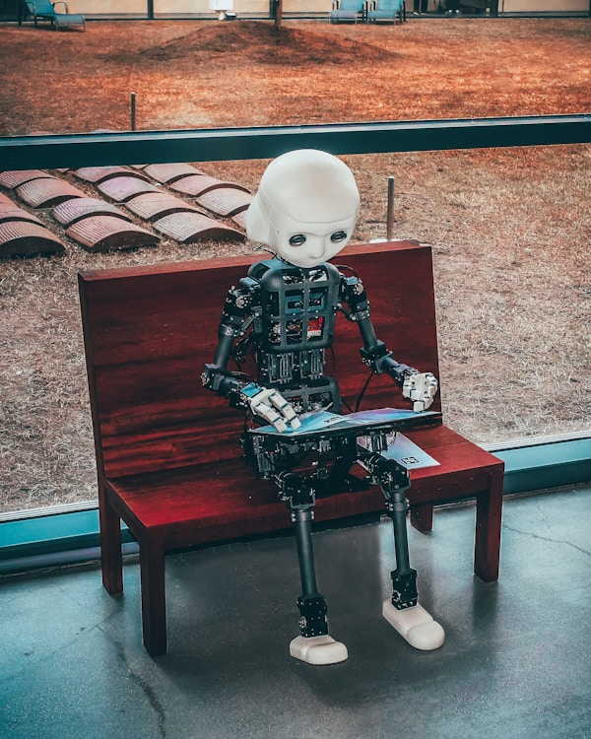
Executive Verdict
Evidence base
Reddit validation exists; hard facts still need primary-source review.
15
Reddit-supported
6
weak Reddit support
13
no Reddit evidence
5
primary required
8 source threads
482 comments
- Old Reddit HTML was parsed into evidence JSON.
- Claims are scored against post and comment text.
- Reddit supports language, pain, and objections; hard facts need official sources.
- Status stays draft until human evidence review is complete.
Old Reddit HTML extraction
DRAFT
Reddit fact-check dossier | confidential
2 / 8

Slide 3
Reddit Evidence Has Clear Limits
Rule
Reddit can support
Reddit cannot prove alone
Output standard
Use Reddit as community evidence.
- Operator pain
- Practitioner language
- Vendor complaints
- Objections and demand
- Market-size numbers
- Regulatory meaning
- Funding or headcount
- Named-company facts
- Claim IDs
- Source metadata
- Short rationale
- No opinion-only labels
Use official sources for hard facts.
Label gaps explicitly.
DRAFT
Reddit fact-check dossier | confidential
3 / 8

Slide 4
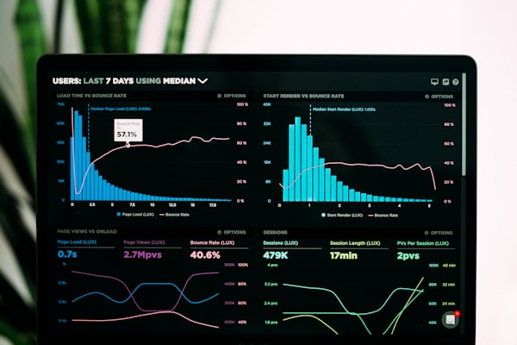
Claim Triage Prioritizes Reddit Review
Signal
The biggest review load sits in market-language and operator-pain claims.
S2
2 | R2 M0 P0
S3
3 | R1 M1 P1
Teal/navy bars show Reddit review load.
S4
4 | R3 M1 P0
S5
3 | R3 M0 P0
Coral marks primary-source risk.
S6
4 | R4 M0 P0
S7
1 | R1 M0 P0
Amber means mixed evidence.
S9
2 | R2 M0 P0
S10
2 | R2 M0 P0
S11
1 | R1 M0 P0
S12
3 | R2 M0 P1
S13
3 | R3 M0 P0
S14
5 | R5 M0 P0
S15
4 | R1 M0 P3
S16
3 | R3 M0 P0
DRAFT
Reddit fact-check dossier | confidential
4 / 8

Slide 5
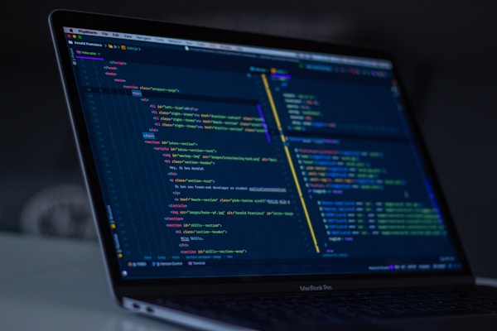
Claims That Still Need Work
Gate
C-006
April 17, 2026: regulators handed agentic AI back to the ba...
no reddit evidence found
Fix unsupported claims.
C-004
2026: capability is commoditized; the model is no longer th...
requires primary source
Attach official sources for numbers and rules.
C-023
Beachhead: the SR 26-2 vacuum in financial services Banks m...
requires primary source
Then mark reviewed.
C-034
The dossier maps to exactly what examiners already ask SR 2...
requires primary source
C-035
Add the agentic layer SR 26-2 omits: tool-call safety, auto...
requires primary source
DRAFT
Reddit fact-check dossier | confidential
5 / 8

Slide 6
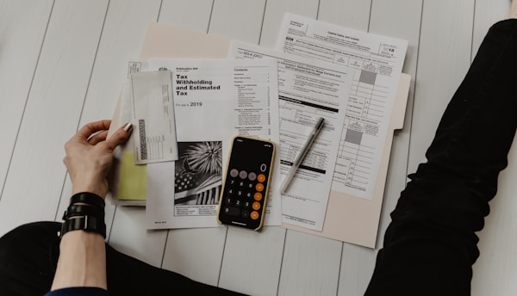
Traceability
Reddit Evidence Sources
Curated old.reddit threads were parsed into JSON and scored against the claim pack.
Source URLs are in the report.
Every claim has evidence status.
R1
r/ChatGPT - I Tested OpenAI's $20/month “Agent” So You Don’t Have To. It Ca...
R2
r/ArtificialInteligence - AI AGENTS today are far more DANGEROUS that you t...
No opinion-only labels.
R3
r/u_ibm - What are the real challenges of automating with AI agents?
R4
r/AI_Agents - AI Agent Governance and Liability?
R5
r/aiagents - I built an airgapped agent governance system in a week by chan...
R6
r/whennews - The PocketOS boss puts greater blame on Railway’s architecture...
R7
r/AI_Agents - Most of you shouldnt build an AI agent and heres why
DRAFT
Reddit fact-check dossier | confidential
6 / 8

Slide 7

Delivery Artifacts
Use case
Annotated source deck
Original review copy with claim rails and Fact Check Notes.
PPTX
Source deck: editing
Dossier: executive readout
Evidence report
Markdown audit trail with claims, queries, and limitations.
MD
JSON: reproducibility
Machine artifacts
JSON source for repeatable scoring and regeneration.
JSON
DRAFT
Reddit fact-check dossier | confidential
7 / 8

Slide 8
DECISION
Reviewed when
Move From Claim Extraction To Evidence Review
Primary facts sourced
- Edit unsupported claims in the annotated source deck.
- Keep Reddit-backed language where it reflects operator pain.
- Attach official sources for SR 26-2, Gartner, named-company facts, and numbers.
Noisy matches removed
Deck QA passed
Current status: EVIDENCE DRAFT - Reddit evidence attached, primary-source review pending.
DRAFT
Reddit fact-check dossier | confidential
8 / 8

