Slide 1
IMPLEMENTATION SOLUTION
Claude Agents In Microsoft Foundry
A 90-day roadmap to move from workshop prototype to governed enterprise agent service.
Claude reasoning
Foundry Agent Service
MCP + tools
Prod controls
Source basis: public LinkedIn workshop clip + aka.ms/claude-workshop launcher + Microsoft Learn Agent Service docs.
Claude + Microsoft Foundry implementation roadmap | draft based on public workshop materials
1 / 13

Slide 2
The Answer: Treat The Workshop As A Production Blueprint
The practical move is not another demo; it is a governed agent program with a narrow first use case.
BLUF: Stand up a Foundry-hosted Claude agent in 30 days, connect enterprise tools in 60, and graduate one measurable workflow to production by day 90.
01
Situation
02
Insight
03
Recommendation
Agent work is shifting from chat responses to systems that plan, use long context, invoke tools, and operate inside enterprise controls.
Microsoft Foundry provides the control plane: Agent Service, model deployment, tools, security, observability, evaluation, and publishing paths.
Anchor the program on one workflow where Claude reasoning plus Foundry governance can show measurable cycle-time or quality improvement.
THE ASK: approve a 90-day pilot with a named business owner, one production integration path, and a governance gate at each phase.
Claude + Microsoft Foundry implementation roadmap | draft based on public workshop materials
2 / 13

Slide 3
Why This Is Ready For Enterprise Implementation
The core constraints are no longer model access; they are tool access, controls, measurement, and ownership.
1
Reasoning
2
Control plane
Claude is positioned in the workshop as the reasoning layer for planning, long context, and multi-step agent behavior.
Foundry gives teams a place to deploy models, build agents, add tools, evaluate behavior, trace runs, and operate at scale.
3
Enterprise stack
4
Adoption wedge
Microsoft identity, security, governance, and publishing paths reduce the gap between prototype and production.
The workshop flow is concrete enough to convert into a field implementation package: deploy, connect, test, govern, scale.
Design principle: the pilot must prove operating capability, not just model capability.
Claude + Microsoft Foundry implementation roadmap | draft based on public workshop materials
3 / 13

Slide 4
SECTION 01
Public Workshop Signal
What the source material verifies, and what remains an implementation assumption.
Claude + Microsoft Foundry implementation roadmap | draft based on public workshop materials
4 / 13

Slide 5
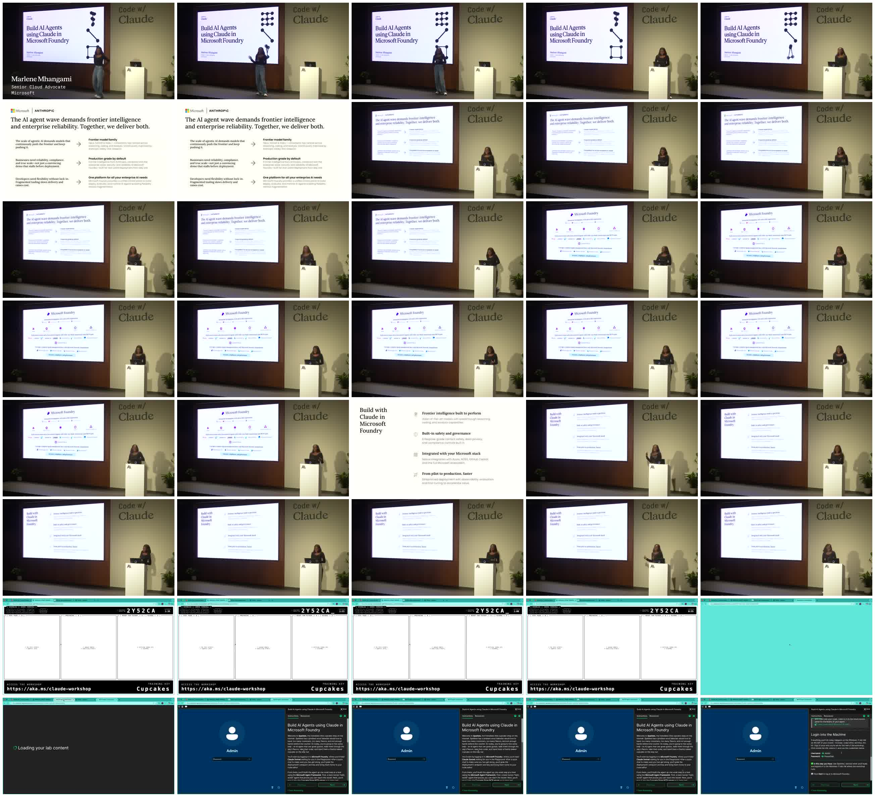
The Workshop Verifies A Practical Build Sequence
The public clip and launcher validate the direction; the private Skillable lab steps were not exposed.
• Workshop title: Build AI Agents using Claude in Microsoft Foundry.
• Stated outcomes: deploy Claude models in Foundry, plug the model into an agent, and give that agent tools.
• Platform claims in the clip: Foundry models, Agent Service, tools/integrations, enterprise security, observability, governance, and 1,400+ connectors/MCP tools.
• Public launcher: aka.ms/claude-workshop redirects to Skillable/LabOnDemand room with Microsoft branding, but current event sign-in returns page-not-found.
Caveat: private lab steps were not exposed; this roadmap is built from verified public materials.
Claude + Microsoft Foundry implementation roadmap | draft based on public workshop materials
5 / 13

Slide 6
Target Architecture: A Governed Agent Service Around Claude
The production design separates user channels, agent orchestration, tools, knowledge, controls, and observability.
Channels
Agent runtime
Model layer
Tools
Data
Controls
Teams, Copilot, web app, API
Foundry Agent Service / Responses API
Claude models deployed through Foundry
MCP servers, built-in tools, enterprise connectors
RAG indexes, system APIs, business records
Identity, approvals, policy, evals, tracing
→
→
→
→
→
Architecture decision: keep enterprise data and tools behind governed connectors; let the agent reason over tasks, not bypass system-of-record controls.
Claude + Microsoft Foundry implementation roadmap | draft based on public workshop materials
6 / 13

Slide 7
Detailed Use Case: Enterprise Support Resolution Agent
A realistic first workflow for proving Claude reasoning plus Foundry operating controls.
Challenge
1. Intake
2. Reason
Support teams lose time triaging tickets, searching policy, drafting replies, and escalating incomplete cases across systems.
Classify ticket, retrieve context, detect missing fields
Plan answer or escalation using policy + history
3. Act
4. Govern
How it is realized
Draft reply, update CRM, open follow-up task
Log trace, score response, route exceptions
Claude plans the resolution path. Foundry manages tools, identity, tracing, evaluation, and deployment. Humans approve sensitive actions.
Stack: Claude in Foundry + Agent Service + MCP/tool connectors + RAG + Microsoft identity/security + eval/tracing dashboards
Claude + Microsoft Foundry implementation roadmap | draft based on public workshop materials
7 / 13

Slide 8
90-Day Roadmap: From Lab To Production-Ready Agent
Gates are designed to kill weak pilots early and scale only what can be operated.
0-15 days
16-30 days
31-60 days
61-90 days
Foundation
Prototype
Pilot
Production gate
Confirm workflow, success metric, data access, risk class, and business owner.
Deploy Claude model, create first Foundry agent, connect sandbox tools, define eval set.
Add enterprise connectors, human approval, telemetry, prompt/tool hardening, and UAT.
Security review, monitoring, runbook, release plan, KPI baseline, and scale decision.
Exit criteria: named use case, working agent, tool traces, evaluation results, control evidence, production decision.
Claude + Microsoft Foundry implementation roadmap | draft based on public workshop materials
8 / 13

Slide 9
Implementation Workstreams And Ownership
The program needs product, platform, security, data, and change management from day one.
Workstream
Deliverables
Owner
Product
Use-case scope, user journey, acceptance criteria
Business owner + PM
Platform
Foundry project, model deployment, agent runtime, environments
AI platform lead
Tools/data
MCP/connectors, RAG, API permissions, test fixtures
Integration + data owners
Governance
Risk review, human-in-loop, logging, policy, security gate
Security + compliance
Adoption
Pilot cohort, training, feedback loop, rollout comms
Ops lead + enablement
Practical staffing: 1 product lead, 1 Foundry/AI engineer, 1 integration engineer, 1 security/compliance partner, 5-10 pilot users.
Claude + Microsoft Foundry implementation roadmap | draft based on public workshop materials
9 / 13

Slide 10
Tool Strategy: Start Narrow, Then Expand Through Governed Connectors
A useful agent needs real tools, but tool access must be staged by business risk.
Read-only
Search knowledge base, retrieve policy, inspect ticket context
Draft actions
Prepare reply, suggest next task, create proposed record update
Approved writes
Human-reviewed updates into CRM, ITSM, email, or workflow tools
Autonomous loops
Only after eval thresholds, monitoring, rollback, and exception routing
Rule: every tool gets a purpose, permission boundary, test fixture, abuse case, trace requirement, and rollback path before pilot use.
Claude + Microsoft Foundry implementation roadmap | draft based on public workshop materials
10 / 13

Slide 11
Governance: Measure The Agent Before Scaling It
The roadmap should make operational evidence visible before production approval.
1
Quality
2
Safety
Resolution accuracy, citation quality, policy adherence, escalation correctness
Tool-call violations, PII exposure, unauthorized action attempts, human override rate
3
Operations
4
Business
Latency, cost per case, trace completeness, incident count, fallback rate
Cycle time, first-contact resolution, user CSAT, avoided rework, adoption
• Evaluation pack: golden tasks, adversarial prompts, tool-call expectations, red-team cases, and regression tests.
• Release gates: no production release without trace visibility, human approval path, KPI baseline, and exception runbook.
Claude + Microsoft Foundry implementation roadmap | draft based on public workshop materials
11 / 13

Slide 12
Pilot Offer: A Fixed-Scope Agent Implementation Sprint
Package the workshop into an executive-ready adoption motion with clear deliverables.
Week 1
Weeks 2-4
Use-case framing, architecture, data/tool readiness, governance plan
Foundry project, Claude deployment, prototype agent, sandbox tools, eval harness
Weeks 5-8
Weeks 9-12
Pilot workflow, enterprise integrations, telemetry, user feedback, hardening
Production gate, runbook, KPI readout, scale recommendation, backlog
Decision needed
Next step: run a 2-hour implementation design workshop and produce a signed 90-day delivery plan.
Select use case + business owner + pilot cohort
Claude + Microsoft Foundry implementation roadmap | draft based on public workshop materials
12 / 13

Slide 13
SECTION 02
Sources And Assumptions
Facts are separated from implementation recommendations.
• LinkedIn public embed: John Peslar post and 8:53 workshop video; analyzed via direct MP4 and auto-caption SRT exposed in the embed HTML.
• Workshop short link: https://aka.ms/claude-workshop redirects to https://skill.info/cupcakes and a Skillable/LabOnDemand Microsoft workshop launcher.
• Microsoft Learn: Azure AI Foundry Agent Service overview, updated June 2, 2026, used for current platform framing.
• Assumption: enterprise client wants a governed 90-day pilot that can graduate to production; use case and integrations should be finalized in discovery.
Claude + Microsoft Foundry implementation roadmap | draft based on public workshop materials
13 / 13

