Slide 1
DATA-BACKED CLIENT DECK
Agent Replacement Scorecard
Client-ready data synthesis: which SaaS layers agents replace, renegotiate, or preserve
25 scored use cases
6 agent domains
3 verdicts
data moat model
Reviewed client-ready draft | 2026-06-30
Agent Replacement Scorecard · client-ready reviewed draft
1 / 60

Slide 2
This deck has been rebuilt around the scorecard data
Use cases and data moats come before the final narrative so the recommendation is earned
25
6
3
H/M/L
scored use cases
agent domains
commercial verdicts
moat model
• Prior version jumped to the story before the use-case and moat evidence.
• This version separates data foundation, use-case catalogue, moat synthesis, and executive narrative.
• Client-ready structure: action titles, guardrails, domain pages, and a decision ask.
Agent Replacement Scorecard · client-ready reviewed draft
2 / 60

Slide 3
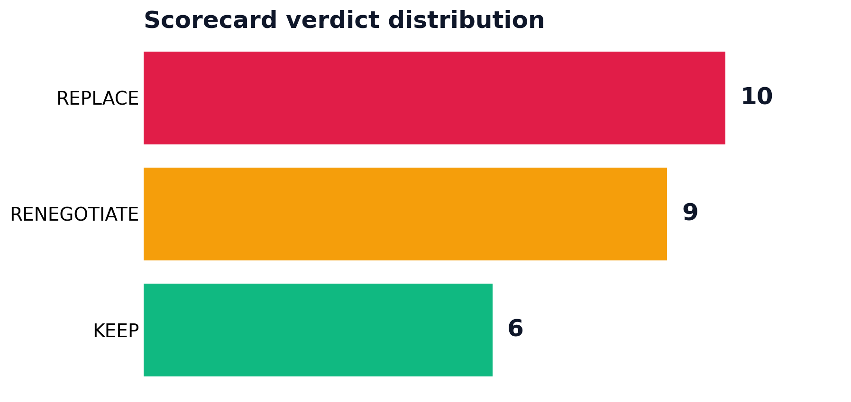
The executive answer is a three-way commercial split
Agents do not create one SaaS outcome; they create replace, renegotiate, and keep motions
Replace
10 workflows where the exposed layer is seats, add-ons, or runbooks.
Renegotiate
9 workflows where the platform survives but modules and seat pricing are challenged.
Keep
6 workflows where proprietary data, audit, permissions, or telemetry defend the system of record.
Agent Replacement Scorecard · client-ready reviewed draft
3 / 60

Slide 4
BLUF: data moat is the boundary, volume is the urgency
The cleanest synthesis is not a category label; it is a mechanism
Data moat explains the verdict boundary in this curated dataset.
• Low-moat workflows map to replacement because the agent can reproduce the work without defending a proprietary substrate.
• Medium-moat workflows map to renegotiation because the platform survives while the workflow layer compresses.
• High-moat workflows map to keep because the durable value is governed records, telemetry, permissions, and audit.
• Volume decides which opportunities deserve commercial attention first.
Client implication: run this as a diagnostic against an account's software estate before making replacement claims.
Agent Replacement Scorecard · client-ready reviewed draft
4 / 60

Slide 5
The storyboard
Situation → Complication → Question → Answer → Action
1. Situation
2. Complication
3. Question
4. Answer
5. Action
Agents are moving from generic copilots into task-owning workflow layers.
SaaS portfolios are full of add-ons and per-seat modules that look valuable until an agent absorbs the workflow.
Which systems are actually replaceable, and which remain protected?
Data moat separates the verdict; volume and determinism prioritize the action.
Use the scorecard to launch targeted replacement pilots and renewal renegotiations.
Agent Replacement Scorecard · client-ready reviewed draft
5 / 60

Slide 6
SECTION 01
Scorecard Data Foundation
We first establish the dataset, scoring method, and high-level segmentation before making client recommendations.
Agent Replacement Scorecard · client-ready reviewed draft
6 / 60

Slide 7
Dataset quality is sufficient for a v1 diagnostic
It is complete and internally consistent, but curated rather than statistically sampled
25
0%
0
medium-high
source rows
null rate
duplicate use cases
confidence
all use cases scored
modeled fields
unique roster
internal synthesis
• Use as a client diagnostic, not a statistically sampled market-sizing study.
• Every row has domain, use case, proof, affected SaaS layer, H/M/L scores, and verdict.
• Validation found no arithmetic mismatch across source, scored output, and deck claims.
Agent Replacement Scorecard · client-ready reviewed draft
7 / 60

Slide 8
The score formula is simple enough for executives to audit
Replacement exposure = volume + determinism + inverse data moat
Volume
Determinism
H/M/L estimate of how much throughput or recurring work is attached to the workflow.
H/M/L estimate of whether the task has repeatable inputs, rules, and outputs.
Moat exposure
Verdict
Inverse of data moat: low moat means high exposure; high moat means lower replacement pressure.
Commercial action: replace, renegotiate, or keep. It is a client action, not a moral score.
Guardrail: if the data moat rating changes, the commercial verdict should be revisited before the deck is used externally.
Agent Replacement Scorecard · client-ready reviewed draft
8 / 60

Slide 9
Verdicts are distributed enough to support real advisory work
The deck does not collapse into a one-note replacement thesis
• Replacement exists, but it is not universal.
• Renegotiation is nearly as large as replacement.
• Keep cases make the framework more credible.
Agent Replacement Scorecard · client-ready reviewed draft
9 / 60

Slide 10
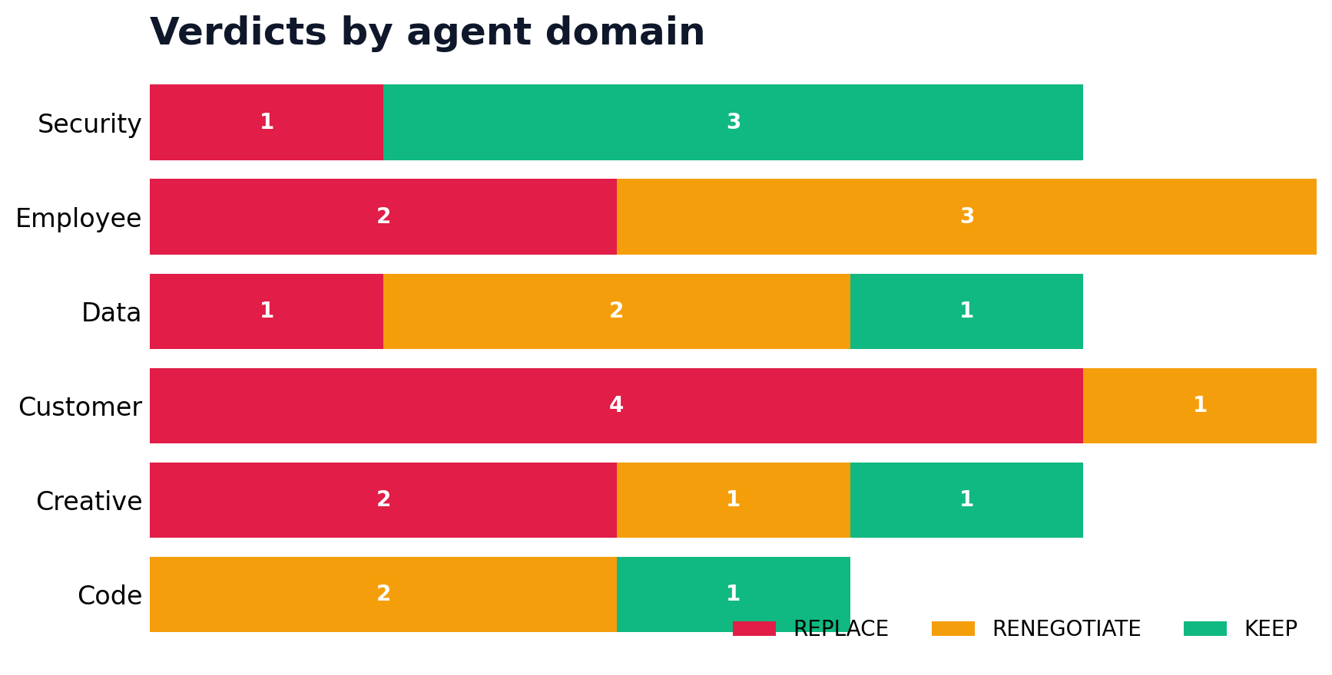
Agent domains expose different commercial motions
Customer-facing workflows skew replacement; security skews durability
• Customer workflows are the clearest pilot start.
• Employee and data workflows create renewal pressure.
• Security is defended by telemetry, audit, and governance.
Agent Replacement Scorecard · client-ready reviewed draft
10 / 60

Slide 11
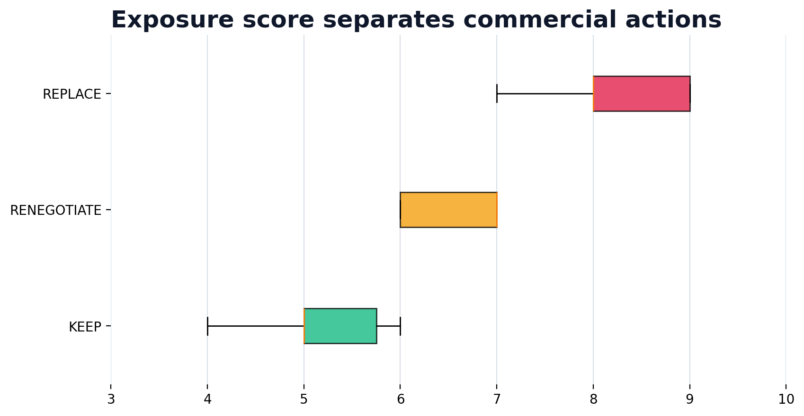
Exposure scores separate the commercial actions
The score does not replace judgment; it makes the judgment inspectable
• Replace cases cluster high.
• Renegotiate cases occupy the middle.
• Keep cases cluster low because moat reduces exposure.
Agent Replacement Scorecard · client-ready reviewed draft
11 / 60

Slide 12
SECTION 02
Use-Case Catalogue
The use cases come before the final narrative so the client sees the evidence base, not just a point of view.
Agent Replacement Scorecard · client-ready reviewed draft
12 / 60

Slide 13
Customer use cases show where the scorecard bites
Domain summary before individual use-case pages
4
1
0
replace
renegotiate
keep
Use-case roster
Conversational support
REPLACE · Low moat · score 9
In-product owner assistant
RENEGOTIATE · Medium moat · score 6
AI shopping / sales consultant
REPLACE · Low moat · score 8
Travel & booking planner
REPLACE · Low moat · score 8
Messaging-channel chatbot
REPLACE · Low moat · score 9
Domain implication
Start client conversations here: visible workflows, measurable volume, and obvious seat compression.
Agent Replacement Scorecard · client-ready reviewed draft
13 / 60

Slide 14
USE CASE 01 · CUSTOMER
Conversational support
REPLACE
Volume
H
Repeat
H
Moat
L
9
score
What is deployed
SaaS in the crosshairs
Commercial translation
Mercedes MBUX, Wendy's FreshAI, Home Depot Magic Apron
Per-seat help desks (Zendesk)
80 support seats → 1 agent + KB
Client narrative
Why the moat matters
Replacement target: high-volume workflow layer, weak proprietary data protection, and visible seat or add-on compression.
Low moat: the agent can reproduce the user-facing workflow without needing a defensible proprietary substrate.
Proof: Mercedes MBUX, Wendy's FreshAI, Home Depot Magic Apron | SaaS affected: Per-seat help desks (Zendesk)
Agent Replacement Scorecard · client-ready reviewed draft
14 / 60

Slide 15
USE CASE 02 · CUSTOMER
In-product owner assistant
RENEGOTIATE
Volume
M
Repeat
M
Moat
M
6
score
What is deployed
SaaS in the crosshairs
Commercial translation
Volkswagen myVW, GM OnStar
Manuals / FAQ / deflection tools
Keep platform; drop deflection seats
Client narrative
Why the moat matters
Renewal target: keep the core platform, challenge workflow modules, assist layers, and per-seat pricing.
Medium moat: the platform likely survives, but workflow modules and seats become negotiable.
Proof: Volkswagen myVW, GM OnStar | SaaS affected: Manuals / FAQ / deflection tools
Agent Replacement Scorecard · client-ready reviewed draft
15 / 60

Slide 16
USE CASE 03 · CUSTOMER
AI shopping / sales consultant
REPLACE
Volume
H
Repeat
M
Moat
L
8
score
What is deployed
SaaS in the crosshairs
Commercial translation
Mercedes smart sales, Mobiauto, Best Buy
Guided-selling SaaS
Guided-selling seats → 1 agent
Client narrative
Why the moat matters
Replacement target: high-volume workflow layer, weak proprietary data protection, and visible seat or add-on compression.
Low moat: the agent can reproduce the user-facing workflow without needing a defensible proprietary substrate.
Proof: Mercedes smart sales, Mobiauto, Best Buy | SaaS affected: Guided-selling SaaS
Agent Replacement Scorecard · client-ready reviewed draft
16 / 60

Slide 17
USE CASE 04 · CUSTOMER
Travel & booking planner
REPLACE
Volume
H
Repeat
M
Moat
L
8
score
What is deployed
SaaS in the crosshairs
Commercial translation
Agoda, Priceline, LATAM Cosmos, Virgin Voyages
Booking / itinerary tools
Booking seats → agent + inventory API
Client narrative
Why the moat matters
Replacement target: high-volume workflow layer, weak proprietary data protection, and visible seat or add-on compression.
Low moat: the agent can reproduce the user-facing workflow without needing a defensible proprietary substrate.
Proof: Agoda, Priceline, LATAM Cosmos, Virgin Voyages | SaaS affected: Booking / itinerary tools
Agent Replacement Scorecard · client-ready reviewed draft
17 / 60

Slide 18
USE CASE 05 · CUSTOMER
Messaging-channel chatbot
REPLACE
Volume
H
Repeat
H
Moat
L
9
score
What is deployed
SaaS in the crosshairs
Commercial translation
LUXGEN (LINE), Banglalink REN, DT MINDR
Chatbot / CCaaS bots
Bot-builder seats → 1 agent
Client narrative
Why the moat matters
Replacement target: high-volume workflow layer, weak proprietary data protection, and visible seat or add-on compression.
Low moat: the agent can reproduce the user-facing workflow without needing a defensible proprietary substrate.
Proof: LUXGEN (LINE), Banglalink REN, DT MINDR | SaaS affected: Chatbot / CCaaS bots
Agent Replacement Scorecard · client-ready reviewed draft
18 / 60

Slide 19
Employee use cases show where the scorecard bites
Domain summary before individual use-case pages
2
3
0
replace
renegotiate
keep
Use-case roster
Enterprise knowledge search
RENEGOTIATE · Medium moat · score 7
Doc summarization & drafting
REPLACE · Low moat · score 8
Contact-center agent assist
RENEGOTIATE · Medium moat · score 7
Legal research & drafting
REPLACE · Low moat · score 7
HR / onboarding agent
RENEGOTIATE · Medium moat · score 7
Domain implication
Expect mixed actions: agent productivity compresses add-ons, but internal systems often remain.
Agent Replacement Scorecard · client-ready reviewed draft
19 / 60

Slide 20
USE CASE 06 · EMPLOYEE
Enterprise knowledge search
RENEGOTIATE
Volume
H
Repeat
M
Moat
M
7
score
What is deployed
SaaS in the crosshairs
Commercial translation
Geotab, Bosch AskBosch, Glean
Enterprise search SaaS
Agent over your data; trim search seats
Client narrative
Why the moat matters
Renewal target: keep the core platform, challenge workflow modules, assist layers, and per-seat pricing.
Medium moat: the platform likely survives, but workflow modules and seats become negotiable.
Proof: Geotab, Bosch AskBosch, Glean | SaaS affected: Enterprise search SaaS
Agent Replacement Scorecard · client-ready reviewed draft
20 / 60

Slide 21
USE CASE 07 · EMPLOYEE
Doc summarization & drafting
REPLACE
Volume
H
Repeat
M
Moat
L
8
score
What is deployed
SaaS in the crosshairs
Commercial translation
KPMG, PwC, Deloitte
Doc / productivity add-ons
Native LLM; drop add-on seats
Client narrative
Why the moat matters
Replacement target: high-volume workflow layer, weak proprietary data protection, and visible seat or add-on compression.
Low moat: the agent can reproduce the user-facing workflow without needing a defensible proprietary substrate.
Proof: KPMG, PwC, Deloitte | SaaS affected: Doc / productivity add-ons
Agent Replacement Scorecard · client-ready reviewed draft
21 / 60

Slide 22
USE CASE 08 · EMPLOYEE
Contact-center agent assist
RENEGOTIATE
Volume
H
Repeat
M
Moat
M
7
score
What is deployed
SaaS in the crosshairs
Commercial translation
Humana Agent Assist, Vodafone
CCaaS agent-assist
Keep CCaaS; agent-assist replaces add-on
Client narrative
Why the moat matters
Renewal target: keep the core platform, challenge workflow modules, assist layers, and per-seat pricing.
Medium moat: the platform likely survives, but workflow modules and seats become negotiable.
Proof: Humana Agent Assist, Vodafone | SaaS affected: CCaaS agent-assist
Agent Replacement Scorecard · client-ready reviewed draft
22 / 60

Slide 23
USE CASE 09 · EMPLOYEE
Legal research & drafting
REPLACE
Volume
M
Repeat
M
Moat
L
7
score
What is deployed
SaaS in the crosshairs
Commercial translation
Harvey, Thomson Reuters, Deutsche Bank DB Lumina
Westlaw, LexisNexis, CLM
Per-lawyer research seats → agent
Client narrative
Why the moat matters
Replacement target: high-volume workflow layer, weak proprietary data protection, and visible seat or add-on compression.
Low moat: the agent can reproduce the user-facing workflow without needing a defensible proprietary substrate.
Proof: Harvey, Thomson Reuters, Deutsche Bank DB Lumina | SaaS affected: Westlaw, LexisNexis, CLM
Agent Replacement Scorecard · client-ready reviewed draft
23 / 60

Slide 24
USE CASE 10 · EMPLOYEE
HR / onboarding agent
RENEGOTIATE
Volume
M
Repeat
H
Moat
M
7
score
What is deployed
SaaS in the crosshairs
Commercial translation
Grupo Ruiz, employee-agent deployments
HR workflow SaaS
Agent runs workflow; keep record system
Client narrative
Why the moat matters
Renewal target: keep the core platform, challenge workflow modules, assist layers, and per-seat pricing.
Medium moat: the platform likely survives, but workflow modules and seats become negotiable.
Proof: Grupo Ruiz, employee-agent deployments | SaaS affected: HR workflow SaaS
Agent Replacement Scorecard · client-ready reviewed draft
24 / 60

Slide 25
Creative use cases show where the scorecard bites
Domain summary before individual use-case pages
2
1
1
replace
renegotiate
keep
Use-case roster
Ad & creative generation at scale
REPLACE · Low moat · score 8
Video generation
RENEGOTIATE · Medium moat · score 6
Personalized marketing content
REPLACE · Low moat · score 8
Brand / 3D asset generation
KEEP · High moat · score 5
Domain implication
Separate production throughput from brand/IP governance; they drive different verdicts.
Agent Replacement Scorecard · client-ready reviewed draft
25 / 60

Slide 26
USE CASE 11 · CREATIVE
Ad & creative generation at scale
REPLACE
Volume
H
Repeat
M
Moat
L
8
score
What is deployed
SaaS in the crosshairs
Commercial translation
WPP, Authentic Brands Group, PODS
Creative production seats
Production seats → gen pipeline
Client narrative
Why the moat matters
Replacement target: high-volume workflow layer, weak proprietary data protection, and visible seat or add-on compression.
Low moat: the agent can reproduce the user-facing workflow without needing a defensible proprietary substrate.
Proof: WPP, Authentic Brands Group, PODS | SaaS affected: Creative production seats
Agent Replacement Scorecard · client-ready reviewed draft
26 / 60

Slide 27
USE CASE 12 · CREATIVE
Video generation
RENEGOTIATE
Volume
M
Repeat
M
Moat
M
6
score
What is deployed
SaaS in the crosshairs
Commercial translation
Veo deployments, Adobe
Video editing SaaS
Agent drafts; editors finish
Client narrative
Why the moat matters
Renewal target: keep the core platform, challenge workflow modules, assist layers, and per-seat pricing.
Medium moat: the platform likely survives, but workflow modules and seats become negotiable.
Proof: Veo deployments, Adobe | SaaS affected: Video editing SaaS
Agent Replacement Scorecard · client-ready reviewed draft
27 / 60

Slide 28
USE CASE 13 · CREATIVE
Personalized marketing content
REPLACE
Volume
H
Repeat
M
Moat
L
8
score
What is deployed
SaaS in the crosshairs
Commercial translation
Adobe, ElevenLabs (voice)
Marketing content tools
Content-tool seats → agent
Client narrative
Why the moat matters
Replacement target: high-volume workflow layer, weak proprietary data protection, and visible seat or add-on compression.
Low moat: the agent can reproduce the user-facing workflow without needing a defensible proprietary substrate.
Proof: Adobe, ElevenLabs (voice) | SaaS affected: Marketing content tools
Agent Replacement Scorecard · client-ready reviewed draft
28 / 60

Slide 29
USE CASE 14 · CREATIVE
Brand / 3D asset generation
KEEP
Volume
M
Repeat
M
Moat
H
5
score
What is deployed
SaaS in the crosshairs
Commercial translation
BMW Group SORDI.ai
Asset / DAM tooling
DAM stays SoR; agent feeds it
Client narrative
Why the moat matters
Keep target: use the agent to improve work while governed data, audit, telemetry, or permissions defend the substrate.
High moat: the system protects value through governed data, audit, permissions, telemetry, or regulatory context.
Proof: BMW Group SORDI.ai | SaaS affected: Asset / DAM tooling
Agent Replacement Scorecard · client-ready reviewed draft
29 / 60

Slide 30
Code use cases show where the scorecard bites
Domain summary before individual use-case pages
0
2
1
replace
renegotiate
keep
Use-case roster
AI code assistant
RENEGOTIATE · Medium moat · score 7
Legacy-IT modernization (NL→SAP)
KEEP · High moat · score 4
App build / migration automation
RENEGOTIATE · Medium moat · score 6
Domain implication
Treat as engineering leverage and renewal pressure, not full replacement of SDLC systems.
Agent Replacement Scorecard · client-ready reviewed draft
30 / 60

Slide 31
USE CASE 15 · CODE
AI code assistant
RENEGOTIATE
Volume
H
Repeat
M
Moat
M
7
score
What is deployed
SaaS in the crosshairs
Commercial translation
Valeo, Broadcom (Gemini Code Assist)
IDE / code-review add-ons
Enriches IDE; consumption not seats
Client narrative
Why the moat matters
Renewal target: keep the core platform, challenge workflow modules, assist layers, and per-seat pricing.
Medium moat: the platform likely survives, but workflow modules and seats become negotiable.
Proof: Valeo, Broadcom (Gemini Code Assist) | SaaS affected: IDE / code-review add-ons
Agent Replacement Scorecard · client-ready reviewed draft
31 / 60

Slide 32
USE CASE 16 · CODE
Legacy-IT modernization (NL→SAP)
KEEP
Volume
M
Repeat
L
Moat
H
4
score
What is deployed
SaaS in the crosshairs
Commercial translation
Suzano, Deutsche Telekom
Modernization consulting / tools
Agent unlocks legacy; keep core systems
Client narrative
Why the moat matters
Keep target: use the agent to improve work while governed data, audit, telemetry, or permissions defend the substrate.
High moat: the system protects value through governed data, audit, permissions, telemetry, or regulatory context.
Proof: Suzano, Deutsche Telekom | SaaS affected: Modernization consulting / tools
Agent Replacement Scorecard · client-ready reviewed draft
32 / 60

Slide 33
USE CASE 17 · CODE
App build / migration automation
RENEGOTIATE
Volume
M
Repeat
M
Moat
M
6
score
What is deployed
SaaS in the crosshairs
Commercial translation
Code-agent deployments
Low-code & migration tooling
Agent replaces low-code seats partially
Client narrative
Why the moat matters
Renewal target: keep the core platform, challenge workflow modules, assist layers, and per-seat pricing.
Medium moat: the platform likely survives, but workflow modules and seats become negotiable.
Proof: Code-agent deployments | SaaS affected: Low-code & migration tooling
Agent Replacement Scorecard · client-ready reviewed draft
33 / 60

Slide 34
Data use cases show where the scorecard bites
Domain summary before individual use-case pages
1
2
1
replace
renegotiate
keep
Use-case roster
NL analytics (text-to-SQL)
RENEGOTIATE · Medium moat · score 7
Document AI / extraction
REPLACE · Low moat · score 9
Forecasting / predictive ops
KEEP · High moat · score 5
Research & insight agent
RENEGOTIATE · Medium moat · score 6
Domain implication
Workflow automation can replace extraction layers while governed analytics substrates survive.
Agent Replacement Scorecard · client-ready reviewed draft
34 / 60

Slide 35
USE CASE 18 · DATA
NL analytics (text-to-SQL)
RENEGOTIATE
Volume
H
Repeat
M
Moat
M
7
score
What is deployed
SaaS in the crosshairs
Commercial translation
Spotify, Etsy (BigQuery)
BI dashboards (Looker-class)
Agent over warehouse; trim BI seats
Client narrative
Why the moat matters
Renewal target: keep the core platform, challenge workflow modules, assist layers, and per-seat pricing.
Medium moat: the platform likely survives, but workflow modules and seats become negotiable.
Proof: Spotify, Etsy (BigQuery) | SaaS affected: BI dashboards (Looker-class)
Agent Replacement Scorecard · client-ready reviewed draft
35 / 60

Slide 36
USE CASE 19 · DATA
Document AI / extraction
REPLACE
Volume
H
Repeat
H
Moat
L
9
score
What is deployed
SaaS in the crosshairs
Commercial translation
Document AI deployments
IDP / OCR SaaS
IDP/OCR seats → agent + Document AI
Client narrative
Why the moat matters
Replacement target: high-volume workflow layer, weak proprietary data protection, and visible seat or add-on compression.
Low moat: the agent can reproduce the user-facing workflow without needing a defensible proprietary substrate.
Proof: Document AI deployments | SaaS affected: IDP / OCR SaaS
Agent Replacement Scorecard · client-ready reviewed draft
36 / 60

Slide 37
USE CASE 20 · DATA
Forecasting / predictive ops
KEEP
Volume
M
Repeat
M
Moat
H
5
score
What is deployed
SaaS in the crosshairs
Commercial translation
Honeywell, Geotab
Predictive-analytics SaaS
Agent augments; data moat compounds
Client narrative
Why the moat matters
Keep target: use the agent to improve work while governed data, audit, telemetry, or permissions defend the substrate.
High moat: the system protects value through governed data, audit, permissions, telemetry, or regulatory context.
Proof: Honeywell, Geotab | SaaS affected: Predictive-analytics SaaS
Agent Replacement Scorecard · client-ready reviewed draft
37 / 60

Slide 38
USE CASE 21 · DATA
Research & insight agent
RENEGOTIATE
Volume
M
Repeat
M
Moat
M
6
score
What is deployed
SaaS in the crosshairs
Commercial translation
MLB Scout Insights, NotebookLM
Market-research tooling
Agent replaces research-tool seats
Client narrative
Why the moat matters
Renewal target: keep the core platform, challenge workflow modules, assist layers, and per-seat pricing.
Medium moat: the platform likely survives, but workflow modules and seats become negotiable.
Proof: MLB Scout Insights, NotebookLM | SaaS affected: Market-research tooling
Agent Replacement Scorecard · client-ready reviewed draft
38 / 60

Slide 39
Security use cases show where the scorecard bites
Domain summary before individual use-case pages
1
0
3
replace
renegotiate
keep
Use-case roster
Threat detection / SecOps
KEEP · High moat · score 6
Agentic auto-remediation
REPLACE · Low moat · score 9
Fraud & risk detection
KEEP · High moat · score 6
Compliance & audit agent
KEEP · High moat · score 5
Domain implication
Most security platforms survive when telemetry and audit are the moat; runbooks are more exposed.
Agent Replacement Scorecard · client-ready reviewed draft
39 / 60

Slide 40
USE CASE 22 · SECURITY
Threat detection / SecOps
KEEP
Volume
H
Repeat
M
Moat
H
6
score
What is deployed
SaaS in the crosshairs
Commercial translation
Google Security Operations deployments
SIEM tier-1
Agent rides on SIEM; keep record system
Client narrative
Why the moat matters
Keep target: use the agent to improve work while governed data, audit, telemetry, or permissions defend the substrate.
High moat: the system protects value through governed data, audit, permissions, telemetry, or regulatory context.
Proof: Google Security Operations deployments | SaaS affected: SIEM tier-1
Agent Replacement Scorecard · client-ready reviewed draft
40 / 60

Slide 41
USE CASE 23 · SECURITY
Agentic auto-remediation
REPLACE
Volume
H
Repeat
H
Moat
L
9
score
What is deployed
SaaS in the crosshairs
Commercial translation
Security-agent deployments
SOAR / runbooks
SOAR/runbook seats → agent in policy
Client narrative
Why the moat matters
Replacement target: high-volume workflow layer, weak proprietary data protection, and visible seat or add-on compression.
Low moat: the agent can reproduce the user-facing workflow without needing a defensible proprietary substrate.
Proof: Security-agent deployments | SaaS affected: SOAR / runbooks
Agent Replacement Scorecard · client-ready reviewed draft
41 / 60

Slide 42
USE CASE 24 · SECURITY
Fraud & risk detection
KEEP
Volume
H
Repeat
M
Moat
H
6
score
What is deployed
SaaS in the crosshairs
Commercial translation
Citi, Wells Fargo, Commerzbank Bene
Fraud / risk add-ons
Agent enriches; proprietary data wins
Client narrative
Why the moat matters
Keep target: use the agent to improve work while governed data, audit, telemetry, or permissions defend the substrate.
High moat: the system protects value through governed data, audit, permissions, telemetry, or regulatory context.
Proof: Citi, Wells Fargo, Commerzbank Bene | SaaS affected: Fraud / risk add-ons
Agent Replacement Scorecard · client-ready reviewed draft
42 / 60

Slide 43
USE CASE 25 · SECURITY
Compliance & audit agent
KEEP
Volume
M
Repeat
M
Moat
H
5
score
What is deployed
SaaS in the crosshairs
Commercial translation
U.S. FDA, regulated deployments
GRC tooling
Agent drafts; GRC stays record system
Client narrative
Why the moat matters
Keep target: use the agent to improve work while governed data, audit, telemetry, or permissions defend the substrate.
High moat: the system protects value through governed data, audit, permissions, telemetry, or regulatory context.
Proof: U.S. FDA, regulated deployments | SaaS affected: GRC tooling
Agent Replacement Scorecard · client-ready reviewed draft
43 / 60

Slide 44
SECTION 03
Data Moat Logic
Data moat is the analytical bridge between use-case evidence and the client-ready recommendation.
Agent Replacement Scorecard · client-ready reviewed draft
44 / 60

Slide 45
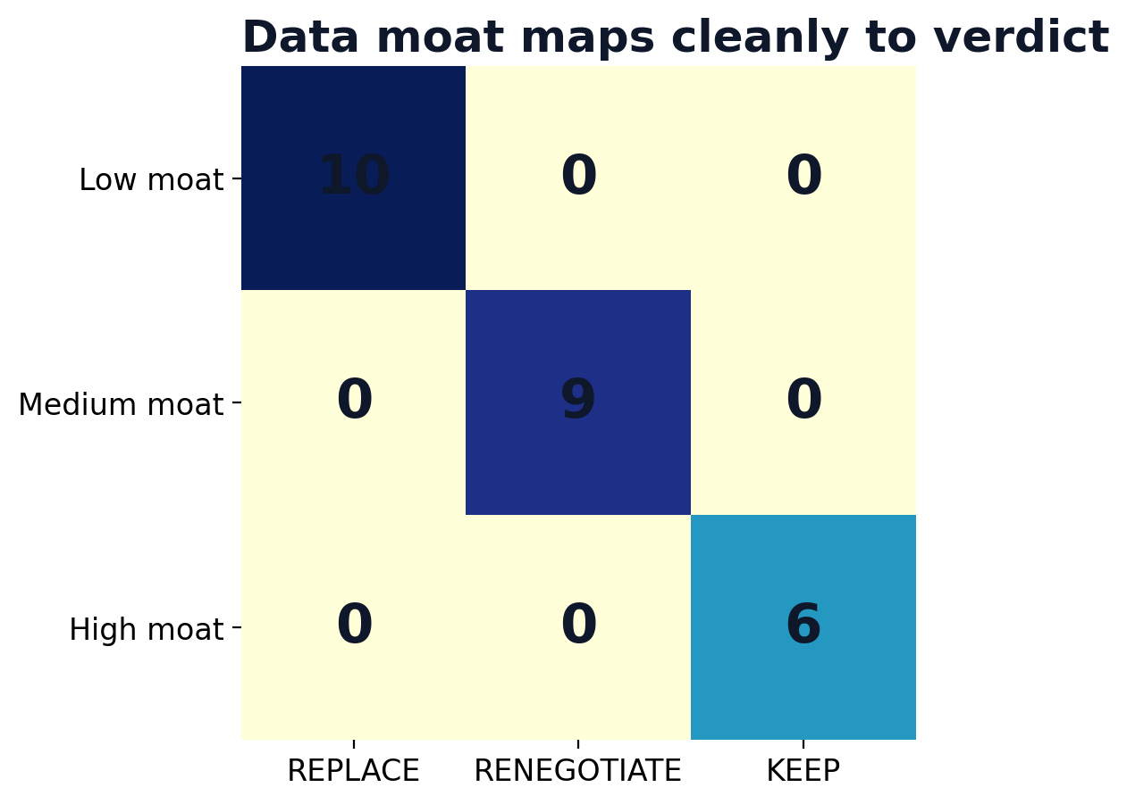
Data moat is the strongest explanatory variable in the scorecard
Low moat maps to replace; medium moat maps to renegotiate; high moat maps to keep
• 10 / 10 low-moat rows are replacement candidates.
• 9 / 9 medium-moat rows are renegotiation candidates.
• 6 / 6 high-moat rows are keep candidates.
• This is a decision heuristic, not market proof.
Agent Replacement Scorecard · client-ready reviewed draft
45 / 60

Slide 46
Low moat: replace the exposed workflow layer
The agent can recreate the task without depending on a defensible proprietary substrate.
10
REPL.
use cases
dominant verdict
Conversational support
Customer · REPLACE · score 9
Messaging-channel chatbot
Customer · REPLACE · score 9
Document AI / extraction
Data · REPLACE · score 9
Agentic auto-remediation
Security · REPLACE · score 9
AI shopping / sales consultant
Customer · REPLACE · score 8
Travel & booking planner
Customer · REPLACE · score 8
Personalized marketing content
Creative · REPLACE · score 8
Doc summarization & drafting
Employee · REPLACE · score 8
Ad & creative generation at scale
Creative · REPLACE · score 8
Legal research & drafting
Employee · REPLACE · score 7
46 / 60
Agent Replacement Scorecard · client-ready reviewed draft

Slide 47
Medium moat: renegotiate the workflow module
The platform survives, but agent absorption gives procurement leverage.
9
RENEG.
use cases
dominant verdict
Enterprise knowledge search
Employee · RENEGOTIATE · score 7
NL analytics (text-to-SQL)
Data · RENEGOTIATE · score 7
Contact-center agent assist
Employee · RENEGOTIATE · score 7
HR / onboarding agent
Employee · RENEGOTIATE · score 7
AI code assistant
Code · RENEGOTIATE · score 7
In-product owner assistant
Customer · RENEGOTIATE · score 6
Video generation
Creative · RENEGOTIATE · score 6
App build / migration automation
Code · RENEGOTIATE · score 6
Research & insight agent
Data · RENEGOTIATE · score 6
Agent Replacement Scorecard · client-ready reviewed draft
47 / 60

Slide 48
High moat: keep the governed substrate
The durable value is records, telemetry, permissions, audit, or regulatory context.
6
KEEP
use cases
dominant verdict
Fraud & risk detection
Security · KEEP · score 6
Threat detection / SecOps
Security · KEEP · score 6
Forecasting / predictive ops
Data · KEEP · score 5
Brand / 3D asset generation
Creative · KEEP · score 5
Compliance & audit agent
Security · KEEP · score 5
Legacy-IT modernization (NL→SAP)
Code · KEEP · score 4
Agent Replacement Scorecard · client-ready reviewed draft
48 / 60

Slide 49
Moat signals to test in client discovery
These questions turn the scorecard into a workshop instrument
1
Where does the workflow read or write the system of record?
2
Which permissions, audit trails, or regulated records must survive?
3
Does the workflow depend on proprietary telemetry or mostly public/common data?
4
Can the agent execute safely in parallel before cutover?
5
Which vendor module is priced by seats but now behaves like an automation layer?
6
What would procurement renegotiate if the agent handles 30-70% of the task?
Agent Replacement Scorecard · client-ready reviewed draft
49 / 60

Slide 50
SECTION 04
Client Narrative & Commercial Motion
Only after the use cases and moats are clear should the deck move into recommendation, execution, and AEO.
Agent Replacement Scorecard · client-ready reviewed draft
50 / 60

Slide 51
The client-ready narrative
From evidence to action
• Agents first compress seats, add-ons, runbooks, and scripted task tools.
• Platforms with proprietary records, permissions, telemetry, and audit survive.
• The strategic move is to separate replace, renegotiate, and keep at workflow level.
• Use the scorecard to target pilots, renewals, and AEO pages with evidence.
Client message: replace exposed workflow layers; renegotiate assist modules; keep governed substrates.
Agent Replacement Scorecard · client-ready reviewed draft
51 / 60

Slide 52
Replace playbook
Replace cases need a distinct commercial motion
REPLACE
Conversational support
Customer · score 9
Messaging-channel chatbot
Customer · score 9
• Target high-volume, low-moat workflows.
• Pilot against real historical tasks.
• Measure seat, add-on, or BPO compression.
• Keep the system of record where needed; remove the workflow layer.
Document AI / extraction
Data · score 9
Agentic auto-remediation
Security · score 9
AI shopping / sales consultant
Customer · score 8
Agent Replacement Scorecard · client-ready reviewed draft
52 / 60

Slide 53
Renegotiate playbook
Renegotiate cases need a distinct commercial motion
RENEGOTIATE
Enterprise knowledge search
Employee · score 7
NL analytics (text-to-SQL)
Data · score 7
• Keep the platform, challenge the module.
• Use agent capability as renewal leverage.
• Quantify assist-layer overlap.
• Ask vendors to reprice around value, not seats.
Contact-center agent assist
Employee · score 7
HR / onboarding agent
Employee · score 7
AI code assistant
Code · score 7
Agent Replacement Scorecard · client-ready reviewed draft
53 / 60

Slide 54
Keep playbook
Keep cases need a distinct commercial motion
KEEP
Fraud & risk detection
Security · score 6
Threat detection / SecOps
Security · score 6
• Protect governed data and audit trails.
• Use agents as workflow accelerators.
• Avoid risky replacement claims.
• Make the moat visible to buyers and executives.
Forecasting / predictive ops
Data · score 5
Brand / 3D asset generation
Creative · score 5
Compliance & audit agent
Security · score 5
Agent Replacement Scorecard · client-ready reviewed draft
54 / 60

Slide 55
SECTION 05
AEO & Productization
The AEO plan should publish the scorecard logic and buyer questions, not generic AI claims.
Agent Replacement Scorecard · client-ready reviewed draft
55 / 60

Slide 56
AEO pages should be generated from the model
Each page answers a buyer question with a scorecard-backed claim
Replacement risk
Use low-moat replacement cases.
Which SaaS seats can AI agents replace first?
Renewal leverage
Use medium-moat renegotiate cases.
Which add-ons should be renegotiated?
Moat defense
Use high-moat keep cases.
Which platforms survive agent adoption?
Pilot design
Use volume + determinism.
How should we test replacement safely?
Procurement script
Use the commercial playbooks.
What should we ask vendors at renewal?
Agent Replacement Scorecard · client-ready reviewed draft
56 / 60

Slide 57
30-day evidence sprint
The sprint turns a strong v1 diagnostic into stronger client proof
1
Expand the dataset from 25 to 75+ scored use cases.
2
Add source URLs and proof-status labels to every deployed example.
3
Run two independent reviewers against volume, determinism, and moat scores.
4
Attach approximate seat/module economics where the client has spend data.
5
Publish five AEO pages grounded in the scorecard model.
6
Rerun the deck after new evidence and mark changed verdicts explicitly.
Agent Replacement Scorecard · client-ready reviewed draft
57 / 60

Slide 58
Decision ask
Launch the diagnostic and harden the evidence base in parallel
v1
75+
5
2x
diagnostic
rows
AEO pages
reviewers
use with clients now
next evidence target
publish model-derived answers
score reliability
• Approve the client-ready scorecard as a reviewed v2 narrative.
• Use it in discovery where the buyer has SaaS renewal, automation, or AI transformation pressure.
• Do not position it as statistical market proof until the evidence sprint is complete.
Agent Replacement Scorecard · client-ready reviewed draft
58 / 60

Slide 59
Appendix: claim guardrails
Use these boundaries when presenting externally
Supported
Not supported yet
Curated 25-row scorecard; directional exposure model; evidence-backed examples; client diagnostic; procurement and pilot prioritization.
Statistical SaaS market forecast; universal category verdicts; guaranteed savings; proof that all named vendors are displaced.
Agent Replacement Scorecard · client-ready reviewed draft
59 / 60

Slide 60
Appendix: source and reproducibility
Deck build artifacts
• Input CSV: /mnt/c/Users/sheke/OneDrive/Desktop/Agent-Replacement-Scorecard.csv
• Builder script: /home/shekerk/content-ideas/runs/2026-06-30-agent-replacement-scorecard-synthesis/build_client_ready_deck_v2.py
• Output deck: /home/shekerk/content-ideas/runs/2026-06-30-agent-replacement-scorecard-synthesis/outputs/Agent-Replacement-Scorecard-Client-Ready-Reviewed-v2.pptx
• Validation: Deck.save() structural validation plus source/scored CSV arithmetic checks.
• Status: reviewed client-ready draft; rendered preview attempted via available tooling.
Agent Replacement Scorecard · client-ready reviewed draft
60 / 60

