Slide 1
REVIEWED DRAFT
Agent Replacement Scorecard
Data synthesis deck built from 25 scored use cases, not AEO gate narration
25
10
9
6
use cases scored
replace candidates
renegotiate cases
keep cases
Question: which SaaS layers are exposed to agent replacement, renegotiation, or durability?
Model: volume + determinism + inverse data moat, validated against verdict distribution.
Main finding: data moat is the dominant separator; volume determines where replacement becomes economically urgent.
Source: Agent-Replacement-Scorecard.csv; original deck repaired because its AEO evidence-gate story did not match the structured scorecard dataset.
Agent Replacement Scorecard | data synthesis reviewed draft | 2026-06-30
1 / 18

Slide 2
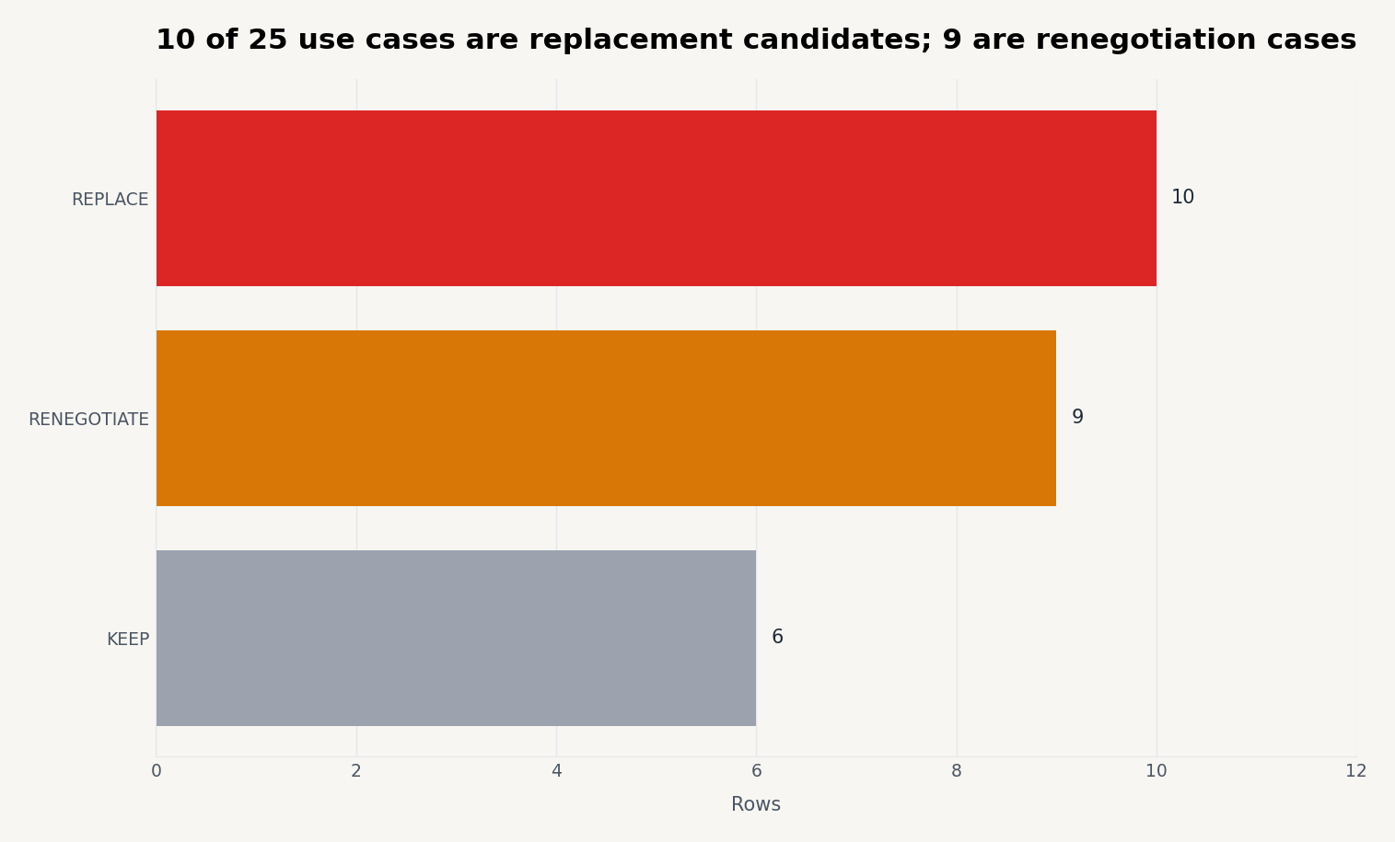
EXECUTIVE TAKE
The answer is not 'agents replace SaaS'; it is a three-way split
Replacement, renegotiation, and durability each appear in the dataset.
Finding
10 workflows are replacement candidates where the exposed layer is seats, add-ons, or scripted workflow tooling.
9 workflows are renegotiation cases where the system of record survives but add-on modules compress.
6 workflows are keep cases, mostly where high data moat, permissions, audit, or proprietary telemetry are the value.
Decision implication
Lead with a diagnostic. Do not market a blanket replacement thesis.
Agent Replacement Scorecard | data synthesis reviewed draft | 2026-06-30
2 / 18

Slide 3
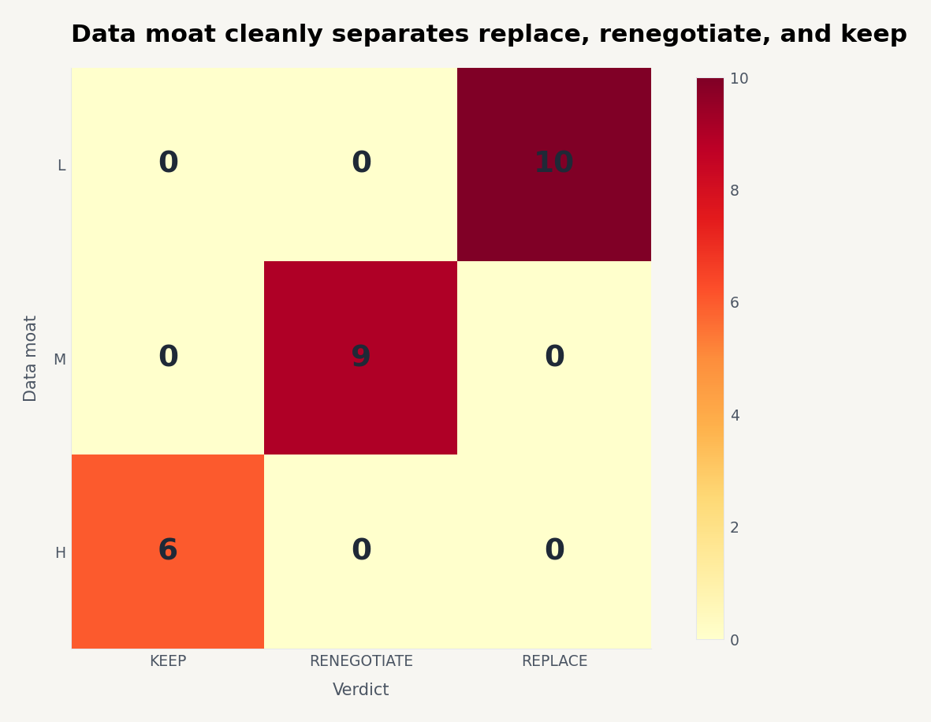
MODEL
Data moat explains the verdict boundary
The scorecard is strongest when it shows the mechanism, not just examples.
Low moat: 10 / 10 rows are REPLACE.
Medium moat: 9 / 9 rows are RENEGOTIATE.
High moat: 6 / 6 rows are KEEP.
This is the cleanest synthetic finding and should anchor the deck.
Interpretation: agents compress the interaction/workflow layer first. The durable substrate is where proprietary records, permissions, governance, and audit trails remain hard to dislodge.
Agent Replacement Scorecard | data synthesis reviewed draft | 2026-06-30
3 / 18

Slide 4
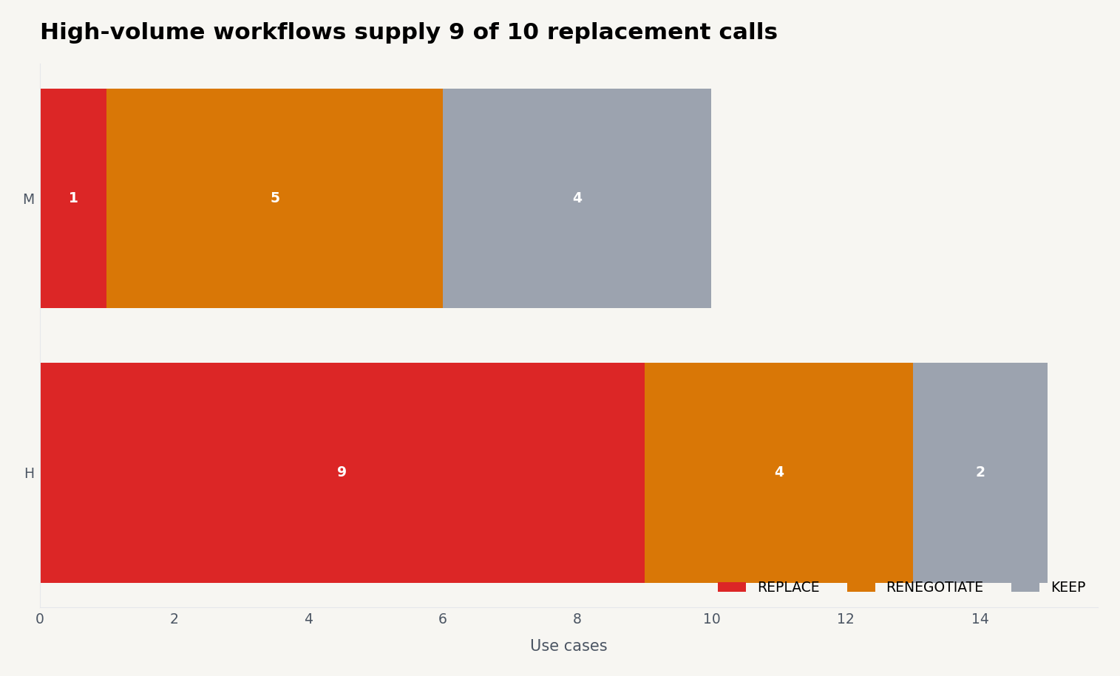
DRIVER CHECK
High volume turns exposure into near-term commercial pressure
Volume does not decide the verdict alone; it makes replacement worth pursuing.
High-volume rows produce 9 of the 10 replacement calls.
Medium-volume rows skew toward renegotiate or keep.
Priority should go to high-volume, low-moat workflows first because the cost takeout is easiest to explain.
Use this as the commercial filter after the technical replacement score.
Agent Replacement Scorecard | data synthesis reviewed draft | 2026-06-30
4 / 18

Slide 5
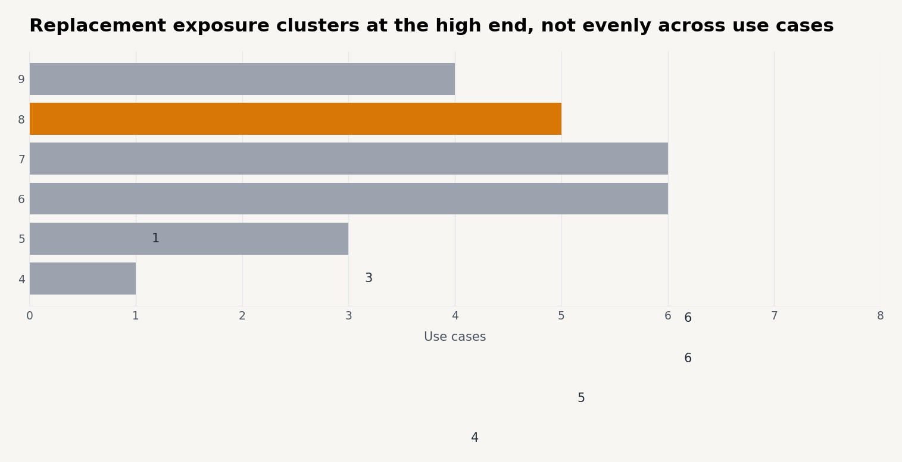
SCORING
The replacement score makes the ranking auditable
Score = volume + determinism + moat exposure. High score is more exposed.
Use case | Type | Vol | Det | Moat | Score
Conversational support | Customer | H | H | L | 9
Messaging-channel chatbot | Customer | H | H | L | 9
Document AI / extraction | Data | H | H | L | 9
Agentic auto-remediation | Security | H | H | L | 9
AI shopping / sales consultant | Customer | H | M | L | 8
Travel & booking planner | Customer | H | M | L | 8
Doc summarization & drafting | Employee | H | M | L | 8
Ad & creative generation at scale | Creative | H | M | L | 8
Agent Replacement Scorecard | data synthesis reviewed draft | 2026-06-30
5 / 18

Slide 6
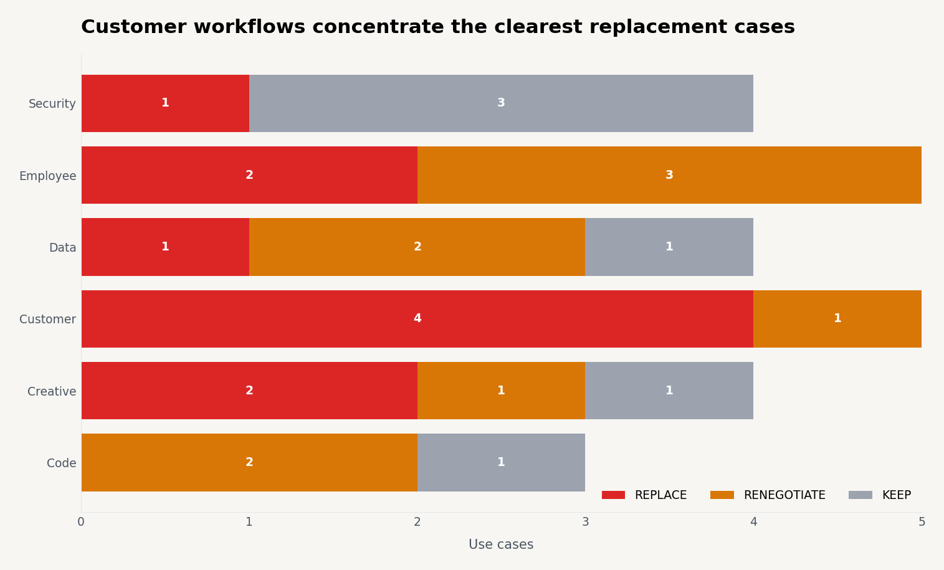
SEGMENT VIEW
Customer-facing workflows carry the clearest replacement signal
The category split shows where to start the client conversation.
Customer use cases: 4 replace, 1 renegotiate, 0 keep.
Security use cases: 3 keep, 1 replace; the moat is usually telemetry, policy, and audit.
Employee and data workflows split because proprietary context often keeps the platform while compressing add-ons.
Agent Replacement Scorecard | data synthesis reviewed draft | 2026-06-30
6 / 18

Slide 7
REPLACE SHORTLIST
Top replacement candidates share the same pattern
High volume, repeatable intent, and weak data moat.
Use case | SaaS exposed | Compression thesis | Score
Conversational support | Per-seat help desks (Zendesk) | 80 support seats → 1 agent + KB | 9
Messaging-channel chatbot | Chatbot / CCaaS bots | Bot-builder seats → 1 agent | 9
Document AI / extraction | IDP / OCR SaaS | IDP/OCR seats → agent + Document AI | 9
Agentic auto-remediation | SOAR / runbooks | SOAR/runbook seats → agent in policy | 9
AI shopping / sales consultant | Guided-selling SaaS | Guided-selling seats → 1 agent | 8
Travel & booking planner | Booking / itinerary tools | Booking seats → agent + inventory API | 8
Doc summarization & drafting | Doc / productivity add-ons | Native LLM; drop add-on seats | 8
Agent Replacement Scorecard | data synthesis reviewed draft | 2026-06-30
7 / 18

Slide 8
DURABLE LAYERS
Keep cases are not anti-agent; they are substrate cases
The agent can improve workflow without replacing the durable system.
Use case | Type | Moat | Verdict | Durable SaaS layer
Legacy-IT modernization (NL→SAP) | Code | H | KEEP | Modernization consulting / tools
Brand / 3D asset generation | Creative | H | KEEP | Asset / DAM tooling
Forecasting / predictive ops | Data | H | KEEP | Predictive-analytics SaaS
Compliance & audit agent | Security | H | KEEP | GRC tooling
In-product owner assistant | Customer | M | RENEGOTIATE | Manuals / FAQ / deflection tools
Video generation | Creative | M | RENEGOTIATE | Video editing SaaS
App build / migration automation | Code | M | RENEGOTIATE | Low-code & migration tooling
Message: sell workflow compression, not platform eradication, when the moat is proprietary data or governance.
Agent Replacement Scorecard | data synthesis reviewed draft | 2026-06-30
8 / 18

Slide 9
RENEGOTIATE
Renegotiate is the commercial middle, not a weak conclusion
Nine rows preserve the system of record while compressing modules and seats.
Use case | Type | SaaS affected | Negotiation lever
In-product owner assistant | Customer | Manuals / FAQ / deflection tools | Keep platform; drop deflection seats
Enterprise knowledge search | Employee | Enterprise search SaaS | Agent over your data; trim search seats
Contact-center agent assist | Employee | CCaaS agent-assist | Keep CCaaS; agent-assist replaces add-on
HR / onboarding agent | Employee | HR workflow SaaS | Agent runs workflow; keep record system
Video generation | Creative | Video editing SaaS | Agent drafts; editors finish
AI code assistant | Code | IDE / code-review add-ons | Enriches IDE; consumption not seats
App build / migration automation | Code | Low-code & migration tooling | Agent replaces low-code seats partially
NL analytics (text-to-SQL) | Data | BI dashboards (Looker-class) | Agent over warehouse; trim BI seats
This is the procurement wedge: keep the core, challenge the per-seat workflow module.
Agent Replacement Scorecard | data synthesis reviewed draft | 2026-06-30
9 / 18

Slide 10
EVIDENCE
Proof examples should be evidence rows, not decoration
Each scorecard row has a deployed proof claim and a SaaS-in-crosshairs claim.
Conversational support
Mercedes MBUX, Wendy's FreshAI, Home Depot Magic Apron
Per-seat help desks (Zendesk)
80 support seats → 1 agent + KB
AI shopping / sales consultant
Mercedes smart sales, Mobiauto, Best Buy
Guided-selling SaaS
Guided-selling seats → 1 agent
Travel & booking planner
Agoda, Priceline, LATAM Cosmos, Virgin Voyages
Booking / itinerary tools
Booking seats → agent + inventory API
Messaging-channel chatbot
LUXGEN (LINE), Banglalink REN, DT MINDR
Chatbot / CCaaS bots
Bot-builder seats → 1 agent
Deck repair: move from anecdote lists to proof-to-verdict traceability.
Agent Replacement Scorecard | data synthesis reviewed draft | 2026-06-30
10 / 18

Slide 11
VALIDATION
Validation passed, with one important limitation
The dataset is internally complete, but it is curated rather than statistically sampled.
0
0
25/25
25/25
null columns over 20%
duplicate use cases
rows with proof text
rows with verdict
High confidence in internal arithmetic: counts, cross-tabs, and score derivation reconcile to 25 rows.
Medium confidence in market generalization: the rows are evidence-backed examples, not a random market sample.
Guardrail: call this a replacement exposure scorecard, not a statistically validated SaaS replacement model.
Agent Replacement Scorecard | data synthesis reviewed draft | 2026-06-30
11 / 18

Slide 12
PRODUCTIZATION
The scorecard should become a diagnostic workflow
Each client account can be scored with the same dimensions.
1. Inventory workflows and attached SaaS modules.
2. Score volume, determinism, and data moat on H/M/L.
3. Classify each line as replace, renegotiate, or keep.
4. Attach deployed proof examples and a buyer-specific savings lever.
5. Convert high-scoring rows into pilot candidates or procurement asks.
The artifact is stronger as an interactive account diagnostic than as a static thought-leadership deck.
Agent Replacement Scorecard | data synthesis reviewed draft | 2026-06-30
12 / 18

Slide 13
AEO REBUILD
AEO angle: publish the model, not just the claim
AEO pages should answer buyer questions grounded in the dataset.
Page cluster | Buyer question | Data-backed answer
Replacement risk | Which SaaS seats can AI agents replace first? | Use replace shortlist + score formula
Renegotiation | Which AI agent gains should lower my SaaS bill? | Use renegotiate table
Moat defense | Which SaaS systems survive agent adoption? | Use keep cases + data moat logic
Pilot design | How do I test agent replacement safely? | Use volume/determinism filters
Procurement script | What should I ask vendors at renewal? | Use compression thesis
This connects AEO to synthesis: pages are generated from observed scorecard patterns, not generic AI positioning.
Agent Replacement Scorecard | data synthesis reviewed draft | 2026-06-30
13 / 18

Slide 14
GUARDRAILS
Claim guardrails keep the deck credible
Separate what the data supports from what still needs proof.
Supported
Not supported yet
25-row curated scorecard
Directional exposure model
Evidence-backed examples
Client diagnostic v1
Procurement/pilot prioritization
Total SaaS replacement forecast
Statistical market sizing
Engine consensus proof
Universal category verdicts
Guaranteed savings
Agent Replacement Scorecard | data synthesis reviewed draft | 2026-06-30
14 / 18

Slide 15
NEXT SPRINT
30-day evidence sprint should harden the model
Move from curated synthesis to repeatable scoring evidence.
Workstream | Target | Why it matters
Dataset | Expand 25 rows to 75+ | More stable segment patterns
Scoring | Score two reviewers independently | Inter-rater reliability
Economics | Attach seat/module cost ranges | Dollarized replacement cases
AEO | Publish 5 model-derived pages | Crawlable buyer answers
Validation | Track vendor/customer proof links | Source tieout for each proof row
Agent Replacement Scorecard | data synthesis reviewed draft | 2026-06-30
15 / 18

Slide 16
DECISION
Decision ask: launch the diagnostic, not the proof claim
The synthesis is strong enough for v1 account work and page briefs.
v1
75+
5
2x
launch
score
publish
validate
diagnostic
next rows
AEO pages
reviewers
Use this deck for client discovery and procurement strategy.
Use the CSV model as the source of truth for page briefs and account diagnostics.
Do not present the current evidence as final market proof until the expanded sprint is complete.
Agent Replacement Scorecard | data synthesis reviewed draft | 2026-06-30
16 / 18

Slide 17
APPENDIX
Appendix: scoring rubric
Simple enough to explain in a workshop; explicit enough to audit.
Dimension | Definition | Interpretation
Volume | H = high throughput / frequent task | More economic pressure
Determinism | H = repeatable rules and stable outputs | Easier automation boundary
Data moat | L = weak proprietary substrate | Higher replacement exposure
Verdict | Replace / Renegotiate / Keep | Commercial action, not moral judgment
Exposure score used in this deck: Volume score + Determinism score + inverse Data Moat score.
Agent Replacement Scorecard | data synthesis reviewed draft | 2026-06-30
17 / 18

Slide 18
APPENDIX
Appendix: files and QA status
Reproducible deck build with explicit status.
Input CSV: /mnt/c/Users/sheke/OneDrive/Desktop/Agent-Replacement-Scorecard.csv
Original deck inspected: /mnt/c/Users/sheke/OneDrive/Desktop/Agent-Replacement-Scorecard-AEO-Data-Backed-Client-Reviewed.pptx
Builder script: /home/shekerk/content-ideas/runs/2026-06-30-agent-replacement-scorecard-synthesis/build_scorecard_synthesis_deck.py
Charts: /home/shekerk/content-ideas/runs/2026-06-30-agent-replacement-scorecard-synthesis/outputs/charts
Status: reviewed draft; data synthesis repaired; visual QA performed by slide text and file generation checks.
Note: the original AEO evidence-gate material was not discarded conceptually; it was reframed as a downstream AEO page plan after the scorecard synthesis.
Agent Replacement Scorecard | data synthesis reviewed draft | 2026-06-30
18 / 18

