Slide 1
DECISION DECK
Approve a 30-Day Agent Replacement Diagnostic
A client-ready recommendation for finding replace, renegotiate, and keep actions across SaaS workflows
Built from the Agent Replacement Scorecard evidence base · reviewed v4
Agent Replacement Scorecard · decision deck reviewed v4
1 / 25

Slide 2
Recommendation: approve a 30-day AI agent software-portfolio diagnostic
The decision is whether to turn a broad AI-agent thesis into a client-specific portfolio action plan
Approve the diagnostic.
Decision ask
Approve v4 as a diagnostic sales narrative, subject to proof-source URL tieout before external final.
• Classify workflows into replace, renegotiate, and keep actions.
• Tie AI-agent potential to SaaS spend, renewal leverage, and governance risk.
• Use the scorecard as the workshop operating model, not as a generic research deck.
Agent Replacement Scorecard · decision deck reviewed v4
2 / 25

Slide 3
The executive problem is not 'will AI replace SaaS?'
The real problem is deciding which workflow spend is exposed before the next renewal cycle
Bad framing
Better framing
Best framing
A category-level prediction: agents replace SaaS.
A workflow-level diagnosis: some layers are exposed; some are defensible.
A portfolio decision: replace, renegotiate, or keep by workflow layer.
The deck must sell a decision process, not explain a framework.
Agent Replacement Scorecard · decision deck reviewed v4
3 / 25

Slide 4
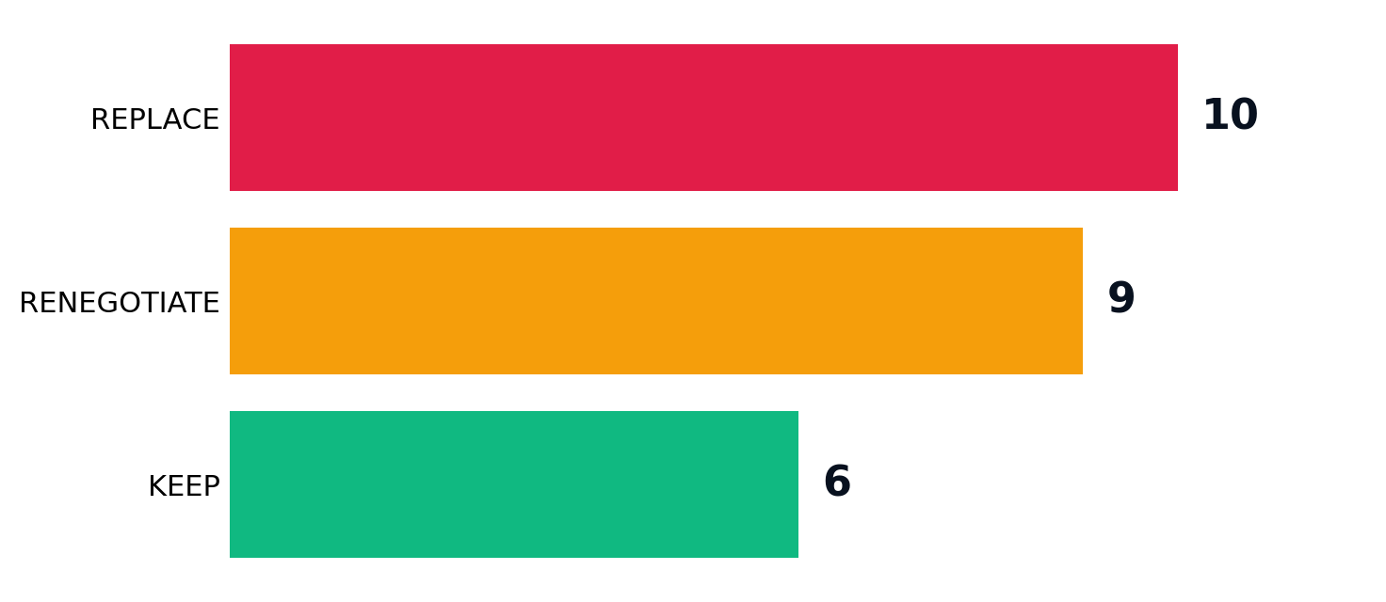
The answer is a three-motion operating model
Each motion has a different owner, evidence bar, and executive conversation
Replace
Run agent pilots against exposed workflow layers.
Renegotiate
Challenge modules, add-ons, and seat pricing.
Keep
Protect governed systems of record and data moats.
Agent Replacement Scorecard · decision deck reviewed v4
4 / 25

Slide 5
The diagnostic creates four executive outputs
This is what the client gets after 30 days
Workflow inventory
Moat scorecard
Named workflows, vendors, seats/modules, renewal timing.
Volume, determinism, data moat, and verdict by workflow.
Action portfolio
Roadmap
Replace pilots, renegotiation targets, protected systems.
Owners, tests, data needs, and 30/60/90-day actions.
Agent Replacement Scorecard · decision deck reviewed v4
5 / 25

Slide 6
01
Decision Logic
The deck should make the decision logic obvious before showing the evidence.
Agent Replacement Scorecard · decision deck reviewed v4
6 / 25

Slide 7
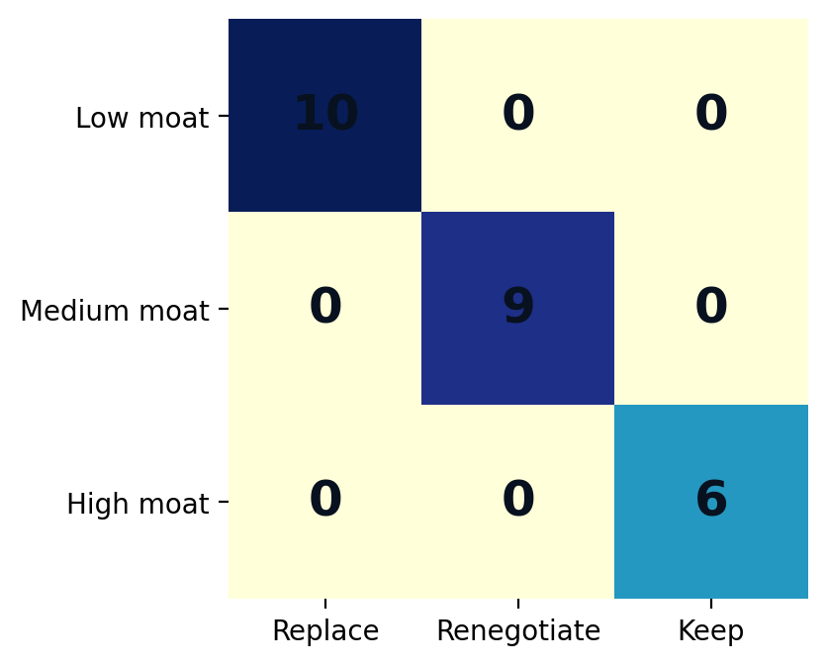
Data moat is the decision boundary
Moat turns AI feasibility into a commercial action
Low moat
Replace: agent can recreate the workflow.
Medium moat
Renegotiate: platform stays, workflow module compresses.
High moat
Keep: governed data and control-plane value remain durable.
Agent Replacement Scorecard · decision deck reviewed v4
7 / 25

Slide 8
Volume and determinism determine sequencing
The first wave should be economically meaningful and operationally testable
High volume
High determinism
Low moat
Enough spend or work volume to matter to CFO and COO stakeholders.
Repeatable enough for replay, parallel run, QA, and measurement.
Weak enough substrate protection to create replacement leverage.
Priority rule: start with high-volume, repeatable, weakly defended workflows.
Agent Replacement Scorecard · decision deck reviewed v4
8 / 25

Slide 9
The scorecard is a workshop instrument
Executives should not be asked to admire the model; they should use it to make decisions
• Map the workflow layer, control layer, and substrate layer.
• Score the workflow with business stakeholders, not only AI experts.
• Assign the action: replace, renegotiate, or keep.
• Translate the action into a pilot, renewal ask, or governance protection.
Agent Replacement Scorecard · decision deck reviewed v4
9 / 25

Slide 10
02
Options
A consulting deck must show what was rejected, not only what is recommended.
Agent Replacement Scorecard · decision deck reviewed v4
10 / 25

Slide 11
Three options were considered; only one creates portfolio leverage
The recommended option links AI capability to renewal economics and operating risk
1. Wait for vendors
2. Run isolated pilots
3. Portfolio diagnostic
Low effort, but vendors keep control of pricing and packaging.
Fast learning, but pilots stay disconnected from SaaS spend.
Connects AI, spend, renewal, risk, and operating action.
Reject
Partial
Recommend
Agent Replacement Scorecard · decision deck reviewed v4
11 / 25

Slide 12
Why isolated pilots are not enough
Pilots prove feasibility; they do not automatically create renewal leverage
Pilot-only failure mode
Diagnostic-led advantage
The team demos an agent, but cannot connect it to module spend, vendor pricing, workflow volume, or risk controls.
The team targets pilots where the commercial motion is already clear: replace, renegotiate, or keep.
Agent Replacement Scorecard · decision deck reviewed v4
12 / 25

Slide 13
03
Evidence Base
The scorecard supports the decision; it should not dominate the story.
Agent Replacement Scorecard · decision deck reviewed v4
13 / 25

Slide 14
The current evidence base is enough for a diagnostic offer
It is not enough for a market-wide replacement forecast
25
10
9
6
scored use cases
replace candidates
renegotiate cases
keep cases
cross-domain examples
exposed workflow layers
module / seat leverage
governed substrates
• Use as directional consulting evidence.
• Add source URLs before external final distribution.
• Do not present as statistical market proof.
Agent Replacement Scorecard · decision deck reviewed v4
14 / 25

Slide 15
Replace targets are exposed workflow layers
The value pool is labor, seats, add-ons, or runbooks.
Conversational support
Customer · Low moat
Messaging-channel chatbot
Customer · Low moat
Document AI / extraction
Data · Low moat
Agentic auto-remediation
Security · Low moat
AI shopping / sales consultant
Customer · Low moat
Travel & booking planner
Customer · Low moat
Personalized marketing content
Creative · Low moat
Commercial motion: Replace is an action, not a category label.
Agent Replacement Scorecard · decision deck reviewed v4
15 / 25

Slide 16
Renegotiation targets are the fastest executive win
The platform matters, but modules and seats become vulnerable.
Enterprise knowledge search
Employee · Medium moat
NL analytics (text-to-SQL)
Data · Medium moat
Contact-center agent assist
Employee · Medium moat
HR / onboarding agent
Employee · Medium moat
AI code assistant
Code · Medium moat
In-product owner assistant
Customer · Medium moat
Video generation
Creative · Medium moat
Commercial motion: Renegotiate is an action, not a category label.
Agent Replacement Scorecard · decision deck reviewed v4
16 / 25

Slide 17
Keep targets prevent overreach
Governed data and audit create durable control-plane value.
Fraud & risk detection
Security · High moat
Threat detection / SecOps
Security · High moat
Forecasting / predictive ops
Data · High moat
Brand / 3D asset generation
Creative · High moat
Compliance & audit agent
Security · High moat
Legacy-IT modernization (NL→SAP)
Code · High moat
Commercial motion: Keep is an action, not a category label.
Agent Replacement Scorecard · decision deck reviewed v4
17 / 25

Slide 18
04
Action Plan
The recommendation needs owners, timeline, and success metrics.
Agent Replacement Scorecard · decision deck reviewed v4
18 / 25

Slide 19
30-day diagnostic plan
The work converts a thesis into a client-specific action portfolio
Week 1
Week 2
Week 3
Week 4
Inventory workflows, vendors, modules, seats, renewal dates.
Score volume, determinism, data moat with stakeholders.
Build replace / renegotiate / keep portfolio view.
Select pilots, renewal asks, protected systems, and AEO pages.
Agent Replacement Scorecard · decision deck reviewed v4
19 / 25

Slide 20
Owners and success metrics
A decision deck must define who does what after approval
CFO / procurement
Modules/seats challenged
Renewal leverage list
CIO / architecture
Governed systems preserved
System-of-record protection
COO / function leads
Workflows moved to test
Pilot backlog
Marketing / AEO
Pages shipped and cited
Buyer-answer pages
Agent Replacement Scorecard · decision deck reviewed v4
20 / 25

Slide 21
Risks and mitigations
The recommendation is credible only if the weak points are named
Evidence is curated
Spend data unavailable
Position as diagnostic; add source URL tieout.
Use workshop to collect modules, seats, and renewals.
Over-replacement risk
Vendor pushback
Make keep and renegotiate first-class outcomes.
Use workflow-level evidence, not category claims.
Agent Replacement Scorecard · decision deck reviewed v4
21 / 25

Slide 22
Decision required now
Approve the diagnostic, then harden the evidence before external final
Approve the 30-day diagnostic.
• Use the deck to sell the problem and recommendation.
• Use the workshop to produce client-specific actions.
• Use proof-source tieout to move from reviewed draft to external final.
Next gate: source-tied proof pack + client-specific spend fields.
Agent Replacement Scorecard · decision deck reviewed v4
22 / 25

Slide 23
05
Appendix
Keep the method available without making it the executive story.
Agent Replacement Scorecard · decision deck reviewed v4
23 / 25

Slide 24
Method guardrails
What this deck can and cannot claim
Supported
Not yet supported
Curated scorecard; workflow-level diagnostic; replace / renegotiate / keep operating model.
Statistical market sizing; guaranteed savings; universal category replacement; source-verified proof for every named example.
Agent Replacement Scorecard · decision deck reviewed v4
24 / 25

Slide 25
Reproducibility
Artifacts generated with the deck
• Decision memo: /home/shekerk/content-ideas/runs/2026-06-30-agent-replacement-scorecard-synthesis/outputs/decision_memo_v4.md
• Input scorecard: /mnt/c/Users/sheke/OneDrive/Desktop/Agent-Replacement-Scorecard.csv
• Decision pack: /home/shekerk/content-ideas/runs/2026-06-30-agent-replacement-scorecard-synthesis/outputs/decision_pack_v4
• Builder: /home/shekerk/content-ideas/runs/2026-06-30-agent-replacement-scorecard-synthesis/build_decision_deck_v4.py
Agent Replacement Scorecard · decision deck reviewed v4
25 / 25

