Slide 1
EXECUTIVE STORY DECK
Agent Replacement Scorecard
Where AI agents create replacement pressure, renewal leverage, and durable SaaS moats
Reviewed client-ready draft | Built from scorecard evidence + executive storyline
Agent Replacement Scorecard · executive story reviewed draft
1 / 37

Slide 2
The plot: AI agents shift value from SaaS seats to executable work
The business question is not which app dies; it is which workflow layer loses pricing power
Old SaaS model
Agentic work model
Executive decision
Value captured through seats, add-ons, workflow modules, and scripted human-in-the-loop tasks.
Value shifts to agents that execute work across tools, data, and approvals.
Replace the exposed layer. Renegotiate the module. Keep the governed substrate.
Decision framework for software portfolio action, not a CSV report.
Agent Replacement Scorecard · executive story reviewed draft
2 / 37

Slide 3
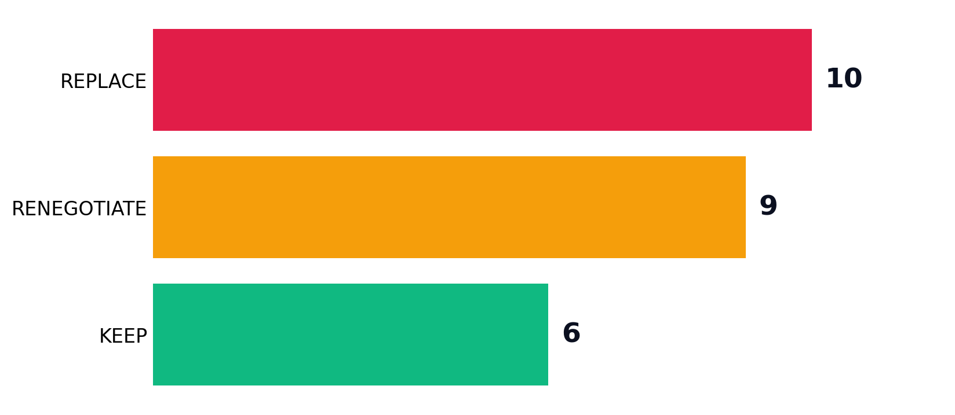
Executive summary: the scorecard creates three commercial motions
Each motion has a different owner, risk profile, and buying conversation
Replace
Target workflow layers where seats, add-ons, or runbooks are the exposed value pool.
Renegotiate
Use agents as renewal leverage where the core platform survives but modules compress.
Keep
Protect systems where governed data, telemetry, permissions, and audit are the moat.
Agent Replacement Scorecard · executive story reviewed draft
3 / 37

Slide 4
What executives should take away
The scorecard changes the discussion from AI enthusiasm to portfolio action
CFO
CIO
Find spend categories where agent execution challenges seat and module pricing.
Protect systems of record while exposing workflow layers to agent pilots.
COO
CMO / CRO
Use volume and determinism to prioritize automation programs.
Publish AEO pages that answer buyer questions with scored evidence.
Agent Replacement Scorecard · executive story reviewed draft
4 / 37

Slide 5
The answer is a portfolio diagnostic, not a replacement manifesto
Blanket claims are weak; workflow-level classification is useful
• The exposed object is usually a workflow layer: support interaction, extraction, drafting, runbook execution, or guided selling.
• The durable object is usually a governed substrate: records, identity, permissions, telemetry, audit, regulated data, or proprietary corpus.
• The scorecard is valuable because it tells a client which conversation to have with each vendor.
Agent Replacement Scorecard · executive story reviewed draft
5 / 37

Slide 6
SECTION 01
Decision Frame
The deck starts with the business architecture of the problem, then uses the data to prove the frame.
Agent Replacement Scorecard · executive story reviewed draft
6 / 37

Slide 7
Agents attack workflows before they attack systems
This is why category-level SaaS replacement claims sound naive to executives
Workflow layer
Control layer
Substrate layer
Human interaction, task execution, drafting, summarization, triage, routing, extraction, or recommendation.
Approvals, policies, escalations, human accountability, and audit gates.
System of record, proprietary data, permissions, telemetry, and compliance record.
Client implication: replacement pressure is highest when SaaS monetizes workflow without owning the substrate.
Agent Replacement Scorecard · executive story reviewed draft
7 / 37

Slide 8
The scorecard answers four executive questions
These are the questions a client can actually act on
1
Which workflows should we pilot for agent replacement?
2
Which SaaS modules should we renegotiate at renewal?
3
Which systems should we protect as durable substrates?
4
Which buyer questions should we publish for AEO and demand capture?
Agent Replacement Scorecard · executive story reviewed draft
8 / 37

Slide 9
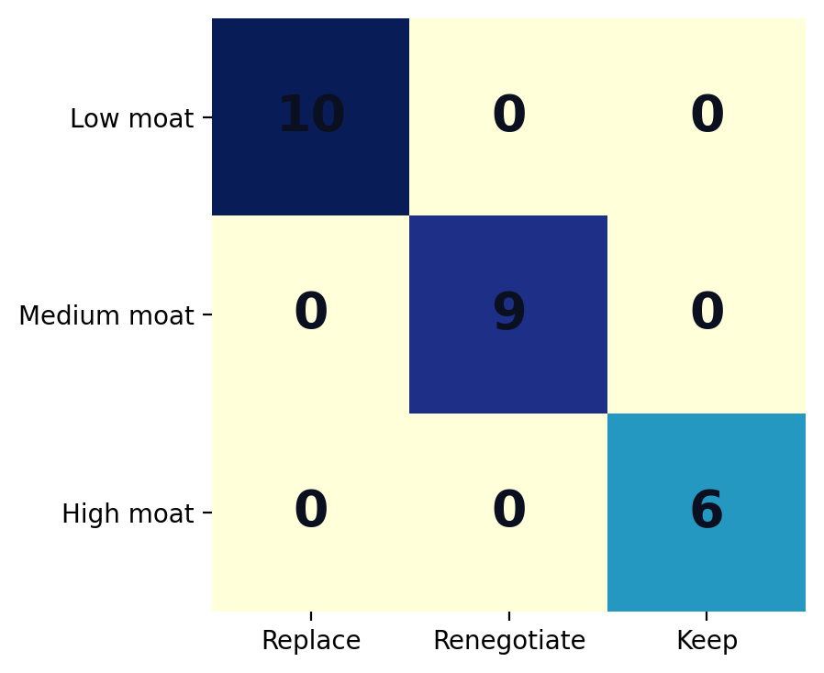
The commercial motion depends on data moat
Moat is the bridge between technical feasibility and business action
Low moat → Replace
Workflow can be recreated without a proprietary substrate.
Medium moat → Renegotiate
Platform survives, workflow modules and seats compress.
High moat → Keep
Governed data and control-plane value remain durable.
Agent Replacement Scorecard · executive story reviewed draft
9 / 37

Slide 10
Volume and determinism decide where to start
Moat tells you the motion; volume and repeatability tell you the urgency
High volume
High determinism
Low moat
Creates enough economic pressure to matter in a renewal, operating plan, or automation business case.
Makes the workflow easier to test, replay, constrain, and measure.
Turns feasibility into replacement leverage.
Priority rule: start with high-volume, deterministic workflows where the vendor is monetizing an exposed workflow layer.
Agent Replacement Scorecard · executive story reviewed draft
10 / 37

Slide 11
SECTION 02
Use-Case Evidence
The use cases are not a catalogue for its own sake; they show where the commercial motions appear.
Agent Replacement Scorecard · executive story reviewed draft
11 / 37

Slide 12
Customer workflows show a different replacement pattern
Domain-level evidence before the final story
4
1
0
replace
renegotiate
keep
Conversational support
Customer · Low moat · Replace
Messaging-channel chatbot
Customer · Low moat · Replace
AI shopping / sales consultant
Customer · Low moat · Replace
Travel & booking planner
Customer · Low moat · Replace
In-product owner assistant
Customer · Medium moat · Renegotiate
Executive implication: Best starting point for replacement pilots because volume, visibility, and seat compression are easy to explain.
Agent Replacement Scorecard · executive story reviewed draft
12 / 37

Slide 13
Employee workflows show a different replacement pattern
Domain-level evidence before the final story
2
3
0
replace
renegotiate
keep
Doc summarization & drafting
Employee · Low moat · Replace
Enterprise knowledge search
Employee · Medium moat · Renegotiate
Contact-center agent assist
Employee · Medium moat · Renegotiate
Legal research & drafting
Employee · Low moat · Replace
HR / onboarding agent
Employee · Medium moat · Renegotiate
Executive implication: Mostly a productivity and renewal story: keep core systems, pressure assist layers.
Agent Replacement Scorecard · executive story reviewed draft
13 / 37

Slide 14
Creative workflows show a different replacement pattern
Domain-level evidence before the final story
2
1
1
replace
renegotiate
keep
Ad & creative generation at scale
Creative · Low moat · Replace
Personalized marketing content
Creative · Low moat · Replace
Video generation
Creative · Medium moat · Renegotiate
Brand / 3D asset generation
Creative · High moat · Keep
Executive implication: Separate production throughput from brand/IP governance.
Agent Replacement Scorecard · executive story reviewed draft
14 / 37

Slide 15
Code workflows show a different replacement pattern
Domain-level evidence before the final story
0
2
1
replace
renegotiate
keep
AI code assistant
Code · Medium moat · Renegotiate
App build / migration automation
Code · Medium moat · Renegotiate
Legacy-IT modernization (NL→SAP)
Code · High moat · Keep
Executive implication: Treat as engineering leverage, not wholesale SDLC replacement.
Agent Replacement Scorecard · executive story reviewed draft
15 / 37

Slide 16
Data workflows show a different replacement pattern
Domain-level evidence before the final story
1
2
1
replace
renegotiate
keep
Document AI / extraction
Data · Low moat · Replace
NL analytics (text-to-SQL)
Data · Medium moat · Renegotiate
Research & insight agent
Data · Medium moat · Renegotiate
Forecasting / predictive ops
Data · High moat · Keep
Executive implication: Extraction can be replaced; governed analytics substrates usually survive.
Agent Replacement Scorecard · executive story reviewed draft
16 / 37

Slide 17
Security workflows show a different replacement pattern
Domain-level evidence before the final story
1
0
3
replace
renegotiate
keep
Agentic auto-remediation
Security · Low moat · Replace
Threat detection / SecOps
Security · High moat · Keep
Fraud & risk detection
Security · High moat · Keep
Compliance & audit agent
Security · High moat · Keep
Executive implication: Telemetry and audit defend the platform; runbooks are more exposed.
Agent Replacement Scorecard · executive story reviewed draft
17 / 37

Slide 18
Replace candidates share one economic pattern
The exposed value pool is not the database; it is the workflow labor or seat layer
Conversational support
Customer · Low moat · Replace
Messaging-channel chatbot
Customer · Low moat · Replace
Document AI / extraction
Data · Low moat · Replace
Agentic auto-remediation
Security · Low moat · Replace
AI shopping / sales consultant
Customer · Low moat · Replace
Travel & booking planner
Customer · Low moat · Replace
Personalized marketing content
Creative · Low moat · Replace
Doc summarization & drafting
Employee · Low moat · Replace
Ad & creative generation at scale
Creative · Low moat · Replace
Legal research & drafting
Employee · Low moat · Replace
Agent Replacement Scorecard · executive story reviewed draft
18 / 37

Slide 19
Renegotiate candidates are where executives can act fastest
The vendor remains important, but pricing and packaging become vulnerable
Enterprise knowledge search
Employee · Medium moat · Renegotiate
NL analytics (text-to-SQL)
Data · Medium moat · Renegotiate
Contact-center agent assist
Employee · Medium moat · Renegotiate
HR / onboarding agent
Employee · Medium moat · Renegotiate
AI code assistant
Code · Medium moat · Renegotiate
In-product owner assistant
Customer · Medium moat · Renegotiate
Video generation
Creative · Medium moat · Renegotiate
App build / migration automation
Code · Medium moat · Renegotiate
Research & insight agent
Data · Medium moat · Renegotiate
Agent Replacement Scorecard · executive story reviewed draft
19 / 37

Slide 20
Keep candidates create credibility
A serious deck must explain what survives, not only what breaks
Fraud & risk detection
Security · High moat · Keep
Threat detection / SecOps
Security · High moat · Keep
Forecasting / predictive ops
Data · High moat · Keep
Brand / 3D asset generation
Creative · High moat · Keep
Compliance & audit agent
Security · High moat · Keep
Legacy-IT modernization (NL→SAP)
Code · High moat · Keep
Agent Replacement Scorecard · executive story reviewed draft
20 / 37

Slide 21
SECTION 03
Executive Storyline
Now that the frame and evidence are established, the storyline becomes sharper and less primitive.
Agent Replacement Scorecard · executive story reviewed draft
21 / 37

Slide 22
The market shift is from software access to work execution
Seat-based SaaS is exposed when a buyer no longer needs a human in every workflow seat
• SaaS monetized access: users logged into tools to move work forward.
• Agents monetize execution: work moves through tools with fewer human seats.
• The durable value shifts toward systems that hold governed context and control.
Agent Replacement Scorecard · executive story reviewed draft
22 / 37

Slide 23
The strategic risk is misclassifying the layer
Replacing a workflow layer is smart; replacing a governed substrate is usually reckless
Bad executive read
Good executive read
Declare a category dead, ignore governance, and overpromise displacement.
Separate task execution from control systems, then pick the right commercial motion.
Agent Replacement Scorecard · executive story reviewed draft
23 / 37

Slide 24
The client conversation changes by function
The same scorecard creates different questions for different executives
CFO
CIO
Where can we challenge seat/module spend?
Which substrates must stay governed?
COO
CRO/CMO
Which workflows are ready for parallel-run pilots?
Which buyer questions should our AEO pages answer?
Agent Replacement Scorecard · executive story reviewed draft
24 / 37

Slide 25
The scorecard becomes a workshop, not a slide artifact
The client value is in applying the frame to their actual software estate
• Inventory workflows and attached vendors.
• Score volume, determinism, and data moat.
• Assign replace / renegotiate / keep by workflow layer.
• Translate the result into pilots, renewal asks, and AEO content.
Agent Replacement Scorecard · executive story reviewed draft
25 / 37

Slide 26
SECTION 04
Commercial Motions
The executive output is not insight; it is a set of decisions, owners, and next actions.
Agent Replacement Scorecard · executive story reviewed draft
26 / 37

Slide 27
Replace the exposed workflow layer
Primary owner: COO + CIO + function owner
Conversational support
REPLACE
Messaging-channel chatbot
Document AI / extraction
Pilot agent execution where the workflow is high-volume, repeatable, and weakly defended by proprietary data.
Agentic auto-remediation
AI shopping / sales consultant
Agent Replacement Scorecard · executive story reviewed draft
27 / 37

Slide 28
Renegotiate the module or seat bundle
Primary owner: CFO + procurement + CIO
Enterprise knowledge search
RENEGOTIATE
NL analytics (text-to-SQL)
Contact-center agent assist
Keep the platform, but use agent capability to challenge assist modules, add-ons, and per-seat economics.
HR / onboarding agent
AI code assistant
Agent Replacement Scorecard · executive story reviewed draft
28 / 37

Slide 29
Keep the governed substrate
Primary owner: CIO + risk + data owner
Fraud & risk detection
KEEP
Threat detection / SecOps
Forecasting / predictive ops
Protect systems where value resides in permissions, audit, telemetry, records, and regulatory control.
Brand / 3D asset generation
Compliance & audit agent
Agent Replacement Scorecard · executive story reviewed draft
29 / 37

Slide 30
The 30-day action plan
Move from thesis to client operating artifact
Week 1
Week 2
Week 3
Week 4
Map the client software estate to workflows.
Score volume, determinism, and data moat with stakeholders.
Build the replace / renegotiate / keep portfolio view.
Pick pilots, renewal asks, and AEO pages.
Agent Replacement Scorecard · executive story reviewed draft
30 / 37

Slide 31
Decision ask
Approve the scorecard as a client-facing diagnostic, not a static research deck
• Use the deck to open executive conversations about SaaS spend, agent pilots, and renewal leverage.
• Use the scorecard workshop to generate client-specific replacement and renegotiation actions.
• Use the AEO plan to publish buyer-facing answers grounded in the model.
Approve v3 for client use after proof-source URL tieout.
Agent Replacement Scorecard · executive story reviewed draft
31 / 37

Slide 32
SECTION 05
Appendix
Method, guardrails, and use-case detail for reviewers.
Agent Replacement Scorecard · executive story reviewed draft
32 / 37

Slide 33
Method guardrails
What this deck can and cannot claim
Supported
Not yet supported
Curated scorecard; directional exposure logic; use-case-backed commercial motions; workshop diagnostic.
Statistical market sizing; universal SaaS replacement forecast; guaranteed savings; source-verified proof URLs for every row.
Agent Replacement Scorecard · executive story reviewed draft
33 / 37

Slide 34
Appendix: replacement use cases
Detailed roster for reviewers
Conversational support
Customer · Low moat · Replace
Messaging-channel chatbot
Customer · Low moat · Replace
Document AI / extraction
Data · Low moat · Replace
Agentic auto-remediation
Security · Low moat · Replace
AI shopping / sales consultant
Customer · Low moat · Replace
Travel & booking planner
Customer · Low moat · Replace
Personalized marketing content
Creative · Low moat · Replace
Doc summarization & drafting
Employee · Low moat · Replace
Ad & creative generation at scale
Creative · Low moat · Replace
Legal research & drafting
Employee · Low moat · Replace
Agent Replacement Scorecard · executive story reviewed draft
34 / 37

Slide 35
Appendix: renegotiation use cases
Detailed roster for reviewers
Enterprise knowledge search
Employee · Medium moat · Renegotiate
NL analytics (text-to-SQL)
Data · Medium moat · Renegotiate
Contact-center agent assist
Employee · Medium moat · Renegotiate
HR / onboarding agent
Employee · Medium moat · Renegotiate
AI code assistant
Code · Medium moat · Renegotiate
In-product owner assistant
Customer · Medium moat · Renegotiate
Video generation
Creative · Medium moat · Renegotiate
App build / migration automation
Code · Medium moat · Renegotiate
Research & insight agent
Data · Medium moat · Renegotiate
Agent Replacement Scorecard · executive story reviewed draft
35 / 37

Slide 36
Appendix: keep use cases
Detailed roster for reviewers
Fraud & risk detection
Security · High moat · Keep
Threat detection / SecOps
Security · High moat · Keep
Forecasting / predictive ops
Data · High moat · Keep
Brand / 3D asset generation
Creative · High moat · Keep
Compliance & audit agent
Security · High moat · Keep
Legacy-IT modernization (NL→SAP)
Code · High moat · Keep
Agent Replacement Scorecard · executive story reviewed draft
36 / 37

Slide 37
Reproducibility
Artifacts generated alongside this deck
• Input scorecard: /mnt/c/Users/sheke/OneDrive/Desktop/Agent-Replacement-Scorecard.csv
• AI Analyst pack: /home/shekerk/content-ideas/runs/2026-06-30-agent-replacement-scorecard-synthesis/outputs/ai_analyst_pack_v3
• Deck builder: /home/shekerk/content-ideas/runs/2026-06-30-agent-replacement-scorecard-synthesis/build_executive_story_deck_v3.py
• Output deck: /home/shekerk/content-ideas/runs/2026-06-30-agent-replacement-scorecard-synthesis/outputs/Agent-Replacement-Scorecard-Executive-Story-Reviewed-v3.pptx
Agent Replacement Scorecard · executive story reviewed draft
37 / 37

