Slide 1
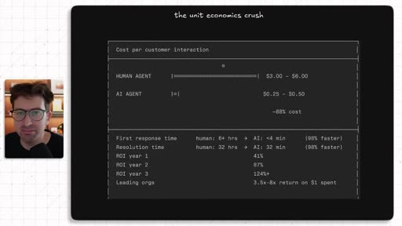
VIDEO-TO-DECK
AI Agents Are The New SaaS
Branded PPTX from cached transcript, frames, and Excalidraw source.
Core answer
The monetizable opportunity is not a generic chatbot. It is a narrow, repeated human workflow that can be shadowed, specified, piloted, and then productized.
Video-to-Deck | AI Agents are the new SaaS
1 / 8

Slide 2
The Playbook Is Service First, Product Second
The video is a founder workflow for turning agent work into a sellable product.
1. Niche
2. Shadow
3. Spec
4. Pilot
Find repeated work where misses are expensive.
Watch the human do the job before building.
Extract trigger, context, tools, rules, and success criteria.
Sell outcome labor first, then productize the repeatable pattern.
• The deck should show the workflow, not just summarize the transcript.
• Markdown remains the source trail; the PPTX is the client-facing artifact.
• Captured frames and recreated diagrams become slide visuals.
Source: cached VTT transcript plus watch frames 0001, 0004, and 0008
Video-to-Deck | AI Agents are the new SaaS
2 / 8

Slide 3
Speed And Cost Are The Wedge
The opening visual frames the agent opportunity as better unit economics.
• Cost per customer interaction shifts from human labor to low-cost agent execution.
• Response time and resolution time become the buyer-facing proof points.
• The claim needs validation per use case before it becomes an executive metric.
Captured diagram frame: the unit economics crush
Video-to-Deck | AI Agents are the new SaaS
3 / 8

Slide 4
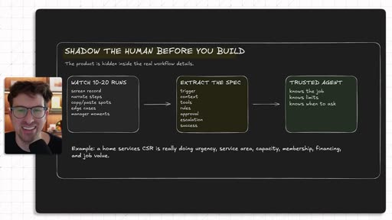
Observe The Workflow Before Building
The first operating move is evidence gathering, not prompt writing.
• Watch 10-20 real workflow runs.
• Capture screens, decisions, exceptions, and handoffs.
• Convert observed behavior into the agent spec.
Captured diagram frame: shadow the human before you build
Video-to-Deck | AI Agents are the new SaaS
4 / 8

Slide 5
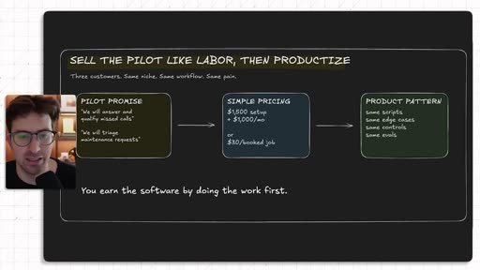
Sell The Pilot Like Labor, Then Productize
The first sale validates pain and workflow fit before software packaging.
• Promise a concrete workflow outcome.
• Use simple pricing that maps to the avoided human job.
• Productize only after the same pattern repeats across pilots.
Captured diagram frame: sell the pilot like labor, then productize
Video-to-Deck | AI Agents are the new SaaS
5 / 8

Slide 6
The Agent SaaS Conversion Loop
Recreated as editable Excalidraw source, then used as a slide-ready visual.
Pick a niche
Shadow the human
Extract the spec
Pilot to product
High-cost repeated work
Observe 10-20 runs
Trigger, context, tools, rules
Sell service, package software
->
->
->
Editable source: ai-agents-new-saas-concept.excalidraw
Use this as the cleaned client-facing version; keep captured frames as evidence.
Recreated diagram derived from transcript and frame references
Video-to-Deck | AI Agents are the new SaaS
6 / 8

Slide 7
The 30-Day Build Path Needs Proof Before Scale
The video closes with an execution rhythm for agent-first businesses.
Days 1-3
Week 1
Weeks 2-3
Week 4
Pick niche, shadow workflow, write agent spec.
Build a narrow workflow pilot with clear success criteria.
Sell two pilots in the same niche and collect real workflow proof.
Turn repeated delivery into a product pattern.
Decision gate: scale only after the same painful workflow repeats across buyers.
Source: transcript section around 22:06-25:30
Video-to-Deck | AI Agents are the new SaaS
7 / 8

Slide 8
Markdown Is Source, PPTX Is Delivery
Keep the evidence files, but wire the workflow to a branded deck.
• Research Markdown: evidence, transcript synthesis, claims, citations, speaker notes.
• Storyboard Markdown: slide outline and action titles before rendering.
• Excalidraw or Draw.io: editable diagram source.
• PNG/SVG/frame captures: visuals embedded into slides.
• Branded PPTX: final delivery artifact after validation and preview QA.
Required final output
ai-agents-new-saas-video-deck-draft.pptx
Status: draft until contact-sheet preview is reviewed.
Video-to-Deck | AI Agents are the new SaaS
8 / 8

