Slide 1
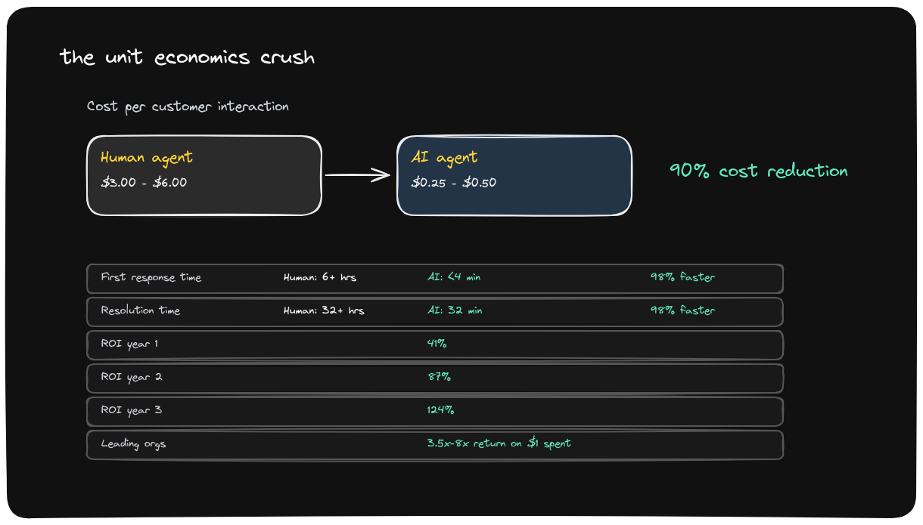
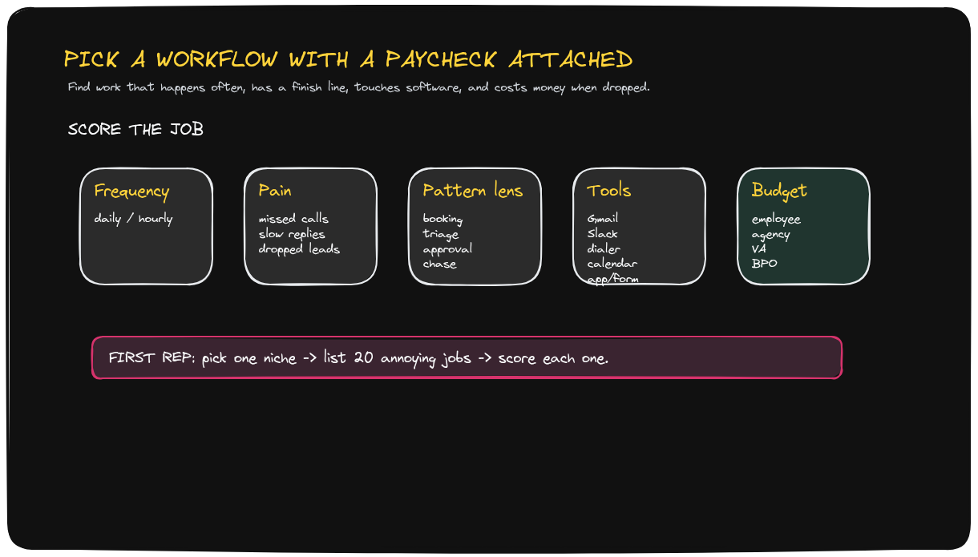
VIDEO-TO-DECK REBUILT FROM HYPERFRAMES
AI Agents Are The New SaaS
A narrow workflow with a paycheck attached becomes an agent business when the operator workflow is observed, encoded, controlled, piloted, and then productized.
What changed in this rebuild
• No original hyperframe screenshots inserted.
• Every meaningful visual frame has an Excalidraw source file.
• Presenter-only frames are excluded.
• Markdown remains audit/source material, not the deliverable.
Status: draft. Visual layer is Excalidraw-generated; editable .excalidraw sources are delivered alongside.
Video-to-Deck | Excalidraw recreation package | Draft
1 / 10

Slide 2
STORYBOARD SYNTHESIS
The Storyline Comes From The Video, Not From A Text Dump
BLUF
The opportunity is not “build an agent.” The opportunity is to find a narrow, repeated, expensive human workflow and productize it after the pattern repeats.
1
Economic wedge
2
Where to search
3
How to build
4
How to trust
5
How to sell
Unit economics compress
Paid workflow scorecard
Shadow the human
Agentic control room
Pilot first, productize second
Storyboard source: ai-agents-new-saas-storyboard.md; ai-analyst unavailable, strategy-consulting fallback used.
Video-to-Deck | Excalidraw recreation package | Draft
2 / 10

Slide 3
RECREATED FROM FRAME_0001 IN EXCALIDRAW
Agents Win When Unit Economics Compress
Why this matters
• AI is compelling where labor cost is frequent and measurable.
• Speed and cost both improve, creating a budget wedge.
• The buyer case starts with operating economics, not novelty.
Deck visual is rendered from ai-agents-new-saas-unit-economics.excalidraw, not a source hyperframe screenshot.
Video-to-Deck | Excalidraw recreation package | Draft
3 / 10

Slide 4
RECREATED FROM FRAME_0003 IN EXCALIDRAW
Pick A Workflow With A Paycheck Attached
Why this matters
• Search where frequency, pain, tools, and budget overlap.
• The first niche should have repeatable jobs with a clear finish line.
• A scorecard beats brainstorming generic agent ideas.
Deck visual is rendered from ai-agents-new-saas-workflow-scorecard.excalidraw, not a source hyperframe screenshot.
Video-to-Deck | Excalidraw recreation package | Draft
4 / 10

Slide 5
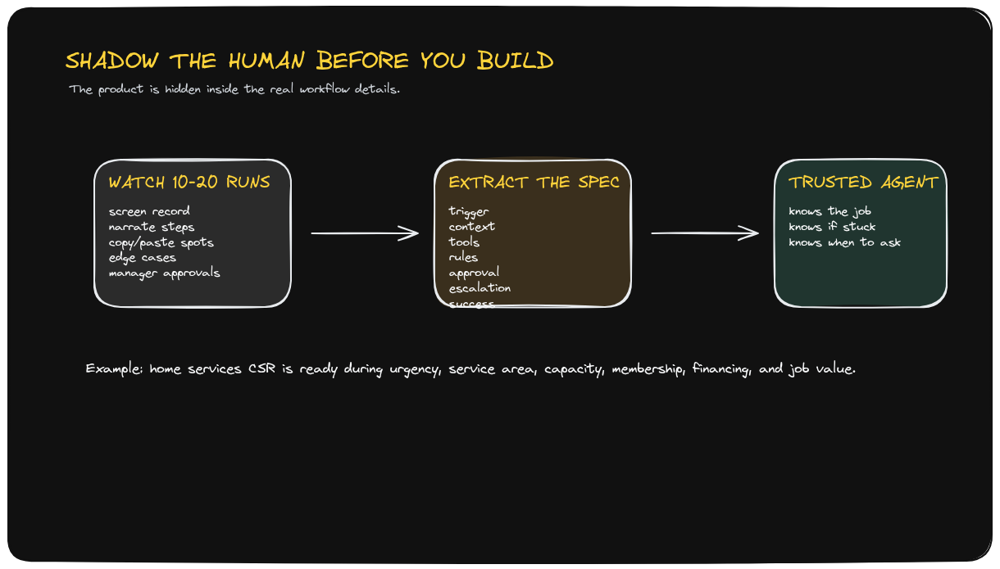
RECREATED FROM FRAME_0004 IN EXCALIDRAW
Shadow The Human Before You Build
Why this matters
• The real spec lives in observed work, exceptions, and approvals.
• Ten to twenty workflow runs reveal hidden rules.
• The agent must know when it is stuck.
Deck visual is rendered from ai-agents-new-saas-shadow-human.excalidraw, not a source hyperframe screenshot.
Video-to-Deck | Excalidraw recreation package | Draft
5 / 10

Slide 6
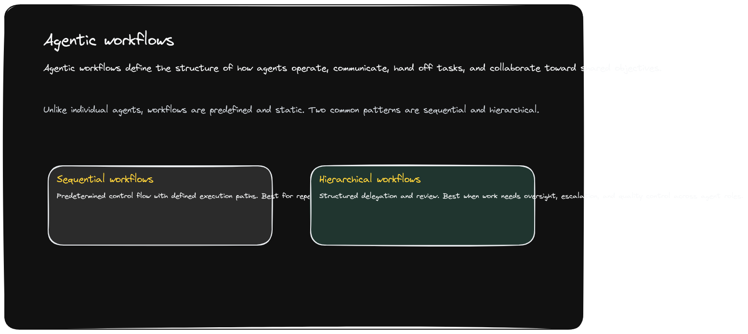
RECREATED FROM FRAME_0006 IN EXCALIDRAW
Agentic Workflows Need A Control Pattern
Why this matters
• Agents require predefined operating patterns.
• Sequential flow handles repeatable paths.
• Hierarchical flow handles review and escalation.
Deck visual is rendered from ai-agents-new-saas-agentic-workflows.excalidraw, not a source hyperframe screenshot.
Video-to-Deck | Excalidraw recreation package | Draft
6 / 10

Slide 7
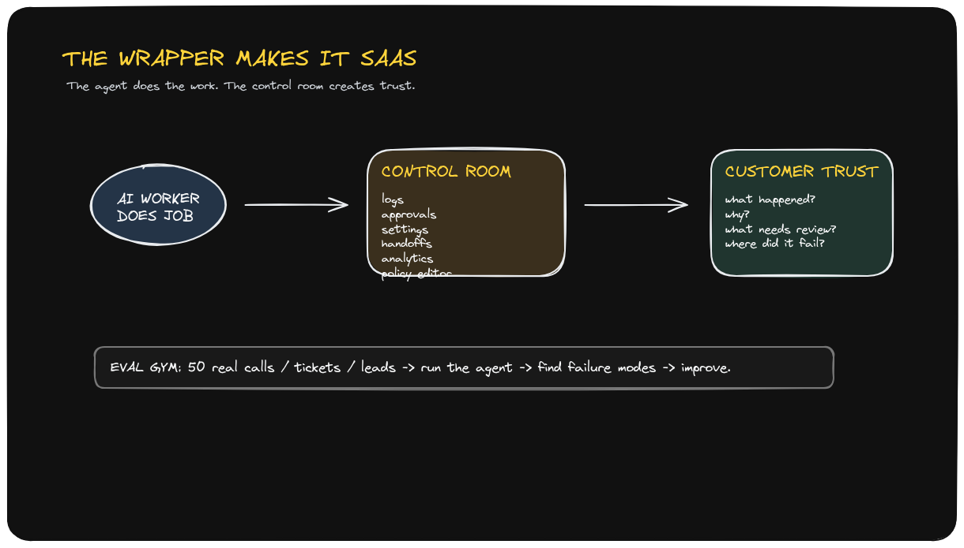
RECREATED FROM FRAME_0007 IN EXCALIDRAW
The Wrapper Turns Work Into SaaS
Why this matters
• The agent does work; the wrapper creates trust.
• Logs, approvals, settings, handoffs, analytics, and policy matter.
• Control surfaces make the product buyable.
Deck visual is rendered from ai-agents-new-saas-wrapper-saas.excalidraw, not a source hyperframe screenshot.
Video-to-Deck | Excalidraw recreation package | Draft
7 / 10

Slide 8
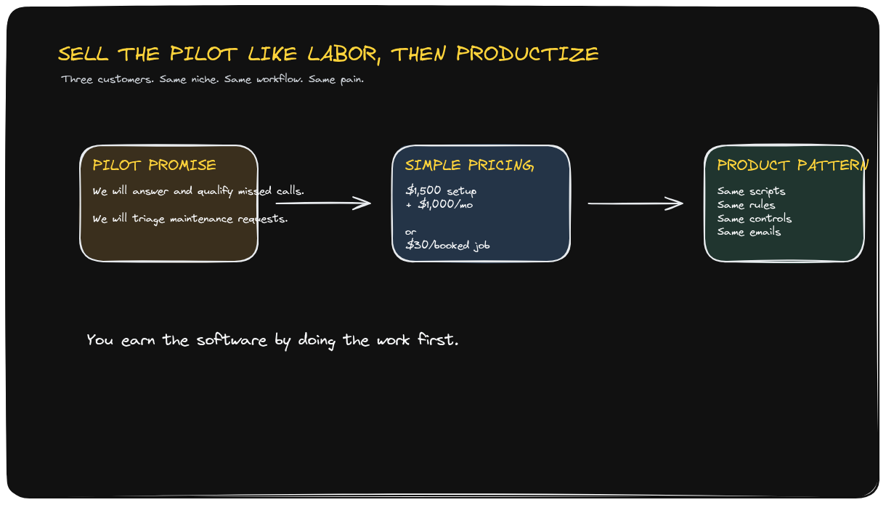
RECREATED FROM FRAMES_0008/0009 IN EXCALIDRAW
Sell The Pilot Like Labor, Then Productize
Why this matters
• Start as a service promise against a specific job.
• Use simple pricing buyers already understand.
• Productize only after the same workflow repeats.
Deck visual is rendered from ai-agents-new-saas-pilot-productize.excalidraw, not a source hyperframe screenshot.
Video-to-Deck | Excalidraw recreation package | Draft
8 / 10

Slide 9
TRANSCRIPT SYNTHESIS
The 30-Day Path Turns Proof Into Product
Days 1-3
Days 4-7
Week 2
Week 3
Week 4
Pick one niche List 20 annoying jobs Score for pain + budget
Shadow real operators Extract trigger/rules/escalation Define success metric
Build narrow pilot Use real tickets/calls/leads Create control room
Sell 2-3 pilots Same niche Same workflow Same promise
Package the pattern Lock repeatable rules Prepare SaaS wrapper
Decision gate: productize only after the same painful workflow repeats across buyers.
This slide is synthesized from transcript notes; it is not a missing hyperframe substitute.
Video-to-Deck | Excalidraw recreation package | Draft
9 / 10

Slide 10
DELIVERY PACKAGE MAP
Every Meaningful Hyperframe Has An Artifact
Frame
Concept
Editable source
Deck
Screenshots excluded
0001
unit economics
ai-agents-new-saas-unit-economics.excalidraw
slide 3
Excalidraw source
0003
workflow scorecard
ai-agents-new-saas-workflow-scorecard.excalidraw
slide 4
PPTX packaged
0004
shadow human
ai-agents-new-saas-shadow-human.excalidraw
slide 5
0006
agentic workflows
ai-agents-new-saas-agentic-workflows.excalidraw
slide 6
0007
wrapper SaaS
ai-agents-new-saas-wrapper-saas.excalidraw
slide 7
0008/0009
pilot to product
ai-agents-new-saas-pilot-productize.excalidraw
slide 8
The PPTX embeds rendered Excalidraw previews for presentation quality. Edit the actual drawings in the paired .excalidraw files, then re-export/rebuild.
Manifest: ai-agents-new-saas-hyperframes.md. Visual spec: ai-agents-new-saas-visual-spec.json.
Video-to-Deck | Excalidraw recreation package | Draft
10 / 10

