Slide 1
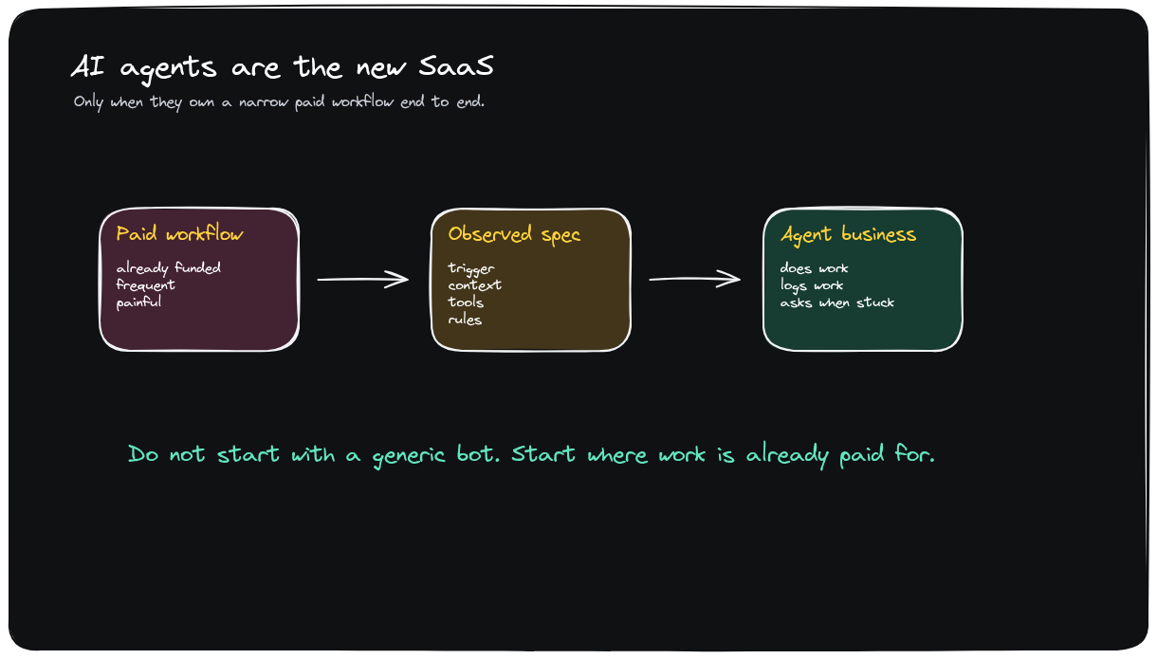
VIDEO-TO-DECK V3
AI Agents Are The New SaaS
Excalidraw-first deck rebuilt from dense hyperframes and transcript storyline.
Delivery rule
Every main content slide uses an Excalidraw-rendered visual. The editable .excalidraw sources are saved beside the PPTX.
1 / 13

Slide 2
THESIS
AI Agents Are The New SaaS
Excalidraw source: ai-agents-new-saas-v3-thesis-workflow.excalidraw
2 / 13

Slide 3
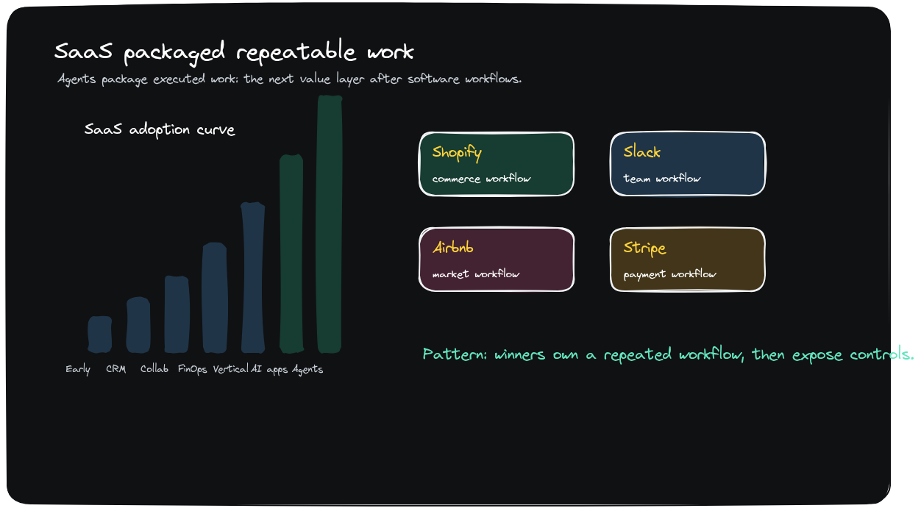
MARKET CONTEXT
SaaS Packaged Workflows; Agents Execute Them
Excalidraw source: ai-agents-new-saas-v3-market-context.excalidraw
3 / 13

Slide 4
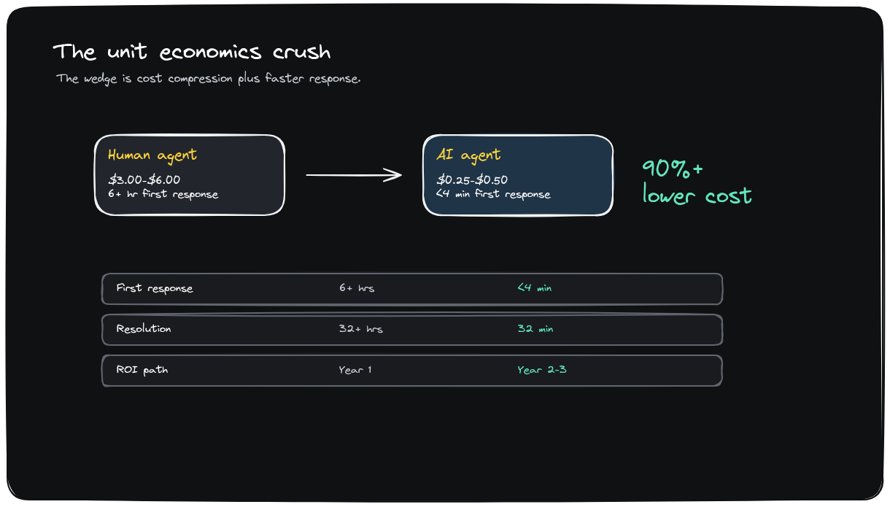
ECONOMIC WEDGE
Unit Economics Make The Wedge Obvious
Excalidraw source: ai-agents-new-saas-v3-unit-economics.excalidraw
4 / 13

Slide 5
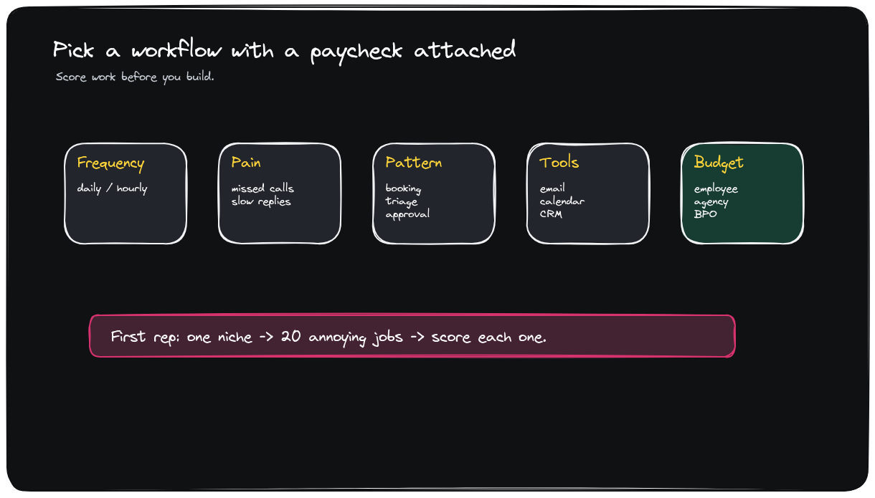
SEARCH DISCIPLINE
Pick A Workflow With A Paycheck Attached
Excalidraw source: ai-agents-new-saas-v3-workflow-scorecard.excalidraw
5 / 13

Slide 6
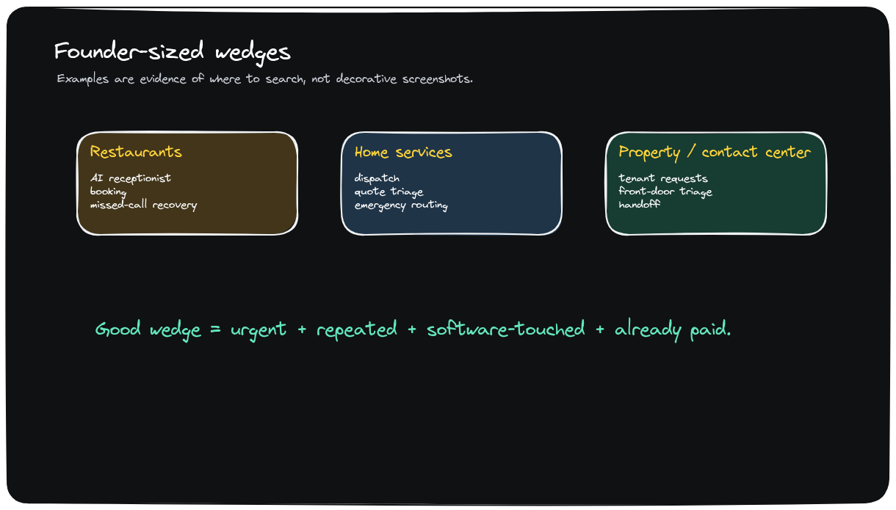
WEDGE EXAMPLES
Founder-Sized Wedges Start In Urgent Service Work
Excalidraw source: ai-agents-new-saas-v3-wedge-examples.excalidraw
6 / 13

Slide 7
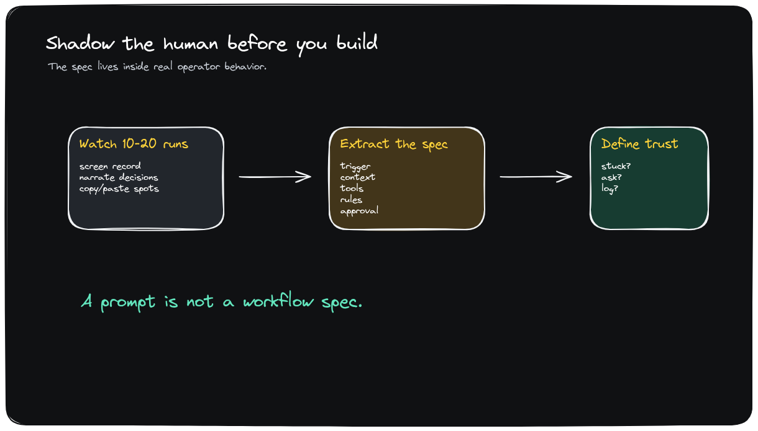
OPERATING METHOD
Shadow The Human Before You Build
Excalidraw source: ai-agents-new-saas-v3-shadow-human.excalidraw
7 / 13

Slide 8
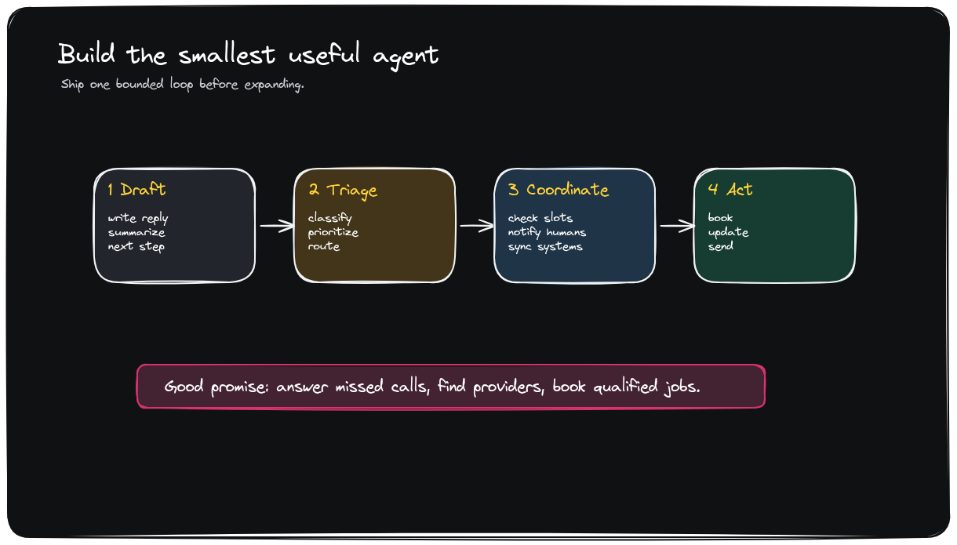
BUILD SCOPE
Build The Smallest Useful Agent
Excalidraw source: ai-agents-new-saas-v3-smallest-agent.excalidraw
8 / 13

Slide 9
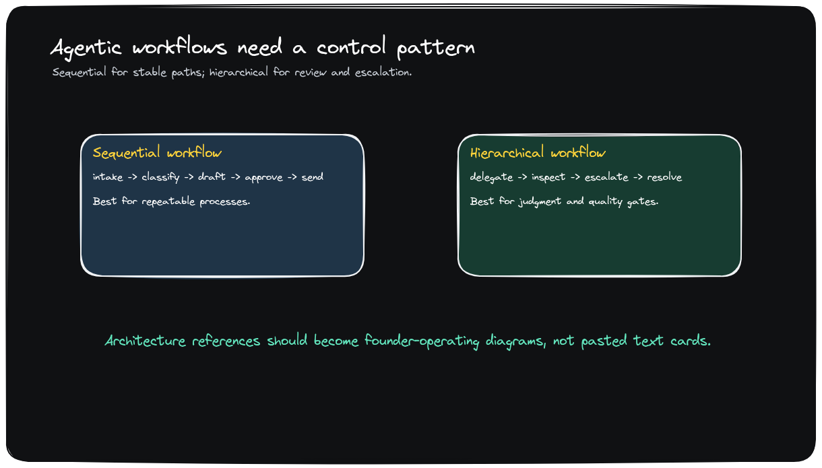
WORKFLOW ARCHITECTURE
Agentic Workflows Need A Control Pattern
Excalidraw source: ai-agents-new-saas-v3-agentic-workflows.excalidraw
9 / 13

Slide 10
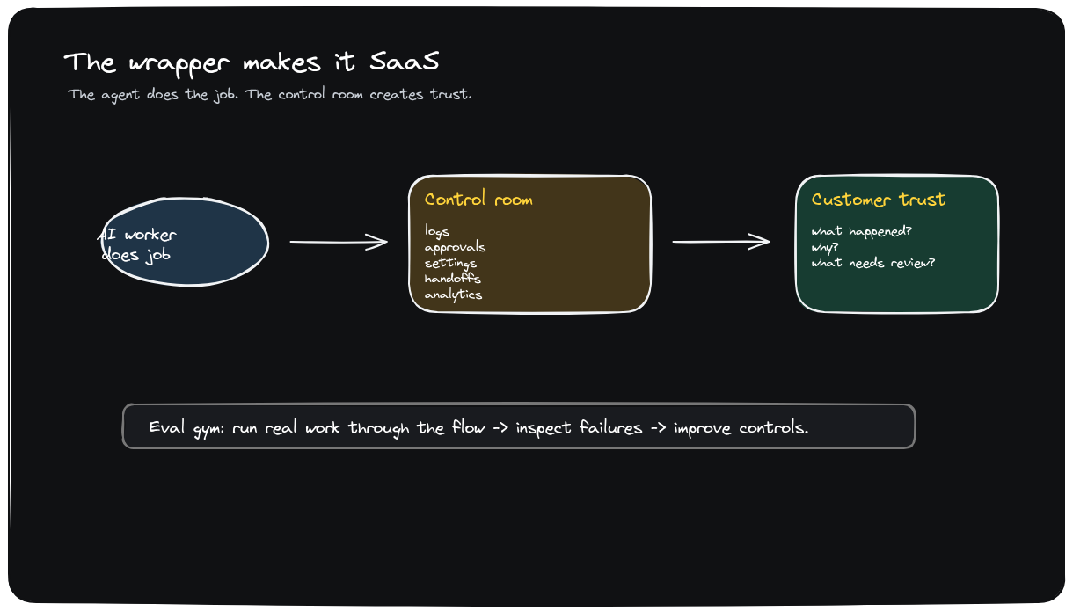
TRUST WRAPPER
The Wrapper Makes It SaaS
Excalidraw source: ai-agents-new-saas-v3-wrapper-saas.excalidraw
10 / 13

Slide 11
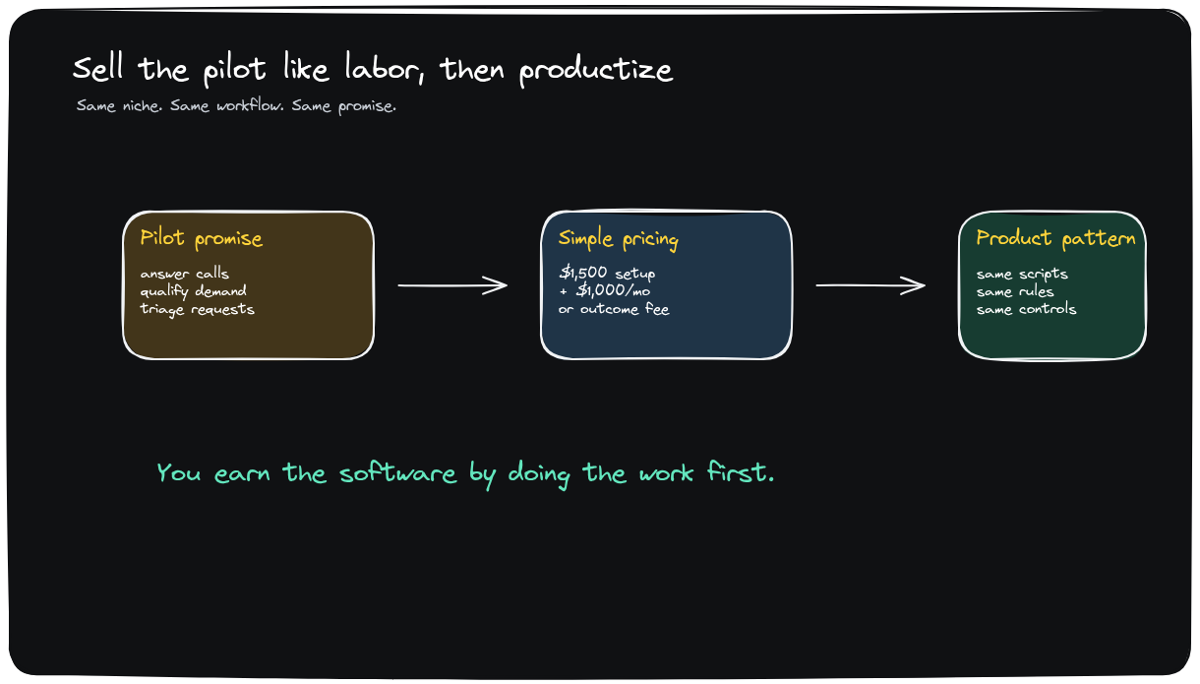
COMMERCIALIZATION
Sell The Pilot Like Labor, Then Productize
Excalidraw source: ai-agents-new-saas-v3-pilot-productize.excalidraw
11 / 13

Slide 12
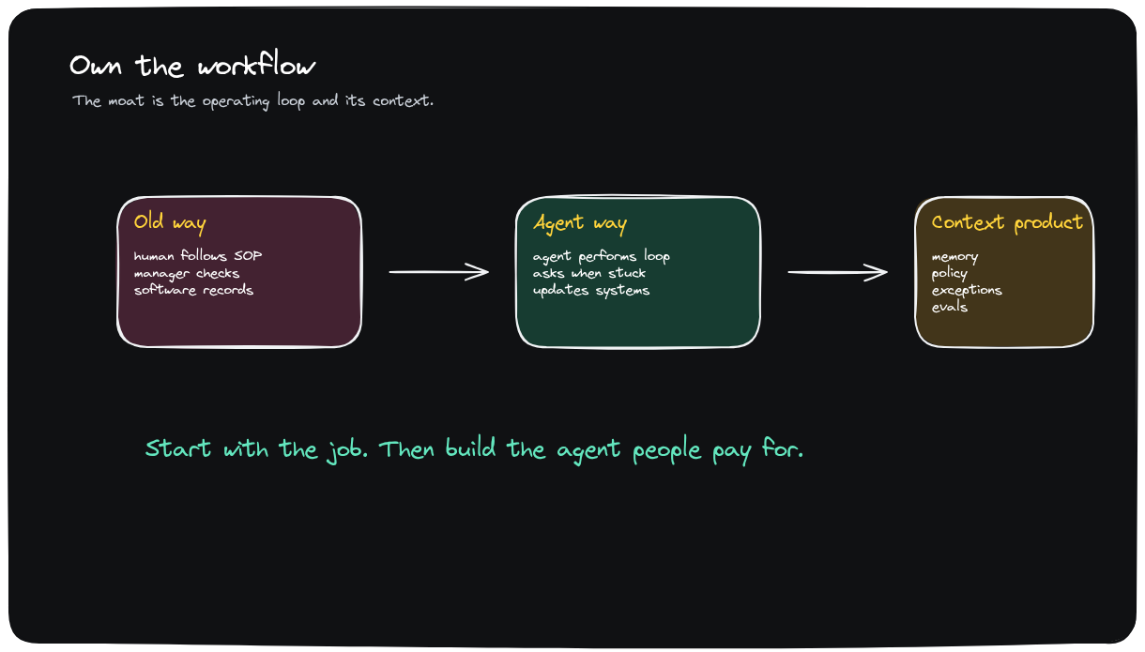
DEFENSIBILITY
Own The Workflow
Excalidraw source: ai-agents-new-saas-v3-own-workflow.excalidraw
12 / 13

Slide 13
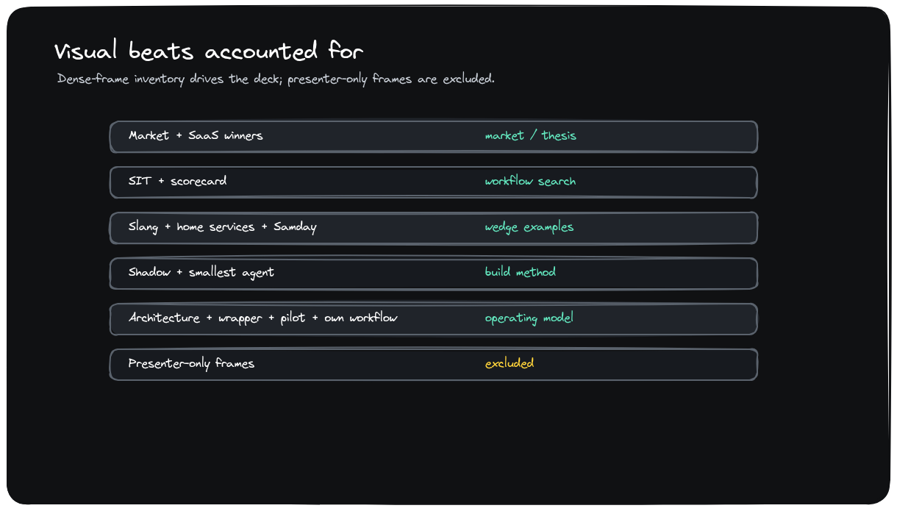
COVERAGE
Every Meaningful Visual Beat Is Accounted For
Excalidraw source: ai-agents-new-saas-v3-coverage-map.excalidraw
13 / 13

