Slide 1
VIDEO-TO-DECK V4
AI Agents Are The New SaaS
Storyboard rebuilt from transcript notes, dense hyperframes, screen-change captures, and Excalidraw-created visuals.
Intro
Product is the job
Workflow selection
Shadow first
Minimum agent
Wrapper + evals
Pilot pricing
Own workflow
30-day plan
1 / 12

Slide 2
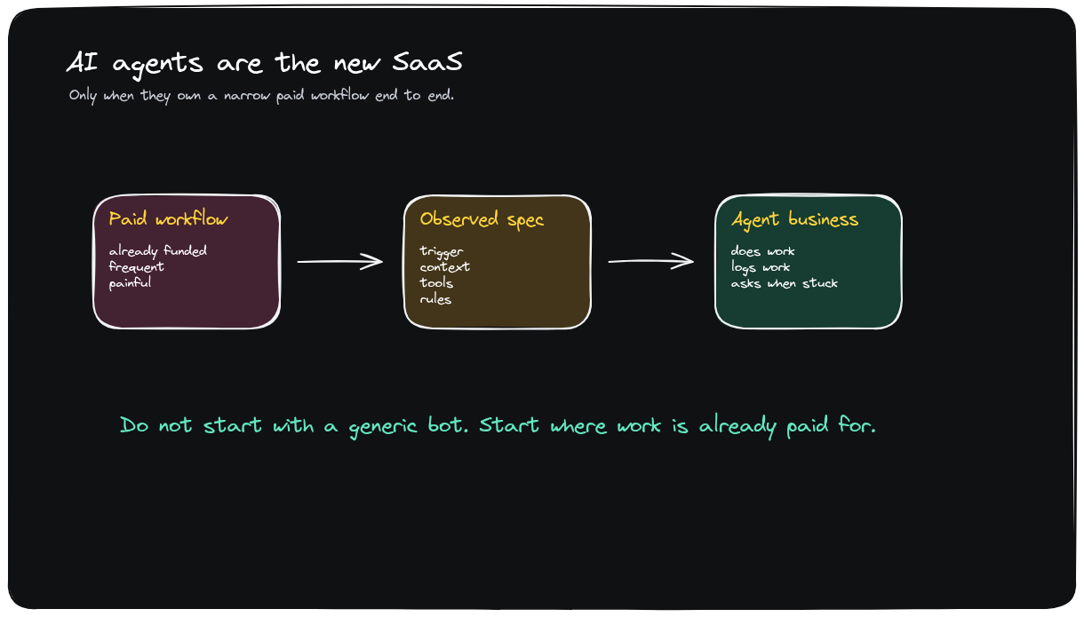
INTRO
AI Agents Are The New SaaS
Synthesis
Agent SaaS sells work as a service; the product is the job itself, priced like labor.
• Core shift: buyer pays for completed work, not software access.
• Implication: package a narrow job before building a broad platform.
Editable source: ai-agents-new-saas-v3-thesis-workflow.excalidraw
2 / 12

Slide 3
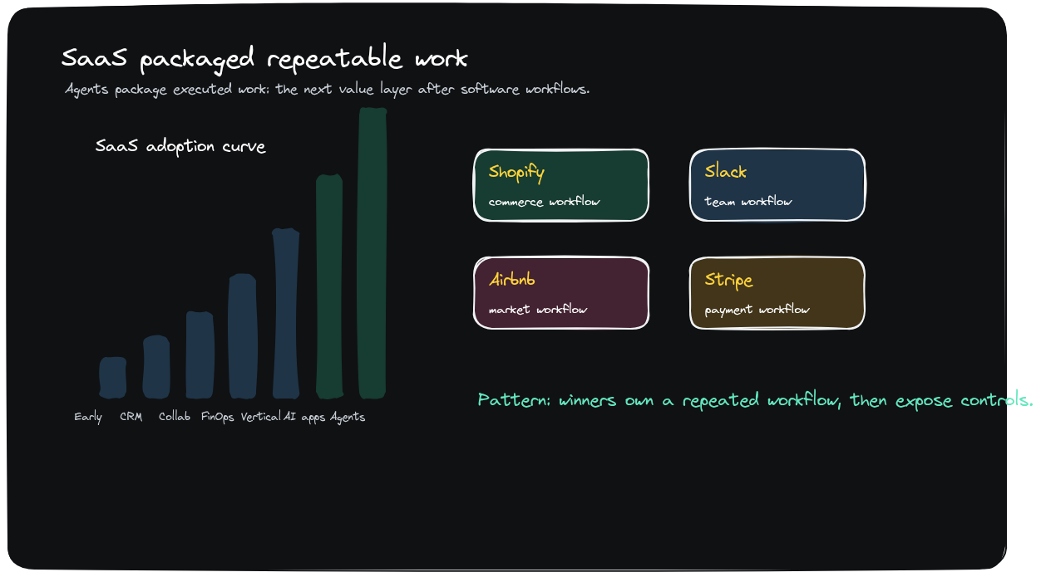
1. THE PRODUCT IS THE JOB
SaaS sells software; agent SaaS sells completed work
Synthesis
Package a job the customer's team can hand off entirely, then sell the outcome as a service.
• Claim: the job becomes the product surface.
• Builder move: define the outcome, SLA, handoff, and exception policy.
Editable source: ai-agents-new-saas-v3-market-context.excalidraw
3 / 12

Slide 4
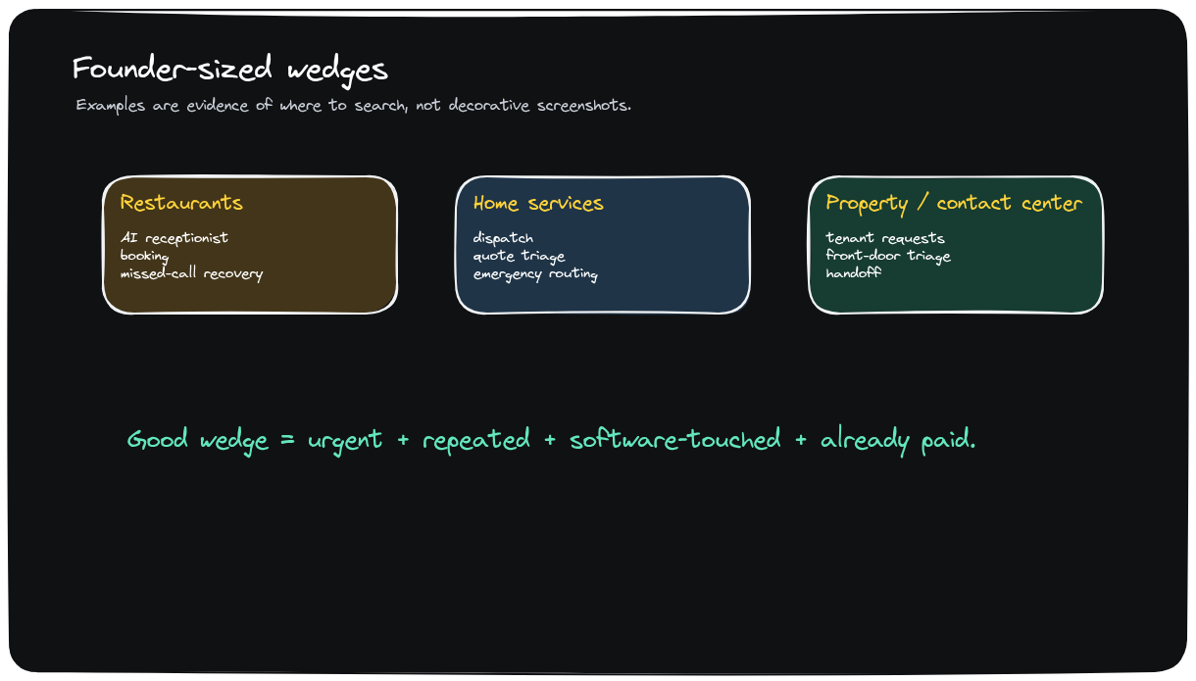
2. REAL EXAMPLES
Slang AI and Same Day make the pattern concrete
Synthesis
Restaurants, home services, property services, and contact centers show where annoying jobs already have budget.
• Named proof: reception, dispatch, reservation, and triage workflows already have spend.
• Pattern: beat junior labor on speed, consistency, and cost.
Editable source: ai-agents-new-saas-v3-wedge-examples.excalidraw
4 / 12

Slide 5
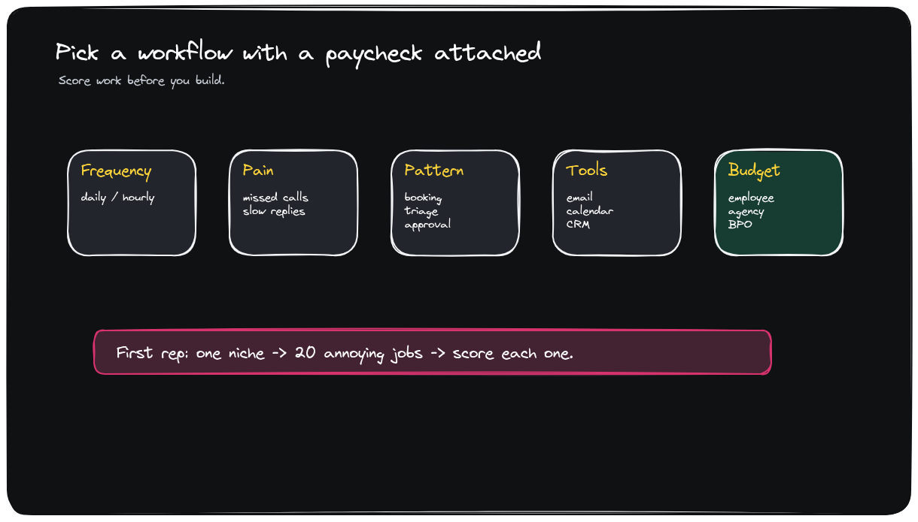
3. PICK A WORKFLOW WITH A PAYCHECK
Start with money already flowing to a role
Synthesis
Score frequency, pain, finish-line clarity, software touchpoints, edge cases, and budget owner.
• Decision rule: no budget owner, no wedge.
• First rep: one niche, 20 annoying jobs, score before building.
Editable source: ai-agents-new-saas-v3-workflow-scorecard.excalidraw
5 / 12

Slide 6
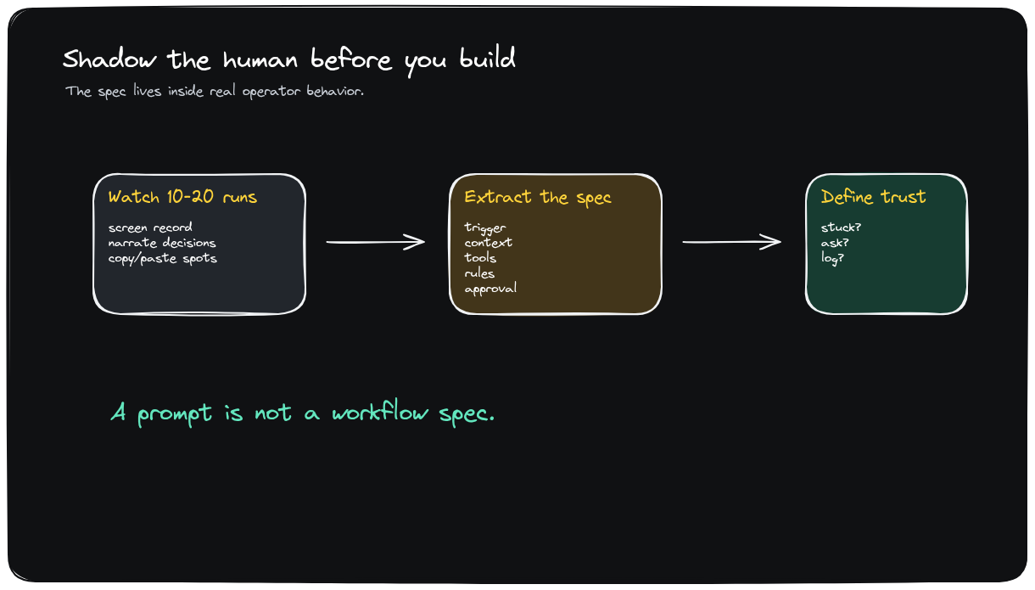
4. SHADOW THE HUMAN FIRST
Watch 10-20 real jobs before writing a prompt
Synthesis
The hidden workflow is what they check, where mistakes happen, and what makes cases weird.
• The detail is the product: hidden checks, weird cases, approvals.
• Output: trigger, context, tools, actions, approvals, escalation, success.
Editable source: ai-agents-new-saas-v3-shadow-human.excalidraw
6 / 12

Slide 7
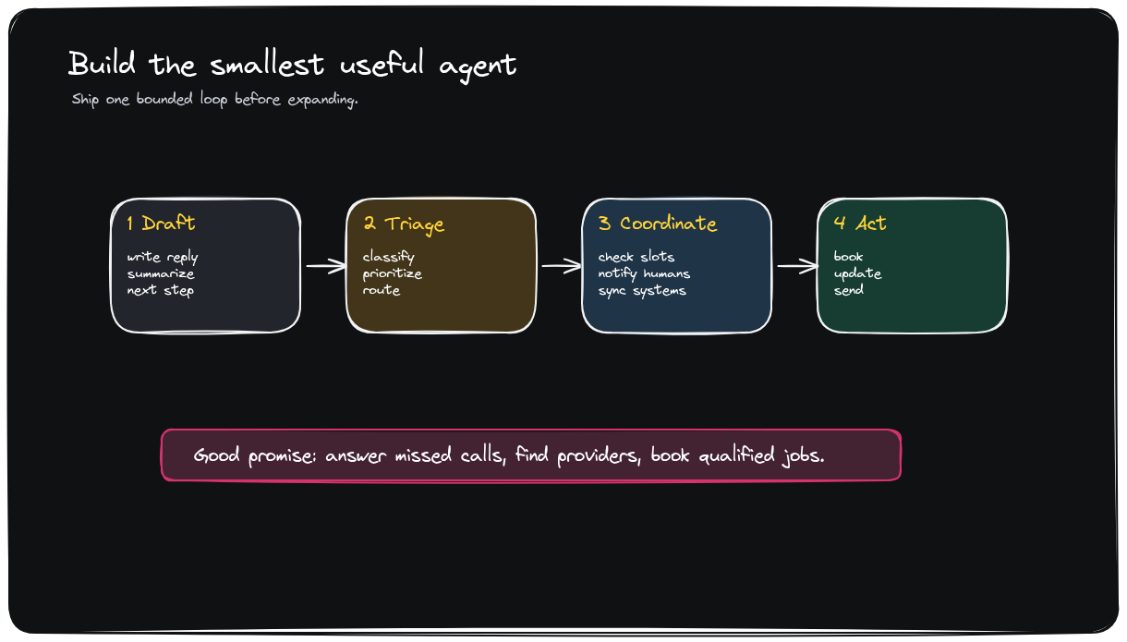
5. BUILD THE MINIMUM USEFUL AGENT
Earn autonomy one bounded loop at a time
Synthesis
Start with draft-and-approve, triage, coordinator, or bounded action before adding judgment.
• Scope discipline: start as assistive, then earn autonomy.
• Good first shapes: draft, triage, coordinate, bounded action.
Editable source: ai-agents-new-saas-v3-smallest-agent.excalidraw
7 / 12

Slide 8
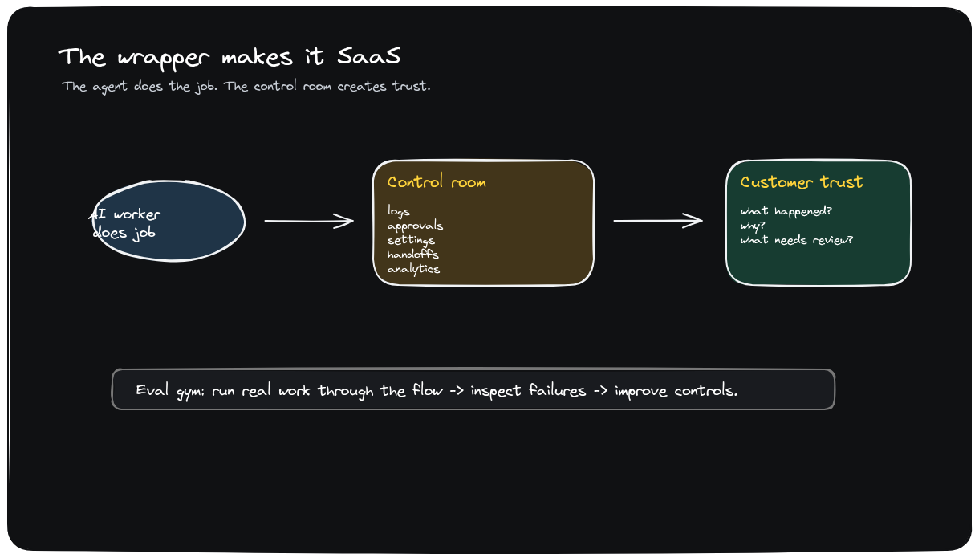
6. PRODUCT WRAPPER AND EVALS
The wrapper turns automation into SaaS
Synthesis
Logs, approvals, controls, handoff rules, analytics, and evals create the trust customers pay for.
• Trust is the product wrapper, not a nice-to-have.
• Build evals from 50 real examples and improve like a gym.
Editable source: ai-agents-new-saas-v3-wrapper-saas.excalidraw
8 / 12

Slide 9
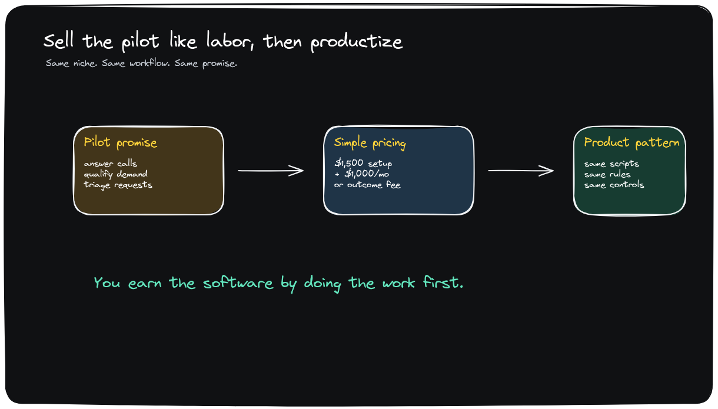
7. SELL THE PILOT LIKE LABOR
Three customers, one niche, one outcome
Synthesis
Charge setup plus monthly first, then move toward usage or outcome pricing as value becomes clear.
• Sell the outcome first; productize after repetition appears.
• Pricing path: setup + monthly -> usage -> outcome pricing.
Editable source: ai-agents-new-saas-v3-pilot-productize.excalidraw
9 / 12

Slide 10
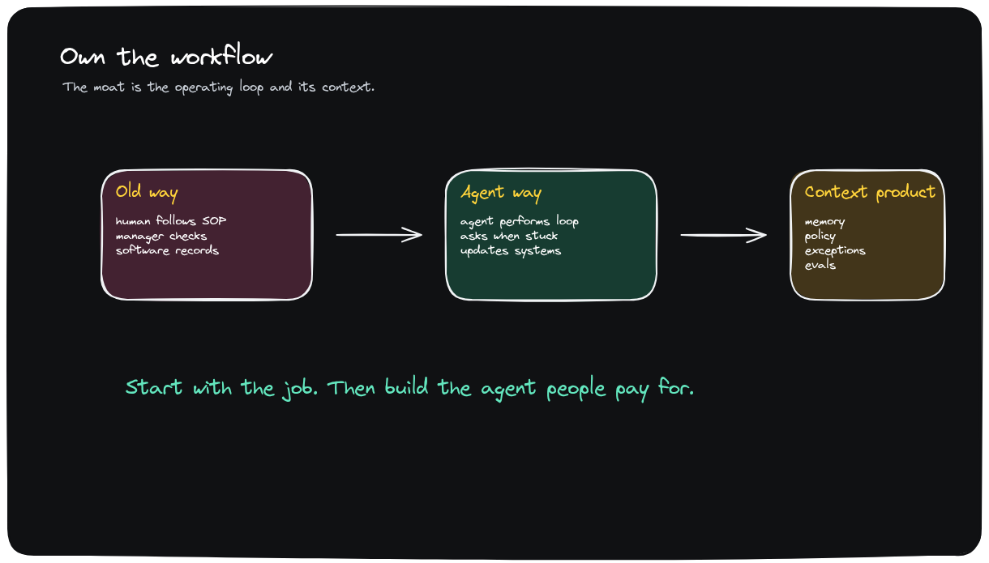
8. OWN THE WORKFLOW
The moat is the operating loop
Synthesis
Context, policy, exceptions, and evals become the product's defensibility.
• Moat: accumulated workflow context and exception handling.
• Defensibility comes from owning the operating loop end to end.
Editable source: ai-agents-new-saas-v3-own-workflow.excalidraw
10 / 12

Slide 11
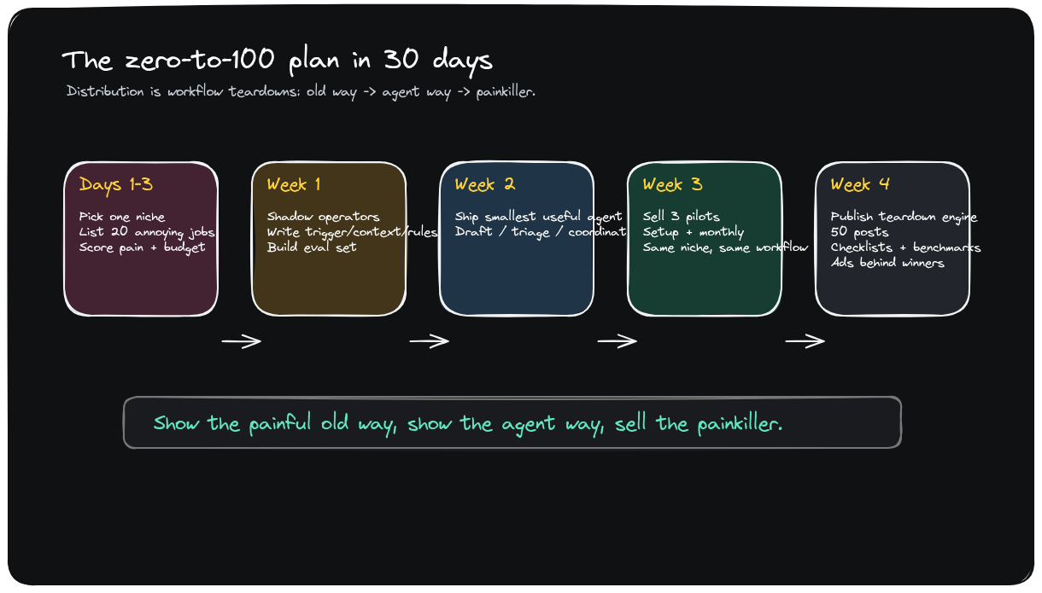
DISTRIBUTION AND 30-DAY PLAN
Win attention with workflow teardowns
Synthesis
Show the painful old way, show the smooth agent way, publish proof, then put ads behind winners.
• Distribution asset: old way vs agent way teardown.
• 30-day motion: niche, shadow, agent, pilots, 50 proof posts.
Editable source: ai-agents-new-saas-v4-zero-to-100-plan.excalidraw
11 / 12

Slide 12
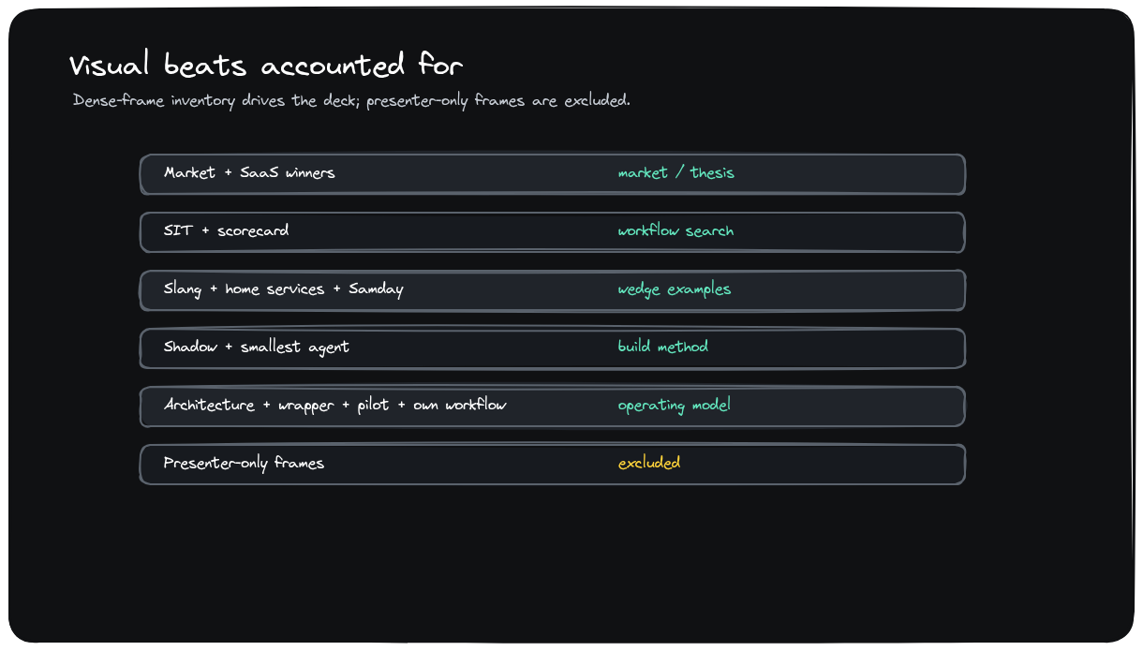
CLOSING THOUGHTS
Start with the job; build the agent people pay for
Synthesis
Dense hyperframes are accounted for; presenter-only frames are excluded from main slides.
• Final recommendation: stop brainstorming agents; choose a paid job.
• Deck audit: screen changes are captured, grouped, and redrawn.
Editable source: ai-agents-new-saas-v3-coverage-map.excalidraw
12 / 12

