Slide 1
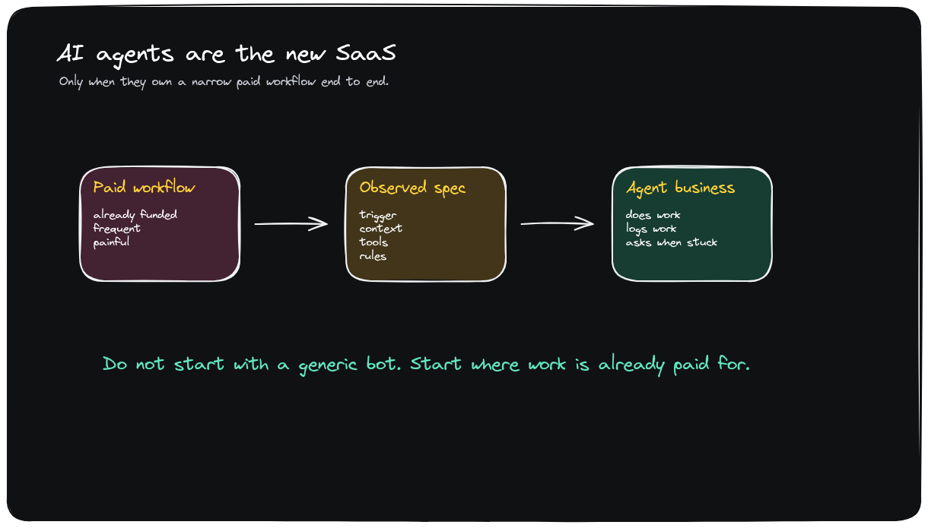
BRANDED EXCALIDRAW VIDEO DECK
AI Agents Are The New SaaS
Client-ready storyboard with visible Excalidraw recreations, concise synthesis, and hyperframe coverage.
No YouTube screenshots used as slide visuals.
Transcript, dense frames, scene changes, and .excalidraw sources are retained in the run folder.
Video-to-deck draft
1 / 14

Slide 2
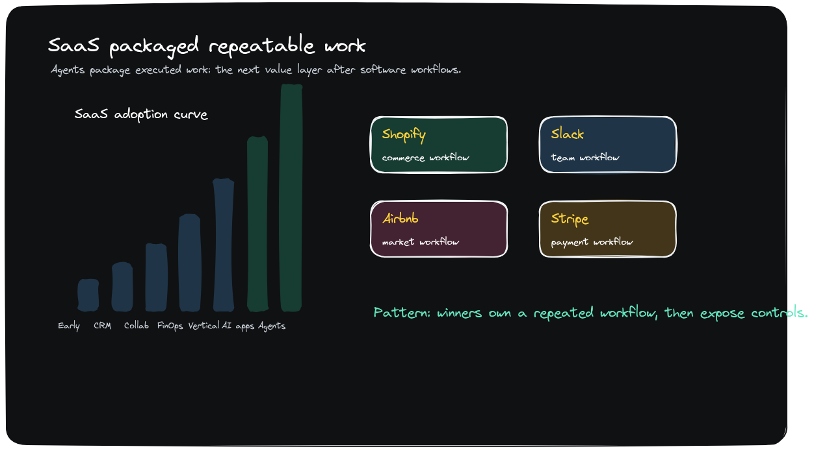
MARKET CONTEXT
Agent SaaS is a packaging shift from software access to completed work
Synthesis
The buyer logic changes when the output is a completed workflow rather than another seat of software.
• SaaS sold tools and usage.
• Agent SaaS sells work capacity.
• The wedge must map to budget already attached to a job.
Recreated Excalidraw visual
TAKEAWAY
Start with the paid job, not the generic agent category.
Excalidraw source: ai-agents-new-saas-v3-market-context.excalidraw
2 / 14
Notes:
Market Context: The buyer logic changes when the output is a completed workflow rather than another seat of software.
Visible Excalidraw visual: ai-agents-new-saas-v3-market-context.png
Editable source: ai-agents-new-saas-v3-market-context.excalidraw

Slide 3
CORE THESIS
The product is the job the customer can hand off
Synthesis
A credible agent business owns a narrow workflow end to end: trigger, context, tools, decisions, and escalation.
• Paid workflow -> observed spec -> agent business.
• Narrow scope makes the offer explainable.
• Trust is designed into the handoff.
Recreated Excalidraw visual
TAKEAWAY
If the job cannot be named, the agent cannot be sold.
Excalidraw source: ai-agents-new-saas-v3-thesis-workflow.excalidraw
3 / 14
Notes:
Core Thesis: A credible agent business owns a narrow workflow end to end: trigger, context, tools, decisions, and escalation.
Visible Excalidraw visual: ai-agents-new-saas-v3-thesis-workflow.png
Editable source: ai-agents-new-saas-v3-thesis-workflow.excalidraw

Slide 4
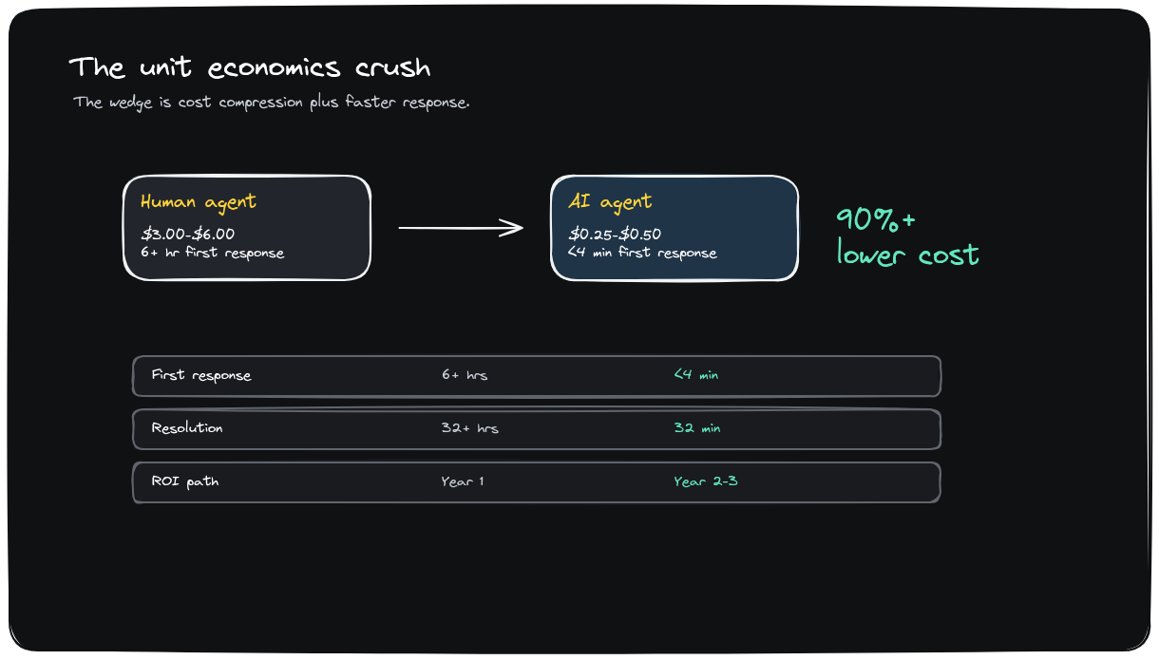
ECONOMICS
Unit economics improve only when the workflow is repeated and bounded
Synthesis
The economic promise depends on replacing repeated labor packets, not vaguely improving productivity.
• Labor spend sets the price anchor.
• Frequency creates learning data.
• Boundaries keep delivery evaluable.
Recreated Excalidraw visual
TAKEAWAY
The workflow must be frequent enough to learn from and valuable enough to price.
Excalidraw source: ai-agents-new-saas-v3-unit-economics.excalidraw
4 / 14
Notes:
Economics: The economic promise depends on replacing repeated labor packets, not vaguely improving productivity.
Visible Excalidraw visual: ai-agents-new-saas-v3-unit-economics.png
Editable source: ai-agents-new-saas-v3-unit-economics.excalidraw

Slide 5
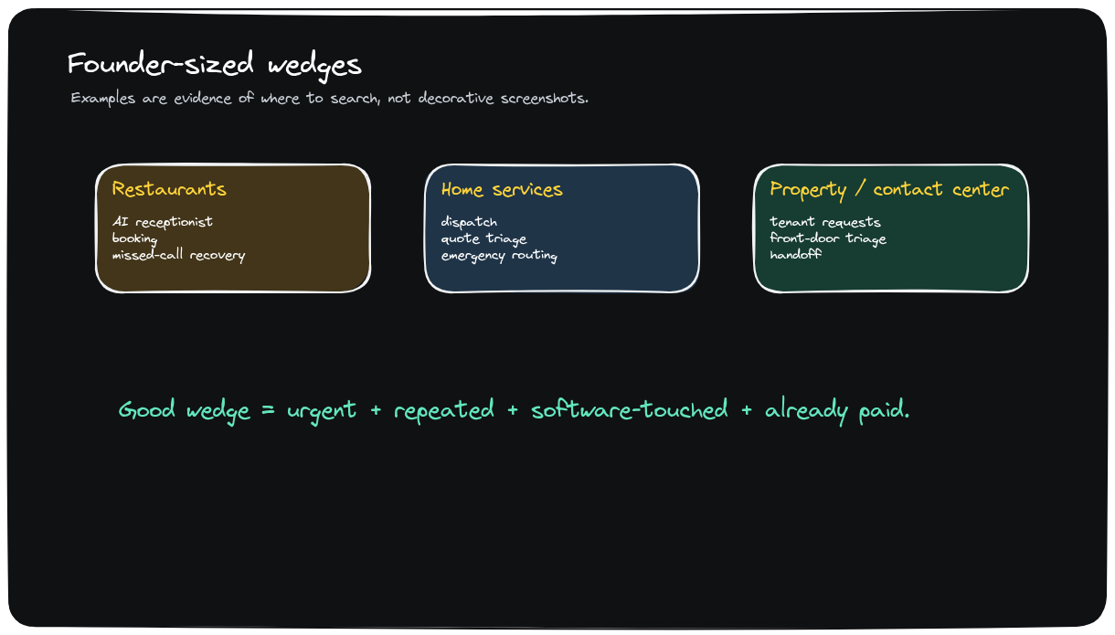
EXAMPLES
The best wedges are boring service workflows with visible labor spend
Synthesis
Restaurants, home services, property operations, and contact centers show the repeatable pattern.
• Reception and dispatch already have budget.
• Missed work creates obvious pain.
• The buyer compares against headcount or agencies.
Recreated Excalidraw visual
TAKEAWAY
Boring operations are better first markets than broad AI productivity.
Excalidraw source: ai-agents-new-saas-v3-wedge-examples.excalidraw
5 / 14
Notes:
Examples: Restaurants, home services, property operations, and contact centers show the repeatable pattern.
Visible Excalidraw visual: ai-agents-new-saas-v3-wedge-examples.png
Editable source: ai-agents-new-saas-v3-wedge-examples.excalidraw

Slide 6
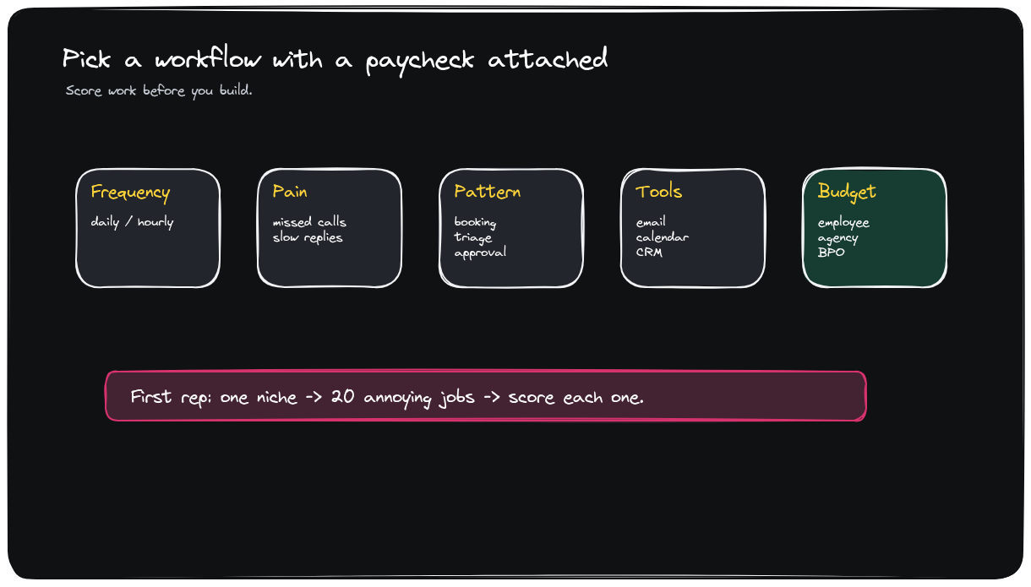
WORKFLOW SELECTION
Pick a workflow with a paycheck attached
Synthesis
Frequency, pain, clarity, tools, edge cases, and budget owner decide whether the idea deserves a build.
• Score 20 jobs in one niche.
• Reject pain with no budget owner.
• Prefer clear finish lines over open-ended judgment.
Recreated Excalidraw visual
TAKEAWAY
No budget owner, no wedge.
Excalidraw source: ai-agents-new-saas-v3-workflow-scorecard.excalidraw
6 / 14
Notes:
Workflow Selection: Frequency, pain, clarity, tools, edge cases, and budget owner decide whether the idea deserves a build.
Visible Excalidraw visual: ai-agents-new-saas-v3-workflow-scorecard.png
Editable source: ai-agents-new-saas-v3-workflow-scorecard.excalidraw

Slide 7
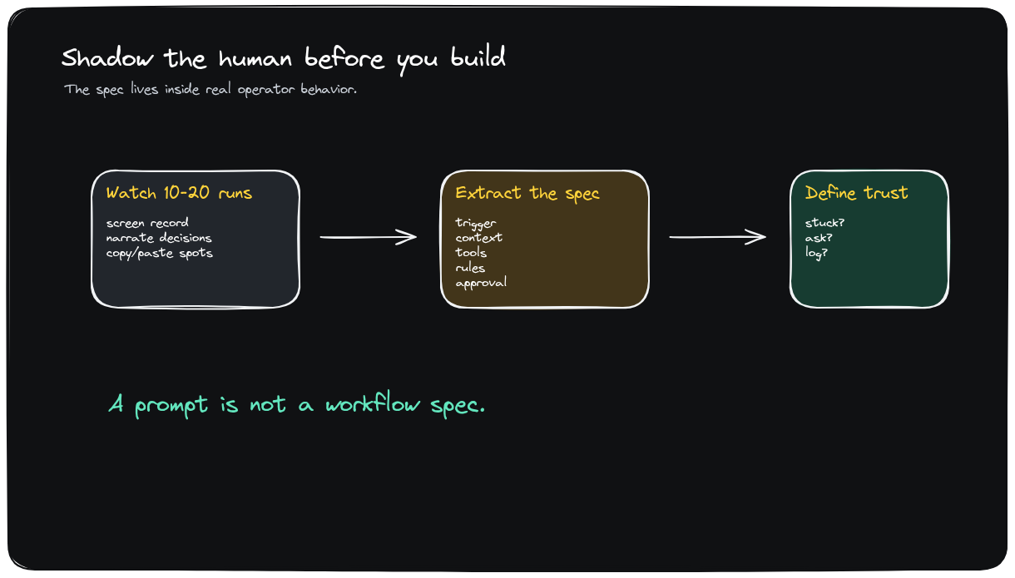
OBSERVATION
Shadow the human before writing prompts
Synthesis
The product spec is hidden in what operators check, where mistakes happen, and when cases become weird.
• Observe 10-20 real cases.
• Record tacit checks and exception paths.
• Convert observation into acceptance criteria.
Recreated Excalidraw visual
TAKEAWAY
The detail is the product.
Excalidraw source: ai-agents-new-saas-v3-shadow-human.excalidraw
7 / 14
Notes:
Observation: The product spec is hidden in what operators check, where mistakes happen, and when cases become weird.
Visible Excalidraw visual: ai-agents-new-saas-v3-shadow-human.png
Editable source: ai-agents-new-saas-v3-shadow-human.excalidraw

Slide 8
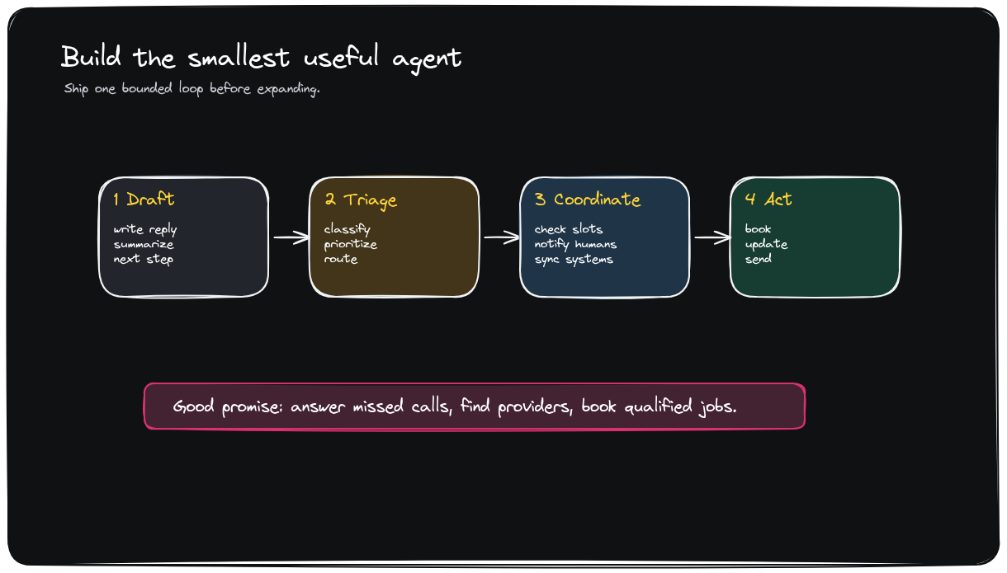
FIRST PRODUCT
Build the minimum useful agent before chasing autonomy
Synthesis
The first version should be useful enough to sell and constrained enough to evaluate.
• Draft-and-approve.
• Triage.
• Coordinator.
• Bounded action.
Recreated Excalidraw visual
TAKEAWAY
Earn autonomy one bounded loop at a time.
Excalidraw source: ai-agents-new-saas-v3-smallest-agent.excalidraw
8 / 14
Notes:
First Product: The first version should be useful enough to sell and constrained enough to evaluate.
Visible Excalidraw visual: ai-agents-new-saas-v3-smallest-agent.png
Editable source: ai-agents-new-saas-v3-smallest-agent.excalidraw

Slide 9
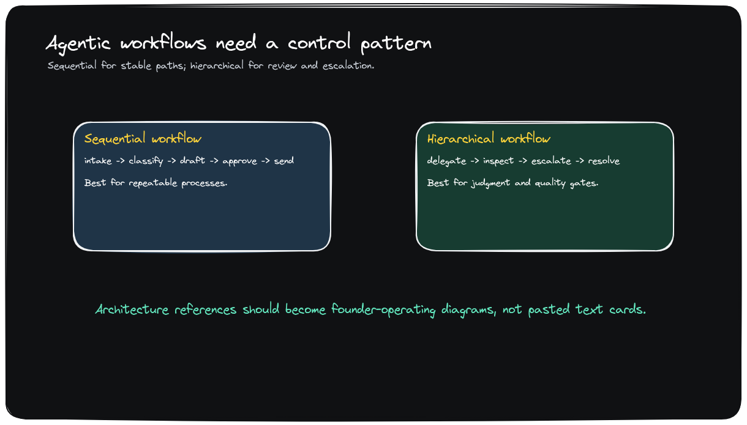
WORKFLOW ARCHITECTURE
Most agent products start as predictable workflows
Synthesis
The architecture should expose where judgment enters, where tools are called, and where humans approve.
• Predictable path first.
• Judgment only where it creates value.
• Escalation is part of the architecture.
Recreated Excalidraw visual
TAKEAWAY
Design the workflow before expanding the agent.
Excalidraw source: ai-agents-new-saas-v3-agentic-workflows.excalidraw
9 / 14
Notes:
Workflow Architecture: The architecture should expose where judgment enters, where tools are called, and where humans approve.
Visible Excalidraw visual: ai-agents-new-saas-v3-agentic-workflows.png
Editable source: ai-agents-new-saas-v3-agentic-workflows.excalidraw

Slide 10
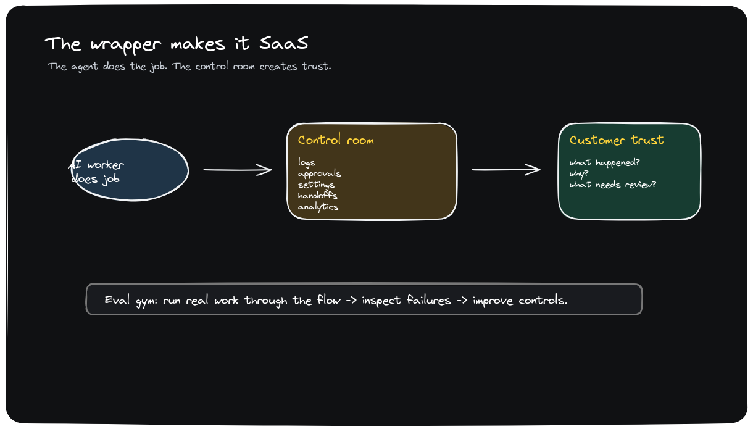
TRUST WRAPPER
The wrapper is what turns automation into SaaS
Synthesis
Logs, approvals, controls, handoffs, analytics, and evals are the product layer customers pay to trust.
• The agent does the job.
• The control room proves what happened.
• Evals make quality improvable.
Recreated Excalidraw visual
TAKEAWAY
A demo shows automation; the wrapper earns production trust.
Excalidraw source: ai-agents-new-saas-v3-wrapper-saas.excalidraw
10 / 14
Notes:
Trust Wrapper: Logs, approvals, controls, handoffs, analytics, and evals are the product layer customers pay to trust.
Visible Excalidraw visual: ai-agents-new-saas-v3-wrapper-saas.png
Editable source: ai-agents-new-saas-v3-wrapper-saas.excalidraw

Slide 11
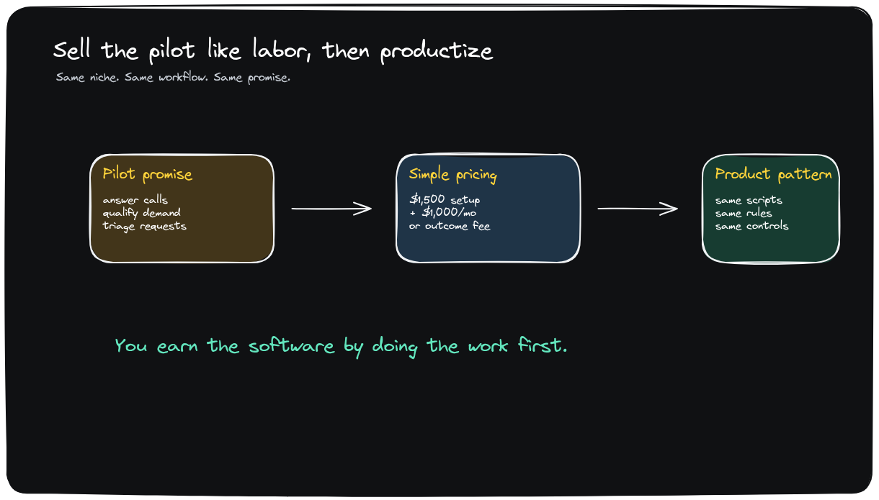
COMMERCIALIZATION
Sell the pilot like labor, then productize the repeated loop
Synthesis
Early sales work when the buyer sees a familiar capacity purchase with a better operating model.
• Three same-niche customers.
• Setup plus monthly first.
• Usage or outcome pricing after proof.
Recreated Excalidraw visual
TAKEAWAY
Productization starts after repetition appears.
Excalidraw source: ai-agents-new-saas-v3-pilot-productize.excalidraw
11 / 14
Notes:
Commercialization: Early sales work when the buyer sees a familiar capacity purchase with a better operating model.
Visible Excalidraw visual: ai-agents-new-saas-v3-pilot-productize.png
Editable source: ai-agents-new-saas-v3-pilot-productize.excalidraw

Slide 12
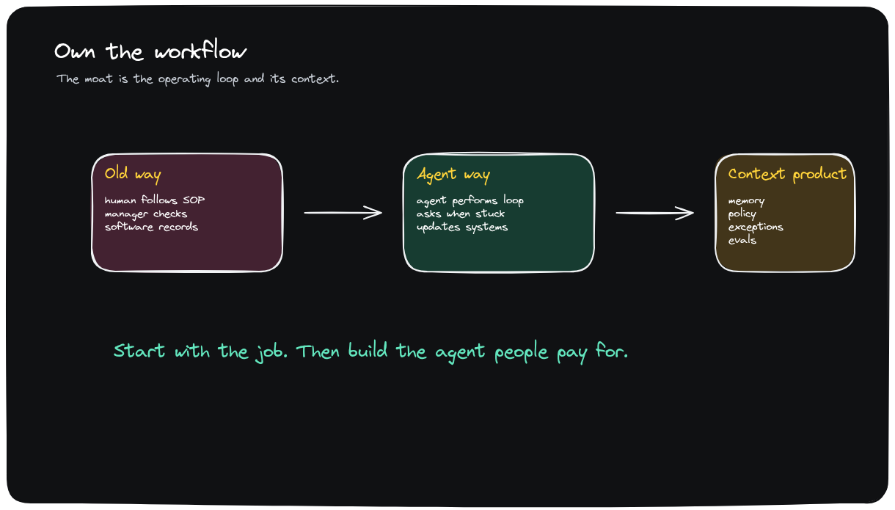
DEFENSIBILITY
Owning the workflow is the moat
Synthesis
Workflow context, policy, exception handling, and eval memory compound into defensibility.
• Prompts are easy to copy.
• Operating memory is harder to replicate.
• Exceptions become product assets.
Recreated Excalidraw visual
TAKEAWAY
The moat is the operating loop around the agent.
Excalidraw source: ai-agents-new-saas-v3-own-workflow.excalidraw
12 / 14
Notes:
Defensibility: Workflow context, policy, exception handling, and eval memory compound into defensibility.
Visible Excalidraw visual: ai-agents-new-saas-v3-own-workflow.png
Editable source: ai-agents-new-saas-v3-own-workflow.excalidraw

Slide 13
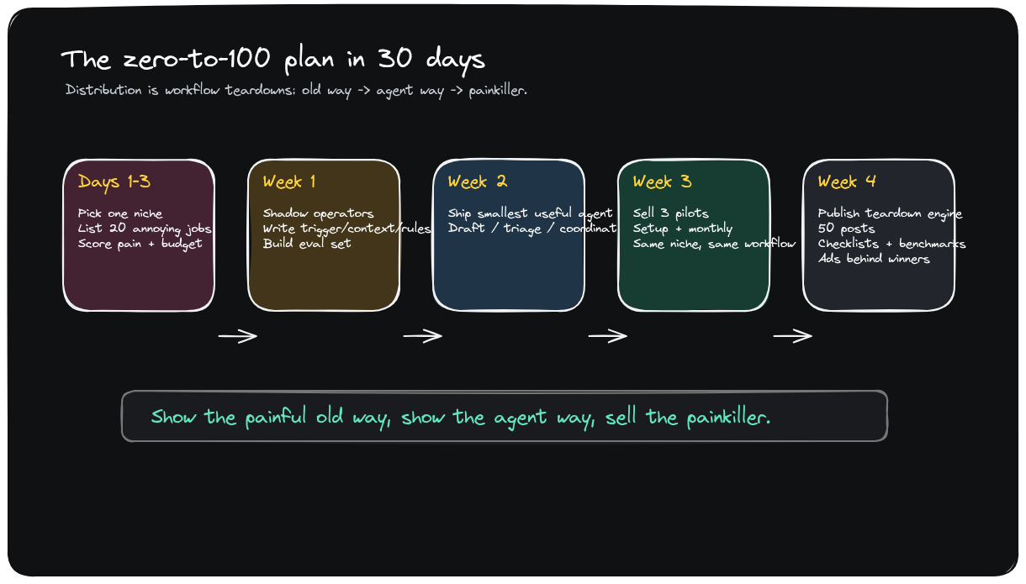
30-DAY PLAN
Use workflow teardowns to turn the build into distribution
Synthesis
Show the painful old way, show the agent way, publish proof, and put spend behind the winners.
• Days 1-3: score jobs.
• Week 1-2: shadow and build.
• Week 3-4: pilot and publish.
Recreated Excalidraw visual
TAKEAWAY
Distribution comes from making the painful workflow visible.
Excalidraw source: ai-agents-new-saas-v4-zero-to-100-plan.excalidraw
13 / 14
Notes:
30-Day Plan: Show the painful old way, show the agent way, publish proof, and put spend behind the winners.
Visible Excalidraw visual: ai-agents-new-saas-v4-zero-to-100-plan.png
Editable source: ai-agents-new-saas-v4-zero-to-100-plan.excalidraw

Slide 14
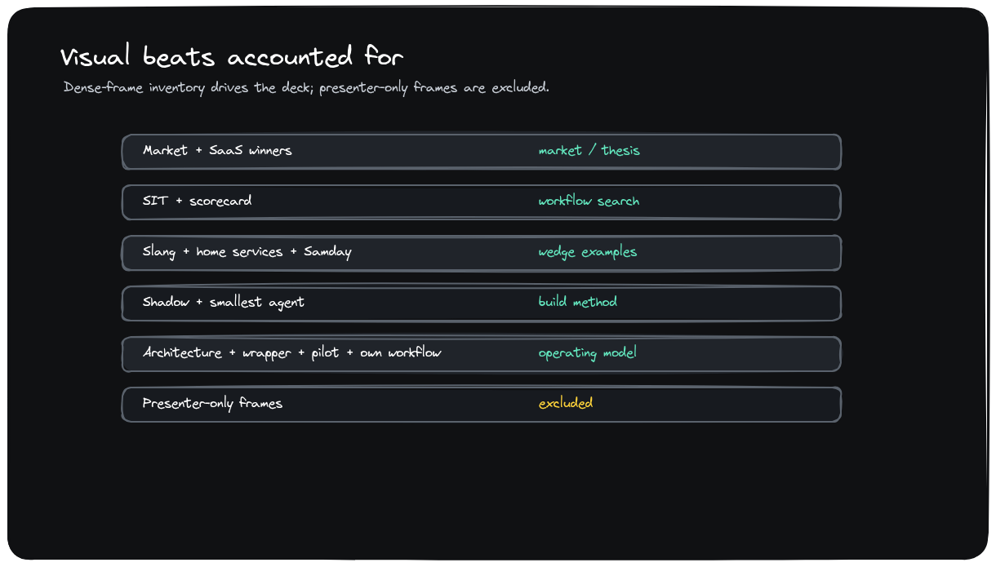
COVERAGE
Screen changes are accounted for without inserting YouTube screenshots
Synthesis
Dense frames and scene-change frames are retained as audit material; meaningful visuals are redrawn as Excalidraw.
• 156 dense frames.
• 56 scene-change frames.
• Presenter-only and duplicates excluded.
Recreated Excalidraw visual
TAKEAWAY
Hyperframes drive reconstruction; they are not the client-facing visual.
Excalidraw source: ai-agents-new-saas-v3-coverage-map.excalidraw
14 / 14
Notes:
Coverage: Dense frames and scene-change frames are retained as audit material; meaningful visuals are redrawn as Excalidraw.
Visible Excalidraw visual: ai-agents-new-saas-v3-coverage-map.png
Editable source: ai-agents-new-saas-v3-coverage-map.excalidraw

