Slide 1
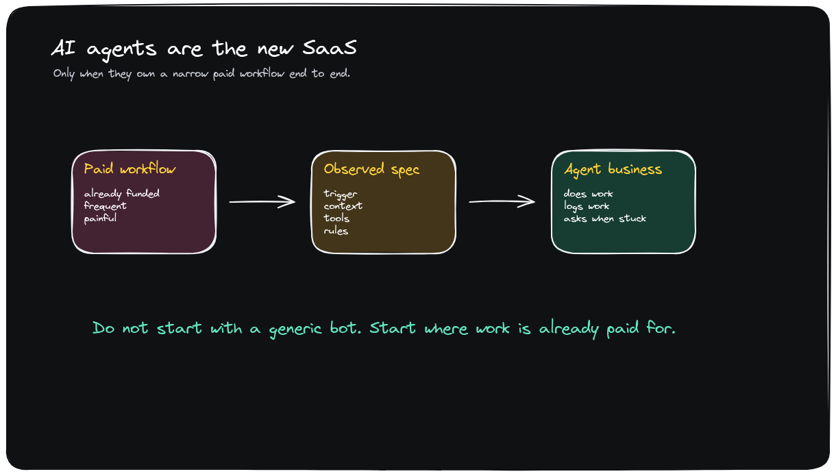
EXECUTIVE BRIEFING
AI Agents Are The New SaaS
A practical playbook for turning AI agents into workflow businesses.
From product idea to sellable workflow wedge.
1 / 15

Slide 2
EXECUTIVE SUMMARY
Agent SaaS succeeds when it sells a finished job, not another tool
BOTTOM LINE
The strongest opportunity is a narrow, high-frequency workflow with budget, a clear finish line, and a trust wrapper.
Where to play
How to build
How to win
Choose a service workflow already funded by headcount, agencies, or outsourcing.
Observe real operators, extract the workflow spec, and ship the smallest useful agent.
Sell pilots like labor, then productize the repeated operating loop with controls and evals.
DECISION
Prioritize one niche and score 20 candidate workflows before committing build effort.
2 / 15

Slide 3
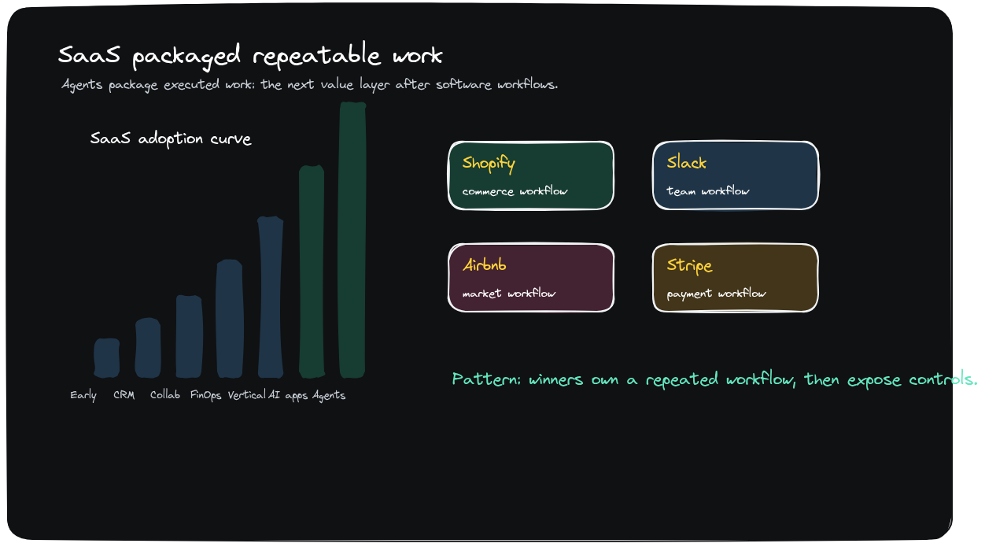
MARKET CONTEXT
Agent SaaS expands the market from software seats to work outcomes
Business implication
The core opportunity shifts from helping teams use software to taking ownership of finished work outcomes.
• The market anchor is labor, not just software seats.
• The offer must map to work already being paid for.
• The first product should be narrow enough to explain.
TAKEAWAY
Start with the paid work, then package the software around it.
3 / 15

Slide 4
CORE THESIS
The product is the job the customer can hand off
Business implication
A credible agent business owns a narrow workflow end to end: trigger, context, tools, decisions, and escalation.
• Paid workflow -> observed spec -> agent business.
• Narrow scope makes the offer explainable.
• Trust is designed into the handoff.
TAKEAWAY
If the job cannot be named, the agent cannot be sold.
4 / 15

Slide 5
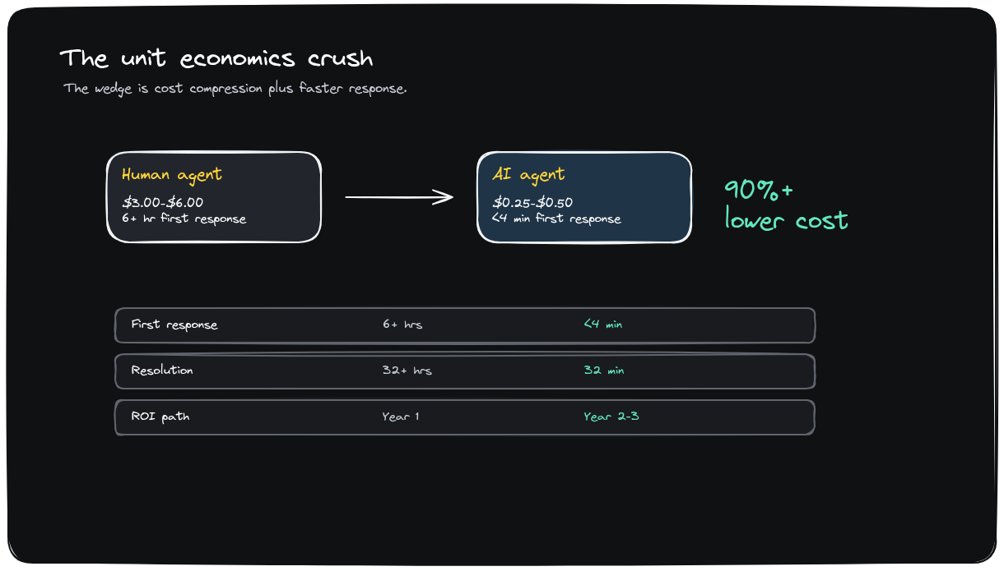
ECONOMICS
The labor comparison sets the value anchor
Business implication
The speaker’s mental model is one annoying job done better than a junior employee, faster than an agency, and cheaper than headcount.
• Labor spend sets the buyer comparison.
• Repeated jobs make the promise easier to prove.
• Bounded work keeps pricing and quality visible.
TAKEAWAY
Price against the work being replaced, not abstract productivity.
5 / 15

Slide 6
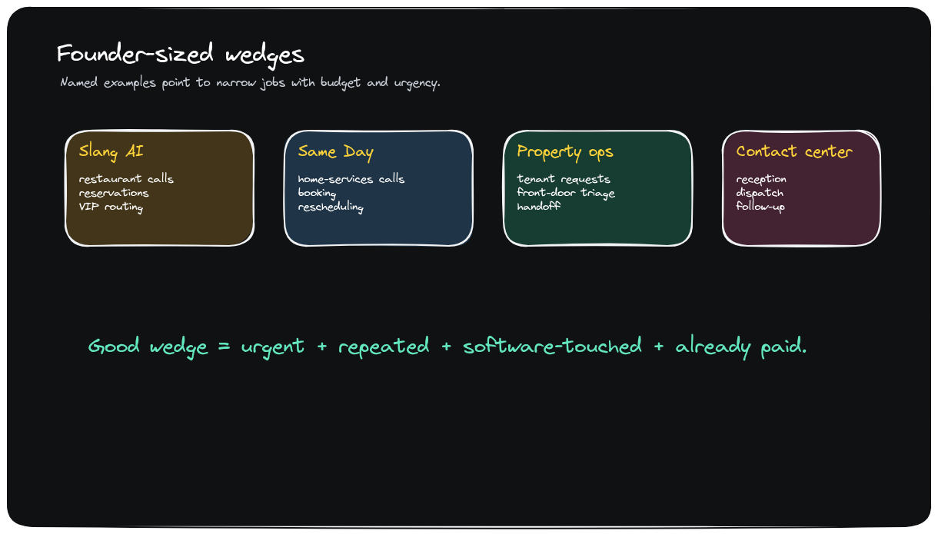
EXAMPLES
The best wedges are boring service workflows with visible labor spend
Business implication
Slang AI and Same Day make the pattern concrete: narrow service workflows with urgent demand and visible labor spend.
• Restaurants need booking and missed-call recovery.
• Home services need dispatch and rescheduling.
• The buyer compares against headcount or agencies.
TAKEAWAY
Boring operations are better first markets than broad AI productivity.
6 / 15

Slide 7
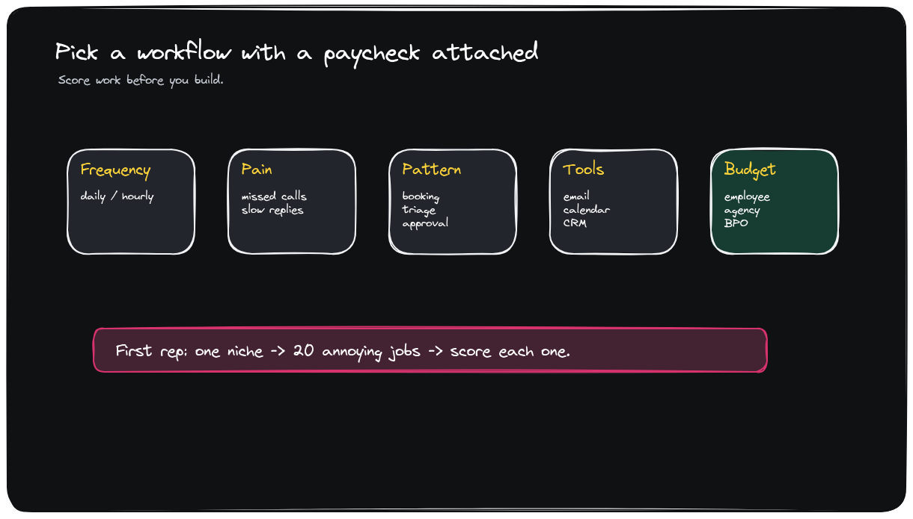
WORKFLOW SELECTION
Pick a workflow with a paycheck attached
Business implication
The selection rule is direct: start where buyers already fund an employee, agency, receptionist, coordinator, or dispatcher.
• Score 20 jobs in one niche.
• Use frequency, pain, finish line, tools, and budget owner.
• Prefer learnable edge cases over pure human judgment.
TAKEAWAY
No budget owner, no wedge.
7 / 15

Slide 8
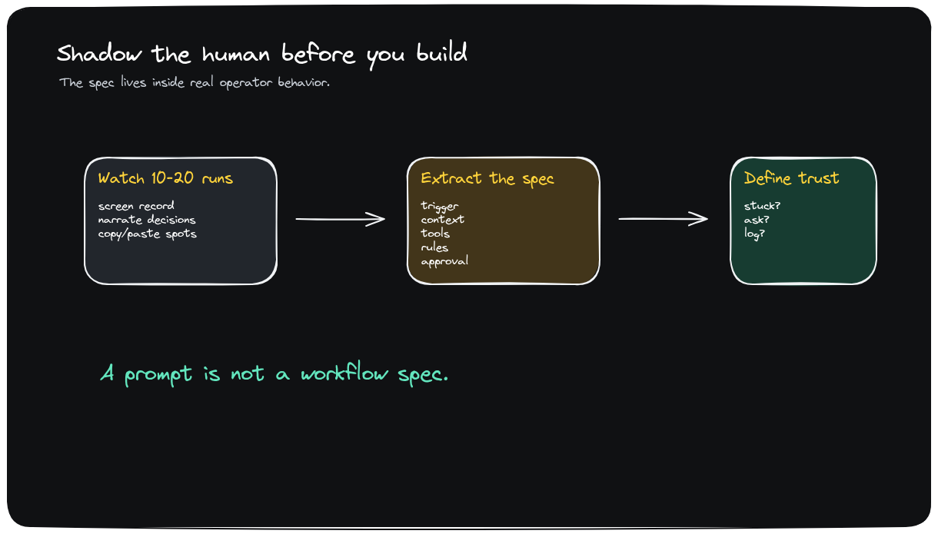
OBSERVATION
Shadow the human before writing prompts
Business implication
The product spec is hidden in what operators check, where mistakes happen, and when cases become weird.
• Observe 10-20 real cases.
• Record tacit checks and exception paths.
• Convert observation into acceptance criteria.
TAKEAWAY
The detail is the product.
8 / 15

Slide 9
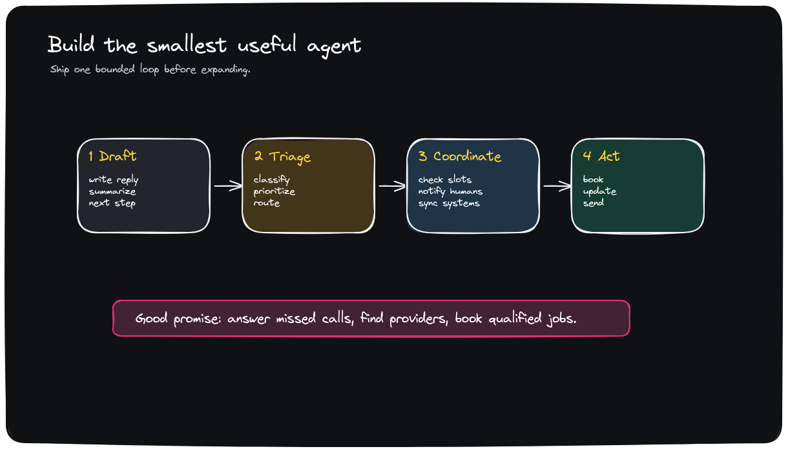
FIRST PRODUCT
Build the minimum useful agent before chasing autonomy
Business implication
The first product should be smaller than the fully autonomous employee promise.
• Draft and approve.
• Triage.
• Coordinator.
• Bounded action.
TAKEAWAY
Earn autonomy one bounded loop at a time.
9 / 15

Slide 10
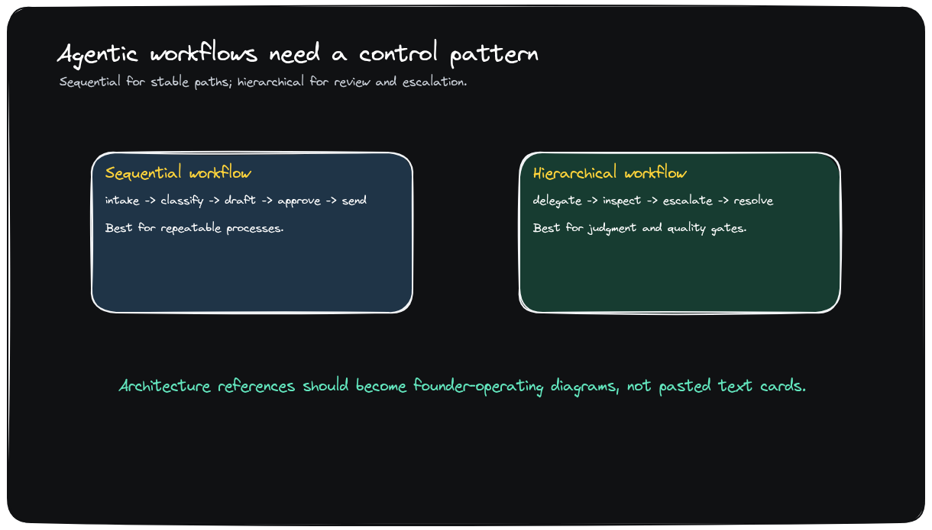
WORKFLOW ARCHITECTURE
Most agent products start as predictable workflows
Business implication
Many agent products should start as predictable workflows before adding judgment-heavy autonomy.
• Predictable path first.
• Add judgment only where it creates value.
• Keep escalation explicit.
TAKEAWAY
Design the workflow before expanding the agent.
10 / 15

Slide 11
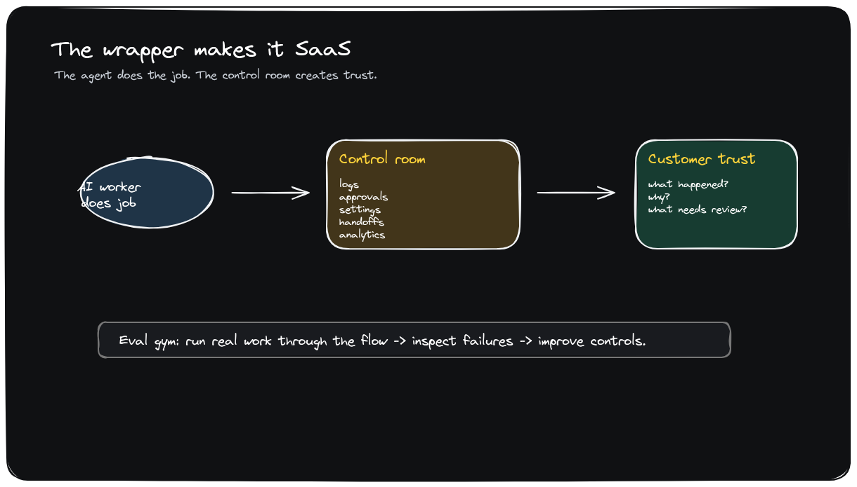
TRUST WRAPPER
The wrapper is what turns automation into SaaS
Business implication
Logs, approvals, controls, handoffs, analytics, and evals are the product layer customers pay to trust.
• The agent does the job.
• The control room proves what happened.
• Evals make quality improvable.
TAKEAWAY
A demo shows automation; the wrapper earns production trust.
11 / 15

Slide 12
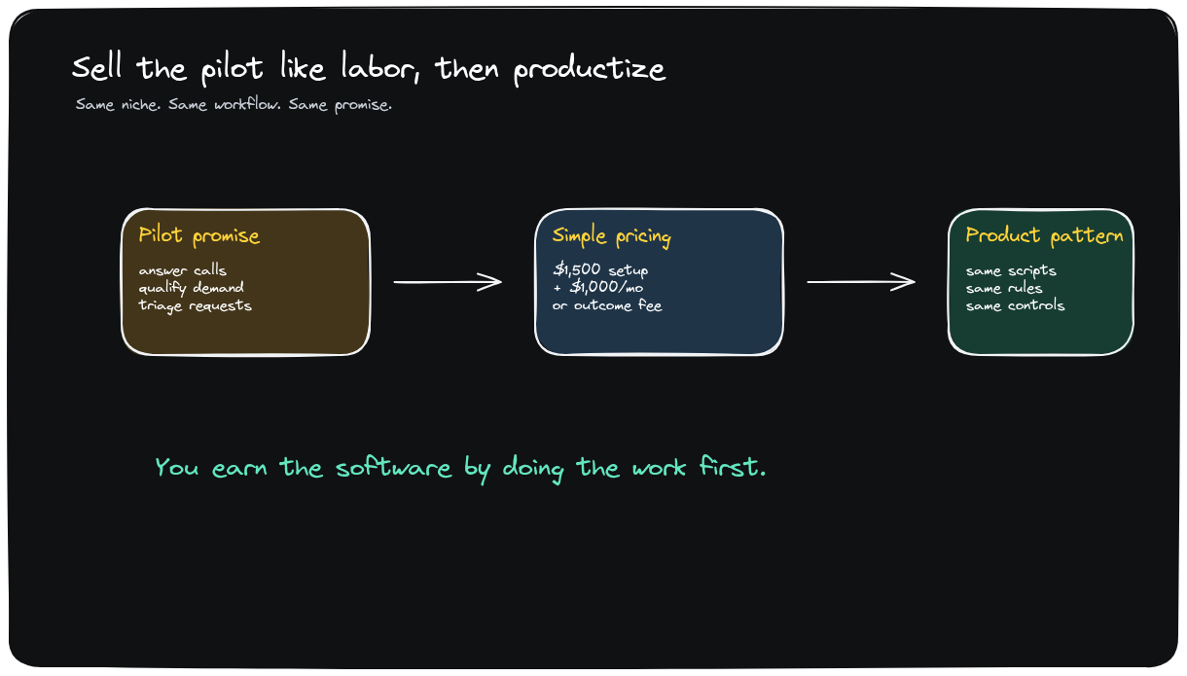
COMMERCIALIZATION
Sell the pilot like labor, then productize the repeated loop
Business implication
Early sales work when the buyer sees a familiar capacity purchase with a better operating model.
• Three same-niche customers.
• Setup plus monthly first.
• Usage or outcome pricing after proof.
TAKEAWAY
Productization starts after repetition appears.
12 / 15

Slide 13
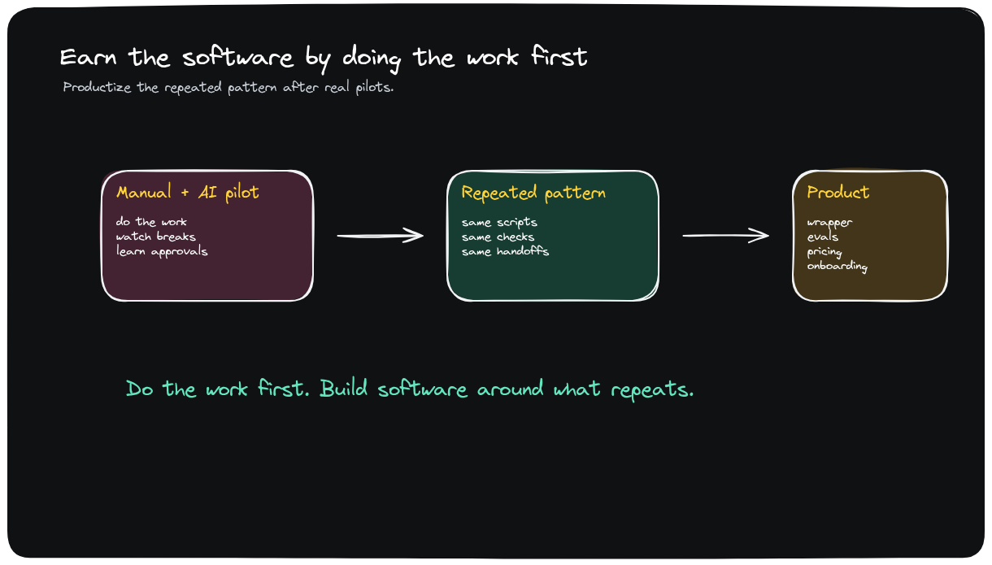
PRODUCTIZATION
Own the workflow by productizing what repeats
Business implication
Workflow ownership comes from doing the work first, learning the repeated pattern, and turning the controls into product.
• Manual-plus-AI pilots expose the repeated pattern.
• Repeated scripts and checks become software.
• Ownership comes from the operating loop, not a generic agent.
TAKEAWAY
Own the workflow by building software around what repeats.
13 / 15

Slide 14
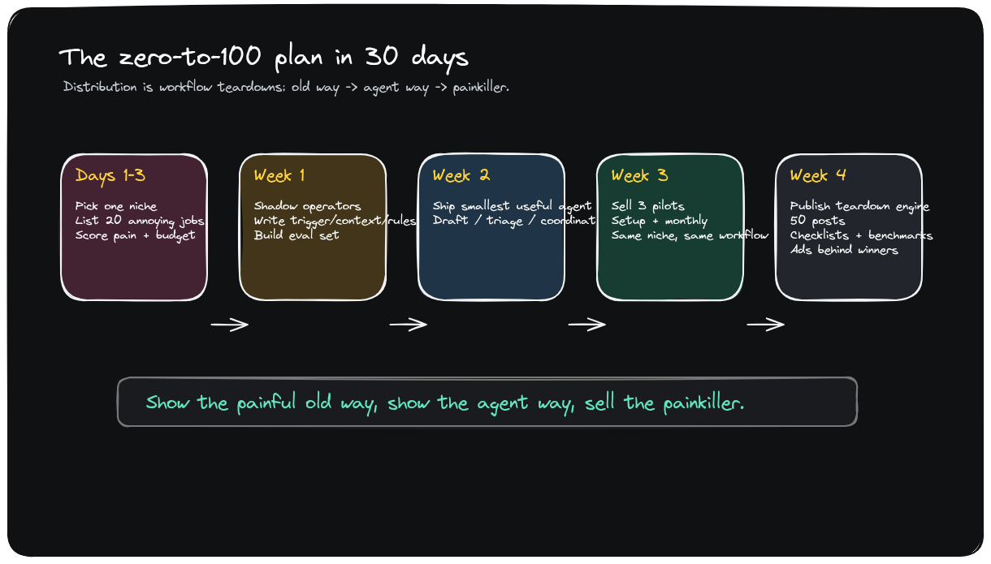
30-DAY PLAN
Use workflow teardowns to turn the build into distribution
Business implication
Show the painful old way, show the agent way, publish proof, and put spend behind the winners.
• Days 1-3: score jobs.
• Week 1-2: shadow and build.
• Week 3-4: pilot and publish.
TAKEAWAY
Distribution comes from making the painful workflow visible.
14 / 15

Slide 15
CONCLUSION
The next move is to choose the workflow, not broaden the agent
1
Pick one niche
2
Score 20 jobs
Constrain the market before evaluating workflows.
Prioritize frequency, pain, finish-line clarity, tools, and budget.
3
Shadow operators
4
Pilot the loop
Turn real work into the agent spec and trust model.
Sell the outcome first; productize after repetition appears.
Winning agent businesses are built around work customers already understand, fund, and want off their plate.
15 / 15

