Slide 1

EXECUTIVE MARKET MAP · CONFIDENTIAL
Do not sell governance software.
Operate governed agents.
Agent governance is being bundled into the platforms customers already own. The durable opening for HDS is a productized managed service for regulated, asset-heavy agent fleets.
AUDIENCE
DATE
DECISION
HDS leadership
July 3, 2026
Enter as managed service, not standalone software
POSITION
Governed Agent Operations: neutral, cross-runtime, regulator-grade operations for OT-adjacent industries

Slide 2

01 THE ANSWER UP FRONT
Enter the market, but avoid the software trap.
The control-plane fight is being won by hyperscalers and SaaS suites through bundling. HDS should unbundle HARC AMS into a named, priced managed service sold per agent under management.
WHERE NOT TO PLAY
WHERE TO PLAY
HOW TO TEST
Standalone governance license SKU competing with Microsoft, ServiceNow, Salesforce, Google, and GRC incumbents.
Cross-runtime operations for regulated, asset-heavy agent fleets touching plant, grid, maintenance, and safety workflows.
Sell paid pilots in 90 days at pricing that implies at least $150K ARR per account.

Slide 3

02 FIVE CLUSTERS
The map is crowded, but only one lane fits HDS.
Platform control planes
GRC software
Observability and eval
Security and identity
Fellow SIs
Credo AI, Holistic AI, IBM, OneTrust, Collibra, and ModelOp split a small standalone software pool.
Accenture, Infosys, Deloitte, and Cognizant use agent platforms as services pull-through, not standalone software.
Microsoft, ServiceNow, Salesforce, Google, and Boomi are making governance a suite feature pulled toward zero.
Arize, Galileo, LangSmith, Langfuse, Fiddler, Braintrust, Maxim, AgentOps, and Datadog fight a developer-led PLG market.
AI TRiSM is the highest-budget lane, but buyers are CISOs and category power is consolidating fast.

Slide 4
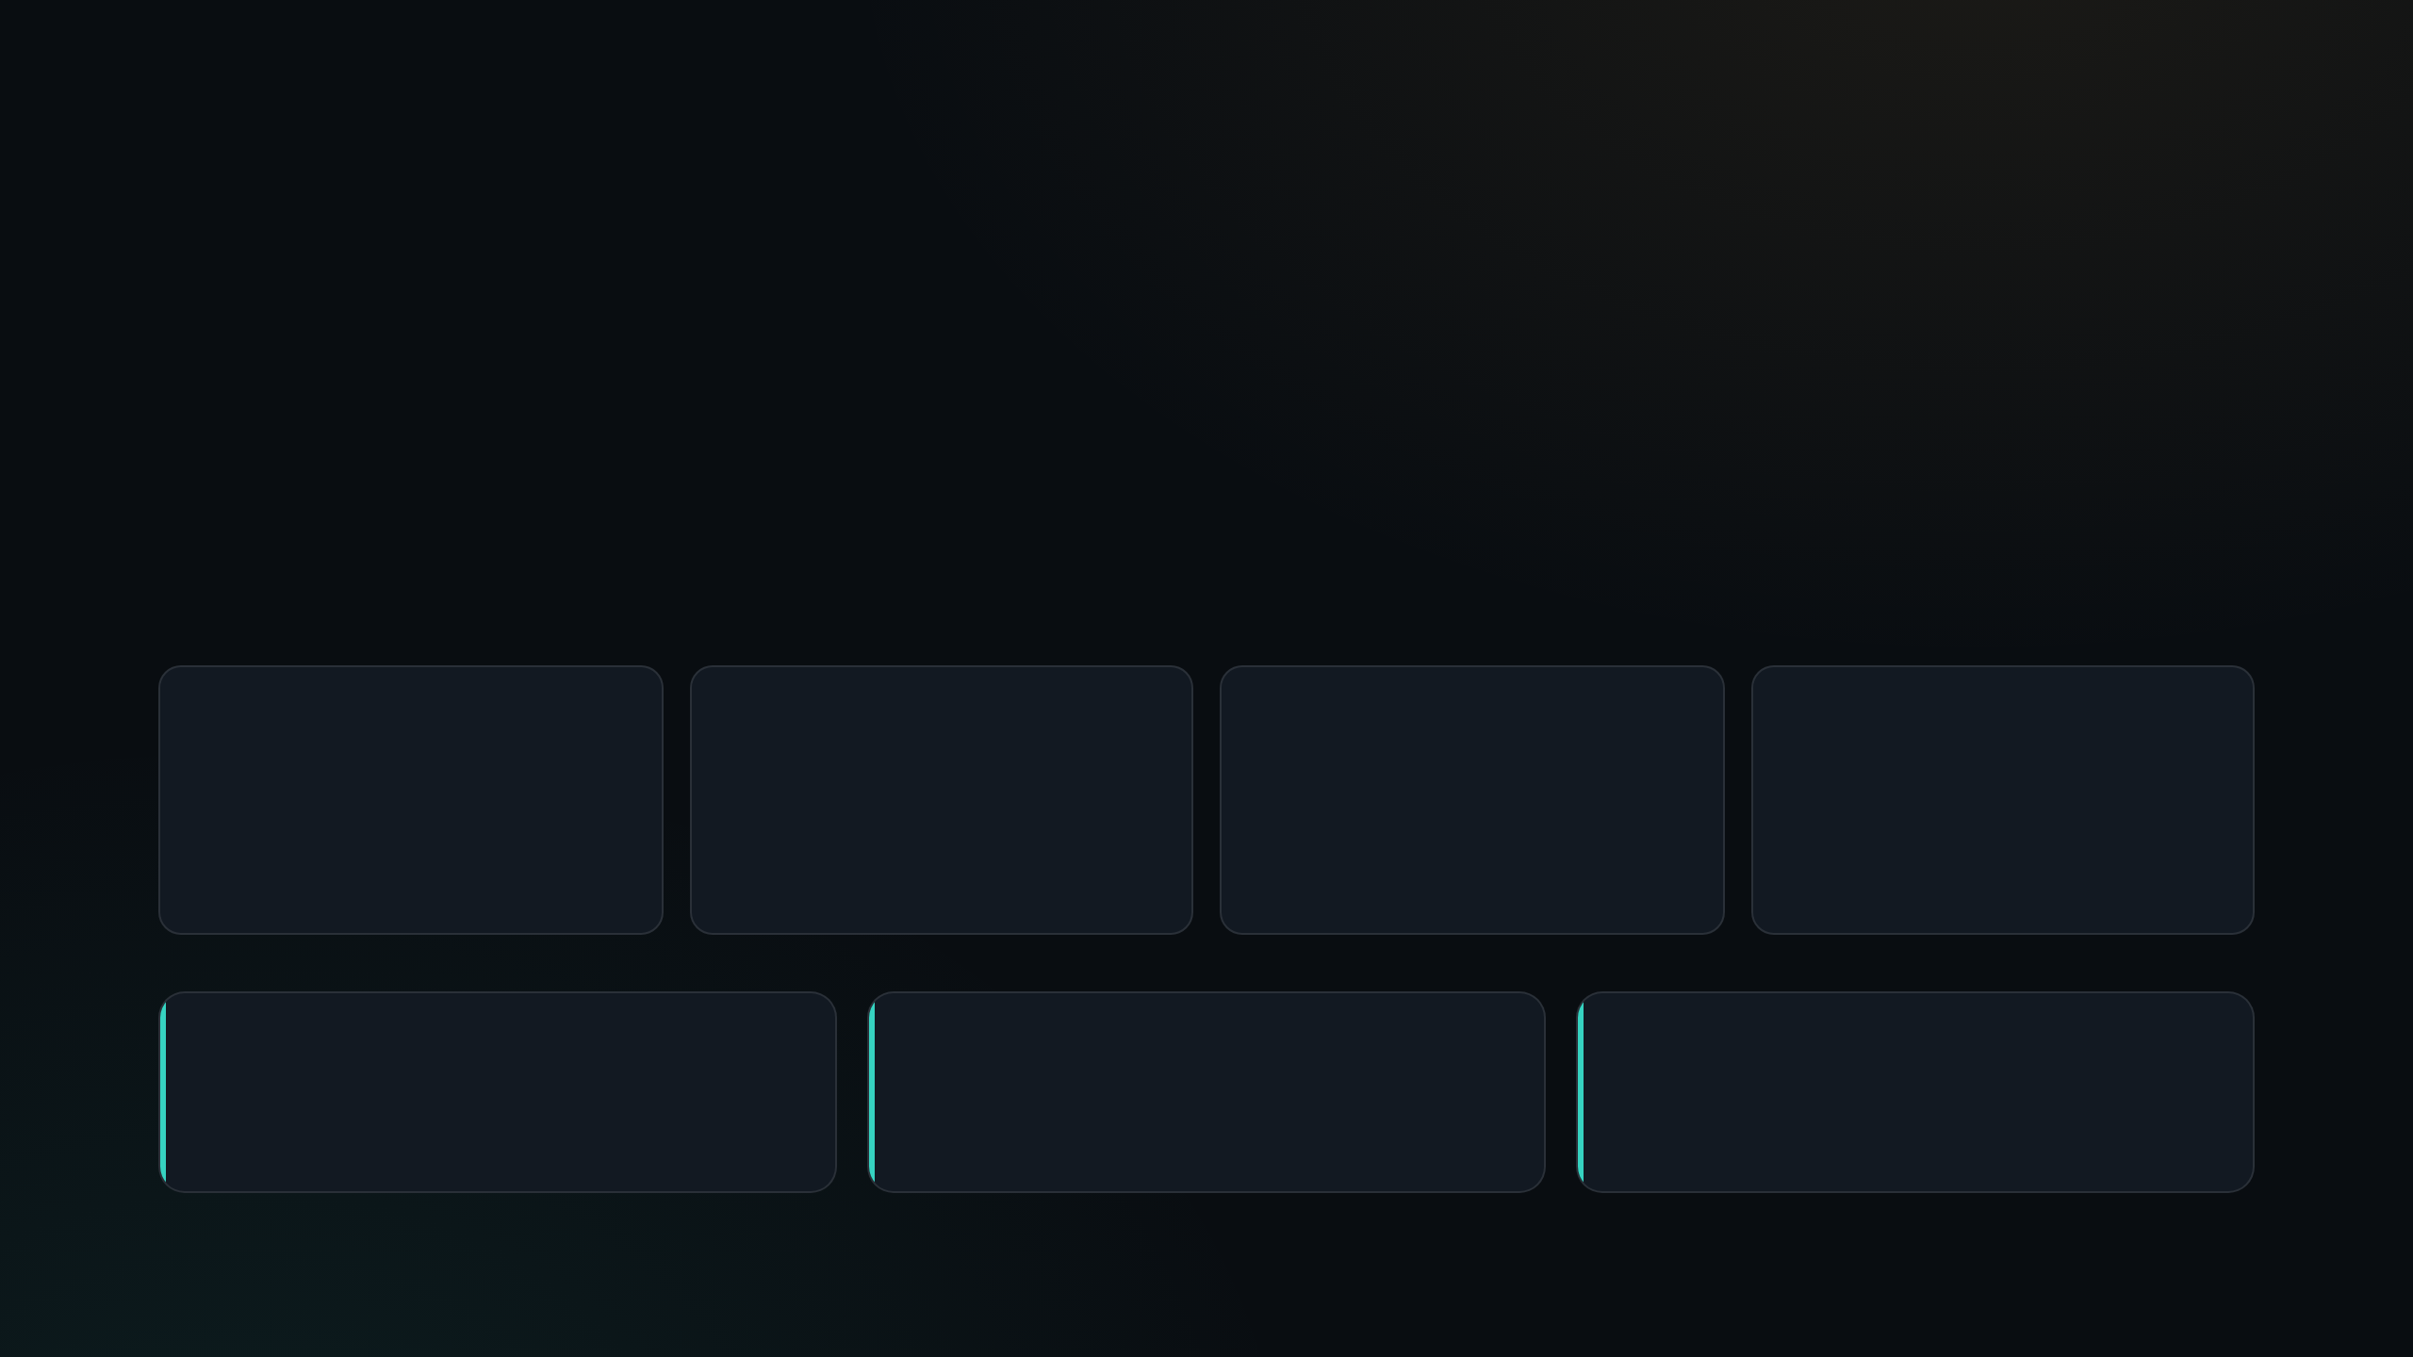
03 PLATFORM GRAVITY WELLS
Governance is being bundled toward zero.
The largest vendors are not maximizing governance license revenue. They are using governance to make their agent runtime, workflow layer, and suite renewal harder to displace.
$15
$99
$0.10
Zero
Agent 365 monthly user price cited in the brief
Bundled M365 E7 price cited for unlimited agents
Agentforce action-style pricing reference
Direction of travel when governance is packaged into the control plane
IMPLICATION
RISK
RESPONSE
Governance is a platform attachment, not a clean standalone product category.
A standalone HDS software SKU will look like duplicate spend to suite customers.
Sell operational accountability the platforms do not want to staff.

Slide 5
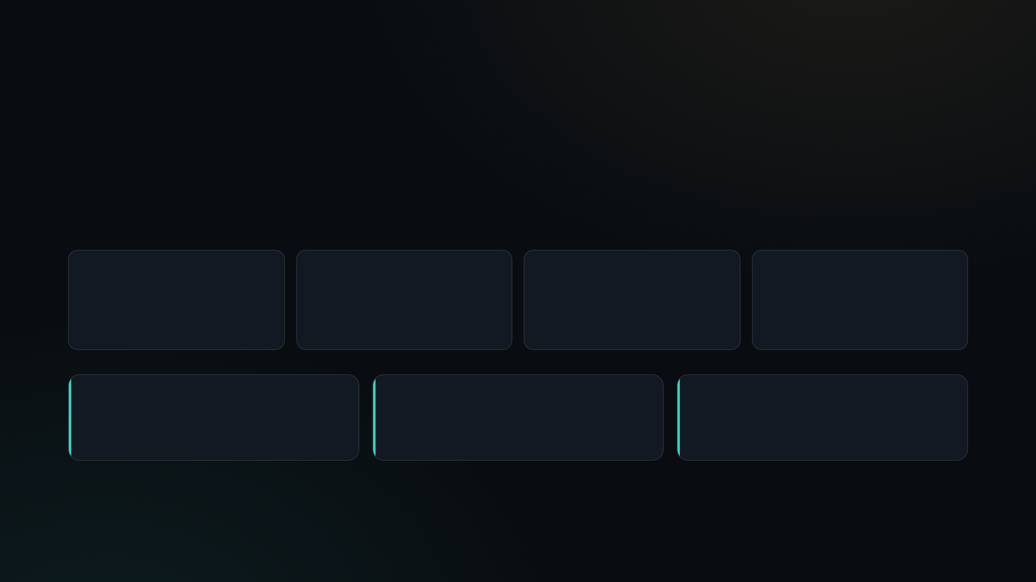
04 MONEY VS. NOISE
The noise is software. The money is operations.
$492M
15–20
$13.8B
$10B+
Standalone governance platform spend cited for 2026
Governance software vendors splitting the small software pool
AI TRiSM market estimate cited for 2030
Agentic services market context around deployment and operations
AVOID
WATCH
ENTER
A governance software SKU where platform vendors bundle comparable capability.
Security and identity budgets, but partner rather than fight category leaders.
The execution gap: run the governed agent fleet after tools are bought.

Slide 6

05 EXECUTION GAP
Enterprise adoption is ahead of governance maturity.
51 pt gap
72%
That gap is not solved by another dashboard. It requires runbooks, human escalation, runtime monitoring, incident response, evidence packs, and ownership.
Those are operations problems. Operations is where HDS has permission to win.
21%
Enterprises
with agents in production
Enterprises
with mature agent governance

Slide 7

06 WHITESPACE
Own cross-runtime governance where agents touch physical operations.
PLATFORM CONTROL PLANES
Govern the suite and the dashboard
Agent 365 · AI Control Tower · Agentforce · Gemini Enterprise · Agentstudio
PLANT, GRID, MAINTENANCE, SAFETY, REGULATED EVIDENCE
HDS GOVERNED AGENT OPERATIONS
Run the fleet across runtime and regulator boundaries
MES · SCADA · historians · work orders · maintenance agents · compliance packs
The wedge is neutrality plus operations: govern and run every agent fleet to the standard of the buyer’s regulator.

Slide 8

07 OFFER DESIGN
Package HARC AMS as Governed Agent Operations.
UNIT
WHY IT FITS HDS
$/agent-under-management/month, not a software seat
The economics look recurring and software-like, but delivery runs through an operating model HDS already understands.
CORE PROMISE
24/7 governed operations across Copilot Studio, Agentspace, Lyzr, Ema, and client runtimes
WHAT TO AVOID
Do not create a license SKU that enters procurement bake-offs against bundled Microsoft or ServiceNow governance.
IP LAYER
Vertical packs: NERC CIP, IEC 62443, FDA 21 CFR Part 11, aviation

Slide 9

08 BUYER SHIFT
Sell to the risk owner, not only the delivery sponsor.
CIO / platform owner
SUITE PULL
Already owns Microsoft, ServiceNow, Salesforce, Google, or Boomi. Default instinct is to turn on the module.
CISO / CRO
RISK PULL
Owns incident exposure, identity risk, regulated workflows, and evidence expectations when agents take action.
Plant / ops leader
RUNTIME PULL
Needs governed automation in maintenance, grid ops, production, and safety-critical processes.
The service should be sold with a second buying center: CISO, CRO, and operations leaders who do not trust a suite checkbox to cover regulated runtime exposure.

Slide 10

09 STRONGEST COUNTERARGUMENT
The neutral-control-plane story may already be gone.
ServiceNow claims cross-system
Microsoft partnership matters
Customers already own it
SI software risk is real
The standalone market size signal argues against building another governance product.
AI Control Tower now positions itself as governance for agents across any system.
Agent 365 integration weakens the outsider-neutrality argument before HDS can own it.
Governance as a suite feature can make third-party spend look duplicative.
Product roadmaps starve when services utilization pressure returns.

Slide 11

10 CHEAPEST EXPERIMENT
Do not build first. Try to sell it.
DURATION
PASS
At least 3 signed paid pilots at pricing that implies $150K ARR each, with one buyer outside the existing delivery sponsor.
SAMPLE
10 accounts: five current HARC clients, five cold CISO or compliance buyers
FAIL
Zero takers at real pricing. Keep AMS as engagement glue and invest in security or identity partnerships instead.
PACK
Start with NERC CIP for utilities, then expand only after paid signal

Slide 12

11 DECISION RULE
The market will tell us if this is IP or collateral.
If three paid pilots do not close in 90 days at a real price —
the correct conclusion is not “build more product.” It is that HARC AMS works best as pull-through collateral inside services engagements.
The discipline: no standalone productization spend until buyers prove they will pay for governance operations separately from people.

Slide 13
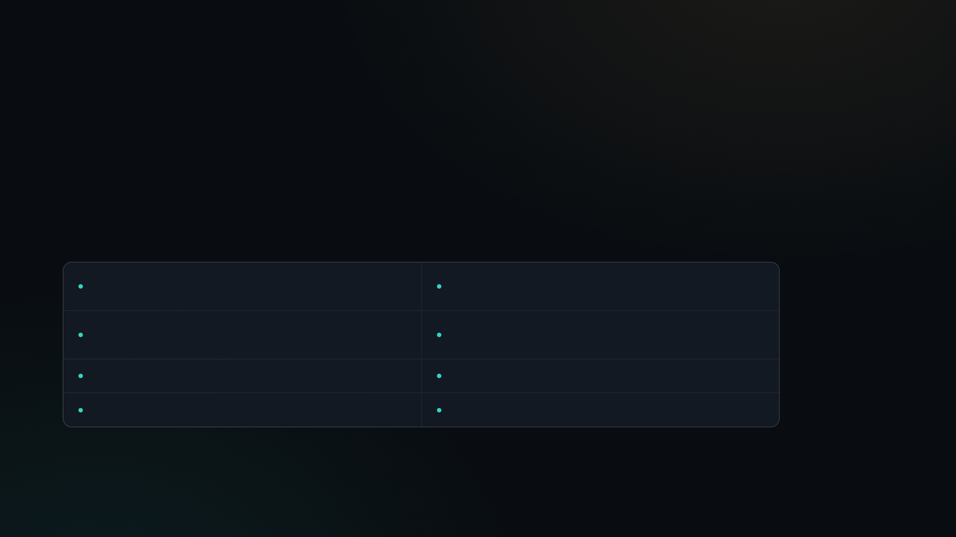
12 EVIDENCE BASE
Claims are anchored to the supplied market brief.
Gartner AI governance platform market estimate
ServiceNow AI Control Tower expansion and Microsoft integration
Agent 365 licensing and pricing analysis
Credo AI, OneTrust, and AI governance vendor pricing references
LLM observability vendor and market comparisons
AI TRiSM market estimate and cybersecurity M&A signals
HFS Agentic Services model and SI positioning
Deloitte and Agentic AI Institute governance-gap research

