Slide 1
COMPETITIVE ANALYSIS · AI-ANALYST PASS
Where DataStaqAI Plays — Quantified
25 use cases · posture mix · price-floor gap · TAM · opportunity map

Slide 2
Method & validation
Source-traceable, judgment labeled
• Dataset: 25 use cases; figures traced to the 6 COMPETITIVE_*.md deep-research files. Blanks = no clean public figure (not zero).
• Tie-out: 25 use cases load (Customer 5 · Employee 5 · Creative 4 · Code 3 · Data 4 · Security 4).
• One unit error caught and removed: Salesforce CPQ $200 is per-seat/mo, not an annual floor.
• Competitive density is a judgment call from funding/competitor counts — not a measured index.
DataStaqAI · Competitive Analysis (AI-Analyst) · 2026
2 / 11

Slide 3
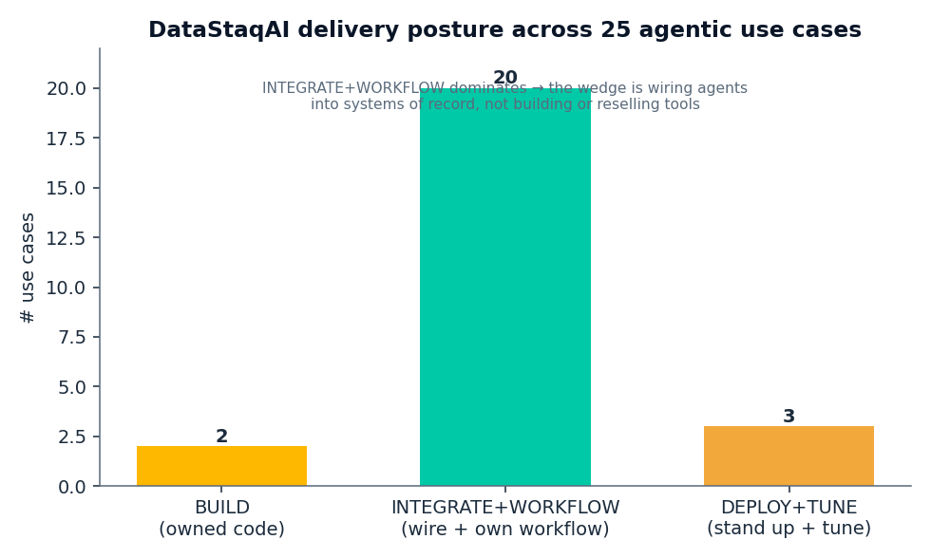
Our motion is integration, not invention
20 of 25 use cases are INTEGRATE+WORKFLOW; only 2 are BUILD

Slide 4
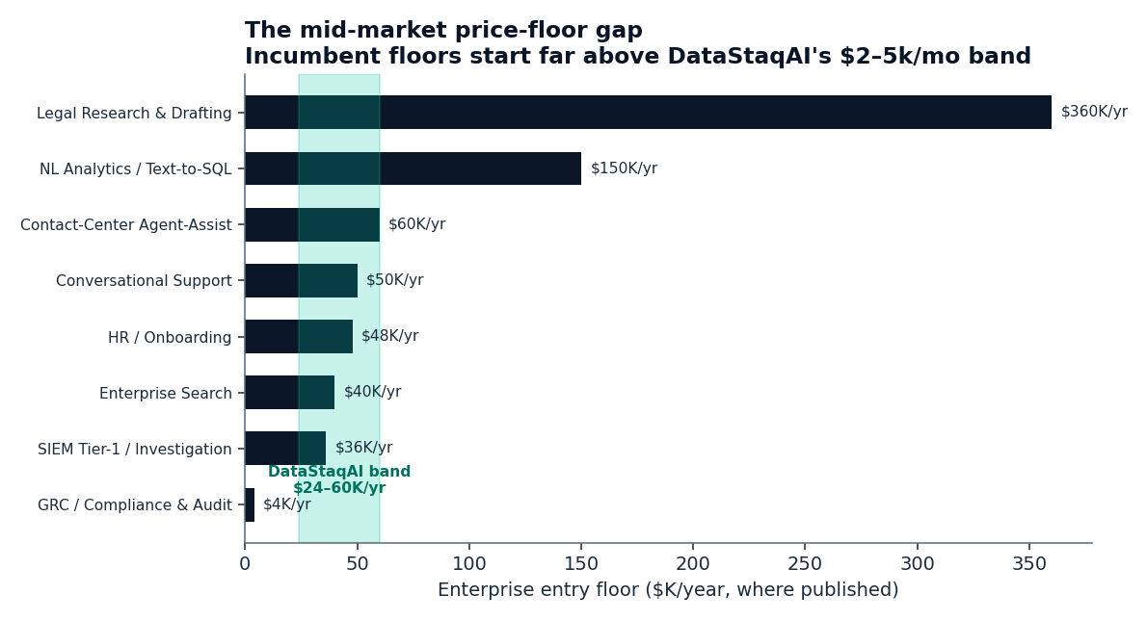
We sit below every incumbent floor but one
Widest gaps: Legal $360K/yr and NL-Analytics $150K/yr

Slide 5
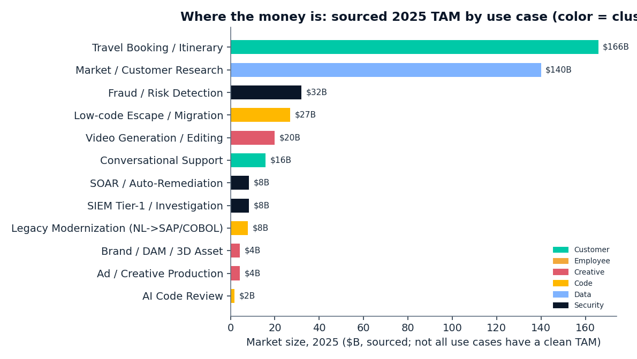
The biggest sourced markets aren't the crowded ones
Travel, research, fraud, low-code dwarf the crowded agent lanes

Slide 6
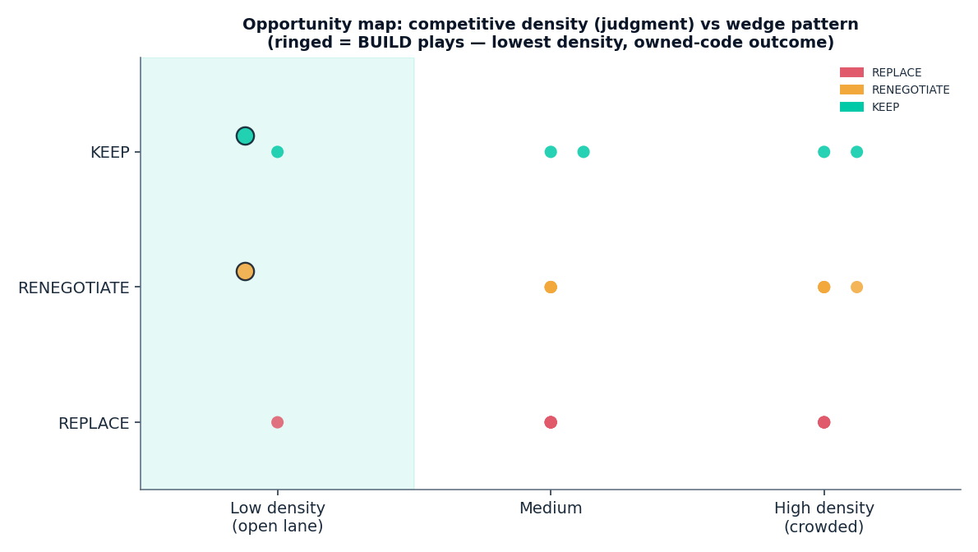
The two BUILD plays own the open lane
Lowest density + owned-code outcome; rivals are Global-2000-only

Slide 7
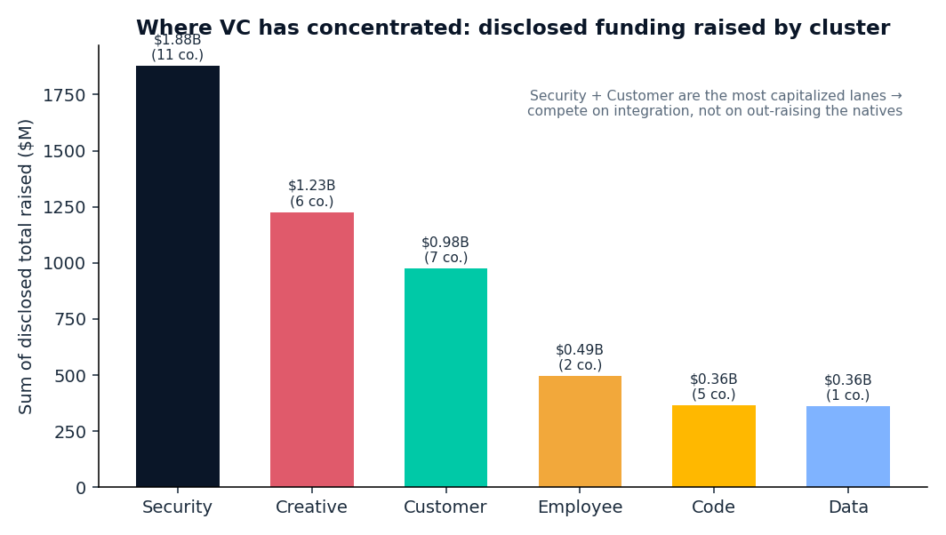
VC has concentrated in Security and Customer
Security $1.9B, Creative $1.2B, Customer $1.0B raised — out-integrate, don't out-raise

Slide 8
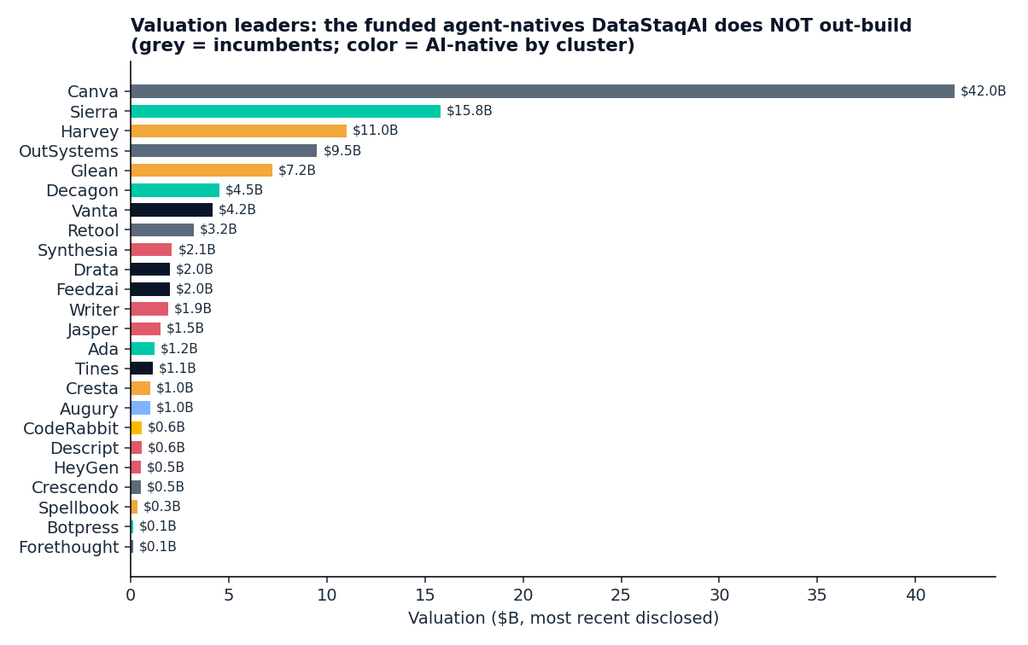
We don't out-build these valuations — we wire them in
Sierra $15.8B, Harvey $11B, Glean $7.2B, Vanta $4.2B lead the agent-natives

Slide 9
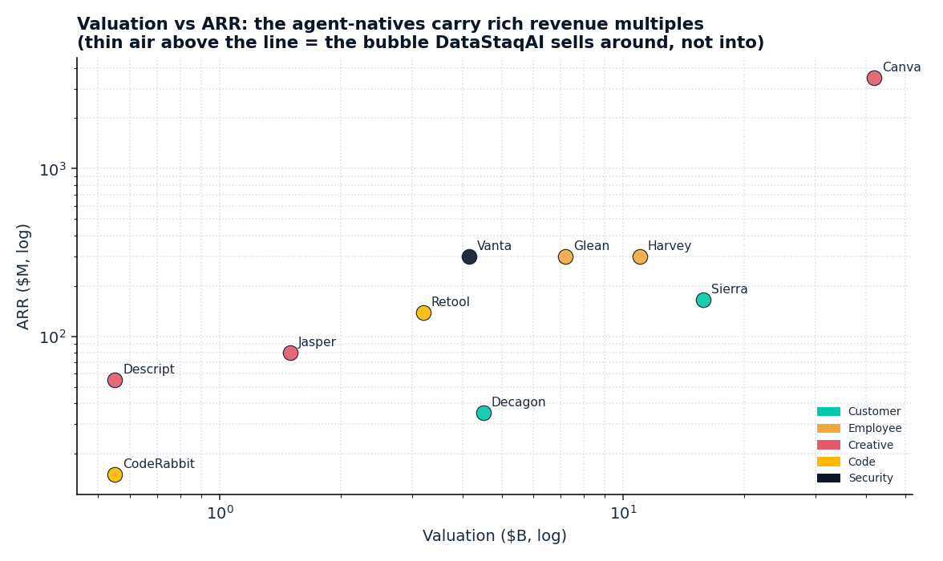
Agent-natives carry rich multiples — the bubble we sell around
High valuation per $ of ARR; the integration layer is the unfunded gap

Slide 10
Recommendation — where to play
• Lead with the BUILD plays (#16 Legacy modernization, #17 Low-code escape): low density + owned-code outcome + competitors that skip the mid-market. Highest defensibility.
• In crowded REPLACE lanes (legal, conversational support, code review): don't out-agent the funded natives — win on mid-market price (below $40–360K floors) + integration + client owns the outcome.
• KEEP / enrichment lanes (SIEM, fraud, predictive ops, GRC, DAM): DEPLOY+TUNE for regulated buyers — 'make the investment you already made finally pay off.'
• Don't price-compete in GRC ($4K floor): anchor on integration + source-grounded evidence provenance.
DataStaqAI · Competitive Analysis (AI-Analyst) · 2026
10 / 11

Slide 11
Attention and market size are misaligned. That gap is the integrator's opening.
DataStaqAI · done-for-you AI engineering · ~$2–5k/mo

