Slide 1
Enterprise software re-platforms every ~15 years — each wave moved intelligence closer to the work
Agents are the fourth wave: the first to move intelligence past the human at the seat
1970s–90s · Mainframe / ERP
1990s–2010s · Client-server → SaaS
2010s–20s · Cloud / Mobile / API
2024+ · Agentic
• Centralized records, IT-operated
• Unit of value: the batch job
• Per-seat apps; humans operate tools
• Unit of value: the seat
• Access everywhere; integration sprawl
• Unit of value: the API call
• Agents operate the tools; outcome-billed
• Unit of value: the agent run
→
→
→
Each wave moved intelligence closer to the work. The agentic wave moves it PAST the human entirely — and resets who captures the budget the seat used to hold.
DataStaqAI · The Agentic Enterprise · Chapter 2: The AI Transformation
4 / 8
Notes:
Open Chapter 2 by giving the audience a frame for change they already intuit: enterprise software re-platforms roughly every fifteen years, and each wave has moved intelligence one step closer to the actual work. The mainframe/ERP era centralized the record but kept intelligence in the IT department running batch jobs. The client-server and SaaS era put applications on every desk and made the seat the unit of value — but the intelligence still lived in the human operating the tool. The cloud/mobile/API era made everything accessible everywhere and turned integration into the dominant cost, but it did not change who did the thinking. The point of walking these three is to make the fourth feel inevitable rather than hyped. The agentic wave is categorically different from the first three because, for the first time, the intelligence moves past the human at the seat: the agent operates the tools itself, and value is billed per outcome rather than per seat. Stress the throughline — each wave moved intelligence closer to the work, and this one moves it through the human entirely. That is why it resets the budget: when the seat is no longer where the work happens, the spend that funded seats is in play. Close by setting up the rest of the chapter: if this is a genuine platform wave, we should expect to see it in the capability curve of AI itself (slide 5), in the limits of half-measures like copilots (slide 6), in a specific unsolved layer (slide 7), and in market data showing the inflection is now (slide 8). Keep the delivery deliberately calm and historical — you are earning the right to the sharper claims that follow by grounding them in a pattern the audience has lived through twice already.

Slide 2
AI crossed from 'predict' to 'do' — and that jump makes orchestration, not the model, the scarce layer
Each step added capability; the last step changes who performs the work
Agentic / Autonomous
Generative / Copilot
• Reasons, decides, ACTS
• Owns the outcome
ML / Predictive
• Drafts & suggests
• Human stays in the loop
Rules / RPA
• Forecasts & scores
• Needs clean labeled data
• If-this-then-that
• Brittle; breaks on change
The jump from PREDICT to DO is the value inflection: once the agent acts across systems, the model becomes a commodity input and orchestration becomes the scarce, defensible layer.
DataStaqAI · The Agentic Enterprise · Chapter 2: The AI Transformation
5 / 8
Notes:
This slide reframes 'AI progress' as a capability staircase so the audience sees that the recent jump is qualitatively different, not just bigger. Step one, rules and RPA: deterministic if-this-then-that automation that is powerful but brittle and breaks the moment the environment changes. Step two, machine learning: forecasts and scores, a real leap, but dependent on clean labeled data and still only predicting, not acting. Step three, generative AI and copilots: the system can now draft and suggest in natural language, which felt revolutionary, but the human stays firmly in the loop and must accept, edit, and execute. Step four, agentic: the system reasons over context, decides the next step, acts across systems, and owns the outcome. The crucial teaching point is that the first three steps all kept the human as the actor; only the fourth makes the software the actor. That is why the jump from 'predict' to 'do' is the value inflection of the entire field. Now connect it to strategy, because this is where Chapter 2 starts doing real work for DataStaqAI: once agents can act, the foundation model becomes a commodity input — interchangeable, rapidly cheapening, and as we will show, unable to function reliably without governed context. What becomes scarce and defensible is the orchestration: wiring the agent into the real systems, giving it the governed context it needs, constraining it with policy, and operating it. Preview the proof that the model is not the moat, which lands harder in slide 7: on realistic enterprise data, frontier text-to-SQL accuracy collapses from ~87% on toy schemas to ~10%, and the accuracy that production systems do achieve comes from the semantic layer, not the raw model. End on the strategic inversion: the part everyone is racing to build — the model — is the part that commoditizes; the part almost no one is building — delivery — is the part that compounds.

Slide 3
Copilots assist the human at the seat — they don't remove it, so they cap out at suggestion not resolution
The capability gap between a copilot and an agent is the gap between faster work and no work
Capability
Copilot (assists the seat)
Agent (replaces the seat)
Triggers itself on an event
No — human invokes
Yes
Decides the next step
Suggests
Decides & executes
Acts across systems of record
No
Yes
Owns the outcome end-to-end
No
Yes
Billing unit
Per seat
Per outcome
In the field: agent-assist tools are used ~1% of the time · AI code review reads as 'mostly noise' · the copilot adds a tab, it doesn't remove the work.
A copilot makes the seat faster. An agent makes the seat unnecessary — and only delivery makes the agent real.
DataStaqAI · The Agentic Enterprise · Chapter 2: The AI Transformation
6 / 8
Notes:
This slide pre-empts the most common pushback an enterprise audience has: 'we already have copilots, isn't that the same thing?' The matrix answers it crisply by separating assistance from autonomy across five dimensions. A copilot does not trigger itself — a human must invoke it; an agent fires on an event. A copilot suggests the next step; an agent decides and executes it. A copilot cannot act across the systems of record; an agent does. A copilot does not own the outcome; an agent does, end to end. And the billing unit gives the game away: copilots are sold per seat, because they presuppose the seat, while agents are increasingly sold per outcome, because they replace it. The strategic significance is that copilots, by construction, cannot reset the budget — they make the existing seat faster, which is why they are an add-on line item rather than a re-architecture. Bring the field evidence to make this concrete and a little provocative: real contact-center audits show push-style agent-assist tools are used about one percent of the time; engineering teams describe AI code review as 'mostly noise' that trains reviewers to rubber-stamp; across the board the copilot adds a tab to an already-cluttered screen rather than removing the work. None of this is a knock on the technology — it is a statement about the ceiling of the form factor. Land the takeaway as the chapter's sharpest line so far: a copilot makes the seat faster, an agent makes the seat unnecessary, and only the second resets the budget. Then immediately set up slide 7's twist — making the second real (an agent that actually acts across a specific company's messy systems, safely) is not a model problem and not even an agent-platform problem; it is a delivery problem, and that is the layer nobody is serving for the mid-market.

Slide 4
The model is solved and the agent exists — the unsolved layer is delivery
Integration, workflow, governance, operation: the value-chain stage everyone skips
Foundation model
Agent platform
Delivery layer
Business outcome
• Commoditized
• Frontier models converge; not the moat
• Funded
• Sierra/Harvey/Glean/Vanta built the agents
• UNOWNED
• Integration · workflow · governance · run
• The prize
• Resolved tickets · owned code · audit-ready
→
→
→
Evidence: 20 of 25 use cases are INTEGRATE work · the semantic layer (not the model) drives accuracy · 'automated' GRC evidence is often organized manual work · the leading modernizer needs system integrators · 80% of orgs still can't fully automate — integration + skills are the blockers.
Everyone optimized the model and the agent. Almost no one delivers them into the mid-market. That gap is the company.
DataStaqAI · The Agentic Enterprise · Chapter 2: The AI Transformation
7 / 8
Notes:
This is the pivotal slide of Chapter 2 — the one that names the company's reason to exist. Present the agentic value chain as four stages and force the audience to locate where the unsolved problem actually is. Stage one, the foundation model: solved and commoditizing, with frontier models converging in capability and falling in price; it is explicitly not the moat. Stage two, the agent platform: built and richly funded — Sierra, Harvey, Glean, Vanta and their peers have already produced excellent agents. Stage three, the delivery layer: integrating the agent into a specific company's systems of record, designing the workflow around it, governing it for safety and audit, and operating it in production — and this stage is essentially unowned for the mid-market. Stage four, the business outcome: the prize the buyer actually wants — resolved tickets, owned code, audit-ready evidence. The whole argument is that the industry has poured capital into stages one and two and almost none into stage three, even though stage three is what converts a demo into a deployed outcome. Marshal the evidence deliberately: twenty of our twenty-five use cases resolve to integration-and-workflow work rather than model or agent invention; production text-to-SQL accuracy comes from the semantic layer, not the model; 'automated' GRC evidence is frequently organized manual work that breaks silently; the best-funded legacy modernizer states its platform must be operated and delivered by system integrators; and surveys show roughly eighty percent of organizations still cannot fully automate, with integration complexity and skills — not appetite — as the blockers. Deliver the takeaway as the thesis of the entire book: everyone optimized the model and the agent; almost no one delivers them into the mid-market; that gap is the company. Then hand to slide 8: the gap is real, but is the timing right? The market data says the window is open now.

Slide 5
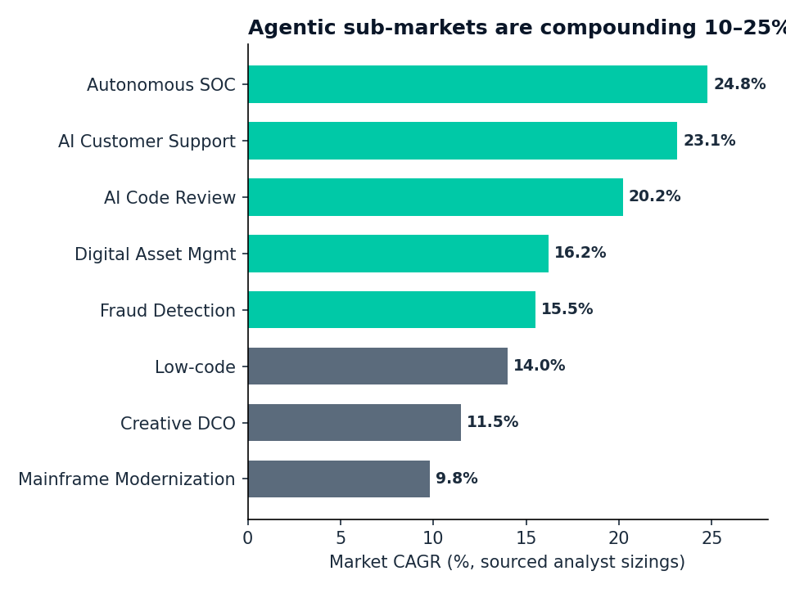
The inflection is now — demand compounding, incumbents forced to migrate, prices resetting
Three signals say the window to land the mid-market is open today, not in two years
DEMAND
Agentic sub-markets compounding 10–25%/yr — autonomous SOC 24.8%, AI support 23.1%, code review 20.2%
SUPPLY SHOCK
Incumbents forcing migrations: Salesforce CPQ End-of-Sale strands 6,000+ orgs; Claude legal plug-ins triggered a ~$285B selloff
PRICE RESET
Outcome pricing collapsing to $0.40–1.50 / resolution; $10/mo agents — 'cheap' is now table stakes
Demand up, incumbents migrating, prices resetting — the mid-market window is open NOW. Chapter 3 maps it function by function.
DataStaqAI · The Agentic Enterprise · Chapter 2: The AI Transformation
8 / 8
Notes:
Close Chapter 2 by answering the timing question directly, because a real gap with the wrong timing is not an opportunity. The argument is that three independent forces have converged right now. First, demand: the chart shows the agentic sub-markets compounding at rates between roughly ten and twenty-five percent a year — autonomous SOC near 24.8%, AI customer support 23.1%, AI code review 20.2%, fraud and DAM in the mid-teens, even the slower modernization and low-code markets in double digits. Markets grow at these rates during platform transitions, not incremental upgrades. Second, a supply shock on the incumbent side: vendors are themselves forcing the disruption. Salesforce putting CPQ into End-of-Sale strands more than six thousand organizations into a $250–750K reimplementation decision; Anthropic shipping Claude legal plug-ins erased roughly $285B of incumbent market value in a single session. When incumbents destabilize their own installed base, buyers are forced into the market — and a forced buyer is the best buyer an integrator can have. Third, a price reset: outcome pricing is collapsing toward $0.40–1.50 per resolution and ten-dollar-a-month agents, which means the conversation is no longer 'can we afford AI' but 'who will make it work in our environment' — exactly the question delivery answers. Put the three together and the message is that the window to land the mid-market is open today, and it will not stay uncontested: as price ceilings fall and forced migrations peak, the buyers are in motion now. End by handing to Chapter 3: with the thesis set and the timing established, the next chapter goes function by function — Customer Operations, Sales, HR, Finance, Procurement, Security, Legal, Analytics, Engineering, Operations — showing the workflow today, the incumbent vendors, the AI disruption, the opportunity, and DataStaqAI's positioning for each. That is where the abstract thesis becomes a concrete, addressable map.

