Slide 1
The enterprise AI stack has four layers — value is migrating to the one nobody serves
Foundation model · agent platform · delivery · system of record — the delivery layer is the gap
FOUNDATION MODELS — commoditizing
OpenAI · Anthropic · Google · Meta · open models
AGENT PLATFORMS — funded
Sierra · Harvey · Glean · Decagon · Vanta · Torq · Rossum
DELIVERY LAYER — unowned for the mid-market
Global SIs (enterprise-only) → DataStaqAI (mid-market, done-for-you)
SYSTEMS OF RECORD — the moat stays
Salesforce · Workday · SAP · Splunk · OutSystems · ERPs
The model commoditizes and the system of record persists. The agent platform is funded. The delivery layer — wiring it all together for the mid-market — is the unowned value layer.
DataStaqAI · The Agentic Enterprise · Chapter 4: Competitive Analysis
19 / 46
Notes:
Open Chapter 4 with the map the rest of the chapter navigates: the enterprise AI stack has four layers, and the purpose of this slide is to show value migrating to the layer nobody serves for the mid-market. The top layer, foundation models, is commoditizing — OpenAI, Anthropic, Google, Meta and open models converge in capability and fall in price, so the model is an input, not a moat. The second layer, agent platforms, is richly funded — Sierra, Harvey, Glean, Decagon, Vanta, Torq, Rossum — and these are genuinely good products. The bottom layer, systems of record — Salesforce, Workday, SAP, Splunk, OutSystems, the ERPs — persists, because the proprietary data and workflow are the durable moat; agents ride on top of it rather than replacing it. The third layer, delivery, is the one this whole document is about: wiring the agent into the systems of record, designing the workflow, governing it, operating it. Today that layer is owned only by global systems integrators, and they serve only the Global 2000. For the mid-market it is unowned. Use the gold band to make the strategic claim unmissable: the model commoditizes, the system of record persists, the agent platform is funded — and the delivery layer is where the value accrues and where the competition is thinnest. Every subsequent slide in the chapter zooms into one part of this map: who the archetypes are, how the incumbents and AI-natives and SIs each compete, how pricing and funding have concentrated, and where the white space sits. Tell the audience to keep this four-layer picture in mind, because DataStaqAI's entire position is 'we own the delivery layer for the mid-market,' and this slide is the proof that such a layer exists and is empty.

Slide 2
Segment two ways — by buyer size and by who delivers — and the mid-market done-for-you cell is empty
The competitive map has a structural hole exactly where DataStaqAI sits
Enterprise · Self-serve product
Mid-market · Self-serve product
• AI-native platforms
• Sierra, Glean, Harvey, Decagon, Vanta
• SMB point tools
• Freshdesk Freddy, Botpress, eesel, Sprinto
Enterprise · Done-for-you
Mid-market · Done-for-you ← EMPTY
• Global SIs + managed tiers
• Accenture, Deloitte, Crescendo (BPO)
• The structural hole
• DataStaqAI: wire + own + run, at $2–5k/mo
BUYER → Enterprise … Mid-market | DELIVERY ↓ Self-serve … Done-for-you
Three cells are crowded. The fourth — mid-market companies that need it done for them — is the opening.
DataStaqAI · The Agentic Enterprise · Chapter 4: Competitive Analysis
20 / 46
Notes:
This slide reduces a noisy market to a single 2x2 so the audience can see the hole rather than be told about it. Segment the market on two axes. The horizontal axis is buyer size: enterprise on the left, mid-market on the right. The vertical axis is who does the delivery: self-serve product at the top, done-for-you at the bottom. Now place the players. Top-left, enterprise buyers served by self-serve products: the funded AI-natives — Sierra, Glean, Harvey, Decagon, Vanta — who sell a powerful platform the enterprise's own engineers operate. Top-right, mid-market buyers served by self-serve products: the SMB point tools — Freshdesk Freddy, Botpress, eesel, Sprinto — cheap but self-operated and shallow. Bottom-left, enterprise buyers served done-for-you: the global systems integrators (Accenture, Deloitte) plus the AI-natives' own managed and BPO tiers (Crescendo). And bottom-right, mid-market buyers who need it done for them: empty. That empty cell is the entire thesis rendered as geography. The mid-market company is too small for the enterprise AI-native and its agent engineers, too complex for a self-serve SMB tool, and not worth a Global SI's time — so no one delivers the agent into their systems for them. DataStaqAI occupies that cell: wire it, own the workflow and governance, run it, at $2–5k/month. Make the closing point explicit — three of the four cells are crowded with well-funded competitors, and the fourth is structurally open, not because it lacks demand (Chapters 1–3 proved the demand) but because every existing archetype is optimized away from it. The next slide names those archetypes and shows precisely how each one is optimized away from this cell.

Slide 3
Five archetypes compete for the agent budget — each optimized away from the mid-market outcome
Knowing the archetype tells you exactly where each competitor stops short
Incumbent Defender
AI-Native Point Solution
Managed / BPO Hybrid
Global Systems Integrator
Horizontal Agent Platform
Play: Bolts AI on the seat it sells
Stops short: Won't cannibalise seat revenue
Play: Best agent, enterprise-first
Stops short: 6-figure floor + agent engineers
Play: Runs it for you, with people
Stops short: Labor-cost scaling, not engineering
Play: Delivers — for the Global 2000
Stops short: Too slow & costly for mid-market
Play: Build-your-own-agent toolkit
Stops short: You still supply the delivery
DataStaqAI is the sixth archetype: the mid-market delivery specialist — engineering economics (not labor), outcome-owned, priced for the middle. It is defined by the gap the other five leave.
DataStaqAI · The Agentic Enterprise · Chapter 4: Competitive Analysis
21 / 46
Notes:
This slide gives the audience a vocabulary that makes the rest of the chapter legible: five competitor archetypes, each with a play and, crucially, a structural reason it stops short of the mid-market outcome. The Incumbent Defender (Zendesk, Salesforce, Workday) bolts AI onto the seat it already sells and cannot cannibalise its own seat revenue, so its AI is an add-on, never a re-architecture. The AI-Native Point Solution (Sierra, Harvey, Glean) builds the best agent but goes enterprise-first, with six-figure floors and a requirement that the buyer supply agent engineers. The Managed/BPO Hybrid (Crescendo) will run it for you, but with people, so its economics scale with labor cost rather than engineering leverage. The Global Systems Integrator (Accenture, Deloitte, IBM) genuinely delivers, but only for the Global 2000, because their cost structure and sales motion are too slow and expensive for a mid-market shop. And the Horizontal Agent Platform (the build-your-own-agent toolkits) hands you primitives but leaves you to supply the delivery yourself. The pattern is the punchline: every archetype is optimized away from the same place — a mid-market company that wants the agent delivered into its systems with engineering economics and an owned outcome. DataStaqAI is best understood as a sixth archetype defined precisely by that gap: the mid-market delivery specialist, with engineering economics rather than labor, the outcome owned rather than a tool handed over, and pricing built for the middle. Stress that this is not a claim of being 'better' than the other five at their own game — it is a claim of occupying a different, empty position. The next three slides examine the three most important archetypes — incumbents, AI-natives, and systems integrators — in detail, because those are the ones a buyer will compare us against.

Slide 4
Incumbents own distribution and the system of record — but can't disrupt the seat they sell
Their strength is also their cage
STRENGTHS
STRUCTURAL LIMITS
• Distribution + installed base + procurement trust
• Compliance, security, and the system-of-record data moat
• AI shipped as a safe add-on to an existing contract
• Won't cannibalise seat revenue → AI as a line item, not a re-architecture
• Slow, committee-bound roadmaps; per-seat pricing preserved
• Agentforce $200/seat, Zendesk add-ons, Looker dev-heavy
Examples: Zendesk · Salesforce · Workday · Splunk · OutSystems · Looker. Implication: incumbents are the system of record we wire INTO — partners, not the battleground.
DataStaqAI · The Agentic Enterprise · Chapter 4: Competitive Analysis
22 / 46
Notes:
Examine the incumbent camp honestly, because a buyer's default is to ask 'why not just wait for Salesforce or Zendesk to ship this?' The strengths are real and should be stated plainly: incumbents own distribution, the installed base, and procurement trust; they hold compliance, security, and the system-of-record data that is the durable moat; and they can ship AI as a low-friction add-on to a contract the customer already has. That is a strong hand. But the limits are structural, not temporary. An incumbent cannot lead the disruption because its revenue is the seat, and cannibalising the seat is irrational — so its AI arrives as a line item bolted onto the existing model rather than a re-architecture of the work, and its pricing stays per-seat (Agentforce at $200/seat, Zendesk's stack of add-ons, Looker's developer-heavy LookML). Roadmaps are committee-bound and slow. The strategic conclusion is the most important takeaway of the slide and a reframe of the whole competitive question: incumbents are not the battleground — they are the system of record DataStaqAI wires INTO. We do not displace Workday or Splunk; we make the agent layer on top of them work for the mid-market. That turns the most fearsome-looking competitor into a partner and an asset: their persistence is what makes the delivery layer necessary and durable. Tell the audience to hold this distinction, because it recurs in the business model — DataStaqAI's defensibility comes partly from being aligned with, not opposed to, the systems the customer will never rip out. The next slide turns to the AI-natives, who are the opposite case: genuinely disruptive, genuinely excellent, and genuinely unable to serve the middle.

Slide 5
AI-natives build the best agents — and price them for the Fortune 500
Excellent products, structurally enterprise-first — they concede the mid-market
STRENGTHS
STRUCTURAL LIMITS
• Best-in-class agent quality and shipping velocity
• Category-defining valuations & capital (winner-take-most bet)
• Sierra $15.8B · Harvey $11B · Glean $7.2B · Decagon $4.5B · Vanta $4.15B
• Six-figure floors + dedicated agent engineers required
• Sit on top of a separate SoR → integration TCO on the buyer
• Wrapper-risk where there's no proprietary data moat
They've already conceded the gap — shipping managed/forward-deployed tiers because mid-market buyers can't run the agents alone. We are the delivery layer they implicitly require.
DataStaqAI · The Agentic Enterprise · Chapter 4: Competitive Analysis
23 / 46
Notes:
Give the AI-natives full credit, because over-claiming against them destroys credibility. Their strengths are genuine and formidable: best-in-class agent quality, extraordinary shipping velocity, and category-defining valuations and capital — Sierra at $15.8B, Harvey at $11B, Glean at $7.2B, Decagon at $4.5B, Vanta at $4.15B — which reflect a deliberate winner-take-most enterprise bet. DataStaqAI does not try to out-build these agents; it rides on them. The limits, again, are structural rather than fixable with a price cut. Their floors are six figures and they require the buyer to supply dedicated agent engineers or accept forward-deployed teams; their products sit on top of a separate system of record, so the integration total-cost-of-ownership lands on the buyer; and where a vendor lacks a proprietary data moat, it carries wrapper-risk as frontier models advance. The decisive evidence — and the reason this slide ends on a navy emphasis band — is that the AI-natives have already conceded the mid-market gap by shipping managed and forward-deployed services, because their own customers cannot operate the agents alone. That concession is DataStaqAI's validation: the delivery layer is not a 'nice to have' the natives could bolt on; it is a function they implicitly require and are bad at, because doing it at mid-market scale needs engineering economics and a services-light delivery model, not six-figure white-glove teams. Frame the relationship precisely: the AI-natives are suppliers and, occasionally, the agent we deploy — not the competitor we beat on agent quality. We beat them only on the question they don't want to answer: who makes this work, affordably, in a mid-market company's messy systems? The next slide addresses the one archetype that does answer that question — the systems integrators — and why they still miss the middle.

Slide 6
The integrators that actually deliver serve only the Global 2000 — leaving the mid-market unintegrated
DataStaqAI is the SI model rebuilt for the mid-market on engineering economics
GLOBAL SIs (Accenture · Deloitte · IBM)
DATASTAQAI (mid-market delivery)
• Real delivery capability + enterprise trust
• But: $M+ engagements, multi-quarter timelines
• Optimized for Global-2000 transformation programs
• Mechanical Orchard's platform is 'built to be operated by SIs'
• Engineering economics: agents + subagents + MCPs, ~$2–5k/mo
• Weeks, not quarters; the client owns the outcome (and the code)
• Wire best-of-breed agents into the client's SoR + governance
• Same delivery role the leading methods require — for the middle
The market's best methods explicitly NEED a delivery layer — and aim it at the Global 2000. DataStaqAI is that layer, repriced and re-architected for the mid-market.
DataStaqAI · The Agentic Enterprise · Chapter 4: Competitive Analysis
24 / 46
Notes:
This slide handles the most direct competitor to DataStaqAI's actual function — the systems integrators — and turns their existence into proof rather than threat. The global SIs (Accenture, Deloitte, IBM) have genuine delivery capability and deep enterprise trust; they are the only archetype that truly does the wiring, governance and operation that the delivery layer requires. But they do it as million-dollar-plus engagements on multi-quarter timelines, optimized for Global-2000 transformation programs. The most important external validation in the entire deck sits here: Mechanical Orchard — the best-funded company using the leading behavior-first modernization method — states its platform is 'built to be operated and delivered by system integrators,' and it serves only the Global 2000. In other words, the market's most advanced methods explicitly require a delivery layer and explicitly aim it at the largest enterprises. DataStaqAI is that same delivery layer, repriced and re-architected for the mid-market: engineering economics rather than billable armies — agents, subagents and thousands of MCP integrations at roughly $2–5k/month — delivering in weeks rather than quarters, with the client owning the outcome and, in the build plays, the code. The argument to land is that DataStaqAI is not inventing a new category; it is taking a proven, necessary role (systems integration for the agent era) and bringing it to a segment the incumbent SIs cannot economically serve. That is a far more credible and fundable story than 'a new kind of company,' because investors and buyers already understand SIs — the novelty is only the economics and the segment. With the three comparison archetypes covered, the next two slides quantify the competition with the pricing and funding data, before sub-iteration two moves to coverage, white space, SWOT, the disruption matrix and why DataStaqAI wins.

Slide 7
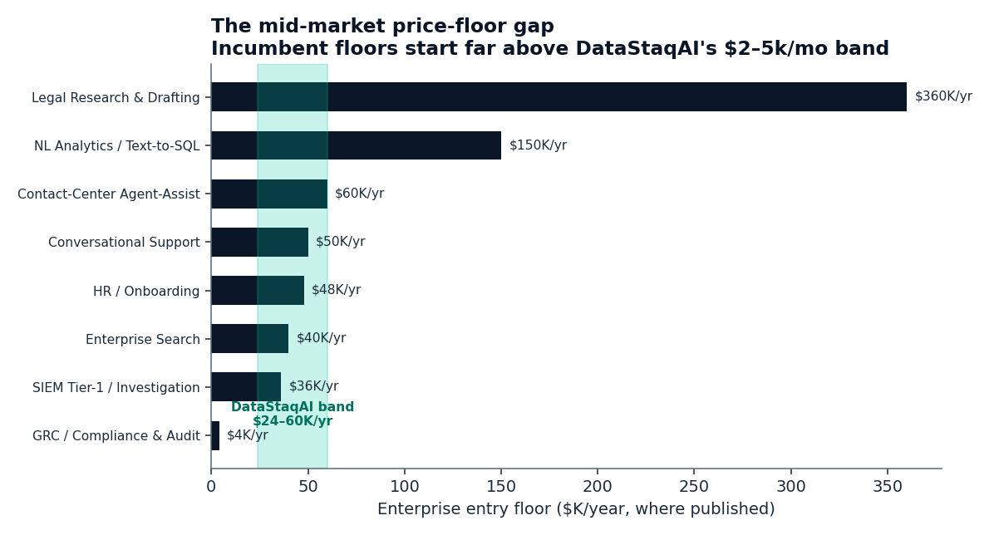
Pricing has bifurcated — enterprise ACV vs usage — and DataStaqAI's band undercuts the floor
The mid-market sits below every published incumbent floor but GRC
TWO PRICING WORLDS
Enterprise ACV ($50K–$4.8M/yr) ↔ usage/outcome ($0.40–1.50 per resolution)
THE FLOOR
Legal $360K · NL-analytics $150K · agent-assist $60K · search $40K /yr
OUR BAND
$24–60K/yr ($2–5k/mo) undercuts every floor but GRC ($4K → compete on integration, not price)
DataStaqAI · The Agentic Enterprise · Chapter 4: Competitive Analysis
25 / 46
Notes:
Now quantify the competition, starting with pricing, because price is where the mid-market gap is most legible to a buyer. The chart shows the published enterprise entry floors across the use cases that disclose them, sorted, with DataStaqAI's $24–60K/year band shaded. The story is in three parts. First, pricing has bifurcated into two worlds that do not meet in the middle: enterprise annual contracts running from roughly $50K to several million dollars a year, versus usage and outcome pricing at $0.40–1.50 per resolution. The model a buyer signs determines their unit economics for years, and neither world is built for a mid-market company that wants a delivered outcome at a predictable price. Second, the floor: legal AI starts around $360K/year, NL-analytics around $150K, agent-assist around $60K, enterprise search around $40K — these are the entry points, before the agent engineers the buyer must also supply. Third, DataStaqAI's band sits below every one of those floors except GRC, where Sprinto already starts near $4K — which is exactly why our position in GRC is to compete on integration and evidence provenance rather than price, and everywhere else to lead with mid-market affordability plus delivery. The strategic point is that this is not 'we're cheaper'; it is 'we're priced for a segment the floor structurally excludes, and we deliver the outcome the cheaper SMB tools don't.' Caution the audience that seventeen of twenty-five use cases lack a cleanly published floor, so this chart is the disclosed subset, not the whole market — but the disclosed subset is consistent and one-directional. The next slide pairs this with the funding picture, which tells us where to avoid head-on competition and where to enter under the radar.

Slide 8
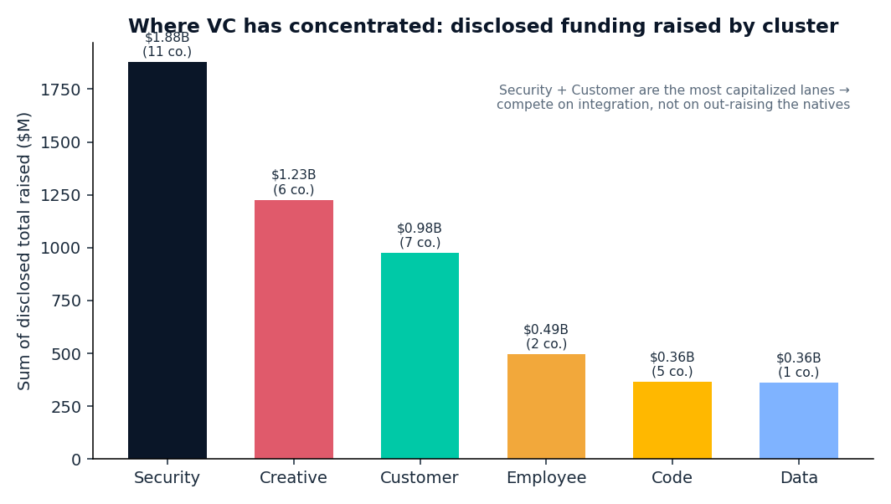
Capital concentrated in Security and Customer — out-integrate, don't out-raise
Where the venture money clusters tells us where NOT to fight head-on
CONCENTRATION
Security ~$1.9B · Creative ~$1.2B · Customer ~$1.0B raised (disclosed, 42 vendors)
VALUATION CEILING
Sierra $15.8B · Harvey $11B · Glean $7.2B — we ride on these, never out-build them
THE PLAY
Capital ≠ delivery. Out-integrate the funded natives; compete on the layer they underfund
DataStaqAI · The Agentic Enterprise · Chapter 4: Competitive Analysis
26 / 46
Notes:
Close sub-iteration one with the funding picture, which answers a question every operator and investor asks: if this opportunity is real, why won't the well-funded AI-natives simply take it? The chart shows disclosed venture capital raised by cluster across the 42 named vendors in our base: Security at roughly $1.9B, Creative around $1.2B, Customer around $1.0B, with Employee, Code and Data lower. Read alongside the valuation ceiling — Sierra $15.8B, Harvey $11B, Glean $7.2B — the message is that capital has concentrated heavily in a few lanes, and those are exactly the lanes where trying to out-build or out-raise the natives would be suicidal. But here is the strategic inversion that makes the funding picture an argument FOR DataStaqAI rather than against it: capital is not delivery. The billions raised fund model and agent development and enterprise go-to-market; almost none of it funds mid-market integration and operation, because that work has services-like economics that venture-scale product companies actively avoid. So the concentration of capital tells us precisely where to NOT fight head-on (build a better support agent than Sierra) and where to enter under the radar (deliver that agent into a mid-market company Sierra won't sell to). The play is to out-integrate, not out-raise. Note the honest limit: 32 of 42 vendors disclose totals, so the bars are a disclosed floor, not a census — but the directional concentration is unambiguous. That completes the competitive picture's supply side. Sub-iteration two builds on it: the coverage heat map showing which functions each archetype actually serves, the explicit white-space analysis, the SWOT, the disruption matrix, why competitors stop short, and finally why DataStaqAI wins — the synthesis the whole chapter has been building toward.

