Slide 1
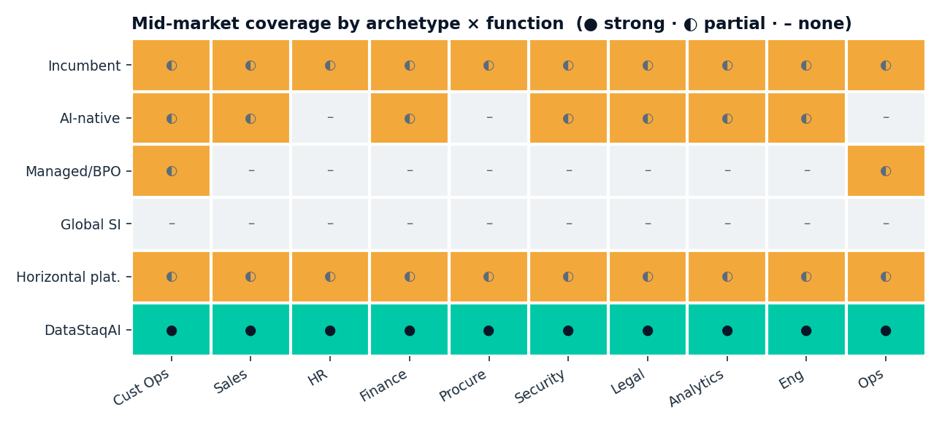
Map coverage by archetype × function and one row lights up — the mid-market is unserved
Every existing archetype is partial-or-none for the mid-market; DataStaqAI is the only full row
Incumbents add-on, AI-natives go enterprise, SIs ignore the middle, platforms are DIY. The done-for-you mid-market row is empty — until DataStaqAI fills it.
DataStaqAI · The Agentic Enterprise · Chapter 4: Competitive Analysis
27 / 46
Notes:
This heat map is the single most efficient proof in the chapter: it shows, in one glance, that the mid-market is structurally unserved across every function. Read the rows as archetypes and the columns as the ten business functions, with each cell scored for how well that archetype serves a mid-market buyer in that function — solid means strong, half means partial, dash means none. The incumbent row is a uniform 'partial' because they bolt AI on as an add-on everywhere but re-architect nowhere. The AI-native row is a patchwork of partial-and-none because they go enterprise-first and skip the middle. The managed/BPO row lights up only in a couple of pockets like customer operations. The global-SI row is essentially all dashes for the mid-market, because they serve the Global 2000 by design. The horizontal-platform row is uniform 'partial' — a do-it-yourself toolkit that still leaves the buyer to deliver. And then the DataStaqAI row is the only one that is solid across the board, because done-for-you mid-market delivery is exactly the position the others vacate. The visual punch is intentional: the eye sees a cool, sparse grid with one hot row. Caution the audience that the scoring is judgment, not a measured index — but the pattern is robust and consistent with every prior slide's evidence. The strategic message is that DataStaqAI is not claiming to be better at any one function than the specialist who owns that column; it is claiming to be the only player serving the row — mid-market delivery — across all of them. That is a category position, not a feature race. The next slide names the specific white-space pockets this map implies and turns them into where-to-play priorities.

Slide 2
The white space is four reinforcing pockets — and they compound into one defensible position
Each pocket is a gap a funded competitor structurally won't fill
1 · Mid-market done-for-you
2 · The delivery layer
The empty 2x2 cell: too big for SMB tools, too small for AI-natives + SIs
Integration + workflow + governance + operation — unowned below the Global 2000
3 · Governed context
4 · Owned-outcome BUILD plays
The semantic/evidence layer that makes agents accurate — the unglamorous real work
Legacy + low-code escape: owned code, lowest density, rivals Global-2000-only
Alone each pocket is a niche. Together — mid-market + delivery + governed context + owned code — they are a category position no single competitor is built to occupy.
DataStaqAI · The Agentic Enterprise · Chapter 4: Competitive Analysis
28 / 46
Notes:
Convert the heat map into a concrete white-space thesis by naming four pockets and, crucially, showing they reinforce one another. Pocket one is the mid-market done-for-you cell from the segmentation 2x2: companies too big for self-serve SMB tools and too small for the AI-natives and global SIs. Pocket two is the delivery layer itself — integration, workflow, governance and operation — which is unowned below the Global 2000. Pocket three is governed context: the semantic layer that makes text-to-SQL accurate, the source-grounded provenance that makes GRC evidence real — the unglamorous work that determines whether an agent actually functions, and which no product ships for the mid-market. Pocket four is the owned-outcome BUILD plays — legacy modernization and low-code escape — where the deliverable is code the client owns, competitive density is lowest, and the rivals are Global-2000-only. The strategic move on this slide is the synthesis in the band: any one of these pockets, alone, is a niche a competitor could eventually contest. But together they are mutually reinforcing and form a category position. Mid-market focus makes the delivery economics work; delivery requires governed context; governed context plus delivery is exactly what the BUILD plays need; and all of it is aimed at the segment the funded players concede. No single competitor is built to occupy all four at once — the incumbent won't do delivery, the AI-native won't do mid-market, the SI won't do the economics, the platform won't do the outcome. That compounding is the moat. The next slide turns these pockets into a ranked where-to-play scorecard so the strategy is actionable, not just defensible.

Slide 3
Where to play: scored by pain, mid-market gap, competitive openness and our fit
Engineering, Finance, HR and Analytics rank highest; scoring is judgment, not measured
Function
Pain
Mid-mkt gap
Openness
Our fit
Priority
Engineering
H
H
H
H
TOP
Finance
H
H
M
H
HIGH
HR
H
H
M
H
HIGH
Analytics
H
H
M
H
HIGH
Procurement
M
H
M
M
HIGH
Security
H
M
L
M
MED
Legal
H
H
L
M
MED
Customer Ops
H
M
L
M
MED
Sales
M
M
L
M
MED
Operations
M
M
M
M
MED
Lead with Engineering (BUILD) → land Finance/HR/Analytics (INTEGRATE) → attach Security/Ops (DEPLOY).
DataStaqAI · The Agentic Enterprise · Chapter 4: Competitive Analysis
29 / 46
Notes:
This is the chapter's actionable centerpiece: a where-to-play scorecard that ranks the ten functions on four factors and assigns a priority. The factors are pain intensity (how acute the problem is), mid-market gap (how unserved the middle is), competitive openness (inverse of how crowded the lane is), and our fit (how well DataStaqAI's model maps to the work). Cells are colored high-teal, medium-amber, low-grey, and the priority pill on the right synthesizes them. Engineering scores high on all four and earns the TOP priority, because it is the one BUILD play — low competitive density, owned-code outcome, acute pain, perfect fit. Finance, HR and Analytics come next at HIGH: severe pain, a wide mid-market gap, reasonable openness, and strong INTEGRATE fit. Procurement also rates HIGH on the strength of its mid-market gap. Security, Legal, Customer Ops and Sales rate MEDIUM — not because the pain is small (it is often acute) but because the lanes are crowded with funded natives, so they are land-on-signal rather than lead-with plays. Operations is MEDIUM as a KEEP/enrichment lane. Be explicit that this scoring is judgment derived from the research, labeled as such, not a measured index — that honesty is what makes it credible to a skeptical buyer or investor. The sequencing instruction in the band is the takeaway: lead with Engineering to establish delivery credibility you can't buy, land Finance, HR and Analytics for volume, and attach Security and Operations as fast deploy-and-tune wins. The next three slides stress-test this with a SWOT, a disruption matrix, and the explicit reasons competitors stop short, before the chapter closes on why DataStaqAI wins.

Slide 4
SWOT: the strengths and opportunities are structural; the risks are real and managed
An honest read — the threats are why focus and speed matter
STRENGTHS
WEAKNESSES
• Engineering economics: agents+subagents+MCPs at ~$2–5k/mo
• Owns the outcome (and the code, in BUILD plays)
• Integration + governance depth; aligned with the SoR
• Delivery capacity scales with team (services flavor)
• Brand/trust vs Accenture-class SIs is nascent
• Depends on third-party agents (supply risk)
OPPORTUNITIES
THREATS
• The empty mid-market done-for-you cell
• Incumbent-forced migrations (CPQ EOS) + AI-natives conceding via managed tiers
• 80% of orgs can't self-automate (integration+skills)
• AI-natives / SIs pushing down-market over time
• Incumbents bundling 'good enough' agents
• Price floors collapsing → margin pressure
DataStaqAI · The Agentic Enterprise · Chapter 4: Competitive Analysis
30 / 46
Notes:
Give an honest SWOT, because a deck that only lists strengths loses a sophisticated audience. The strengths are structural: engineering economics — agents, subagents and thousands of MCP integrations delivered at roughly $2–5k/month, which is a fundamentally different cost base than an SI's billable teams or an AI-native's white-glove services; ownership of the outcome, and in the BUILD plays the actual code; and depth in integration and governance while being aligned with, not opposed to, the systems of record. The weaknesses are equally real and worth naming first to build trust: delivery capacity scales with the team, giving the model a services flavor that must be engineered down with reusable agents and templates; brand and trust against Accenture-class incumbents is nascent and must be earned deal by deal; and reliance on third-party agents introduces supply risk if a key vendor changes terms. The opportunities restate the thesis as external forces: the empty mid-market done-for-you cell, incumbent-forced migrations like Salesforce CPQ's End-of-Sale, AI-natives conceding the gap through managed tiers, and the survey finding that ~80% of organizations cannot fully automate because of integration and skills gaps. The threats are the honest risks that justify urgency: AI-natives and SIs could push down-market over time, incumbents could bundle 'good enough' agents into existing contracts, and collapsing price floors could pressure margins. The strategic conclusion to deliver is that the strengths and opportunities are structural and durable while the threats are time-based — which is precisely why focus (lead with the BUILD plays) and speed (land the mid-market while the window is open) are the right responses. The disruption matrix on the next slide visualizes where that focus should go.

Slide 5
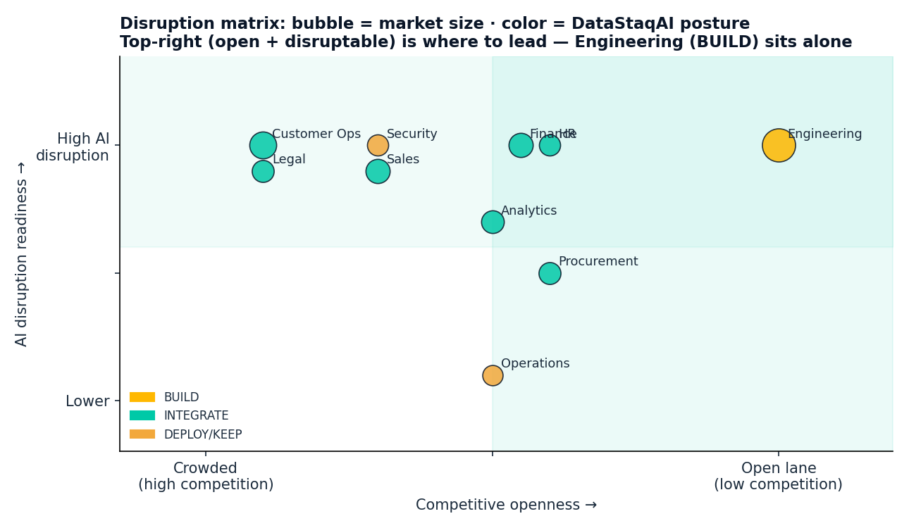
Disruption matrix: lead where high disruptability meets an open lane
Engineering sits alone in the top-right; the crowded REPLACE lanes are land-on-signal
TOP-RIGHT = LEAD
Open + disruptable: Engineering (BUILD), Finance/HR/Procurement (INTEGRATE)
TOP-LEFT = LAND ON SIGNAL
Disruptable but crowded: Customer Ops, Legal, Sales, Security
BUBBLE = MARKET SIZE
Big markets aren't always the open ones — pick openness over size
DataStaqAI · The Agentic Enterprise · Chapter 4: Competitive Analysis
31 / 46
Notes:
The disruption matrix turns the where-to-play logic into a picture an executive can hold in memory. The horizontal axis is competitive openness, from crowded on the left to open lane on the right; the vertical axis is AI disruption readiness, from lower at the bottom to high at the top; each bubble is a function, sized by market size and colored by DataStaqAI posture — gold for BUILD, teal for INTEGRATE, amber for DEPLOY/KEEP. The shaded top-right quadrant is where to lead: high disruptability meeting low competition. Engineering sits there essentially alone, which is the visual restatement of why it is the TOP priority — a highly disruptable, owned-code opportunity in an open lane. Finance, HR, Procurement and Analytics cluster just inside the lead zone as strong INTEGRATE plays. The top-left holds the lanes that are highly disruptable but crowded with funded natives — Customer Ops, Legal, Sales, and Security — which is why they are land-on-signal rather than lead-with: enter when a specific buyer signal appears (a CPQ End-of-Sale, a SOC-analyst job posting, a legal 'which-tools' review) and win on integration and price rather than trying to out-build the category leader. The most important interpretive point, captured in the right-hand callouts, is that bubble size and openness are not correlated — the biggest markets (Customer Ops, Finance) are often the more crowded ones, so the discipline is to prioritize openness over raw size, because an open lane with engineering economics beats a giant crowded lane where you would be the sixth-best agent. This matrix and the scorecard agree, which is the point: two independent views converge on the same sequence. The final two slides explain why the competitors can't simply follow us into these lanes, and then synthesize why DataStaqAI wins.

Slide 6
Why competitors stop short — each is structurally, not temporarily, blocked from the cell
These are business-model constraints; a roadmap update won't fix them
Incumbents
Seat revenue makes self-disruption irrational → AI stays an add-on
AI-natives
Venture economics demand enterprise ACVs → mid-market is uneconomic to serve directly
Managed / BPO
Labor-cost scaling caps margin → can't reach engineering economics
Global SIs
Cost base + sales motion built for $1M+ Global-2000 deals
Horizontal platforms
Sell tools, not outcomes → the delivery is still the buyer's problem
Every barrier is a business-model constraint, not a capability gap — which is why the cell stays open.
DataStaqAI · The Agentic Enterprise · Chapter 4: Competitive Analysis
32 / 46
Notes:
This slide answers the killer investor question — 'if this is such a good opportunity, why won't the well-funded competitors just take it?' — by showing that each is blocked by a business-model constraint, not a capability gap, which is the difference between a defensible position and a temporary head start. Incumbents are blocked because their revenue is the seat; self-disruption is irrational, so their AI stays an add-on no matter how good the technology gets. AI-natives are blocked because venture-scale economics demand large enterprise ACVs and winner-take-most capture; serving a mid-market company directly, with its messy systems and modest budget, is uneconomic for a company priced at fifteen billion dollars — so they hand it to partners or skip it. Managed and BPO players are blocked because their costs scale with labor, capping margins below what engineering economics achieve, so they cannot match DataStaqAI's price-for-outcome at scale. Global SIs are blocked because their cost base and sales motion are built for million-dollar Global-2000 transformation deals; a $2–5k/month mid-market engagement is below their floor. And horizontal platforms are blocked because they sell tools, not outcomes, so the delivery — the hard part — remains the buyer's problem. The unifying point, and the reason this is a durable thesis rather than a race, is that none of these barriers is fixed by a roadmap update or a price cut; each is woven into how the competitor makes money. That is what keeps the mid-market delivery cell open long enough for DataStaqAI to own it. The final slide of the chapter synthesizes the whole argument into why DataStaqAI wins.

Slide 7
Why DataStaqAI wins
Owns the empty cell
Engineering economics
The only done-for-you player built for the mid-market — a category position, not a feature
Agents+subagents+MCPs at ~$2–5k/mo undercut SIs on cost and AI-natives on price
Rides, doesn't fight
Owned outcomes + governed context
Wires best-of-breed agents into the SoR — never out-builds the funded natives or wrappers the model eats
Delivers resolved tickets, owned code, audit-ready evidence — the layer competitors underfund
The competition optimized the model and the agent. DataStaqAI owns the delivery layer the mid-market can't buy anywhere else.
DataStaqAI · The Agentic Enterprise · Chapter 4: Competitive Analysis
33 / 46
Notes:
Close the competitive chapter by synthesizing everything into four reasons DataStaqAI wins, stated as a position rather than a boast. First, it owns the empty cell: it is the only done-for-you player built for the mid-market, which is a category position — a place on the map — not a feature that can be copied. Second, engineering economics: delivering with agents, subagents and thousands of MCP integrations at roughly $2–5k/month undercuts the systems integrators on cost and the AI-natives on price simultaneously, a combination neither can match because of their own structures. Third, it rides rather than fights: by wiring best-of-breed agents into the customer's systems of record, it never has to out-build the funded natives or bet on a wrapper that the next model release will eat — it benefits from their R&D instead of competing with it. Fourth, it delivers owned outcomes and governed context: resolved tickets, owned code, audit-ready evidence, built on the semantic and provenance layer that the competitors underfund because it has services-like economics they avoid. Tie it together with the closing line — the competition optimized the model and the agent; DataStaqAI owns the delivery layer the mid-market cannot buy anywhere else. Remind the audience that this conclusion is earned, not asserted: the heat map showed the empty row, the segmentation showed the empty cell, the archetype analysis showed why each competitor vacates it, the scorecard and disruption matrix showed where to lead, and the stop-short slide showed the barriers are structural. That is the case the rest of the book now operationalizes — the business model in Chapter 5, the path to $5–10M in Chapter 6, and the investment thesis in Chapter 7.

