Slide 1
Acquisition is trigger-led outbound + proof-led referral — few logos needed because each compounds
Hunt the signal, land a small pilot, turn it into a case study and a referral (illustrative)
Trigger signal
→
Targeted outbound
→
Pilot ($2–3k/mo)
→
Case study
→
Referral / expand
CHANNELS
WHY IT'S EFFICIENT
CAC (illustrative)
LOGOS NEEDED
• Trigger monitoring (job posts, EOS, re-pricing)
• Vertical referrals & communities
• Partner / agent-vendor ecosystem
• Founder-led + targeted content
• Triggered buyers are in-market (forced)
• Small pilot = low approval friction
• Proof, not promises, sells the next deal
• Each win seeds referrals in the vertical
• Founder-led: low cash CAC, high time
• Target CAC payback < 6–9 months
• Pilot converts to managed within 1–2 quarters
• Referral CAC ≈ near-zero
• ~40–50 accounts at ~$120k/yr → ~$5–7M
• Expansion (NRR) cuts the new-logo count
• High-trust BUILD wins punch above ACV
The hunt from Chapter 4's signals is the acquisition engine: in-market buyers, low-friction pilots, proof-led referrals — a motion a small team can run.
DataStaqAI · The Agentic Enterprise · Chapter 6: Path to $5–10M
39 / 46
Notes:
Open the path-to-scale chapter with acquisition, because the credibility of every later number depends on a believable way to win customers. The motion across the top is the funnel: a trigger signal, targeted outbound against it, a small pilot at $2–3k a month, a case study, and then referral and expansion. The key idea is that this reuses the hunt established in Chapter 4 — DataStaqAI does not need to generate demand from scratch; it monitors for in-market, forced buyers (a Salesforce CPQ End-of-Sale, a SOC-analyst job posting, a low-code re-pricing, a failed OCR rollout) and reaches them at the moment of pain. The four channels — trigger monitoring, vertical referrals and communities, the partner and agent-vendor ecosystem, and founder-led targeted content — are all low-cash, high-leverage for a small team. Why it is efficient: triggered buyers are already shopping, a small pilot clears approval without a committee, proof rather than promises sells the next deal, and each win seeds referrals within the same vertical, which compounds. On economics, be explicit that these are illustrative: founder-led selling means low cash CAC but real time cost; the target is CAC payback inside six to nine months, with pilots converting to managed retainers within a quarter or two and referral CAC approaching zero. The logos-needed callout is the slide's strategic punchline and the bridge to the rest of the chapter: roughly 40–50 accounts at about $120k a year gets you to $5–7M, and expansion (net revenue retention) reduces how many new logos you actually need, while high-trust BUILD wins punch above their headline ACV. The takeaway to land is that this is an acquisition motion a small, disciplined team can actually execute — not a venture-scale demand-gen machine — which is exactly right for a delivery business compounding toward $5–10M. Expansion, the real growth engine, is next.

Slide 2
Expansion is the growth engine: land one function, expand to 3–5, NRR > 130%
A single account compounds from a $2–3k pilot to a $10–15k/mo multi-function program (illustrative)
Pilot: 1 function $2–3k/mo
→
+2nd function
→
+3rd function
→
Multi-function $10–15k/mo
→
+ BUILD project
WHY ACCOUNTS EXPAND
THE MATH OF NRR (illustrative)
• Trust from the first win + system access already in place
• Same buyer owns adjacent broken workflows
• Reusable library makes the 2nd–5th use case cheap to add
• Switching cost rises as the agent embeds in the SoR
• NRR > 130% means the base grows before new logos
• A cohort can ~double in value over 24 months
• Expansion revenue carries near-zero incremental CAC
• Few logos + strong NRR = capital-efficient path to $5–10M
Land-and-expand is why the logo count stays small: each account compounds 3–5x, so growth comes mostly from within the installed base.
DataStaqAI · The Agentic Enterprise · Chapter 6: Path to $5–10M
40 / 46
Notes:
Expansion is the single most important mechanic in the path to $5–10M, so give it its own slide and make the compounding vivid. The step diagram shows one account's journey: a pilot on a single function at $2–3k a month, then a second function, a third, a multi-function program at $10–15k a month, and ultimately a BUILD project layered on top. Why accounts expand is structural, not hopeful: the first win creates trust and, just as importantly, the agent is already wired into the customer's systems, so the integration cost of the next use case is largely paid; the same buyer typically owns several adjacent broken workflows; the reusable library makes the second-through-fifth use case cheap to deliver; and switching cost rises as the agent embeds in the system of record, protecting the base. The math of net revenue retention is the strategic payoff: at NRR above 130%, the installed base grows in value before a single new logo is added, a cohort can roughly double over 24 months, and that expansion revenue carries near-zero incremental customer-acquisition cost because you are selling to an existing, happy buyer. Put the two together — few logos plus strong NRR — and you have a capital-efficient path to $5–10M that does not require a large sales organization. This is the answer to the skeptic who assumes a delivery business must grind out hundreds of logos: it does not, if each account compounds three-to-five-fold. Be explicit that the NRR figure and cohort doubling are illustrative targets, not promises, and that achieving them depends on delivery quality and the reusable library maturing as planned — which is exactly why the hiring and delivery model must be right, the subject of the next slide. The headline to leave in the room: growth comes mostly from within the installed base, which is the most capital-efficient growth there is.

Slide 3
Hire delivery pods, not an army — a senior core plus agent leverage covers many accounts
Revenue per head rises as the reusable library matures (illustrative)
Founder / Principal
→
Delivery Pod
→
Delivery Pod
→
+ Pods as ARR grows
THE POD MODEL
HEADCOUNT RAMP (illustrative)
• Pod = 1–2 senior engineers + the agent/MCP library
• Each pod runs several accounts (leverage, not 1:1)
• Productized scope lets mid-level staff execute
• Add a pod only when recurring ARR justifies it
• Y1: founder + 2–3 (prove + first library)
• Y2: ~6–10 (2–3 pods + GTM/ops)
• Y3: ~15–25 to support $5–10M
• Revenue/head trends up as reuse compounds
Lean by design: the agent library is the force multiplier, so headcount grows slower than revenue — the opposite of a billable-hours SI.
DataStaqAI · The Agentic Enterprise · Chapter 6: Path to $5–10M
41 / 46
Notes:
Hiring is where a delivery business either earns software-like economics or collapses into a body-shop, so the model must be explicit. The unit of scaling is the pod, not the individual: a pod is one or two senior engineers plus the shared agent and MCP library, and — this is the leverage point — each pod runs several accounts rather than one engineer per client. Productized scope (the three service lines from Chapter 5) lets mid-level staff execute against a known playbook instead of every senior reinventing each engagement, and a new pod is added only when recurring ARR justifies it, keeping hiring disciplined and demand-led. The illustrative headcount ramp shows the shape: Year 1 is the founder plus two or three people, focused as much on building the first reusable library as on delivery; Year 2 is roughly six to ten — two or three pods plus go-to-market and operations; Year 3 is roughly fifteen to twenty-five to support $5–10M in revenue. The critical metric is revenue per head trending upward over time, because the library compounds and each engagement gets cheaper to deliver — the exact opposite of a systems integrator whose revenue and headcount rise together. Make the contrast explicit in the band: lean by design, headcount grows slower than revenue, and the agent library is the force multiplier. Be honest, echoing the SWOT, that in the early years before the library is deep, the model is more labor-intensive and the revenue-per-head advantage is a trajectory being built, not an instant property — which is why disciplined productization and pod leverage are non-negotiable rather than nice to have. The numbers are illustrative and will flex with delivery efficiency and deal mix; the durable claim is the structure — pods over armies, reuse over rework, hire behind ARR. The economics slide quantifies what this leverage produces.

Slide 4
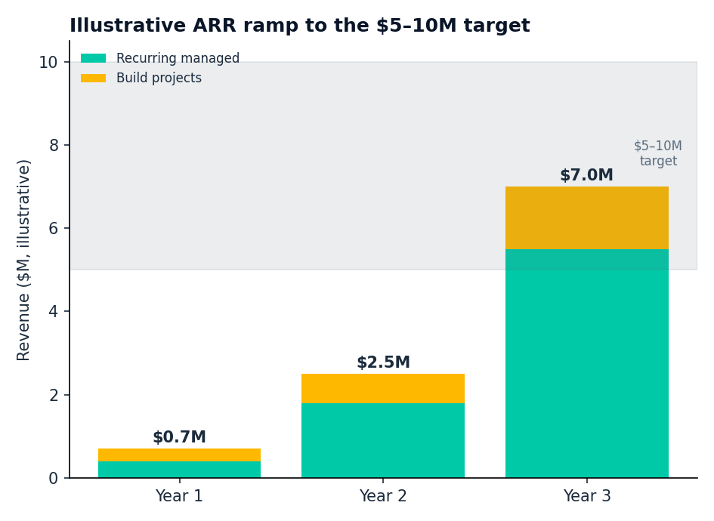
Unit economics: software-trending gross margin, fast payback, LTV/CAC that funds its own growth
An illustrative model — the shape (recurring base + rising margin) is the point
GROSS MARGIN
~50–55% early → 65–70%+ as the reusable library matures
CAC PAYBACK
< 6–9 months (trigger-led + founder/referral motion)
LTV / CAC
> 4–5x, driven by NRR>130% and low churn (embedded in SoR)
MIX
~70% recurring + ~30% build → durable, growing ARR
Assumptions (illustrative): ~$120k avg account/yr · NRR>130% · ~40–50 accounts · margin rising with library reuse.
DataStaqAI · The Agentic Enterprise · Chapter 6: Path to $5–10M
42 / 46
Notes:
This slide quantifies what the model produces, and the framing must be disciplined: these are illustrative unit economics whose value is the shape, not the decimal places. The chart shows the ARR ramp — recurring managed revenue in teal stacking with build-project revenue in gold — climbing from under a million in Year 1 to roughly $2.5M in Year 2 and into the $5–10M target band by Year 3, with recurring becoming the dominant and compounding component. The unit economics on the right define the engine. Gross margin starts at a services-like 50–55% but trends toward software-like 65–70%-plus as the reusable library matures and each engagement requires less bespoke work — that upward margin trajectory is the whole bet. CAC payback under six-to-nine months reflects the trigger-led, founder-and-referral acquisition motion with low cash cost. LTV-to-CAC above four-to-five-times is driven by net revenue retention over 130% and low churn, because the agent is embedded in the system of record and expensive to rip out. And the roughly 70% recurring, 30% build mix gives durable, growing ARR rather than lumpy project revenue. State the assumptions plainly so the model is auditable: roughly $120k average account per year, NRR above 130%, around 40–50 accounts to reach the target, and margin rising with library reuse — and label every one of them illustrative, to be replaced with real cohort data. The strategic message is the investor one: this is a services business on a software trajectory — capital-efficient, recurring, margin-expanding — which is precisely the profile that can reach $5–10M without massive funding. The honest caveat to voice is that the margin expansion and NRR are earned through delivery discipline, not guaranteed by the model; the next slide lays out the execution roadmap that earns them phase by phase.

Slide 5
Execution roadmap: prove → productize → expand → scale, in four phases to $5–10M
Each phase has a single objective and a clear exit milestone (illustrative)
PHASE 1 · 0–6 mo PROVE
PHASE 2 · 6–12 mo PRODUCTIZE
PHASE 3 · 12–24 mo EXPAND
PHASE 4 · 24–36 mo SCALE
• Land first BUILD win + 2–3 pilots
• Build the first reusable library
• Exit: 3–5 reference logos
• Harden the 3 service lines + governance
• Templatize top use cases
• Exit: repeatable margins, ~$1M ARR
• Land-and-expand accounts (NRR>130%)
• Add 2–3 delivery pods + GTM
• Exit: ~$2.5–4M ARR
• Vertical playbooks + partner channel
• Scale pods behind ARR
• Exit: $5–10M ARR
→
→
→
Prove delivery → productize for margin → expand the base → scale behind ARR. Disciplined, demand-led, and capital-efficient at every phase.
DataStaqAI · The Agentic Enterprise · Chapter 6: Path to $5–10M
43 / 46
Notes:
Close the path-to-scale chapter with an execution roadmap that turns the model into a sequence anyone can hold accountable, each phase with one objective and a clear exit milestone. Phase 1, the first six months, is Prove: land the first BUILD win and two or three pilots, and — just as important — build the first reusable library; the exit milestone is three to five reference logos that make the next deals easier. Phase 2, months six to twelve, is Productize: harden the three service lines and the governance layer, templatize the top use cases, and reach repeatable margins at roughly $1M ARR; this is the phase that converts a consultancy into a scalable delivery firm. Phase 3, the second year, is Expand: drive land-and-expand across the installed base toward net revenue retention above 130%, add two or three delivery pods and a go-to-market function, and exit around $2.5–4M ARR. Phase 4, the third year, is Scale: codify vertical playbooks, open a partner channel, scale pods behind ARR, and reach the $5–10M target. The discipline to emphasize is that each phase is demand-led — you productize before you scale, you expand the base before you chase logos, and you add headcount behind recurring revenue, never ahead of it — which keeps the whole path capital-efficient. Note that the phases are illustrative and the timeline will flex with traction, but the ordering is deliberate and load-bearing: proving delivery must come before productizing, productizing before expanding, expanding before scaling. The sequence also de-risks the threats from the SWOT — by building the reusable library and embedding in systems of record early, the business raises switching costs and margin before larger competitors might push down-market. With acquisition, expansion, hiring, economics and roadmap established, the book has shown not just that the opportunity exists but that there is a credible, capital-efficient path to capture it. Chapter 7 closes with the investment thesis: why now, why DataStaqAI, and why this becomes a $5–10M company.

