Slide 1
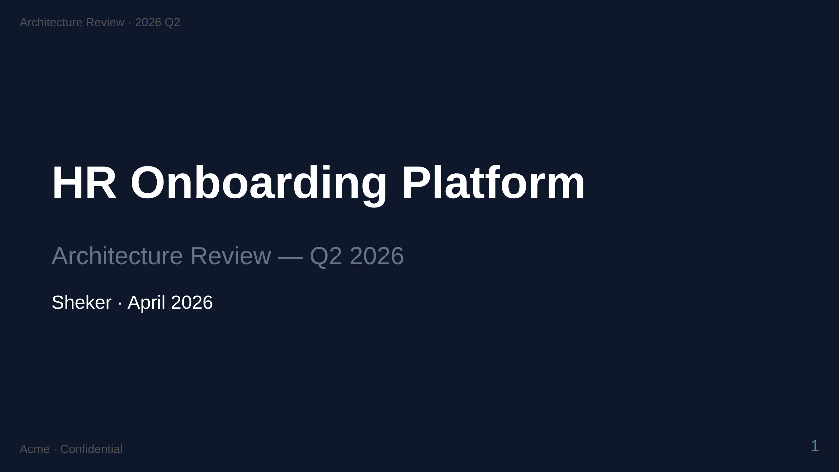

Slide 2
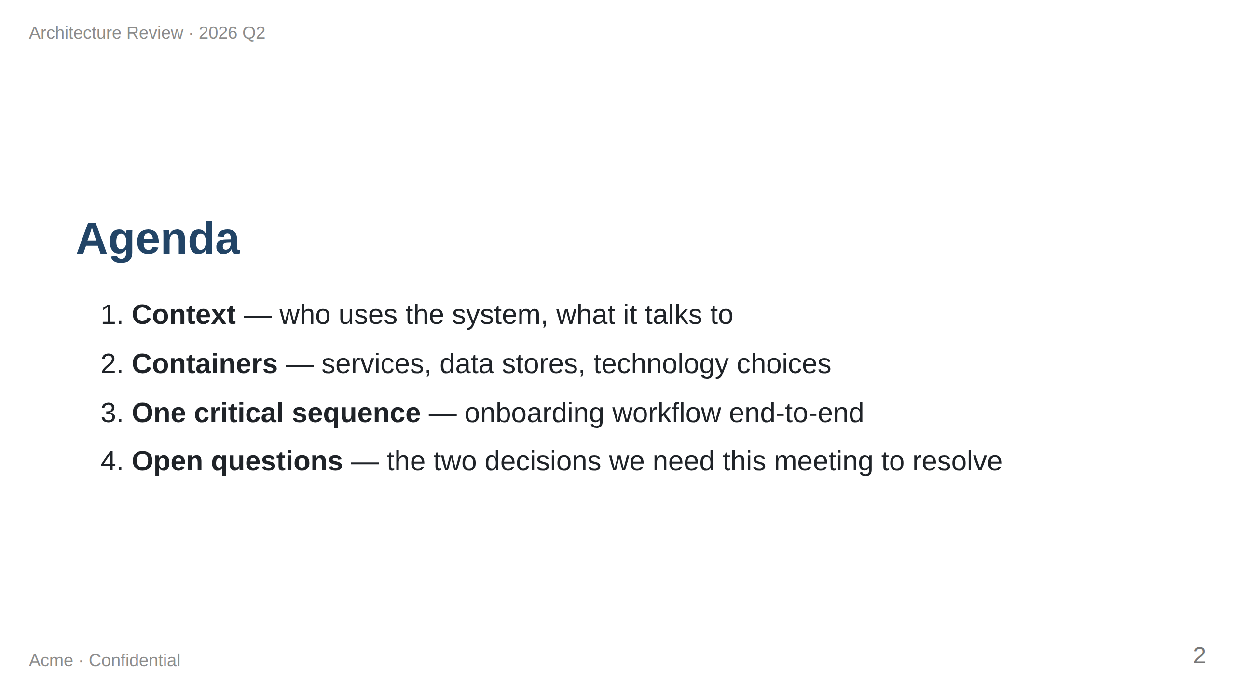
Notes:
Speaker note: 25 min total. 5 / 10 / 5 / 5. Hold questions to the end of each section.

Slide 3
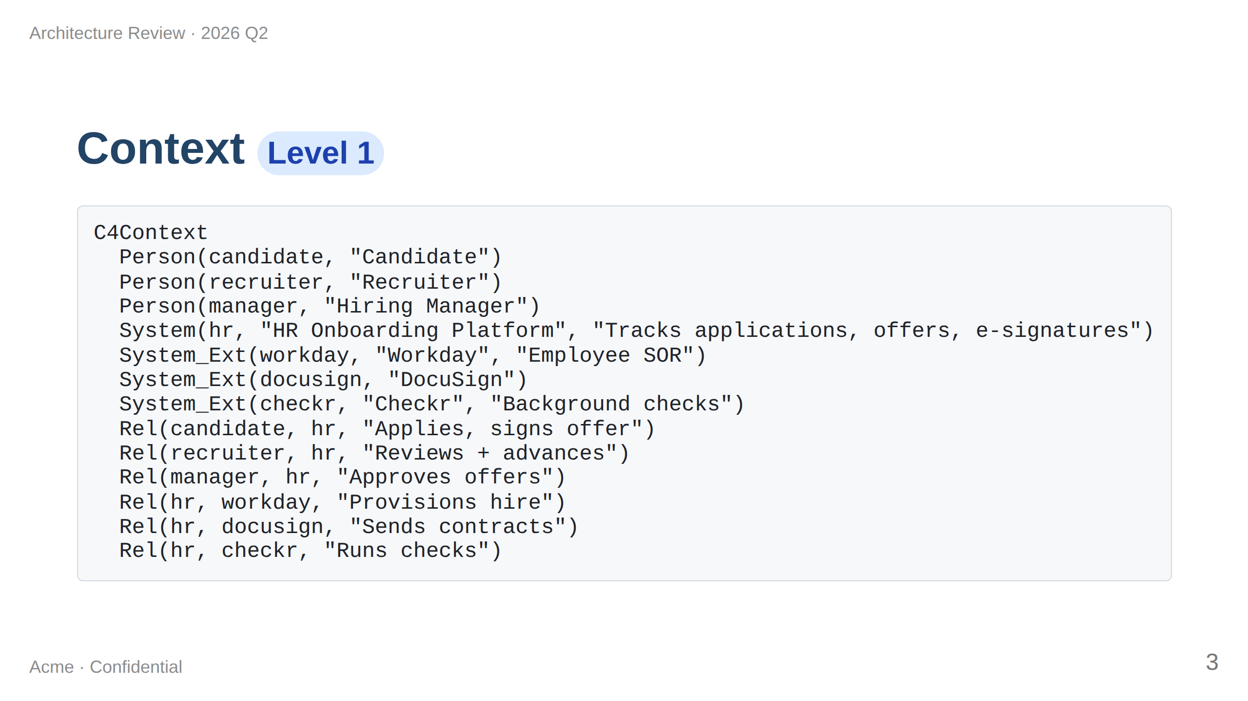

Slide 4
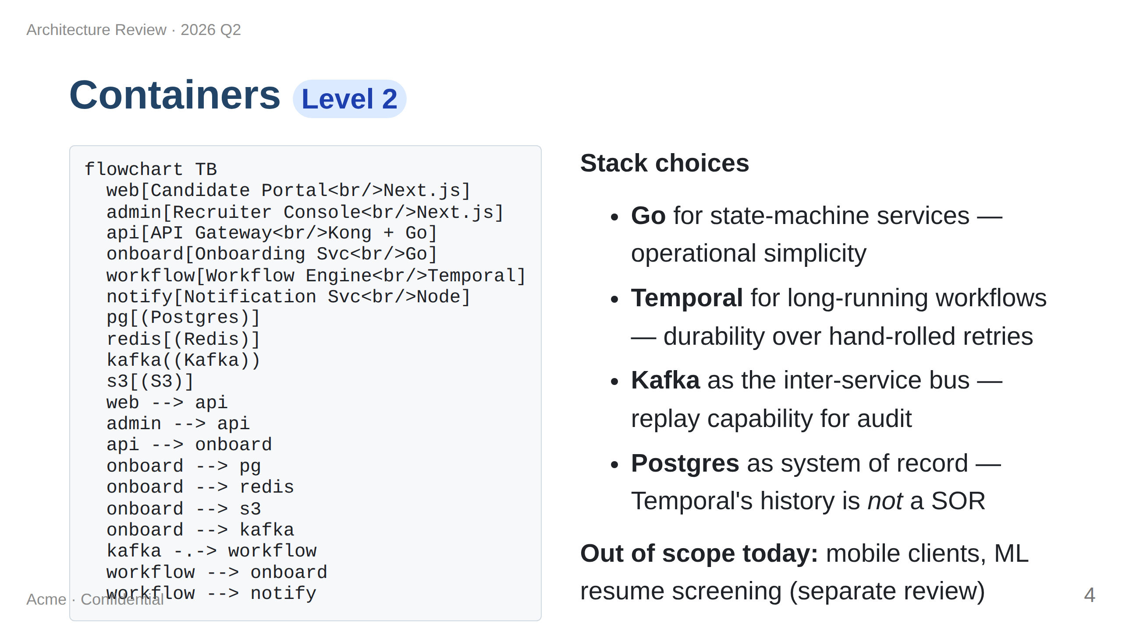

Slide 5
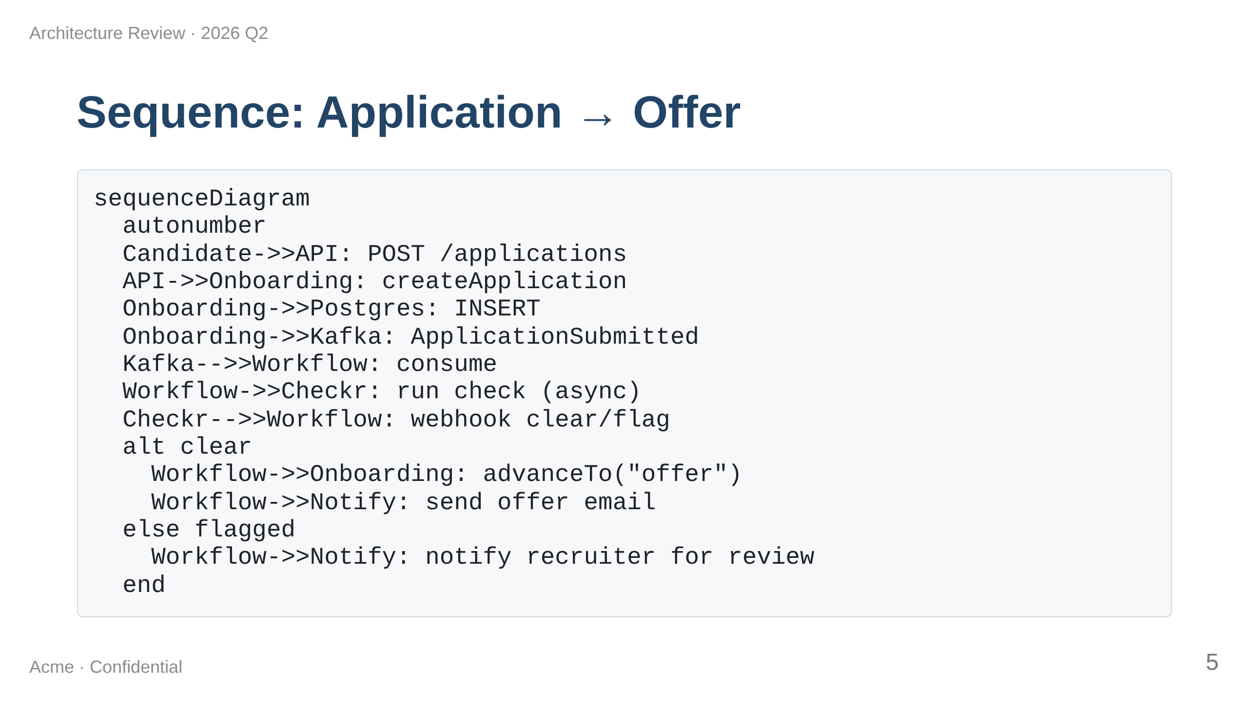
Notes:
The async fan-out is the architecturally interesting bit. Walk through why we put Workflow on the consume side rather than calling Checkr from Onboarding directly: durability, retry semantics, separation of state.

Slide 6
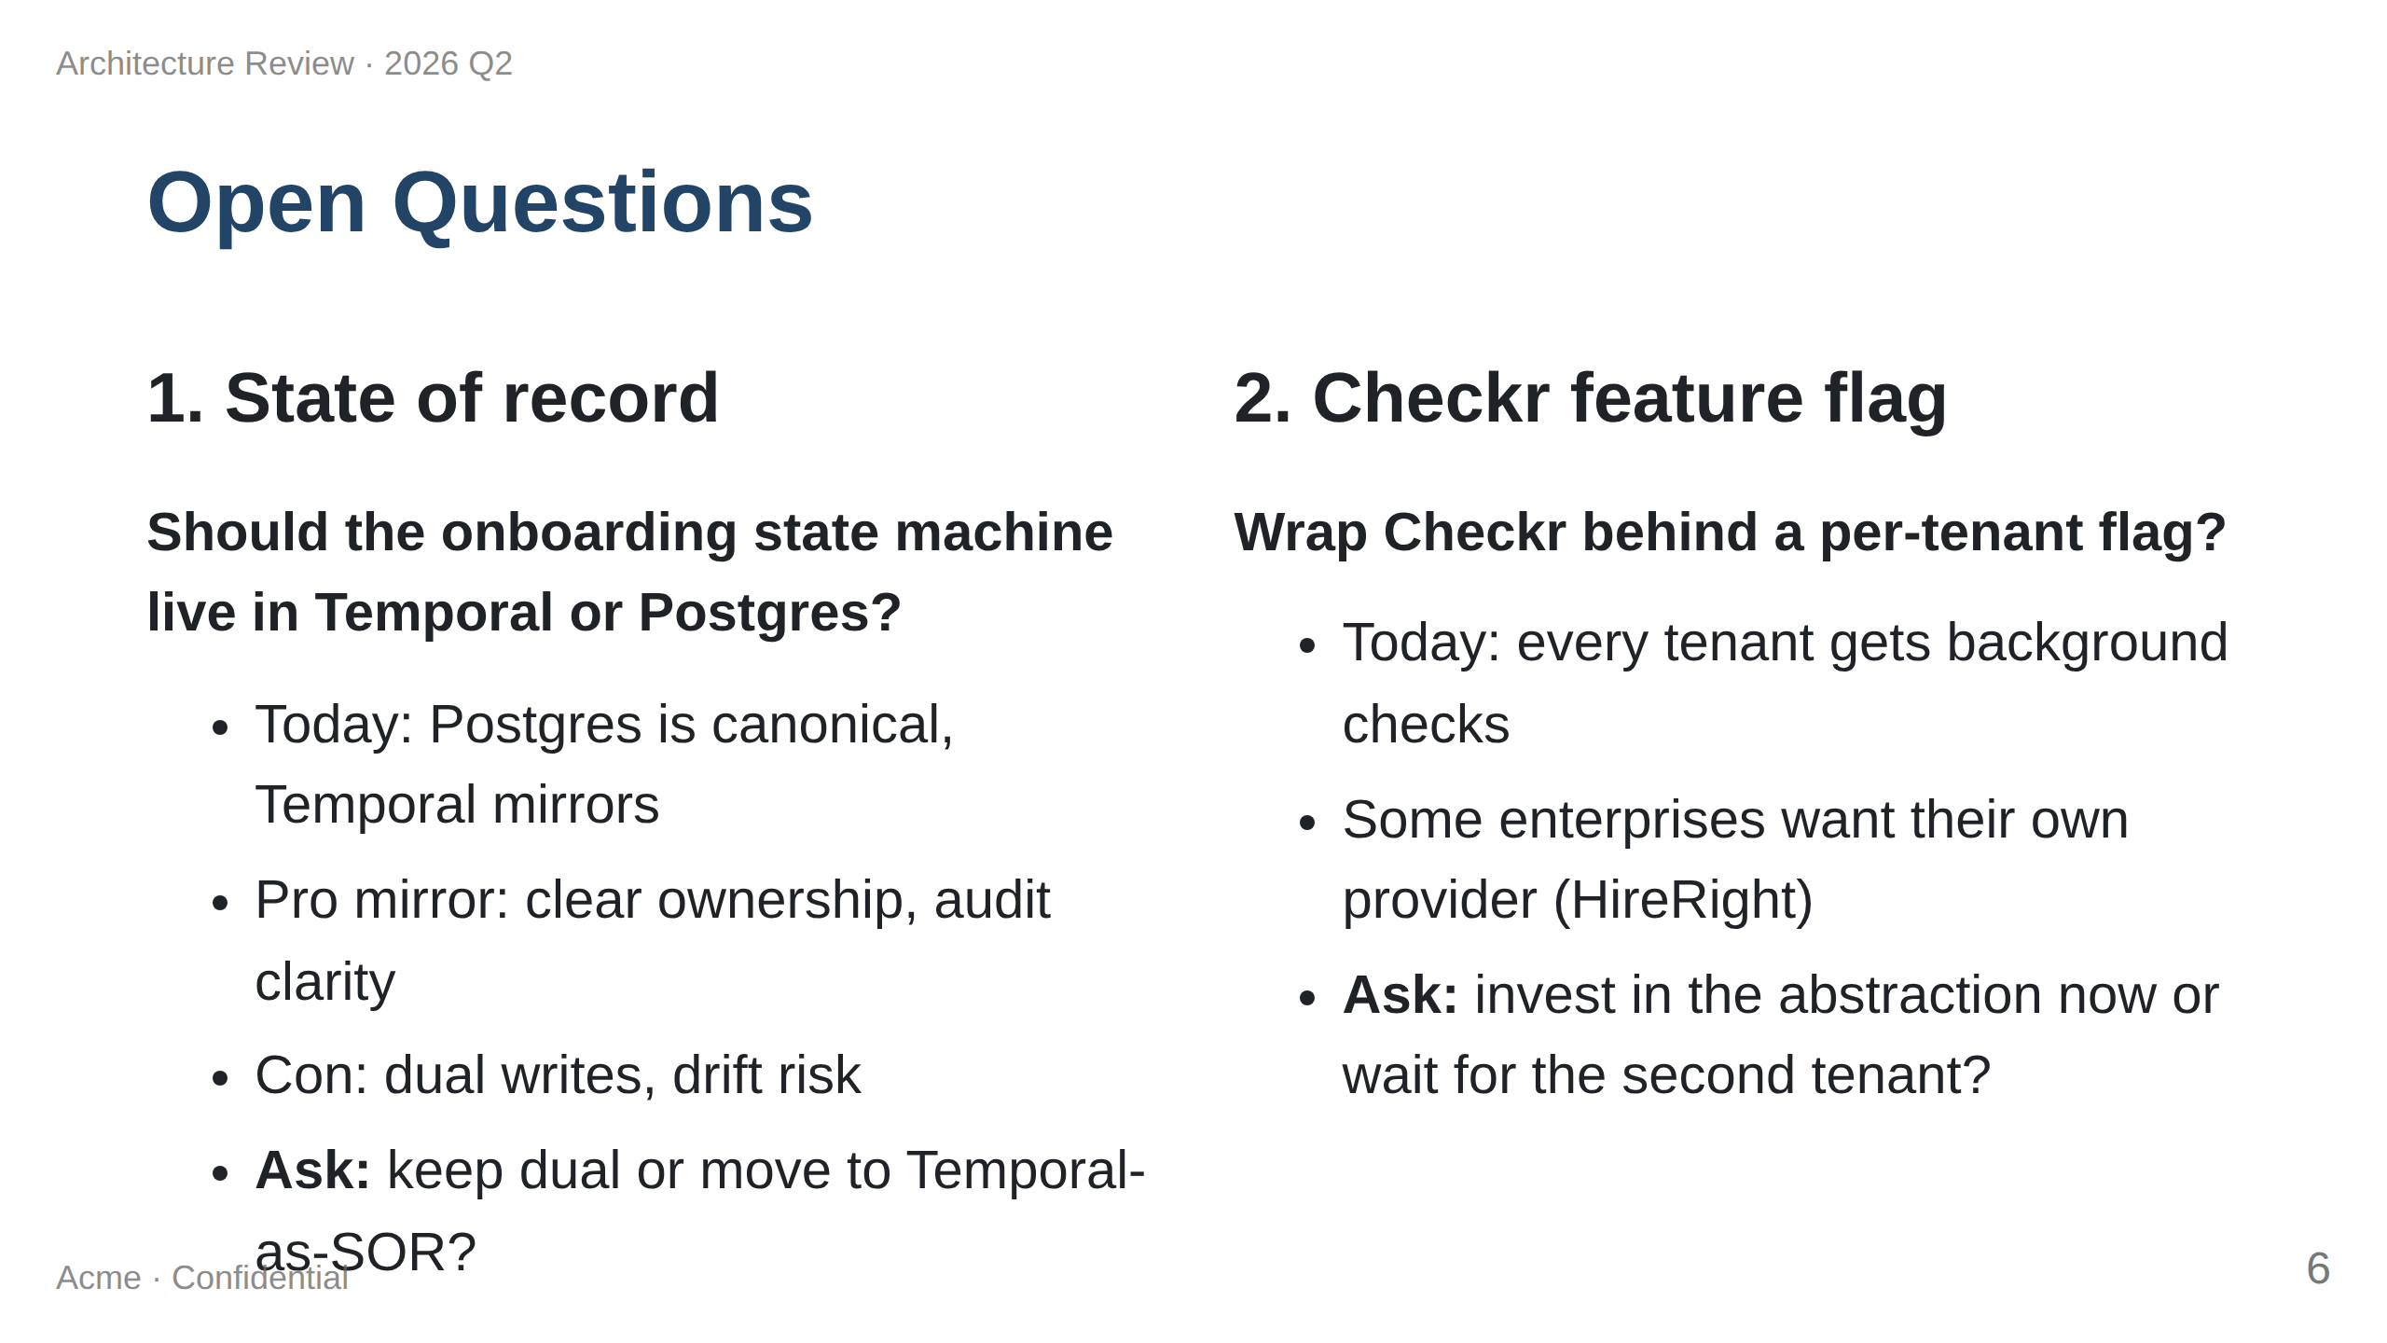

Slide 7
