Slide 1

Y COMBINATOR
Agent Companies
What Spring 2025's small-team agent startups are actually building
Structured business use cases, a use-case density map, and the implications for Sync2 and ReprisesAI.
Workflow
Customer Ops
Healthcare
Tooling
Infra
TicketForge | YC Agent Companies | June 2026

Slide 2
What You'll See
01
What the cohort actually says
Headline findings, cohort size, and the use-case density map
02
Business use cases
Ten clusters structured as jobs, buyers, and evidence
03
Strategic implications
Sync2, ReprisesAI, recommendations, and a 90-day plan
TicketForge | YC Agent Companies | June 2026
2

Slide 3
The Cohort At A Glance
A young, focused cohort with a visible use-case pattern
27
3
13
10
companies
median team
teams of 1-2
use-case lanes
filtered Spring 2025 cohort
very early-stage teams
nearly half the cohort
distinct business shapes
Likely winners will be defined by workflow choice and ownership, not by model novelty.
TicketForge | YC Agent Companies | June 2026
3

Slide 4
SECTION 01
What The Cohort Actually Says
The data is more operational and workflow-shaped than the generic agent narrative suggests.
TicketForge | YC Agent Companies | June 2026
4

Slide 5
Three Conclusions Matter Most
The headline reads of the cohort
Workflow automation leads
01
The strongest YC signal is not generic assistants. It is agents wrapped around concrete operational jobs.
Ops and tooling dominate
02
Customer ops, analytics, QA/testing, context, and infra appear far more often than broad platform narratives.
Healthcare is a real vertical wedge
03
Administrative healthcare workflows show enough density and pain to warrant focused product bets.
TicketForge | YC Agent Companies | June 2026
5

Slide 6
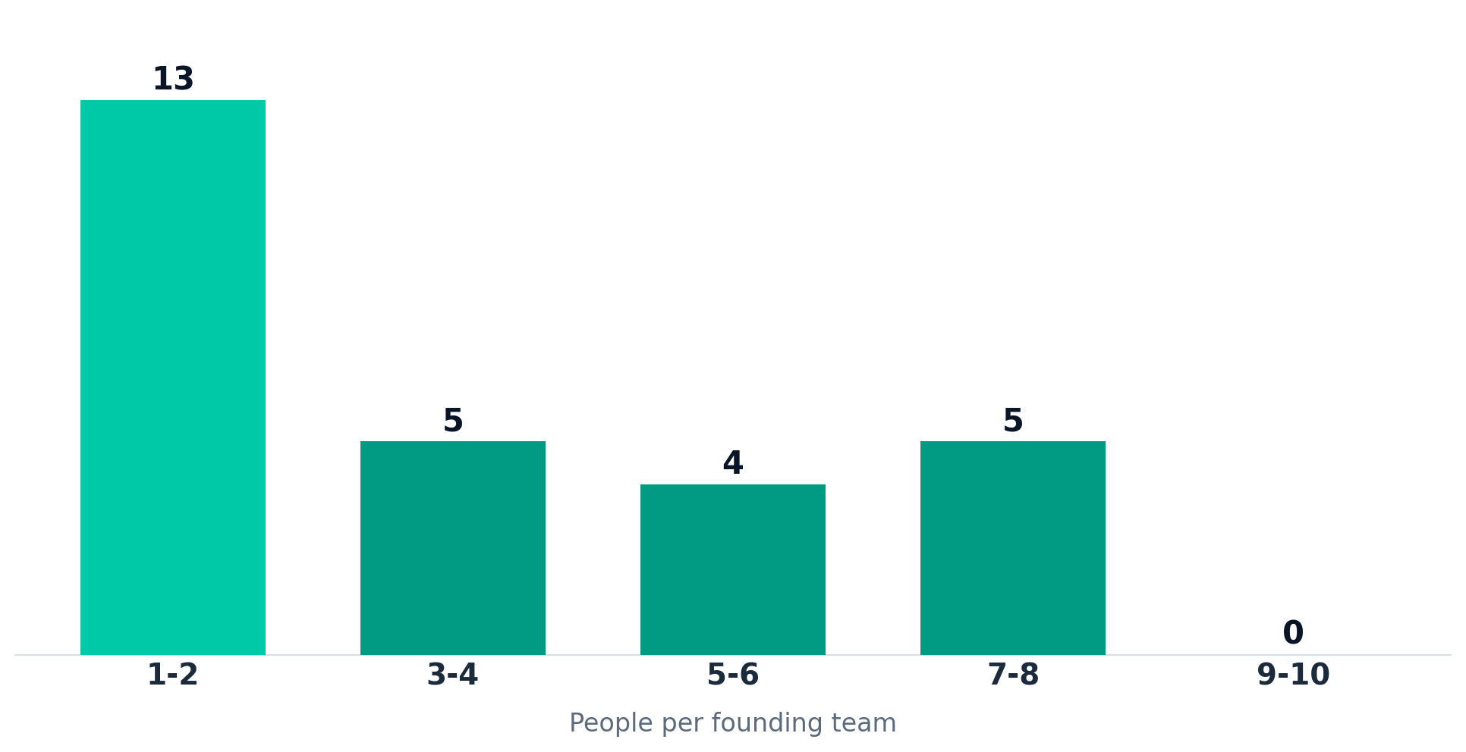
This Cohort Is Extremely Early
Distribution of founding-team size across the 27 companies
13 of 27 teams have just 1-2 people; the median team is 3. Execution focus beats headcount here.
TicketForge | YC Agent Companies | June 2026
6

Slide 7
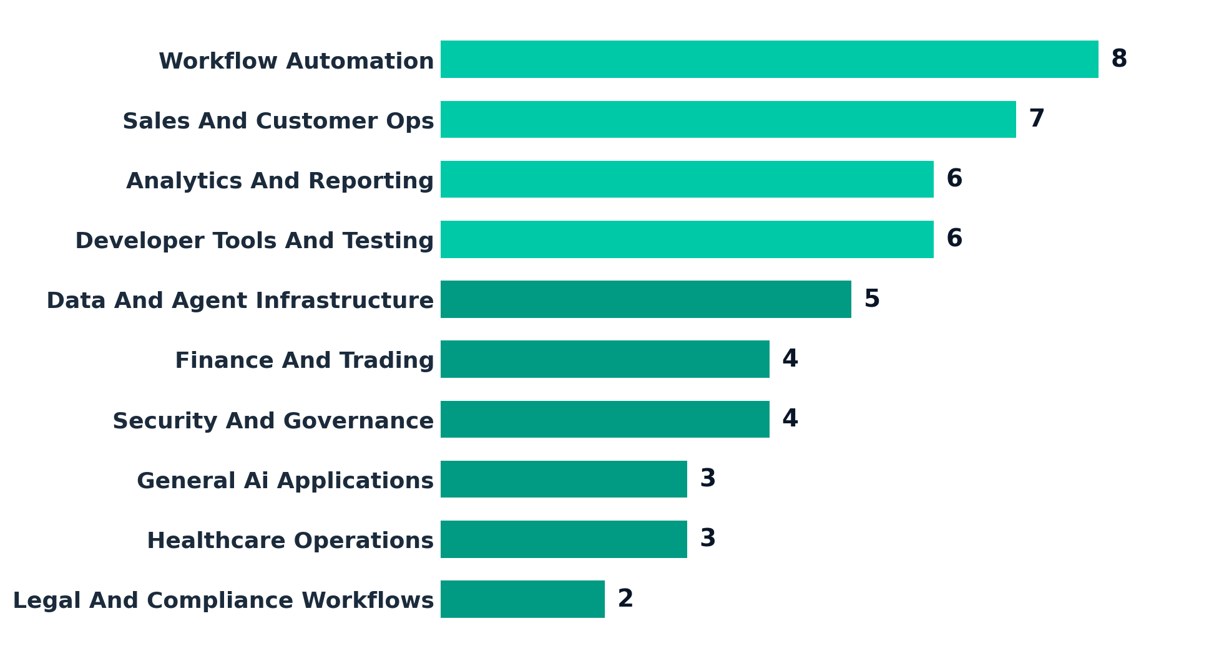
Use-Case Density Favors Real Jobs
Number of companies per use-case cluster (companies can span lanes)
The center of gravity is workflow automation, customer ops, analytics, testing, and infrastructure.
TicketForge | YC Agent Companies | June 2026
7

Slide 8
What People Expect vs. What The Cohort Shows
Previous expectation vs. what the YC cohort actually reveals
Expected narrative
Observed YC pattern
✕ General-purpose agent assistants
✓ Workflow-bound systems of action
✕ Broad agent-platform positioning
✓ Buyer-owned operational categories
✕ Abstract AI capability claims
✓ Testing, context, claims, reporting, ops
✕ Model novelty as the main story
✓ Clear job boundaries & measurable outcomes
TicketForge | YC Agent Companies | June 2026
8

Slide 9
SECTION 02
Business Use Cases
Ten clusters, structured as the jobs they do, the buyers they serve, and the evidence behind them.
TicketForge | YC Agent Companies | June 2026
9

Slide 10
Top Use Cases, Structured As Business Jobs
The four highest-signal business shapes in the cohort
Workflow Automation
Sales And Customer Ops
Analytics And Reporting
Developer Tools And Testing
Buyer
COO, operations leader, or workflow owner
sales leaders, revenue ops, customer success, or service managers
heads of analytics, operations leaders, and knowledge-work teams
engineering leaders, product teams, QA, and platform teams
Business job
Turn high-volume, rules-heavy operational queues into agent-run systems of action.
Use agents to qualify, route, support, and operationalize customer interaction workflows.
Turn raw data or context into dashboards, summaries, and decision-ready reporting.
Use agents to test, monitor, and validate software and model-driven systems.
Value prop
Throughput, faster cycle times, and lower labor cost without requiring users to learn a new interface.
Improves responsiveness and rep leverage while keeping the workflow anchored in revenue teams.
Makes information work faster and cheaper while reducing manual synthesis.
Catches regressions and scales QA capacity without linearly scaling headcount.
Why now
LLMs plus tool use make it possible to automate the whole queue, not just summarize it.
Customer conversations already create structured data and clear SLAs, which agents can exploit.
Reporting is repetitive, high-frequency, and already evaluated on output quality and speed.
Agentic products create new failure modes, so testing and observability have become first-order needs.
TicketForge | YC Agent Companies | June 2026
10

Slide 11
USE CASE 1 OF 5
Workflow Automation
8
companies
BUYER
VALUE PROP
COO, operations leader, or workflow owner
Throughput, faster cycle times, and lower labor cost without requiring users to learn a new interface.
BUSINESS JOB
WHY NOW
Turn high-volume, rules-heavy operational queues into agent-run systems of action.
LLMs plus tool use make it possible to automate the whole queue, not just summarize it.
RECOMMENDATION
Best starting point when a team already exists and the handoffs are obvious.
Cohort examples: Anana, stratify, Scalar Field, Cotool, MindFort
TicketForge | YC Agent Companies | June 2026
11

Slide 12
USE CASE 2 OF 5
Sales And Customer Ops
7
companies
BUYER
VALUE PROP
sales leaders, revenue ops, customer success, or service managers
Improves responsiveness and rep leverage while keeping the workflow anchored in revenue teams.
BUSINESS JOB
WHY NOW
Use agents to qualify, route, support, and operationalize customer interaction workflows.
Customer conversations already create structured data and clear SLAs, which agents can exploit.
RECOMMENDATION
Strong wedge when the product can own a narrow workflow like intake, triage, or follow-up.
Cohort examples: Alpha Research, Anana, Cohesive, Galen AI, stratify
TicketForge | YC Agent Companies | June 2026
12

Slide 13
USE CASE 3 OF 5
Analytics And Reporting
6
companies
BUYER
VALUE PROP
heads of analytics, operations leaders, and knowledge-work teams
Makes information work faster and cheaper while reducing manual synthesis.
BUSINESS JOB
WHY NOW
Turn raw data or context into dashboards, summaries, and decision-ready reporting.
Reporting is repetitive, high-frequency, and already evaluated on output quality and speed.
RECOMMENDATION
Works best when paired with trusted data access and a narrow reporting loop.
Cohort examples: Alpha Research, BitBoard, nao Labs, Scalar Field, Cotool
TicketForge | YC Agent Companies | June 2026
13

Slide 14
USE CASE 4 OF 5
Developer Tools And Testing
6
companies
BUYER
VALUE PROP
engineering leaders, product teams, QA, and platform teams
Catches regressions and scales QA capacity without linearly scaling headcount.
BUSINESS JOB
WHY NOW
Use agents to test, monitor, and validate software and model-driven systems.
Agentic products create new failure modes, so testing and observability have become first-order needs.
RECOMMENDATION
Durable if the product becomes part of the default release process.
Cohort examples: Alpha Research, Golf, Capacitive, Docket, Galen AI
TicketForge | YC Agent Companies | June 2026
14

Slide 15
USE CASE 5 OF 5
Data And Agent Infrastructure
5
companies
BUYER
VALUE PROP
platform engineering, CTO staff, and teams building agent products
Becomes infrastructure rather than a single workflow app, increasing platform stickiness.
BUSINESS JOB
WHY NOW
Provide the data, context, and permissioning layer that agent products depend on.
Agents fail without trustworthy context and controlled system access.
RECOMMENDATION
Attractive when the team wants a horizontal wedge instead of a workflow application.
Cohort examples: Golf, Capacitive, Scalar Field, Airweave, Kaelio
TicketForge | YC Agent Companies | June 2026
15

Slide 16
Vertical & Specialist Lanes Matter Too
Smaller clusters, but high pain and high willingness to pay
Lane
Count
Business job
Cohort evidence
Finance & Trading
4
Apply agents to high-value workflows with direct financial consequences.
Aegis, Pelica, Parsewise
Security & Governance
4
Automate security workflows and govern how agents interact with systems and data.
Golf, Capacitive, Cotool
Healthcare Operations
3
Reduce repetitive administrative work in patient and provider operations.
Galen AI, Aegis, Pelica
General AI Applications
3
Own a narrow operational workflow with agents.
Plexe, Cua, Klavis AI
Legal & Compliance
2
Embed agents inside document-heavy or policy-heavy professional workflows.
Vesence, Third Chair
Smaller clusters can still be strategically attractive when workflow pain and willingness to pay are high.
TicketForge | YC Agent Companies | June 2026
16

Slide 17
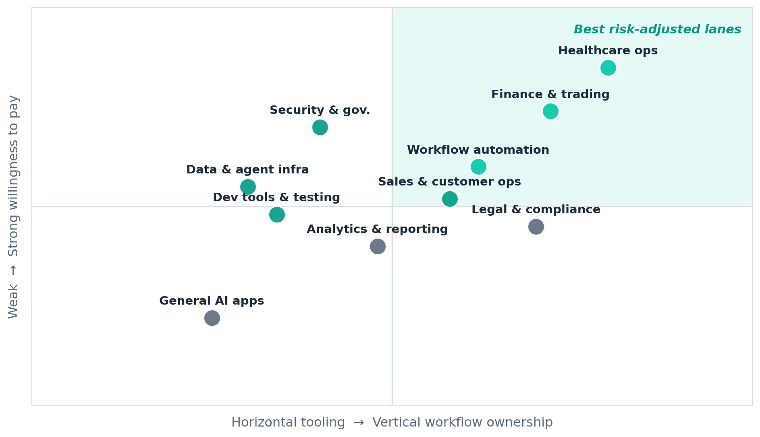
Where The Strong Lanes Sit
Workflow ownership vs. willingness to pay — by use-case cluster
Healthcare ops and finance sit top-right: deep workflow ownership and strong willingness to pay.
TicketForge | YC Agent Companies | June 2026
17

Slide 18
Representative Companies
A cross-section of the filtered cohort
Anana
2p
Golf
1p
Pelica
5p
One place for Revenue, Sales, and Operations to work together with AI — investigating pickup, triaging RFPs, and acting in the tools your team already uses.
Your agents connect to your data & you can’t see it
Pelica Health builds AI co-pilots for value-based care quality teams, unifying EHR, claims, pharmacy, and lab data to close care gaps and improve outcomes.
stratify
2p
BitBoard
2p
Airweave
7p
Automate your user research with AI-powered insights. Get deeper customer understanding without the manual work.
Connect your data, build with your agent, share with your team.
The open-source context retrieval layer for agents
Aegis
3p
Cotool
4p
MindFort
5p
AI Agents to win denied health insurance claims.
AI Agents for Security Operations Teams
Autonomous Security Agents
TicketForge | YC Agent Companies | June 2026
18

Slide 19
SECTION 03
Strategic Implications
Where the YC pattern supports Sync2, where it pressures ReprisesAI, and what to build next.
TicketForge | YC Agent Companies | June 2026
19

Slide 20
Sync2 Has Real YC Adjacency
CLOSEST YC MATCHES
WHAT THIS MEANS
Pelica
Pelica Health builds AI co-pilots for value-based care quality teams, unifying EHR, claims, pharmacy, and lab data to close care gaps and improve outcomes.
Simbie AI
Simbie AI’s clinically-trained voice agents act as your 24/7 AI medical receptionist—handling scheduling, refills & intake with 60% cost savings. Loved by doctors & patients.
Prosper
AI Voice Agents ‍ for Patient Access and RCM
Toothy AI
Toothy takes insurance off your team
• The lane is real, but the stronger names own deeper workflow than a thin front-desk wrapper.
• Scheduling, claims, billing, intake, and patient comms are stronger system-of-action wedges.
• The winning product likely captures more of the actual clinic workflow.
5
Ops
$$$
strong adjacency matches
workflow depth wins
high-friction buyer pain
Key question: does the product own enough workflow to become system-of-action software?
TicketForge | YC Agent Companies | June 2026
20

Slide 21
ReprisesAI Faces Productization Risk
CLOSEST YC MATCHES
WHAT THIS MEANS
Contour
AI voice agents for healthcare operational calls
flowscope
Agents that learn how your business actually runs, then redesign and automate the work on top of existing systems. The AI team for businesses that don't have one.
Unisson
AI agents that learn to use your product and run directly inside it to execute any task your customers need, accelerating their time to value.
Lua Global Inc
Build, deploy, and scale enterprise-grade AI agents. Ship your first agent without touching infrastructure.
• There are fewer direct AI-agency clones than expected.
• The bigger risk is productized implementation software absorbing repeatable service work.
• The safer posture is a specialized wedge, not generic AI delivery.
4
Risk
Focus
clear comparables
services get productized
specialize the wedge
Key question: can a service offer defend a wedge before software productizes the work?
TicketForge | YC Agent Companies | June 2026
21

Slide 22
Support vs. Pressure, Side By Side
How the cohort cuts for each strategy
Where the pattern SUPPORTS Sync2
Where it PRESSURES ReprisesAI
• Healthcare ops is a validated, dense lane.
• Buyers feel acute, measurable admin pain.
• Deep workflow ownership is rewarded, not punished.
• Voice + RCM + intake are proven entry wedges.
• Productized implementation tools are emerging fast.
• Generic 'AI agency' positioning is easily copied.
• Repeatable service work is the first to be automated.
• Defensibility requires a narrow, owned workflow.
TicketForge | YC Agent Companies | June 2026
22

Slide 23
What I Would Do Next
Recommendations follow directly from the cohort structure
01
Choose workflow-heavy use cases first
02
Own context, governance, or workflow position
8 companies cluster around operational systems of action, making this the clearest YC pattern.
The more durable clusters pair agents with data access, infrastructure, or embedded workflow ownership.
03
Treat healthcare operations as a real wedge
04
Avoid generic agent-platform messaging
The count is smaller than horizontal ops, but the workflow pain and willingness to pay are strong.
The cohort repeatedly rewards products with explicit jobs and operators, not broad agent claims.
TicketForge | YC Agent Companies | June 2026
23

Slide 24
Risks & Watch-Outs
What could invalidate this read
Cohort is tiny (n=27)
01
Patterns are directional, not statistically conclusive. Treat counts as signal, re-test next batch.
Labels are inferred
02
Use-case clusters come from company text, not official YC categories — boundaries are fuzzy.
Cohort attrition is real
03
Some names have already wound down (e.g. Capacitive), so survivorship will reshape the map.
TicketForge | YC Agent Companies | June 2026
24

Slide 25
A 90-Day Action Plan
Turning the read into concrete moves
Days 0-30
Days 30-60
Days 60-90
Validate the wedge
Build the proof
Prove ownership
• Pick one workflow-heavy lane to own end-to-end.
• Interview 10 buyers in healthcare ops or finance.
• Define the system-of-action boundary precisely.
• Ship a narrow agent that owns one painful queue.
• Instrument cycle-time and error-rate baselines.
• Secure 2-3 design partners with clear SLAs.
• Embed into the default workflow / release loop.
• Show measurable ROI vs. manual baseline.
• Decide: deepen the wedge or expand adjacent.
→
→
TicketForge | YC Agent Companies | June 2026
25

Slide 26
Method & Reproducibility
• Website tested: https://www.ycombinator.com/companies
• yc-companies discovers the live YC backend from the public page on each run.
• Primary filter: Spring 2025, agent / agentic pattern, team size ≤ 10.
• Structured cluster counts derived from 27 filtered companies (companies may span lanes).
• Use-case labels are inferred from company text, not official YC categories.
This deck is chained from a structured analysis pack — not freehand slide writing.
TicketForge | YC Agent Companies | June 2026
26

Slide 27
THE BOTTOM LINE
Winners are defined by workflow choice and ownership — not model novelty.
1
Lead with workflow-heavy use cases
8 companies cluster around operational systems of action.
2
Own context, governance, or workflow position
Durable clusters pair agents with data, infra, or embedded workflow.
3
Treat healthcare operations as a real wedge
Smaller count, but strong pain and willingness to pay.
4
Avoid generic agent-platform messaging
The cohort rewards explicit jobs and operators.
TicketForge | YC Agent Companies | June 2026
27

