Slide 1
EXECUTIVE BRIEFING
Winning In Agentic AI
FOR THE EXECUTIVE TEAM
Where The Value Is — And Where To Place Our Bets
THE QUESTION
Where do agents create durable value?
A decision-grade read of the agent market: ten operational use cases, the
organizations proving them out, and a scored view of where to invest first.
THE ANSWER
In owned operational workflows.
THE ASK
Approve a 90-day wedge bet.
Agentic AI · Executive Briefing | Strictly Confidential | June 2026

Slide 2
SECTION 01
The Executive Read
The market, the value, and the bet — in ten slides.
Agentic AI · Executive Briefing | Strictly Confidential | June 2026
2 / 30

Slide 3
Executive Summary
If you read one slide, read this one
BOTTOM LINE
In agentic AI, winners are defined by workflow ownership — not model novelty — and the value concentrates in a handful of operational lanes.
THE SITUATION
THE INSIGHT
THE RECOMMENDATION
• Agents are moving from demos to systems of action that complete real work.
• Activity clusters in operational lanes: workflow, customer ops, analytics, testing, infra.
• The market is crowded with generic 'agent platform' positioning.
• The durable wedge is owning a workflow end-to-end, not summarizing it.
• Value is highest where workflow ownership meets willingness to pay.
• Healthcare ops and finance are the strongest vertical lanes.
• Pick one workflow-heavy lane and own context, actuation, and governance.
• Treat healthcare operations as a priority wedge.
• Avoid generic agent-platform messaging entirely.
THE ASK:
Approve a 90-day bet on one owned workflow lane — starting with healthcare operations or workflow automation.
Agentic AI · Executive Briefing | Strictly Confidential | June 2026
3 / 30

Slide 4
The Story In Five Beats
Read left to right — this is the argument, in order
01
02
03
04
05
SITUATION
→
COMPLICATION
→
QUESTION
→
ANSWER
→
ACTION
Agents are becoming systems of action.
But generic agent platforms don't defend.
So where does durable value actually sit?
In owned operational workflows.
Bet on one lane for 90 days.
Every slide that follows develops one of these five beats — and nothing else.
Agentic AI · Executive Briefing | Strictly Confidential | June 2026
4 / 30

Slide 5
OUR POINT OF VIEW
Don't buy the agent hype. Buy the workflow.
01
02
03
Own the workflow
Pick where pain meets pay
Prove it in 90 days
The defensible position is completing a job end-to-end inside the systems of record — not chatting about it.
Concentrate where workflow ownership and willingness to pay are both high: healthcare ops, finance, customer ops.
Ship one narrow lane, instrument the baseline, and show a measurable cycle-time or error-rate delta.
Agentic AI · Executive Briefing | Strictly Confidential | June 2026
5 / 30

Slide 6
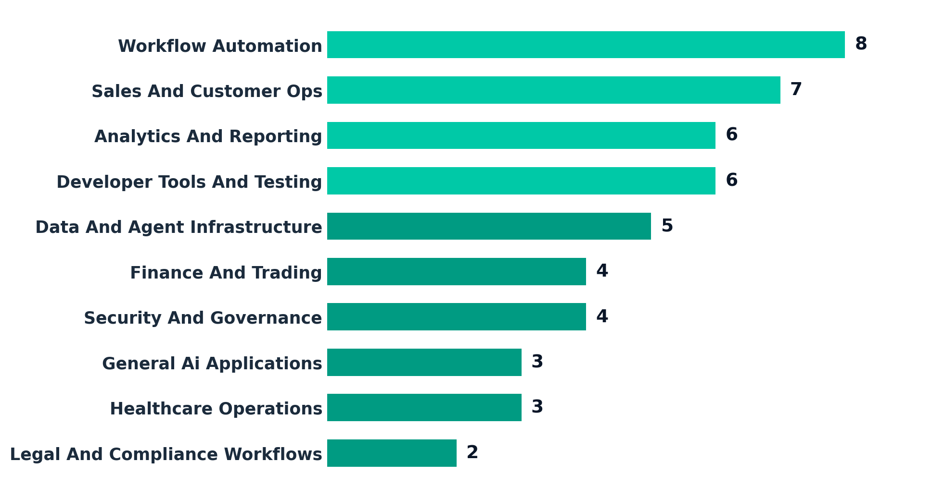
Builder Activity Concentrates In Five Operational Lanes
Number of organizations active in each use case
The market is voting with its feet: operational workflows, not generic assistants.
Agentic AI · Executive Briefing | Strictly Confidential | June 2026
6 / 30

Slide 7
The Value Concentrates In A Few Lanes
Executive decision scorecard — ten lanes scored on what determines payoff
Use-case lane
Demand
Workflow ownership
Willingness to pay
Defensi- bility
Time to value
Priority
Healthcare operations
M
H
H
H
M
PRIORITY
Workflow automation
H
H
M
M
H
PRIORITY
Finance & trading
M
H
H
H
M
PRIORITY
Sales & customer ops
H
M
M
M
H
STRONG
Security & governance
M
M
H
H
M
STRONG
Data & agent infra
M
M
M
H
M
STRONG
Developer tools & test
H
L
M
M
M
WATCH
Analytics & reporting
H
M
L
L
H
WATCH
Legal & compliance
L
H
M
M
L
WATCH
General AI apps
L
L
L
L
M
LOWER
H = high / attractive · M = mixed · L = weak | Scoring is a strategic judgment from builder activity and the ownership-vs-willingness-to-pay map.
Agentic AI · Executive Briefing | Strictly Confidential | June 2026
7 / 30

Slide 8
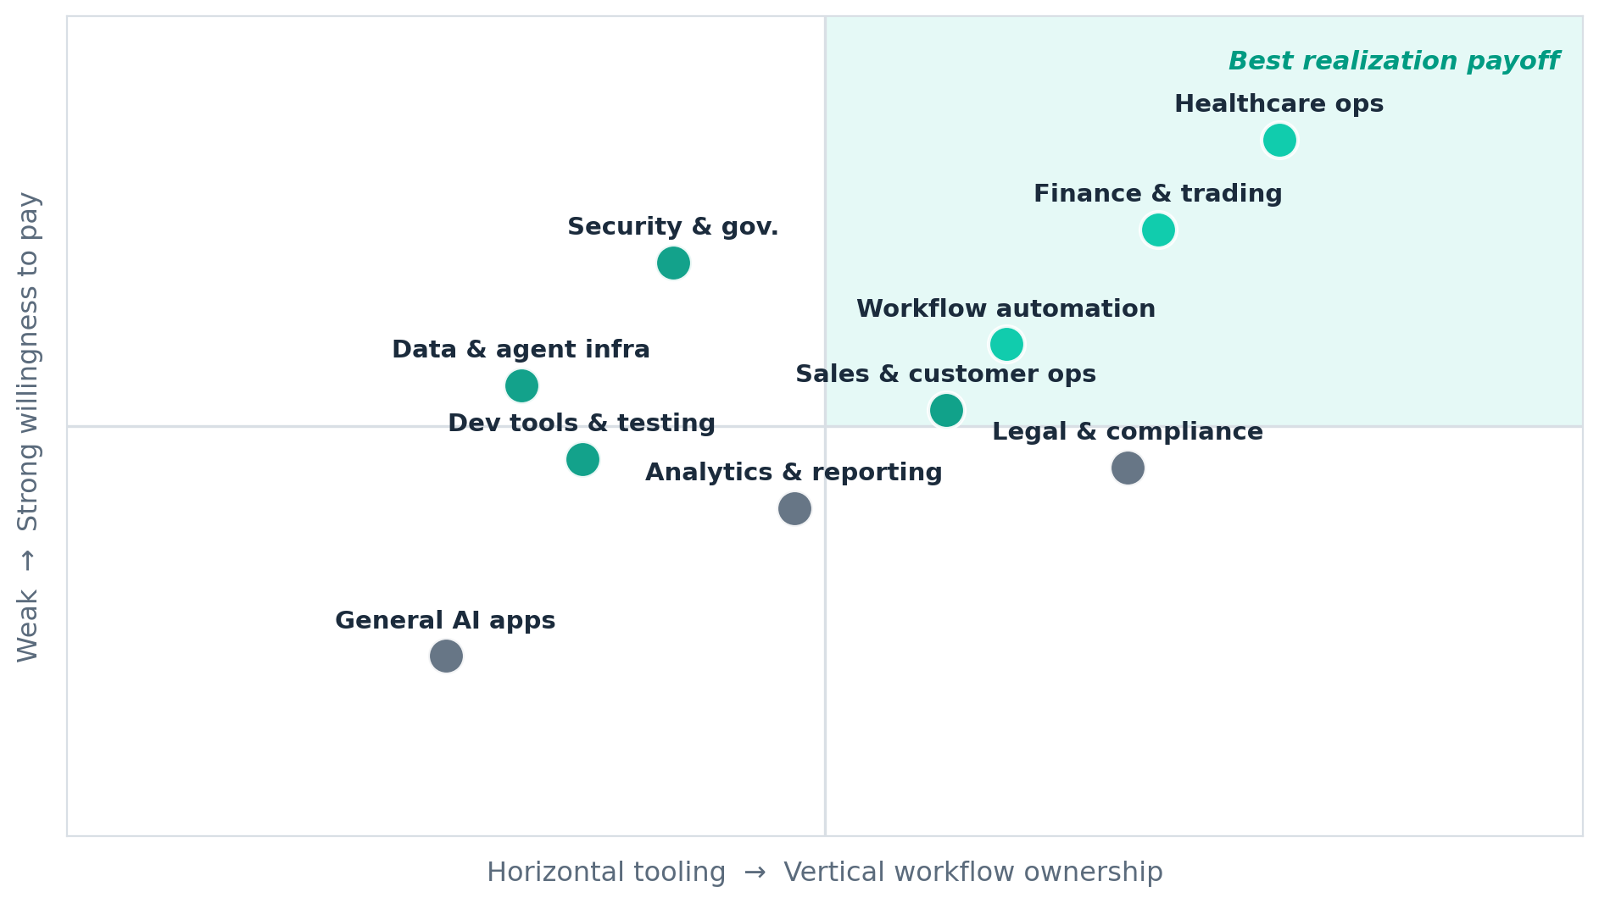
The Payoff Sits Where Ownership Meets Willingness To Pay
Workflow ownership vs. willingness to pay, by use case
Healthcare ops and finance occupy the top-right — deep ownership and strong willingness to pay. (Illustrative positioning, not measured.)
Agentic AI · Executive Briefing | Strictly Confidential | June 2026
8 / 30

Slide 9
Where To Play, And How To Win
The two questions every executive bet has to answer
WHERE TO PLAY
HOW TO WIN
• Healthcare operations — deep workflow, high willingness to pay.
• Workflow automation — broadest builder activity, fast time-to-value.
• Finance & trading — error/cycle-time maps straight to money.
• Customer ops — structured data and clear SLAs to exploit.
• Own context + actuation — write back into the system of record.
• Wrap it in governance — identity, scoping, audit, human-in-the-loop.
• Complete the job — don't stop at a summary.
• Instrument the ROI — prove the delta vs. the manual baseline.
Agentic AI · Executive Briefing | Strictly Confidential | June 2026
9 / 30

Slide 10
The Decision In Front Of Us
Three paths — one recommendation
OPTION A
OPTION B
OPTION C
Own a vertical workflow
Build horizontal infra
Wait and watch
Pick healthcare ops or finance and own the workflow end-to-end.
Provide the context / governance layer agents depend on.
Hold until the lanes consolidate.
Highest defensibility & willingness to pay.
Stickier, but slower to revenue and more crowded.
Lowest cost today, highest opportunity cost.
✓ RECOMMENDED
THE ASK: approve a 90-day, single-lane wedge bet — scoped, instrumented, and reviewed against a hard baseline.
Agentic AI · Executive Briefing | Strictly Confidential | June 2026
10 / 30

Slide 11
SECTION 02
How The Value Gets Realized
The same agent loop, wrapped around ten different operational jobs.
Agentic AI · Executive Briefing | Strictly Confidential | June 2026
11 / 30

Slide 12
The Use-Case Landscape
Ten agent use cases — each shown with the organizations delivering it
Workflow Automation
Sales And Customer Ops
8
7
Anana, stratify, Scalar Field, Cotool
Alpha Research, Anana, Cohesive, Galen AI
Analytics And Reporting
Developer Tools And Testing
6
6
Alpha Research, BitBoard, nao Labs, Scalar Field
Alpha Research, Golf, Capacitive, Docket
Data And Agent Infrastructure
Finance And Trading
5
4
Golf, Capacitive, Scalar Field, Airweave
Aegis, Pelica, Parsewise, Avallon AI
Security And Governance
Healthcare Operations
4
3
Golf, Capacitive, Cotool, MindFort
Galen AI, Aegis, Pelica
Legal And Compliance Workflows
General Ai Applications
2
3
Vesence, Third Chair
Plexe, Cua, Klavis AI
Agentic AI · Executive Briefing | Strictly Confidential | June 2026
12 / 30

Slide 13
The Common Realization Pattern
Almost every use case is the same agent loop wrapped around a different job
01 TRIGGER
02 CONTEXT
03 REASON & PLAN
A queue item, message, ticket, document, alert, or schedule kicks off the run.
→
Retrieval + permissioned access pull the data, history, and policy the agent needs.
→
The agent decomposes the job, chooses tools, and drafts the action sequence.
04 ACT VIA TOOLS
05 GUARDRAILS
06 SYSTEM OF ACTION
It executes in the systems of record — CRM, EHR, repo, ticketing, ledgers.
→
Confidence thresholds, policy checks, and human-in-the-loop on exceptions.
→
The work is completed and logged — not just summarized — with an audit trail.
Agentic AI · Executive Briefing | Strictly Confidential | June 2026
13 / 30

Slide 14
The Reference Realization Stack
The layers organizations actually assemble to ship an agent into production
EXPERIENCE & DECISION
Inboxes, dashboards, review queues, approvals — where operators stay in control.
Anana · BitBoard · Vesence
ORCHESTRATION & REASONING
Planning, tool selection, multi-step execution, evals and retries.
stratify · Docket · Propolis
CONTEXT & RETRIEVAL
Permissioned access to data, memory, and policy — the layer agents fail without.
Airweave · Kaelio · Scalar Field
ACTUATION & INTEGRATION
Writes back into CRM, EHR, repos, ledgers and ticketing systems of record.
Cohesive · Aegis · Cua
GOVERNANCE & SECURITY
Identity, scoping, audit, and guardrails on what agents may touch.
Golf · MindFort · Cotool
Agentic AI · Executive Briefing | Strictly Confidential | June 2026
14 / 30

Slide 15
USE CASE 01 · HORIZONTAL OPS
Workflow Automation
ORGANIZATIONS
DELIVERING THIS
Anana
CHALLENGE
HOW IT'S REALIZED
The agentic system of action for hotel groups and management companies.
• High-volume, rules-heavy operational queues
• Manual multi-step handoffs across tools
• Throughput capped by headcount
• Agents run the whole queue as a system of action
• Multi-step execution inside existing tools
• No new interface for the operator to learn
stratify
AI agents that help you understand your customers' needs.
8
Whole queue
HITL
Scalar Field
Your agentic trading desk — agentic operations for finance.
organizations
automation scope
on exceptions
Cotool
HOW IT WORKS
AI agents for security operations teams.
→ Trigger from a queue item → agent pulls context and policy
→ Plans and executes the multi-step task across the team's tools
→ Logs the completed action; routes only exceptions to a human
SOLUTION STACK
EXPERIENCE
ORCHESTRATION
CONTEXT
ACTUATION
Operator inbox / queue
Multi-step planner
Process + policy memory
Writes to tools of record
SYSTEMS: CRM · Ticketing · ERP · Email/Slack
USERS: COO · ops leaders · workflow owners
Agentic AI · Executive Briefing | Strictly Confidential | June 2026
15 / 30

Slide 16
USE CASE 02 · REVENUE
Sales & Customer Ops
ORGANIZATIONS
DELIVERING THIS
Cohesive
CHALLENGE
HOW IT'S REALIZED
The agentic CRM for blue-collar services.
• Repetitive customer-facing work at scale
• Slow response and uneven follow-up
• Reps stretched across intake and triage
• Agents qualify, route, support, and follow up
• Anchored in the revenue team's workflow
• Exploits the structured data conversations create
Anana
Revenue, sales, and operations working together with AI.
7
Intake→follow-up
SLA
Alpha Research
Open-source, agentic knowledge bases for customer teams.
organizations
owned workflow
anchored
Parsewise
HOW IT WORKS
Multi-document processing for risk and ops teams.
→ Inbound message / lead triggers the agent
→ It enriches, qualifies, and routes against SLAs
→ Drafts or sends the response; updates the CRM record
SOLUTION STACK
EXPERIENCE
ORCHESTRATION
CONTEXT
ACTUATION
Rep console / CRM
Qualify + route logic
Account + convo history
CRM + messaging write-back
SYSTEMS: CRM · Helpdesk · Email · Calendar
USERS: Sales · RevOps · CS · service managers
Agentic AI · Executive Briefing | Strictly Confidential | June 2026
16 / 30

Slide 17
USE CASE 03 · KNOWLEDGE WORK
Analytics & Reporting
ORGANIZATIONS
DELIVERING THIS
BitBoard
CHALLENGE
HOW IT'S REALIZED
Let your agent build dashboards and reporting.
• Manual synthesis of raw data and context
• High-frequency, repetitive reporting
• Decisions wait on slow dashboards
• Agents turn data into decision-ready reporting
• Dashboards and summaries built on demand
• Paired with trusted, governed data access
nao Labs
Open-source analytics agent.
6
On-demand
Governed
Airweave
The open-source context retrieval layer for agents.
organizations
dashboards
data access
Alpha Research
HOW IT WORKS
Agentic knowledge bases for decision support.
→ Request or schedule triggers the reporting run
→ Agent queries governed data and composes the view
→ Delivers the dashboard / summary with sources cited
SOLUTION STACK
EXPERIENCE
ORCHESTRATION
CONTEXT
ACTUATION
Dashboards / summaries
Query + compose
Semantic + retrieval layer
Publishes reports
SYSTEMS: Warehouse · BI tools · Sheets · APIs
USERS: Heads of analytics · operators
Agentic AI · Executive Briefing | Strictly Confidential | June 2026
17 / 30

Slide 18
USE CASE 04 · ENGINEERING
Developer Tools & Testing
ORGANIZATIONS
DELIVERING THIS
Docket
CHALLENGE
HOW IT'S REALIZED
AI agents for web testing.
• Agentic products create new failure modes
• QA can't scale linearly with headcount
• Regressions slip into releases
• Agents test, monitor, and validate systems
• Become part of the default release process
• Catch regressions before they ship
Propolis
Hands-off QA via intelligent browser agents.
6
In CI
↓ regressions
Golf
Agentic AI security and governance for engineering.
organizations
release loop
outcome
Alpha Research
HOW IT WORKS
Open-source agentic knowledge bases used across engineering.
→ Code change / deploy triggers the test agent
→ It drives the app, generates and runs cases
→ Files findings into CI and the issue tracker
SOLUTION STACK
EXPERIENCE
ORCHESTRATION
CONTEXT
ACTUATION
CI + PR checks
Test generation/exec
Repo + spec access
Issues + status writes
SYSTEMS: GitHub/CI · Browsers · Issue tracker · Observability
USERS: Eng leaders · QA · platform teams
Agentic AI · Executive Briefing | Strictly Confidential | June 2026
18 / 30

Slide 19
USE CASE 05 · PLATFORM
Data & Agent Infrastructure
ORGANIZATIONS
DELIVERING THIS
Airweave
CHALLENGE
HOW IT'S REALIZED
The open-source context retrieval layer for agents.
• Agents fail without trustworthy context
• Uncontrolled system access is risky
• Every team rebuilds the same plumbing
• Provide the context + permissioning layer
• Become infrastructure, not a single app
• Horizontal wedge with platform stickiness
Kaelio
The open-source context layer for data agents.
5
Context layer
Scoped
Scalar Field
An agentic trading desk built on its own data/context layer.
organizations
the wedge
access
Golf
HOW IT WORKS
Agentic AI security and governance.
→ Agent product requests data or an action
→ Infra layer enforces scope and retrieves context
→ Returns permissioned context / brokered access
SOLUTION STACK
EXPERIENCE
ORCHESTRATION
CONTEXT
ACTUATION
SDK / API surface
Access broker
Retrieval + memory
Permissioned connectors
SYSTEMS: Data sources · Vector stores · IdP · Connectors
USERS: Platform eng · CTO staff
Agentic AI · Executive Briefing | Strictly Confidential | June 2026
19 / 30

Slide 20
USE CASE 06 · VERTICAL
Finance & Trading
ORGANIZATIONS
DELIVERING THIS
Aegis
CHALLENGE
HOW IT'S REALIZED
AI agents to win denied health-insurance claims.
• High-value workflows, direct $ consequences
• Structured rules, financially sensitive
• Errors and cycle time map straight to money
• Agents on claims, trading, and risk ops
• Easy ROI: cycle time and error rates = $
• Domain expertise + clear control boundaries
Avallon AI
AI agents for insurance claims operations.
4
$ impact
Bounded
Parsewise
Multi-document processing for risk teams.
organizations
measurable
controls
Pelica
HOW IT WORKS
Healthcare operations with financial consequences.
→ Claim / order / document triggers the agent
→ It applies rules, checks data, and proposes the action
→ Executes within limits; escalates edge cases
SOLUTION STACK
EXPERIENCE
ORCHESTRATION
CONTEXT
ACTUATION
Ops review console
Rules + reasoning
Docs + records
Ledger / claims write
SYSTEMS: Claims systems · Market data · Docs · Ledgers
USERS: Finance ops · claims · risk teams
Agentic AI · Executive Briefing | Strictly Confidential | June 2026
20 / 30

Slide 21
USE CASE 07 · TRUST
Security & Governance
ORGANIZATIONS
DELIVERING THIS
Golf
CHALLENGE
HOW IT'S REALIZED
Agentic AI security and governance.
• Every agent deployment adds governance need
• Alerts, access, and policy at scale
• Security pain is urgent and measurable
• Automate security workflows
• Govern how agents touch systems and data
• Sit in a real enforcement / response loop
MindFort
Autonomous security agents.
4
Enforcement
Audited
Cotool
AI agents for security operations teams.
organizations
loop
decisions
HOW IT WORKS
→ Alert / access request triggers the agent
→ It investigates, correlates, and applies policy
→ Enforces or escalates; records the decision
SOLUTION STACK
EXPERIENCE
ORCHESTRATION
CONTEXT
ACTUATION
SOC / policy console
Investigate + decide
Telemetry + policy
Enforce / quarantine
SYSTEMS: SIEM · IdP · Cloud APIs · Ticketing
USERS: CISO orgs · security eng · compliance
Agentic AI · Executive Briefing | Strictly Confidential | June 2026
21 / 30

Slide 22
USE CASE 08 · VERTICAL
Healthcare Operations
ORGANIZATIONS
DELIVERING THIS
Pelica
CHALLENGE
HOW IT'S REALIZED
AI co-pilots for value-based care quality teams.
• Repetitive patient & provider admin work
• Overloaded scheduling, billing, claims
• High friction, high willingness to pay
• Reduce manual coordination end to end
• Own a painful workflow, not a thin wrapper
• Measurable ROI in staffing and collections
Aegis
AI agents to win denied health-insurance claims.
3
End-to-end
ROI
Galen AI
Personal AI healthcare agent on clinical + wearable data.
organizations
workflow
staffing + collections
HOW IT WORKS
→ Call / referral / claim triggers the agent
→ It handles scheduling, intake, or billing steps
→ Writes back to the EHR / RCM; flags exceptions
SOLUTION STACK
EXPERIENCE
ORCHESTRATION
CONTEXT
ACTUATION
Front-desk / RCM UI
Scheduling + claims
EHR + claims + labs
EHR / RCM write-back
SYSTEMS: EHR · Claims/RCM · Scheduling · Telephony
USERS: Clinic ops · RCM leaders · provider groups
Agentic AI · Executive Briefing | Strictly Confidential | June 2026
22 / 30

Slide 23
USE CASE 09 · PROFESSIONAL
Legal & Compliance
ORGANIZATIONS
DELIVERING THIS
Vesence
CHALLENGE
HOW IT'S REALIZED
Cursor for lawyers — agentic AI in MS Office.
• Document- and policy-heavy review work
• Expert time is expensive; throughput matters
• Language-heavy work, now tractable
• Embed agents inside the pro workflow
• Specialize around a precise task
• Save expert time, not generic 'legal AI'
Third Chair
AI-native IP enforcement agent.
2
In-workflow
Specialist
organizations
embedded
wedge
HOW IT WORKS
→ Document / matter triggers the agent
→ It drafts, reviews, or enforces against policy
→ Surfaces the result inside the pro's tools
SOLUTION STACK
EXPERIENCE
ORCHESTRATION
CONTEXT
ACTUATION
MS Office / matter UI
Draft + review
Docs + policy corpus
Edits / filings
SYSTEMS: MS Office · DMS · Filing systems · Email
USERS: Legal ops · compliance · IP teams
Agentic AI · Executive Briefing | Strictly Confidential | June 2026
23 / 30

Slide 24
SECTION 03
Two Bets Worth A Closer Look
Where the pattern is strongest — and where it is most at risk.
Agentic AI · Executive Briefing | Strictly Confidential | June 2026
24 / 30

Slide 25
Healthcare Operations Is The Strongest Vertical Wedge
ORGANIZATIONS REALIZING THIS · ADJACENCY — YC BATCHES VARY
REALIZATION READ
Pelica
Pelica Health builds AI co-pilots for value-based care quality teams, unifying EHR, claims, pharmacy, and lab data to close care gaps and improve outcomes.
Simbie AI
Simbie AI’s clinically-trained voice agents act as your 24/7 AI medical receptionist—handling scheduling, refills & intake with 60% cost savings. Loved by doctors & patients.
Prosper
AI Voice Agents ‍ for Patient Access and RCM
Toothy AI
Toothy takes insurance off your team
Sully.ai
Autonomous team of AI agents that runs the entire hospital operations
• The lane is real; the strong names own deep workflow, not a front-desk wrapper.
• Scheduling, claims, billing, intake, and patient comms are the system-of-action wedges.
• Winners capture more of the actual clinic workflow end to end.
WHAT TO OWN
• Own the EHR / RCM write-back, not just the conversation.
• Instrument collections and staffing ROI from day one.
Does the product own enough of the clinic workflow to become system-of-action software?
Agentic AI · Executive Briefing | Strictly Confidential | June 2026
25 / 30

Slide 26
Implementation Automation Is The Biggest Realization Risk
ORGANIZATIONS REALIZING THIS · ADJACENCY — YC BATCHES VARY
REALIZATION READ
Contour
AI voice agents for healthcare operational calls
flowscope
Agents that learn how your business actually runs, then redesign and automate the work on top of existing systems. The AI team for businesses that don't have one.
Unisson
AI agents that learn to use your product and run directly inside it to execute any task your customers need, accelerating their time to value.
Lua Global Inc
Build, deploy, and scale enterprise-grade AI agents. Ship your first agent without touching infrastructure.
• Fewer direct 'AI agency' clones than expected.
• The real risk: productized implementation software absorbing repeatable service work.
• Generic AI delivery is easily copied; a narrow owned workflow is not.
WHAT TO OWN
• Specialize the wedge around one repeatable, painful workflow.
• Turn the service motion into owned product before someone else does.
Can a service motion defend a wedge before software productizes the work?
Agentic AI · Executive Briefing | Strictly Confidential | June 2026
26 / 30

Slide 27
Realization Risks & Controls
What breaks agent use cases in production — and the control that contains each
Risk
What goes wrong
Control
Context failure
Agents act on stale, missing, or over-broad data.
Permissioned retrieval layer; scope reads to the task.
Silent wrong actions
An agent writes a bad record with full confidence.
Confidence thresholds + human-in-the-loop on exceptions.
Unbounded access
Over-privileged agents touch systems they shouldn't.
Identity, least-privilege scoping, and full audit trails.
No measurable outcome
Cycle-time / error-rate impact is never proven.
Instrument baselines before rollout; report deltas.
Workflow not owned
The agent summarizes but doesn't complete the job.
Close the loop into the system of record end-to-end.
Evidence note: counts tie out to 27 filtered companies; organization names are from the live YC listing, with deep-research notes confirming a 14-company subset. Adjacency examples span multiple YC batches.
Agentic AI · Executive Briefing | Strictly Confidential | June 2026
27 / 30

Slide 28
A 90-Day Realization Plan
From a chosen use case to a proven system of action
Days 0-30
Days 30-60
Days 60-90
Pick & scope
Build the loop
Prove ownership
• Choose one workflow-heavy use case to own end-to-end.
• Map the trigger → action loop and the systems of record.
• Instrument cycle-time and error-rate baselines.
• Ship the context + retrieval layer first.
• Wire actuation into one system of record.
• Add guardrails and a human-in-the-loop queue.
• Run against the baseline with 2-3 design partners.
• Show measurable delta vs. the manual workflow.
• Decide: deepen the wedge or expand adjacent.
→
→
Agentic AI · Executive Briefing | Strictly Confidential | June 2026
28 / 30

Slide 29
Recommendations
Where to focus realization effort first
01
Choose workflow-heavy use cases first
02
Own context, governance, or workflow position
8 companies cluster around operational systems of action, making this the clearest YC pattern.
The more durable clusters pair agents with data access, infrastructure, or embedded workflow ownership.
03
Treat healthcare operations as a real wedge
04
Avoid generic agent-platform messaging
The count is smaller than horizontal ops, but the workflow pain and willingness to pay are strong.
The cohort repeatedly rewards products with explicit jobs and operators, not broad agent claims.
Agentic AI · Executive Briefing | Strictly Confidential | June 2026
29 / 30

Slide 30
THE BOTTOM LINE
Buy the workflow, not the hype — and prove it in 90 days.
1
Winners own workflows end-to-end
Model novelty is not the moat; completing the job inside the system of record is.
2
Concentrate where pain meets pay
Healthcare ops, finance, workflow automation, and customer ops lead the scorecard.
3
Make a single, scoped bet
One lane, owned context + actuation + governance — not a broad platform.
4
Decide now, review in 90 days
Approve the wedge, instrument the baseline, and judge it on a measurable delta.
Agentic AI · Executive Briefing | Strictly Confidential | June 2026
30 / 30

