Slide 1
◆
AGENTIC AI
Business Use Cases
ORGANIZATIONS REFERENCED
& How They Get Realized
Anana
stratify
Cohesive
BitBoard
nao Labs
Golf
Airweave
Aegis
Pelica
Cotool
MindFort
Docket
Propolis
Galen AI
Vesence
Ten agent use cases, the organizations delivering them, and the realization
pattern behind each — from challenge to system of action.
Workflow
Customer Ops
Analytics
Dev & Testing
Infra
Healthcare
Agentic AI · Business Use Cases & Realization | June 2026

Slide 2
What This Deck Covers
01
The use-case landscape
Ten agent use cases and the organizations building each one
02
Use cases in depth
Challenge, realization, how-it-works, stack, and named organizations
03
Strategic realization
Healthcare ops, implementation automation, risks, and a 90-day plan
Agentic AI · Business Use Cases & Realization | June 2026
2 / 27

Slide 3
SECTION 01
The Use-Case Landscape
Ten agent use cases and the organizations building each one.
Agentic AI · Business Use Cases & Realization | June 2026
3 / 27

Slide 4
The Use-Case Landscape
Ten agent use cases — each shown with the organizations delivering it
Workflow Automation
Sales And Customer Ops
8
7
Anana, stratify, Scalar Field, Cotool
Alpha Research, Anana, Cohesive, Galen AI
Analytics And Reporting
Developer Tools And Testing
6
6
Alpha Research, BitBoard, nao Labs, Scalar Field
Alpha Research, Golf, Capacitive, Docket
Data And Agent Infrastructure
Finance And Trading
5
4
Golf, Capacitive, Scalar Field, Airweave
Aegis, Pelica, Parsewise, Avallon AI
Security And Governance
Healthcare Operations
4
3
Golf, Capacitive, Cotool, MindFort
Galen AI, Aegis, Pelica
Legal And Compliance Workflows
General Ai Applications
2
3
Vesence, Third Chair
Plexe, Cua, Klavis AI
Agentic AI · Business Use Cases & Realization | June 2026
4 / 27

Slide 5
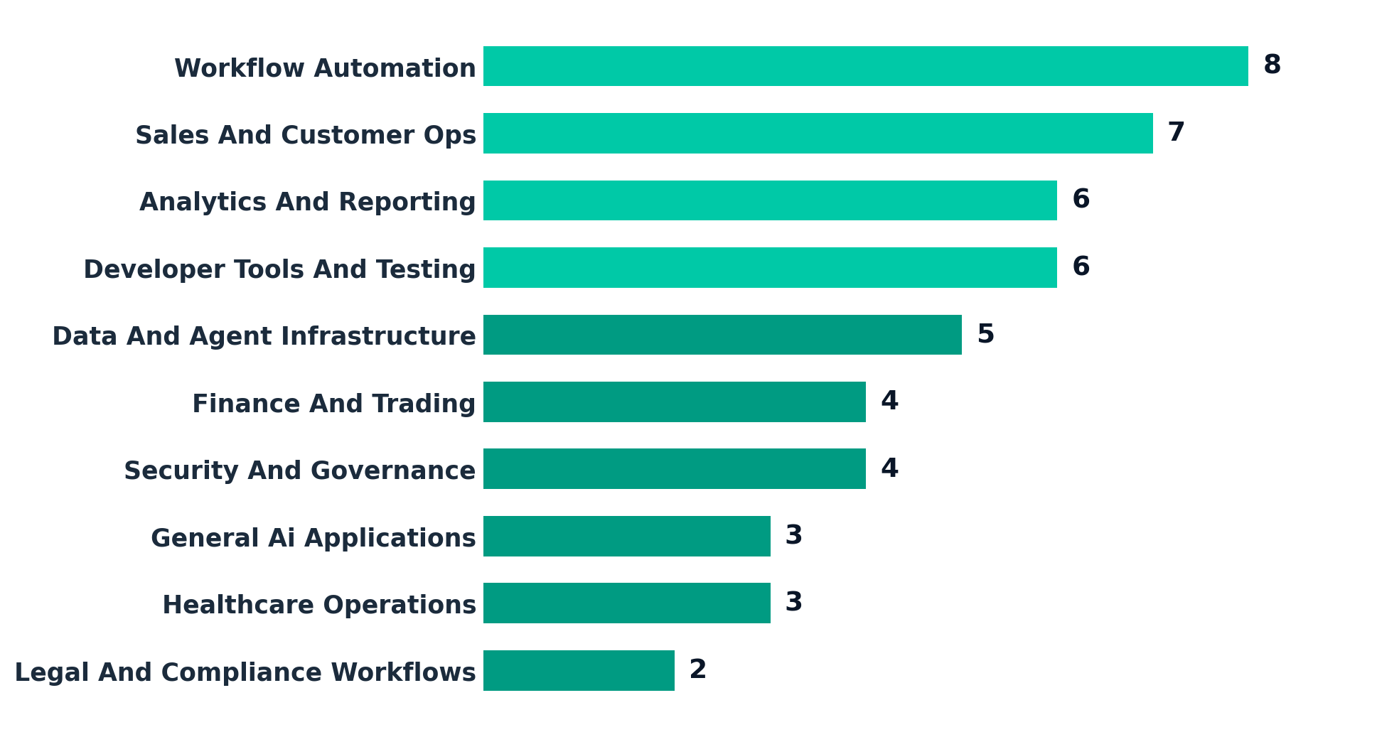
Where Organizations Are Building
Number of named organizations active in each use case
Workflow automation, customer ops, analytics, testing, and infrastructure see the most activity.
Agentic AI · Business Use Cases & Realization | June 2026
5 / 27

Slide 6
The Common Realization Pattern
Almost every use case is the same agent loop wrapped around a different job
01 TRIGGER
02 CONTEXT
03 REASON & PLAN
A queue item, message, ticket, document, alert, or schedule kicks off the run.
→
Retrieval + permissioned access pull the data, history, and policy the agent needs.
→
The agent decomposes the job, chooses tools, and drafts the action sequence.
04 ACT VIA TOOLS
05 GUARDRAILS
06 SYSTEM OF ACTION
It executes in the systems of record — CRM, EHR, repo, ticketing, ledgers.
→
Confidence thresholds, policy checks, and human-in-the-loop on exceptions.
→
The work is completed and logged — not just summarized — with an audit trail.
Agentic AI · Business Use Cases & Realization | June 2026
6 / 27

Slide 7
The Reference Realization Stack
The layers organizations actually assemble to ship an agent into production
EXPERIENCE & DECISION
Inboxes, dashboards, review queues, approvals — where operators stay in control.
Anana · BitBoard · Vesence
ORCHESTRATION & REASONING
Planning, tool selection, multi-step execution, evals and retries.
stratify · Docket · Propolis
CONTEXT & RETRIEVAL
Permissioned access to data, memory, and policy — the layer agents fail without.
Airweave · Kaelio · Scalar Field
ACTUATION & INTEGRATION
Writes back into CRM, EHR, repos, ledgers and ticketing systems of record.
Cohesive · Aegis · Cua
GOVERNANCE & SECURITY
Identity, scoping, audit, and guardrails on what agents may touch.
Golf · MindFort · Cotool
Agentic AI · Business Use Cases & Realization | June 2026
7 / 27

Slide 8
SECTION 02
Use Cases In Depth
Each use case: the challenge, how it's realized, how it works, and who delivers it.
Agentic AI · Business Use Cases & Realization | June 2026
8 / 27

Slide 9
USE CASE 01 · HORIZONTAL OPS
Workflow Automation
ORGANIZATIONS
DELIVERING THIS
Anana
CHALLENGE
HOW IT'S REALIZED
The agentic system of action for hotel groups and management companies.
• High-volume, rules-heavy operational queues
• Manual multi-step handoffs across tools
• Throughput capped by headcount
• Agents run the whole queue as a system of action
• Multi-step execution inside existing tools
• No new interface for the operator to learn
stratify
AI agents that help you understand your customers' needs.
8
Whole queue
HITL
Scalar Field
Your agentic trading desk — agentic operations for finance.
organizations
automation scope
on exceptions
Cotool
HOW IT WORKS
AI agents for security operations teams.
→ Trigger from a queue item → agent pulls context and policy
→ Plans and executes the multi-step task across the team's tools
→ Logs the completed action; routes only exceptions to a human
SOLUTION STACK
EXPERIENCE
ORCHESTRATION
CONTEXT
ACTUATION
Operator inbox / queue
Multi-step planner
Process + policy memory
Writes to tools of record
SYSTEMS: CRM · Ticketing · ERP · Email/Slack
USERS: COO · ops leaders · workflow owners
Agentic AI · Business Use Cases & Realization | June 2026
9 / 27

Slide 10
USE CASE 02 · REVENUE
Sales & Customer Ops
ORGANIZATIONS
DELIVERING THIS
Cohesive
CHALLENGE
HOW IT'S REALIZED
The agentic CRM for blue-collar services.
• Repetitive customer-facing work at scale
• Slow response and uneven follow-up
• Reps stretched across intake and triage
• Agents qualify, route, support, and follow up
• Anchored in the revenue team's workflow
• Exploits the structured data conversations create
Anana
Revenue, sales, and operations working together with AI.
7
Intake→follow-up
SLA
Alpha Research
Open-source, agentic knowledge bases for customer teams.
organizations
owned workflow
anchored
Parsewise
HOW IT WORKS
Multi-document processing for risk and ops teams.
→ Inbound message / lead triggers the agent
→ It enriches, qualifies, and routes against SLAs
→ Drafts or sends the response; updates the CRM record
SOLUTION STACK
EXPERIENCE
ORCHESTRATION
CONTEXT
ACTUATION
Rep console / CRM
Qualify + route logic
Account + convo history
CRM + messaging write-back
SYSTEMS: CRM · Helpdesk · Email · Calendar
USERS: Sales · RevOps · CS · service managers
Agentic AI · Business Use Cases & Realization | June 2026
10 / 27

Slide 11
USE CASE 03 · KNOWLEDGE WORK
Analytics & Reporting
ORGANIZATIONS
DELIVERING THIS
BitBoard
CHALLENGE
HOW IT'S REALIZED
Let your agent build dashboards and reporting.
• Manual synthesis of raw data and context
• High-frequency, repetitive reporting
• Decisions wait on slow dashboards
• Agents turn data into decision-ready reporting
• Dashboards and summaries built on demand
• Paired with trusted, governed data access
nao Labs
Open-source analytics agent.
6
On-demand
Governed
Airweave
The open-source context retrieval layer for agents.
organizations
dashboards
data access
Alpha Research
HOW IT WORKS
Agentic knowledge bases for decision support.
→ Request or schedule triggers the reporting run
→ Agent queries governed data and composes the view
→ Delivers the dashboard / summary with sources cited
SOLUTION STACK
EXPERIENCE
ORCHESTRATION
CONTEXT
ACTUATION
Dashboards / summaries
Query + compose
Semantic + retrieval layer
Publishes reports
SYSTEMS: Warehouse · BI tools · Sheets · APIs
USERS: Heads of analytics · operators
Agentic AI · Business Use Cases & Realization | June 2026
11 / 27

Slide 12
USE CASE 04 · ENGINEERING
Developer Tools & Testing
ORGANIZATIONS
DELIVERING THIS
Docket
CHALLENGE
HOW IT'S REALIZED
AI agents for web testing.
• Agentic products create new failure modes
• QA can't scale linearly with headcount
• Regressions slip into releases
• Agents test, monitor, and validate systems
• Become part of the default release process
• Catch regressions before they ship
Propolis
Hands-off QA via intelligent browser agents.
6
In CI
↓ regressions
Golf
Agentic AI security and governance for engineering.
organizations
release loop
outcome
Alpha Research
HOW IT WORKS
Open-source agentic knowledge bases used across engineering.
→ Code change / deploy triggers the test agent
→ It drives the app, generates and runs cases
→ Files findings into CI and the issue tracker
SOLUTION STACK
EXPERIENCE
ORCHESTRATION
CONTEXT
ACTUATION
CI + PR checks
Test generation/exec
Repo + spec access
Issues + status writes
SYSTEMS: GitHub/CI · Browsers · Issue tracker · Observability
USERS: Eng leaders · QA · platform teams
Agentic AI · Business Use Cases & Realization | June 2026
12 / 27

Slide 13
USE CASE 05 · PLATFORM
Data & Agent Infrastructure
ORGANIZATIONS
DELIVERING THIS
Airweave
CHALLENGE
HOW IT'S REALIZED
The open-source context retrieval layer for agents.
• Agents fail without trustworthy context
• Uncontrolled system access is risky
• Every team rebuilds the same plumbing
• Provide the context + permissioning layer
• Become infrastructure, not a single app
• Horizontal wedge with platform stickiness
Kaelio
The open-source context layer for data agents.
5
Context layer
Scoped
Scalar Field
An agentic trading desk built on its own data/context layer.
organizations
the wedge
access
Golf
HOW IT WORKS
Agentic AI security and governance.
→ Agent product requests data or an action
→ Infra layer enforces scope and retrieves context
→ Returns permissioned context / brokered access
SOLUTION STACK
EXPERIENCE
ORCHESTRATION
CONTEXT
ACTUATION
SDK / API surface
Access broker
Retrieval + memory
Permissioned connectors
SYSTEMS: Data sources · Vector stores · IdP · Connectors
USERS: Platform eng · CTO staff
Agentic AI · Business Use Cases & Realization | June 2026
13 / 27

Slide 14
USE CASE 06 · VERTICAL
Finance & Trading
ORGANIZATIONS
DELIVERING THIS
Aegis
CHALLENGE
HOW IT'S REALIZED
AI agents to win denied health-insurance claims.
• High-value workflows, direct $ consequences
• Structured rules, financially sensitive
• Errors and cycle time map straight to money
• Agents on claims, trading, and risk ops
• Easy ROI: cycle time and error rates = $
• Domain expertise + clear control boundaries
Avallon AI
AI agents for insurance claims operations.
4
$ impact
Bounded
Parsewise
Multi-document processing for risk teams.
organizations
measurable
controls
Pelica
HOW IT WORKS
Healthcare operations with financial consequences.
→ Claim / order / document triggers the agent
→ It applies rules, checks data, and proposes the action
→ Executes within limits; escalates edge cases
SOLUTION STACK
EXPERIENCE
ORCHESTRATION
CONTEXT
ACTUATION
Ops review console
Rules + reasoning
Docs + records
Ledger / claims write
SYSTEMS: Claims systems · Market data · Docs · Ledgers
USERS: Finance ops · claims · risk teams
Agentic AI · Business Use Cases & Realization | June 2026
14 / 27

Slide 15
USE CASE 07 · TRUST
Security & Governance
ORGANIZATIONS
DELIVERING THIS
Golf
CHALLENGE
HOW IT'S REALIZED
Agentic AI security and governance.
• Every agent deployment adds governance need
• Alerts, access, and policy at scale
• Security pain is urgent and measurable
• Automate security workflows
• Govern how agents touch systems and data
• Sit in a real enforcement / response loop
MindFort
Autonomous security agents.
4
Enforcement
Audited
Cotool
AI agents for security operations teams.
organizations
loop
decisions
HOW IT WORKS
→ Alert / access request triggers the agent
→ It investigates, correlates, and applies policy
→ Enforces or escalates; records the decision
SOLUTION STACK
EXPERIENCE
ORCHESTRATION
CONTEXT
ACTUATION
SOC / policy console
Investigate + decide
Telemetry + policy
Enforce / quarantine
SYSTEMS: SIEM · IdP · Cloud APIs · Ticketing
USERS: CISO orgs · security eng · compliance
Agentic AI · Business Use Cases & Realization | June 2026
15 / 27

Slide 16
USE CASE 08 · VERTICAL
Healthcare Operations
ORGANIZATIONS
DELIVERING THIS
Pelica
CHALLENGE
HOW IT'S REALIZED
AI co-pilots for value-based care quality teams.
• Repetitive patient & provider admin work
• Overloaded scheduling, billing, claims
• High friction, high willingness to pay
• Reduce manual coordination end to end
• Own a painful workflow, not a thin wrapper
• Measurable ROI in staffing and collections
Aegis
AI agents to win denied health-insurance claims.
3
End-to-end
ROI
Galen AI
Personal AI healthcare agent on clinical + wearable data.
organizations
workflow
staffing + collections
HOW IT WORKS
→ Call / referral / claim triggers the agent
→ It handles scheduling, intake, or billing steps
→ Writes back to the EHR / RCM; flags exceptions
SOLUTION STACK
EXPERIENCE
ORCHESTRATION
CONTEXT
ACTUATION
Front-desk / RCM UI
Scheduling + claims
EHR + claims + labs
EHR / RCM write-back
SYSTEMS: EHR · Claims/RCM · Scheduling · Telephony
USERS: Clinic ops · RCM leaders · provider groups
Agentic AI · Business Use Cases & Realization | June 2026
16 / 27

Slide 17
USE CASE 09 · PROFESSIONAL
Legal & Compliance
ORGANIZATIONS
DELIVERING THIS
Vesence
CHALLENGE
HOW IT'S REALIZED
Cursor for lawyers — agentic AI in MS Office.
• Document- and policy-heavy review work
• Expert time is expensive; throughput matters
• Language-heavy work, now tractable
• Embed agents inside the pro workflow
• Specialize around a precise task
• Save expert time, not generic 'legal AI'
Third Chair
AI-native IP enforcement agent.
2
In-workflow
Specialist
organizations
embedded
wedge
HOW IT WORKS
→ Document / matter triggers the agent
→ It drafts, reviews, or enforces against policy
→ Surfaces the result inside the pro's tools
SOLUTION STACK
EXPERIENCE
ORCHESTRATION
CONTEXT
ACTUATION
MS Office / matter UI
Draft + review
Docs + policy corpus
Edits / filings
SYSTEMS: MS Office · DMS · Filing systems · Email
USERS: Legal ops · compliance · IP teams
Agentic AI · Business Use Cases & Realization | June 2026
17 / 27

Slide 18
Organization Spotlights — Horizontal
Operators and tooling building agent systems of action
Anana
Cohesive
BitBoard
Workflow automation
Sales & customer ops
Analytics & reporting
The agentic system of action for hotel groups and management companies.
The agentic CRM for blue-collar services.
Let your agent build dashboards and reporting.
Docket
Propolis
nao Labs
Dev tools & testing
Dev tools & testing
Analytics & reporting
AI agents for web testing.
Hands-off QA via intelligent browser agents.
Open-source analytics agent.
Agentic AI · Business Use Cases & Realization | June 2026
18 / 27

Slide 19
Organization Spotlights — Vertical & Infra
Specialist and platform organizations
Pelica
Aegis
Golf
Healthcare ops
Finance / healthcare
Security & infra
AI co-pilots for value-based care quality teams.
AI agents to win denied health-insurance claims.
Agentic AI security and governance.
Airweave
Vesence
Galen AI
Agent infrastructure
Legal & compliance
Healthcare ops
The open-source context retrieval layer for agents.
Cursor for lawyers — agentic AI in MS Office.
Personal AI healthcare agent on clinical + wearable data.
Agentic AI · Business Use Cases & Realization | June 2026
19 / 27

Slide 20
SECTION 03
Strategic Realization
Two high-value lanes, the risks to contain, and the plan to ship.
Agentic AI · Business Use Cases & Realization | June 2026
20 / 27

Slide 21
Healthcare Operations — Deep Realization
ORGANIZATIONS REALIZING THIS · ADJACENCY — YC BATCHES VARY
REALIZATION READ
Pelica
Pelica Health builds AI co-pilots for value-based care quality teams, unifying EHR, claims, pharmacy, and lab data to close care gaps and improve outcomes.
Simbie AI
Simbie AI’s clinically-trained voice agents act as your 24/7 AI medical receptionist—handling scheduling, refills & intake with 60% cost savings. Loved by doctors & patients.
Prosper
AI Voice Agents ‍ for Patient Access and RCM
Toothy AI
Toothy takes insurance off your team
Sully.ai
Autonomous team of AI agents that runs the entire hospital operations
• The lane is real; the strong names own deep workflow, not a front-desk wrapper.
• Scheduling, claims, billing, intake, and patient comms are the system-of-action wedges.
• Winners capture more of the actual clinic workflow end to end.
WHAT TO OWN
• Own the EHR / RCM write-back, not just the conversation.
• Instrument collections and staffing ROI from day one.
Does the product own enough of the clinic workflow to become system-of-action software?
Agentic AI · Business Use Cases & Realization | June 2026
21 / 27

Slide 22
Implementation Automation — Realization Risk
ORGANIZATIONS REALIZING THIS · ADJACENCY — YC BATCHES VARY
REALIZATION READ
Contour
AI voice agents for healthcare operational calls
flowscope
Agents that learn how your business actually runs, then redesign and automate the work on top of existing systems. The AI team for businesses that don't have one.
Unisson
AI agents that learn to use your product and run directly inside it to execute any task your customers need, accelerating their time to value.
Lua Global Inc
Build, deploy, and scale enterprise-grade AI agents. Ship your first agent without touching infrastructure.
• Fewer direct 'AI agency' clones than expected.
• The real risk: productized implementation software absorbing repeatable service work.
• Generic AI delivery is easily copied; a narrow owned workflow is not.
WHAT TO OWN
• Specialize the wedge around one repeatable, painful workflow.
• Turn the service motion into owned product before someone else does.
Can a service motion defend a wedge before software productizes the work?
Agentic AI · Business Use Cases & Realization | June 2026
22 / 27

Slide 23
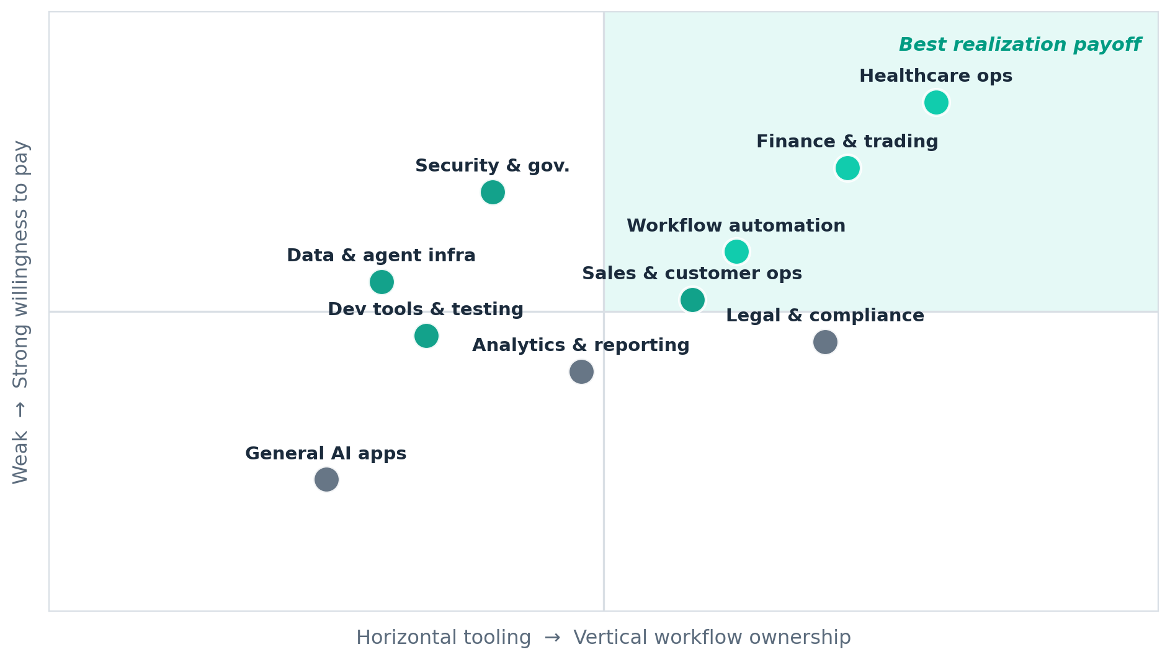
Where The Realization Payoff Concentrates
Workflow ownership vs. willingness to pay, by use case
Healthcare ops and finance sit top-right: deep workflow ownership and strong willingness to pay. (Illustrative positioning, not measured.)
Agentic AI · Business Use Cases & Realization | June 2026
23 / 27

Slide 24
Realization Risks & Controls
What breaks agent use cases in production — and the control that contains each
Risk
What goes wrong
Control
Context failure
Agents act on stale, missing, or over-broad data.
Permissioned retrieval layer; scope reads to the task.
Silent wrong actions
An agent writes a bad record with full confidence.
Confidence thresholds + human-in-the-loop on exceptions.
Unbounded access
Over-privileged agents touch systems they shouldn't.
Identity, least-privilege scoping, and full audit trails.
No measurable outcome
Cycle-time / error-rate impact is never proven.
Instrument baselines before rollout; report deltas.
Workflow not owned
The agent summarizes but doesn't complete the job.
Close the loop into the system of record end-to-end.
Evidence note: counts tie out to 27 filtered companies; organization names are from the live YC listing, with deep-research notes confirming a 14-company subset. Adjacency examples span multiple YC batches.
Agentic AI · Business Use Cases & Realization | June 2026
24 / 27

Slide 25
A 90-Day Realization Plan
From a chosen use case to a proven system of action
Days 0-30
Days 30-60
Days 60-90
Pick & scope
Build the loop
Prove ownership
• Choose one workflow-heavy use case to own end-to-end.
• Map the trigger → action loop and the systems of record.
• Instrument cycle-time and error-rate baselines.
• Ship the context + retrieval layer first.
• Wire actuation into one system of record.
• Add guardrails and a human-in-the-loop queue.
• Run against the baseline with 2-3 design partners.
• Show measurable delta vs. the manual workflow.
• Decide: deepen the wedge or expand adjacent.
→
→
Agentic AI · Business Use Cases & Realization | June 2026
25 / 27

Slide 26
Recommendations
Where to focus realization effort first
01
Choose workflow-heavy use cases first
02
Own context, governance, or workflow position
8 companies cluster around operational systems of action, making this the clearest YC pattern.
The more durable clusters pair agents with data access, infrastructure, or embedded workflow ownership.
03
Treat healthcare operations as a real wedge
04
Avoid generic agent-platform messaging
The count is smaller than horizontal ops, but the workflow pain and willingness to pay are strong.
The cohort repeatedly rewards products with explicit jobs and operators, not broad agent claims.
Agentic AI · Business Use Cases & Realization | June 2026
26 / 27

Slide 27
THE BOTTOM LINE
Use cases win on realization — owning the workflow end to end, not on model novelty.
1
Lead with workflow-heavy use cases
The deepest realization payoff is in operational systems of action.
2
Own context, governance, and actuation
Durable agents pair reasoning with data access and write-back into systems of record.
3
Treat healthcare operations as a wedge
High-friction admin workflows with strong willingness to pay — Pelica, Aegis, Galen AI.
4
Close the loop, then measure it
Complete the job and prove the cycle-time / error-rate delta.
Agentic AI · Business Use Cases & Realization | June 2026
27 / 27

