Slide 1


DATA 606: Capstone In Data Science
By- Adishree Pandey and Shekha Desai
In Tech Industry

Slide 2


What's Mental Health
Mental health is one of those subjects given the least priority in the workplace and society. The tech industry still has a long way to go in terms of addressing mental health
Associated Reason of occurrence:
Long Lasting hours of work
prioritize productivity and innovation
constant need to stay up-to-date with new technologies
stigma associated with mental health

Slide 3


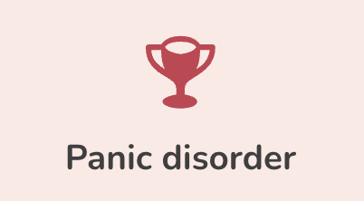
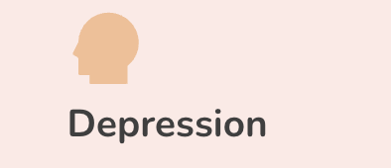
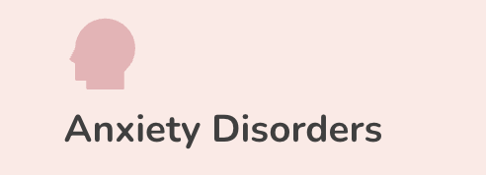
Why we Chose?
Mental health affects individuals in all domains
Addressing this important issue within a specific context
Intersection of data science and mental health is a growing field that offers many opportunities for research and innovation (identify patterns and trends, and develop predictive models)
Personal connect with mental health being a part of It and Master's student

Slide 4

Research questions/hypothesis
According to OSMI data conducted annually since 2014:
- 51% of tech professionals have been diagnosed with a mental health condition
- 71% of tech workers said their productivity is affected by a mental health issue
- 57% of tech industry employees reported burnout
What is the prevalence of mental health issues among tech employees?
How can data science be used to predict and prevent mental health issues in the tech industry?
What are the barriers to seeking mental health treatment among tech employees?
Anxiety, depression, and burnout, are common among tech employees
Data science techniques, such as machine learning and predictive modeling, can be used to analyze large datasets related to mental health in the tech industry and develop interventions to prevent mental health issues before they occur
Barriers to seeking mental health treatment among tech employees may include stigma, lack of awareness about available resources, and fear of negative repercussions at work.

Slide 5
Similar Approaches
"Mental Health in the Technology Workplace" by Emma Charlton, published in the Journal of Technology in Human Services in 2018. The paper discusses the factors that contribute to mental health issues in the tech industry, such as long working hours, high levels of stress and pressure, and a lack of work-life balance. The author argues that addressing these factors is crucial for improving mental health outcomes in the tech industry.
"Mental Health in the Tech Industry: A Case Study" by Nadia Huq, published in the Journal of Business Case Studies in 2020. This paper presents a case study of a tech company that implemented a mental health initiative to support its employees. The study found that the initiative was successful in improving employee well-being and reducing stigma around mental health issues.
"Burnout in the Information Technology Sector" by Jocelyn Glass, published in the International Journal of Business and Social Science in 2014. The paper examines the prevalence of burnout among IT workers and the factors that contribute to it, such as high workload and a lack of social support. The author argues that addressing burnout is crucial for improving mental health outcomes in the tech industry.
"Mental Health Stigma in the Computer Science Field" by Stephanie Lee and Adriana Kezar, published in the Journal of Women and Minorities in Science and Engineering in 2017. The paper examines the stigma surrounding mental health issues in the computer science field, particularly among women and minority groups. The authors argue that addressing stigma is crucial for creating a more inclusive and supportive work environment for all employees.
"A Systematic Literature Review of Mental Health Interventions in the Information and Communications Technology Workplace" by Tanuja Singh, published in the International Journal of Workplace Health Management in 2019. This paper presents a systematic review of the literature on mental health interventions in the tech industry. The study found that interventions such as mindfulness training and cognitive-behavioural therapy can be effective in improving mental health outcomes for tech employees.

Slide 6
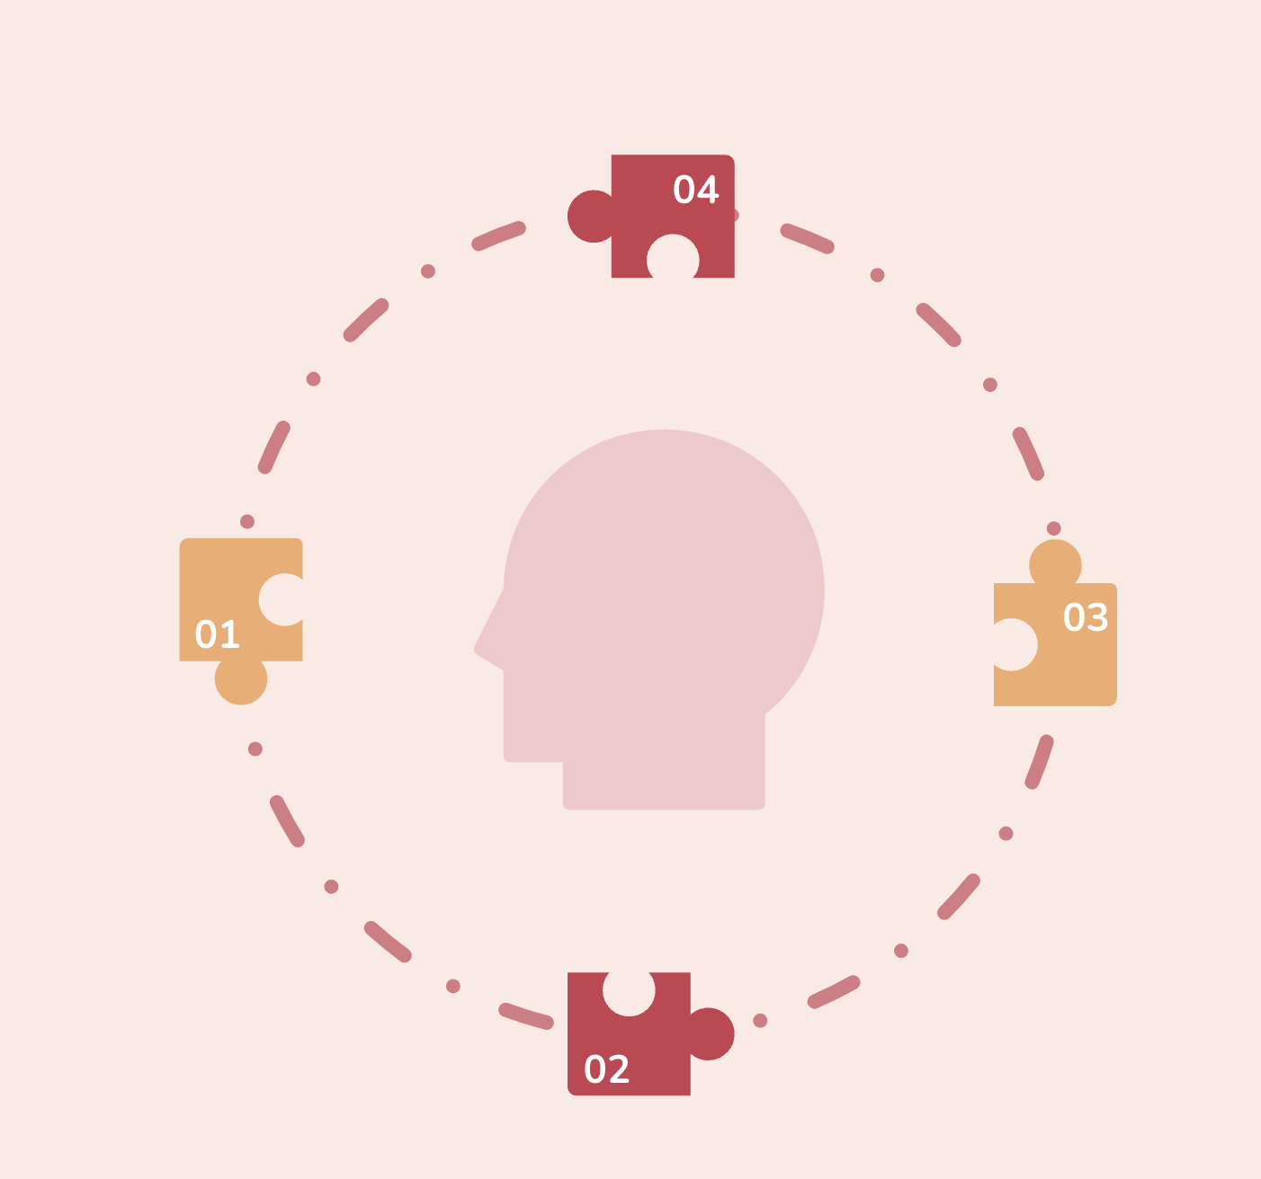
"More research is needed: While there has been significant research on mental health in thetech industry, more research is needed to fully understand the issue and develop effective interventions. This includes research on the effectiveness of different types of mental health interventions, as well as research on the impact of remote work on employee mental health.
Mental health issues are common: Research consistently shows that mental health issues such as anxiety, depression, and burnout are prevalent among tech industry employees. Factors suchas high workload, pressure to perform, and a lack of work-life balance can contribute to these issues.
Remote work presents new challenges: The COVID-19 pandemic has led to a significant increase in remote work in the tech industry, which can present new challenges for employee mental health. Factors such as social isolation, blurred boundaries between work and personal life, and increased workload can contribute to stress and burnout.
Employers are taking action: Many tech companies are implementing initiatives to support employee mental health, such as providing mental health resources, promoting work-life balance, and reducing stigma through education and awareness campaigns.
Stigma remains a barrier: Despite increased awareness and efforts to address mental health in the tech industry, stigma remains a significant barrier to seeking help. Many employees may feel reluctant to disclose mental health issues or seek treatment due to fear of negative repercussions at work.
State of Art

Slide 7
State of Art
01.
More research is needed: While there has been significant research on mental health in the tech industry, more research is needed to fully understand the issue and develop effective interventions. This includes research on the effectiveness of different types of mental health interventions, as well as research on the impact of remote work on employee mental health.​
02.
Mental health issues are common: Research consistently shows that mental health issues such as anxiety, depression, and burnout are prevalent among tech industry employees. Factors such as high workload, pressure to perform, and a lack of work-life balance can contribute to these issues.
03.
Remote work presents new challenges: The COVID-19 pandemic has led to a significant increase in remote work in the tech industry, which can present new challenges for employee mental health. Factors such as social isolation, blurred boundaries between work and personal life, and increased workload can contribute to stress and burnout.
04.
Employers are taking action: Many tech companies are implementing initiatives to support employee mental health, such as providing mental health resources, promoting work-life balance, and reducing stigma through education and awareness campaigns.
05.
Stigma remains a barrier: Despite increased awareness and efforts to address mental health in the tech industry, stigma remains a significant barrier to seeking help. Many employees may feel reluctant to disclose mental health issues or seek treatment due to fear of negative repercussions at work.

Slide 8
Longitudinal studies: While there are some studies on mental health in the tech industry, few studies have followed participants over an extended period of time. Longitudinal studies can provide insights into how mental health issues change over time and what factors may be contributing to them.
Intersectionality: Mental health research in the tech industry often focuses on white, male, and affluent populations. There is a need for research that takes into account the experiences of individuals from diverse backgrounds and considers the intersection of factors such as gender, race, sexuality, and socioeconomic status.
What's missing?

Slide 9
About Dataset
The OSMI (Open Sourcing Mental Illness) Mental Health in Tech Survey is an annual survey that aims to gather data on the mental health experiences of individuals working in the technology industry. The survey is open to anyone who works in tech, regardless of job role or level of experience.
In 2019, 85% of respondents reported experiencing symptoms of a mental health condition, while in 2020 and 2021, the number increased to 86% and 87%, respectively.
Depression and anxiety were the most commonly reported mental health conditions in all three years of the survey.
In 2021, the COVID-19 pandemic had a significant impact on the mental health of tech workers, with 90% of respondents reporting that their mental health had been affected by the pandemic.
Despite the high prevalence of mental health issues in the tech industry, many respondents reported that their employer did not provide adequate support or resources for mental health.

Slide 10
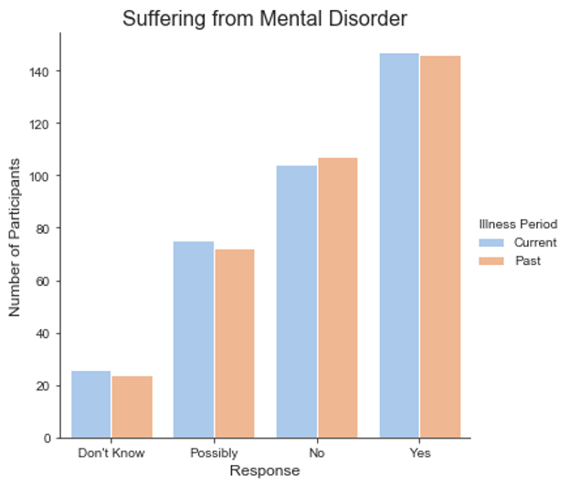
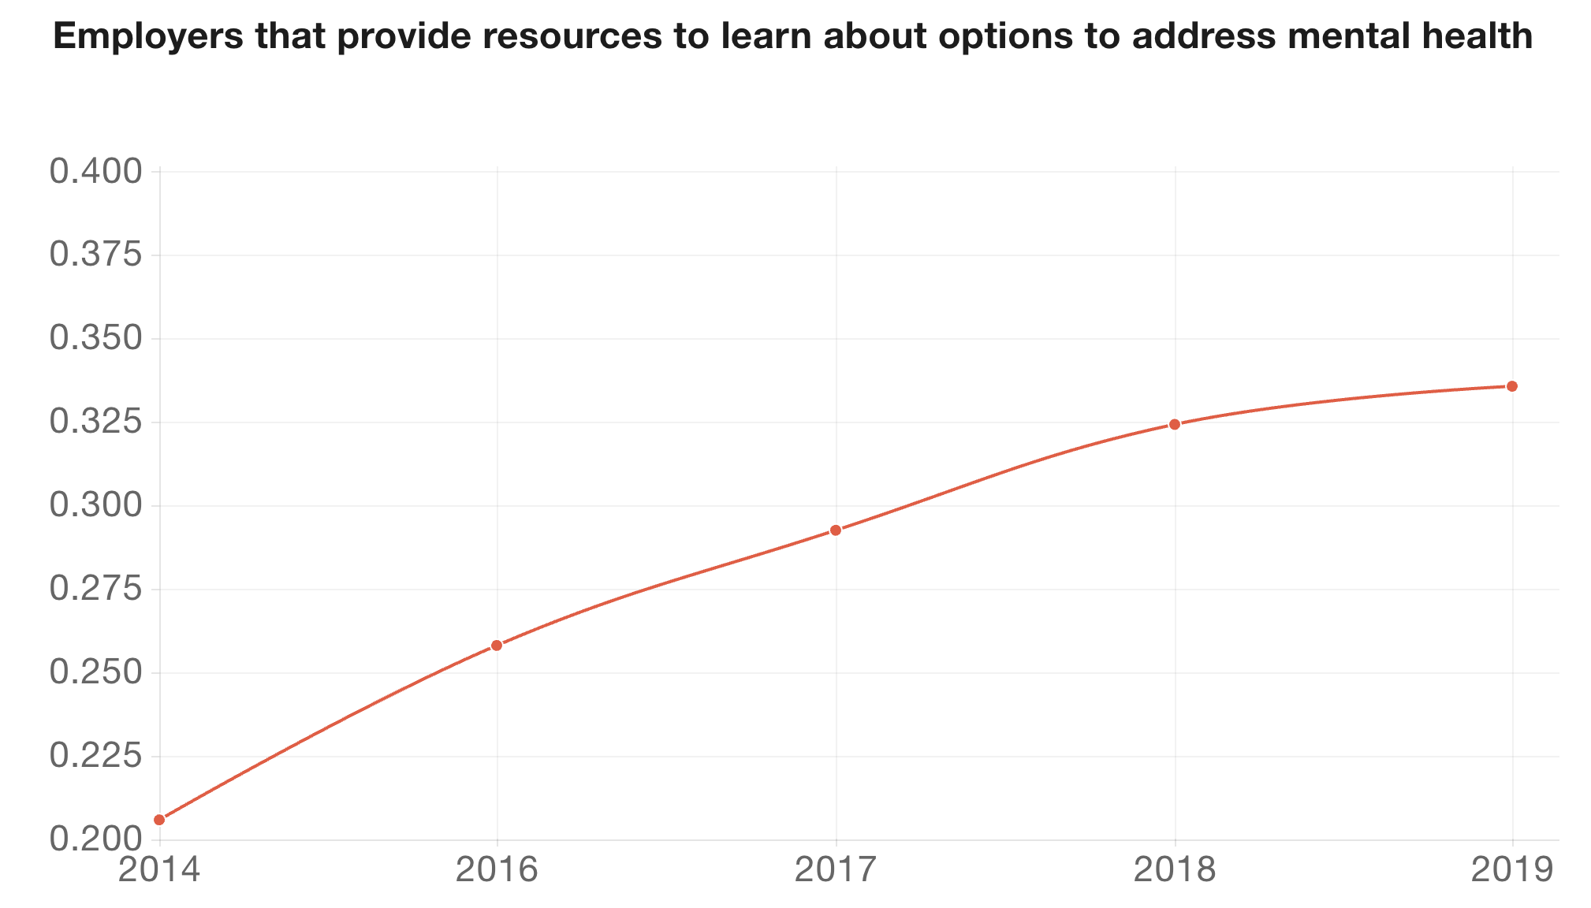
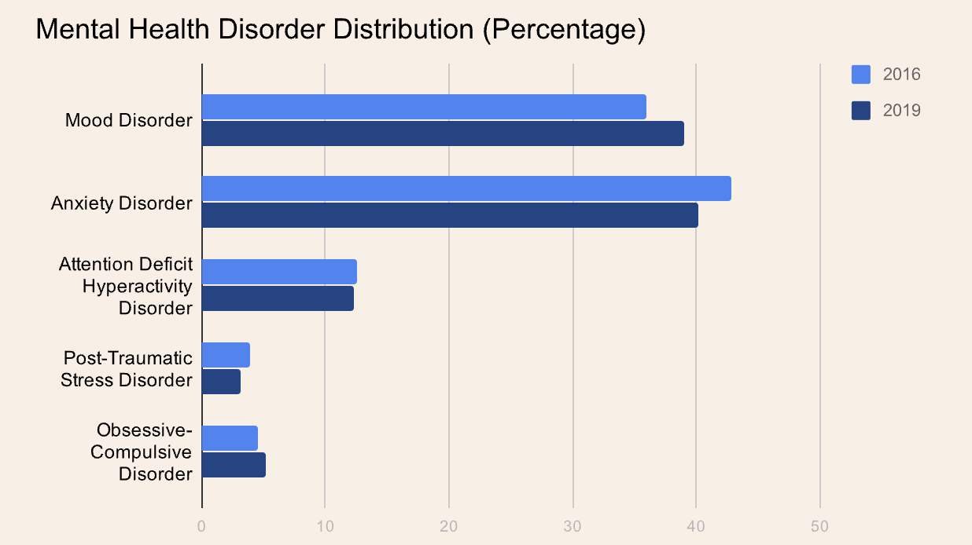
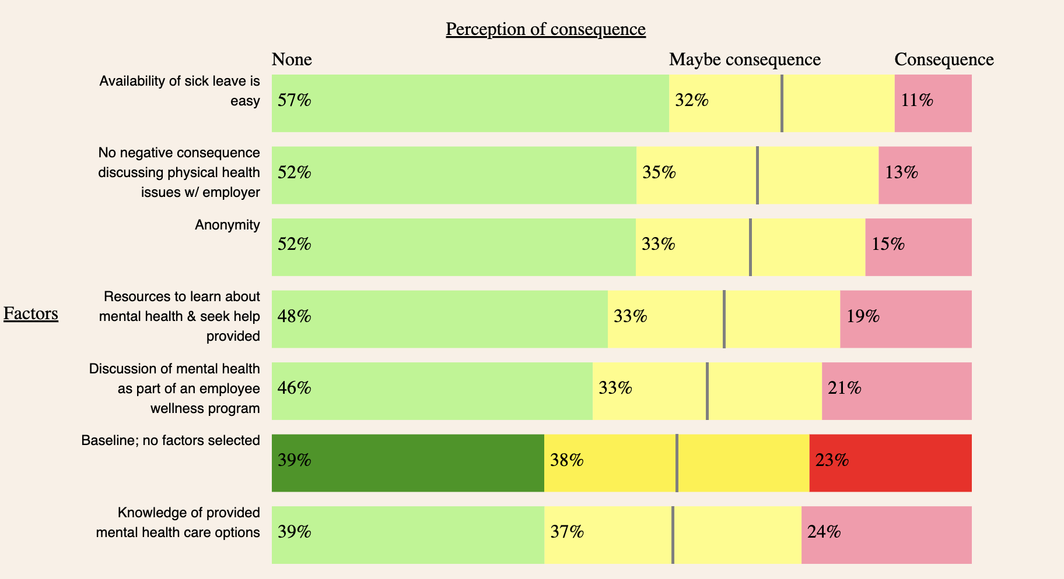
Facts

Slide 11
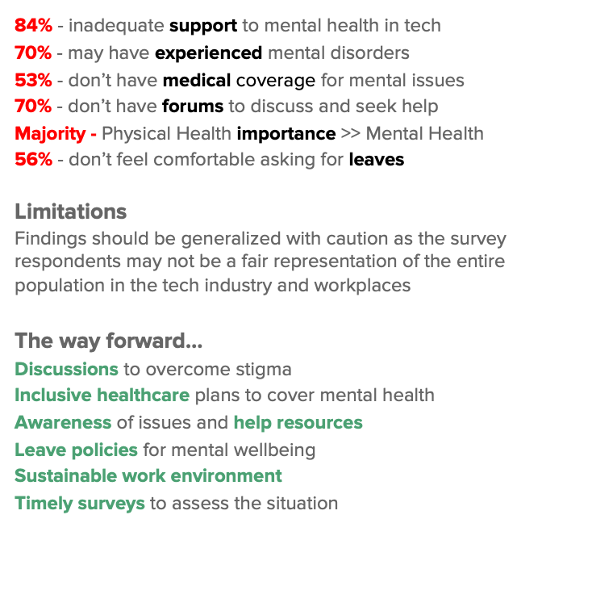
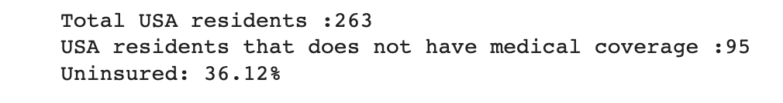
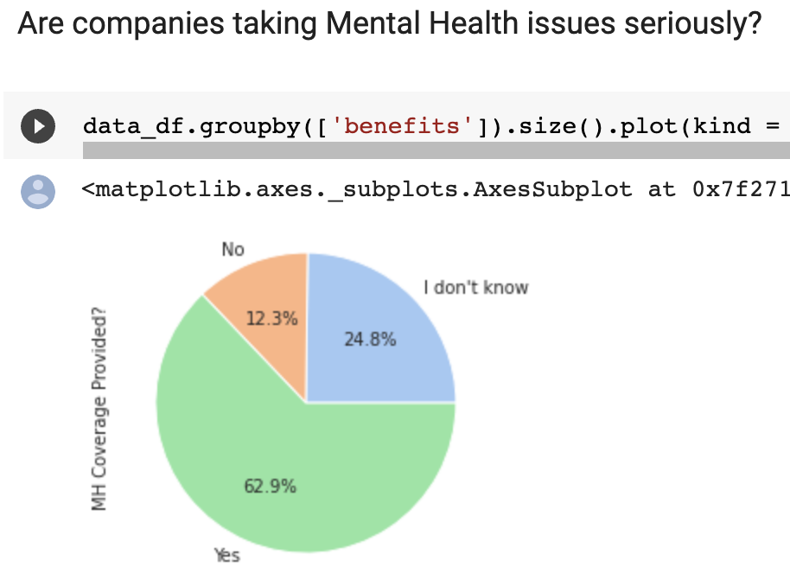
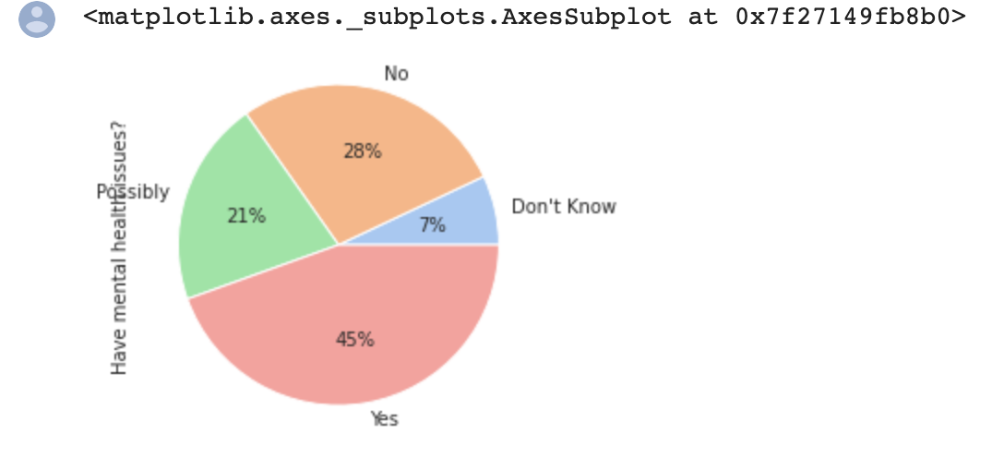
Dataset Analysis

Slide 12
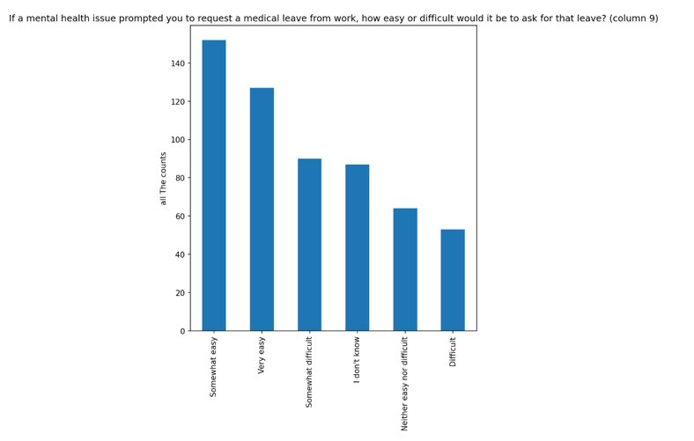
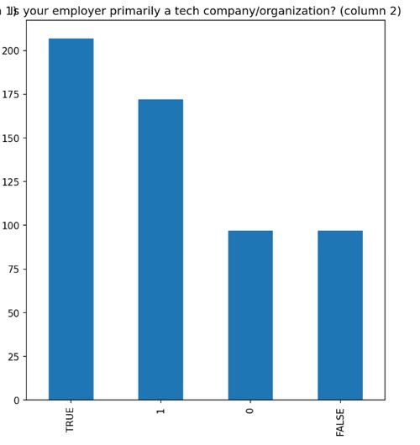
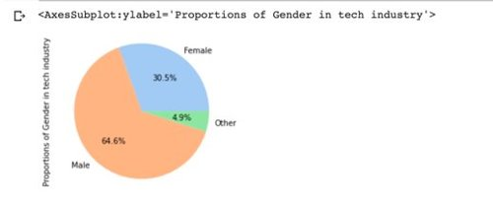
Dataset Analysis

Slide 13
References
https://manuntag.com/data-project-state-of-mental-health-support
https://shezanmirzan.github.io/DataVis-Mental-Health/
https://www.ncbi.nlm.nih.gov/pmc/articles/PMC9907184/
https://www.linkedin.com/pulse/mental-health-major-concern-tech-industry-mentortribes?trk=public_post-content_share-article

