Slide 1
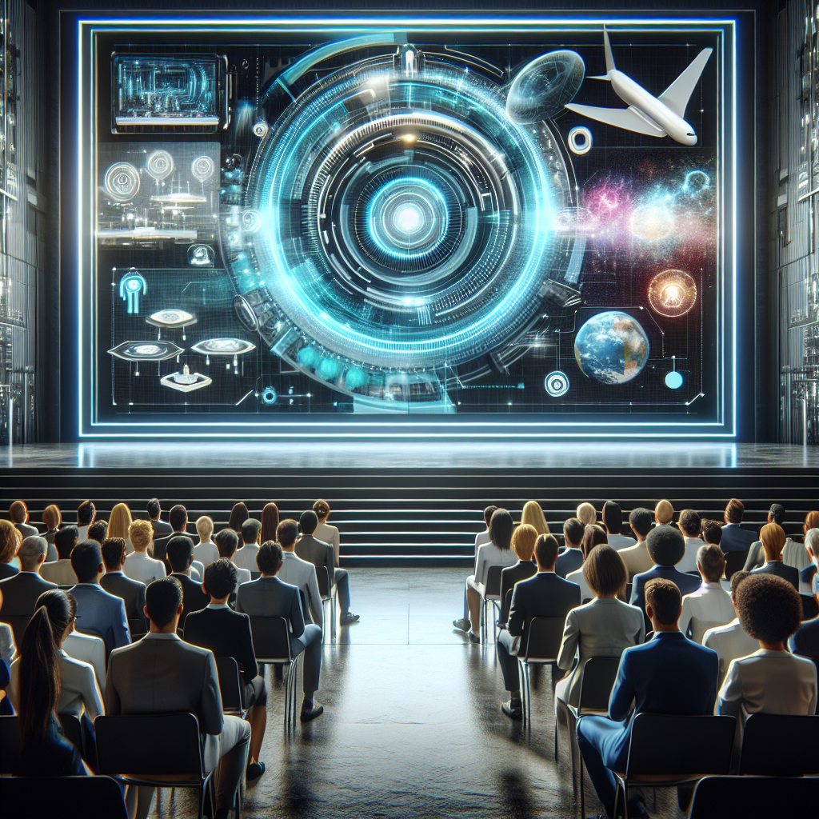
Title: Unveiling the Future: Exploring the Marvels of Futuristic Technology
Introduction:
Good morning/afternoon/evening, ladies and gentlemen. Today, I am thrilled to present to you an enthralling journey into the realm of futuristic technology. In this presentation, we will explore the awe-inspiring advancements that are set to shape our world and revolutionize the way we live, work, and play. So, fasten your seatbelts and get ready to be amazed!
Slide 1: The Dawn of a New Era
- An image depicting a sunrise symbolizing the beginning of a new era in technology.
- A captivating quote highlighting the potential of futuristic technology.
Slide 2: Artificial Intelligence (AI)
- Brief explanation of AI and its impact on various industries.
- Real-world examples of AI applications, such as self-driving cars, virtual assistants, and medical diagnoses.
- A mesmerizing image illustrating AI-powered robots or smart devices.
Slide 3: Virtual Reality (VR)
- Definition and significance of VR in transforming entertainment, education, and training.
- Showcasing popular VR devices and their applications, such as gaming, virtual tours, and medical simulations.
- A visually stunning image capturing a person immersed in a virtual reality experience.
Slide 4: Augmented Reality (AR)
- Differentiating AR from VR and its potential in enhancing our perception of the world.
- Demonstrating AR implementations in fields like architecture, retail, and education.
- A captivating image displaying a person using AR glasses to interact with virtual objects in a real environment.
Slide 5: Internet of Things (IoT)
- Explaining the concept of IoT and its role in creating smart homes, cities, and industries.
- Presenting practical examples of IoT in action, such as smart appliances, wearables, and energy management systems.
- An eye-catching image showing interconnected devices communicating seamlessly.
Slide 6: Robotics and Automation
- Discussing the impact of robotics and automation in revolutionizing industries like manufacturing, healthcare, and agriculture.
- Showcasing humanoid robots, drones, and automated systems.
- An attention-grabbing image depicting a robotic arm working alongside humans in a factory.
Slide 7: Quantum Computing
- Introducing the concept of quantum computing and its potential to solve complex problems exponentially faster.
- Presenting real-world applications, such as drug discovery, weather forecasting, and cryptography.
- A visually striking image representing the intricate nature of quantum computing.
Slide

