Slide 1
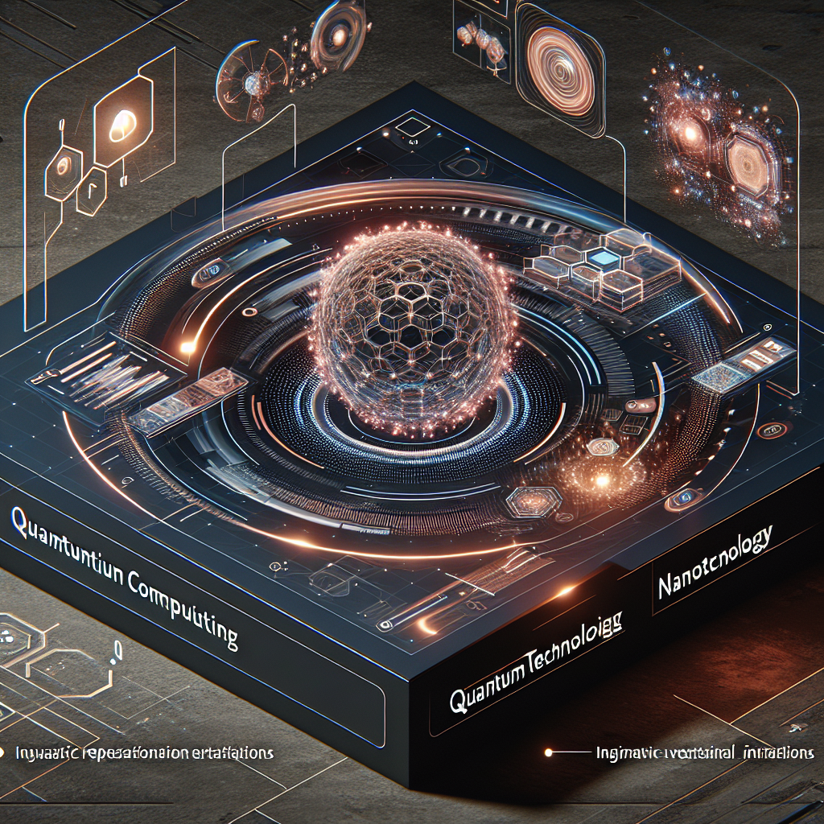
Title: Unveiling the Future: Exploring the Fascinating World of Futuristic Technology
Introduction:
Ladies and gentlemen, distinguished guests, and fellow technology enthusiasts, welcome to the world of tomorrow! In this captivating presentation, we will embark on a journey through the vast expanse of futuristic technology. Brace yourselves as we explore innovations that were once deemed unimaginable, but are now becoming a reality. Buckle up and get ready to be amazed!
Slide 1: The Technological Revolution
- Begin with a visually stunning image depicting various futuristic technologies.
- Introduce the topic of the technological revolution and its impact on society.
- Highlight the rapid progress made in recent years and the possibilities that lie ahead.
Slide 2: Artificial Intelligence (AI)
- Present an image showcasing AI technology.
- Discuss the concept of AI and its potential applications in various fields.
- Highlight advancements in machine learning, natural language processing, and robotics.
- Provide real-world examples such as self-driving cars, personal assistants, and medical diagnosis.
Slide 3: Virtual Reality (VR) and Augmented Reality (AR)
- Display an immersive image representing VR and AR.
- Explain the difference between VR and AR.
- Showcase the transformative power of VR and AR in gaming, education, and healthcare.
- Share examples of VR and AR devices like Oculus Rift, Microsoft HoloLens, and Magic Leap.
Slide 4: Internet of Things (IoT)
- Present an image illustrating the interconnectedness of IoT devices.
- Define IoT and its significance in our daily lives.
- Explain how smart homes, wearable devices, and smart cities are shaping the future.
- Discuss potential challenges and security concerns associated with IoT.
Slide 5: Biotechnology and Genetic Engineering
- Showcase a captivating image representing biotechnology and genetic engineering.
- Introduce the concept of gene editing, CRISPR technology, and personalized medicine.
- Discuss the ethical implications and potential benefits of these advancements.
- Present examples of gene therapies and genetically modified organisms.
Slide 6: Renewable Energy and Sustainable Solutions
- Display a visually striking image highlighting renewable energy sources.
- Discuss the urgent need for sustainable solutions to combat climate change.
- Explore advancements in solar, wind, and hydroelectric power generation.
- Highlight breakthroughs in energy storage and the potential for a greener future.
Slide 7: Quantum Computing
- Present an image representing quantum computing technology.
- Explain the fundamental principles behind quantum computing.
- Discuss the potential of quantum computing

