Slide 1
Data Science Projects
Gunjan Pandey
0801CS171025

Slide 2
Loan Restitution Predictor
Project-1

Slide 3
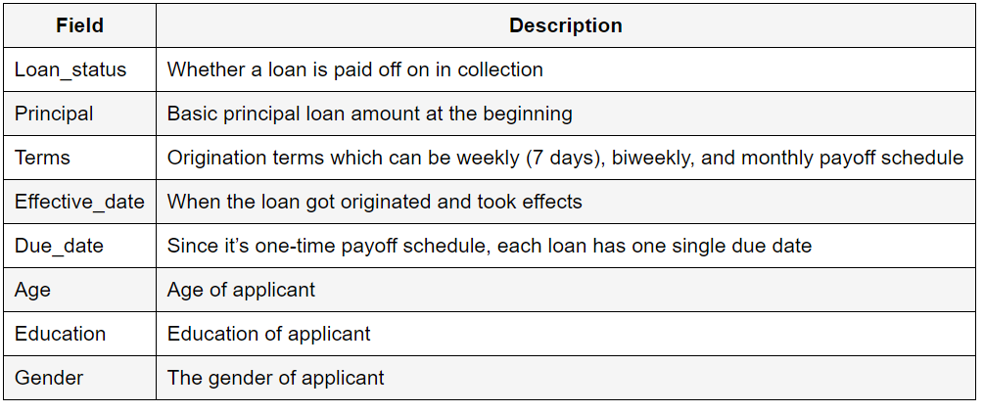
Dataset Description
The dataset contains information about past loans, it includes following fields-

Slide 4
Objectives – To forecast whether a person will repay a loan or not.
Process –
Import libraries, Read data, Check dataset info, Covert effective_date and due_date to date-time objects.
Check value counts, Perform data visualization, Convert effective_date to day_of_week, Convert numerical to categorical values, Feature selection.
Split data, Choose Classifier, Train, Predict, Optimize Parameters, Test.
Findings -
We can see that male takes more loan than female. Irrespective of gender, more number of persons are having Principal amount 800 and 1000.
We can infer that people who get the loan at the end of the week don't pay it off, so we add a new attribute weekend.
SVM gave accuracy of 81.481% on test set.

Slide 5
Canonical Correlation Analysis With L_{2,1}-Norm for Multiview Data Representation
Project-2

Slide 6
Introduction
Multi-view data is referred as the data collected or generated from different domains.
For instance, for the semantic object “car”, we can extract its features using different descriptors, e.g., color, local shape, and texture, and each corresponding feature descriptor (view) is sufficient to describe the object itself.
The essence of multi-view learning (MVL) is to exploit the consensual and complementary information, between different views, to achieve better learning performance.
As one of classical approaches in multivariate data analysis, CCA and its variants have become the most compelling method for multi-view representation learning.

Slide 7
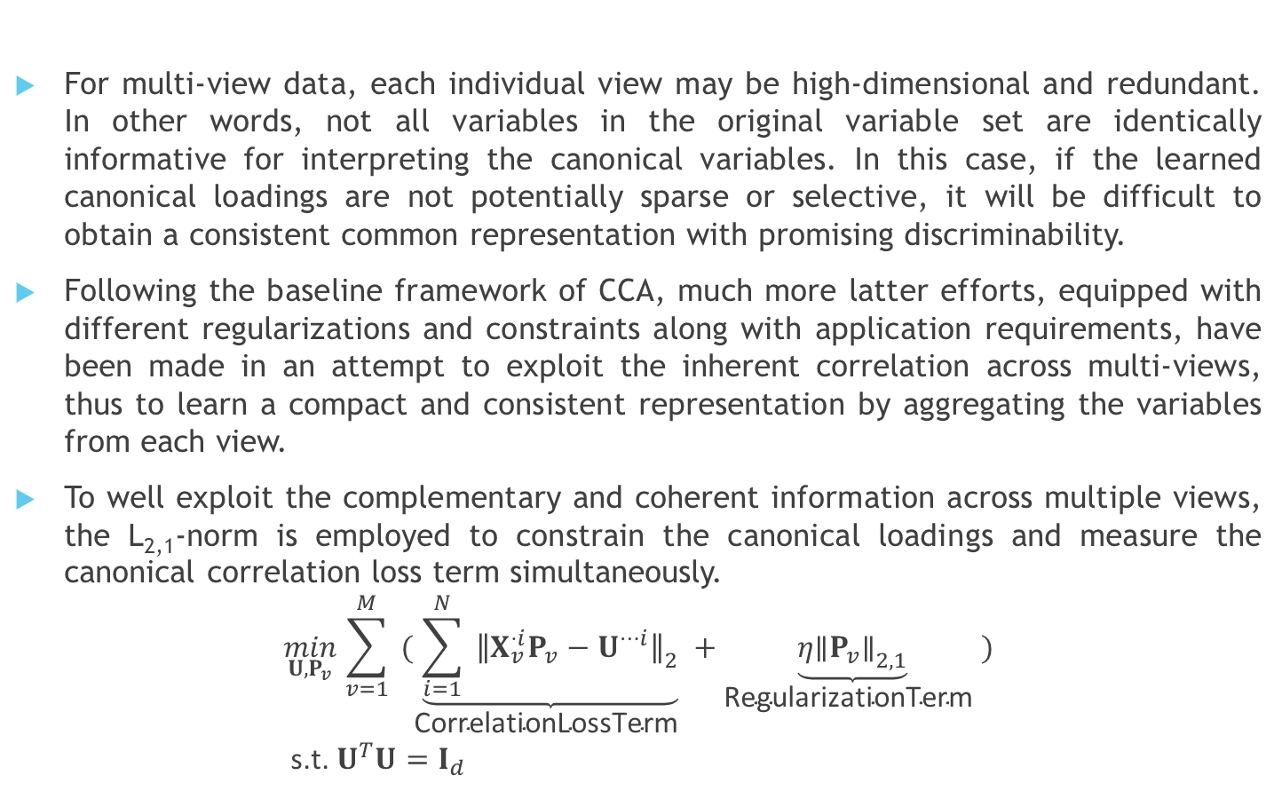
Purpose
For multi-view data, each individual view may be high-dimensional and redundant. In other words, not all variables in the original variable set are identically informative for interpreting the canonical variables. In this case, if the learned canonical loadings are not potentially sparse or selective, it will be difficult to obtain a consistent common representation with promising discriminability.
Following the baseline framework of CCA, much more latter efforts, equipped with different regularizations and constraints along with application requirements, have been made in an attempt to exploit the inherent correlation across multi-views, thus to learn a compact and consistent representation by aggregating the variables from each view.
To well exploit the complementary and coherent information across multiple views, the L_{2,1}-norm is employed to constrain the canonical loadings and measure the canonical correlation loss term simultaneously.
$$\begin{aligned}&\min_{U,P_{v}} \sum_{v=1}^{M}{ }(\underset{\text{CorrelationLossTerm} }{\underbrace{\sum_{i=1}^{N}{ }{∥X_{v}^{⋅i}P_{v}−U^{⋯i}∥}_{2}}}+\underset{\text{RegularizationTerm} }{\underbrace{η{∥P_{v}∥}_{2,1}}}) \\ & \text{s}\text{.}\text{t}\text{. }U^{T}U=I_{d}\end{aligned}$$

Slide 8
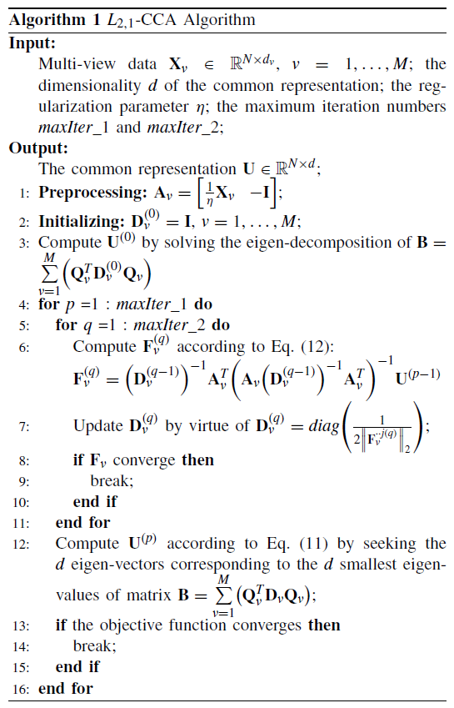
Algorithm -

Slide 9
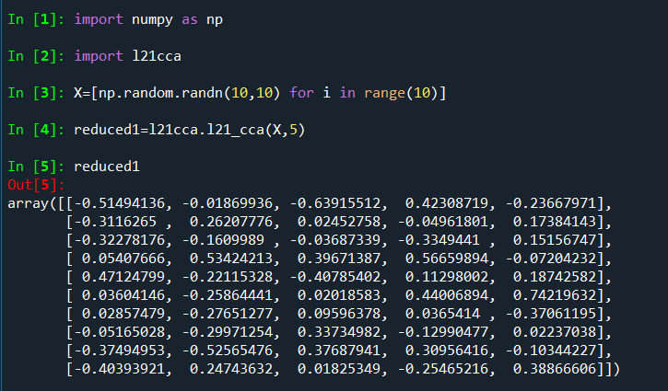
Example

