Slide 1

GOA · E-WASTE MANAGEMENT BRIEFING · 2025
E-Waste in Goa
The Hidden Cost of a Digital Paradise
From growing electronic consumption to an emerging circular-economy opportunity — a briefing for policy-makers, local government, NGOs and stakeholders in Goa.
Sources: Government of Goa — E-Waste Policy 2024 · GWMC · GSPCB · CAG

Slide 2

THE BIG PICTURE
High Consumption,
Growing E-Waste
Goa's tourism-driven, high-consumption economy produces significant e-waste. The real challenge isn't production — it's capturing and processing it safely.
~7,000
~570
4,320
t / year
t / year
tonnes
Scheduled e-waste — state inventorisation
Actually collected (GSPCB, 2019–20)
Per-capita projection applied to Goa (2020 basis)
Bottom line: Large discrepancies between figures reflect differing methods, reporting gaps and high equipment penetration across the state — not a shrinking problem.
Reference: gwmc.goa.gov.in
02

Slide 3
MEASURING THE PROBLEM
Fragmented Numbers, Clear Risk
Different studies use different methods and years — these figures should not be read as a single continuous series. The working conclusion: generation is consistently larger than formal collection indicates.
2005
2015
2019–20
Ongoing
427.4 t
~1,000 t
~570 t
~7,000 t
Measured collection amount
Approximate increase reported
Collected in that period (GSPCB)
State inventorisation — estimated per year
Caveat: GSPCB and state-inventorisation figures each carry their own methodology caveats — treat them as independent snapshots, not a trend line.
03

Slide 4


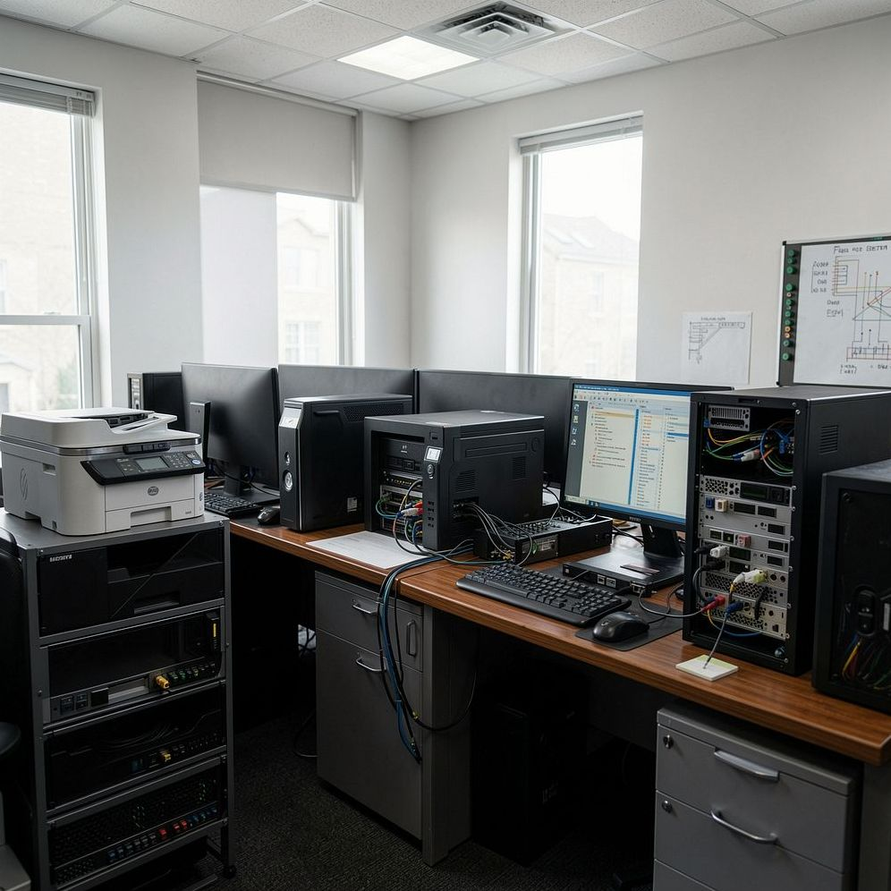
DRIVERS
Why Goa Generates So Much
State policy highlights high equipment penetration across three groups as the driver of higher real-world e-waste than per-capita estimates alone suggest.
Households
Tourism & Hospitality
Business & Industry
High ownership of smartphones, laptops, TVs, fridges, washing machines and small appliances.
Hotels, restaurants and resorts use and replace large volumes of entertainment and catering electronics.
Offices, shops and industrial sites generate IT equipment, printers and control electronics.
04

Slide 5
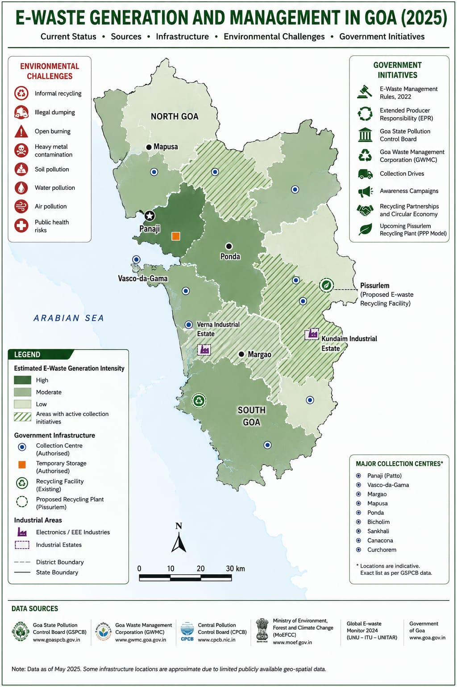
STATEWIDE VIEW
Infrastructure & Risk,
Mapped Across Goa
Estimated generation intensity is highest around Panaji and the Ponda–Kundaim–Verna industrial belt, where authorised collection centres and electronics/EEE industries also cluster. The proposed Pissurlem facility sits at the state's eastern edge, and a recycling facility is already active near South Goa.
High-intensity zones — Panaji, Ponda & the central industrial belt
9 authorised collection centres — Patto, Vasco, Margao, Mapusa, Ponda, Bicholim, Sankhali, Canacona, Curchorem
Pissurlem (proposed) — Common e-waste recycling facility, eastern North Goa
Verna & Kundaim estates — Concentrated electronics / EEE industry
Source: GSPCB · GWMC · CPCB · MoEFCC · Global E-waste Monitor 2024 (data as of May 2025)
05

Slide 6
MATERIAL FLOW
Where Does the Waste Go?
Historically, Goa had no authorised recyclers, few authorised collection centres or refurbishers, a single authorised dismantler — and hundreds of scrap dealers, many informal.
1
Consumer
2
Old electronics
3
Collection
Households & businesses
End-of-life devices
Authorised centres & scrap dealers
4
Informal scrap market
5
Dismantling / Resale
6
Formal system
Major flow via scrap dealers
Manual dismantling, material loss
Small residual volume to recyclers
~700 scrap dealers statewide — only ~350 registered with the Goa Scrap Dealers Association
06

Slide 7
COMPLIANCE GAP
The Leakage — A Stark Gap
A CAG-related audit covering 2019–2023 found that the vast majority of e-waste bypassed formal collection centres entirely — over 35,000 tonnes moved outside formal channels in the audited period.
Consequences
Weak traceability and enforcement
98%
Unauthorised dismantling and unsafe practices
of e-waste bypassed
formal collection
(CAG period, 2019–23)
Loss of recoverable materials and economic value
Environmental and health hazards
Footnote: This CAG finding covers 2019–23 and should not be read as a current (2026) generation estimate.
Source: The Times of India · CAG report (2019–2023 audit)
07

Slide 8
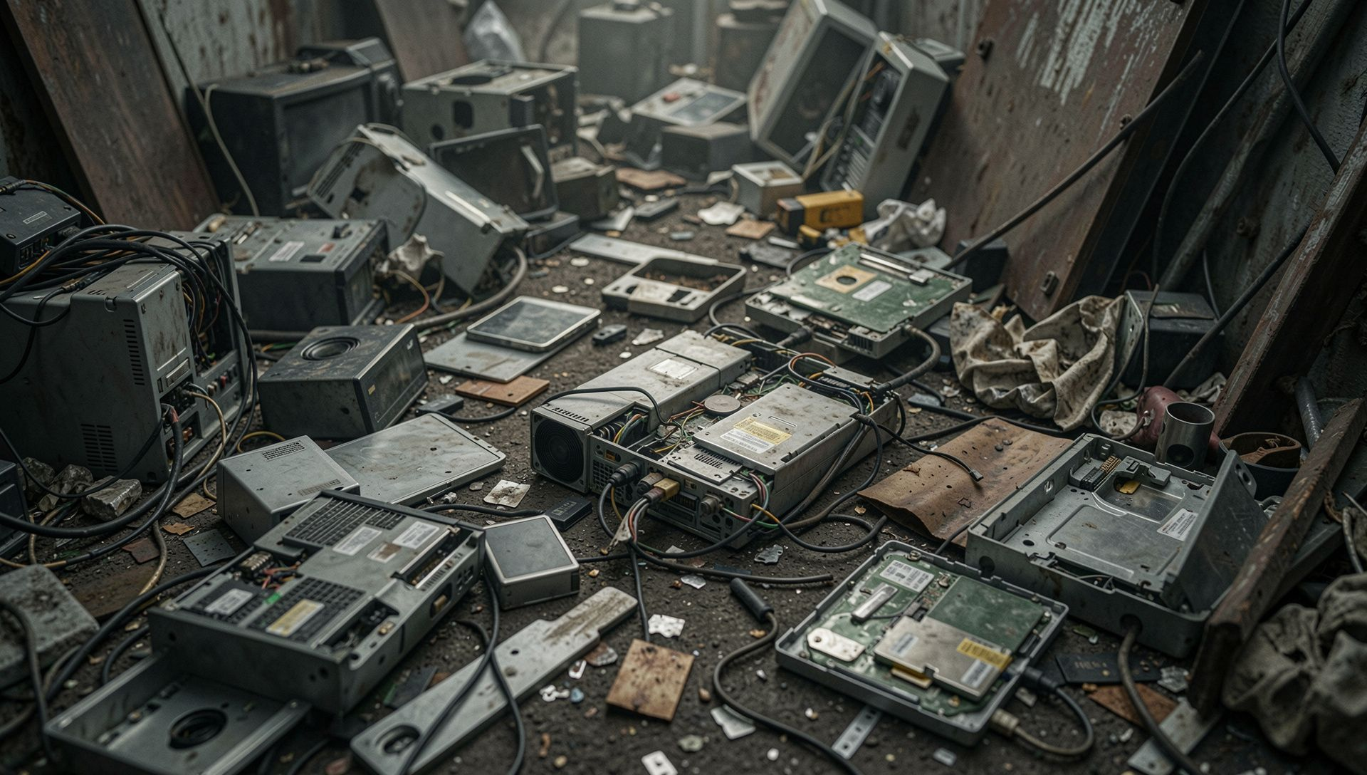
IMPACT
Environmental &
Health Costs
Air
Burning and open dismantling release toxic fumes — persistent organic pollutants and heavy-metal particulates.
Water & Soil
Leaching of lead, mercury, cadmium and flame retardants contaminates groundwater and sediments.
People
Informal workers and nearby communities face chronic exposure, respiratory issues, and long-term health risks.
Goa policy identifies toxic releases, environmental impacts and lost materials as key risks.
08

Slide 9
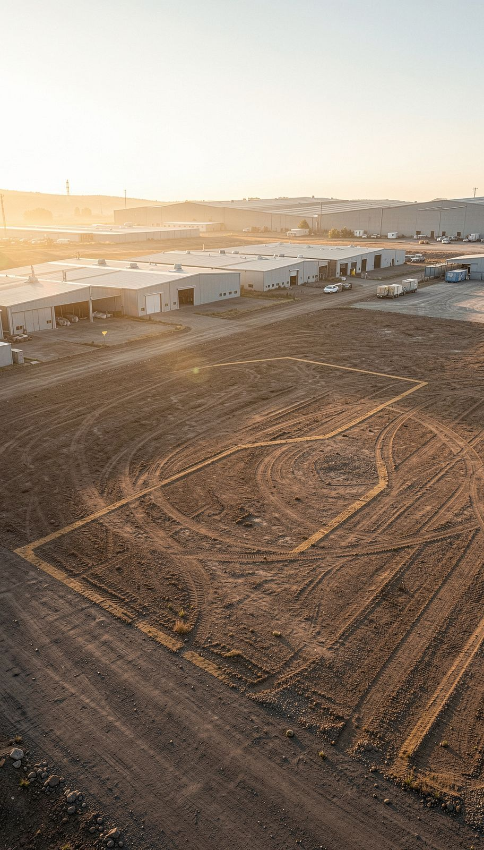
FORMALISATION IN PROGRESS
Pissurlem & Early Infrastructure
Goa is shifting from informal disposal toward formal collection, dismantling and authorised recycling.
01
Planned Facility
Common E-Waste Management Facility proposed at Pissurlem Industrial Estate — 4,000 m² of land allocated.
02
Planned Capacity
Earlier project plan noted ~15 tonnes/day capacity, subject to final design and approvals.
03
Interim Operations
GWMC reports collection from ULBs/RLBs is already underway, with collected e-waste sent to authorised recyclers while the facility is established.
Big idea: Scale and integration remain the urgent tasks as Goa builds out formal e-waste infrastructure.
Sources: GWMC · Green Tribunal references
09

Slide 10
DRAFT 2024
Policy Framework — A Complete Ecosystem
Stakeholder chain: Producer → Dealer → Consumer → Collector → Refurbisher / Dismantler → Recycler
1
2
3
4
EPR
Collection & Logistics
Traceability
Informal Sector Integration
Producer responsibility for end-of-life; obligations for take-back and financing collection.
Convenient collection points and reverse-logistics from municipalities, panchayats, hotels and institutions.
Digital records tracking consumer → collection → transport → dismantling → recycling.
Train, register and partner with scrap collectors to bring them into safe, traceable workflows.
Also part of the framework: Formal Recycling (transforms waste into resources, ensures safety, creates jobs) and Awareness (educates citizens, encourages responsible behaviour). Policy emphasises environmentally sound recycling, capacity building and clear stakeholder roles.
10

Slide 11
FROM WASTE TO VALUE
The Opportunity & Roadmap
"From a waste destination to a circular-economy destination."
Recommended correction: avoid the erroneous "500 tonnes/day" figure circulating elsewhere — it conflicts with state estimates and likely reflects a unit error. Use the ~15 TPD proposed-capacity figure instead.
1
Collect
Recover
Convenient collection across municipalities, panchayats, hotels, offices and institutions.
Copper, aluminium, iron, gold, silver, plastics — extract valuable materials.
2
Connect
Register, train and partner with scrap collectors; incentivise formal channels.
Refurbish
Extend device life through repair and certified refurbishing.
3
Process
Scale Pissurlem; expand authorised refurbishment, dismantling and recycling capacity.
Recycle
4
Track
Environmentally sound material recovery through authorised recyclers.
Deploy a transparent digital chain of custody for weights, transport and disposal.
Value
Green jobs, local economic activity, and reduced import dependence for raw materials.
~7,000
98%
4,000 m²
15 TPD
t/year scheduled generation
bypassed formal collection (2019–23)
land provided at Pissurlem
earlier proposed facility capacity
11

