Slide 1
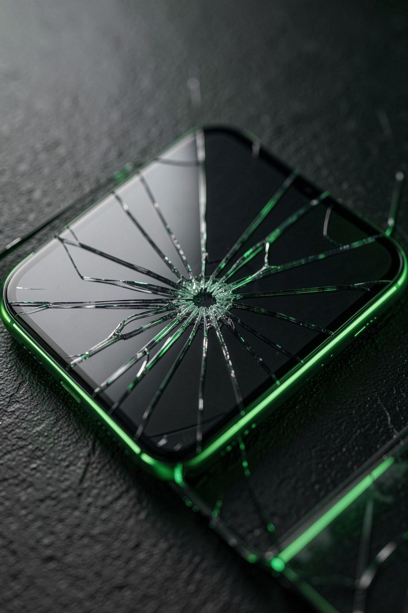
REBOOT — Repair More. Waste Less.
College pitch: sustainable tech for the circular electronics economy

Slide 2
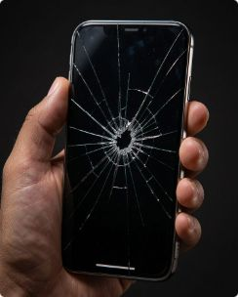
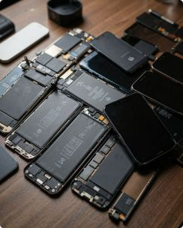
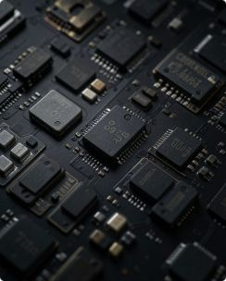

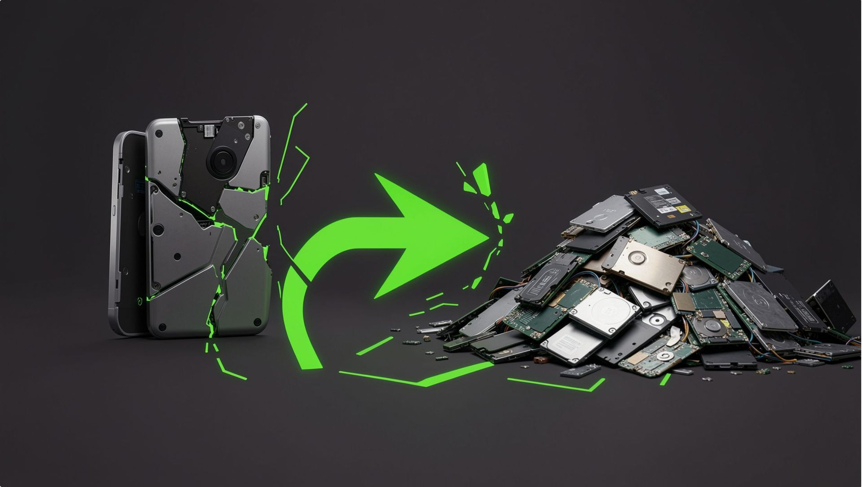
The Repair Gap in Electronics
Repair is becoming expensive
Spare parts are hard to find
Usable components become e‑waste
Shorter device lifecycles
Devices replaced years earlier than necessary.
Official service costs push users to replace devices.
Older models lack available compatible components.
Working modules are discarded with damaged devices.
One broken component shouldn't mean one discarded device.

Slide 3





REBOOT: Give Electronics a Second Life
Device Problem
Digital Diagnosis
Repair / Refurbish
Technician Match
Platform that connects customers, verified technicians, recovered parts, and certified recyclers in a circular loop.
01 — Diagnose
02 — Match
Upload device details & photos; AI-assisted fault detection.
Verified local technicians matched by skill & availability.
03 — Reuse Parts
04 — Recycle
Marketplace for tested, recovered spare parts.
Unrepairable units routed to accredited recyclers.
Verified repair technicians
Recovered spare-parts marketplace
AI-assisted fault diagnosis
Doorstep pickup & delivery
Repair history & warranty
Responsible recycling network

Slide 4
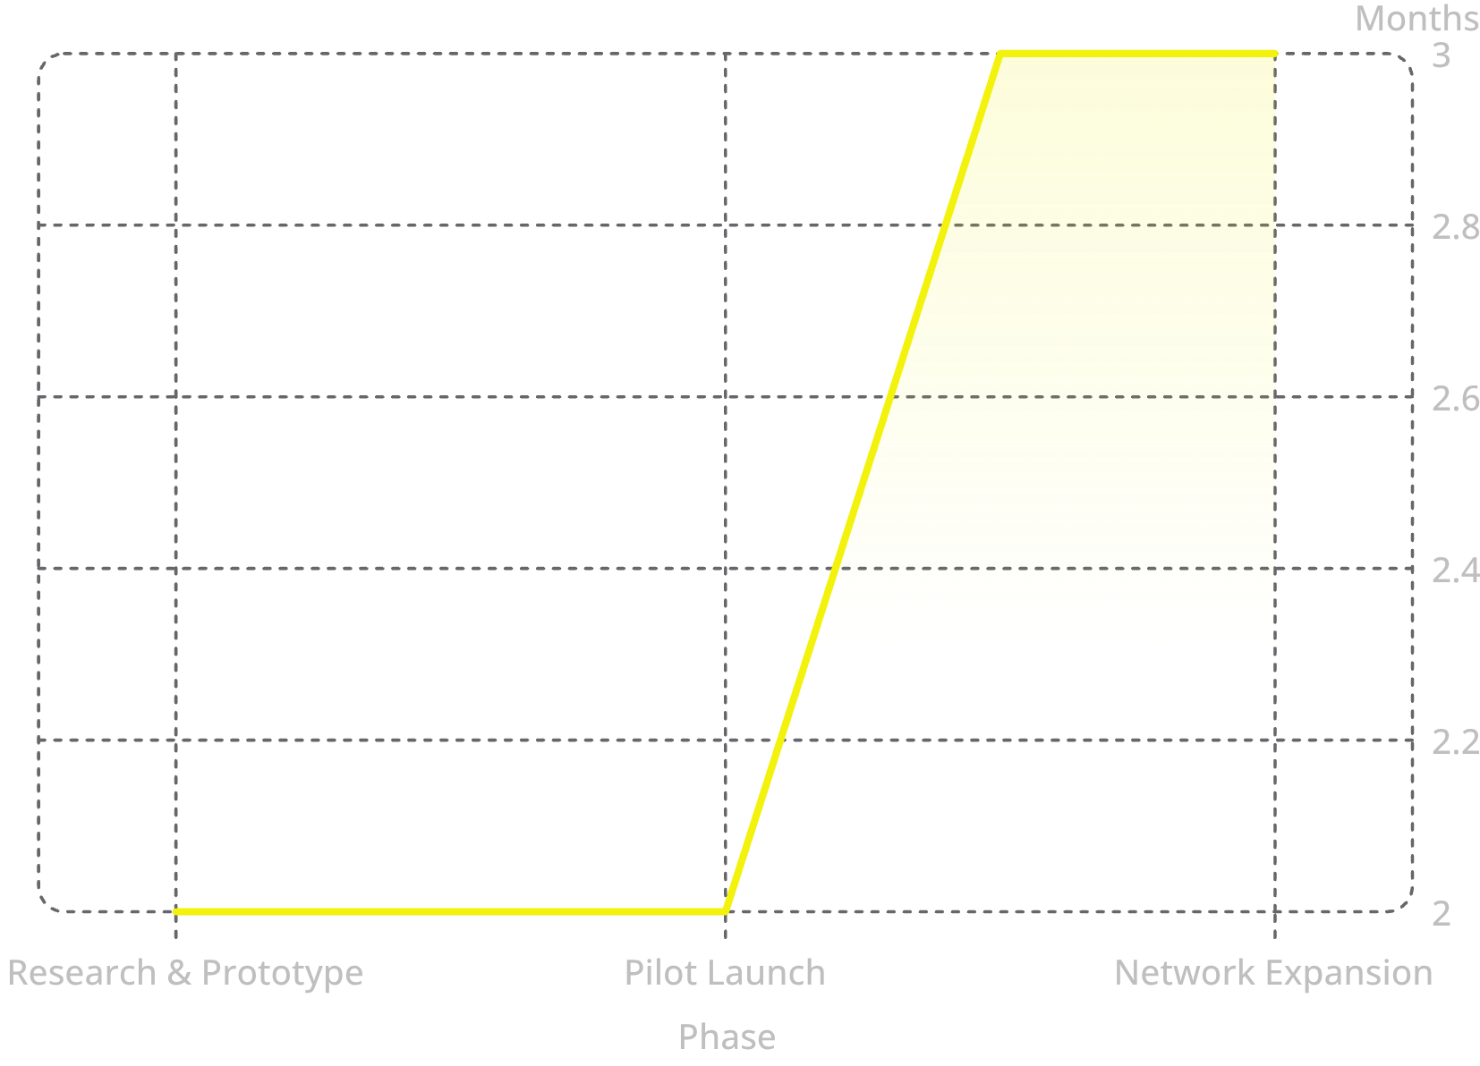
A Circular Business Model
Revenue Model
12‑Month Roadmap
Repair Commission
Parts Marketplace
Percentage per completed job.
Commission on recovered/refurbished component sales.
Service Plans
B2B Partnerships
Annual protection & priority repair subscriptions.
Lifecycle programs for campuses and SMBs.
Recycling Partnerships
Revenue-share with authorized recyclers.
Flow: Customer → REBOOT → Technician / Parts Partner → Repair → Revenue
Month 1–2: research • 3–4: MVP & technicians • 5–6: pilot • 7–9: marketplace & warranty • 10–12: scale network

Slide 5

Repair Is the New Recycling
♻️ LESS E‑WASTE
💰 LOWER COST
Extends device lifecycles; fewer materials landfilled.
Cheaper repairs vs replacement for end users.
🔧 MORE REPAIR JOBS
🌍 CIRCULAR ECONOMY
Local technician income and skills growth.
Keeps components in circulation; reduces raw extraction.
Impact pathway: REPAIR → REUSE → RECOVER → RECYCLE
Vision: Build a world where electronics are repaired before they are replaced.
REBOOT — Turn broken electronics from waste into opportunity.

