Slide 1
RESEARCH · MACHINE LEARNING · MICRO-EDM
Predicting Supporting-Boundary Circularity at Any Tool Position in Lattice EDM
Physics-informed Gradient Boosting · Gaussian Process data expansion · SEM-validated outcomes Interactive LatticeFlow analyzer for spatial circularity prediction
Lattice Circularity Analyzer Project · Premium Presentation Deck

Slide 2
Agenda
What this presentation covers
01
02
03
Problem & Geometry
SEM Evidence & Graphs
Ideation & ML Pipeline
Oversized tool on a fine lattice
16 runs, paradox, parameter effects
How prediction becomes possible
04
05
06
Train · Validate · Infer
LatticeFlow Website
Final Answers
Features, models, any-position path
Live analyzer UI walkthrough
Recommended EDM settings by zone
LatticeFlow · EDM Circularity Research
2 / 20

Slide 3
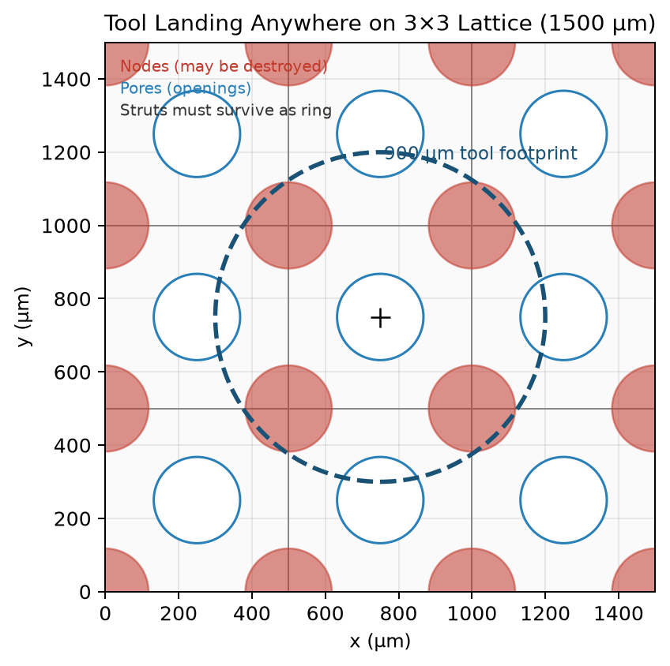
The Engineering Problem
900 µm tool vs 235.6 µm pore — ratio 3.82×
What must succeed
▸ Unit cell side = 500 µm
▸ Pore / node diameter ≈ 235.6 µm
▸ Tool tip diameter = 900 µm
▸ Tool overlaps pore + nodes + struts at once
▸ Supporting ring (black) must stay continuous & circular
▸ Nodes (red) may be destroyed — acceptable
▸ Need circularity ratio for ANY landing (x, y)
LatticeFlow · EDM Circularity Research
3 / 20

Slide 4
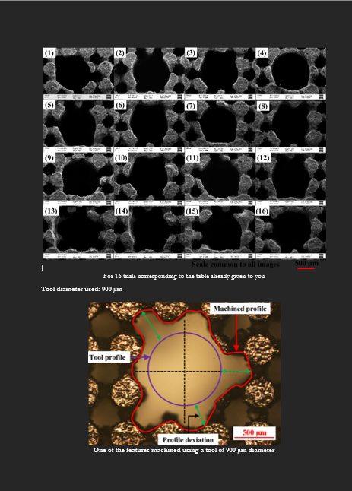
SEM Ground Truth
Only visual truth of supporting-boundary circularity
Key finding
▸ 16 lab EDM trials imaged by SEM
▸ ONLY Run 4 PASS
▸ 4 A · 150 µs · 80%
▸ 15 / 16 fail the ring test
▸ SEM > hole-deviation metrics
▸ ML must maximize SEM circularity
LatticeFlow · EDM Circularity Research
4 / 20

Slide 5
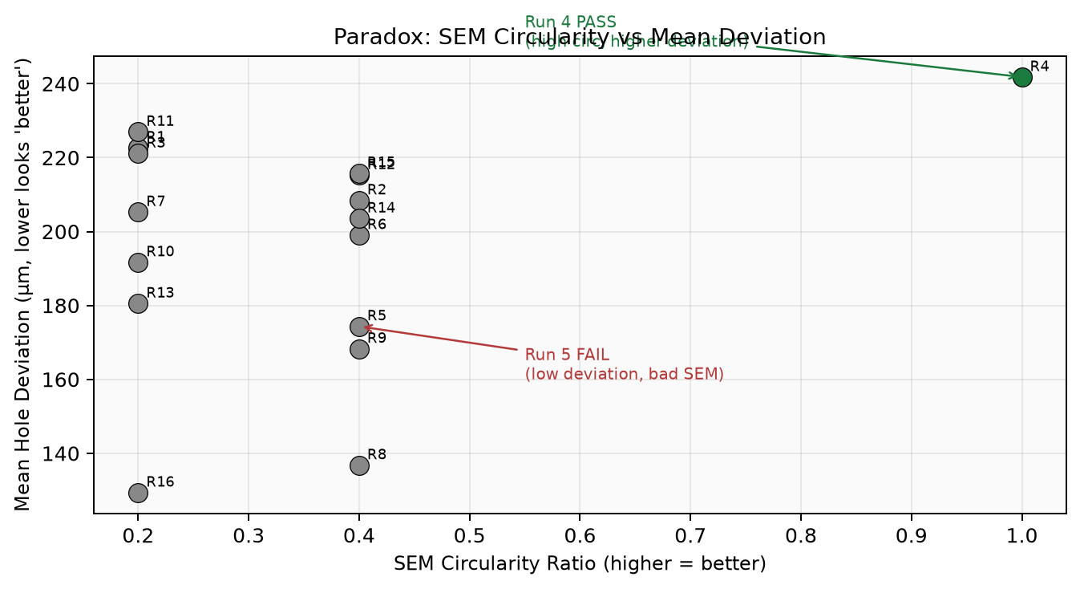
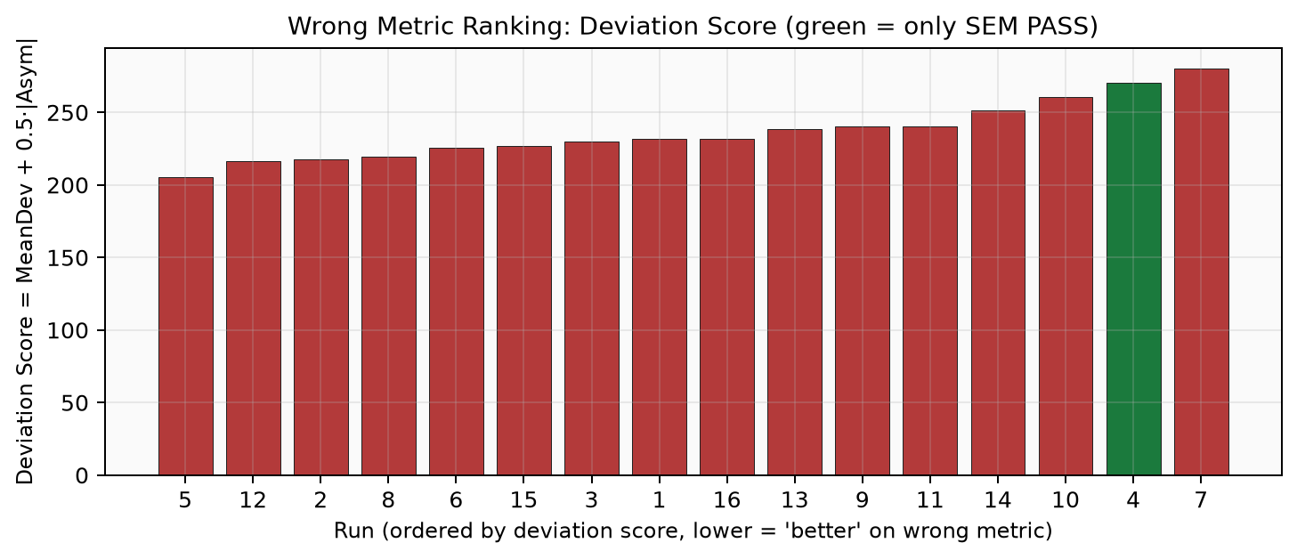
The Central Paradox
Best numerical deviation ≠ best supporting ring
Run 5 (6 A, 50 µs, 64%) wins deviation ranking but FAILS SEM · Run 4 (4 A, 150 µs, 80%) is near-worst by deviation yet is the ONLY PASS
LatticeFlow · EDM Circularity Research
5 / 20

Slide 6
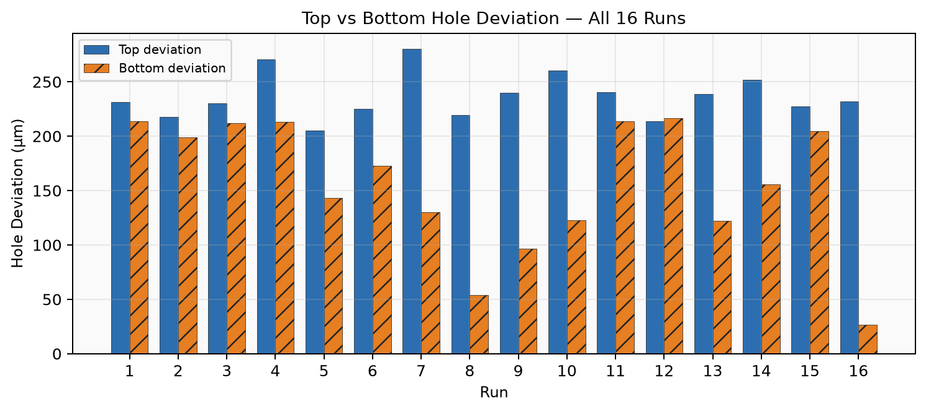
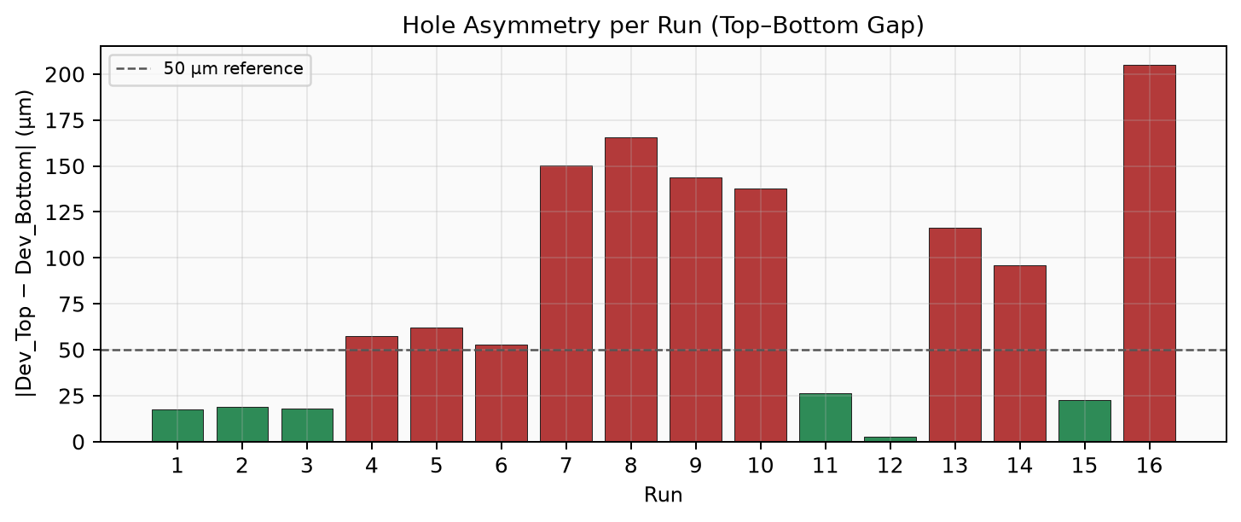
Experimental Graphs — Top/Bottom Deviation & Asymmetry
LatticeFlow · EDM Circularity Research
6 / 20

Slide 7
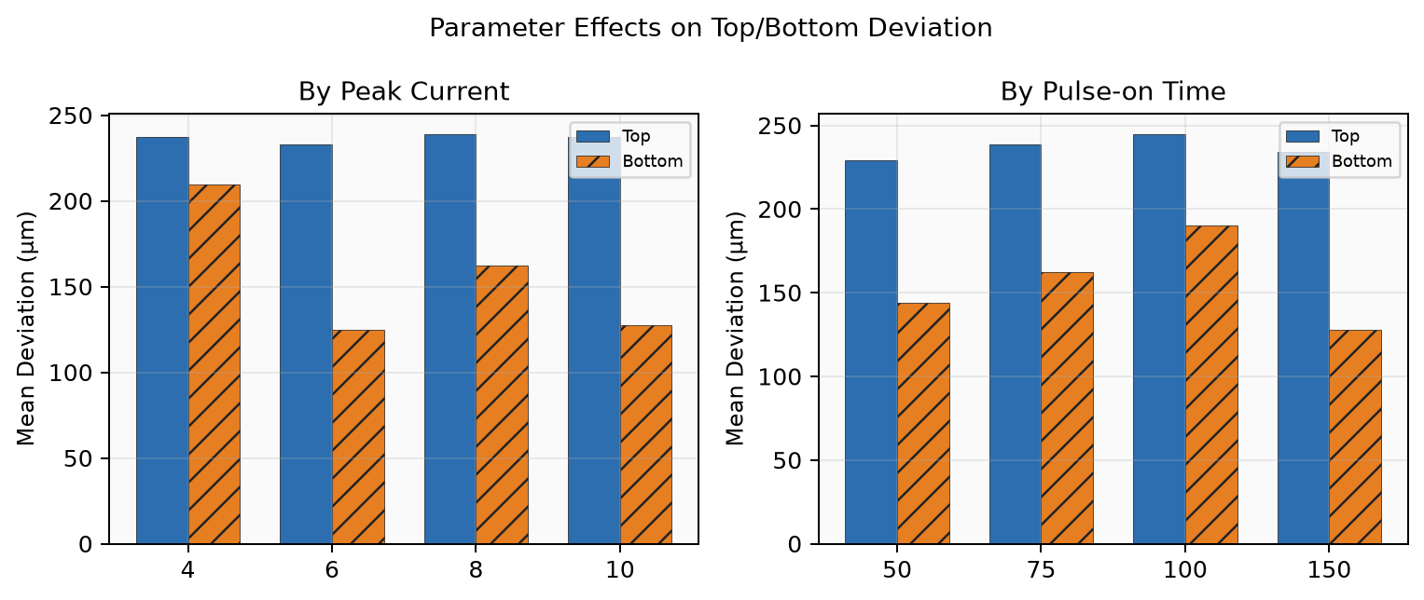
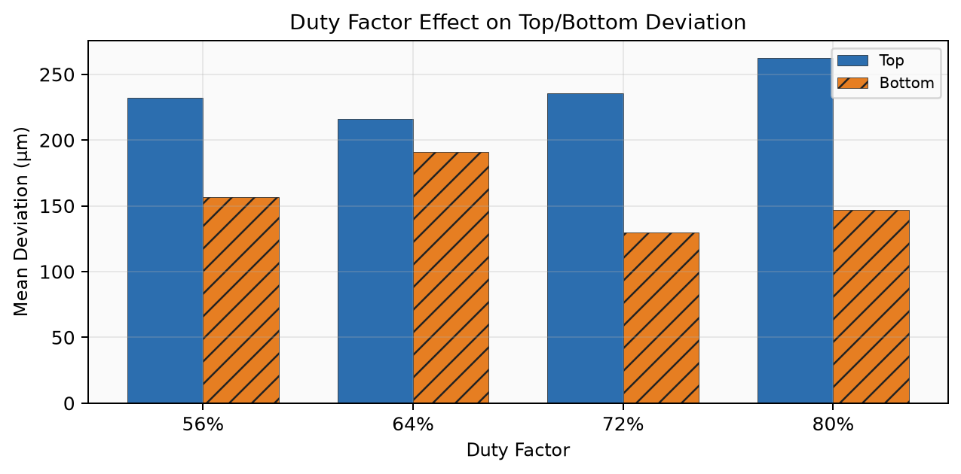
Parameter Effects
How current, pulse-on, and duty shape deviation
LatticeFlow · EDM Circularity Research
7 / 20

Slide 8
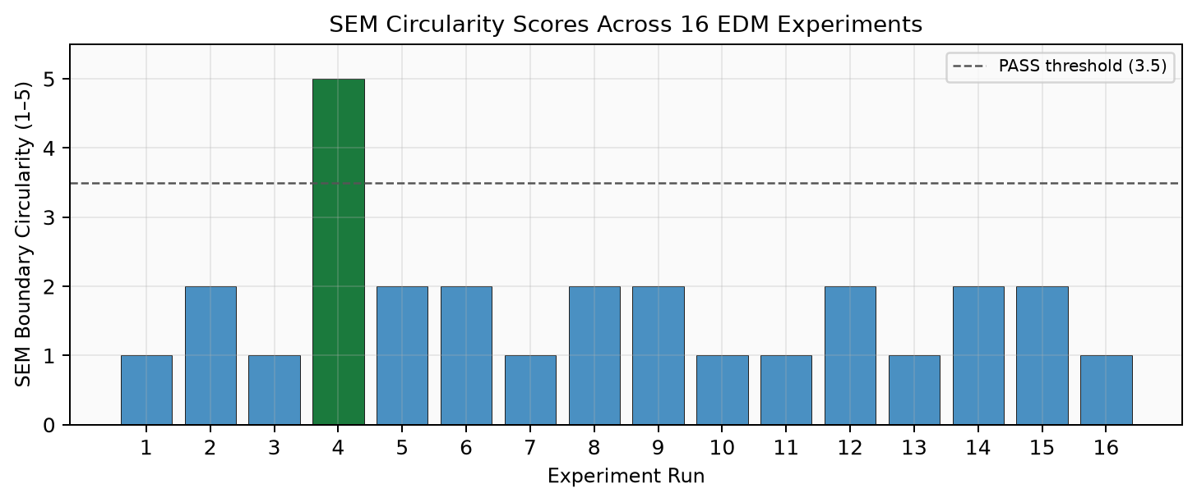
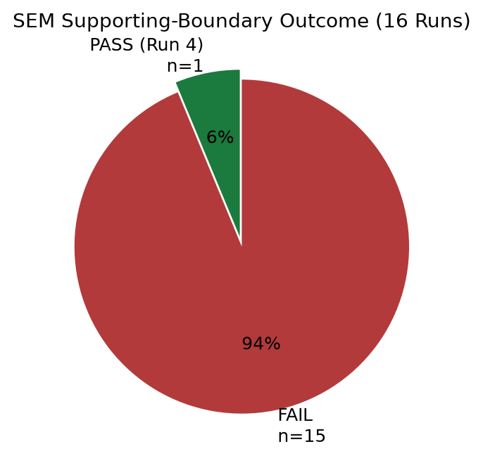
SEM Circularity Outcomes
Pass/fail distribution across the DOE
LatticeFlow · EDM Circularity Research
8 / 20

Slide 9
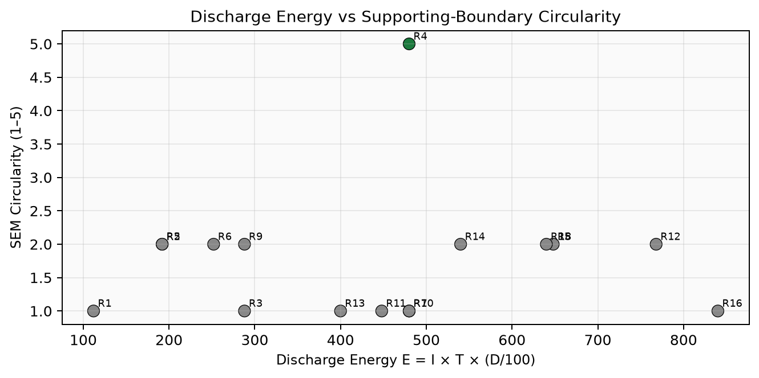
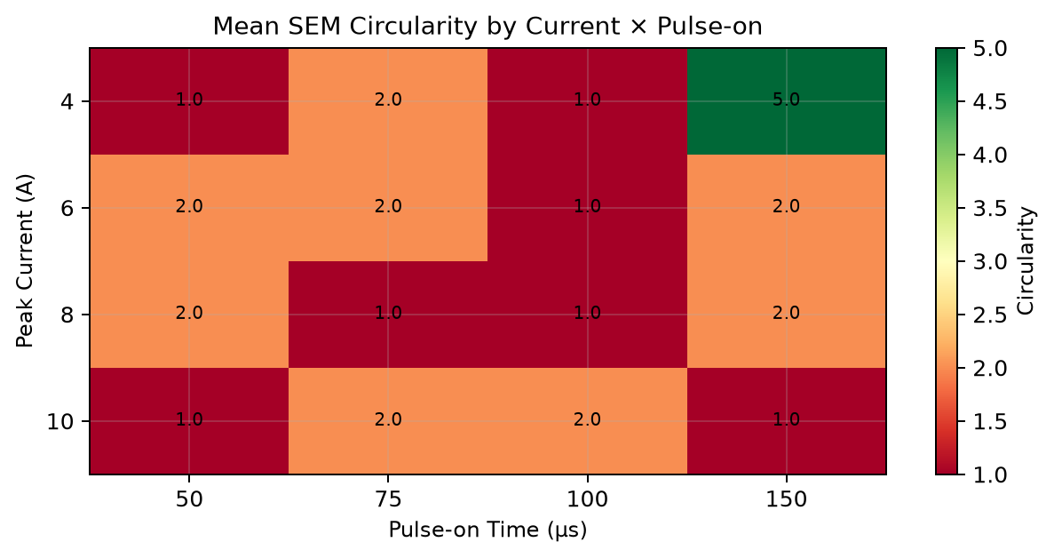
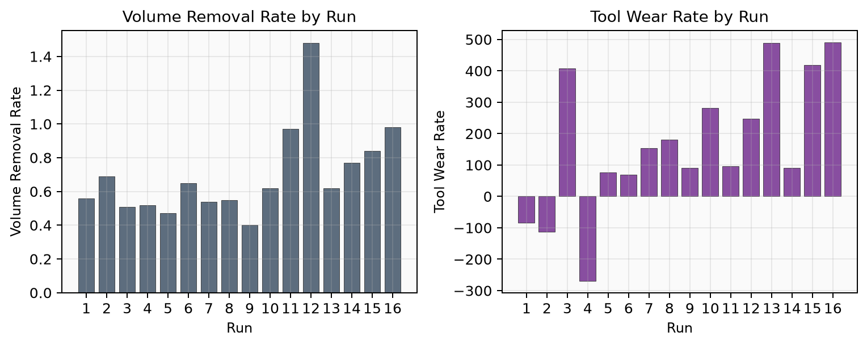
Energy, Heatmap & Process Responses
LatticeFlow · EDM Circularity Research
9 / 20

Slide 10
Ideation — Working Mind of the Solution
Circularity = process intensity × local geometry
Idea 1 — SEM objective
Idea 2 — Geometry features
Idea 3 — Sparse-data expansion
▸ Train on supporting-ring circularity
▸ Do NOT minimize Hole_Dev alone
▸ Run 5 is the wrong optimum
▸ Run 4 is the reference success
▸ Tool footprint vs struts/nodes
▸ Distances, overlaps, intersection
▸ Geometry risk index ∈ [0,1]
▸ Same recipe, different (x,y) outcome
▸ GP posterior → 1,100 EDM synthetics
▸ 16 × landing grid → ~400 rows
▸ Risk-modulated SEM label replay
▸ Physics blend at inference time
LatticeFlow · EDM Circularity Research
10 / 20

Slide 11
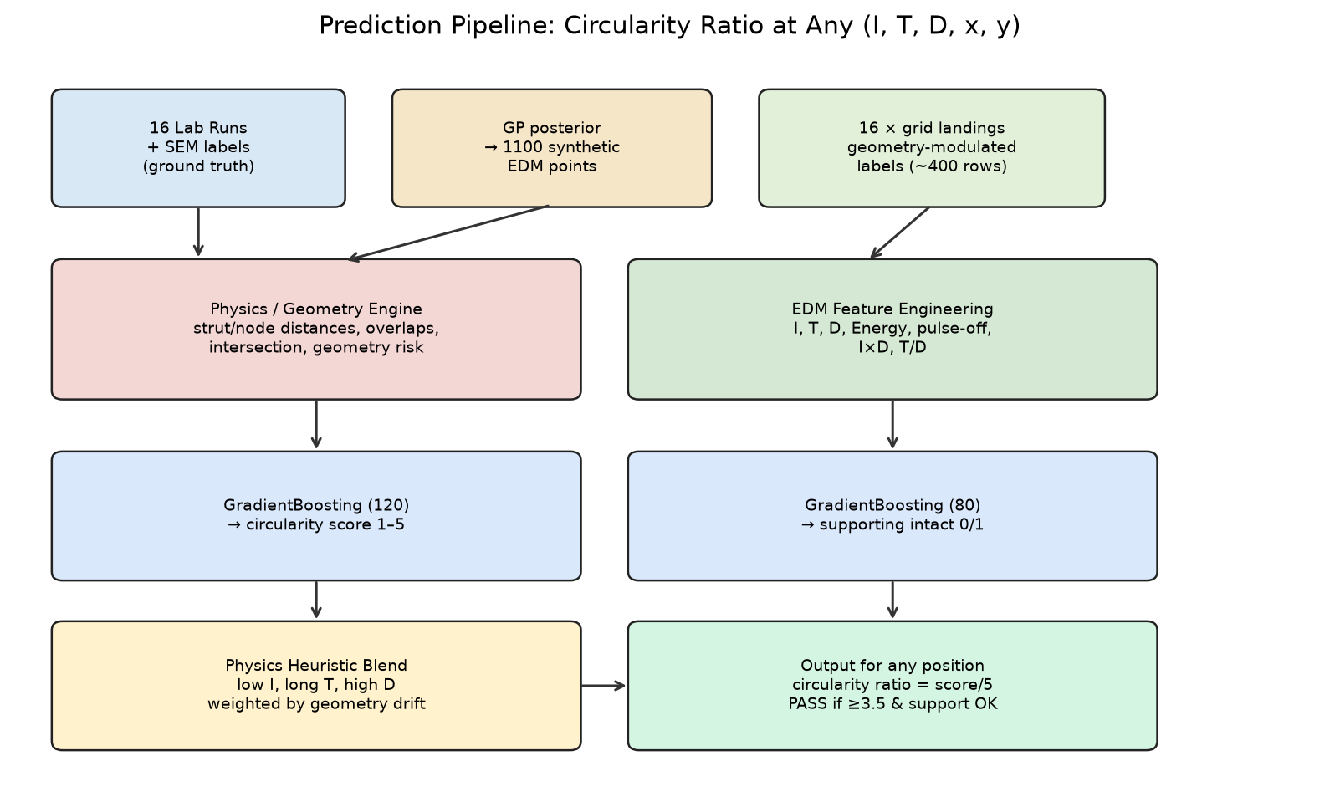
End-to-End Prediction Pipeline
LatticeFlow · EDM Circularity Research
11 / 20

Slide 12
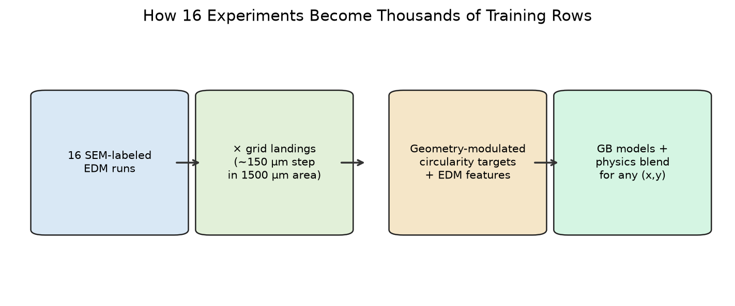
From 16 Experiments to Trainable Data
▸ Augmentation A: Gaussian Process posterior sampling densifies (I, T, D) space → 1,100 synthetics (tagged GP_posterior; not new lab trials)
▸ Augmentation B: each SEM label replayed on ~25 landings → c_train = clip(c_SEM − 2.5·geometry_risk + edm_bonus, 1, 5)
▸ Result: models learn that gentle recipes degrade when the oversized tool sits on dense strut intersections
LatticeFlow · EDM Circularity Research
12 / 20

Slide 13
Machine Learning Detail
Features · models · train · validate · blend
20-D Feature Vector
Algorithms
Inference Blend
▸ EDM (7): I, T, D, Energy, pulse-off, I·D, T/D
▸ Geometry (13): x/W, y/W, distances,
▸ nodes/pores in tool, strut length,
▸ overlaps, geometry risk, ratio, W, tool Ø
▸ Targets: score 1–5 + support 0/1
▸ Ratio reported as score / 5
▸ GBR circularity: 120 trees, depth 4
▸ GBR supporting: 80 trees, depth 3
▸ GP Matérn 5/2 + WhiteKernel on 16 SEM
▸ Ridge poly LOOCV → MAE ≈ 1.02 / 5
▸ Shallow trees limit small-n overfitting
▸ GP ranks μ + 0.15·σ candidates
▸ c = (1−w)·c_ML + w·c_H
▸ w rises if tool/pore drifts from lab
▸ Heuristic encodes gentle vs blast rules
▸ PASS: c≥3.5, support OK, risk≤0.55
▸ Consistency tests replace huge holdout
▸ SEM remains ultimate acceptance
LatticeFlow · EDM Circularity Research
13 / 20

Slide 14
Predict Circularity Ratio for Any Position
Runtime path for query (I, T, D, x, y)
1
Geometry pass
2
Feature build
3
ML forward
analyze_position(x,y) → risk & overlaps
Concatenate 7 EDM + 13 geometry = 20-D
GBR score + supporting probability
4
Heuristic
5
Blend
6
Report
Gentle/aggressive rules + risk penalty
Drift-weighted mix of ML and physics
Score, ratio=score/5, PASS/FAIL
LatticeFlow · EDM Circularity Research
14 / 20

Slide 15
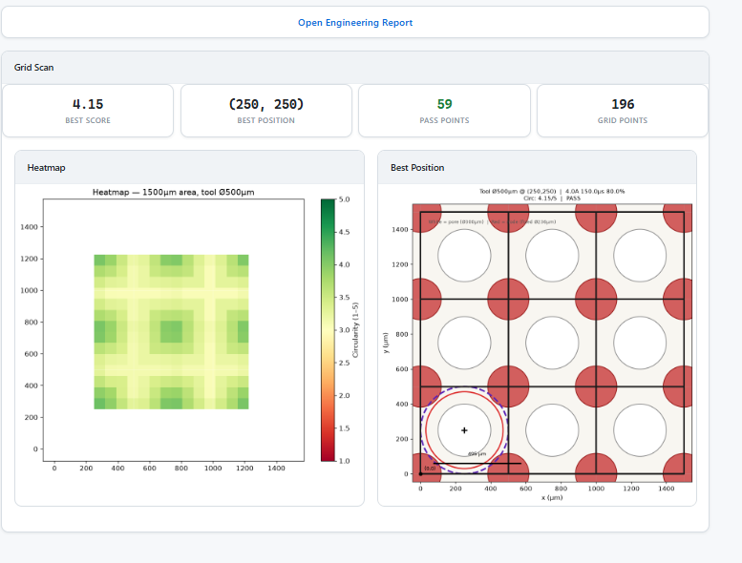
LatticeFlow Website — Overview
Interactive circularity analyzer deployed for engineers
▸ Enter EDM parameters: I, T, duty
▸ Set tool / pore / working area geometry
▸ Choose landing position (x, y)
▸ Get circularity score, ratio, PASS/FAIL
▸ Run full-grid heatmap scans
▸ AI recommends best landing position
▸ Auto engineering report + chat assistant
▸ Supports additional tool shapes
LatticeFlow · EDM Circularity Research
15 / 20

Slide 16
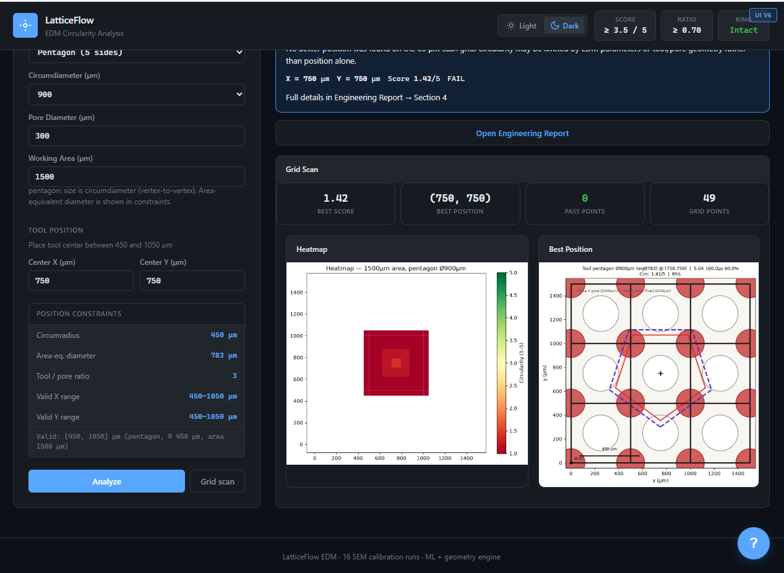
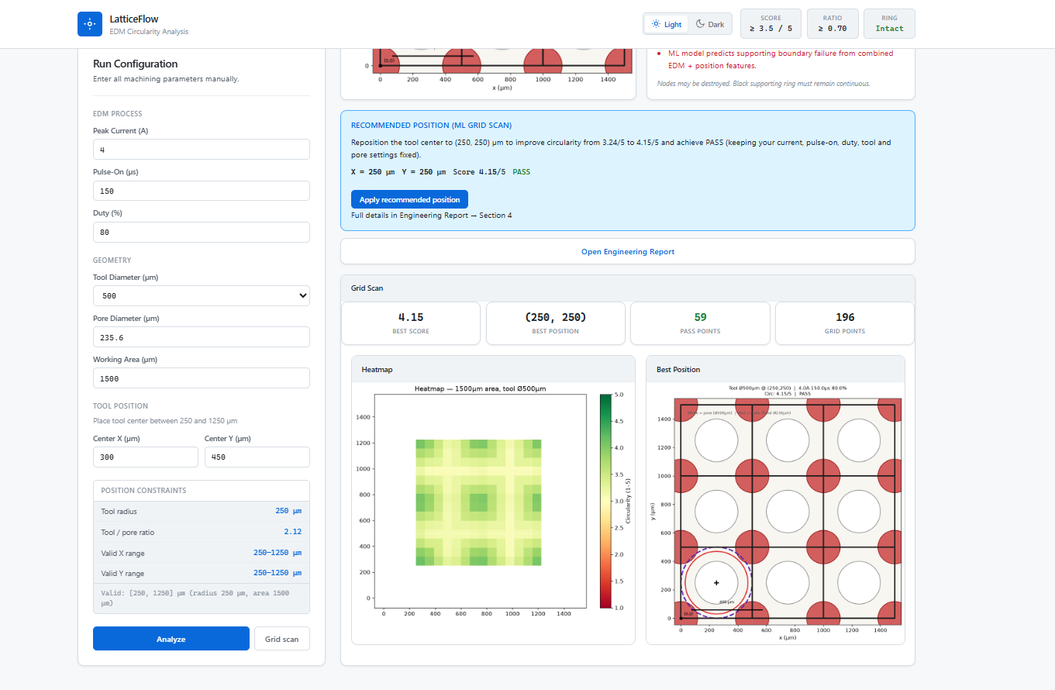
Website — Grid Scan & AI Best Position
LatticeFlow · EDM Circularity Research
16 / 20

Slide 17
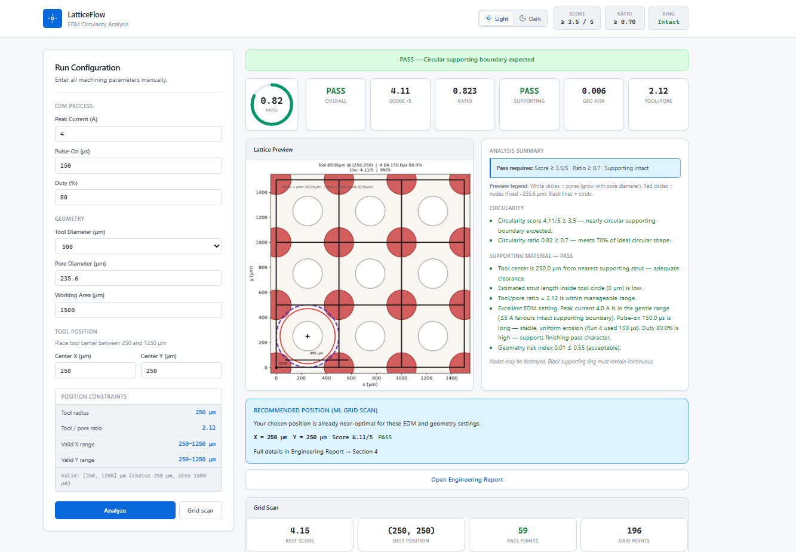
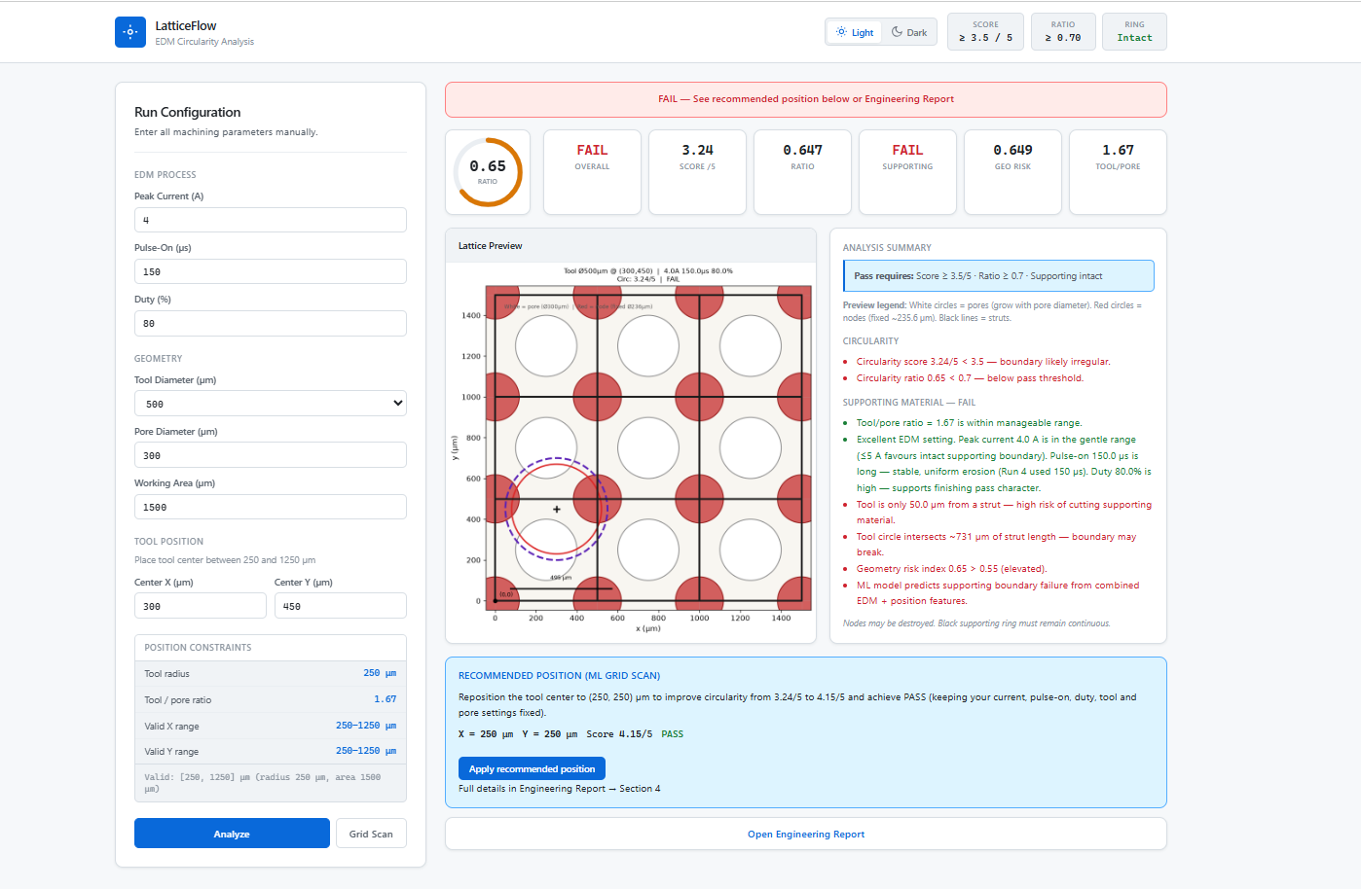
Website — PASS / FAIL Circularity Detection
PASS gates: circularity ≥ 3.5/5 · ratio ≥ 0.70 · supporting intact · geometry risk ≤ 0.55
LatticeFlow · EDM Circularity Research
17 / 20

Slide 18
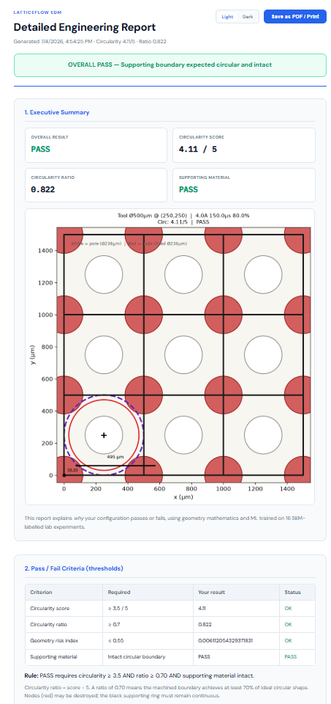
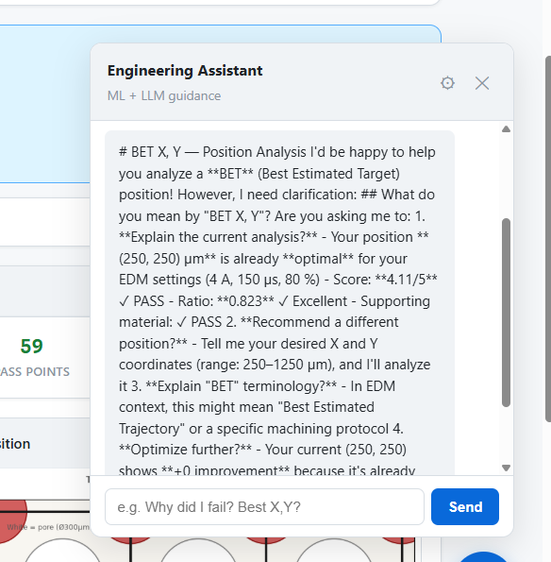
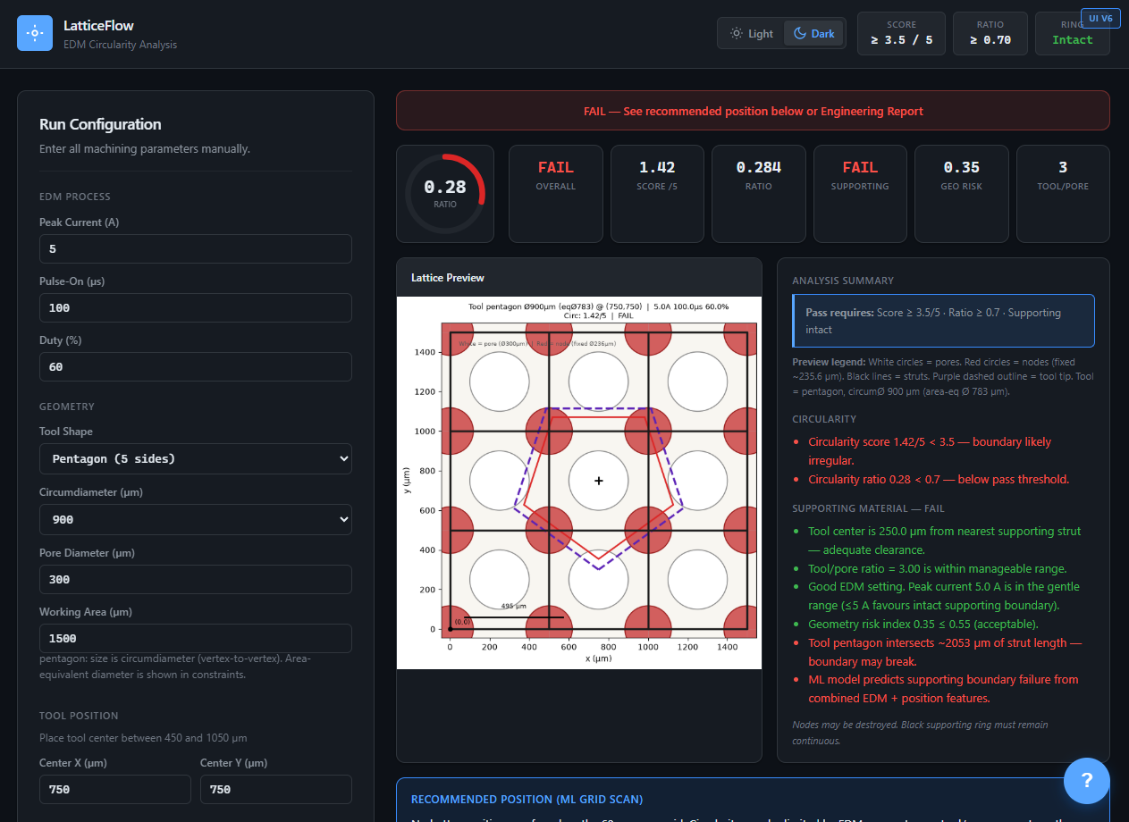
Website — Report, AI Assistant & Shape Analysis
LatticeFlow · EDM Circularity Research
18 / 20

Slide 19
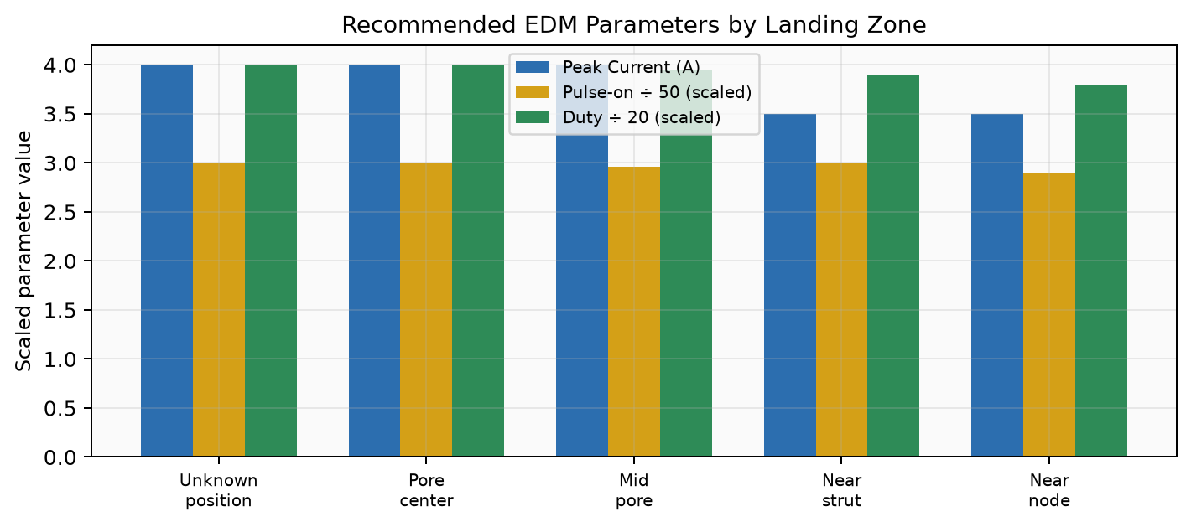
Final Recommended Parameters
SEM-informed answers by landing situation
Recommended settings
▸ Unknown position: 4 A, 150 µs, 80%
▸ Pore center: 4 A, 150 µs, 80%
▸ Mid pore: 4 A, 148 µs, 79%
▸ Near strut: 3.5 A, 150 µs, 78%
▸ Near node: 3.5 A, 145 µs, 76%
▸ Reject: 6 A, 50 µs, 64% (deviation-only)
▸ Pattern: low I + long T + high D
▸ Fine servo feed + stable flush
LatticeFlow · EDM Circularity Research
19 / 20

Slide 20
Conclusion & Thank You
SEM first — supporting-ring circularity beats hole-deviation metrics
Sparse → dense — GP synthetics + geometry-risk spatial label replay
Any position — 20-D features + GBR + physics blend → ratio at any (x,y)
LatticeFlow — heatmaps, PASS/FAIL, reports, and AI guidance in one tool
Questions & Discussion
PDF research paper + presentation decks are in the project repository Lattice Circularity Analyzer · LatticeFlow

