Slide 1
Physics-Informed Machine Learning for Predicting Supporting-Boundary Circularity at Any Tool Position in Micro-EDM of Metallic Lattices
Research Presentation · SEM Validation · Gradient Boosting · Gaussian Processes
Lattice Circularity Analyzer Project Team

Slide 2
Agenda
• Problem: oversized EDM tool on a fine metallic lattice
• Experimental evidence from 16 SEM-labeled runs (graphs)
• Ideation: circularity = process intensity × local geometry
• How 16 experiments become a trainable dataset
• Machine learning in detail — features, models, train/validate
• Predicting circularity ratio for any (I, T, D, x, y)
• Final recommended parameters and conclusions
Lattice EDM Circularity — Research Presentation | 2/18

Slide 3
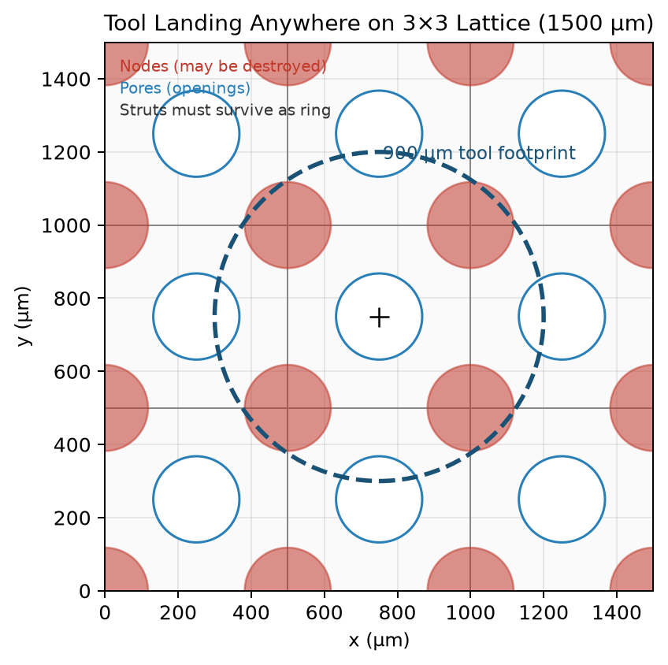
The Problem
• Unit cell = 500 µm; pore/node Ø ≈ 235.6 µm
• EDM tool tip = 900 µm → tool/pore ratio = 3.82
• Tool always hits pores + nodes + supporting struts together
• Goal: continuous nearly circular supporting ring
• Nodes may be destroyed — that is acceptable
• Hole-deviation numbers alone mislead (Run 5 paradox)
• Need: predict circularity ratio at any landing (x, y)
Lattice EDM Circularity — Research Presentation | 3/18

Slide 4
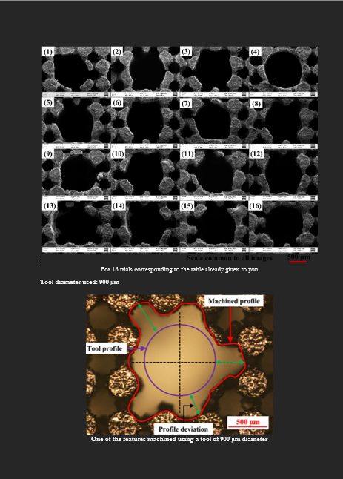
SEM Ground Truth — 16 Experiments
• Only Run 4 PASS: 4 A, 150 µs, 80%
• 15 / 16 runs destroy or irregularize the ring
• SEM is the true success metric
• Deviation ranking ≠ SEM ranking
Lattice EDM Circularity — Research Presentation | 4/18

Slide 5
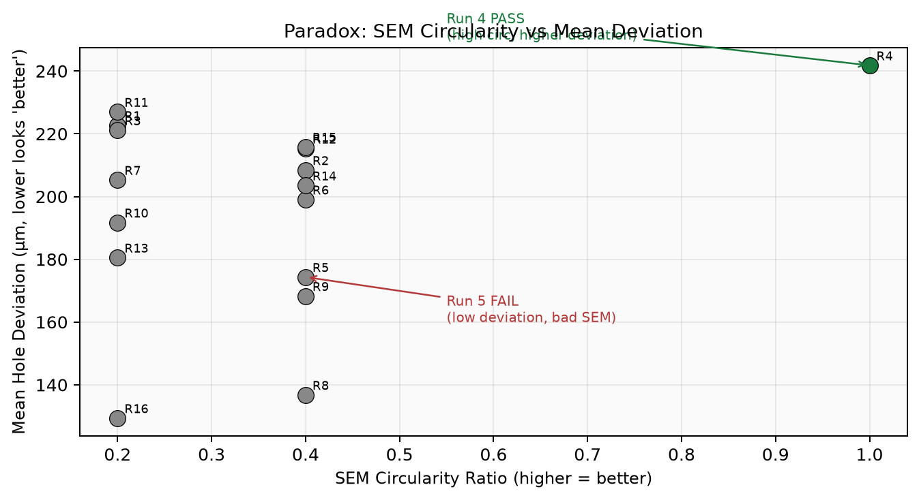
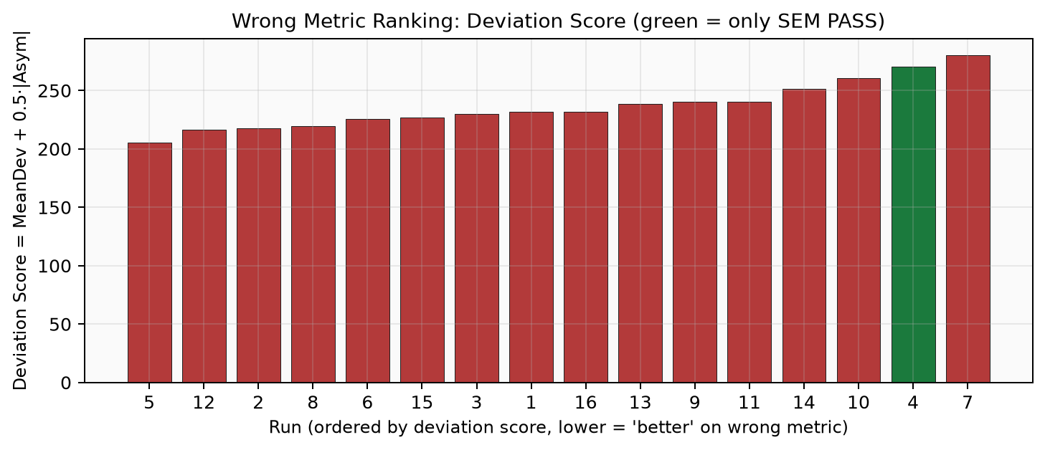
The Central Paradox (Graphs)
Run 5: best deviation score → FAIL SEM | Run 4: near-worst deviation → ONLY PASS
Lattice EDM Circularity — Research Presentation | 5/18

Slide 6
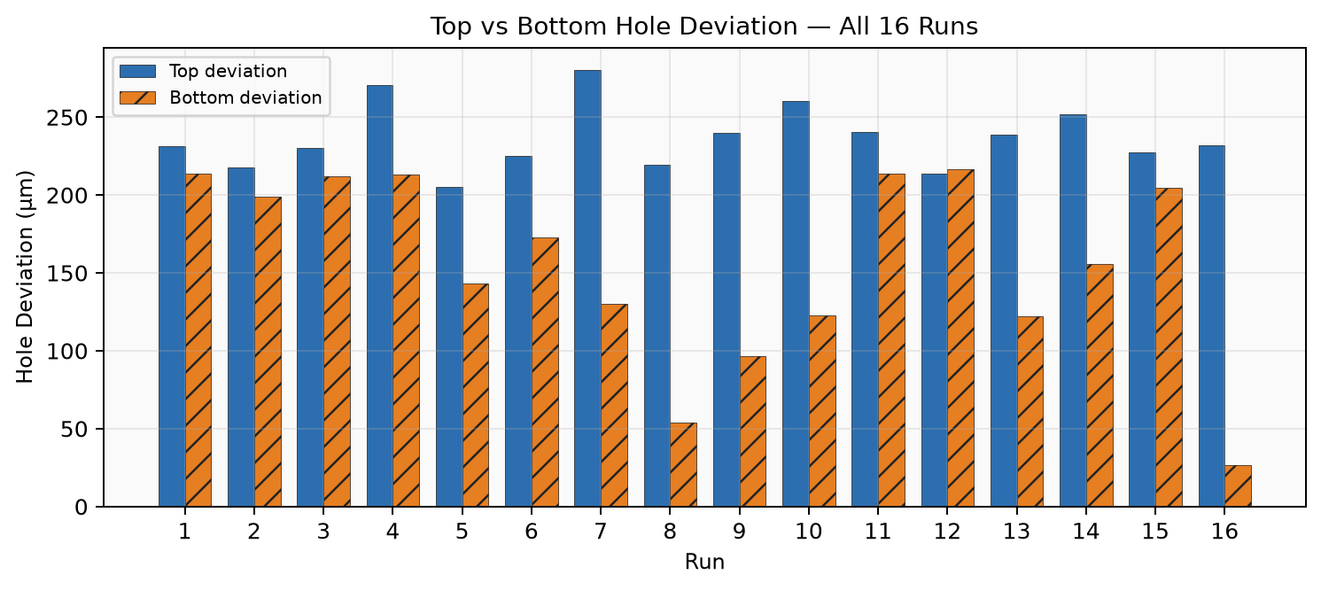
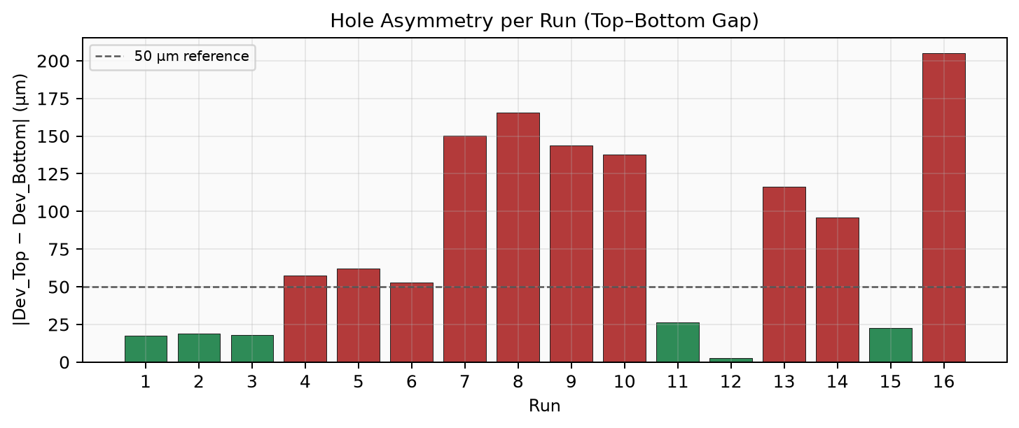
Experimental Graphs — Deviation & Asymmetry
Lattice EDM Circularity — Research Presentation | 6/18

Slide 7
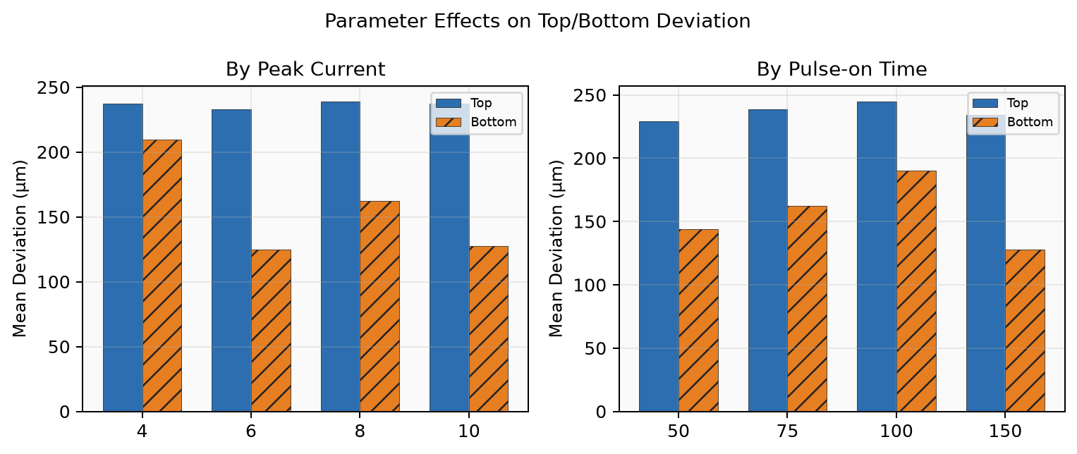
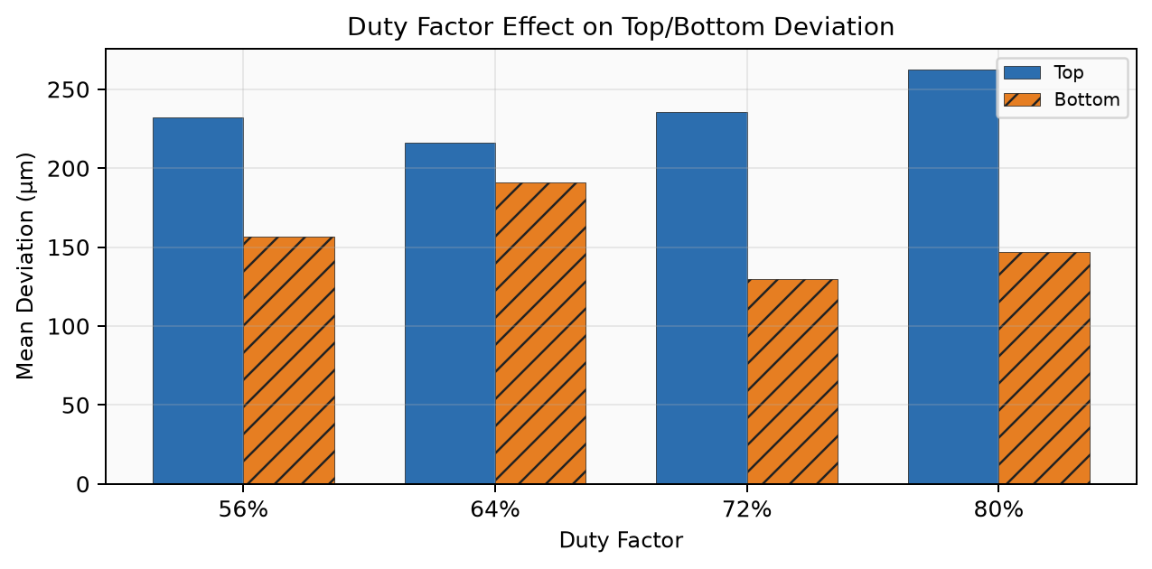
Parameter Effects on Deviation
Lattice EDM Circularity — Research Presentation | 7/18

Slide 8
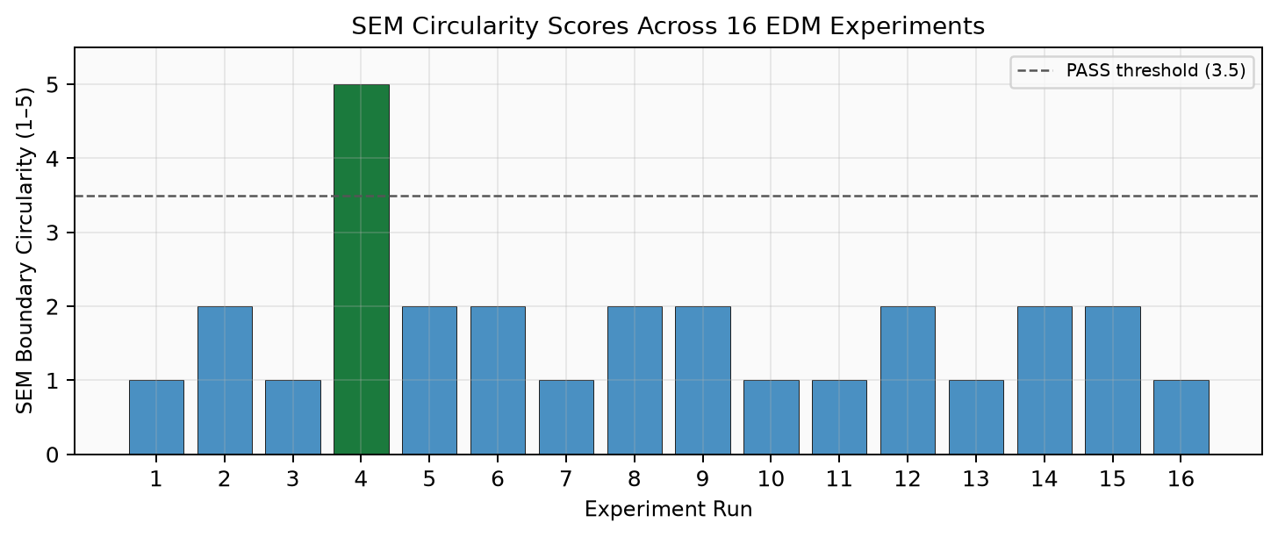
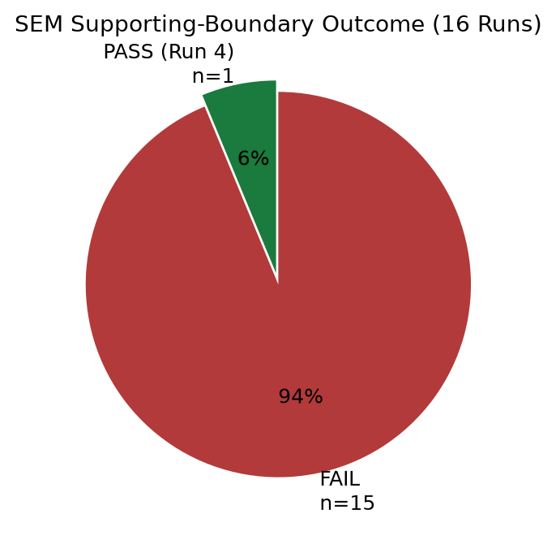
SEM Circularity Outcomes
Lattice EDM Circularity — Research Presentation | 8/18

Slide 9
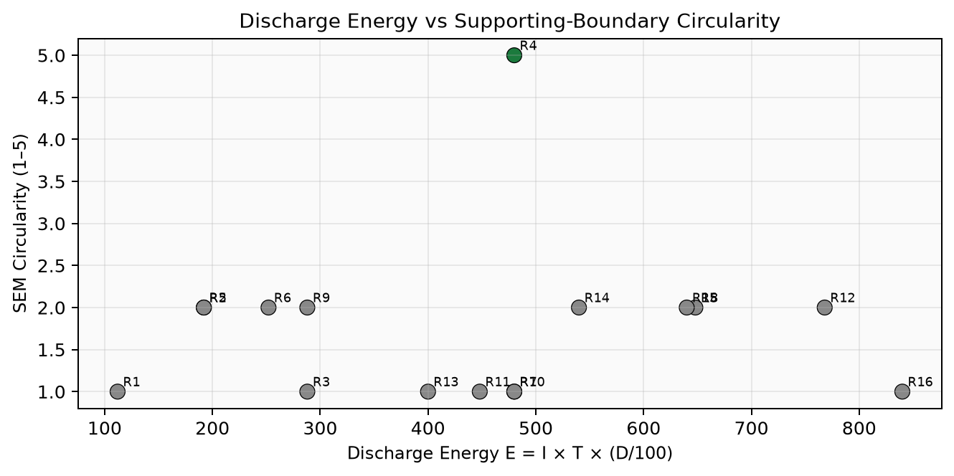
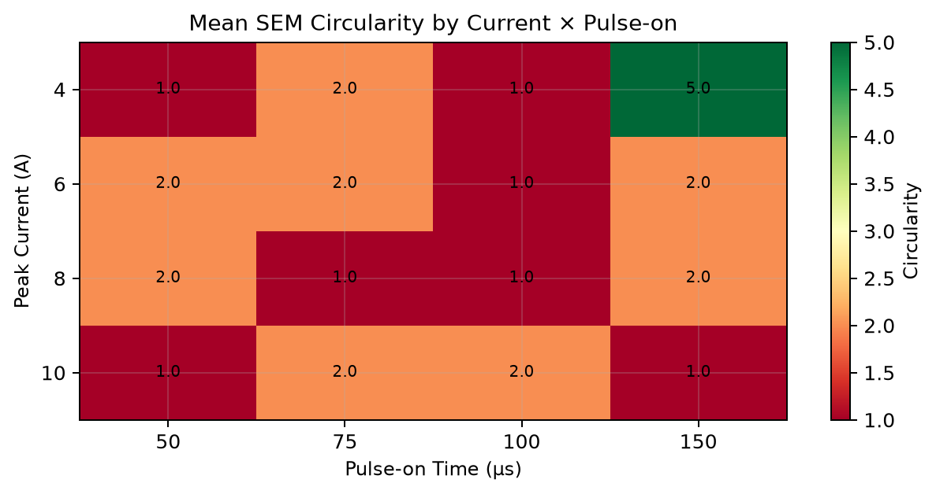
Energy & Current × Pulse-on Patterns
Lattice EDM Circularity — Research Presentation | 9/18

Slide 10
Ideation — The Working Mind of the Solution
• Idea 1: Train on SEM boundary truth — not hole-deviation proxies
• Idea 2: Geometry is a first-class feature (strut/node overlap under the tool)
• Idea 3: Expand sparse lab truth with physics-structured data (GP + spatial replay)
• Circularity = joint effect of EDM intensity AND local lattice geometry at (x, y)
• Same recipe can PASS at pore center and FAIL near a strut
Lattice EDM Circularity — Research Presentation | 10/18

Slide 11
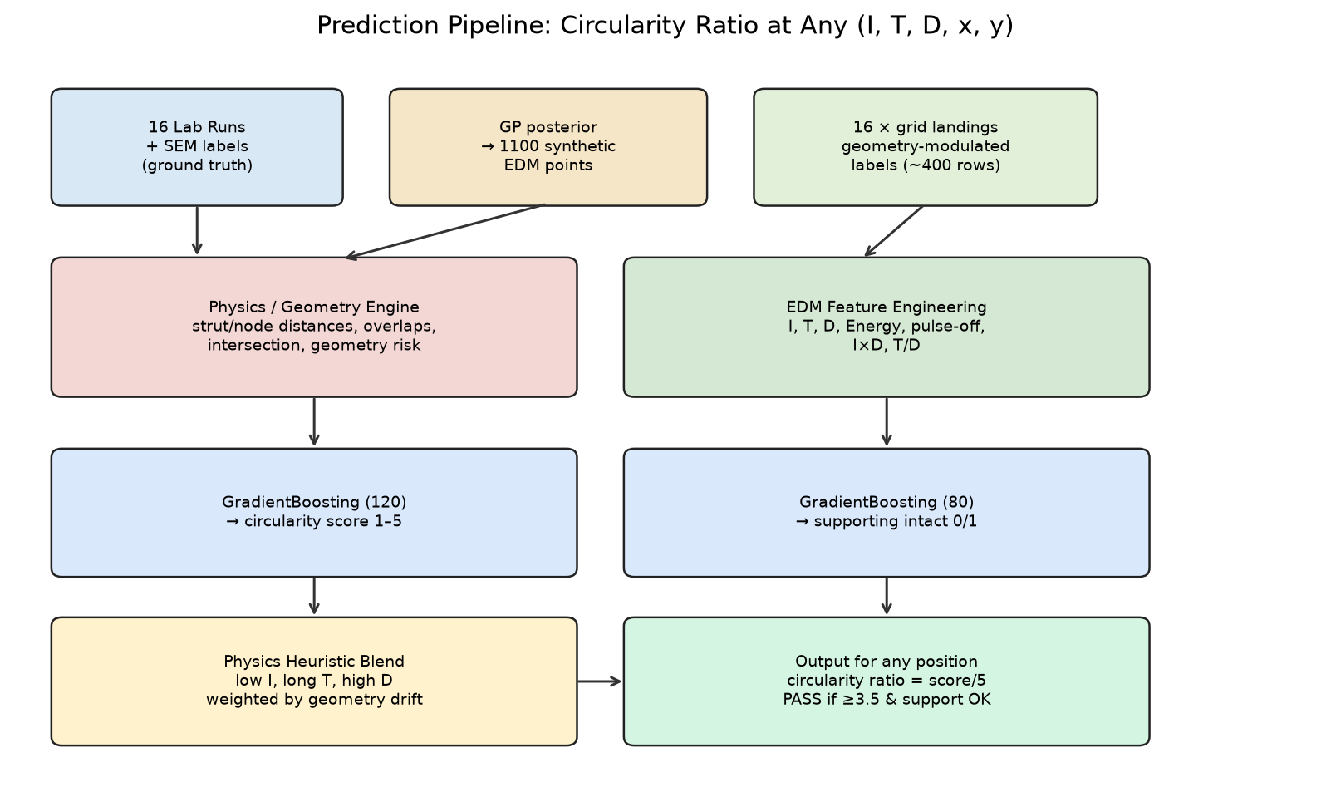
Prediction Pipeline
Lattice EDM Circularity — Research Presentation | 11/18

Slide 12
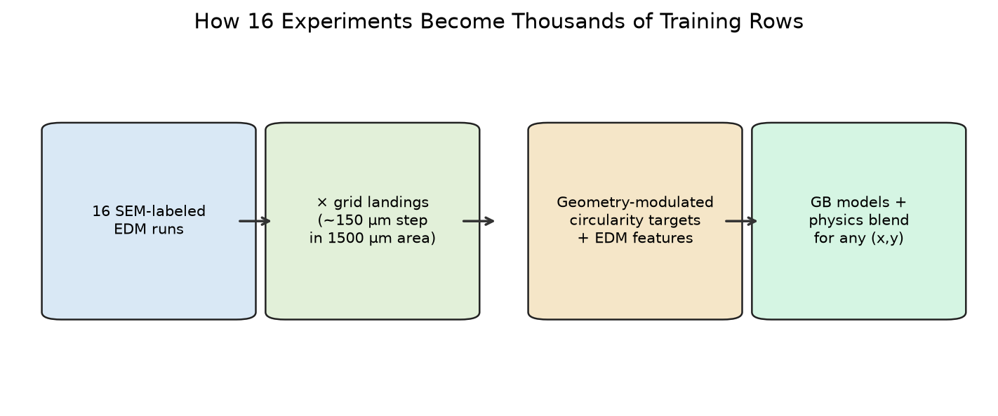
From 16 Experiments → Trainable Data
• Augmentation A: Gaussian Process posterior → 1,100 synthetic EDM points (not new lab trials)
• Augmentation B: 16 SEM labels × ~25 landings → ~400 position-aware rows
• Label rule: c_train = clip(c_SEM − 2.5·geometry_risk + edm_bonus, 1, 5)
Lattice EDM Circularity — Research Presentation | 12/18

Slide 13
ML Features — 20-D Vector
• EDM block (7): I, T, D, Energy E=I·T·D/100, pulse-off proxy, I·D, T/D
• Geometry block (13): x/W, y/W, dist to strut/node, nodes/pores in tool, strut intersection, overlaps, geometry risk, tool/pore ratio, working area, tool Ø
• Why: trees can split on intensity AND local damage exposure
• Same (I,T,D) with different (x,y) → different prediction
• Targets:
• A) Circularity score c ∈ [1,5] from SEM
• B) Supporting intact s ∈ {0,1}
• Reported ratio = c / 5
• PASS if c ≥ 3.5, support OK, risk ≤ 0.55
• NOT trained to minimize Hole_Dev
Lattice EDM Circularity — Research Presentation | 13/18

Slide 14
Models, Training & Validation
• Gradient Boosting (circularity): 120 trees, max depth 4 → score 1–5
• Gradient Boosting (supporting): 80 trees, max depth 3 → threshold 0.5
• Gaussian Process (Matérn 5/2 + WhiteKernel) on 16 SEM labels to search robust (I,T,D)
• Polynomial Ridge LOOCV on 16 runs → MAE ≈ 1.02 / 5 (small-n honesty check)
• Train: load 16 runs → expand on landing grid → fit both GBRs → save joblib bundle
• Validate: LOOCV + consistency tests (gentle recipes peak at pore centers; I≥8 stays FAIL)
• Inference blend: c = (1−w)·c_ML + w·c_H, where w rises if tool/pore drifts from lab geometry
Lattice EDM Circularity — Research Presentation | 14/18

Slide 15
Predict Circularity Ratio for Any Position
• 1. Geometry pass at (x, y) → risk, distances, overlaps
• 2. Build 20-D feature row (EDM + geometry)
• 3. ML forward: circularity GBR + supporting GBR
• 4. Heuristic forward: gentle/aggressive rules + geometry risk
• 5. Blend with drift weight w
• 6. Report score, ratio = score/5, supporting OK, PASS/FAIL
• Repeat on a grid → spatial circularity field for fixed EDM settings
Lattice EDM Circularity — Research Presentation | 15/18

Slide 16
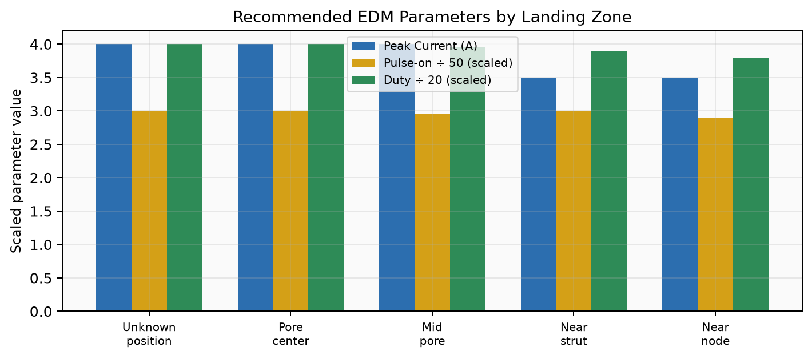
Final Recommended Parameters
• Unknown position (robust): 4 A, 150 µs, 80%
• Pore center: 4 A, 150 µs, 80%
• Mid pore: 4 A, 148 µs, 79%
• Near strut: 3.5 A, 150 µs, 78%
• Near node: 3.5 A, 145 µs, 76%
• Reject deviation-only: 6 A, 50 µs, 64%
• Pattern: low I + long T + high D
Lattice EDM Circularity — Research Presentation | 16/18

Slide 17
Conclusion
• SEM — not hole deviation — defines success for oversized-tool lattice EDM
• Winning pattern: low current + long pulse-on + high duty (Run 4)
• 16 labels become useful via GP synthesis + geometry-risk spatial replay
• 20-D EDM+geometry features + Gradient Boosting + physics blend enable any-position prediction
• Circularity ratio = score/5 is computable for any (I, T, D, x, y)
• Next: more SEM trials in the 3.5–4.5 A / 140–150 µs / 76–80% island
Lattice EDM Circularity — Research Presentation | 17/18

Slide 18
Thank You
Questions & Discussion

