Slide 1
Overview of CGE models
a

Slide 2
Economic models
a

Slide 3
Economic models
Using models often forces us to be clearer about our economic thinking
Can help us quantify the effects we anticipate from a policy change or in the future
Can force us to make our assumptions explicit, and allows us to evaluate the sensitivity of results to different assumptions

Slide 4
Different problems require different approaches
Single-equation (MVARs) approaches often best for very short-term analyses / bridge equations
Input-Output fixed coefficient models allow to break out impacts at very detailed level
Financial Programming models allow for significant detail, respect identities may have some limited behavioral qualities
Macro-econometric models suited for short-term judgment-assisted forecasting and macro simulation both at country and global level
Static CGE models allow detailed examination of all-in affects of policy changes (i.e. tax and trade policy changes)
Recursive Dynamic CGE models, as above plus well suited for examining long-term structural questions (China 2030, Climate change)
Dynamic Stochastic GE models good for financial policy simulations (IMF, Central Banks)
VARS / Now casting
SVARS
Structural Macroeconometric
DSGE
CGE
Input-Output
Financial Programing
Data driven
Theoretical purity

Slide 5
Different models have different strengths/weaknesses
VARS / SVARs
Widely used in ad hoc work and short-term data driven forecasting work (Used in IMF WEO; World bank GEP; academic working papers; and journals)
Advantages include:
Low data requirements, relatively easy to estimate
Good short-term forecasting properties
Good dynamic properties (when estimated using HF data)
Disadvantages include:
Generally require higher frequency data to be useful
Causality difficult to identify
Identification restrictions tend to be arbitrary and interpretation of results very sensitive to these

Slide 6
Different models have different strengths/weaknesses
Financial Programming models / Input-output models
Widely used in weak data environments and for budget planning and macro consistency work (IMF Financial Programming models; World Bank Debt models; WB RMSM-X)
Advantages:
Ensure consistency across modelled economic sectors
Causal chains relatively easily followed
Relatively easy to add detail, low technical requirements from users
Disadvantages:
Limited economic logic / behavior – tend to be highly linear
Often excel based which makes them error prone
Simulation properties tend to be weak due to fixed parameters

Slide 7
Different models have different strengths/weaknesses
Macro-structural models
Widely used to generate short-term forecasts (IMF: Multimod; OECD: Interlink; World Bank MFMod; US Federal Reserve FRB/US model)
Advantages include:
Interactions and causal chains easily to follow and disentangle
Historic forecast errors can be used to inform future
Allow forecasts to incorporate judgment
Decent inter-temporal tracking (length of time between a shock and full impacts)
Relatively low data requirements
Models with structural detail exist, but tend to be top-down rather than bottom up
Disadvantages include:
Behavior based on backward-looking regressions (Lucas critique)
Expectations tend to be irrational
Theoretical underpinnings not as well established as in other models

Slide 8
Different models have different strengths/weaknesses
Recursive Computable General Equilibrium
Tend to be used for long-term policy analysis (WBG Linkage, ENVISAGE, MAMS; OECD GREEN; GTAP Trade model etc)
Advantages:
Scalable, can have very or less detailed structure (derived from NIA input/output tables; GTAP project)
Computationally efficient
Allows analysis of how policies can change a country’s economic structure
Can often illuminate unexpected consequences because of multiple channels of interdependence
Disadvantages:
Relatively heavy data requirements
Calibrated and imposed (drawn from literature) behavioral coefficients rather than estimated
Not really suited for cyclical analysis / shocks – although models can be built that explicitly include cyclical behavior

Slide 9
Different models have different strengths/weaknesses
Dynamic Stochastic General Equilibrium models (various country-level IMF papers; G-Cubed)
Advantages:
Micro foundations well defined (firm and consumer optimization), all interlinkages mapped out
Account for inter-temporal optimization
Disadvantages:
Heavy data requirements
Tend to be best for shock-control analysis (unaided forecasts are often unreliable)
Computationally expensive (can take very long time to solve)
Can be difficult to trace out logic behind results because of influence of forward looking behavior
Combination of data and computational requirements means tend to be highly aggregated as compared with CGE models

Slide 10
CGE models
a

Slide 11
What are CGE models
Computable General Equilibrium models capture the interactions between economic agents (e.g. households, firms, governments and external sector) in a simplified way
Provide a snapshot of the economy in equilibrium where all agents are maximizing their utility/profit subject to constraints and markets clear
Supply-side dominates; size of economy determined by the factors of production
Usually run on specialized software: GAMS or Gempack

Slide 12
Flow of Payments
Factor Markets
domestic wages and rents
private investment financing
Households
private consumption
trnsfr+interest
dir taxes
lending
trnsfr-interest
factor demand
indir taxes
Government
gov cons and inv
Private Capital Account
intermediate input demand
trnsfr-interest
lending
Activities
lending
FDI
Domestic Commodity Markets
Rest of World
imports
domestic demand
exports
foreign wages and rents
private investment
Source: Lofgren et al

Slide 13
CGE Outputs
GDP by Expenditure
Government Fiscal Accounts
Other
Expenditure accounts: Y=C+I+G+ (X-M)
Current Account of Balance of Payments: X, M and net income payments
Agriculture, Industry, Services
Revenue sources
Employment by industry
GDP by Industry
Level of detail depends on data availability
Expenditure pattern
Government debt/asset holdings
Real Wages
Relative prices e.g. the price of agricultural commodities
Household consumption patterns

Slide 14
How CGE models can help
CGE models are well suited for estimating the economy-wide effects of policy reforms
Estimates the direct and indirect or flow-on effects of the policy change. E.g. removing a subsidy leads to more revenue and how this revenue is spent has different economic consequences
Captures how the long-term structure of the economy changes in response to government policy
Can be used to analyse distributional effects when combined with a microsimulation module
E.g. how will the income and welfare of a rural, low income household be affected?
Models are customized to the needs of policy analysts
Sectoral detail
Factors of production (e.g. natural resource in oil-rich countries, foreign workers etc)
Policy levers

Slide 15
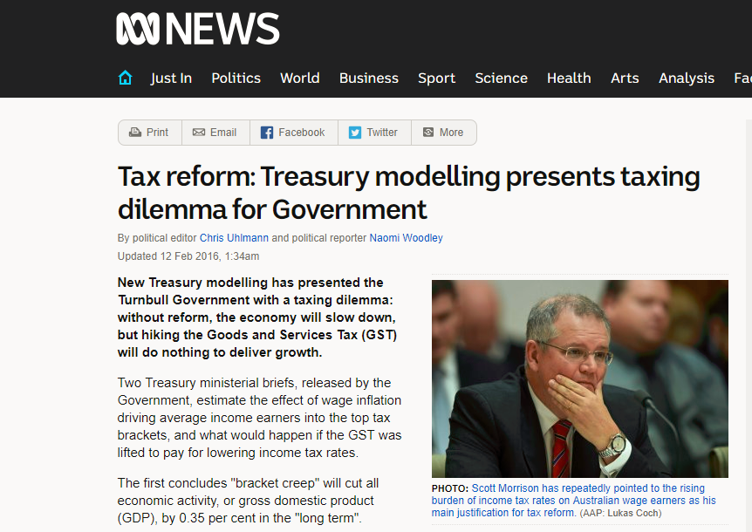
Often used by government to assess policy and generate debate

Slide 16
