Slide 1
Calibration a

Slide 2
Broad steps in model development
Model Design
Data collection
Data construction
Calibration and estimation
Coding
Validation
Steps 3 to 5 are illustrated in the GAMS file

Slide 3
Calibration
Calibrate model so that it provides a snapshot of the structure of the economy, under the assumption that the economy is in equilibrium
Choose elasticities of substitution from literature
Then use SAM data and first order conditions to calculate implied scale parameters
Other policy parameters, e.g. tax rates are also calibrated from the data and model’s equations
Thus, without any shocks, the model should replicate exactly the SAM in the base year

Slide 4
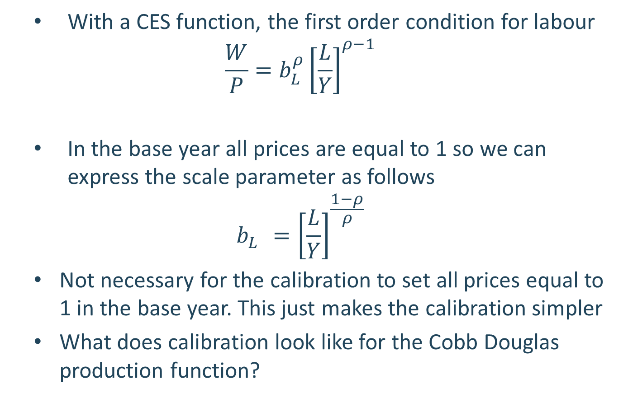
Calibration of CES
With a CES function, the first order condition for labour
$$\frac{W}{P}=b_{L}^{ρ}{\left[\frac{L}{Y}\right]}^{ρ−1}$$
In the base year all prices are equal to 1 so we can express the scale parameter as follows
$$b_{L}^{}={\left[\frac{L}{Y}\right]}^{\frac{1−ρ}{ρ}}$$
Not necessary for the calibration to set all prices equal to 1 in the base year. This just makes the calibration simpler
What does calibration look like for the Cobb Douglas production function?

Slide 5

Calibration of other equations
Tax rates:
$$τz_{j}≡\frac{Tz_{j}}{pz_{j}∙Z_{j}}$$
Expenditure shares:
$$μ_{j}≡\frac{Xg_{j}}{XXg }$$
Transfer rates:
$$τtr ≡\frac{Trf}{\sum_{h}{pf_{h}∙FF_{h}}}$$

