Slide 1
Simulations with the CGE model a

Slide 2
Policy analysis with CGE models
Lift in price level
Boost in factors of production
Boost TFP
Higher export prices

Slide 3
Interpreting results
For any policy analysis there are two simulations run using the CGE model
Baseline or business-as-usual case where there has been no change in policy
An alternative scenario where the policy change is implemented
Comparing the alternative scenario with the baseline scenario gives estimates of the impact of the policy change
Results are usually presented as percent deviation from baseline

Slide 4
Quick tips for policy analysis
Think about what you expect to happen first, then run the simulation in the model
Compare expectations with model results
Did the model allow for some interactions that you did not?
Is there an error with the model or the way the simulation is set up?
Consider the direct impacts of the shock first, then the follow-on or indirect impacts

Slide 5
Policy analysis with CGE models
Lift in price level
Boost in factors of production
Boost TFP
Higher export prices

Slide 6
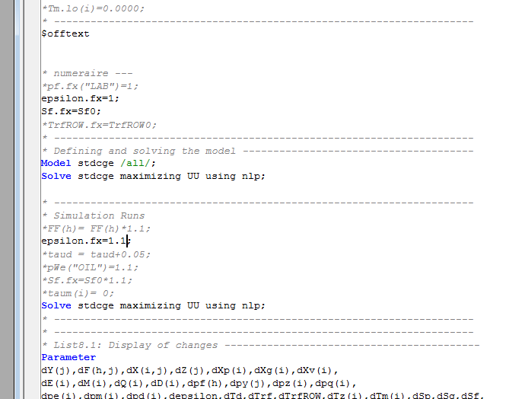
Entering the alternative scenario (#3 & #4)

Slide 7
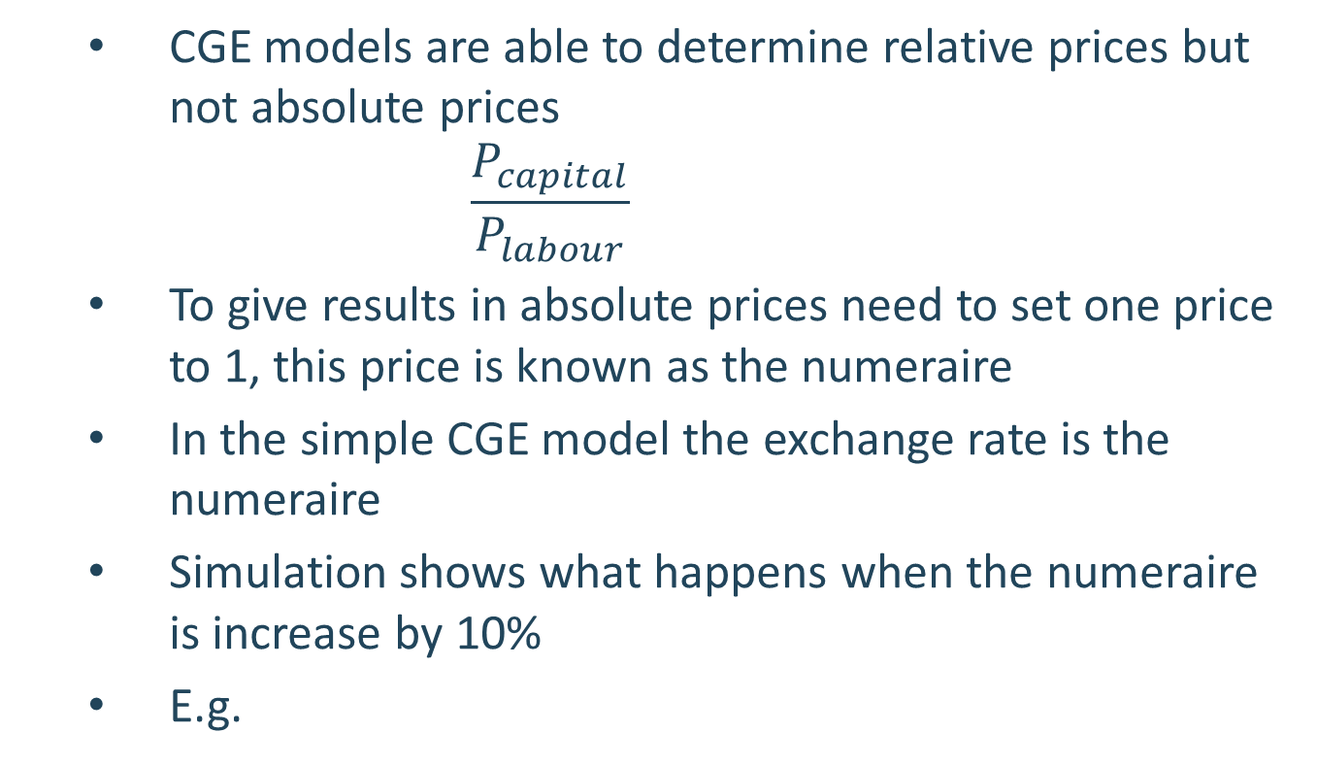
Lift in price level
CGE models are able to determine relative prices but not absolute prices
$$\frac{P_{capital}}{P_{labour}}$$
To give results in absolute prices need to set one price to 1, this price is known as the numeraire
In the simple CGE model the exchange rate is the numeraire
Simulation shows what happens when the numeraire is increase by 10%
E.g.

Slide 8
Lift in price level
Impact on key aggregates (% deviation from baseline)
 | Agriculture | Oil | Industry | Services | Total
Price of domestic sales | 10 | 10 | 10 | 10
Price of consumption | 10 | 10 | 10 | 10
Household Consumption | 0 | 0 | 0 | 0 | 0
Government Consumption | 0 | 0 | 0 | 0 | 0
Investment | 0 | 0 | 0 | 0 | 0
Exports | 0 | 0 | 0 | 0 | 0
Imports | 0 | 0 | 0 | 0 | 0

Slide 9
Lift in price level
Increasing the numeraire by 10% leads to all prices increasing by 10% but does not change volumes
No change to the composition of GDP by expenditure or GDP by industry
This is because there has been no change to relative price levels only a change in the absolute price level
No change in relative prices means that there is no change in the behavior of households or firms

Slide 10
Policy analysis with CGE models
Lift in price level
Boost in factors of production
Boost TFP
Higher export prices

Slide 11
Boost in factors of production
Simulation investigates what happens when we increase all inputs (natural resource, land, labour and capital) into production by 10%
A boost in the labour used in production is a proxy for policies which :
Lift female participation rates
Permanently lower unemployment rate

Slide 12
Boost in factors of production
A boost in capital is a proxy for policies which:
Lower the cost of investing domestically
Increase openness to foreign investment in KSA
A boost in the natural resource is a proxy for :
Discovery of new reserves
A boost in land is a proxy for :
Increases in the amount of arable land
In this simulation we boost all the factors of production by the same amount to illustrate some model properties

Slide 13
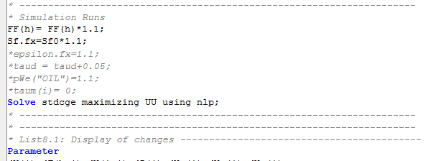
Entering the alternative scenario (#3 & #4)
Increase baseline inputs
Increase size of foreign saving

Slide 14
Double factors of production
Impact on key aggregates (% deviation from baseline)
 | Agriculture | Oil | Industry | Services | Total
Price of domestic sales | 0 | 0 | 0 | 0
Price of consumption | 0 | 0 | 0 | 0
Household Consumption | 10 | 10 | 10 | 10 | 10
Government Consumption | 10 | 10 | 10 | 10 | 10
Investment | 10 | 10 | 10 | 10 | 10
Exports | 10 | 10 | 10 | 10 | 10
Imports | 10 | 10 | 10 | 10 | 10

Slide 15
Double factors of production
CGE models generally display constant returns to scale production technology
So increasing all factors of production by 10% leads to a 10% increase of all outputs and no changes in prices
The structure of the economy has not changed since there has been no change in relative prices – economy just becomes twice as large
Foreign saving also increased to allow investment to expand and get “nice” results

Slide 16
Policy analysis with CGE models
Lift in price level
Boost in factors of production
Boost TFP
Higher export prices

Slide 17
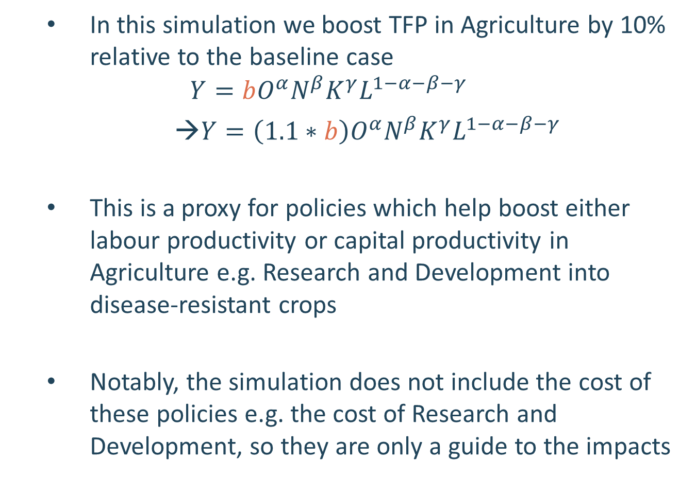
Boost Total Factor Productivity
In this simulation we boost TFP in Agriculture by 10% relative to the baseline case
$$Y=b{{O^{α}N}^{β}K}^{γ}L^{1−α−β−γ}$$
→$Y=\left(1.1∗b\right){{O^{α}N}^{β}K}^{γ}L^{1−α−β−γ}$
This is a proxy for policies which help boost either labour productivity or capital productivity in Agriculture e.g. Research and Development into disease-resistant crops
Notably, the simulation does not include the cost of these policies e.g. the cost of Research and Development, so they are only a guide to the impacts

Slide 18
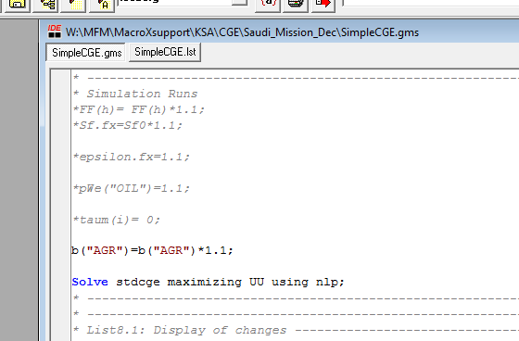
Entering the alternative scenario (#3 & #4)
10% lift in Agriculture productivity

Slide 19
Lift in Agriculture productivity
Impact on key aggregates (% deviation from baseline)
 | Agriculture | Oil | Industry | Services | Total
Price of domestic production | -6.4 | 0.03 | 0.01 | 0.3
Domestic production | 8.8 | -0.05 | 0.2 | -0.06
Labour | -1.8 | -0.4 | 0.3 | -
Capital | -1.9 | -0.5 | 0.2 | -0.1
Household Consumption | 5.4 | - | 0.4 | 0.1 | 0.4
Government Consumption | 0.03 | - | 0.03 | 0.03 | 0.03
Investment | - | - | -0.1 | -0.1 | -0.1
Exports | 33 | -0.1 | 0.1 | -1 | -
Imports | -12 | 0.4 | 0.2 | 0.9 | -0.1

Slide 20
Lift in Agriculture Productivity
A boost in productivity means we can produce more output with the same amount of inputs, so the economy expands
The price of Agriculture commodities falls relative to baseline because we have become more efficient in producing these goods
Agriculture expands by the greatest percentage since it directly enjoys the productivity boost → Agriculture becomes a larger component of the economy
Lower production cost means Agriculture is more internationally competitive → boosts exports and lowers imports of Agriculture

Slide 21
Lift in Agriculture Productivity
Industry also expand. They use Agriculture as an input to production and the fall in the cost of Agriculture commodities lowers the relative price of Industry. Lower prices encourage greater demand. The rise in incomes from the productivity boost also supports demand for goods from the Industry sector.
Production of Services and Oil contract. Agriculture is not an important input into production for these sectors so they only benefit slightly from the fall in Agriculture prices. On the other hand, these sectors have to compete for inputs with Industry. The rise in wages and capital rents increase costs, which are passed on as higher prices and lowers demand.

Slide 22
Lift in Agriculture Productivity
The amount of labour and capital used in Agriculture production is lower relative to the baseline. There are two effects which work in opposite directions:
Production effect: Lower price boost demand and this induces firm to hire more factors of production → works to lift labour and capital used in Agriculture
Productivity effect: Boost to productivity means we can produce any given level of output with less input → works to cut labour and capital used in Agriculture
In this case productivity effect offsets production effect

Slide 23
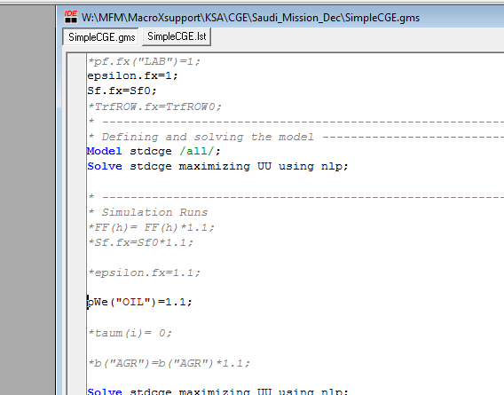
Higher export prices

Slide 24
Higher oil prices
Impact on key aggregates (% deviation from baseline)
 | Agriculture | Oil | Industry | Services | Total
Price of domestic production | 2 | 9.3 | 2.6 | 2.7
Domestic production | -0.8 | 0.7 | -4.5 | 2.3
Labour | -3.1 | 5.8 | -6.3 | 1.0
Capital | -1 | 8 | -4.1 | 3.3
Household Consumption | 10 | - | 9.4 | 8.8 | 9.2
Government Consumption | 3.8 | - | 3.8 | 3.8 | 3.8
Investment | - | - | 1.0 | 1.0 | 1.0
Exports | -6.3 | 1.5 | -11.5 | -5.6 | -2
Imports | 5.3 | 1.8 | 8.9 | 11.2 | 9.2

Slide 25
Higher export prices
Oil sector expands to take advantage of the higher export prices
Boost in export prices increases the real incomes of domestic households and this supports a boost in consumption. The consumption boost supports an expansion of the services sector
Greater demand for labour and capital from the Oil industry pushes up wages and capital rents. This increases the cost of domestic production making imports more price competitive and non-oil exports less competitive
Not a large change in overall size of the economy because the available factors of production and technology has not changed. But there is a change in the structure of the economy, with the Oil and Services sector expanding

